Slide 1
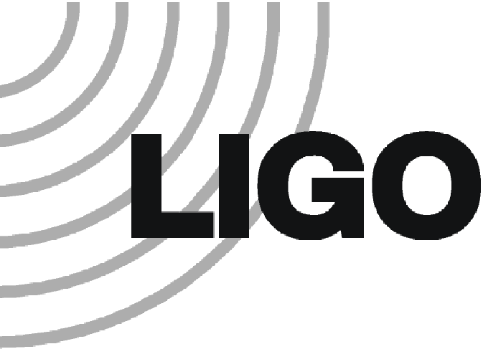
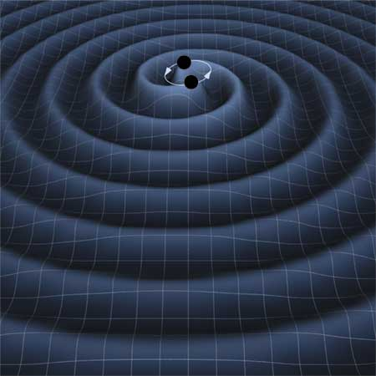
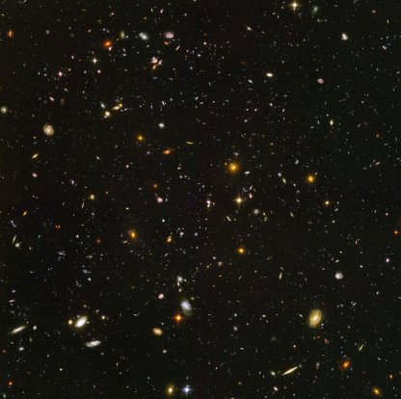
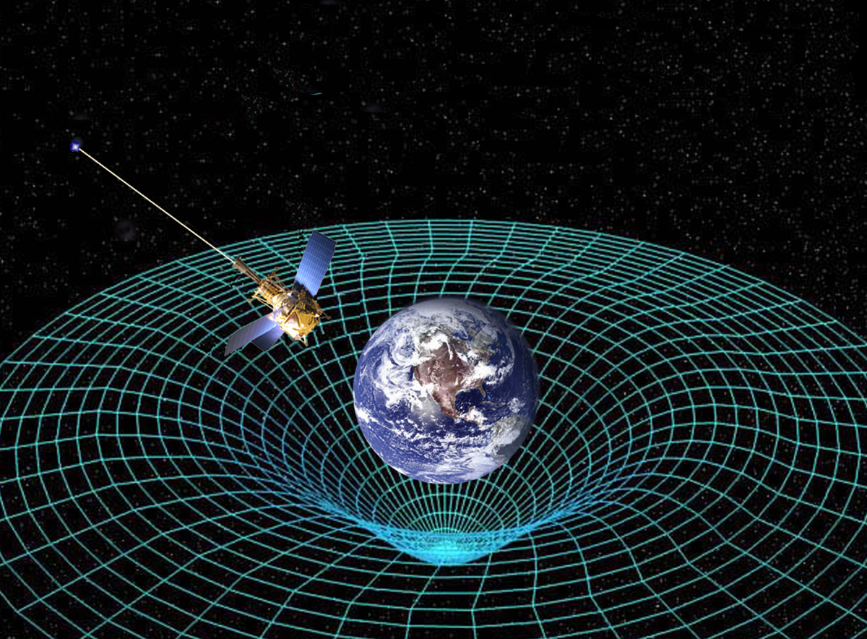
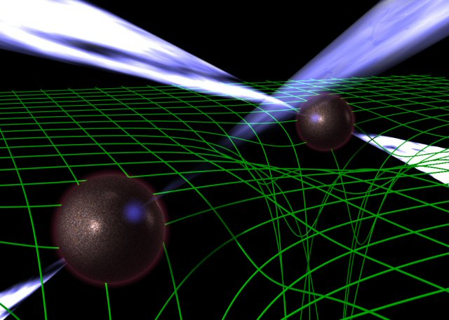
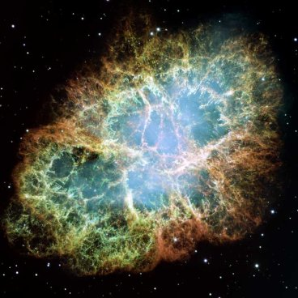
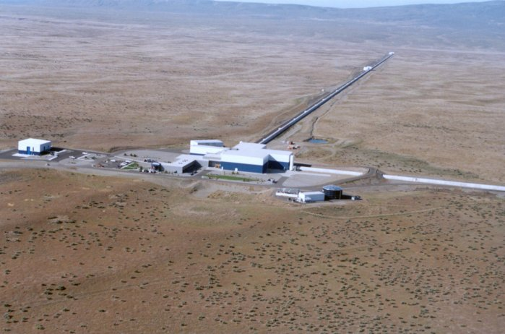
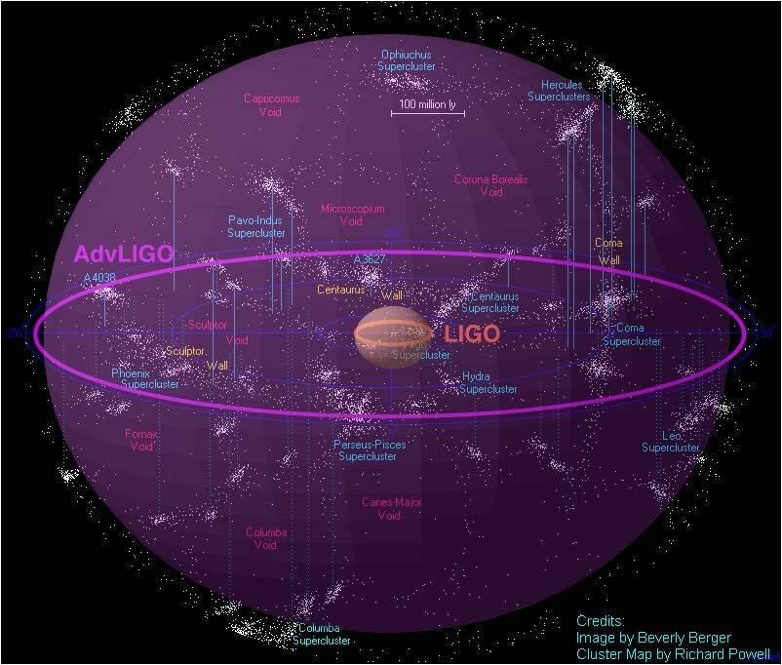
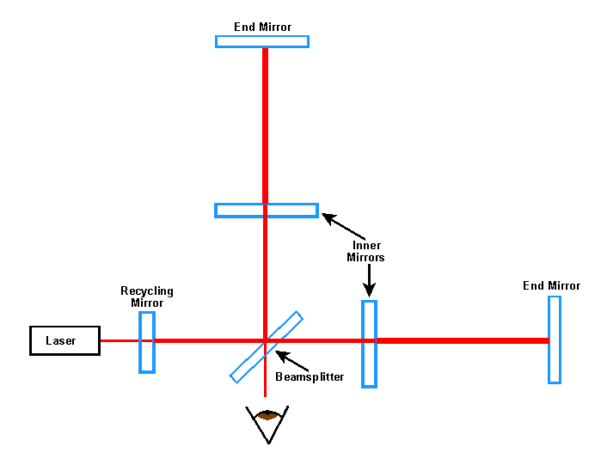
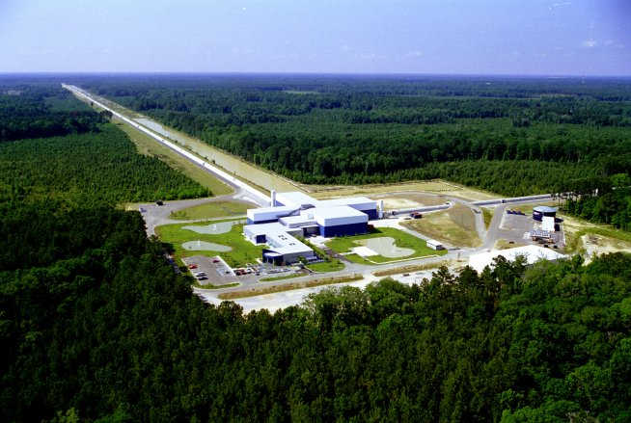
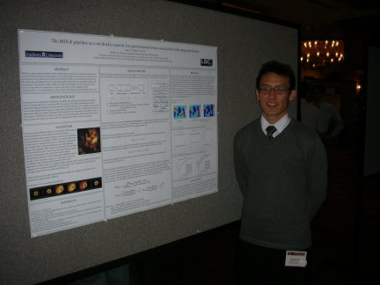
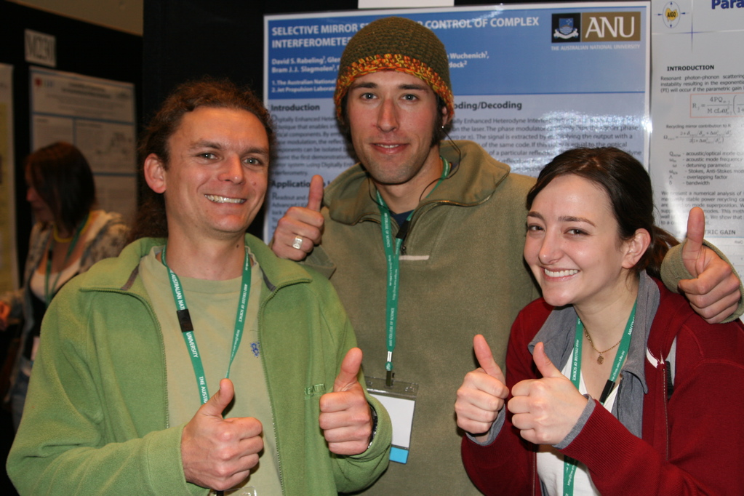
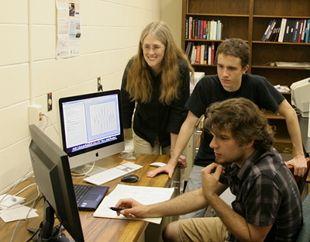
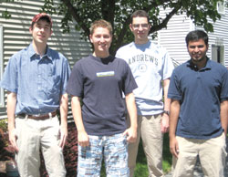
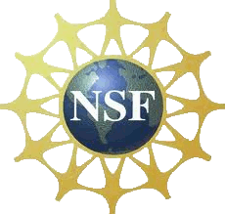
Gravitational Waves and LIGO
Tiffany Summerscales, Dept. of Physics
What are gravitational waves?
Einstein’s theory of General Relativity predicts that mass curves the fabric of spacetime. John Wheeler summarized this prediction in the statement, “Mass tells spacetime how to curve and spacetime tells matter how to move.” If you imagine spacetime as a rubber sheet, a heavy mass placed on the sheet will cause it to stretch and curve in much the same way as spacetime. Now imagine that the mass causing the curvature is suddenly changed. (Maybe it is removed or splits in two pieces that move away from each other) The change in the mass will cause a change in the curvature. BUT! Einstein’s theory also says that nothing can travel faster than the speed of light, so this change must propagate outwards like the ripples on a pond. It is these ripples that we call gravitational waves.
Gravitational waves are ripples in the fabric of spacetime itself, therefore they stretch and squeeze the space they pass through, changing the distance between objects. The strength of a gravitational wave is measured in strain (h) which is proportional to the change in the distance between two objects (ΔL) divided by the length (L) or h = ΔL/L. Why don’t we notice these ripples in everyday life? Gravitational waves are extremely weak. Only the most cataclysmic events in the universe, involving the most massive objects, are capable of producing measureable gravitational waves. However, even these strongest gravitational waves are likely have only strains of about 10⁻²¹ by the time they reach Earth. That means that if you looked for changes in the distance between two objects separated by a distance equal to the diameter of the earth, the change in distance that you would have to measure would be far less than the diameter of a proton.
What produces gravitational waves?
The gravitational waves that we hope to measure are produced by the most massive objects involved in the most cataclysmic events in the universe. Not only are these events dramatic, but they are mysterious as well. Gravitational waves will carry important information about the objects that produce them and will allow us to look at the universe in a completely new way.
At left is an artist’s depiction of two black
holes orbiting around each other and
producing gravitational waves. Black
holes are believed to be behind the most
energetic phenomena in the universe but
produce no light themselves. The
gravitational waves produced by the
supermassive black holes at the center of
all galaxies are too low in frequency to
be measured by LIGO. LIGO should be
able to measure gravitational waves from
the black holes resulting from the deaths
of massive stars. Image from [4].
At left is an image of the crab nebula
which was produced in a supernova
explosion. During a supernova, a dying
star collapses to such high densities that
it essentially becomes a large ball of
neutrons. Nobody knows how this
neutron star material behaves.
gravitational waves produced by
supernovae, bumps on rotating neutron
stars and by “starquakes” will give
important clues. Image from [5].
Point an eight foot long drinking straw at a region of the night sky where there are no stars. What would you see? In an equivalently tiny piece of sky, Hubble saw 10,000 galaxies. These galaxies are very far away and hence very old since their light took so long to reach us. With gravitational waves we will be able to see even further back in time, to the beginning of the universe itself. Image from [6].
The above is an artist’s depiction of two pulsars orbiting around
each other and producing gravitational waves. Pulsars are the
remnants of dead stars whose powerful magnetic fields produce
beams of radio waves that sweep around as the pulsar rotates.
Such systems have been observed and seem to be loosing energy
to gravitational waves [2]. Image from [3].
Image from [1]
How are gravitational waves measured?
Gravitational waves stretch and squeeze the space they pass through, changing the
distances between objects. Therefore, we need a way to measure distance changes
very accurately. The LIGO (Laser Interferometer Gravitational-wave Observatory)
detectors were built to do just that [7].
An interferometer is a device that measures tiny changes in distance. A laser
shines a beam of light on a beam-splitting mirror that allows half of the light to
pass through and reflects the other half. These two beams travel down perpendicular
arms where they are reflected off mirrors at the ends. The light is then reflected back
to the beamsplitter and the two beams are recombined and sent to a photodetector
which measures the intensity of the light. If the two beams of light come back
180° out of phase, that is, the peaks of one wave match up with the troughs of the
other, then the beams will destructively interfere (cancel out) and no light will reach
the photodetector. If a gravitational wave passes by, the lengths of the arms change.
It will now take one beam of light longer to make the trip down the arm and back,
the two beams will no longer destructively interfere, and light will be measured by
the photodetector.
In order to be sensitive enough to measure gravitational waves, LIGO must employ
some tricks. One trick is to be BIG. The arms of the LIGO detectors are 4 kilometers
long. The beams and mirrors are encased by vacuum systems so that the light is
not scattered by air molecules. Inner mirrors send most of the light headed back to
beamsplitter down the arms again, increasing their effective length. Most difficult
of all, the mirrors must be shielded from ground motion (earthquakes, people walking
around) as that could also change the length of the arms. This is done by hanging the
mirrors as pendulums and applying tiny forces to cancel their motion.
Has LIGO measured gravitational waves?
Data from the LIGO detectors has been collected and analyzed, along with the
data from other gravitational wave detectors such as the Virgo detector in Italy,
GEO600 in Germany, and TAMA in Japan. None of the analyses completed thus far
has found a gravitational wave signal. However, even not detecting gravitational
waves has allowed LIGO scientists to make some important astrophysical
discoveries. For example, there was a gamma ray burst (GRB), or burst of very
high energy light, that occurred on February 1, 2007. Some GRBs may be caused
by the inspiral and collision of two neutron stars or a neutron star and a black hole.
The position of this particular GRB suggested that it might be located in the nearby
Andromeda Galaxy. Since LIGO did not see gravitational waves associated with this
GRB, we can say that either it was not produced by the inspiral of two massive
objects or the event that caused the GRB took place further away than the
Andromeda Galaxy [9]. A second example of science resulting from LIGO is related
to the pulsar at the center of the Crab nebula. If this neutron star were aspherical
enough, it would produce measurable gravitational waves as it rotates. Since no
gravitational waves have been measured, we have been able to constrain the size
of bumps on the neutron star which tells us about the strength of the neutron star
material [10].
The first measurement of gravitational waves will, of course, be even more
exciting. The LIGO detectors are currently undergoing a series of upgrades that
will improve their sensitivity by a factor of 10. Once the upgrades are completed
in 2014, the detectors will be known as “Advanced LIGO” and gravitational
waves should be measured regularly.
The drawing above shows what would happen if a gravitational
wave were travelling through this poster in a direction
perpendicular to the poster. A ring of masses would get stretched
in one direction, compressed in the other and then the opposite
would happen. LIGO’s arms would get stretched and compressed
too which changes their length relative to each other.
LIGO Hanford Observatory in Hanford, WA (above) and
LIGO Livingston Observatory in Livingston, LA (below)
Images from [8]
The above diagram shows the volume of space for which LIGO is
able to measure gravitational waves produced by the inspiral of two
neutron stars. Once the detectors are upgraded, Advanced LIGO
will be able to see far enough to make frequent detections.
LIGO research at Andrews
The Andrews University Gravitational Wave Group has been a member of the LIGO Scientific Collaboration (LSC) since 2006. During that time, several Andrews students have been able to participate in LIGO research.
References & Acknowledgements
[1] http://www.nasa.gov/mission_pages/gpb/gpb_012.html
[2] Taylor, J. H. and Weisberg, J. M. “Further experimental tests of relativistic gravity using the binary pulsar PSR 1913 + 16”, Ap. J. 345, p434 (1989)
[3] http://www.jb.man.ac.uk/research/pulsar/doublepulsarcd/
[4] Thorne, K. and Carnahan, T. http://lisa.jpl.nasa.gov/gallery/binary-wave.html
[5] http://hubblesite.org/gallery/album/entire/pr2005037a/
[6] http://www.nasa.gov/vision/universe/starsgalaxies/hubble_UDF.html
[7] Abbott, B. et al. “Detector Description and Performance for the First Coincidence Observations between LIGO and GEO”, Nucl. Instrum. Meth. A, 517 p 154 (2004) gr-qc/0308043
[8] http://www.ligo.caltech.edu/~beckett/LIGO_Images
[9] Abbott, B. et al. “Implications for the origin of GRB 070201from LIGO observations”, Ap. J. 681, p 1419 (2008) arXiv:0711.1163
[10] Abbott, B. et al. “Searches for gravitational waves from known pulsars with S5 LIGO data”, Ap. J. 713, p 671 (2010) arXiv:0909.3583
[11] http://www.aps.org/publications/apsnews/200808/ligo.cfm
[12] http://www.phys.ufl.edu/~bernard/IREU2007/
LIGO research at Andrews University is
supported by NSF grant PHY-0969810
Nick Valles and Jon Van Ornam worked on a project where they collected information on events that occur at the detector sites, such as passing trains and earthquakes, that could compromise detector performance. They looked at the electronic logs maintained at each site and made lists of such events that could be easily read by a computer during the course of data analysis. Later, Nick Valles continued the project by creating a website where these data quality “flags” could be entered, automatically compiled and searched for various attributes such as time, location and type of event.
Nick presented a talk describing his webpage at the March 2008 meeting of the LSC at Caltech
Eric Shull, Garret Catron, Michael McMearty, Chris Greenley and
John (Archie) Wheeler have worked on an ongoing project to apply
the Maximum Entropy waveform recovery method to data
from times associated with Gamma Ray Bursts. Work done thus
far involves testing the sensitivity of the method by measuring
how well it recovers fake signals of varying strengths. In the picture
below, Chris Greenley and Michael McMearty work on the waveform
recovery project with Tiffany Summerscales.
For his honors thesis, Philip Roberts worked on improving a gravitational wave signal recovery program called Maximum Entropy. His improvements greatly increased the speed of the algorithm. Philip also spent six months at the LIGO Hanford Observatory, running one of the detectors while the other
Hanford detector and the Livingston detector were being upgraded. Philip, along with several other graduate students ensured that at least one detector would be on in case an interesting astronomical event occurred. Philip (second from right)) and some of his fellow “Astrowathers” are pictured at right. Photo from [11].
Jason Lee did his honors thesis project on using a data analysis
algorithm called RIDGE. This algorithm combines the data
from multiple detectors and looks for a common signal. Jason
tested how well this algorithm would be able to find the
gravitational waves produced by soft gamma repeaters (SGRs)
which are multiple flashes of high energy light thought to be
caused by “starquakes” or fractures in a neutron star’s crust. In
the picture above, Jason presents his research at the 2008 March
meeting of the American Physical Society.
Danielle Wuchenich participated in an international
summer research experience for undergraduates (REU)
that was open to students from LSC institutions. She spent
a summer at The Australian National University working on
advanced laser systems for the next generation of detectors.
She and her fellow students presented their work at the 2007
Edoardo Amaldi meeting in Sydney (pictured above). Photo
from [12].
Background: simulation of merging black holes by Werner Berger
This poster has been given LIGO document number LIGO-G0900196

