Slide 1
Construction of a Seismic Array at the Former Homestake Mine
Luca Naticchioni (Sapienza University of Rome - Italy)
Thomas O’Keefe (Saint Louis University)
Jan Harms (University of Minnesota)
Abstract: This summer, five additional seismometer stations were deployed at the Sanford Underground Laboratory in order to determine the magnitude of the seismic noise at various depths. Construction of the stations required insulation of the seismometers from air currents and temperature fluctuations. Sensor boards were installed at the sites to monitor environmental conditions. The data produced by this array of stations might aid in determining the feasibility of modeling seismic activity so that the associated Newtonian noise could be subtracted from gravitational-wave detector data. Correlation measurements between the signals from neighboring stations would provide the most relevant results for this noise-subtraction technique.
LIGO-G0900736.

Slide 2
Why a seismic array underground ?
Future generation ground based interferometric detectors for gravitational waves will operate below 10Hz.
Significant noise sources in 1-10Hz frequency range :
- Newtonian Noise (i.e. gravity gradient noise) limit
- Earth’s crust motion (tidal stresses and seismic activity)
- Cultural noise: human activity
Notes:
Future generation ground based interferometric detectors for gravitational waves will need to operate below 10Hz.
In this range of frequencies GWI detectors will be limited by the Newtonian Noise (i.e. gravity gradient noise) and by Earth’s crust motion due to tidal stresses and seismic activity as well as human activity).

Slide 3
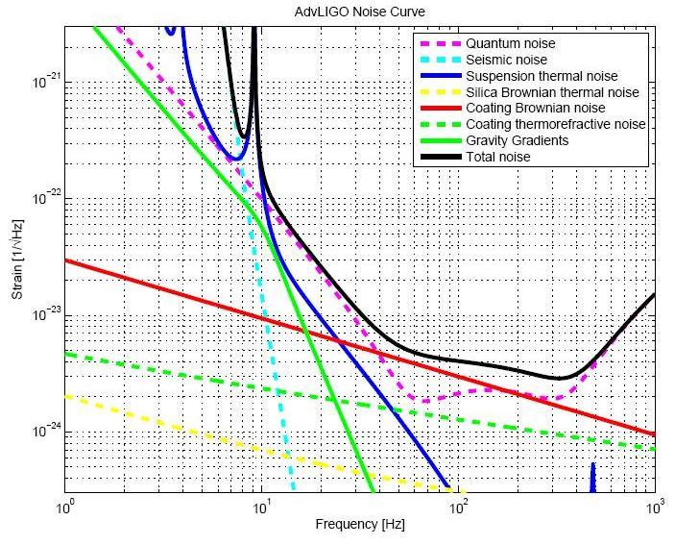
Why a seismic array underground ?
Notes:
As we can see in this plot the gravity gradients –in green- are an important source of noise, only reducing it we can reach lower frequencies

Slide 4
Why a seismic array underground ?
Newtonian Noise is due to seismic and atmospheric density fluctuations
Fluctuating gravity fields couple to the test masses themselves:
no filter can act against it !
Underground in a seismic quiet site:
- lower density fluctuations
- higher correlation
- lower seismic noise
- no surface modes
Notes:
We sow that NN due to seismic and atmospheric density fluctuations plays is very important: seismically induced fluctuating gravitational fields directly couple to the test masses themselves, bypassing all attenuation stages.: no filter can act against it.
Going underground in a seismic quiet site means lower density fluctuations, higher correlation , lower seismic noise and no surface modes.

Slide 5
Why a seismic array underground ?
Lower seismic noise… but how much?
Reduction expected:
To measure it and the wave propagation an underground array of seismometers is needed.
the seismic data produced by a 3D network of seismometers will help us to calculate and subtract it from the data of a future generation GWID.
Notes:
Now, how much can we reduce the seismic noise going underground?
We expect an exponentional reduction depending on depth and wavelenght, but in order to measure it and the wave propagation we need to build an underground array of seismometers with a good timing.
Moreover if we find a model that links the gravity gradient noise to the seismic data produced by this 3D network of seismometers we can hope to be able to calculate and subtract it from the data of a future generation GWI detector.
so going underground we could have a double gain: first reducing the seismic noise, for example a factor ten, second subtracting it from the the data improving the reduction to a factor one houndred

Slide 6
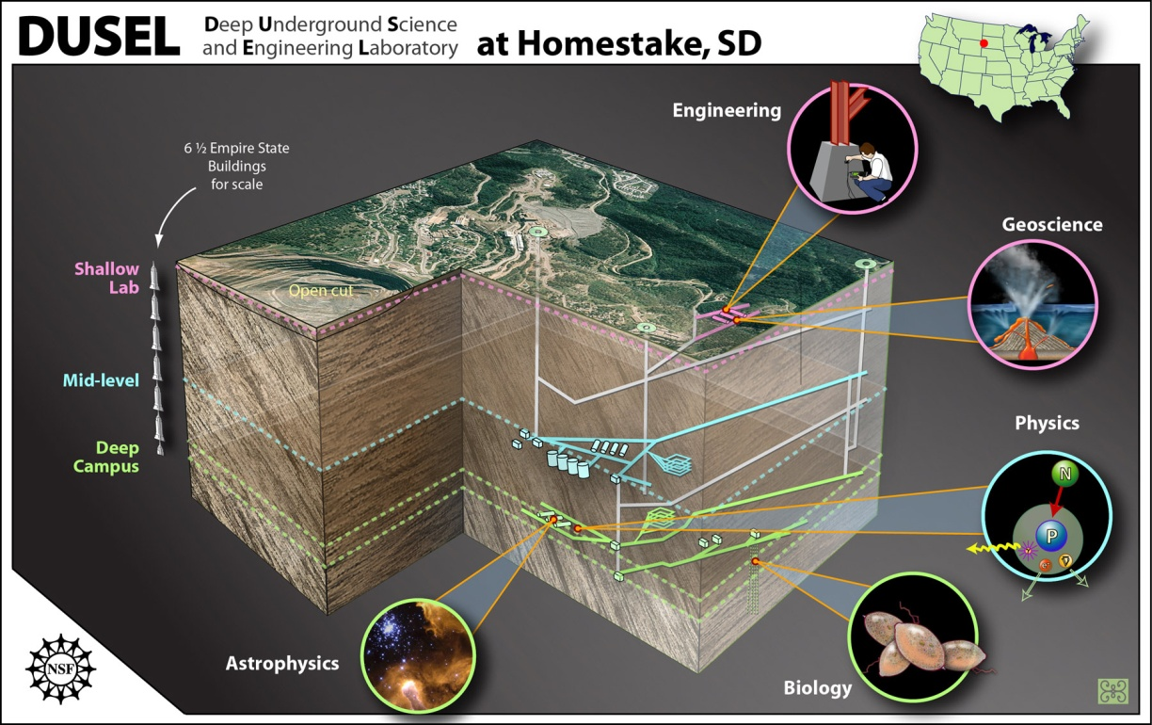
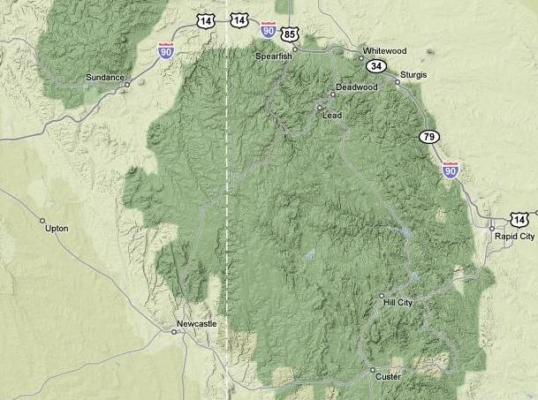
Why the Homestake former mine ?
Former Homestake gold mine in Lead is being transformed into an underground scientific laboratory by the SDSTA (South Dakota Science and Technology Authority)
Now it is known as the Sanford Underground Laboratory
chosen also to host the future NSF DUSEL (Deep Underground Science and Engineering Lab)
SD
Black Hills
8000 ft
2.4 km
Notes:
The former Homestake gold mine in Lead was closed in 2002 and then donated to the state of South Dakota. Now it is being transformed into an underground scientific laboratory by the SDSTA (South Dakota Science and Technology Authority), funded by a private gift from Mr. Sanford and the NSF. Now it is known as the Sanford Underground Laboratory.Homestake was chosen also to host the future NSF DUSEL (Deep Underground Science and Engineering Lab)
Homestake has the deepest reaching tunnels in North America (8000ft)

Slide 7
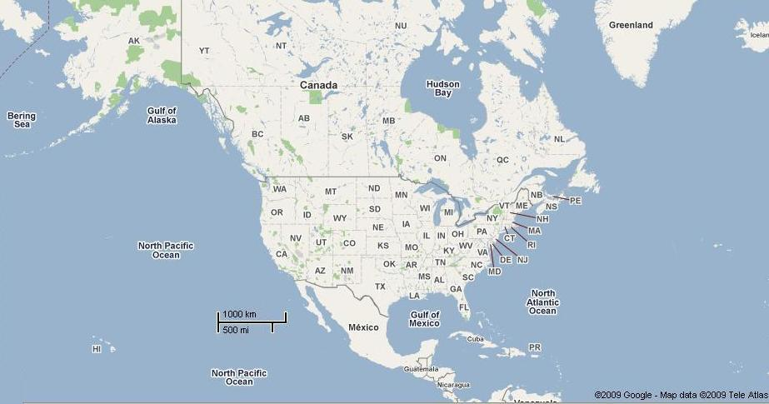
Why the Homestake former mine ?
Notes:
is located in a seismically quiet region and due to its distance from the Atlantic, Pacific and Artic oceans it’s the ideal place for a 3D underground array of seismometers.

Slide 8
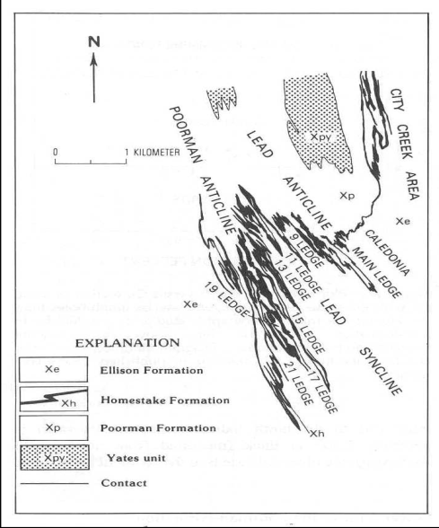
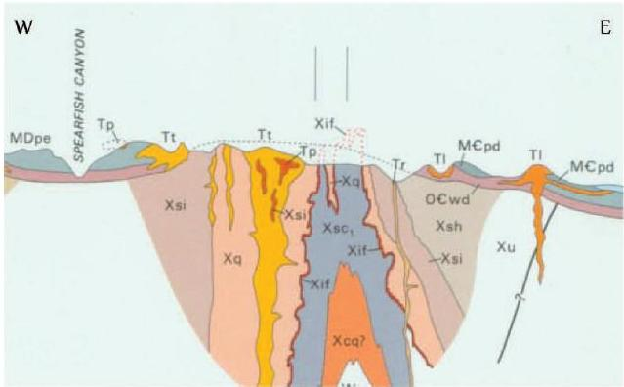
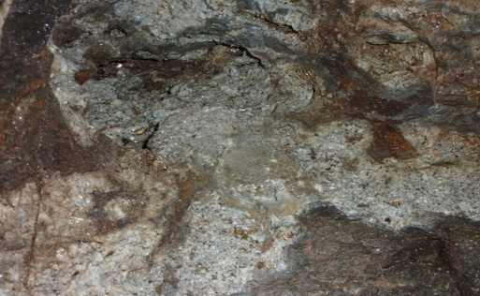
Homestake site geology
The geological history of the Homestake site is quite complicated
- oldest rock strata 2 billion years old
stratification, folding and metamorphism
discontinuity: original and intrusive rock strata
- network of fractures: meteoric water intrusion
underground levels are accessible only with a constant water drain
A database of rock samples is owned by Sanford Lab
Notes:
The geological history of the Homestake site is quite complicated, the oldest rock strata are 2 billion years old, and the current rock formations are the result of stratification, folding and metamorphism, with two principal uplifts. The consequent deformations caused a network of fractures which facilitates meteoric water intrusion; during tunnels excavation watercourses were intersected, and so the underground levels are accessible only with a constant water drain. The Sanford Lab owns an extensive database of rock samples which can be used to calculate profiles of rock density at varius levels.

Slide 9
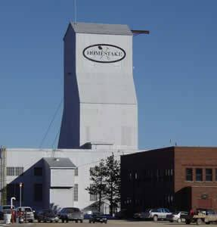
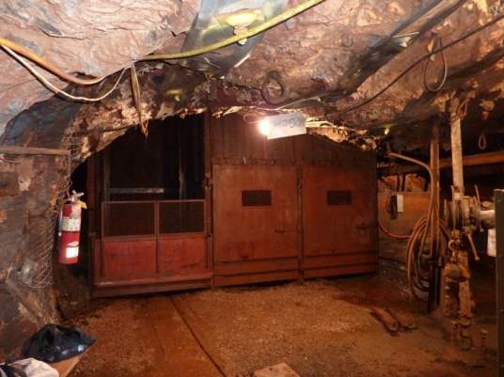
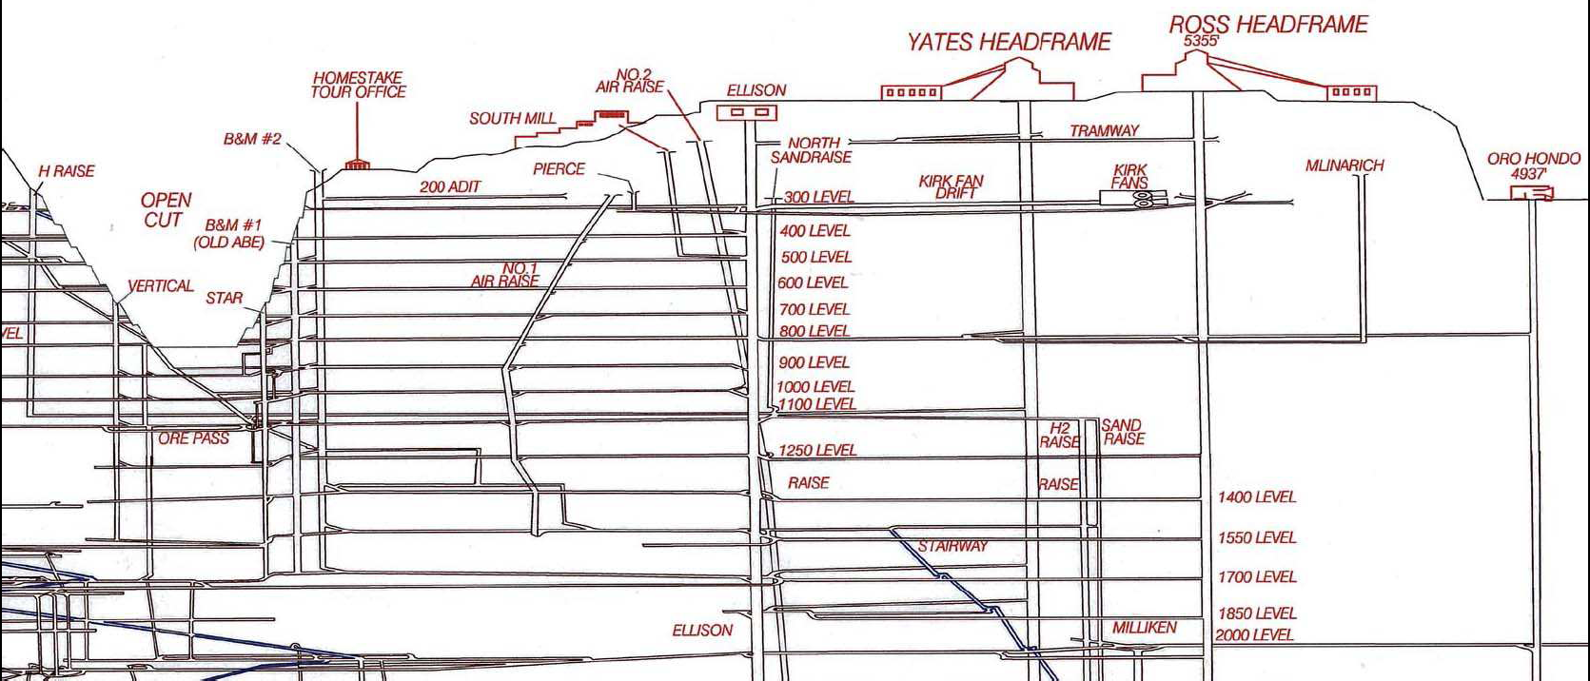
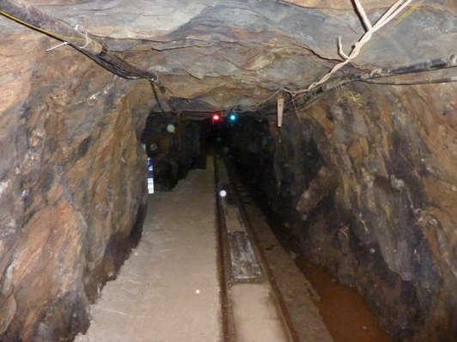
Homestake infrastructure
On July 2009 the deepest accesible level was 4100ft
(although the 4850 ft level was recently made accesible).
Actually the only Shaft accesible is the “Ross” Shaft.
The main office building is situated in the “Yates” area
A power and internet connection between underground levels and surface is still developing by SDSTA.
Shaft +Office building
“Cage”
Shafts
Drifts and cross-cuts
Notes:
On July 2009 the deepest accesible level was 4100ft although the 4850 ft level was recently made accesible.
As we see here the foundamental units of a mine are the vertical shafts linking the horizontal tunnels.
Actually the only Shaft accesible is the “Ross” Shaft.
A connection between the main office building (situated in the “Yates” area) and the “Ross” Shaft is granted by a bus.
A power and internet connection between underground levels and surface is still developing by SDSTA.

Slide 10
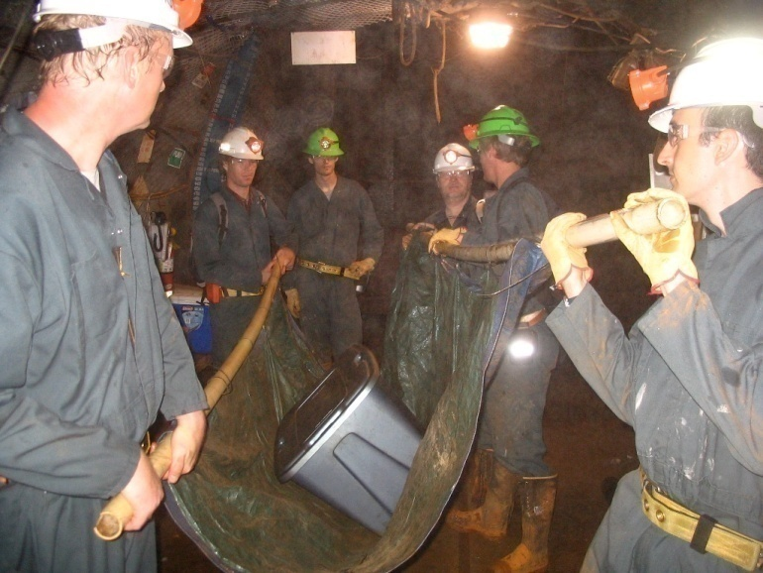
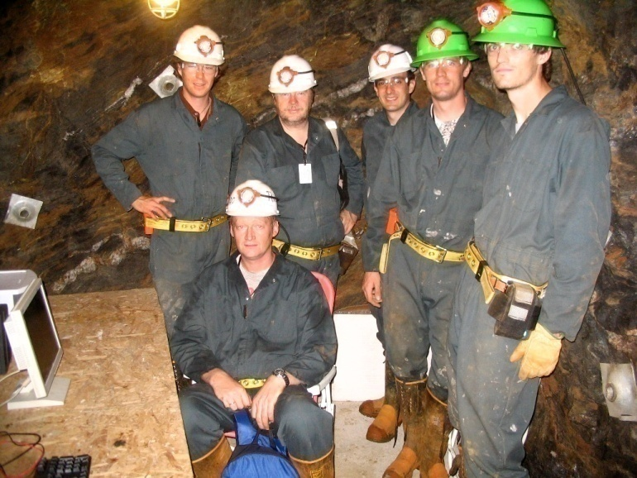
Construction of the new stations of the Homestake seismic array
Initial situation: three stations completed and at three different levels (300ft, 800ft, 2000ft)¹.
Our goal: fix the old stations configuration and extend the seismometers network with five new stations
Work duration: 9th June - July 31st
New stations: two at 2000ft level, three at 4100ft level
Collaboration with ET (group of Jo van den Brand from Netherlands) and Guido Mueller (from the University of Florida).
[1]: J. Harms et al. ; seismic studies at the Homestake mine in Lead, South Dakota
Notes:
At June 2009 three stations were completed and operative in Homestake at three different levels (300ft, 800ft, 2000ft)¹. Our goal was to fix the old stations configuration and to extend this network of stations with five new stations creating the present-day 8 stations array of seismometers.
Our work began on 9th June and ended on July 31st, in this period we were able to build two new stations at 2000ft level, and three new stations in the now-accesible 4100ft level.
This summer we started a collaboration with ET: the group of Jo van den Brand sent people from Netherlands (Jo van den Brand and Mark Beker themselves helped us in the construction of some new stations) and are providing two new Trillium240 seismometers in addition to the new two bought by LIGO, the one borrowed from LSU and the old three seismometers. Also Guido Mueller from the University of Florida joined our team helping us in the development of the new stations.

Slide 11
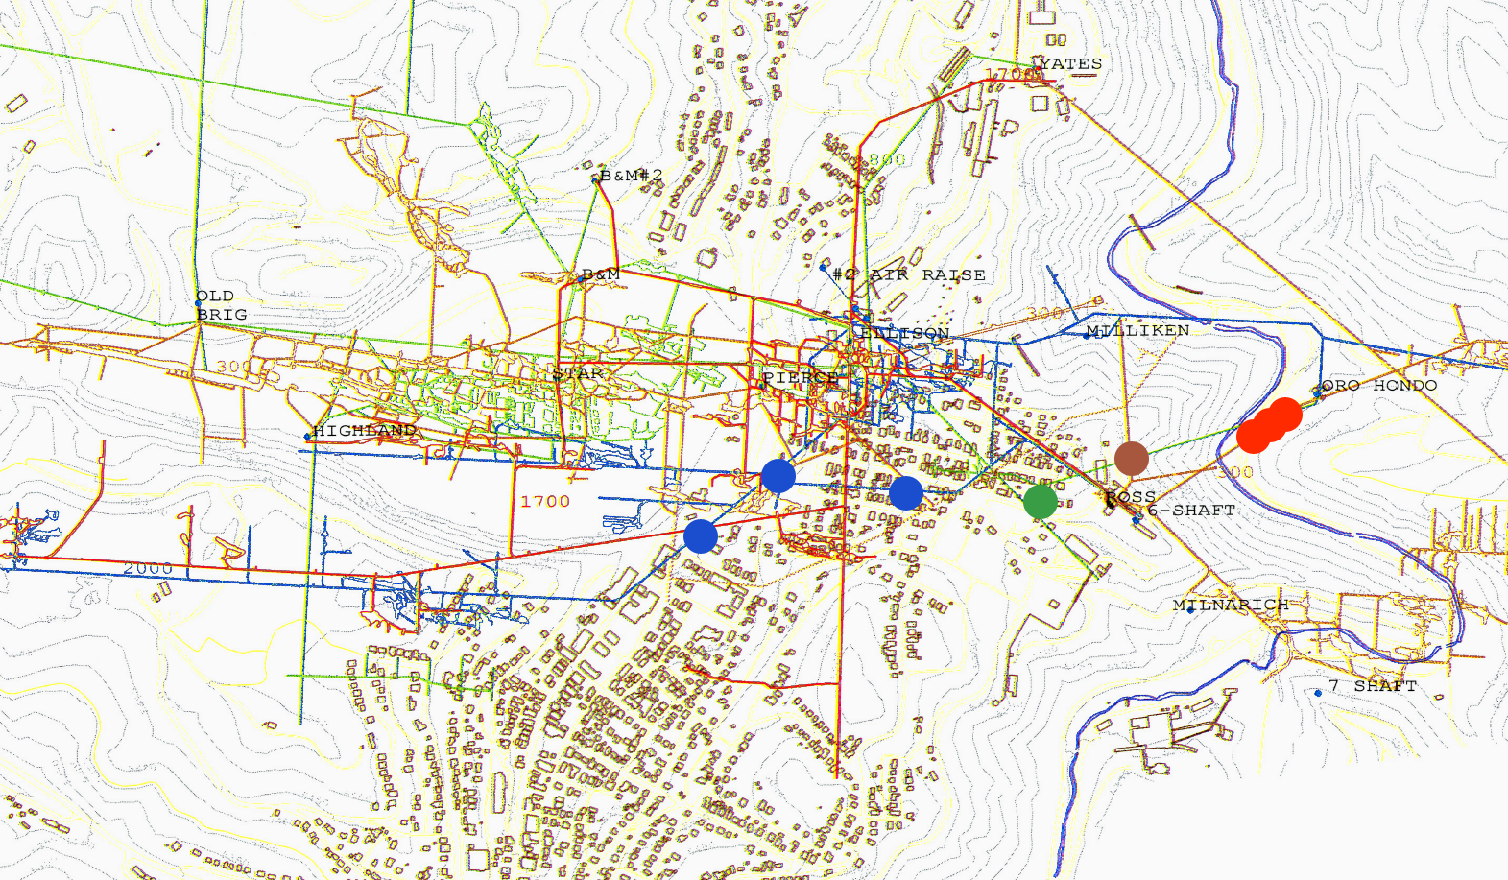
Construction of the new stations of the Homestake seismic array
Homestake seismic array at August 2009
90m
300 ft (91m)
4100 ft (1250m)
2000 ft (610m)
800 ft (244m)
350m
Notes:
Here we can see the present day configuration of the underground seismometers array of homestake.
Blue spots 2000 stations, green spot eight houndred feet station, brown spot three houndred feet station, finally the red spots are the fourtyone houndred feet stations.
The distance between the 2000ft sub-array stations is roughly 350m
The stations of the 4100ft sub-array are about 300ft away from each other

Slide 12
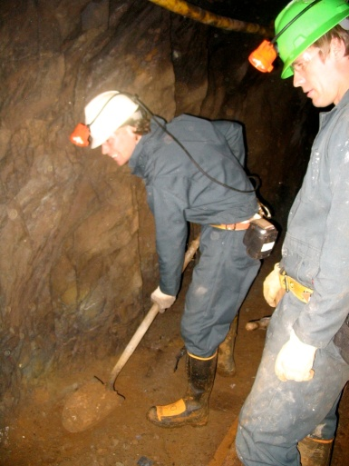
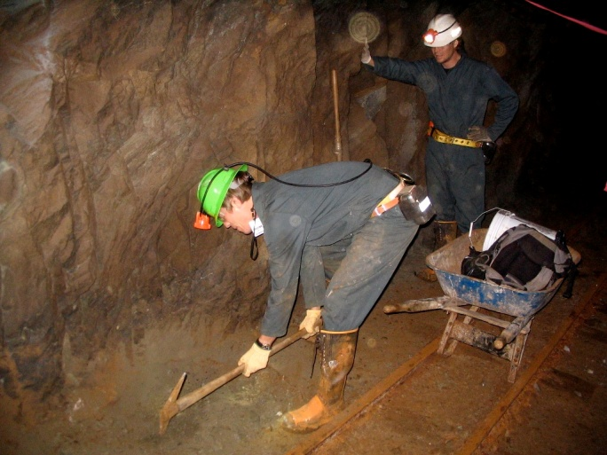
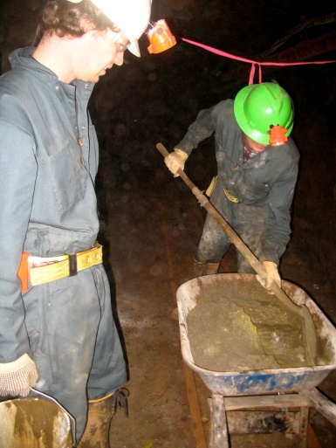
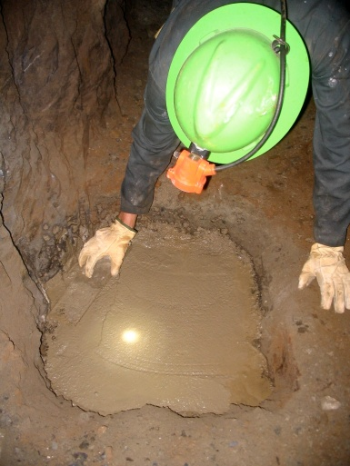
Preparing the sites… digging and concrete laying
- Locate a site
- dig and shovel rocks and debris
- sound the rocks to avoid rock fractures
- build a stable concrete base well connected to the bedrock
Notes:
Once a good site is located, the first thing needed is to dig and shovel rocks and debris from the area, and sound the rocks. Then we built a stable concrete base for the instruments well connected to the bedrock. All the necessary stuff must be carried and prepared in the site

Slide 13
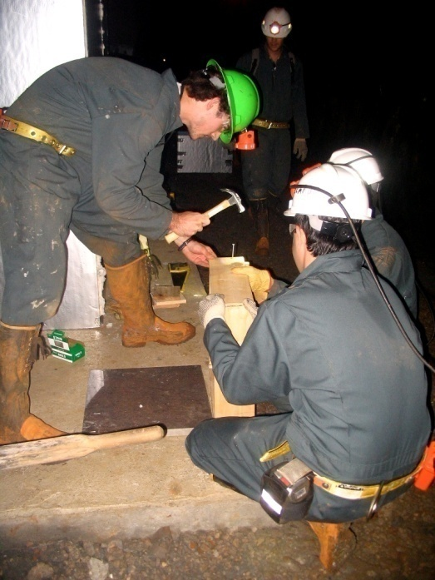
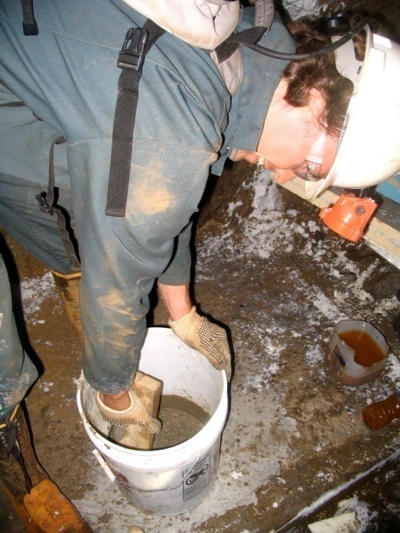
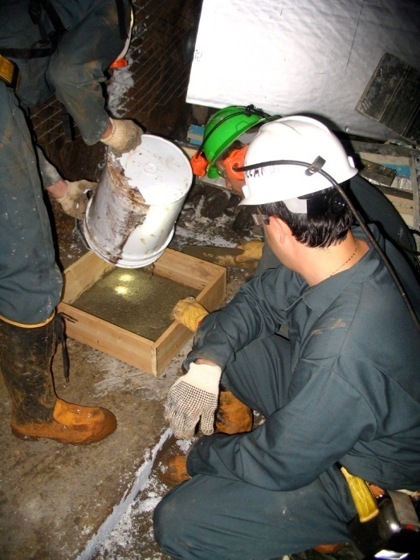
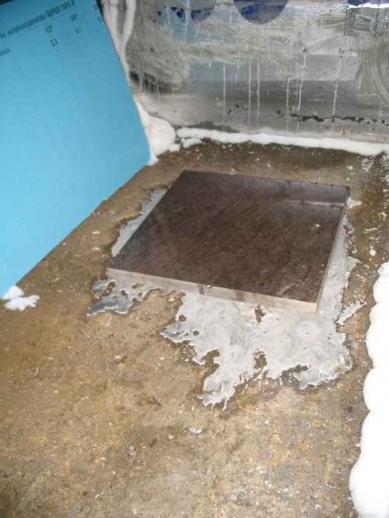
Preparing the sites… the seismometer base
A levelled square granite tile for each seismic instrument is implemented with a concrete slab to the bottom rock. The seismometer itself can be levelled once it is placed on the tile.
Notes:
In order to ensure a stable and levelled base for the seismometers a square granite tile for each seismic instrument is implemented with a concrete slab to the bottom rock. The seismometer itself can be levelled once it is placed on the tile.

Slide 14
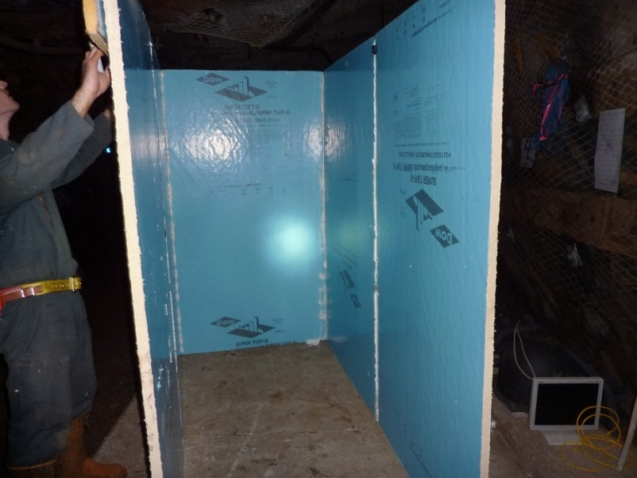
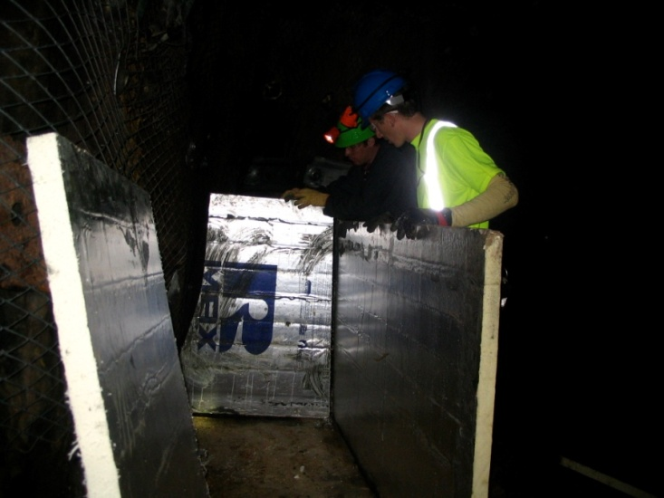
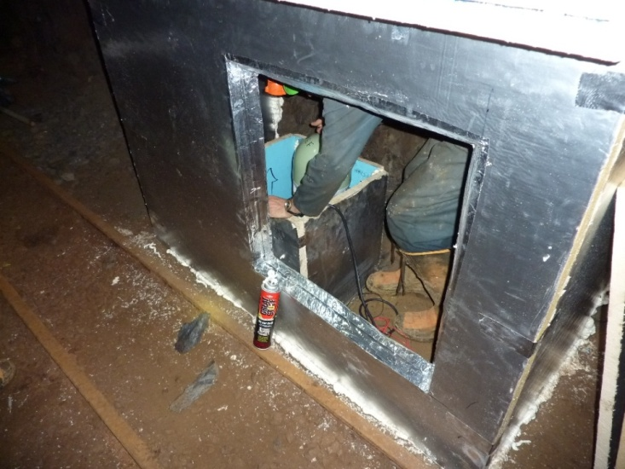
Preparing the sites… insulation
Building a hut to insulate
computers, DAQ and UPS
Instruments box
Double layer panel
Polyisocyanurate panel
The “great stuff” (Polyurethane foam glue)
Additional internal box
Variable environmental conditions depending on ventilation
- Very high humidity (over 90% to 100%)
- Acoustic noise from ventilation or people working around
- Computers noise
Insulation ensured by polyisocyanurate boxes
Notes:
Environmental conditions may vary considerably from one level to another, and from a day to another (especially the 300 ft and 800 ft levels), also depending on ventilation. Usually humidity is very high (over 90% to100%). Acoustic noise from ventilation or people working around should be reduced. A good thermal and humidity insulation is needed. To ensure it we built boxes for instruments and computers using polyisocyanurate panels and a foam glue. For the instruments a double layer was needed as an additional internal instrument box.

Slide 15
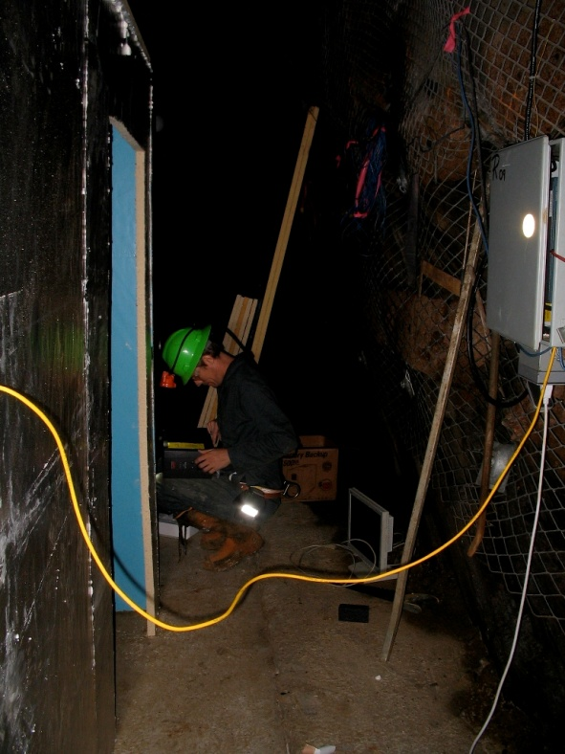
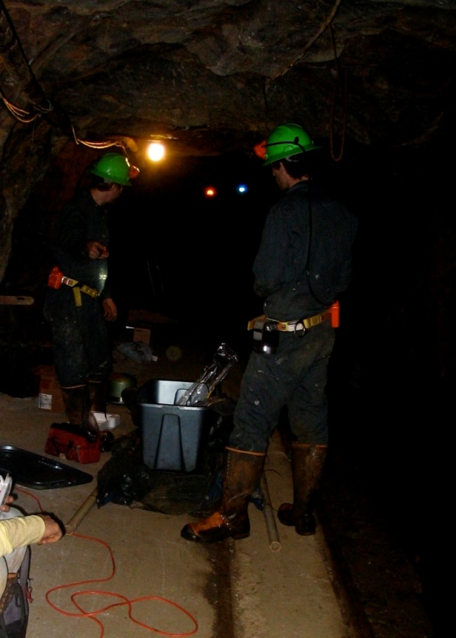
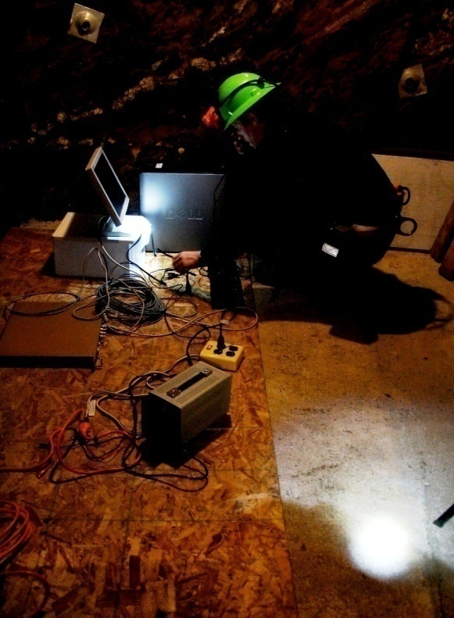
Preparing the sites… power and network
- Power and fiber-optic-cable network provided to an electric box by Sanford Lab
Prepare connections and cable links
UPS units ensures a continuous power supply, preventing black-outs and voltage surges
Notes:
Sanford Underground Laboratory is providing power and fiber-optic-cable network in the levels hosting our instruments up to an electric box. Connection and cable links have to be prepared in situ as the data cables between instruments, DAQ, computers and internet. UPS units for each station ensures a continuous power supply, preventing black-outs and voltage surges.

Slide 16
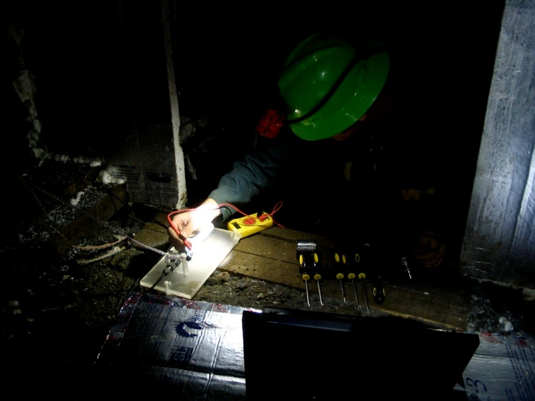
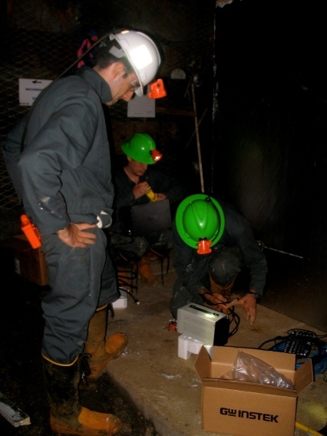
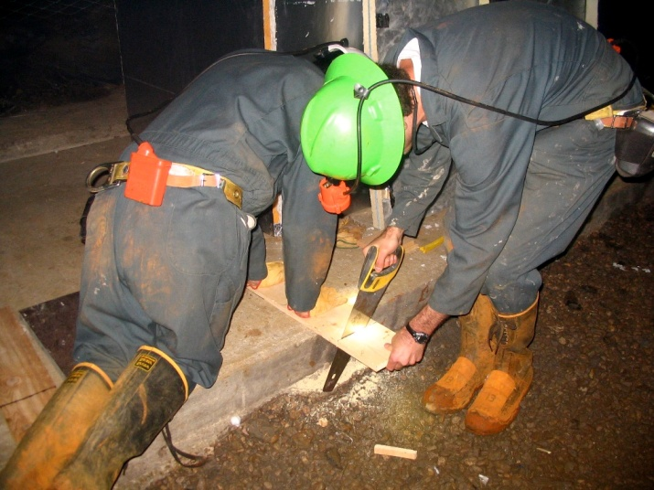
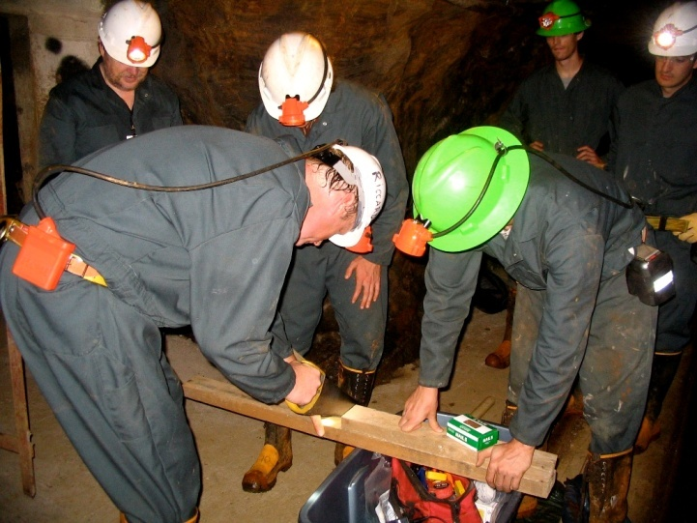
Preparing the sites… constructing what is needed
- Reparations
- Solder wires
- Fix eletronics
- carpentry work
Notes:
To set-up a new station we needed also to solder wires and fix electronic components, as to do some “carpentry work” for the instruments infrastructures…

Slide 17
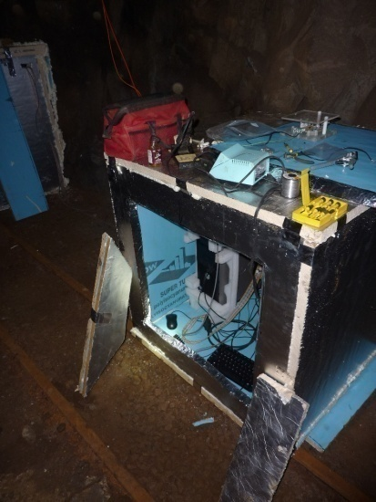
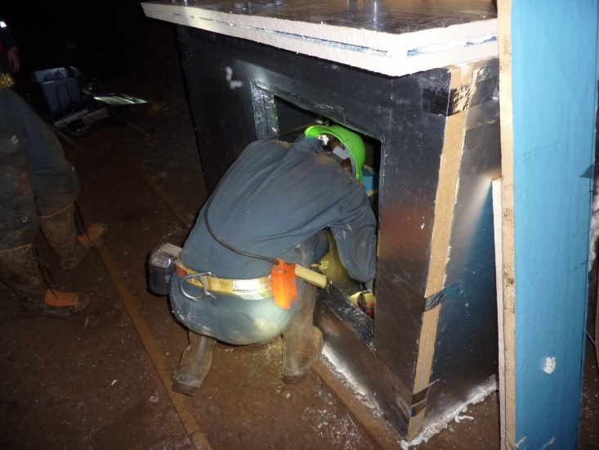
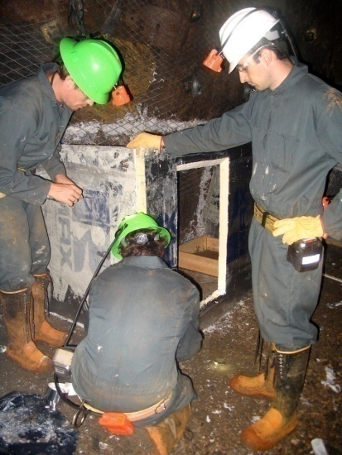
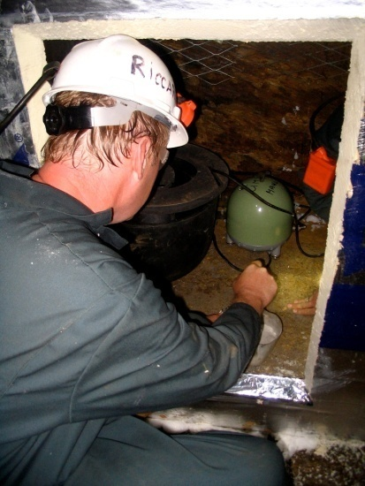
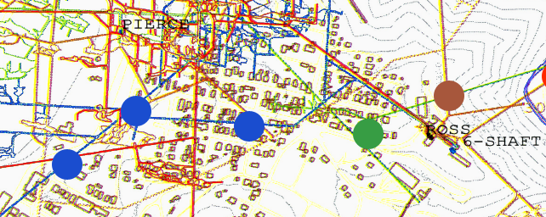
Two new stations at 2000 ft
110V AC power supply:
available
Internet connection:
available
350m
110V AC power supply:
available
Internet connection:
available
2000 ft sub-array
Notes:
Distance: 350 meters

Slide 18
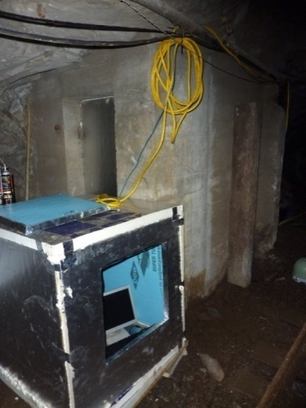
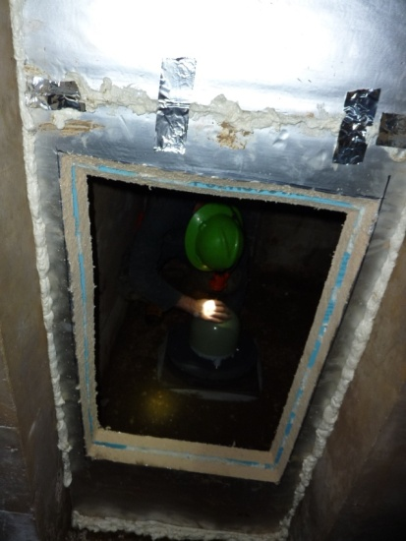
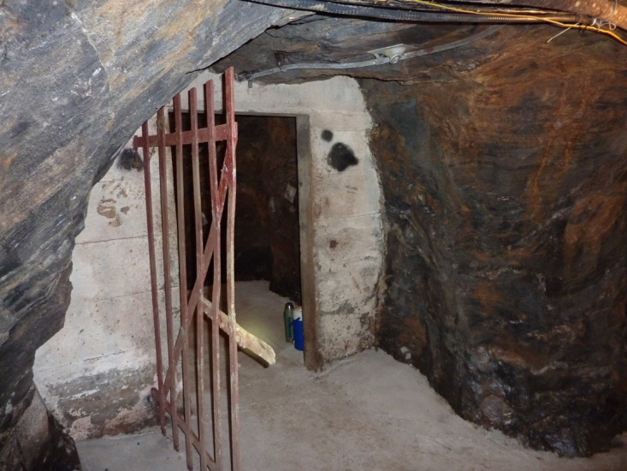
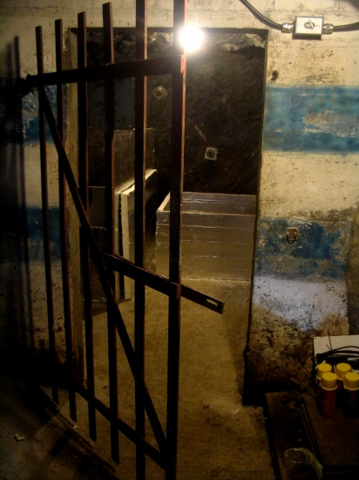
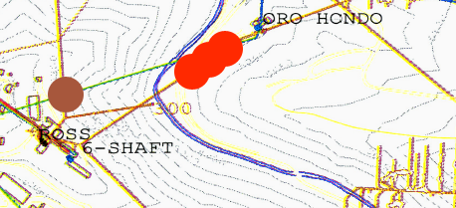
Three new stations at 4100 ft
110V AC power supply:
available
Internet connection:
still not available
110V AC power supply:
available
Internet connection:
available
90m
4100 ft sub-array
Notes:
Distance: 91 meters

Slide 19
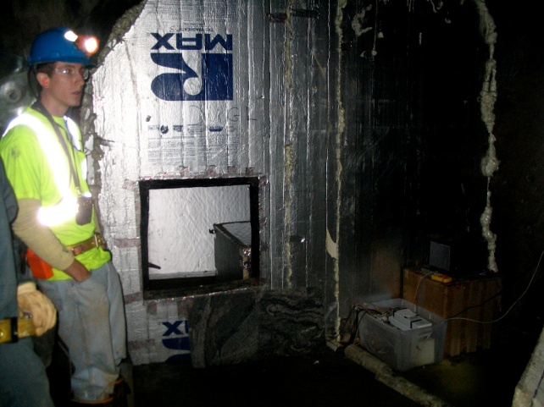
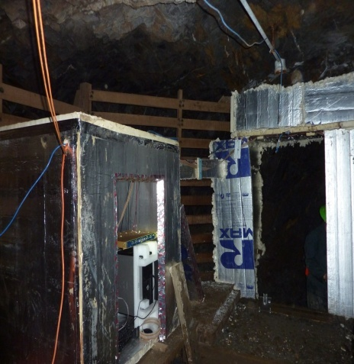
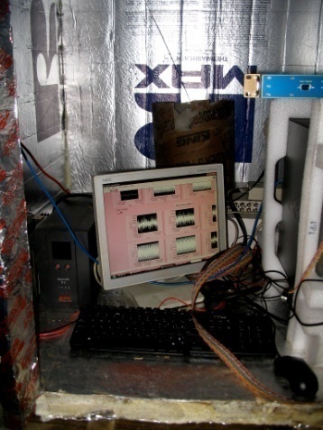
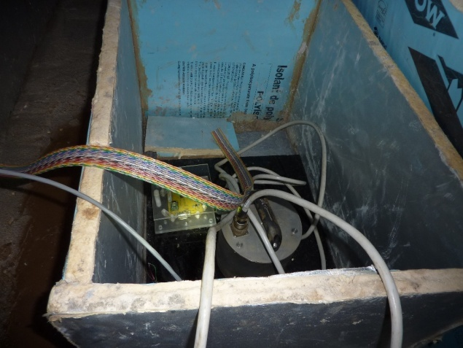
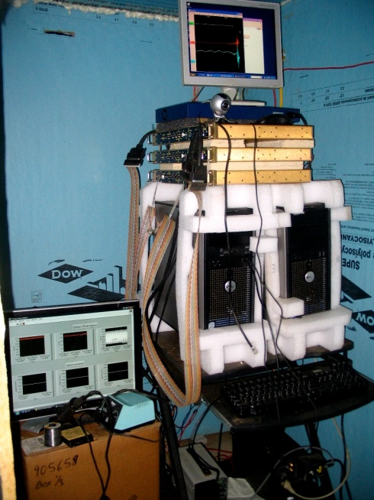
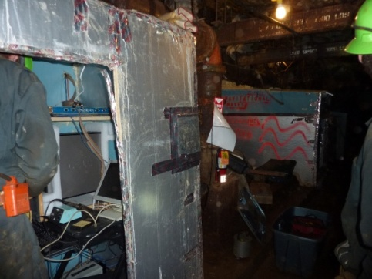
The old three stations
800 ft
300 ft
2000 ft
300 ft
2000 ft
800 ft
Notes:
The old stations at 2000ft, 800 ft and 300 ft have been fixed
300ft: Güralp CMG-40T. We borrowed it from Nelson Christensen in the 300ft , two trillium at 800ft and 2000ft old.

Slide 20
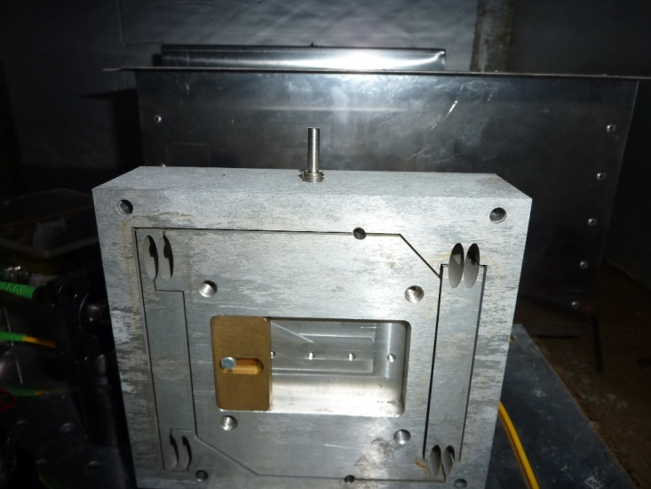
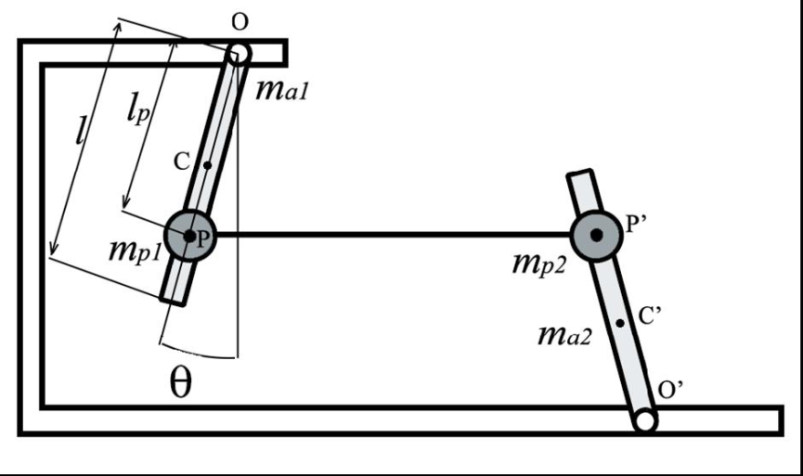
The horizontal seismometers prototypes
The 2000 ft station hosts two Italian horizontal seismometers prototypes
(group of Fabrizio Barone -University of Salerno - INFN)
monolithic tunable folded pendulum²
shaped from one original body of Al-CuBe alloy
central mass linked by 4 flex joints (100μm minimum thickness)
very sensitive in the low frequency seismic noise band
tunable resonance frequency and laser optical readout
[2]: F. Acernese et al. ; tunable mechanical monolithic horizontal accelerometer for low frequency seismic noisemeasurement
Notes:
Since December 2009 in addition to the Trillium 240 seismometer the 2000 ft station host two prototypes of seismometers aligned to a common horizontal direction and developed by the group of Fabrizio Barone (University of Salerno - INFN) based on a monolithic tunable folded pendulum². This is shaped with precision machining and electric discharge machining from one original body of Al-CuBe alloy, and the central mass is linked by 4 flex joints (100μm minimum thickness).
This instrument is very sensitive in the low frequency seismic noise band. The resonance frequency is tunable as the integrated laser optical redout (optical lever + interferometer).
The acquisition was made in parallel with Trillium on a DAQ system.

Slide 21
The horizontal seismometers prototypes
optical lever + interferometer
tunable central mass position
Resonance frequencies vs mass position²
70 mHz
[2]: F. Acernese et al. ; tunable mechanical monolithic horizontal accelerometer for low frequency seismic noisemeasurement

Slide 22
The horizontal seismometers prototypes
Notes:
125mA Operating … IR-A – NIR

Slide 23
The horizontal seismometers prototypes
2000 ft seismometers box
2000 ft I.p. electronic box
failure in the DC power supply caused electronics damages
new electronic box have been installed
the DC power supply must be repaired or replaced
a new instrument calibration may be needed
- new prototypes could be added to the seismometers array in the next future
Notes:
After the implementation of these two prototypes on December 2008, there were some unidenfied problems with the remote read-out system. In this summer we could make a check-up of the instruments: the folded pendulum, the laser source and the optical lever were OK, but there was a failure of the electronics. We changed the electronic boxes with two new boxes from F. Barone group, eventually replacing operational circuits and looking for shorts. We found a failure in the DC power supply caused electronics damages: this power supply must be repaired or replaced before the seismometers will be able to function again. A new instrument calibration may be needed.
A new prototype could be added to the seismometers array in the next future.

Slide 24
Data Collection
LabVIEW
Mass Centering
LIGO frame conversion
Amplifiers (bit conversion)
Noise sources from mine

Slide 25
DAQ System—Local

Slide 26
Sensor Boards
Components used
Components removed from old design for current design

Slide 27
DAQ System—General

Slide 28
STS-2 Seismometers
Two at 4100 ft level
Coordinate systems
Locking ability
Frequency range without transfer function: 10 mHz to 10 Hz
Mass centering: as many times as necessary to within ±2V (±10°C)

Slide 29
Trillium 240 Seismometers
One 800 ft
Three 2000 ft
One 4100 ft
Center after installing
and 12 hrs after
Protective cover

Slide 30
Data Transformations
Raw seismometer data:
velocity in u-v-w coordinates
Linear transformations
Only Trillium 240 and STS-2

Slide 31
Güralp Seismometer
Decoupled sensors
Less sensitive but also less expensive
One 300 ft

Slide 32
Homestake LHO ASD Comparison

Slide 33
Homestake LHO ASD Comparison

Slide 34
Comparison with Peterson Noise

Slide 35
Homestake ASDs Over One Day

Slide 36
Timing Issues and Replacement

Slide 37
Finding the Necessary Time Shift

Slide 38
Spectral Coherence of 2000 ft Stations A and B

Slide 39
Concluding Remarks
The LIGO timing system will take care of our timing problems and allow for more accurate correlation measurements between the 2000 ft stations.
Knowing the calibrated time for the data will allow for a determination of the feasibility of modeling seismic activity.
The seismic signals at LHO during noisy and quiet times can differ at some frequencies by as much as three orders of magnitude. Such extreme differences do not exist at the Homestake site.

Slide 40
Comments or Questions

Slide 41
Working conditions and safety procedures
Safety training
Site must be secured before scientific activities
Experienced miner accompaining
Daily work: 7am to 12.30pm or 4.30pm
Daily action plan
- Tag-in system
- Be on time at the cage
Notes:
Scientists who plan to work underground in the Sanford Lab have to attend a safety class and a specific training. Before being accesible to scientific work a site must be secured by removing loose rocks and constructing supporting structures. According to the policy of Sanford Lab, scientific teams must be accompanied by an experienced miner. This summer Tom Trancynger (geologist), Jaret Heise (science-liaison director) and Reggie Walters (summer student geologist) joined our team and helped us in our work.
Daily work usually starts at the Yates office building where the team pick up the personal equipment in order to be ready to “cage” at the Ross shaft at 7:00 a.m.
Team members has to “tag-in”, which means pick a numbered metal plate and leave a copy at surface, with ones name on a daily action plan, in order to know everytime who is underground if something happens and also to identify burned people by the metal plate.
A scientific team has to be on time to get a cage as general rule, coming late would mean to delay work of other teams in the mine, and a long wait for a next cage.
Team can work underground until noon or 4:30 pm, everything must be scheduled before in the daily action plan.

