Slide 1
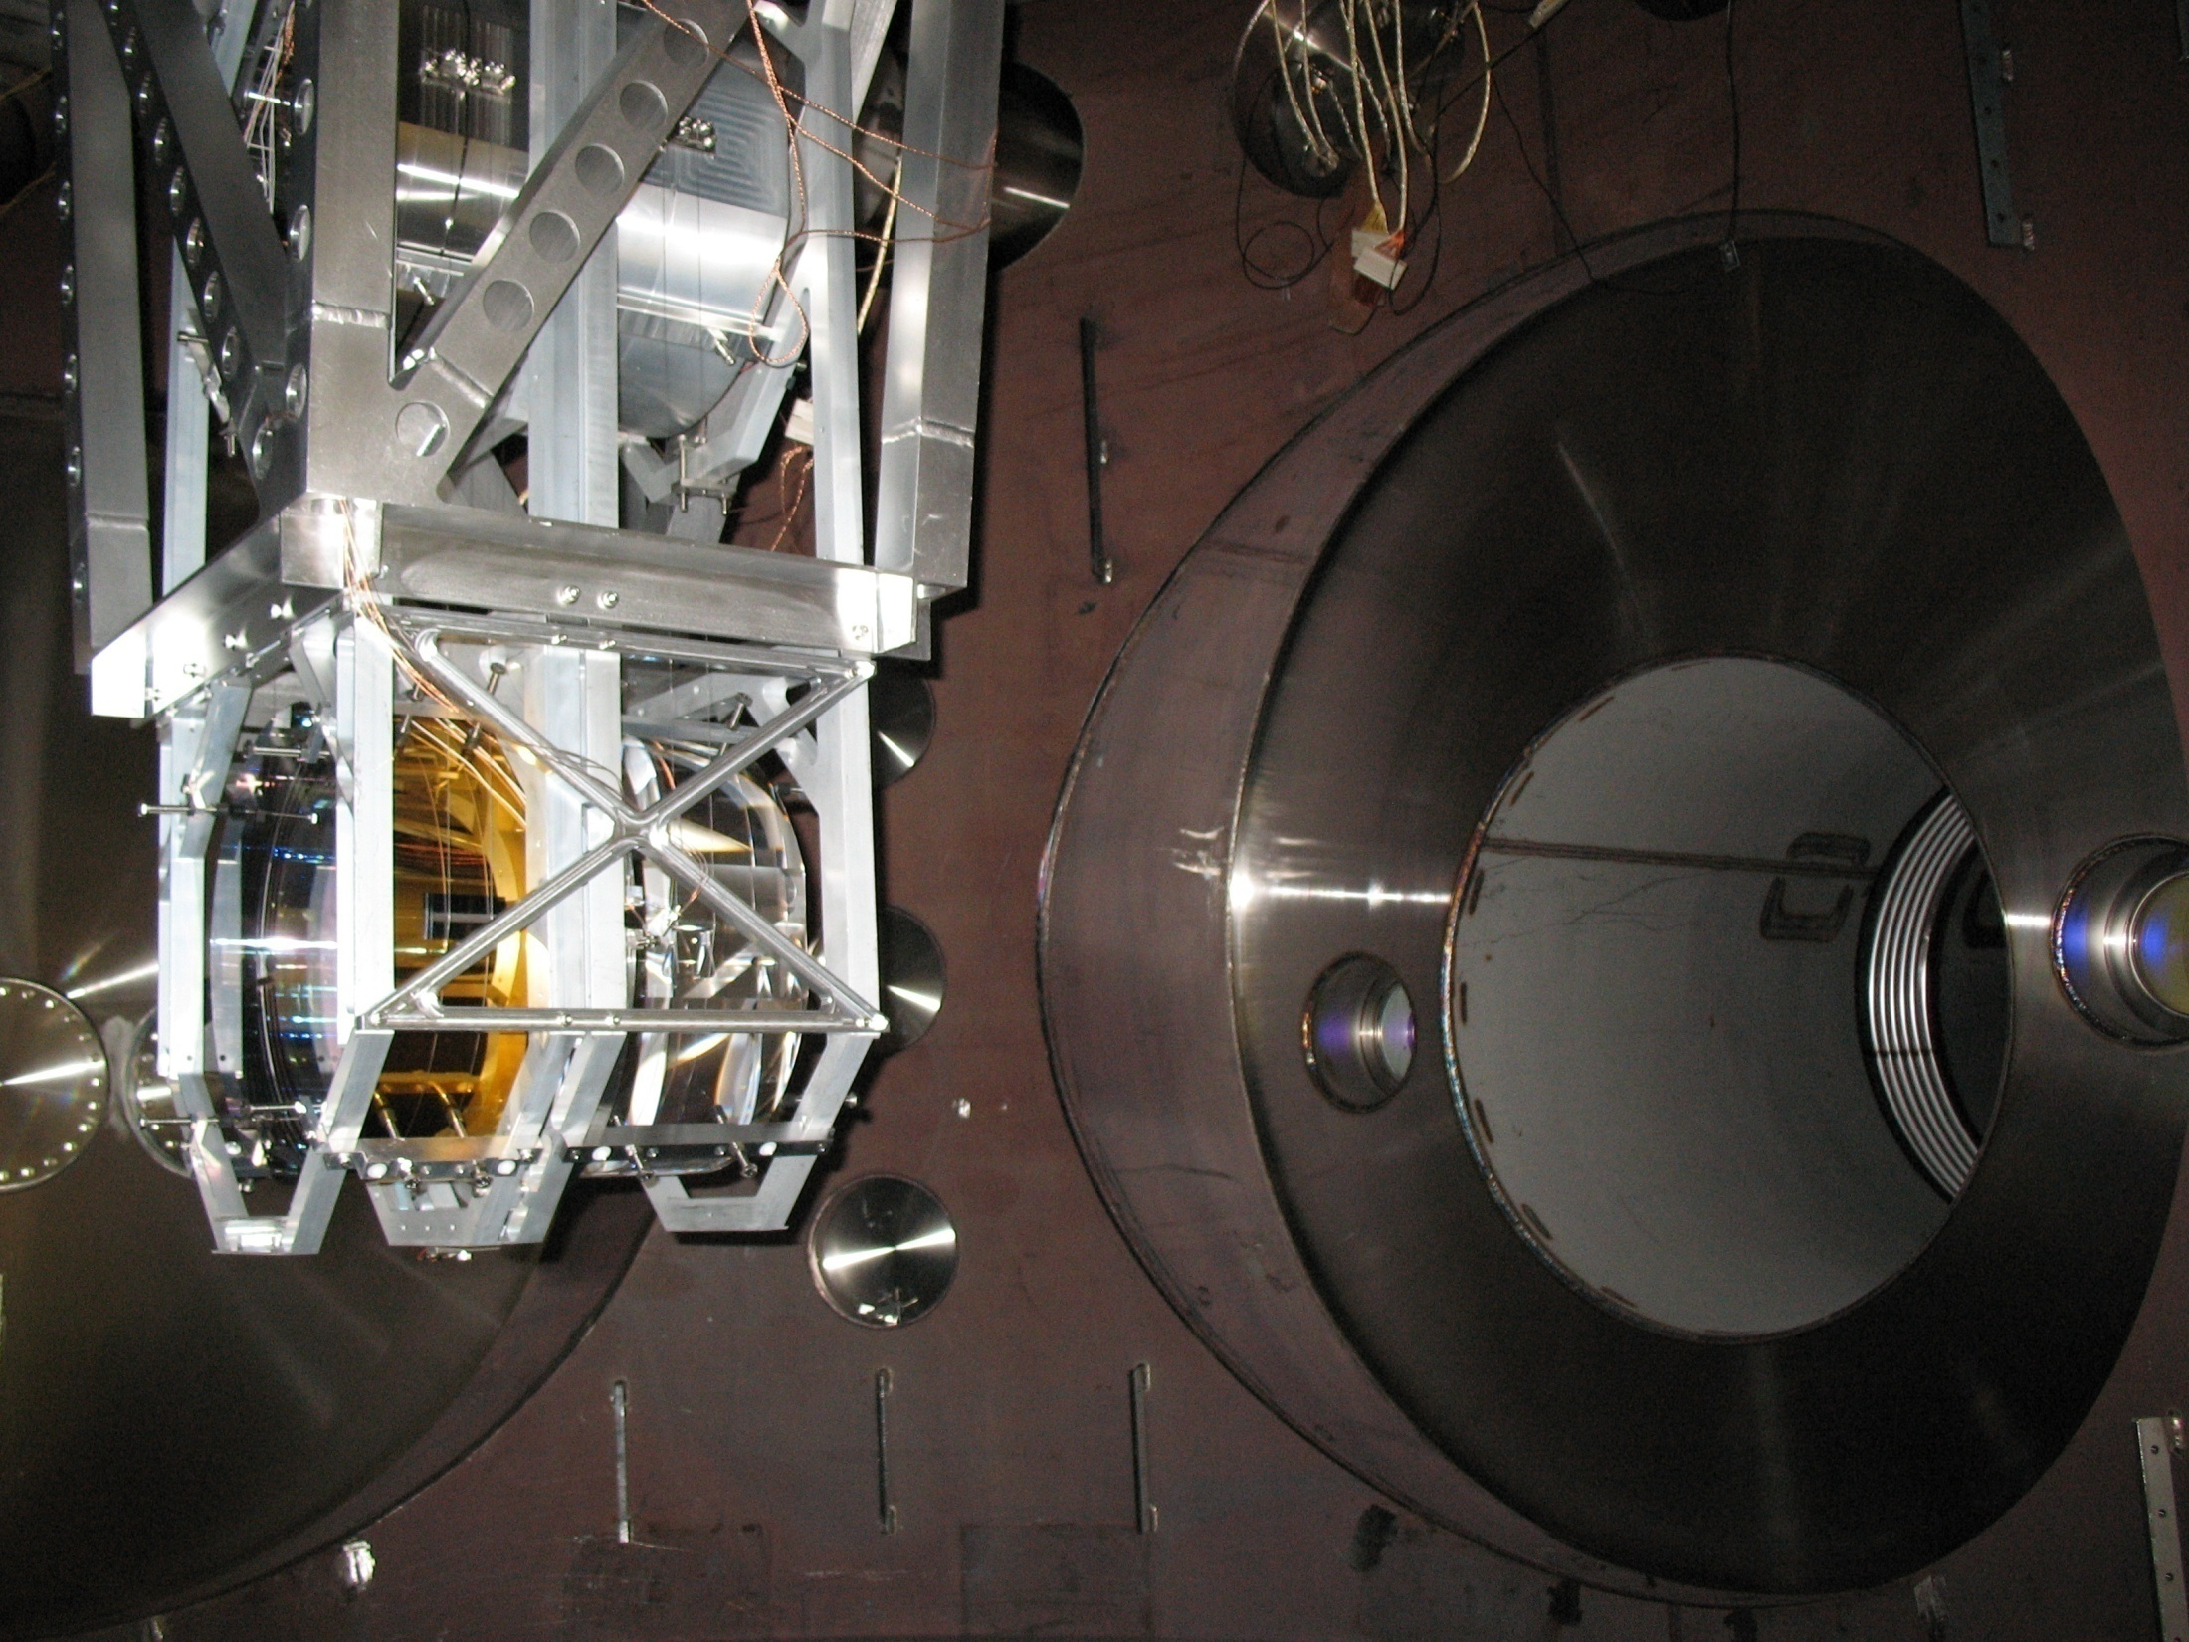
Quad NP Update
LV Meeting – 22 September 2009
Brett Shapiro
G0900876-v1

Slide 2

Timeline of Last Year’s Progress
Glass on metal wire hang: Jan
ESD reworking: Feb-April
Quad Triple Cavity Setup: Feb-April
Eddy Current Damping: end of April
Acoustic Mode Characterization: May-June
Charging measurements: August
Ring heater testing: end of August
Monolithic tests: July-Aug
Jan
Feb
Mar
Apr
May
June
July
Aug

Slide 3
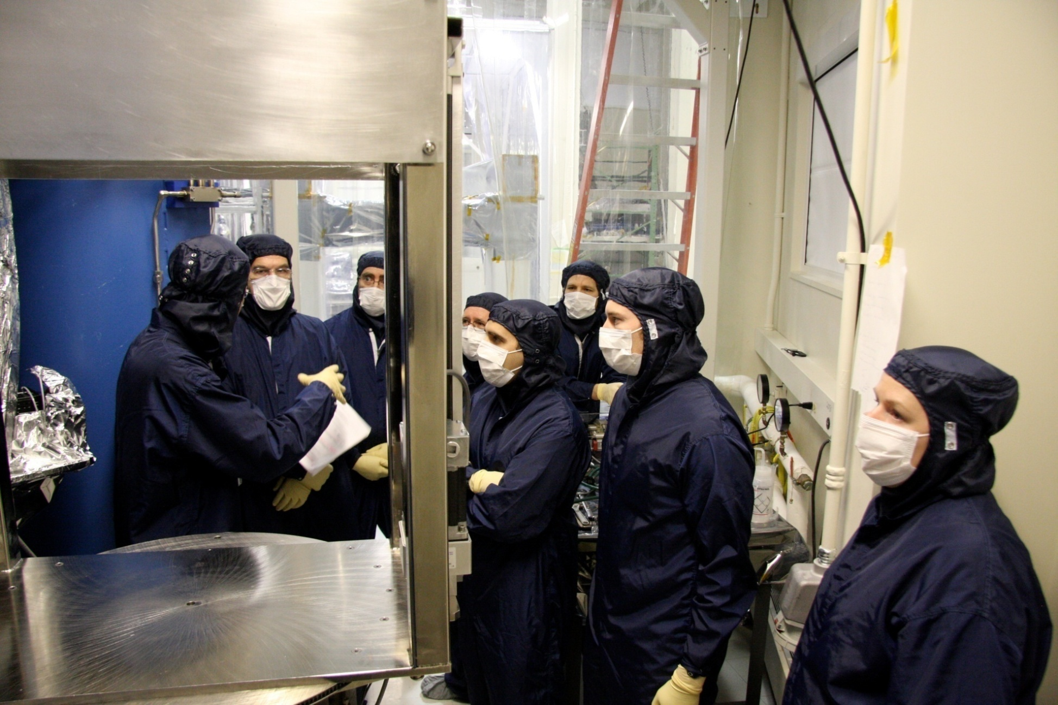
Wire Hang – Jan 2009

Slide 4
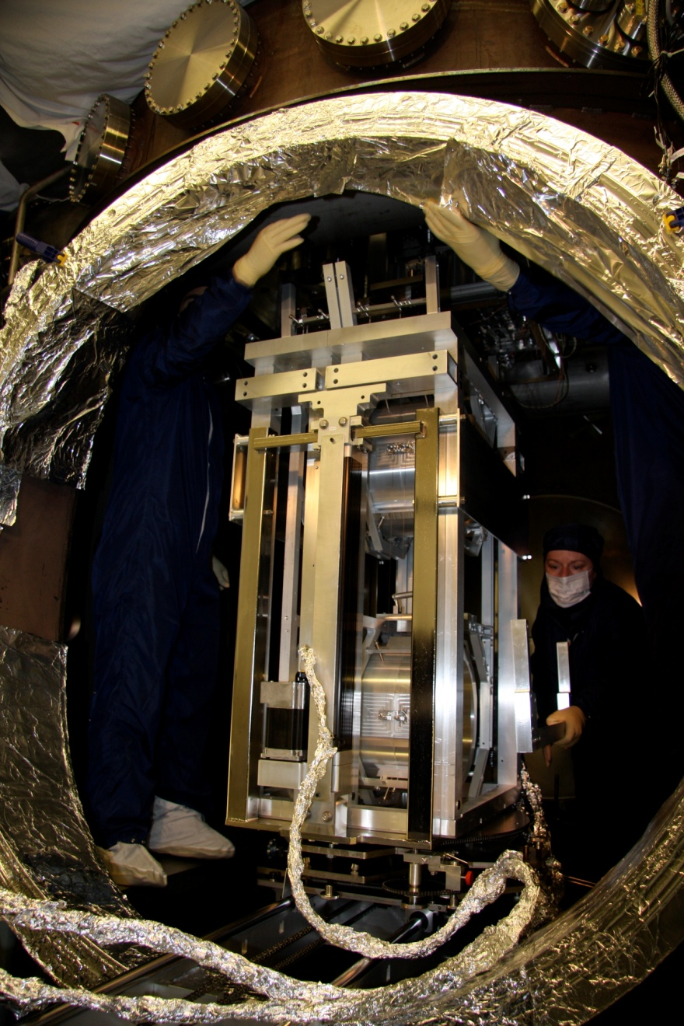

Slide 5
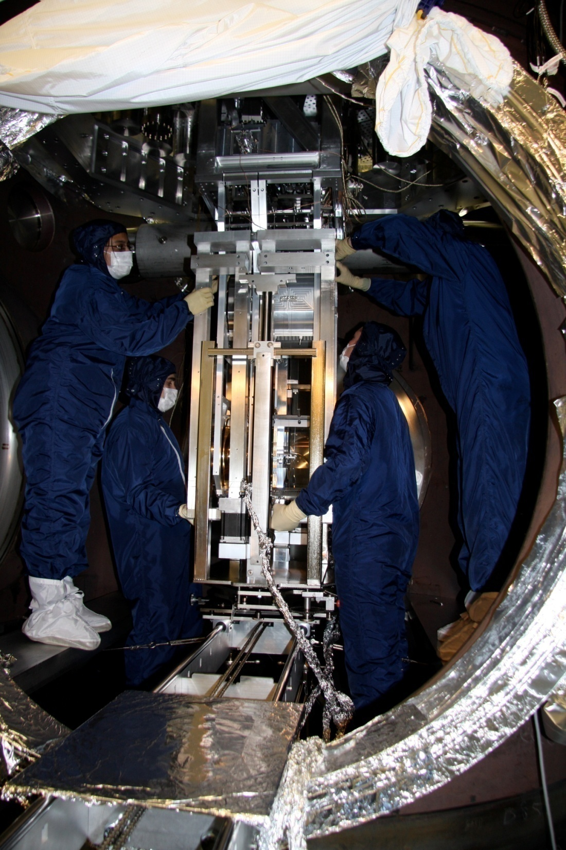

Slide 6
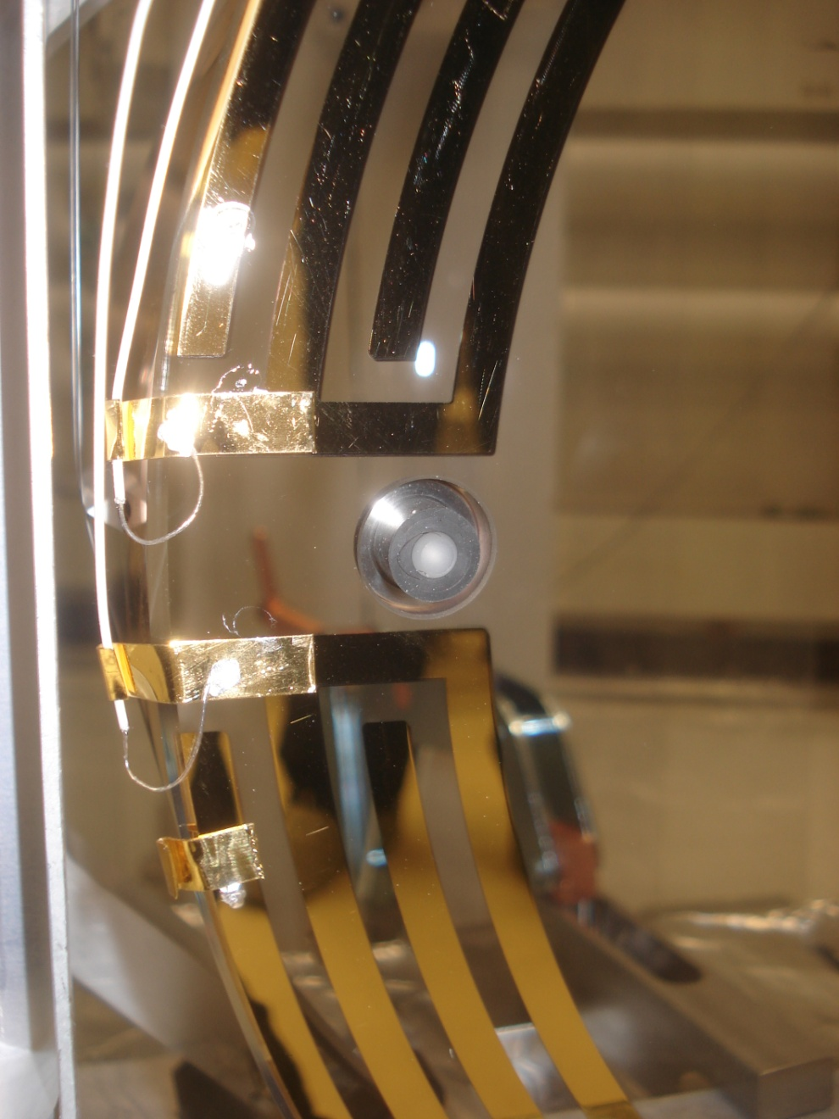
ESD Work
Old soldering procedure – new tab style
Suboptimal solder
Delicate cabling – poor clamping

Slide 7
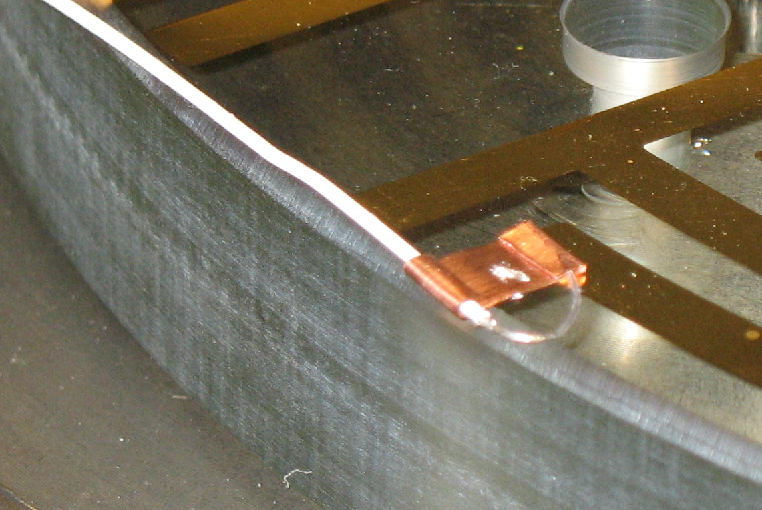
ESD Work
Refined soldering procedure
  Better Geometry
  Fancier tools
  Optimal solder
  More heat
  Practice!
Padded clamps
ESD pattern may yet change
ESD cables may yet change
Dirty test ESD pattern from the controls prototype

Slide 8
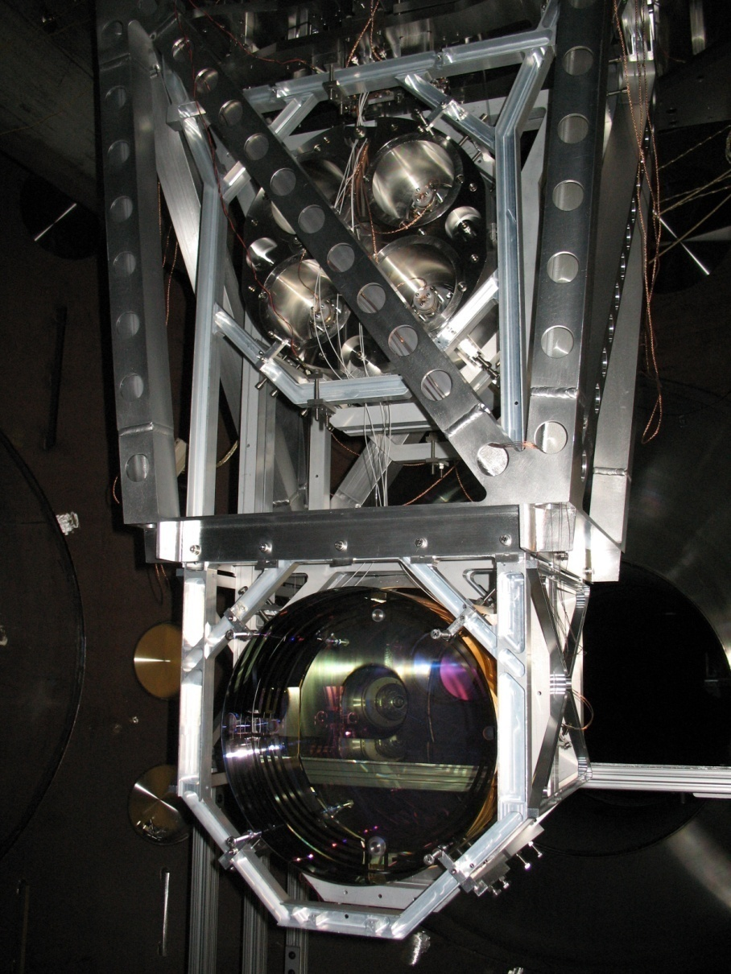
OSEM and ESD
Cabling/Clamping Considerations
Number of clamps at PUM
Clamps on ISI
Padding in clamps
Specialized clamps between top and UI masses

Slide 9
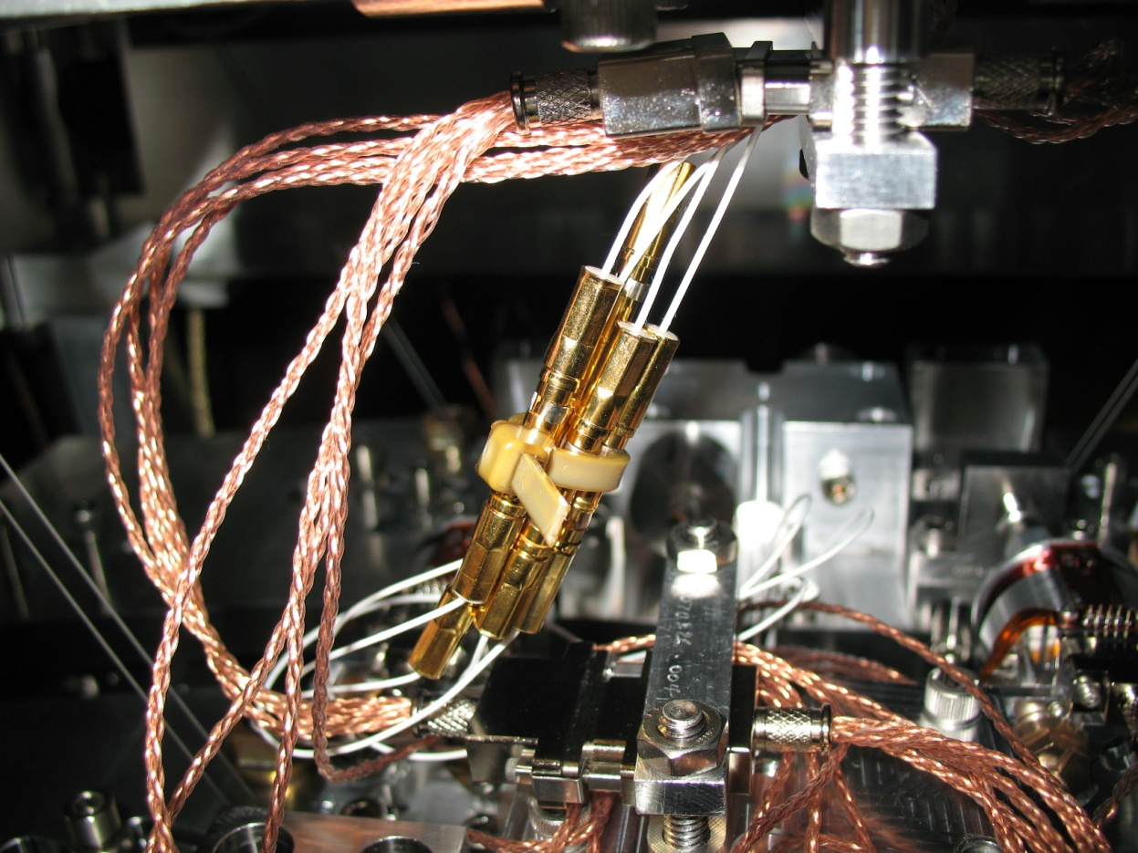
Cable Routing
‘Large’ connectors between top and UI masses.
OSEM Cables
ESD Cables
Cable Clamp
Cable stiffness related to
Main Chain
Reaction Chain

Slide 10
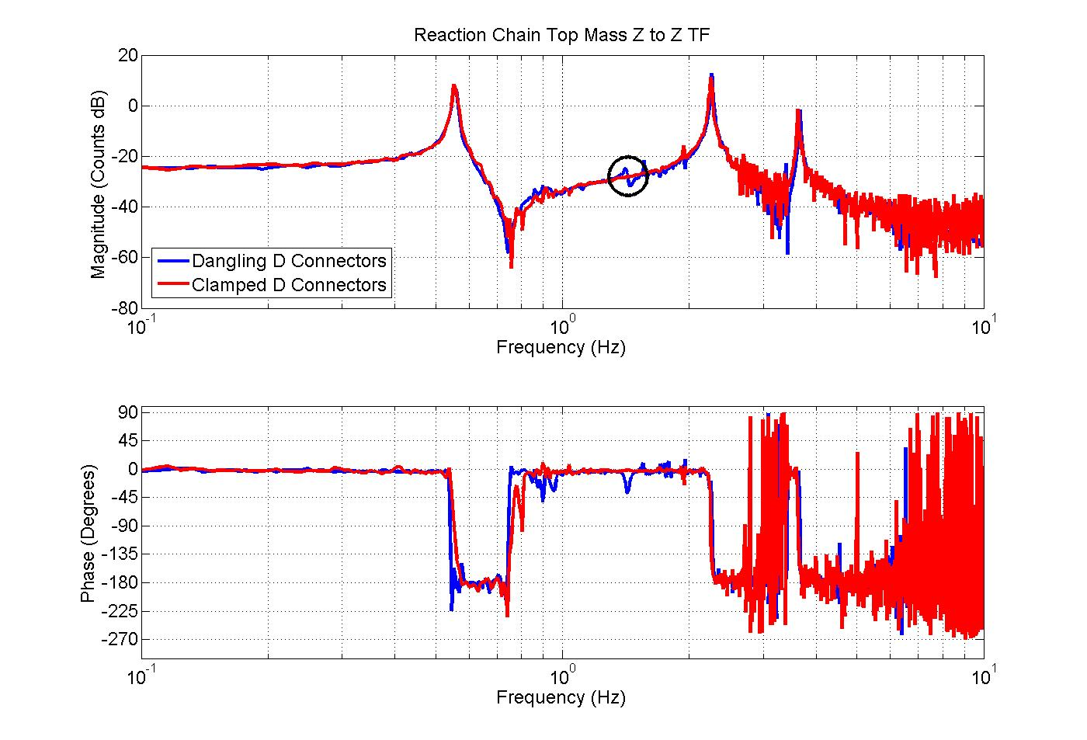
Mechanical Effect on TFs
The large connectors impact pitch and z modes.

Slide 11
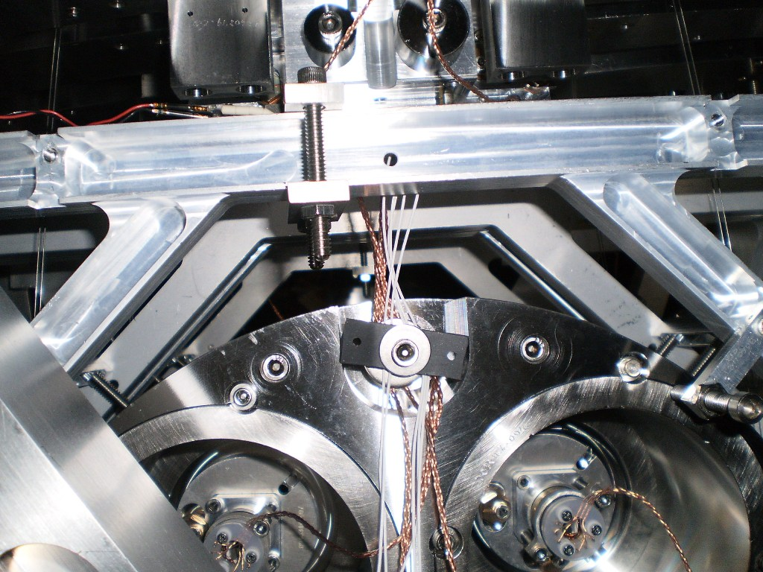
Poor Clamping
Improvised ‘clamp’ at top of PUM

Slide 12
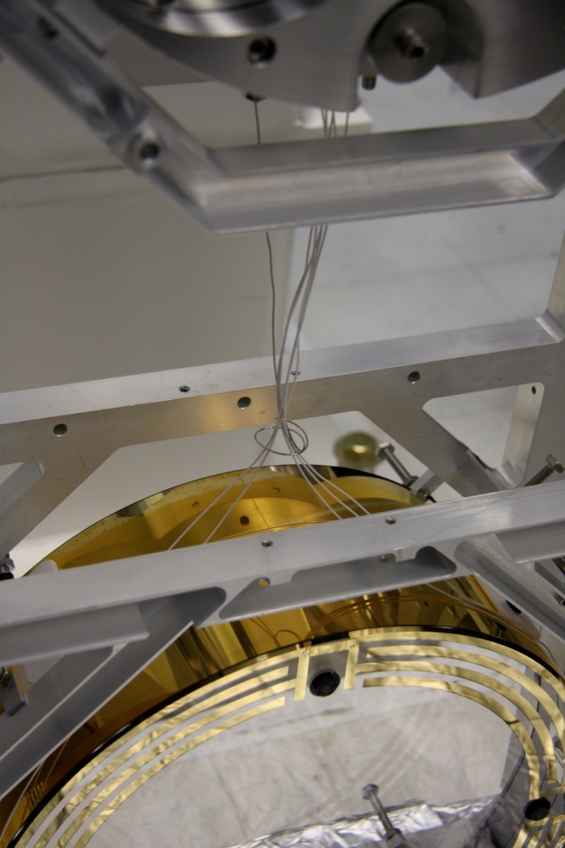
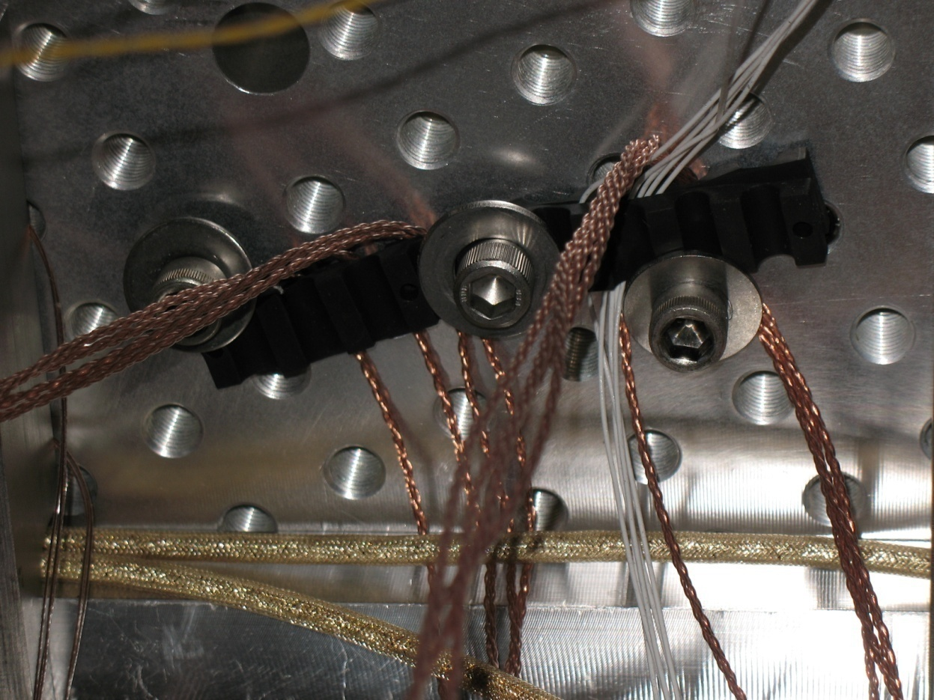
Additional Cabling Routing Issues
Improvised clamp at ISI optics table
Improvised wire guide to ESD

Slide 13
Measurements

Slide 14
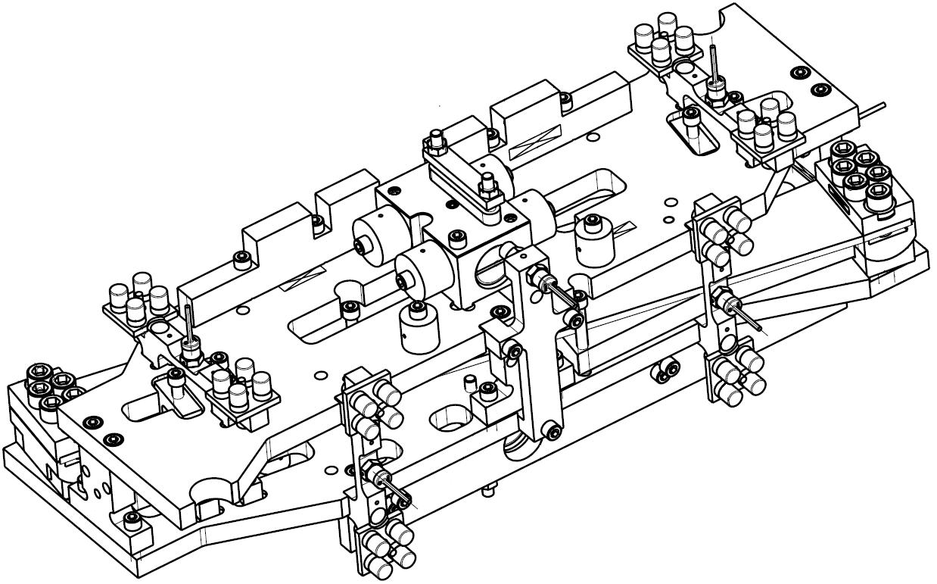
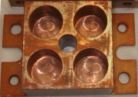
Eddy Current Damping (ECD)
ECDs
ECDs

Slide 15
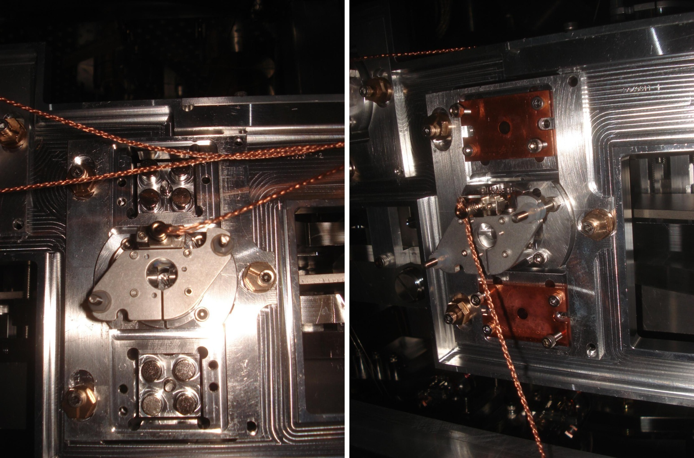
Eddy Current Damping

Slide 16
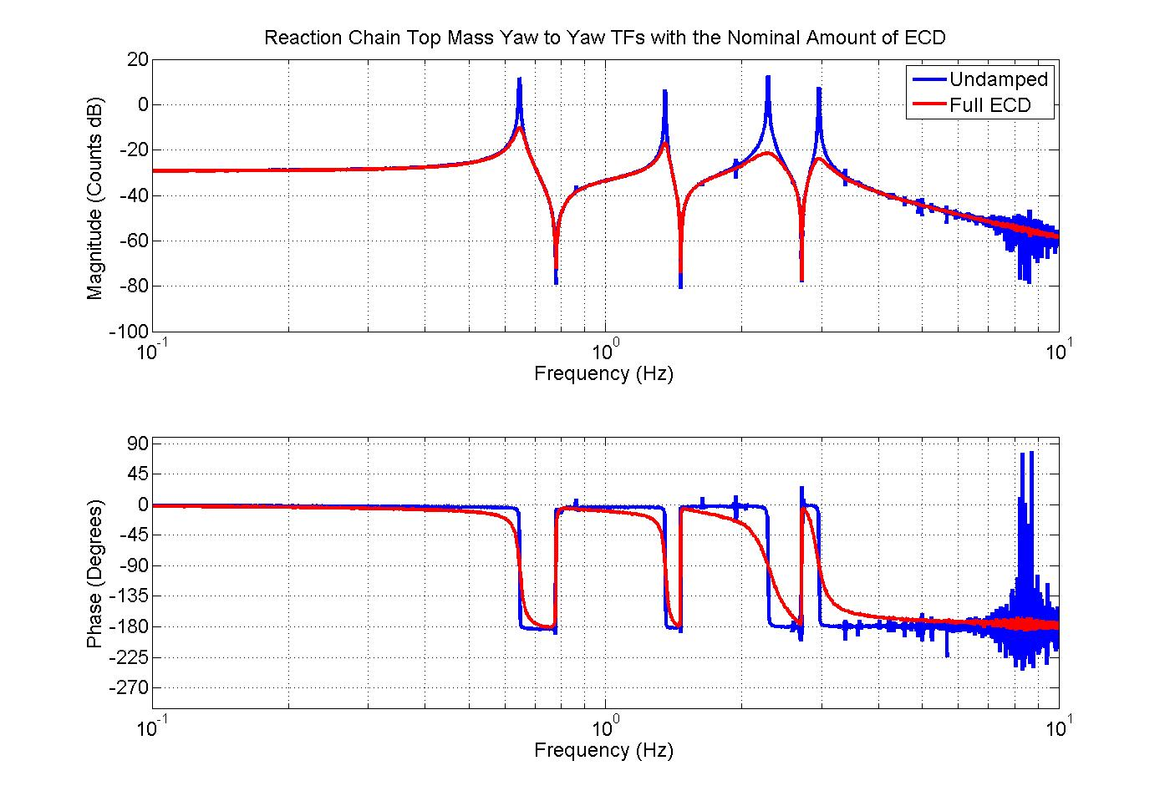
ECD ≈ 2x greater than modeled

Slide 17
Yaw Eddy Current Damping
Transverse Dampers
Longitudinal Dampers
Damping comes from 2 DOFs of magnet motion.

Slide 18
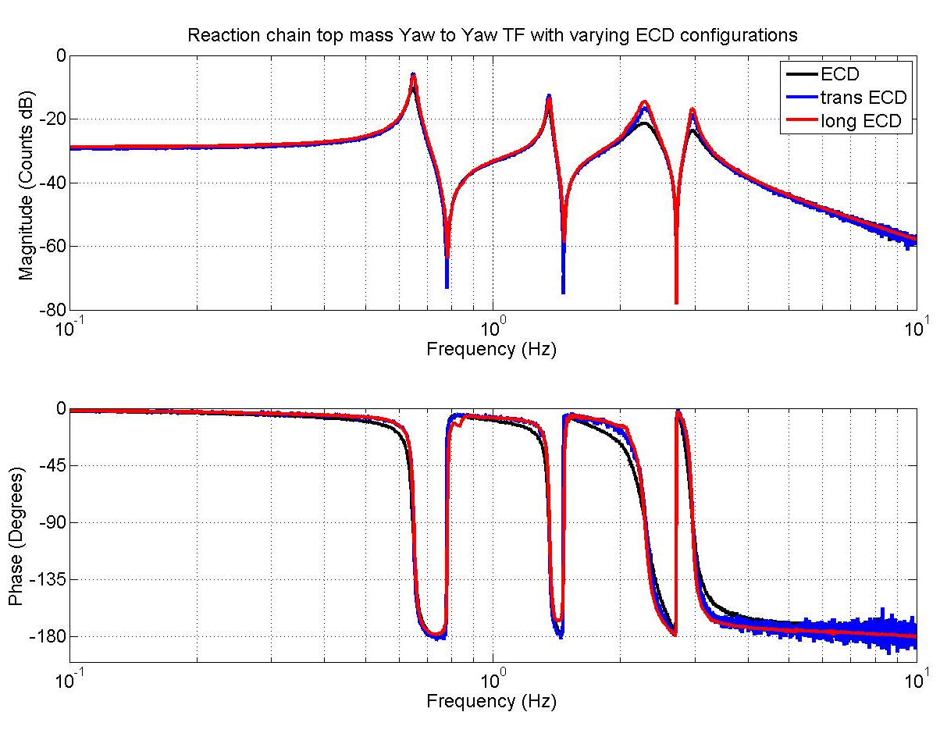
ECD Nominal Results
Longitudinal and transverse damping are roughly equal

Slide 19
Opening the Magnet Bore from 12 to 12.7 mm
12 mm
12.7 mm
(0.5 in)
Magnet
Magnet
Top Mass
Top Mass
The copper magnet bores were drilled out to simultaneously increase clearance and reduce damping.

Slide 20
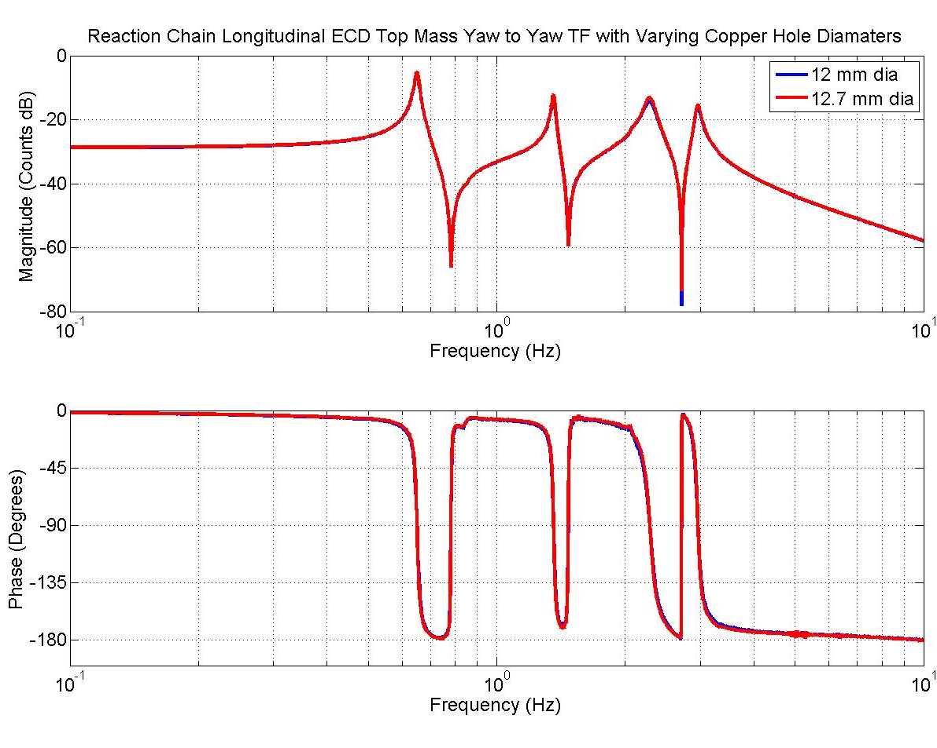
12.7 mm Bore Long. Damping
Larger holes have negligible impact on damping.

Slide 21
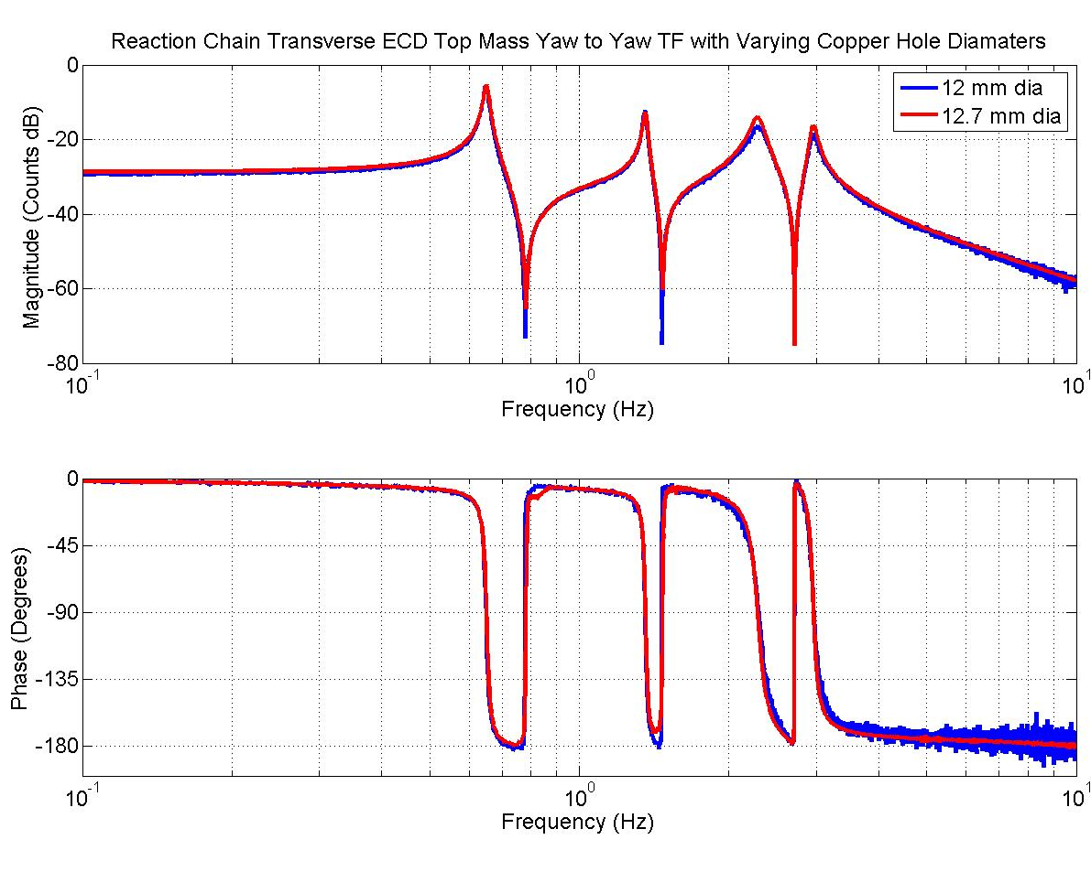
12.7 mm Transverse Damping
Larger holes have negligible impact on damping.

Slide 22
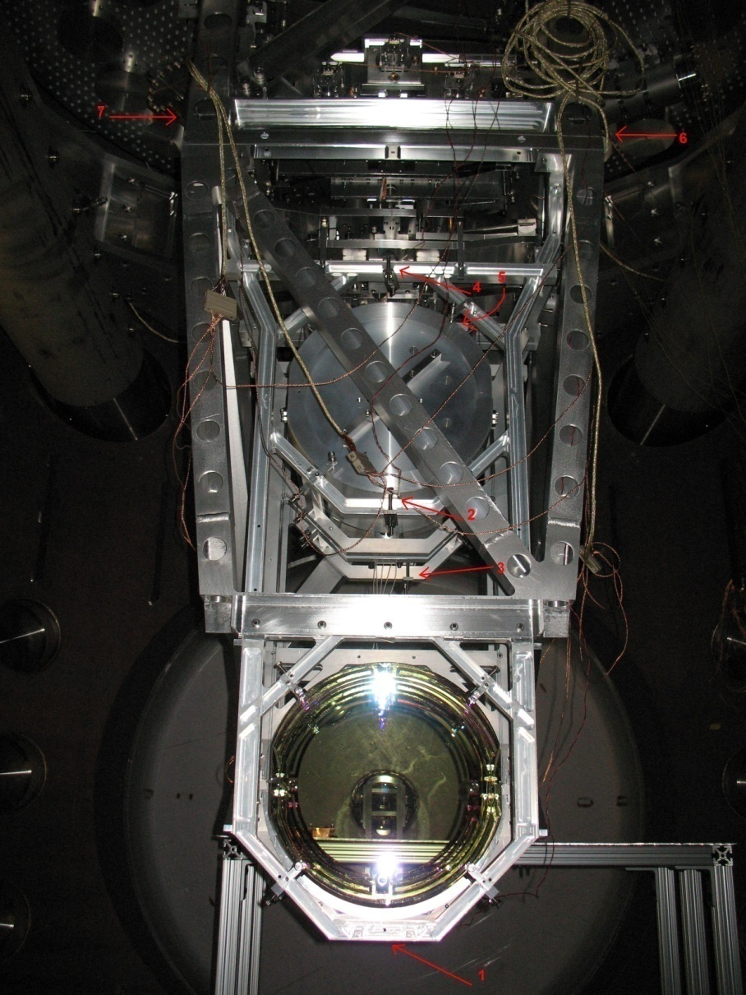
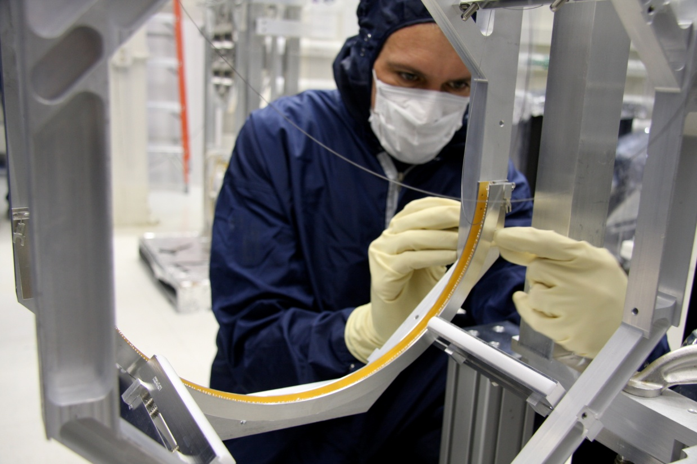
Ring Heater Testing

Slide 23
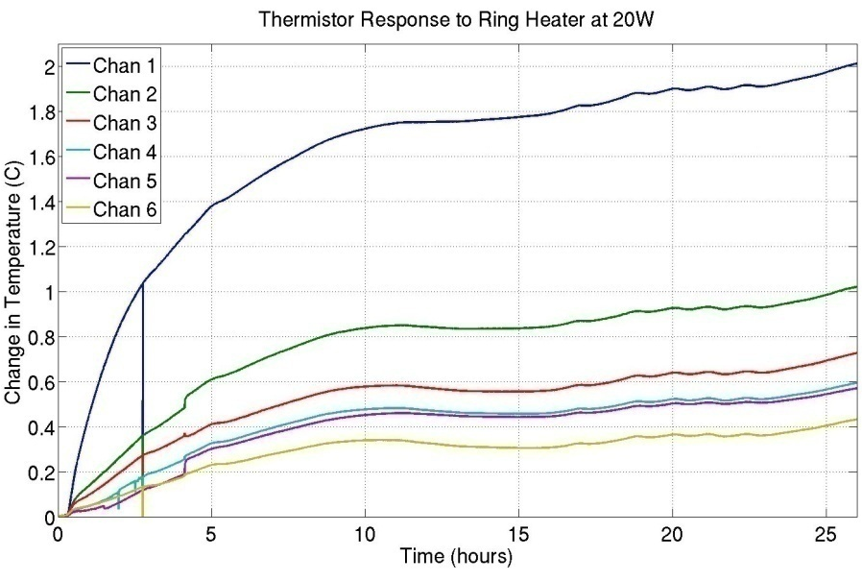
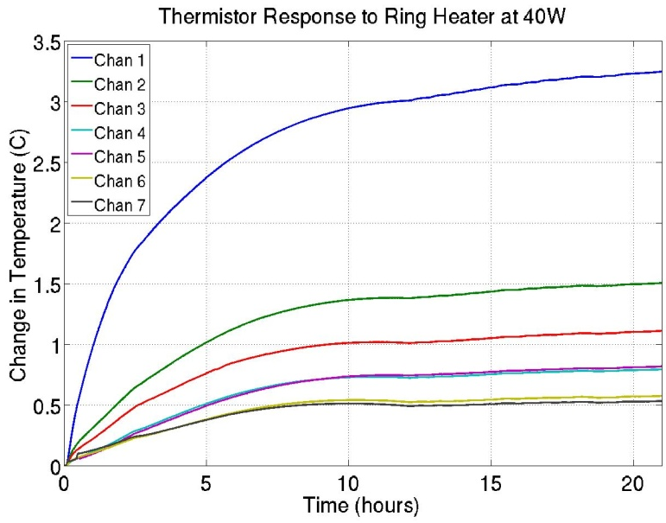
Ring Heater Testing
The bottom of the quad structure warms by about 0.8 C/10W
No gross effects on quad or ISI
Vacuum pressure increase on order of 10 ntorr. No RGA available.
Will try again with the full monolithic suspension.
Should find an upper power limit considering the suspension becomes transparent at high power. Ryan Lawrence’s thesis to provide insight.

Slide 24
Modal Damping Results

Slide 25
Modal Damping Results

Slide 26
Upcoming Work
Monolithic installation
Global control tests
  Hierarchical
  New methods
  HAM ISI integration
Local Damping
  Noise measurements with modal damping
TCS

Slide 27
Documentation Produced this Year
Summary of ECD Results on the Quad Noise Prototype - T090245-00
2. Quad Noise Prototype Cabling Routing - T0900380-v1
3. Quad Noise Prototype Results Summary - T0900426
4. Rehang of the Quad NP with glass masses but metal wires - T0900055-v1
  (Includes ESD procedure)

