Slide 1
HAM6: Summary of Beam Parameters
L. Barsotti
Jun 12, 2013

Slide 2
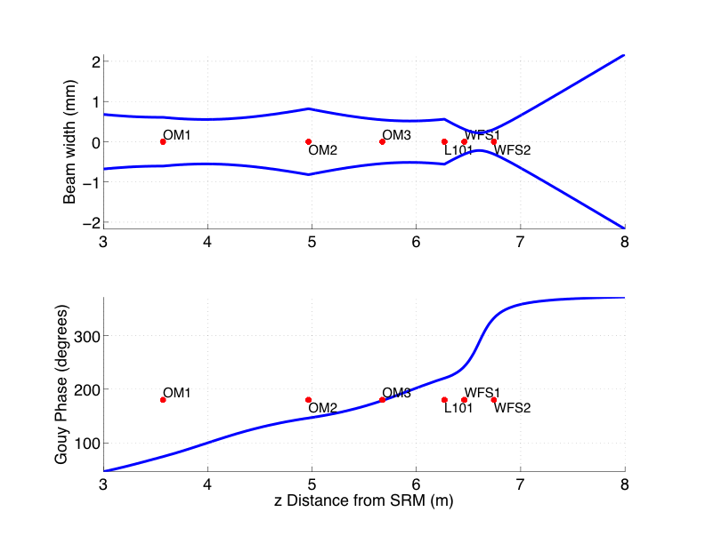
AS WFS (see T1000247)
'label' 'z (m)' 'type' 'Gouy Phase'
'-----' '-----' '----' '----'
'SRM' [0] 'thick lens ' '0.23064 '
'OM1' [3.5710] 'curved mirror' '74.4485 '
'OM2' [4.9660] 'curved mirror' '146.3 '
'OM3' [5.6740] 'flat mirror' '178.91 '
'L101' [6.2688] 'lens' '220.4774 '
'WFS1' [6.4600] 'flat mirror' '242.4142 '
'WFS2' [6.7435] 'flat mirror' '332.4142 '

Slide 3
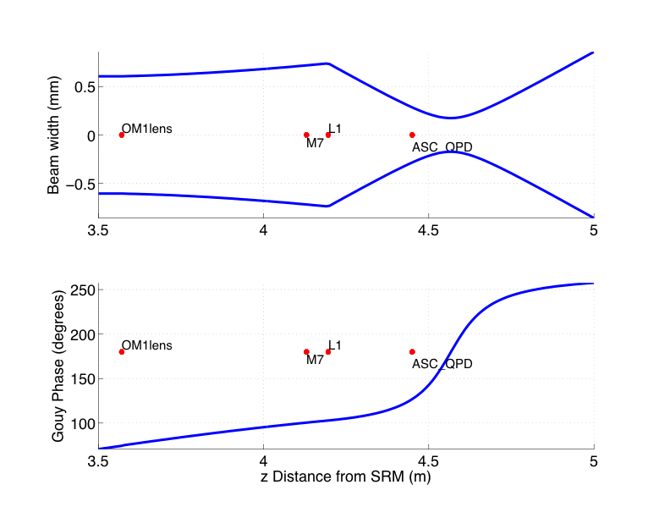
AS QPD (trigger diode)
'label' 'z (m)' 'BeamWidth' 'Gouy Phase'
'-----' '-----' '----' '----'
'SRM' [0] '2.0724 ' '0.23064 '
'OM1lens' [ 3.5710] '0.60694 ' '74.7948 '
'M7' [4.1298] '0.71974 ' '100.468 '
'L1' [4.1958] '0.7408 ' '102.8722 '
'ASC\_QPD' [4.4498] '0.28556 ' '126.8669 '

Slide 4
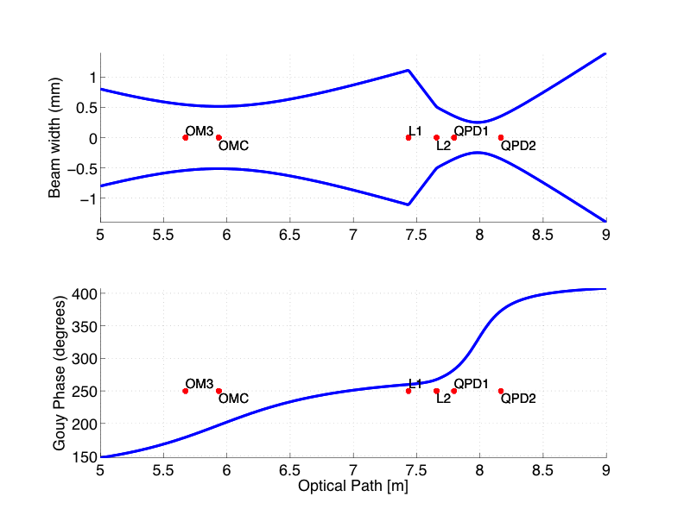
OMC REFL QPDs (see T1000247)
'label' 'z (m)' 'BeamWidth' 'Gouy Phase'
'-----' '-----' '----' '----'
'SRM' [0] '2.0724 ' '0.23064 '
'OM1' [ 3.5710] '0.60646 ' '74.4485 '
'OM2' [ 4.9660] '0.81983 ' '146.3 '
'OM3' [ 5.6740] '0.54273 ' '178.91 '
'OMC' [ 5.9357] '0.51467 ' '197.4135 '
'L1' [7.4357] '1.1132 ' '259.8759 '
'L2' [7.6578] '0.50511 ' '267.5606 '
'QPD1' [7.7972] '0.35356 ' '282.894 '
'QPD2' [8.1663] '0.35356 ' '372.894 '

