Slide 1
Squeezer Update
February 10, 2010
H1 Squeezer Experiment
ANU, AEI, MIT, CIT and LHO collaboration

Slide 2
Progress
On budget & no major roadblocks so far
No major schedule setback (maybe ~2 month behind with optics procurement)
2nd update review was held on February 9
New postdoc (Lisa B.)
Lasers ready at MIT; locked together
OPO ready at ANU with 5-6dB of squeezing
Ready to ship in March, required in early May
Electronics is 80% complete; will be done by May
Developed a noise and servo model
Next: Set up the AEI SHG at MIT

Slide 3
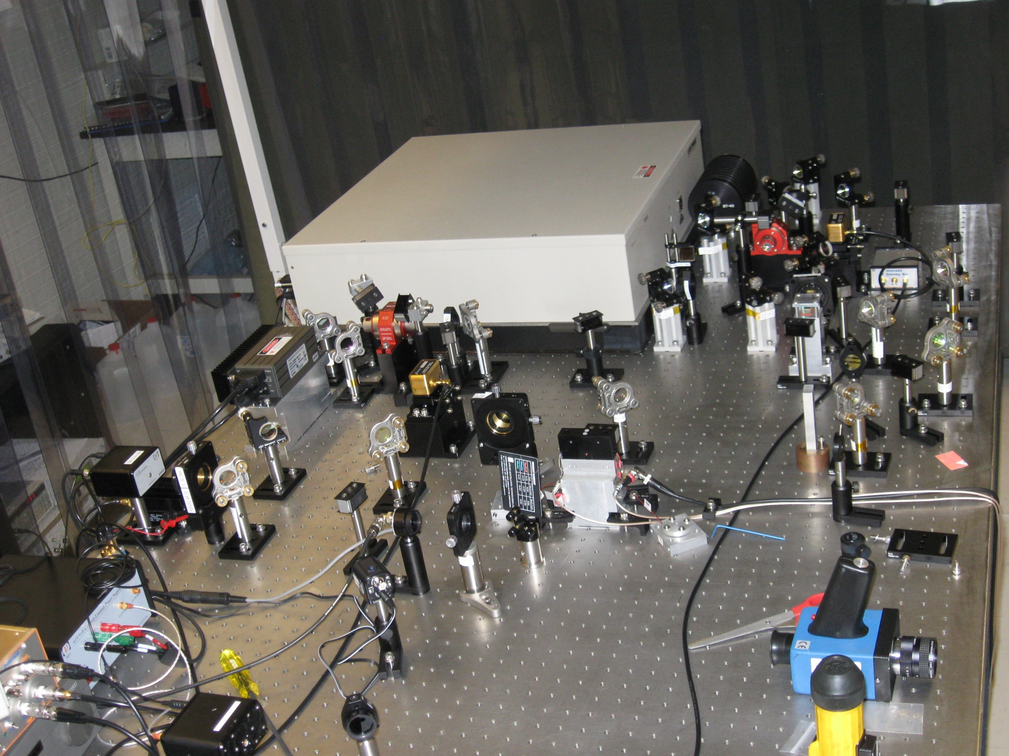

Slide 4
ANU Traveling wave OPO

