Slide 1
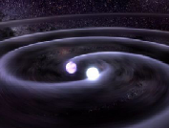
Searches for Compact Binary Coalescences in LIGO and Virgo data
Gabriela González
For the LIGO Scientific Collaboration and the Virgo Collaboration
APS meeting, Feb 13 2010
Session B13: Observational Implications of Gravitational Waves
LIGO-G1000112

Slide 2
The LIGO-Virgo CBC group searches
LIGO – S5: November 4, 2005 – September 30, 2007
Virgo – VSR1: May 18, 2007 – September 30, 2007
S6 and VSR2 started on July 7 2009 – S6/VSR2a=First 7 weeks
Low mass search: Total mass from 2-35 M
S5 First year search: PRD 79, 122001 (2009)
S5 12-18 month search: PRD 80, 047101 (2009)
S5-VSR1 5 month joint search (nearing completion)
S6/VSR2a: Data analyzed
High mass search: Total mass from 25-100 M
(nearing completion)
S5-VSR1 GRB (triggered) search
arXiv:1001.0165v1 (2010)
S5 Ringdown Search
Spinning Search

Slide 3
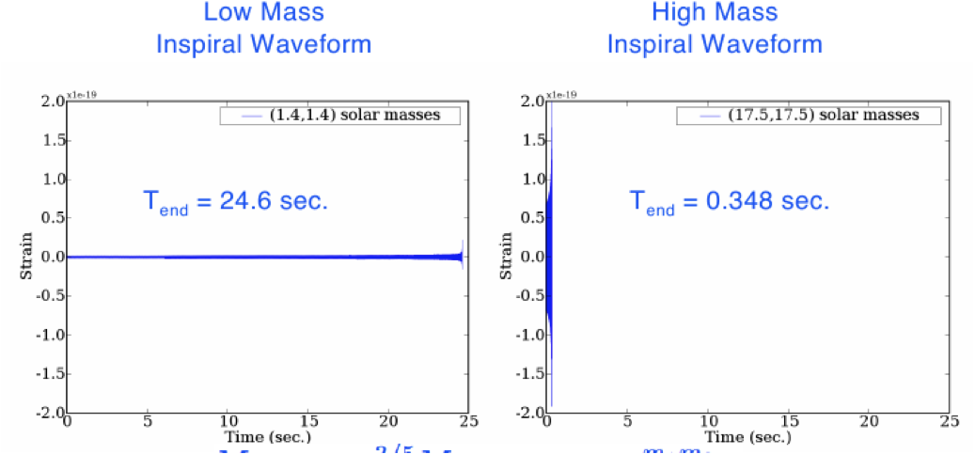
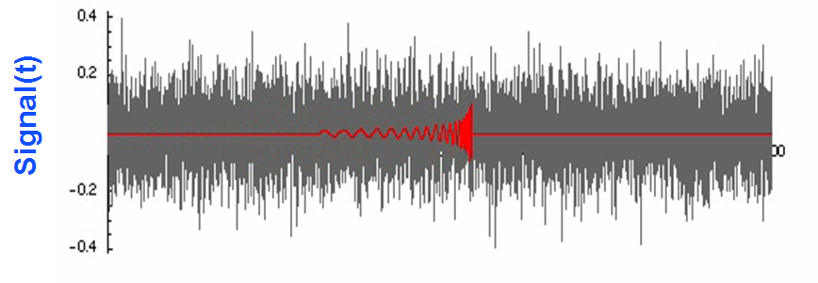
Overview of the Search Pipeline
Generate a template bank
Total mass from 2-35 M (low mass search)
Total mass from 25-100 M (high mass search)
Minimum component mass 1 M
Match filter the data
Search for coincidence in multiple detectors
Apply data quality
Signal consistency checks
Use χ² parameter
Calculate a false alarm rate
Interpret the results

Slide 4
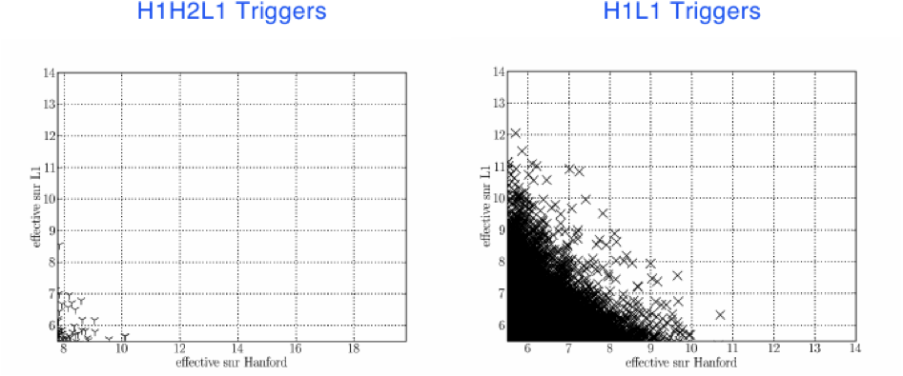
False alarm rates (FAR)
Estimate looking for coincidences with unphysical time delays.
2 ifo background coincidences are more likely than 3 or 4 ifo coincidences
We combine results using FAR, not SNR

Slide 5
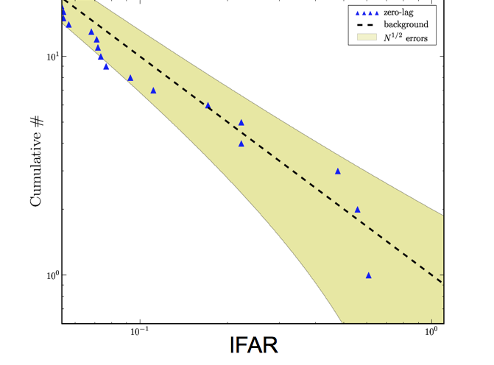
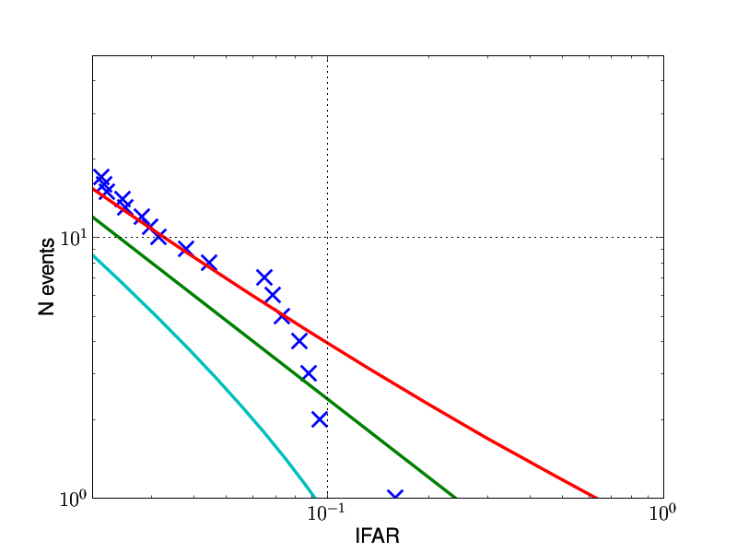
Low Mass Results (pre-VSR1) Loudest triggers
S5 1st year low mass
S5 12-18 month search
PRD 80, 047101 (2009)
PRD 79, 122001 (2009)
1/FAR
1/FAR
High mass results and remaining S5-VSR1 low mass results will be ready soon!

Slide 6
Low Mass Results (pre-VSR1)
No triggers were found that were inconsistent with background estimates.
The loudest triggers were subject to our “follow-up process”
Our conclusion is that no gravitational wave candidates were found in this search ☹
With no potential events, we set upper limits on the rates of binary coalescences.

Slide 7
Upper limits (pre-VSR1)
PRD 80, 047101 (2009)
 | Binary neutron stars | Neutron star – black holes | Binary black holes
Current results | 1.4x10⁻²L₁₀⁻¹yr⁻¹ | 3.6x10⁻³L₁₀⁻¹yr⁻¹ | 7.3x10⁻⁴L₁₀⁻¹yr⁻¹
Predicted “plausible” astrophysical rates | 6x10⁻⁴L₁₀⁻¹yr⁻¹ | 6x10⁻⁵L₁₀⁻¹yr⁻¹ | 2x10⁻⁵L₁₀⁻¹yr⁻¹
Predicted “realistic” astrophysical rates | 6x10⁻⁵L₁₀⁻¹yr⁻¹ | 2x10⁻⁶L₁₀⁻¹yr⁻¹ | 2x10⁻⁷L₁₀⁻¹yr⁻¹
Definition | m₁ = m₂ =1.35M⊙ | m₁ = 5.0 M⊙, m₂ = 1.35 M⊙ | m₁ = m₂ =5.0 M⊙
Astrophysical rates: LIGO-P0900125
Milky Way – 1.7 L₁₀

Slide 8
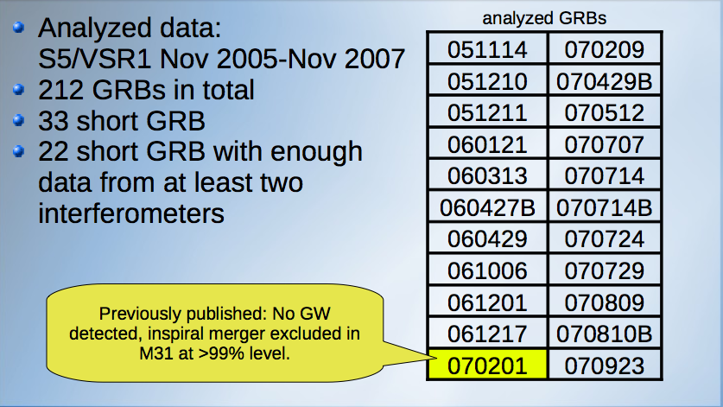
Searches for short GRBs
L1, H1, V1 on!!
Astrophys. J. 681, 1419 (2008)
070923
B13, Sat 12:09pm: Seeking optical counterparts to gravitational wave event candidates (Jonah Kanner)
K13, Sun 3:30pm: High Energy Gamma Rays from GRB and Gravitational Wave Detection (many talks!)

Slide 9
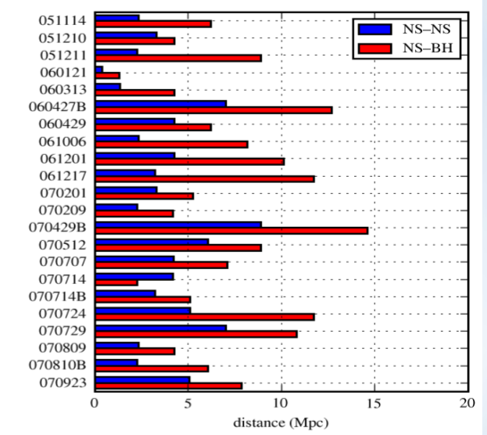
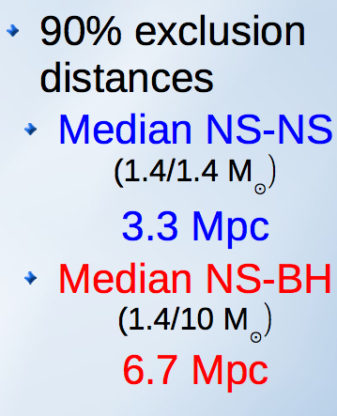
GRB search result
No GWs detected ☹
arXiv:1001.0165v1 (2010)

Slide 10
S6-VSR2 Status Update
S6 and VSR 2 started on July 7 2009
S6 is LIGO's 6th science run, “Enhanced LIGO”
VSR2 is Virgo's 2nd science run
Planned to run for about a year with interspersed commissioning breaks
S6-VSR2a ran 7 weeks; ended August 24th with first LIGO commissioning break
Virgo started commissioning break to install new mirrors (better sensitivity!) in January 8, back in ~June

Slide 11
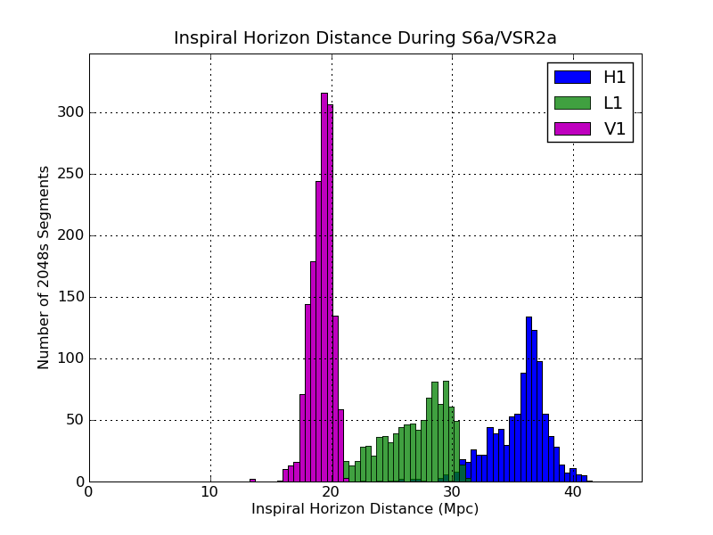
S6-VSR2a Current Status
All seven weeks analyzed and boxes opened
Results will undergo internal review and be released soon
S6a included a Blind Injection Challenge

Slide 12
The Future
S6 will continue until ~Fall 2010
Virgo is installing monolithic suspensions and plans to rejoin in three to four months
Advanced LIGO detectors will begin to be installed in the fall, and will start to come online in 2014 and begin working towards 10x the sensitivity of S5/VSR1
This will allow us to see 1000 times as many galaxies!

Slide 13
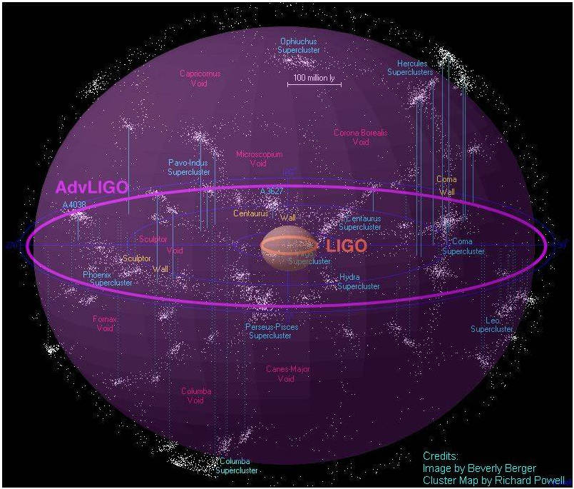
The future

