Slide 1
First Contact: Practical Engineering Solutions
By Margot Phelps

Slide 2
Outline
The purpose of this talk is to explain dos and don’ts of using First Contact, and how to apply and remove it correctly.
Lessons learned on:
Drag wiping and First Contact
Methanol and First Contact
Surface charge on optic
Ergo-arm compatibility
Correct application and removal
Notes:
The purpose…I will do this by explaining the practical problems and solutions faced when using FC to keep optics clean.

Slide 3
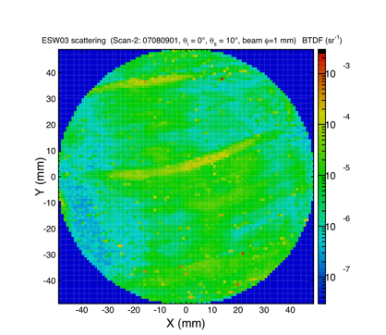
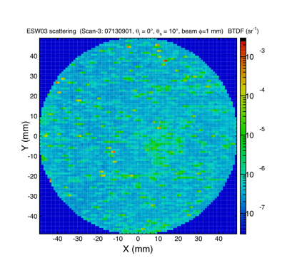
Drag Wiping and First Contact
Liyuan Zhang and I took BRDF measurements with his CASI of the surface of an optic cleaned with both drag wiping and first contact to see which method worked better.
Scans: 1. Optic before cleaning. 2. Optic after drag wipe with old methanol, residue is left. 3. Optic after cleaning with First Contact, most of drag wiping residue is gone.
Important note: In Enhanced LIGO drag wipe procedure T0900402 it is noted that old methanol leaves residue and that new, spectroscopic grade methanol does not. Scan 2 verifies that old methanol does indeed leave a residue. After this scan, new spectroscopic grade methanol is all that is used.
Scan 1
Scan 2
Scan 3

Slide 4
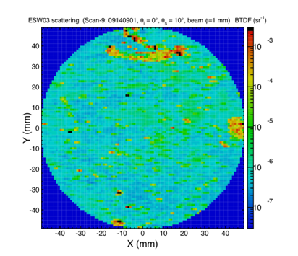
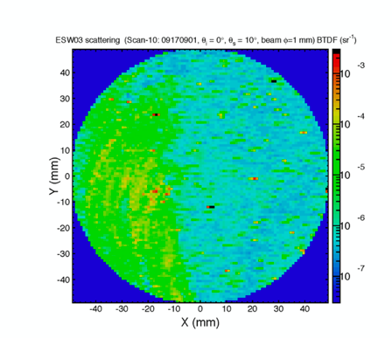
Methanol & First Contact
Top plot: Some dried pieces of first contact purposefully left on optic.
Bottom plot: Optic after a bath in new spectroscopic grade methanol.
Using methanol to clean optics after using First Contact on them results in a nasty residue.
Interesting note: Methanol is also harder on the respiratory system than acetone.
OSHA Permissible Exposure Limits Acetone: PEL of 1000ppm or 2400 mg/m³ Methanol: PEL of 200ppm or 260 mg/m³

Slide 5
Old methanol and new methanol
Scans: 1. Submerged optic in bath of reagent grade methanol, hoping to get rid of residue then drag wiped after removing from bath. 2. Submerged optic in bath of newly opened spectroscopic grade methanol and drag wiped on removal.
New methanol leaves less residue.
When CASI is working again (needs a part, will take 8-10 weeks) additional drag wipe tests will be done.
Scan 1
Scan 2

Slide 6
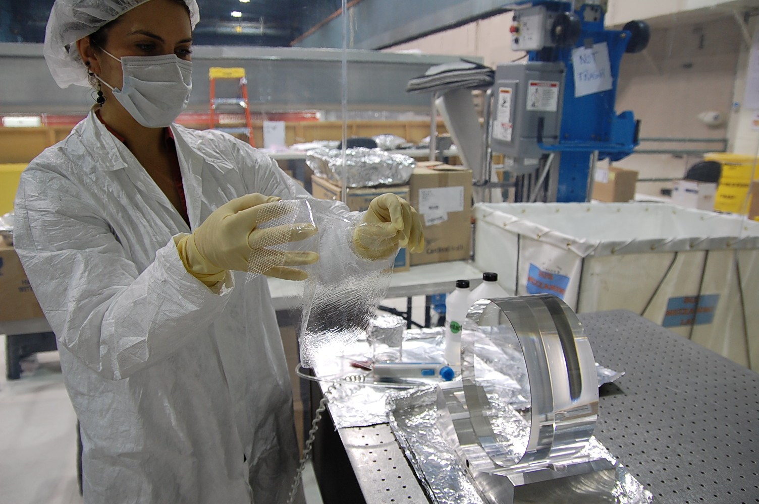
Surface Charge
Problem: Pulling a dried FC film off of an optic creates a charged surface. The danger of this is that charged surfaces attract dust particles from the air.
Rand Dannenburg reported surface charges averaging 30kV/in after removing FC. (See his full LIGO doc #T0900351 for tests)
Solution: Using an N2 ionizer gun when pulling off film results in zero surface charge

Slide 7
First Contact under vacuum
Vacuum Tests:
Ergo-Arm: A full sized dummy core optic was coated with FC and lifted with an ergo-arm. The FC coated optic held vacuum just as well as the non-coated one had.
Clean sucker plate: In a clean room, plate glass was coated with FC. Then a sucker plate was left on it for 3 days. It held vacuum well, and there was no residue left on the glass after removing FC.

Slide 8
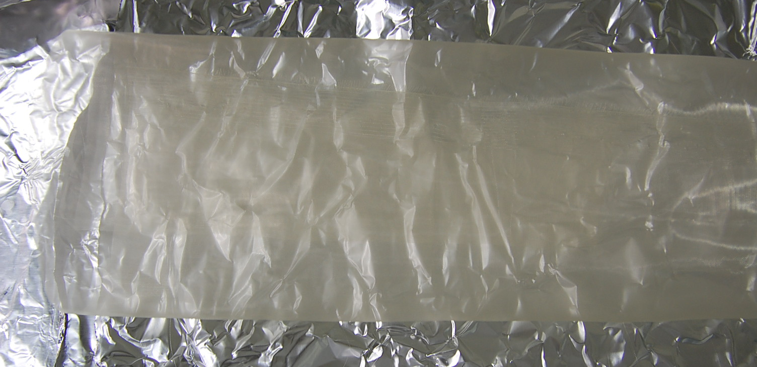
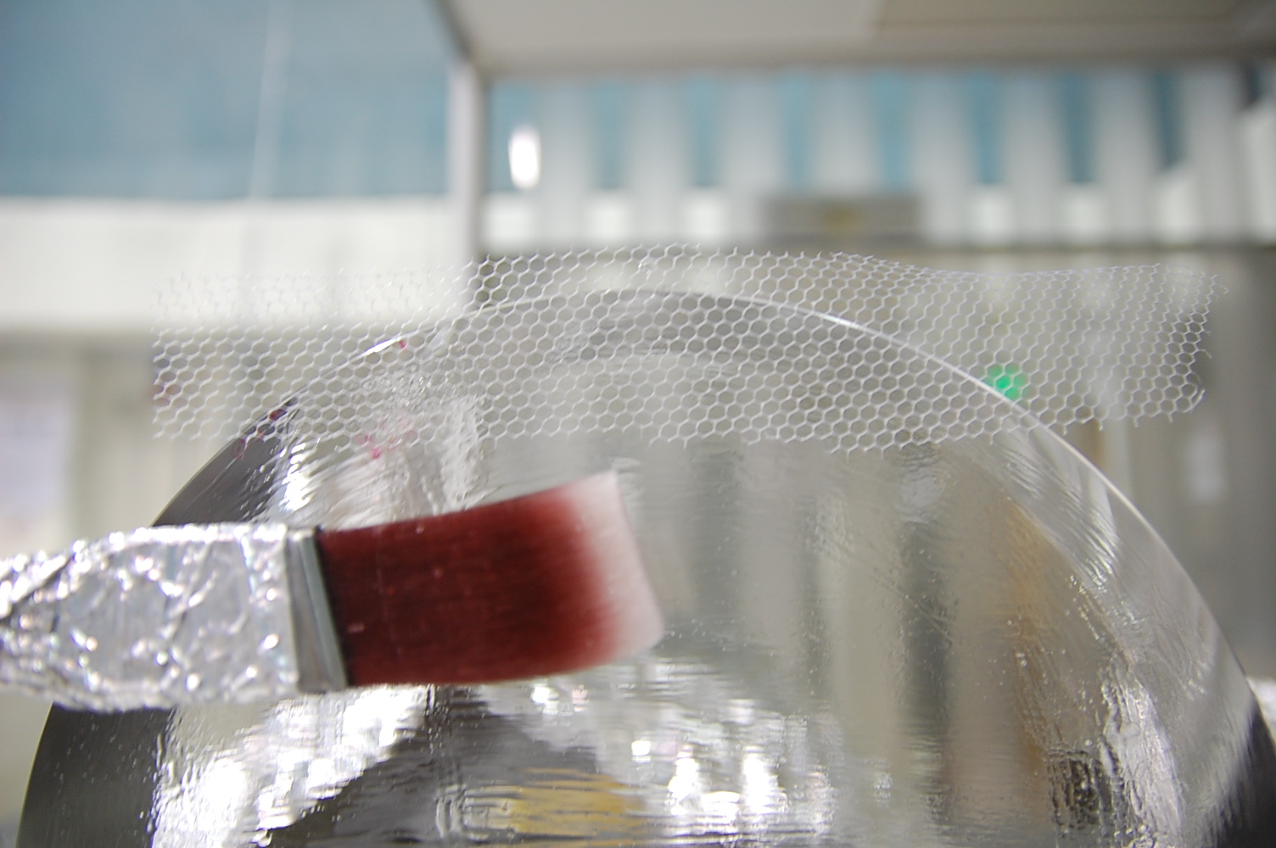
Ways to remove
Yes
PEEK mesh: works the best, shown in top picture. Bottom picture shows nylon mesh.
Kapton tape: Tape works well but is not allowed in vacuum chamber
No
Aluminum foil: Keeps FC from drying
Clean room wipes: Leaves bits of dried FC behind.
Razors: Unnecessary in most cases.

Slide 9
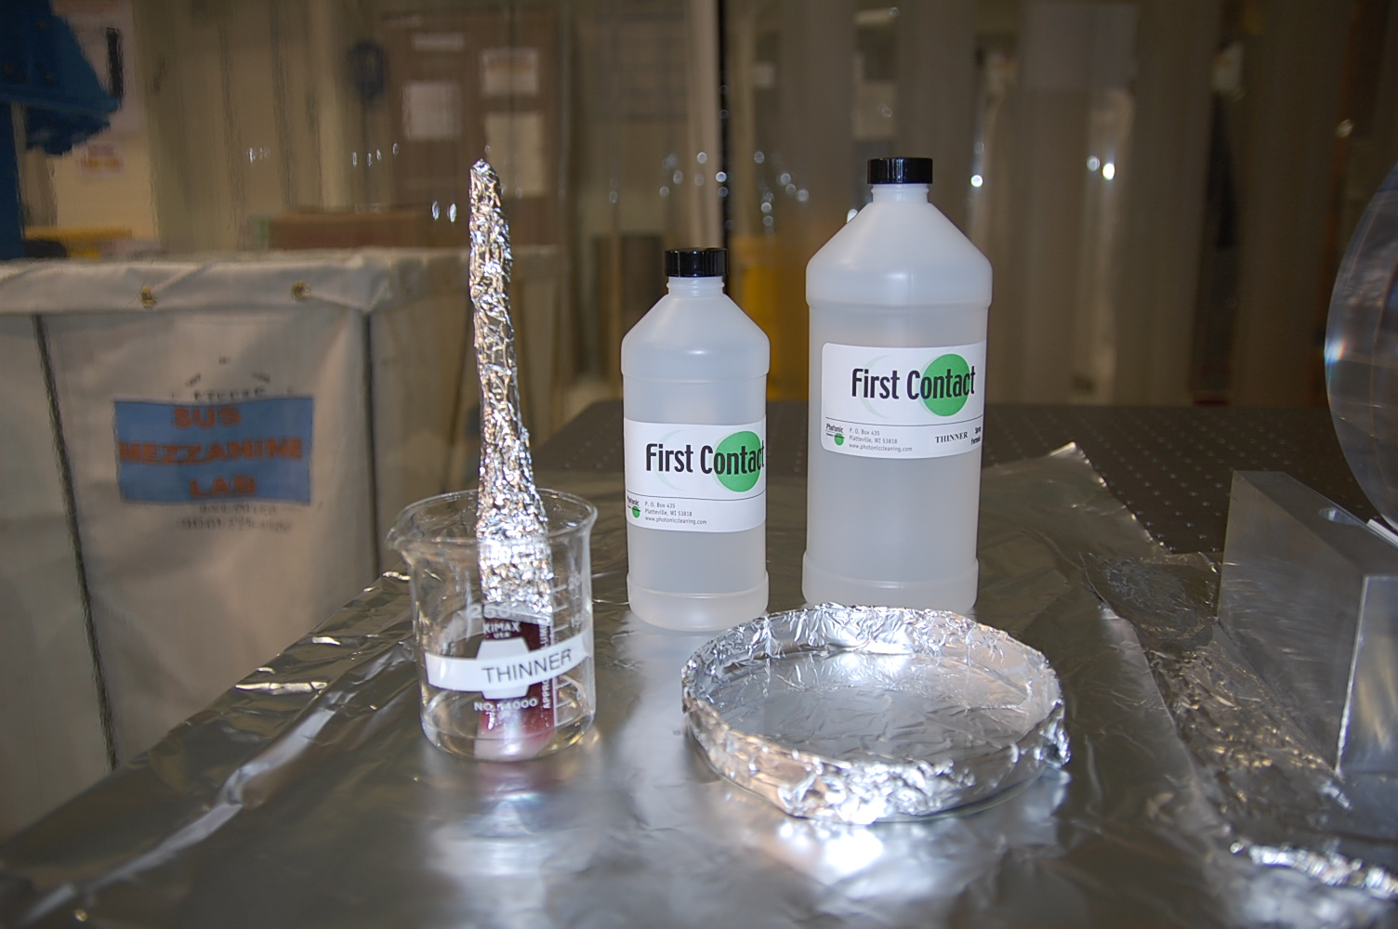
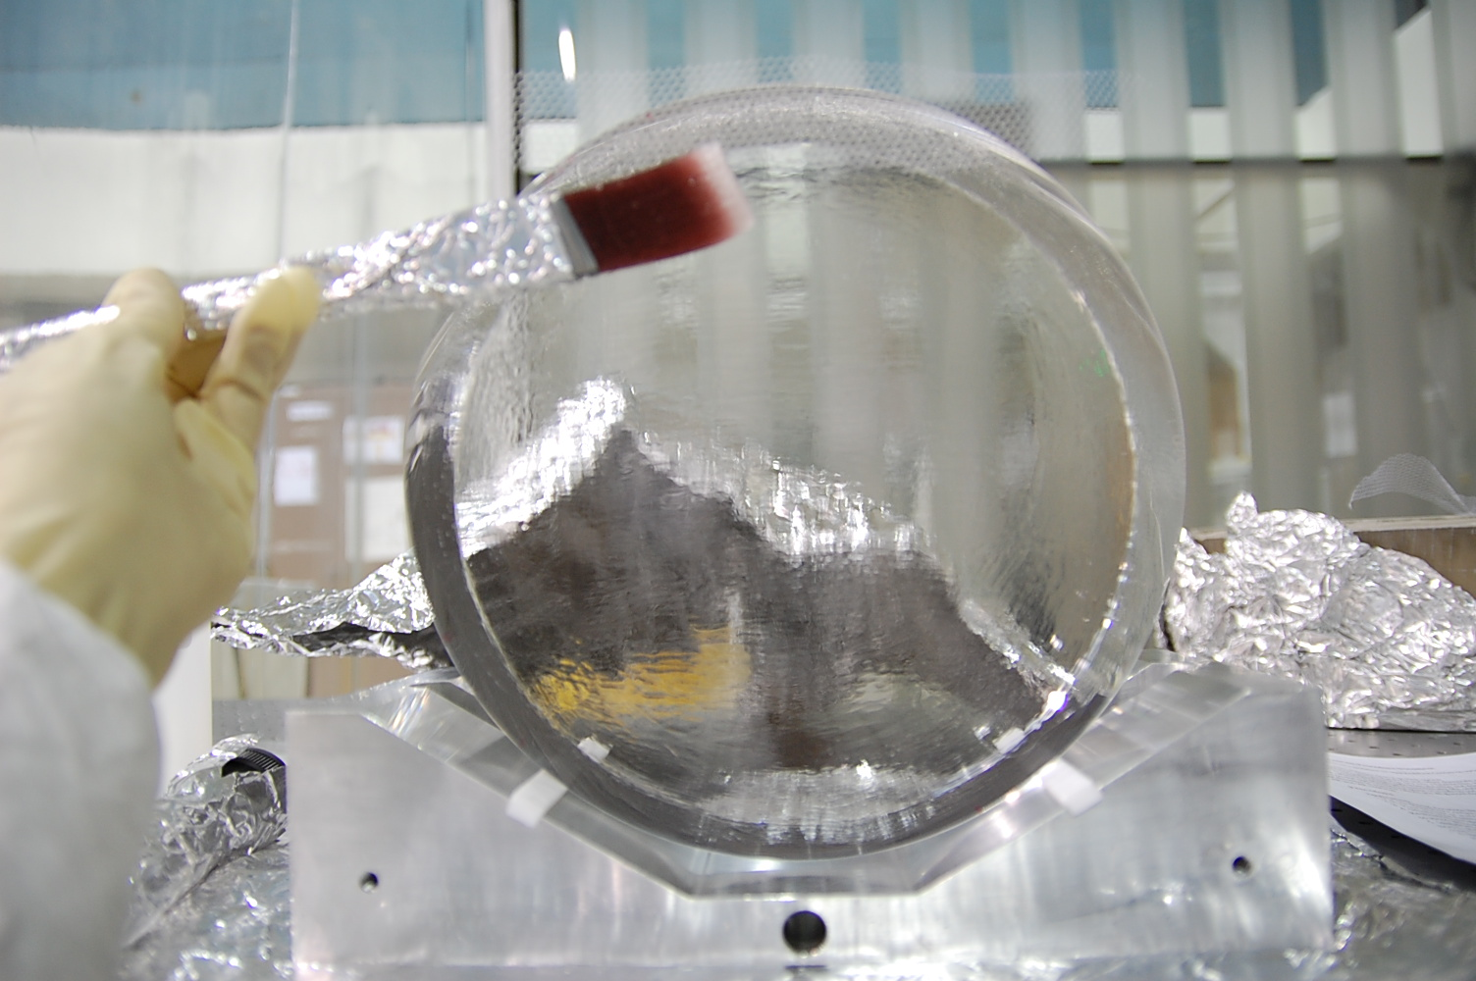
Application
Full procedure on dcc, T1000079.
Pour some First Contact into a clean petri dish.
Brush FC on in a circular outer shell first, then fill in the rest. (a circular crust minimizes drips on vertical optics.)
Set brush in thinner and wait 20 minutes, then repeat twice.
Cut a strip of PEEK mesh ~2’’x5’’, hold against top of optic.
Brush FC over the mesh to keep it in place, leave to dry

Slide 10
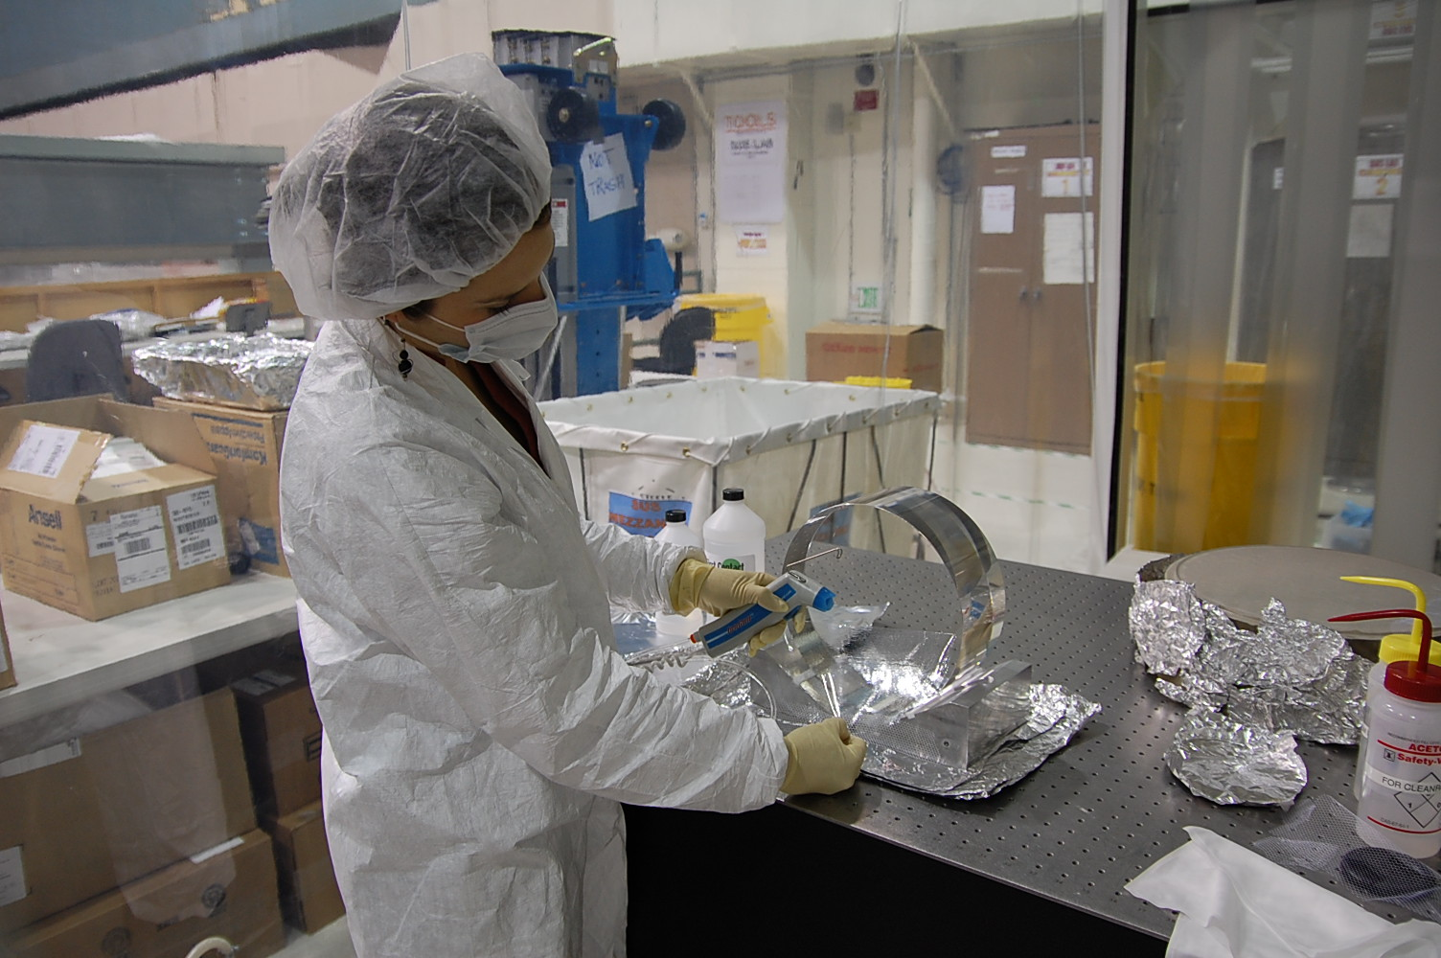
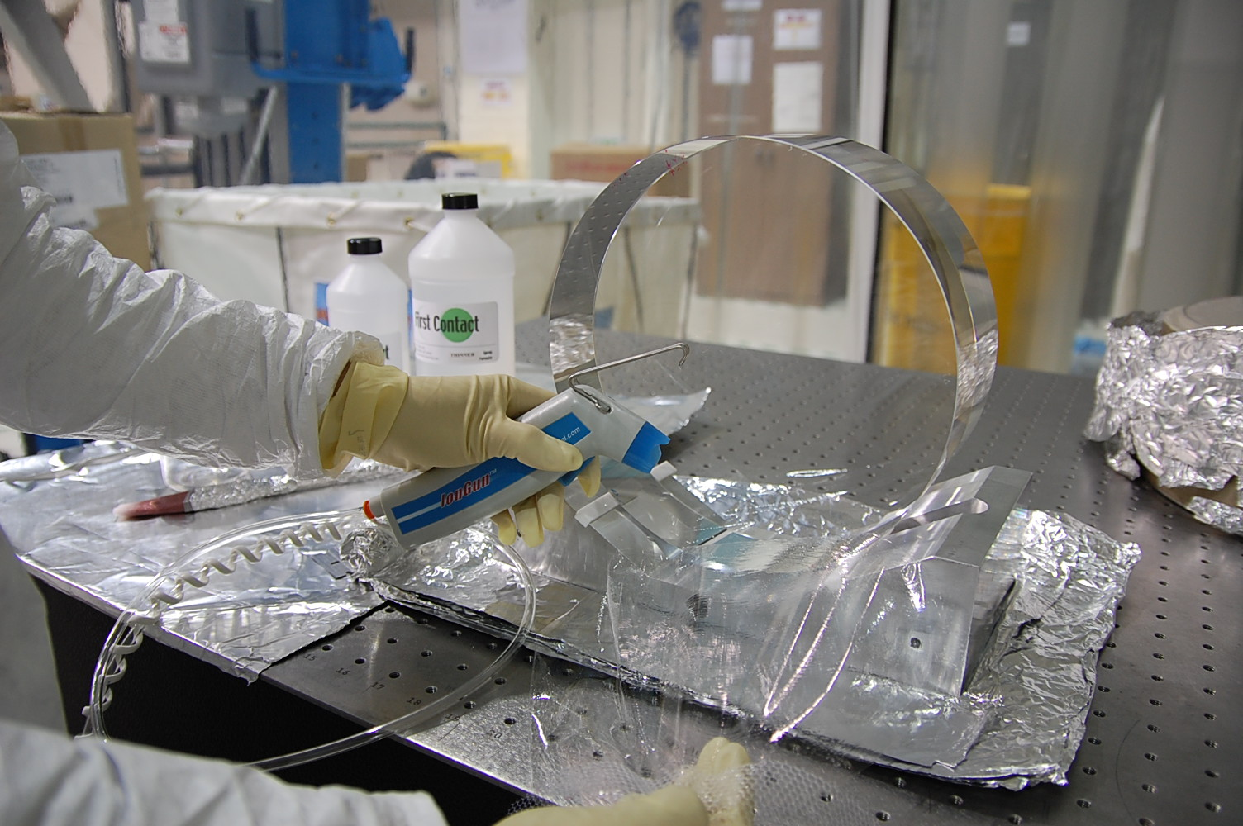
Removal
Let First Contact dry for at least 12 hours.
Holding an ion gun in one hand, pull on the PEEK strip with the other. If the film does not come off in one piece it is either too thin or not dry.
Keep a steady stream of nitrogen on the optic while pulling to keep the optical surface from charging & attracting dust.
With a flashlight, check optic for stray FC. Wipe any off with an acetone soaked lenswipe. Wipe radially around the outer edge, avoiding the clean center.
There should not be any First Contact on the barrel. If there are any stray drops, wipe off with acetone.

Slide 11
Conclusions
First Contact has passed an FTIR test( old dcc T060161) and a Contamination Control Cavity test, see T0900438 or Bob Taylor’s webpage http://www.ligo.caltech.edu/~rtaylor/OTF/OTF.htm
CASI scans done at Caltech show that First Contact gets optical surfaces cleaner overall than cleaning with methanol. (Photonic Cleaning Technologies developed it with this in mind)
First Contact can keep optics clean for long periods of time if left on the surface.
Only spectroscopic grade acetone should be used with FC to clean optics, no methanol. Methanol and FC may create a residue on the optic's surface.
An N2 ionizing gun must be used on removal of dried FC film to keep surface charge at zero.
An optic coated with first contact will hold vacuum when the Ergo-arm is attached to it.

Slide 12
Links/References
E1000079: First Contact application and removal procedure.
T060161: FTIR and scatter measurements indicate FC leaves no residue on clean optics.
T0900438: LIGO Vacuum Qualification of First Contact
T070280: Technical information from Photonic Cleaning Technologies.
T0900351: FC Peeling and Charging Tests
T1000137: Drag Wiping and First Contact
T0900402: Enhanced LIGO drag wiping procedure for large optics

