Slide 1
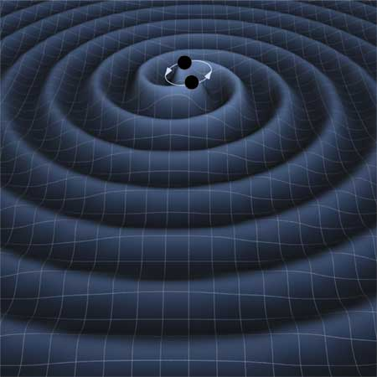
LIGO Status
Brett Shapiro for the LIGO Scientific Collaboration
May 21, 2010
13th Eastern Gravity Meeting
LIGO - G1000500

Slide 2


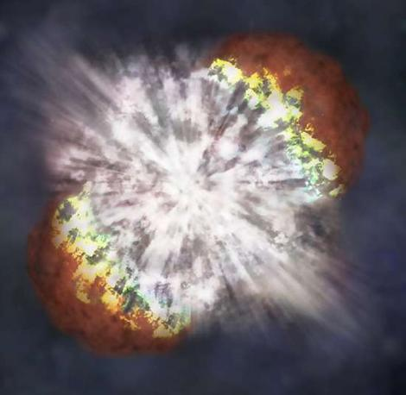
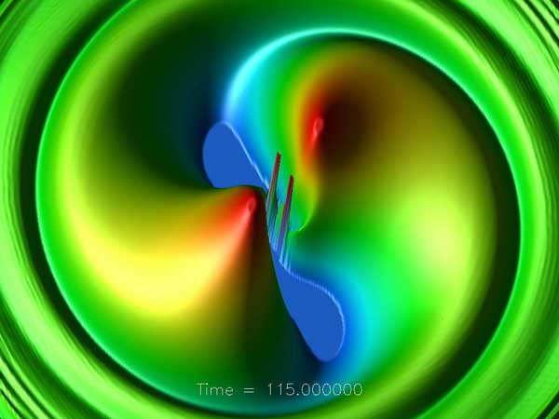
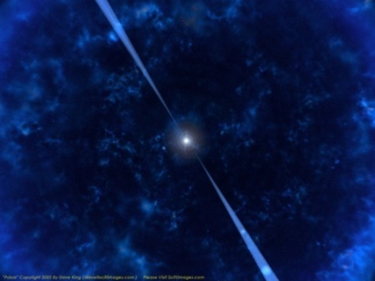
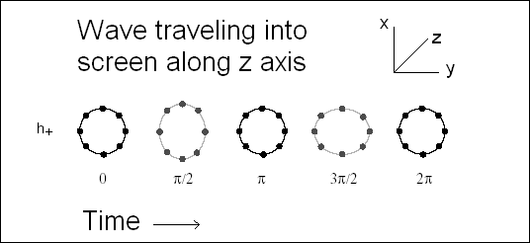
Gravitational Waves
Supernova
Merging Black Holes
Pulsar
Wave of strain amplitude h
Supernovae
  Asymmetry required
Coalescing Binaries
  Black Holes or Neutron Stars
  Mergers
Pulsars
    Asymmetry required
Stochastic Background
(Big bang, etc.)

Slide 3


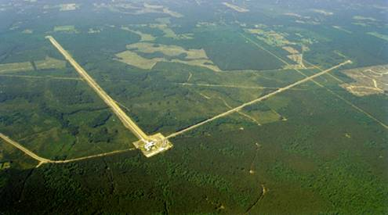
The Laser Interferometer
Gravitational-wave Observatory (LIGO)
Funded by
Hanford, WA
Two 4 km and one 2 km long
interferometers at 2 sites in the US
Michelson interferometers with
Fabry-Pérot arms
Optical path enclosed in vacuum
Sensitive to strains around 10⁻²¹ -> 10⁻¹⁸m_{rms}
Livingston, LA

Slide 4
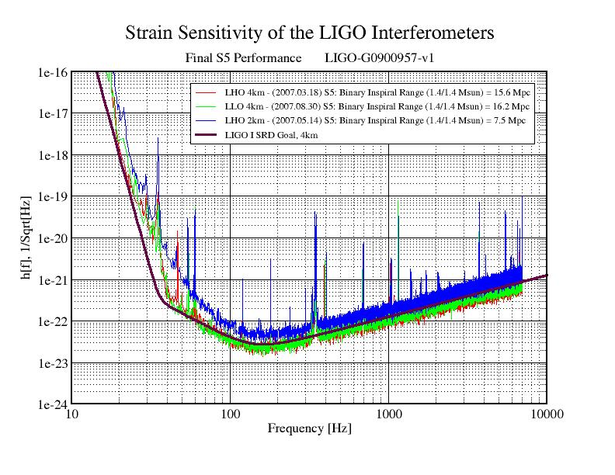
Initial LIGO Noise
Dominant noise sources
Seismic below 40 Hz – Optics are suspended
Suspension thermal from 40 Hz to 200 Hz
Shot Noise above 200 Hz

Slide 5
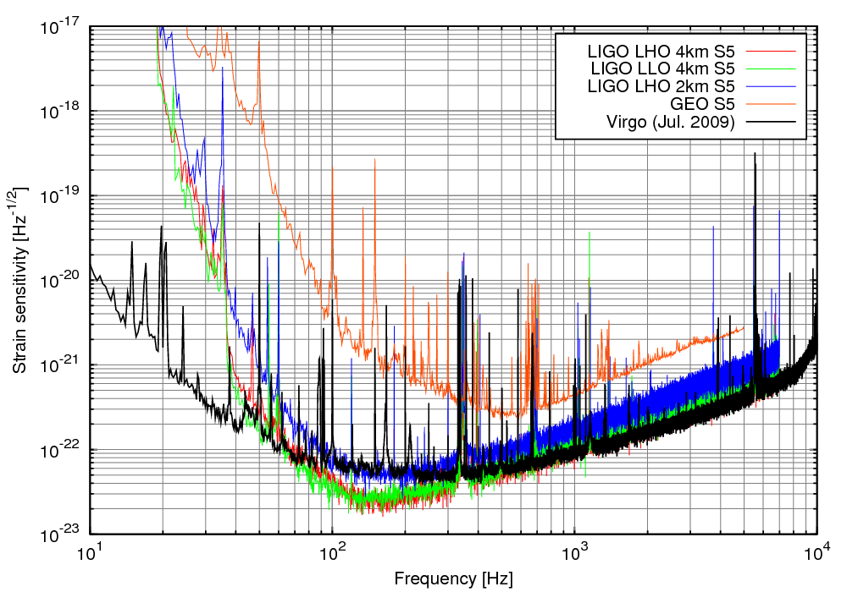
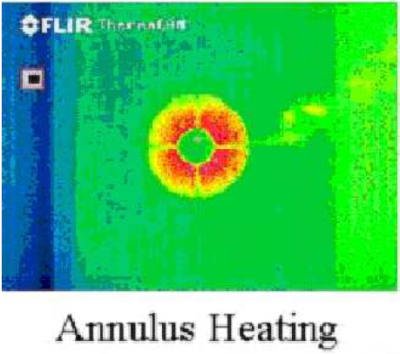
Initial LIGO Accomplishments
Reached design sensitivity
  ~ 10 W laser, shot noise limited
  Seismic isolation, suspensions
  (Close to) thermal noise limits
First Generation Noise
Demonstrated important technologies
  Thermal compensation
  interferometer controls
Data provided real astrophysics
  Crab pulsar primarily not spinning down from GW
  GRB070201 was not neutron star inspiral in M31
  Stochastic limit beat Big Bang Nucleosynthesis
GRB070201

Slide 6
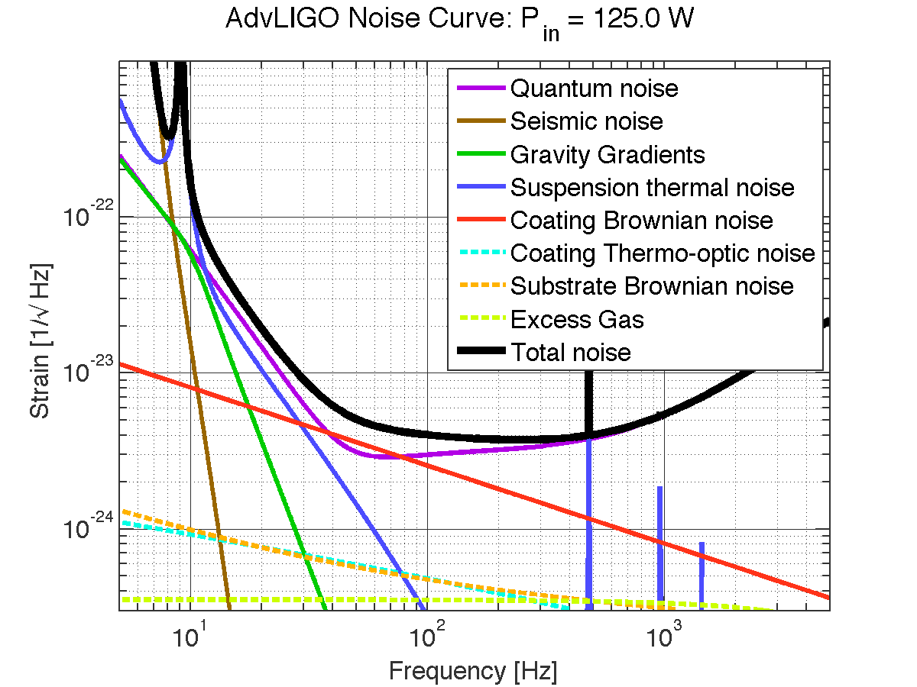
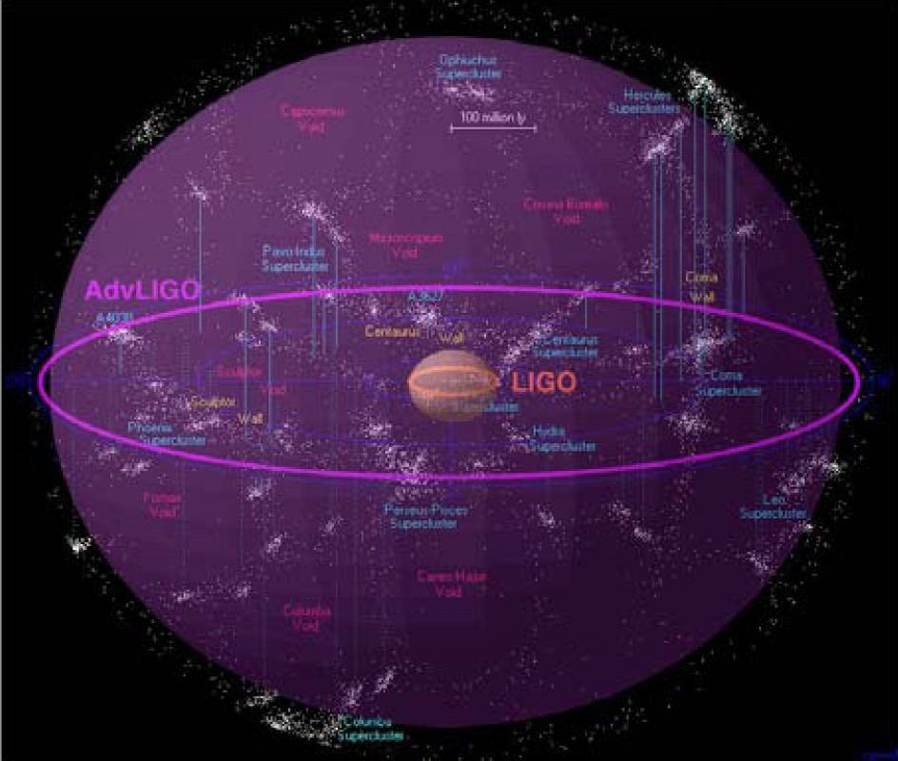
Advanced LIGO
Quantum noise limited in much of band
Thermal noise in most sensitive region
About factor of 10 better sensitivity
Expected sensitivity
  Neutron star inspirals to about
    200 Mpc, ~40/yr
  10 M_{O} black hole inspirals to
  775 Mpc, ~30/y
LIGO infrastructure designed for a progression of instruments
  Nominal 30 year lifetime
All subsystems to be replaced and upgraded
  More powerful laser – from 10W to 180 W
  Larger test masses – from 10 kg to 40 kg
  More aggressive seismic isolation
  Lower thermal noise coatings
Advanced LIGO Astronomical Reach

Slide 7
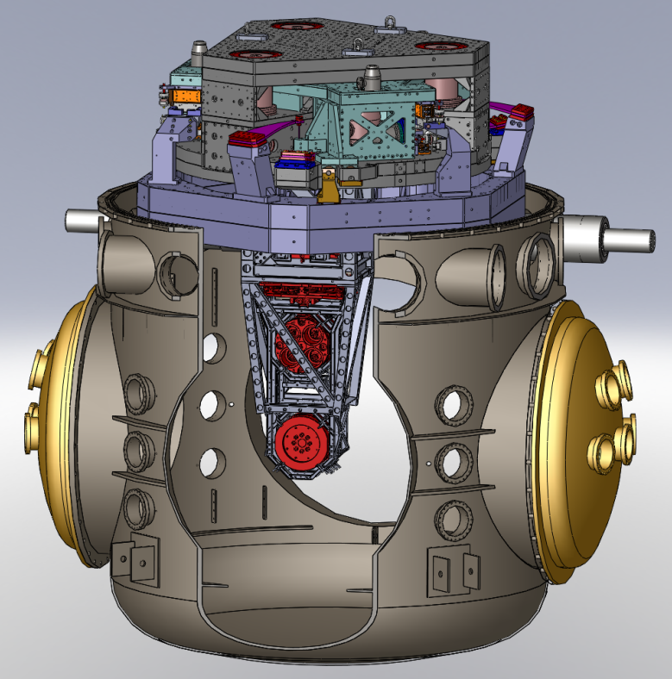
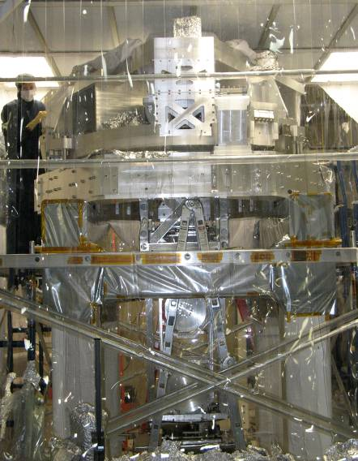
Seismic Isolation
Overall Isolation 9 to 10 orders of magnitude at 10 Hz.
ISI and Quad in LIGO Vacuum Chamber
Prototype ISI and Quad at MIT
7 cascaded stages of seismic isolation
  External Hydraulic Pre-Isolator (HEPI). Active isolation up to 10 Hz.
  2 stage Internal Seismic Isolation (ISI). Active isolation up to 30 Hz, passive above.
  4 stage Quadruple Pendulum (Quad). Mirror is the final stage. Passive isolation above 1 Hz.

Slide 8
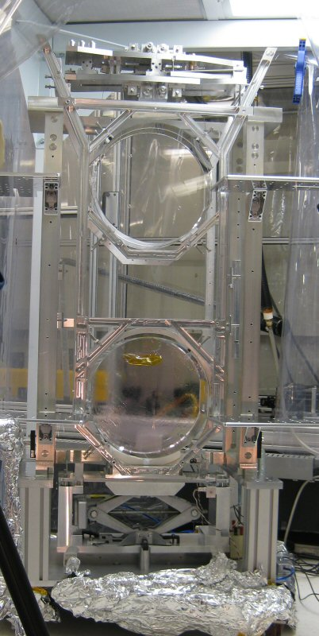
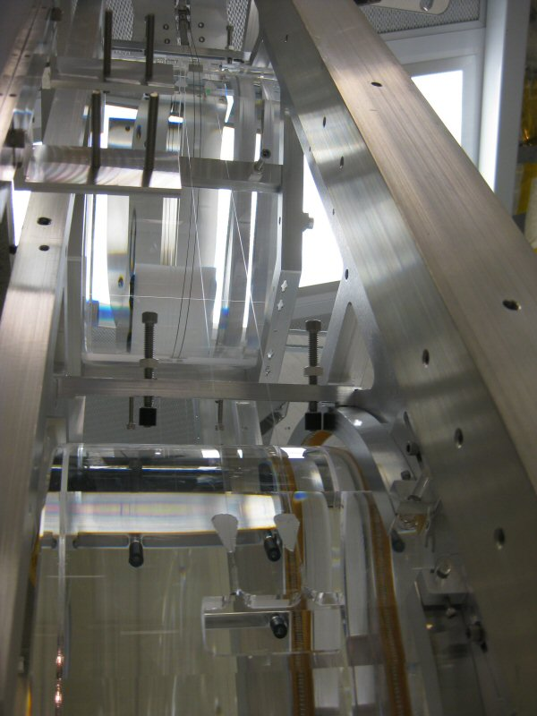
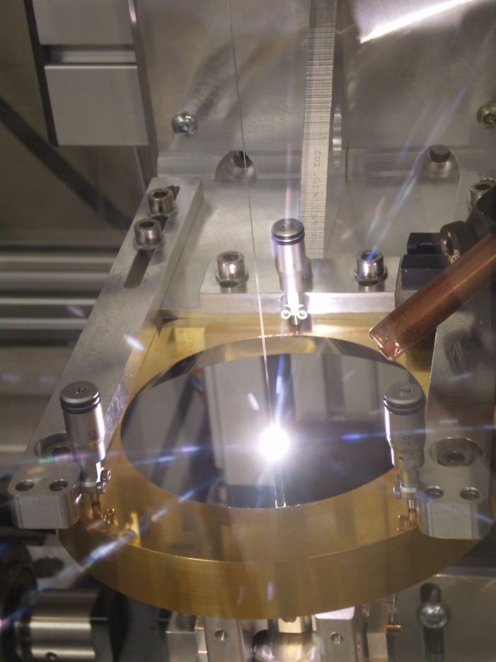
Mirrors Suspend from Glass Fibers
Developed by the University of Glasgow
Suspension thermal noise suppressed by suspending low loss fused silica test masses from fused silica fibers.
0.6m long, 400 µm diameter silica fibers pulled from 3 mm diameter stock and laser welded between the two silica lower stages of the quadruple pendulum.

Slide 9
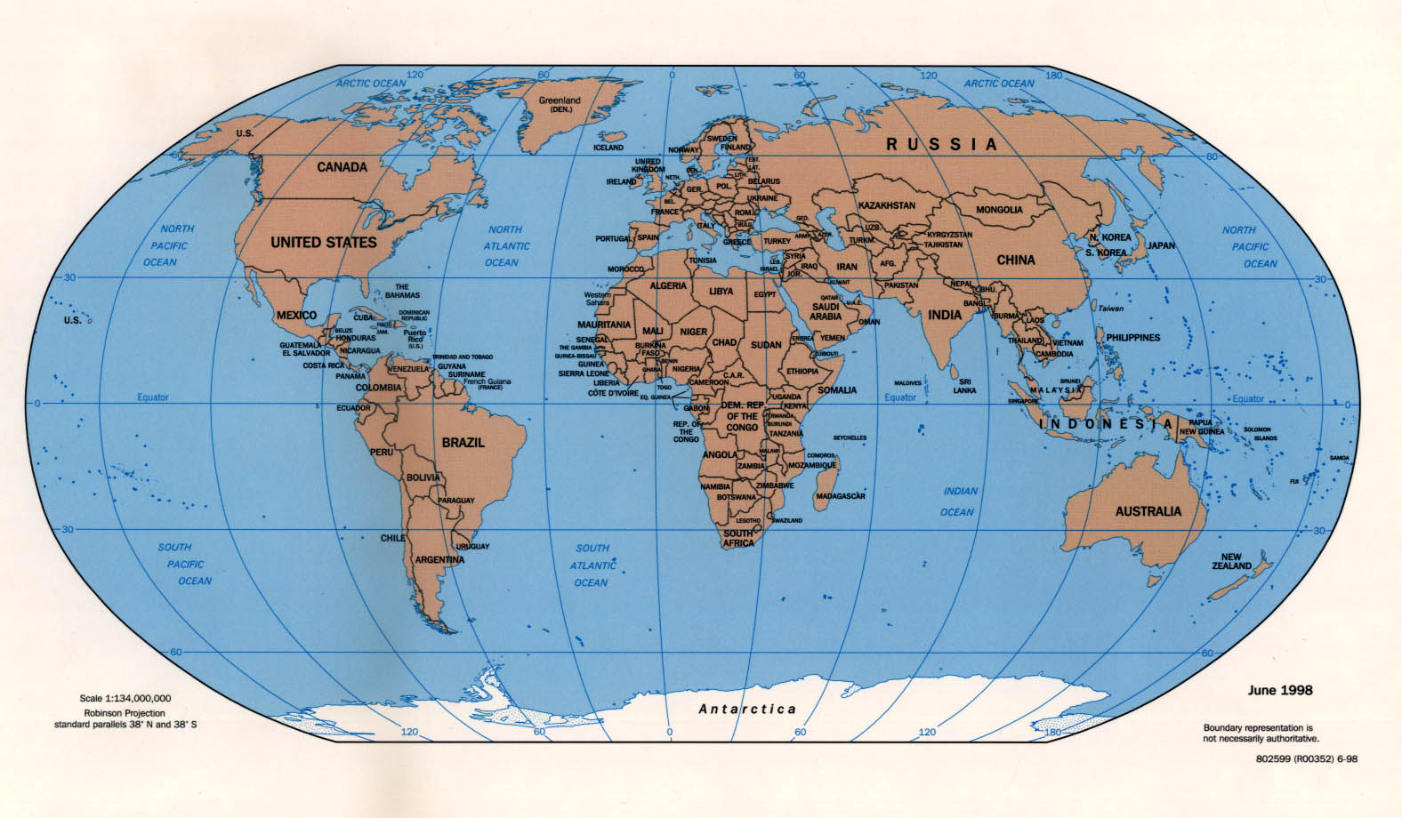
Advanced LIGO Schedule
2010
2011
2012
2013
2014
2015
Installation
Pre-assembly happening now
Testing
Likely first science run
Other observatories around the world collecting data during this time.

Slide 10
Conclusions
First generation detectors at design sensitivity
  gave new astrophysical upper limits
Plan on real gravitational astronomy
Range of technologies to improve sensitivity
  Active and passive isolation
  Monolithic silica suspensions
  Improved coatings
  Higher laser power
  Larger test masses
Network of detectors with comparable sensitivity operating ~2015
10

Slide 11



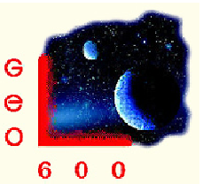





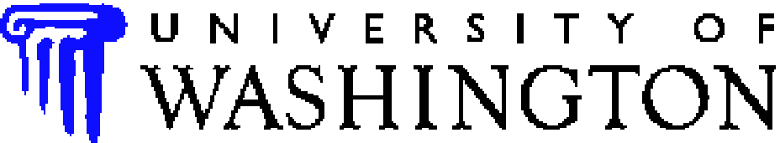

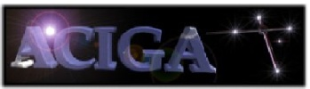

















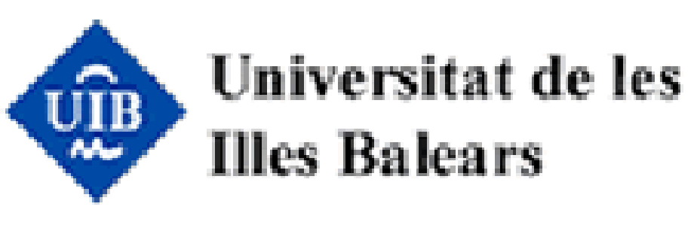





























LIGO Scientific Collaboration
University of Michigan
University of Minnesota
The University of Mississippi
Massachusetts Inst. of Technology
Monash University
Montana State University
Moscow State University
National Astronomical Observatory
of Japan
Northwestern University
University of Oregon
Pennsylvania State University
Rochester Inst. of Technology
Rutherford Appleton Lab
University of Rochester
San Jose State University
Univ. of Sannio at Benevento,
and Univ. of Salerno
University of Sheffield
University of Southampton
Southeastern Louisiana Univ.
Southern Univ. and A&M College
Stanford University
University of Strathclyde
Syracuse University
Univ. of Texas at Austin
Univ. of Texas at Brownsville
Trinity University
Tsinghua University
Universitat de les Illes Balears
Univ. of Massachusetts Amherst
University of Western Australia
Univ. of Wisconsin-Milwaukee
Washington State University
University of Washington
Australian Consortium
for Interferometric
Gravitational Astronomy
The Univ. of Adelaide
Andrews University
The Australian National Univ.
The University of Birmingham
California Inst. of Technology
Cardiff University
Carleton College
Charles Sturt Univ.
Columbia University
CSU Fullerton
Embry Riddle Aeronautical Univ.
Eötvös Loránd University
University of Florida
German/British Collaboration for
the Detection of Gravitational Waves
University of Glasgow
Goddard Space Flight Center
Leibniz Universität Hannover
Hobart & William Smith Colleges
Inst. of Applied Physics of the Russian Academy of Sciences
Polish Academy of Sciences
India Inter-University Centre
for Astronomy and Astrophysics
Louisiana State University
Louisiana Tech University
Loyola University New Orleans
University of Maryland
Max Planck Institute for Gravitational Physics

Slide 12
Backup Slides

Slide 13
Readout
Dual recycled (signal & power) Michelson with Fabry-Perot arms
  Offers flexibility in instrument response
  Can provide narrowband sensitivity
  Critical advantage: can distribute optical power in interferometer as desired
  Output mode cleaner
DC rather than RF sensing
Offset ~ 1 pm at interferometer dark fringe
Best signal-to-noise ratio
  Simplifies laser, photodetection requirements
  Perfect overlap between signal & local oscillator
  Easier to upgrade to quantum non-demolition in future
13

Slide 14
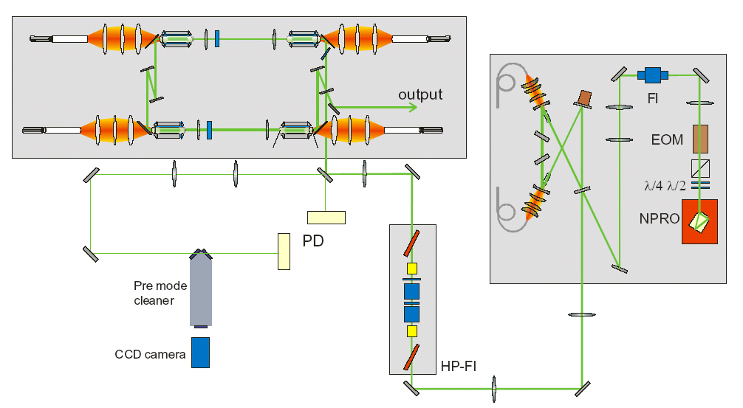
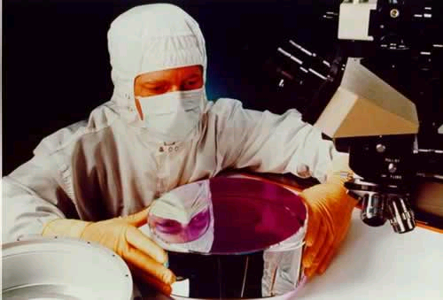
Laser and Optics
180 W end-pumped Nd:YAG rod injection locked needed
  Backup efforts in slabs & fiber lasers
Frequency stabilization
  10 Hz/Hz^{1/2} at 10 Hz required
Development at Max-Planck Hannover, Laser Zentrum Hannover
Silica chosen as substrate material
  Improved thermal noise performance from original anticipation
  Some concerns about unknowns with sapphire (absorption, construction,…)
Coatings dominate thermal noise & optical absorption
  Progress reducing φ with doping
  See talk by Matt Abernathy
14

