Slide 1
Binary I/O
A presentation of Interface Solutions
R. Abbott

Slide 2
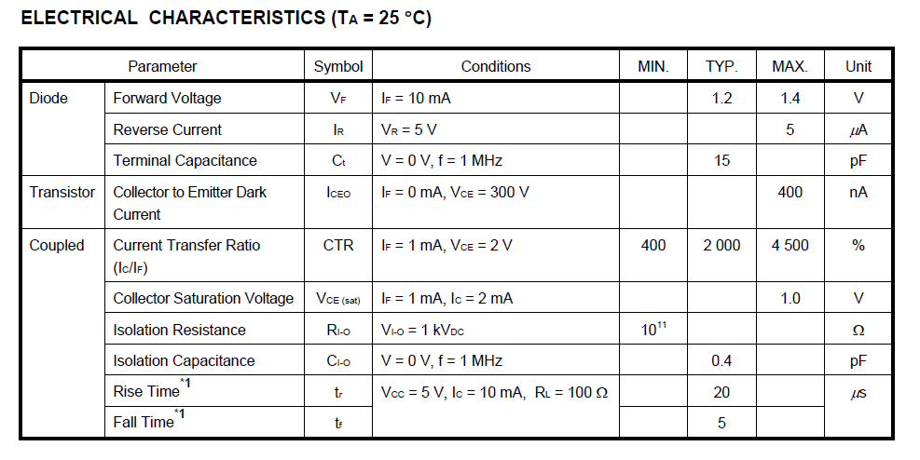
Binary Input Building Block
To Binary Input Card
From Field

Slide 3
Binary Input 8 Channel Section
From Field

Slide 4
Binary Input Board Configuration
To Binary I/O Card in I/O Chassis
D37
D37
D9
D9
D9
D9
D9
D9
D9
D9
From Field Modules in Banks of 8

Slide 5
Binary Output Building Block
For Switching in Field
To Pull-down on Binary Output Card

Slide 6
Binary Output 8 Channel Section
To Field
To Binary Out Card

Slide 7
Binary Output Board Configuration
To Binary I/O Card in I/O Chassis
D37
D37
D9
D9
D9
D9
D9
D9
D9
D9
To Field Modules in Banks of 8

