Slide 1
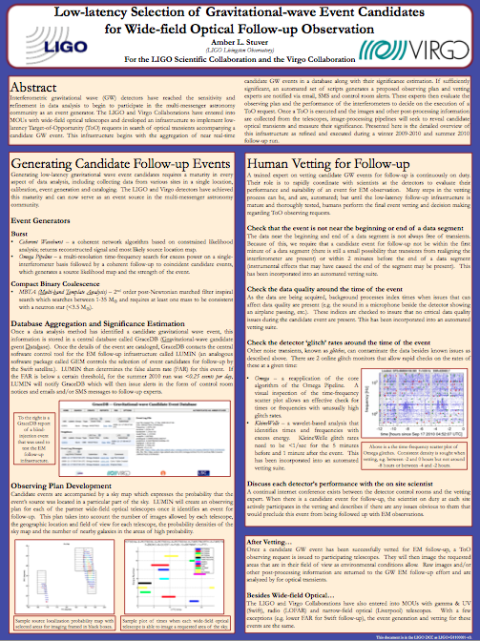
Low-latency Selection of Gravitational-wave Event Candidates for Wide-field Optical Follow-up Observation
Amber Stuver for the LSC and the Virgo Collaboration
LIGO & Virgo have been recently operated as a multi-messenger event generator.
Humans do final event event vetting and decision making regarding EM observing requests.
This poster presents the EM follow-up infrastructure from event generation and focusing on the human vetting process.
Notes:
Entire data analysis infrastructure, from calibration, event generation and cataloging, is now running online for near-real time data analysis.
Until the EM follow-up infrastructure is more mature, humans do final vetting and decision making. (This poster focuses on the wide-field optical follow-up effort, but this work is nearly identical for human vetting.)
A trained expert is available 24/7 to assist scientists on site with this vetting.
The human vetting focuses on verifying that there are no instrumental issues that would prevent a ToO observation from being requested.
This poster discusses the EM follow-up infrastructure focusing on the human vetting process.

