Slide 1
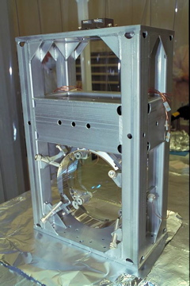
LOS Absorption
Presentation for TCS Group
Rupal S. Amin
Tuesday, August 26, 2008

Slide 2
Outline
Motivation
Theory
Procedure
Data
Result

Slide 3
Motivation
Question:
1) What do we care about the absorption of the large optics?
2) What is the absorption value?
Answer: Silica mirrors inside IFO unfortunately absorb resonant laser power.

Slide 4
Motivation
Ans (con’t): Mirrors expand due to temperature changes. Depending on absorption coefficient, mirrors may distort beyond or below design optimum.
Cold ρ
Hot ρ

Slide 5
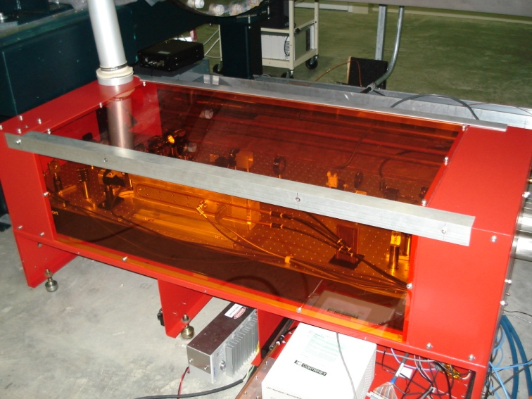
Motivation
Measuring absorption (especially the ITMS) allows TCS team to build effective absorption models (Mathematica, Matlab, Finesse, SIS)
Correct setup scheme for Enhanced TCS.
So…We need the absorption values of the large Fabry-Perot optics.

Slide 6
Theory
Crude theory
  Mirrors have body modes
    Finite temperature Brownian motion
  Frequencies are thermally dependent
    Due to Young’s modulus having a Y(T).
  Track body mode frequency evolutions due to ΔT
  Δf yields power absorption

Slide 7
Theory
Crude theory
Better theory
We need f and ∆f to determine α*

Slide 8
Procedure
Power Cycle IFO during fully locked state.
  Do this over several hours
Save data from fast ASQ sample channels and temperature sensors.
Download GBs of data from LDAS and analyze.

Slide 9
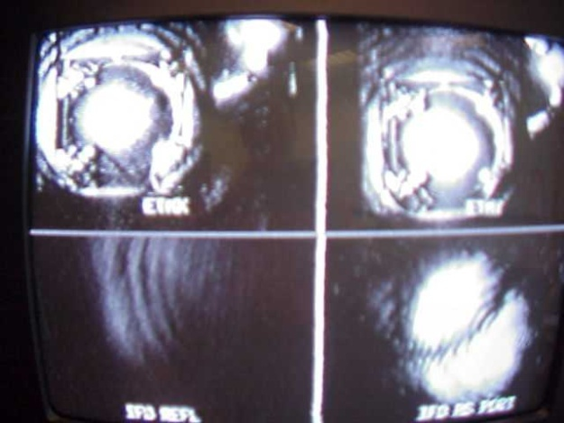
Procedure
Pwr
4 W
1 W
t
df/f

Slide 10
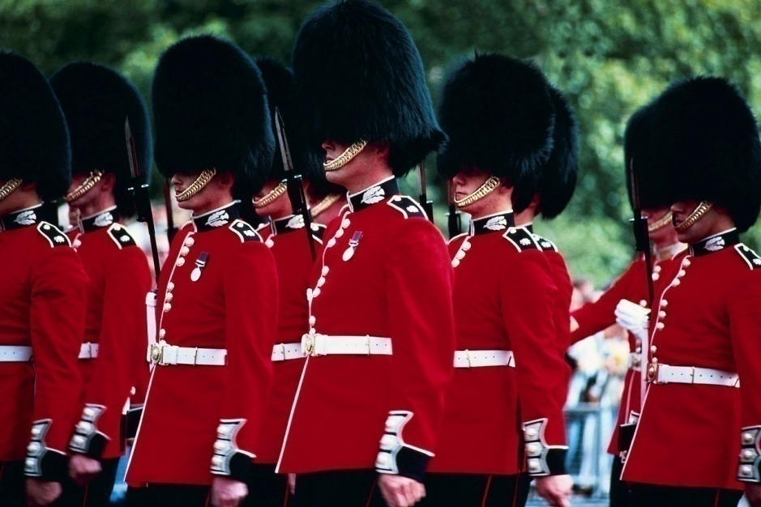
Data
Lock data from 899867714 s
Thermal data: Mirror modes are history dependent

Slide 11
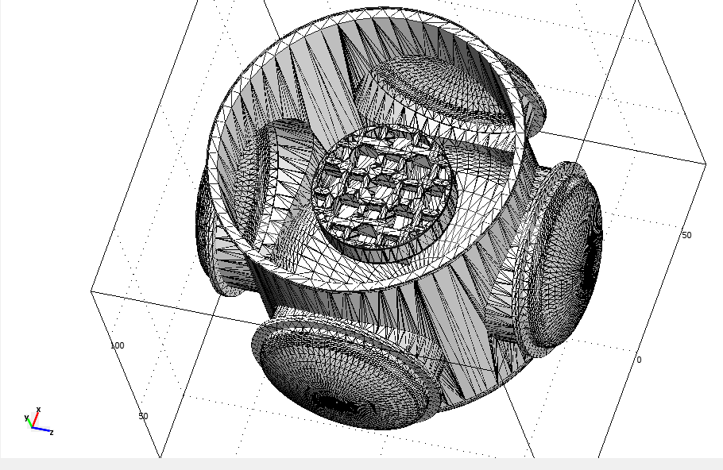
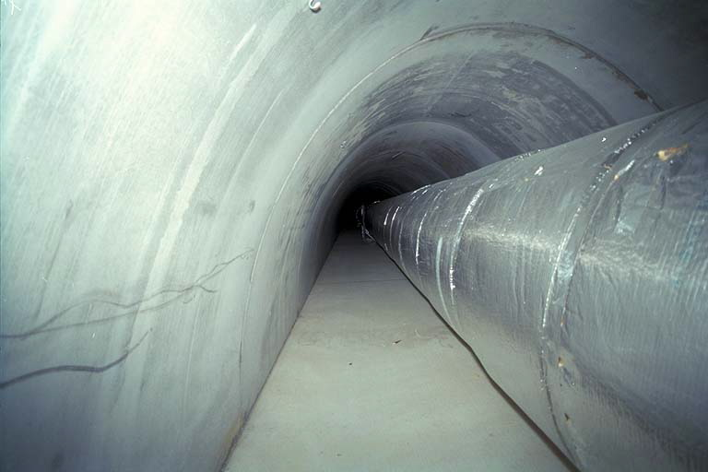
Thermal Resistances and Sources
BSC and contents slow LVEA to ITM interaction time.
Beam tubes: heat source but negligible

Slide 12
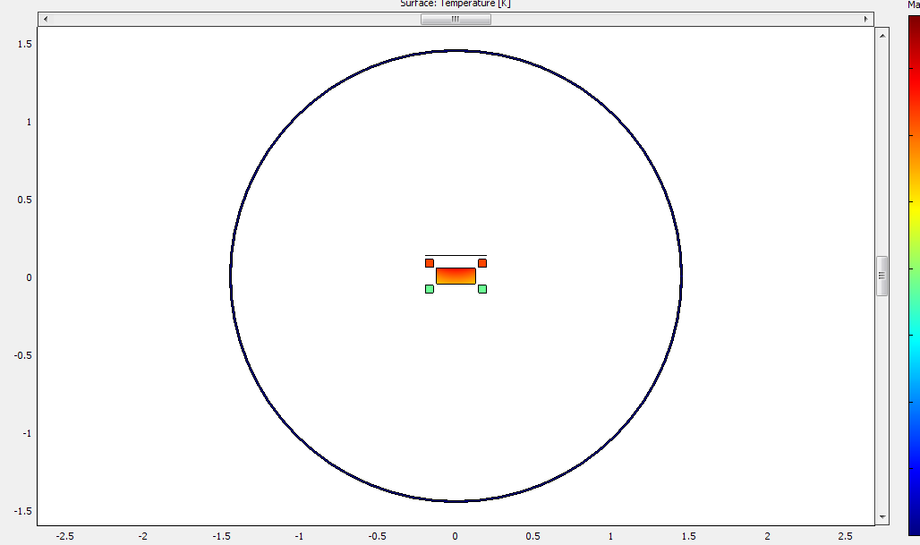
Thermal Resistance
Simulation of TM interaction with BSC. Small perturbations lead to simulation problems.

Slide 13
Analysis using raw data

Slide 14
Raw Data (noisy)

Slide 15
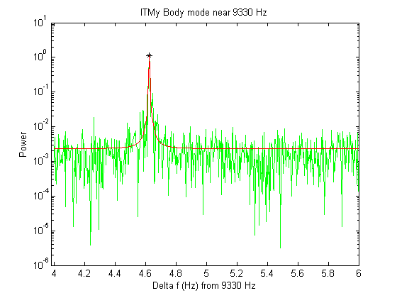
Fitting Data
Peak = (x0 , Amplitude)
Γ
DC based on noise average

Slide 16
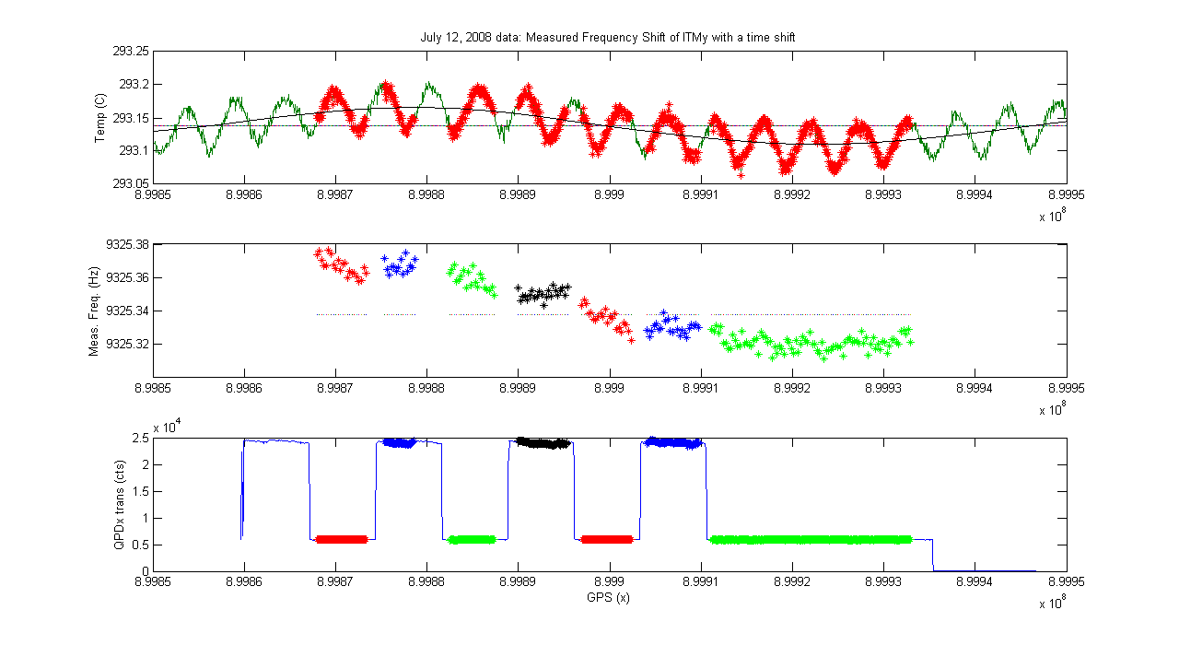
Analysis using fitted data

Slide 17
Analysis
∆f/f for ITMy

Slide 18
Results
Total uncorrected slope = 1.3(3)e-6+/- 1.3e-6 Hz/s
Uncorrected for high power = 4.(43)e-7+/- 3. e-7 Hz/s
Crudely Corrected slope = ?
Refined df/f = Need to do

Slide 19
Ambient temperature f-drift
Crude shift due to temperature fluctuations

Slide 20
Questions?
1) What is your purpose?
2) What is your favourite color?

