Slide 1
Dissipation processes in Metal springs
Maria Ascione Arianna Di Cintio
Riccardo DeSalvo
Caltech 2008
LIGO G080574-00-R

Slide 2
Abstract
We studied the dissipation properties of the Maraging springs used in the seismic isolation system of Advanced LIGO, Virgo, TAMA, et c., with emphasis on mechanical hysteresis, which seems to play a more important role than expected. The Monolithic Geometric Anti Spring vertical attenuation filter at very low frequency presented an anomalous transfer function of 1/f instead of the expected 1/f², static hysteresis and eventually instability.
While characterizing these effects we discovered a new dissipation mechanism and an unexpected facet of elasticity. Not all elasticity comes from the rigid crystalline structure. A non-negligible fraction of elasticity is contributed by a changing medium, probably entangled dislocations. Oscillation amplitude (or other external disturbances) can disentangle some of these dislocations thus reducing the available restoring force of a spring. The disentangled dislocations temporarily provide boosted viscous like dissipation, then they lock back providing elasticity with a different equilibrium point. A stable oscillator can be made unstable by small external perturbation and fall over, or can be re-stabilized by externally providing temporary restoring forces while the dislocations re-entangle. The process likely explains the anomalous transfer function.
We may be getting closer to solve the old dilemma if dissipation in metals is better described by viscous losses or by a loss angle.

Slide 3
Introduction
We study the dissipation properties of the Maraging springs used in the
seismic isolation system of Ad-LIGO
(but also Virgo, TAMA, …)
With particular emphasis on the study of mechanical hysteresis, which seems to play a more important role than expected

Slide 4
Introduction
Hysteresis is likely responsible for the unexpected 1/f attenuation behavior observed in the GAS-filter transfer function, when the system is tuned at very low frequency, (at or below 100 mHz)
Anomalous instability is observed as well
Hysteresis may be generating a
new class of excess 1/f noise

Slide 5
Questioning the old models
Viscosity was very successful to explain MANY material behaviors
But viscosity is proportional to speed,
its effects must disappear at lower frequencies
We observe a static effect, viscosity is not adequate to explain it, we need a different model.
The new model needs to
include the effects previously attributed to viscosity

Slide 6
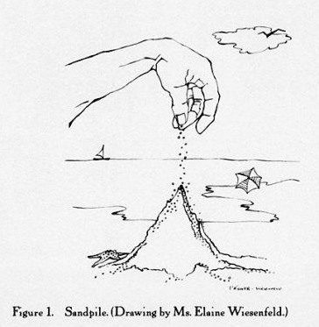
Which theory we like
The theoretical bases that comes closer to our observation is Marchesoni’s Self Organized Criticality of dislocations
Dislocations can entangle forming a rigid lattice which can contribute to elasticity
Dislocations can disentangle and produce viscous like effects
They can re-entangle to produce
static hysteresis
Cagnoli G, et al.
1993 Phil. Mag. A 68 865
Per Bak 1996
How nature works: The Science
of Self-Organized Criticality

Slide 7
Experimental technique
Our experiment is based on a GAS spring
The GAS mechanism is used to null the restoring forces of a spring
It is a very useful tool to expose the dissipation properties of the materials, including hysteresis
To study losses and hysteresis we need instruments, like LVDTs, actuators, controls, …
But let’s start talking about GAS-filter first!

Slide 8
The GAS mechanism
At the working point the vertical spring (S) supports the weight of the payload.
The two horizontal springs (A) carry no load, they are radially compressed, but their forces cancel
Moving away from the working point the compression of the A-springs results in a vertical component, proportional to the displacement, the Anti-Spring force.
The Anti-spring effect is proportional to the radial compression.
The repulsive springs may be mechanical or magnetic.

Slide 9
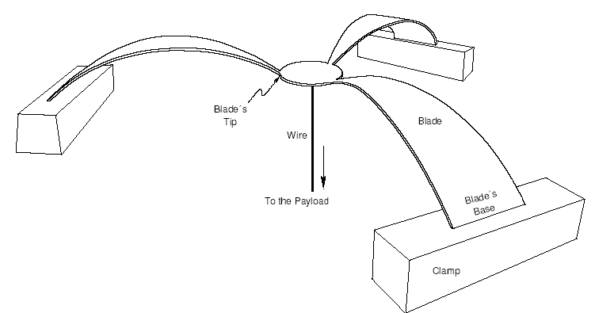
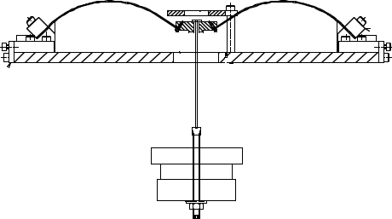
the Geometric Anti Spring Vertical attenuation filter
In the Geometric Anti Spring filter, the functions of the supporting and repulsive springs are combined
Specially designed leaf springs carry the load
Arranging them in a symmetric radial configuration, and radially compressing one against the other, generates the Anti Spring effect

Slide 10
the Geometric Anti Spring Vertical attenuation filter
Large amount of pre-stressing energy is stored in the blades because of the supporting function
A tunable fraction of what would be the oscillation kinetic energy is stored in the radial compressive load

Slide 11
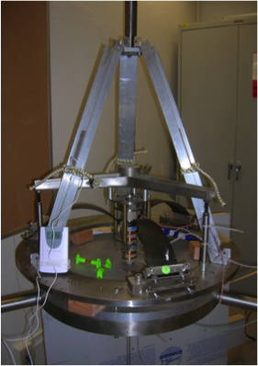
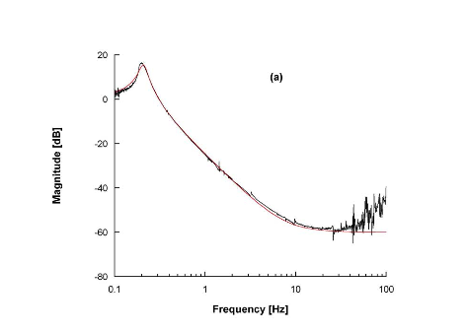

Theoretical transfer function of a GAS-filter

Slide 12


Depressing transfer function with
Electr-Magnetic Anti Springs and counterweights
Moves down
With tune
Stationary and
Unexpected 1/f
Transfer Function

Slide 13
The instrumentation used in this experiment

Slide 14
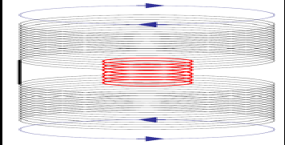
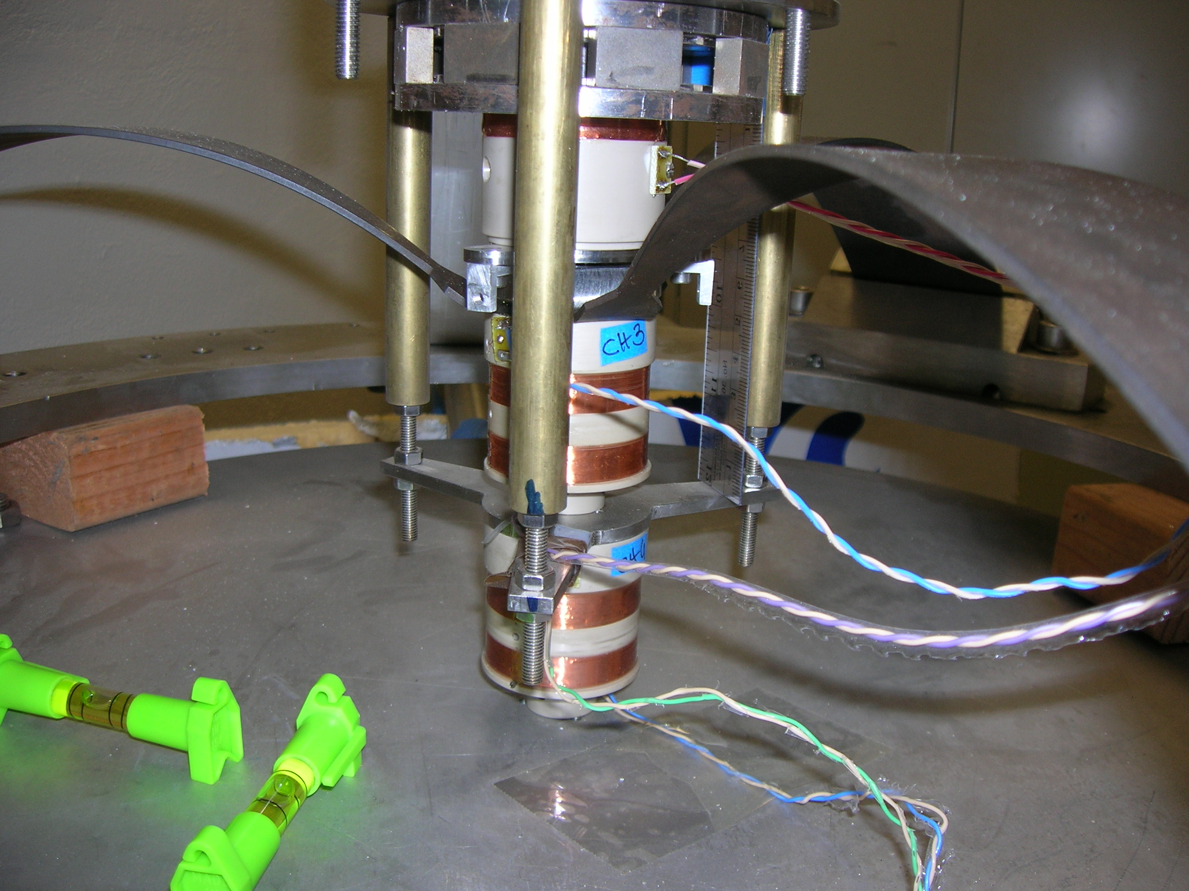
Linear variable differential transformer (LVDT)
The RF emitter coil is mounted on ground
The two receiver coils on the moving blades

Slide 15
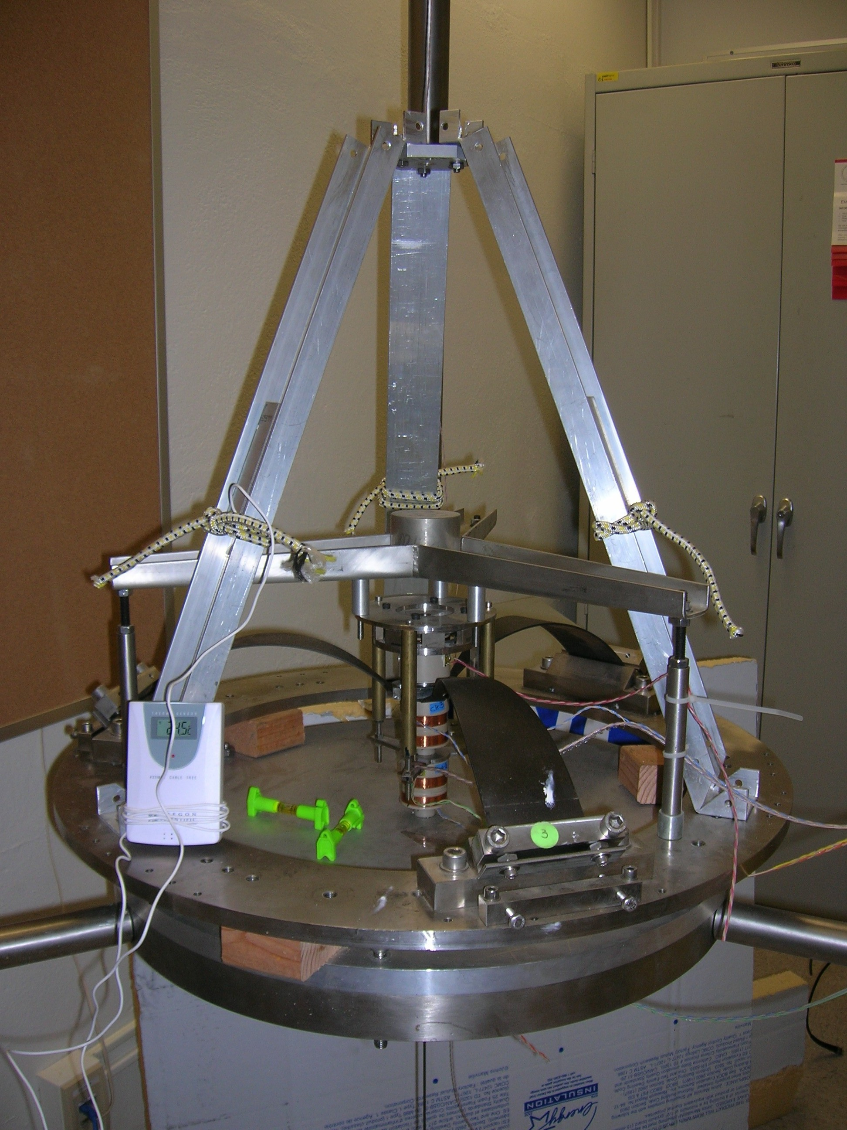
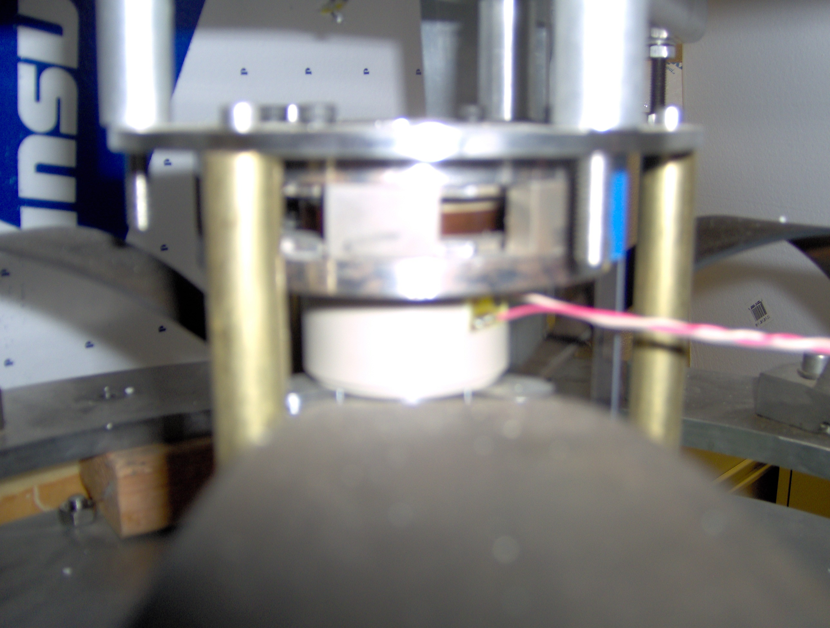
The actuator
Voice coil and magnet
driven by control program
ACTUATOR

Slide 16
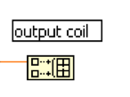
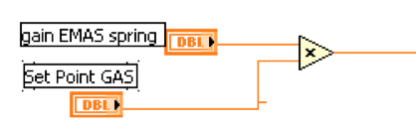
Electro Magnetic Anti Spring (EMAS)
The GAS is tuned to obtain a low mechanical resonant frequency (typically 200 mHz)
We need to work at lower frequencies
To further reduce, and to remotely change the resonant frequency, we implemented the EMAS
The EMAS is feeding the position sensor signal to the vertical actuator built in the spring, through an external gain.

Slide 17

Effect of EMAS on the filter
(M= 65Kg
F=0.22Hz)

Slide 18
Initial tuning of the system
Finding the working point…
The GAS effect is optimized when the radial compression of the blades is maximized
The height of this optimal working point must be determined
The GAS filter has minimal resonant frequency at this working point
The working point is found by loading the filter with the appropriate load, and exploring the vertical movement by applying a progression of fixed vertical forces with the actuator

Slide 19
Initial tuning of the system
Finding the working point…
Procedure
Scan the position by applying a progression of voltages (forces) on the actuator, in 0.5V steps starting from -3V to +3V and then back to -3V
For every set point apply
1V short pulse to generate a ring down
Fit the observed oscillations with the function:
h+ A sin[2πf (t-ϕ)] exp-[(t-ϕ)/τ]
For each ringdown extract the actual height h and the oscillation frequency f of the system

Slide 20
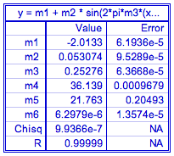
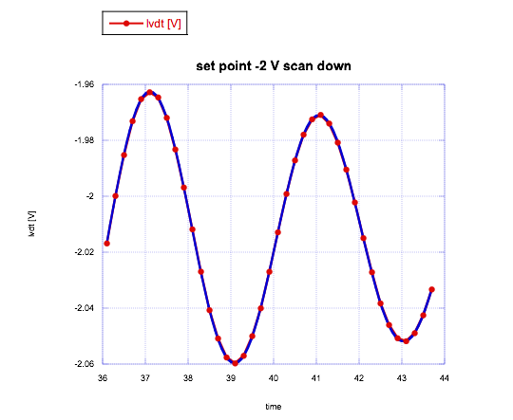
Fit example
LVDT height [V]
Oscillation amplitude [V] Frequency [Hz]
Time delay [s]
Lifetime [s]
Thermal slope [mm/s]
frequency fit performed when the oscillation amplitude is 0,053 V (0,04 mm)

Slide 21
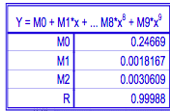
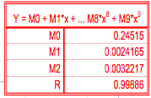
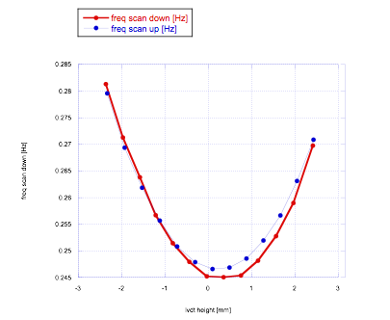
Working point definition

Slide 22

Need of thermal correction
The principal source of perturbations for the spring is the variation of room temperature, causing the following fluctuations of lift force:
This force is depends only on the load,
when the restoring force is tuned to be small
(low frequency) the displacements are large.

Slide 23
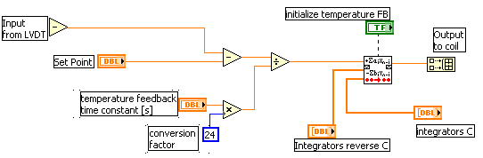
To reduce the wandering of the working point, we introduced a feedback integrator (IIR filter) that
continuously sums the displacements from the working point and feeds the sum to the vertical actuator coil.
IIR filter
It also eliminate the need for very fine tuning of the load.

Slide 24
Thermal feedback
Always maintains the spring at its working point
The gain of this feedback determines
  The time constant at which the system returns to the set point
  The residual distance from the set point during temperature drifts
High feedback gain keeps the spring from wandering,
Too much gain interferes with the behavior of the spring.
The thermal correction time constant must be kept much larger than the natural pulsation of the system

Slide 25
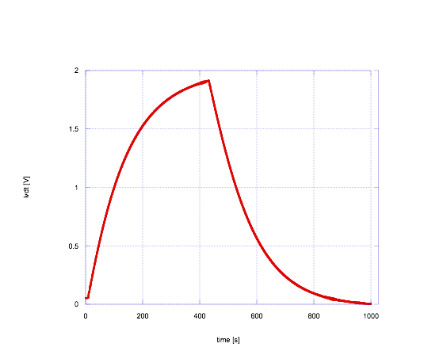
Thermal-feedback time-constant characterization
We set the integration constant to a nominal value (100 s)
we started from a set point (0.07V)
We changed it to 2V
Then we changed it back to 0V
We then fit the data with an exponential decay

Slide 26
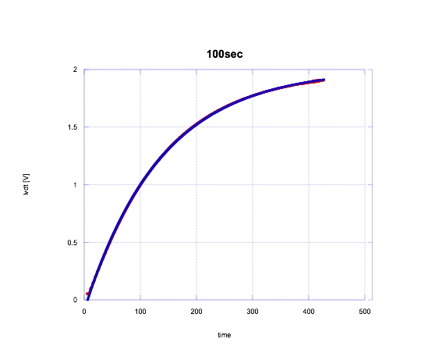
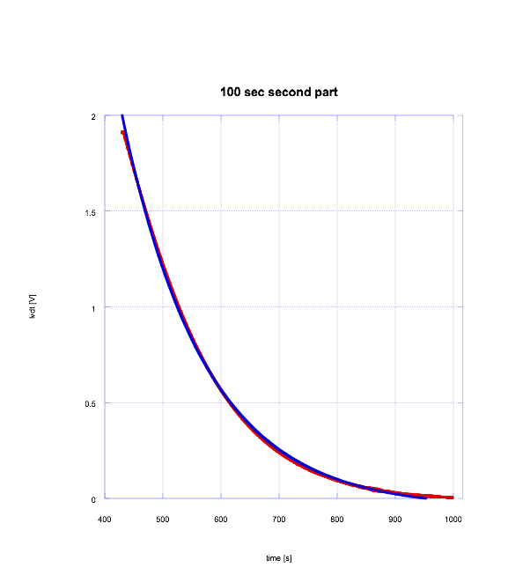
100 seconds integration time
The fit
lifetime was different from the 100 s nominal integrator gain

Slide 27
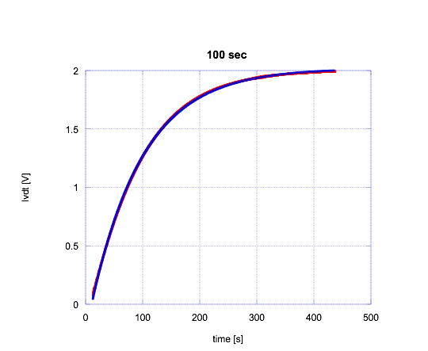
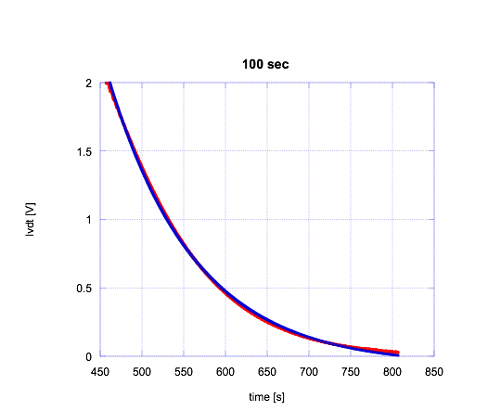
We added a multiplicative constant in the control program so that the value of the nominal integrator constant corresponds to the real thermal correction response time

Slide 28
First relevant scientific understanding

Slide 29
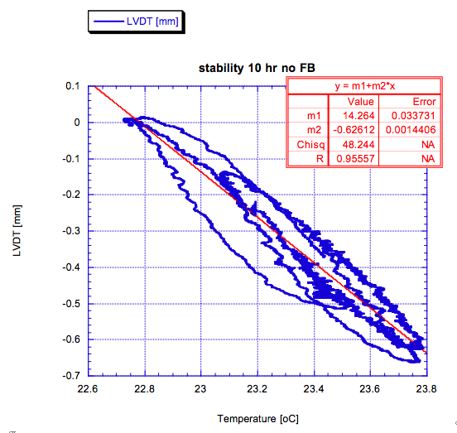
Thermal hysteresis
Filter movement under overnight lab thermal variations
No feedback
The movement shows Thermal hysteresis

Slide 30
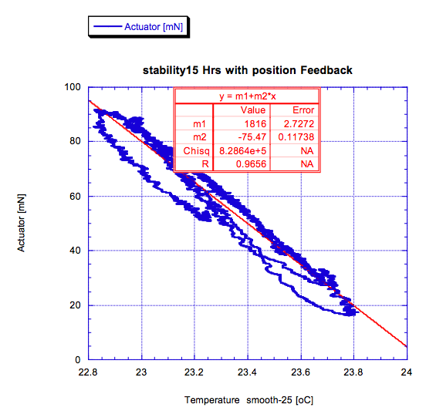
Thermal hysteresis
Blade working point stabilized by integrator feedback
No actual blade movement
Hysteresis shifted to the control current ! !
Actuator [mN]

Slide 31
Surprising (should not) evidence
Hysteresis does not originate from the actual movement
Hysteresis derives from evolving stresses inside the materials
Obvious if you think that metal grains can only “see” internal stresses

Slide 32
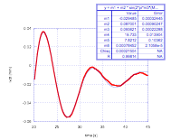
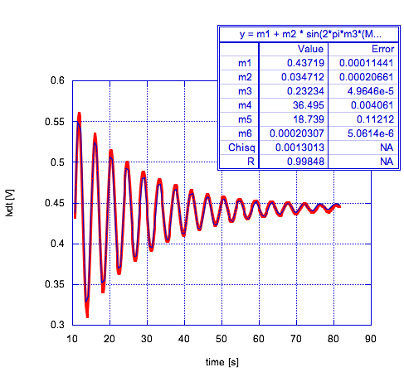
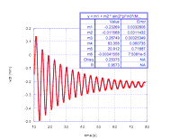
Electro Magnetic Anti Spring (EMAS)
EMAS= 1
Lifetime= 20.95s
EMAS can be applied with positive or negative sign, and arbitrary gain, in parallel to the GAS effect.
Used to stiffen or weaken
the spring restoring force and change its frequency tune
Large negative gain brings instability
10 s
80 s
EMAS=-0.5
Lifetime= 18.74s
10 s
90 s
EMAS=-3.9
Lifetime = 7.82s
20s
45 s

Slide 33
EMAS measurements
The EMAS were used for different measurements:
To measure the actual resonant frequency and oscillation quality factors as function of EMAS value
To set the spring resonant frequency for swept frequency measurements
To test the spring’s stability at the lowest frequency tunings

Slide 34
Resonant Frequency and
Quality factor measurements
For each EMAS setting we excited the spring applying a short voltage pulse on the actuator, and monitored the ringdown.
The pulse was typically ¼ period long.
Larger excitation amplitudes (~1V) were used at highest frequency tunes (stiffer spring).
Smaller excitation amplitudes (~0.1V) were used for the lowest frequency tunes.
All fitting procedures were applied for a fixed time window chosen to start the fit at the same signal amplitude.

Slide 35
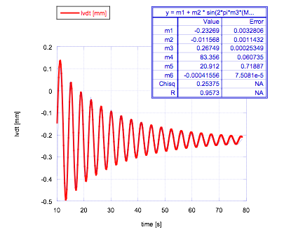
Spring’s Height scan
The data was analyzed with a damped sinusoid function
h+ A sin(2πf (t-ϕ))exp-((t-ϕ)/τ) +v(t-ϕ)
For each set point settings
we extracted the spring’s
Height, the frequency and lifetime
EMAS = 1V

Slide 36
EMAS scan analysis: high frequency
We observed that the frequency slowly changes with amplitude.
The damped sinus fails at high frequency, where the Q-factor is very high.
Different fitting procedure for higher freq.
(More discussion about frequency versus amplitude later.)

Slide 37
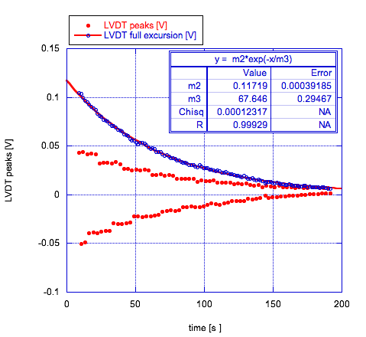
EMAS scan analysis: high frequency
EMAS = 4V
We used the ringdown envelope (difference between each maximum and next minimum of the LVDT signal) to calculate the ringdown lifetime.

Slide 38
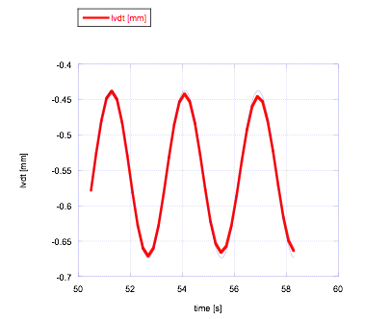
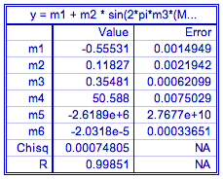
EMAS scan analysis: high frequency
The ringdown frequency was fit in a much shorter window
The error on the frequency was dominated by systematics, as the resonant frequency is amplitude dependent (see subsequent discussion)

Slide 39
Lowest achieved frequency
We were able to reach a lowest frequency, 93.6 mHz.
The scans showed though that the spring is not stable below 150-200 mHz.
External perturbations are capable to cause the system to run-off even if mathematically this should be impossible.

Slide 40

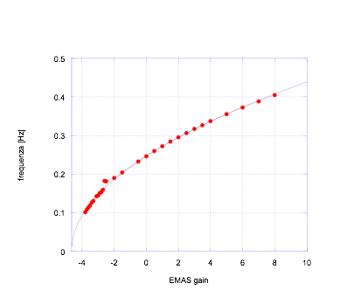
Fitting the frequency vs. EMAS data with a square root function
The data fits perfectly the expected function
(except for two points at 0.19 Hz that correspond to a load resonance).

Slide 41
Quality factor vs. frequency
If the quality factors is a quadratic with frequency
=> the energy loss is independent from frequency
found a deviation from the quadratic rule
for frequencies over 0.28Hz

Slide 42
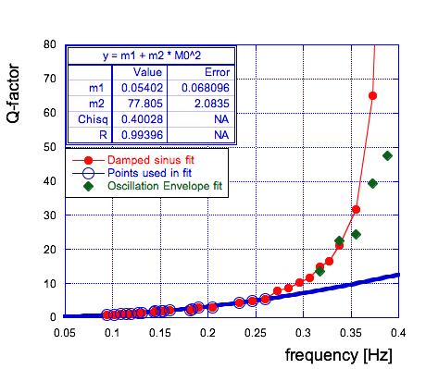
Resonant Frequency and oscillation Quality factor measurements
Deviation from quadratic
Above 0.27 Hz
the expected quadratic behavior

Slide 43
Resonant Frequency and oscillation Quality factor measurements
Looking for systematic errors that could fake the departure from the quadratic law,
repeated the fits using the oscillation envelope technique.
Found a problem with the fit for the three highest points, but not enough to eliminate the discrepancy
Note: As a cross check the procedure was also repeated with fit windows tuned to start for different amplitudes (0.1V and 0.01V) with no significant differences

Slide 44
Tuning the GAS system towards lower frequencies
Suspecting that the departure from the quadratic law of the Q-factor could be somehow related to the EMAS and our control system, we changed the filter’s mechanical tune.
Changing the radial compression of the blades by 1/6 mm we moved the resonant frequency from 245 to 219 mHz,
a substantial amount, -25% in stiffness.

Slide 45
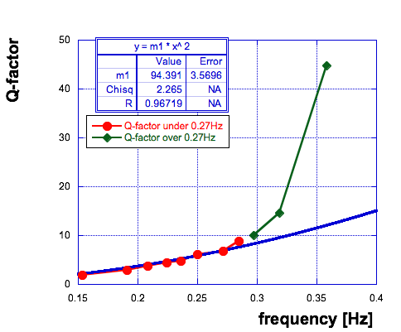
Lower GAS setting
Q-factor measurement
The Quality-factor follows the f² function but still jumps up above 0.27 Hz
confirmed the deviation from the f² law at ~270 mHz

Slide 46
The deviation of Q from the f² function seems to be material dependent,
not tune dependent.
If confirmed it may indicate that dislocations need time to disentangle and mobilize.
Less losses and noise at higher frequency?

Slide 47
Oscillations and hysteresis
In order to explore the effects of hysteresis at various tunes,
we applied excitations of different amplitude and shape.
Half sinusoid slow pulses to avoid ringdowns
Quarter sinusoid to allow ringdowns
Alternated sign pulses
Same sign pulses

Slide 48
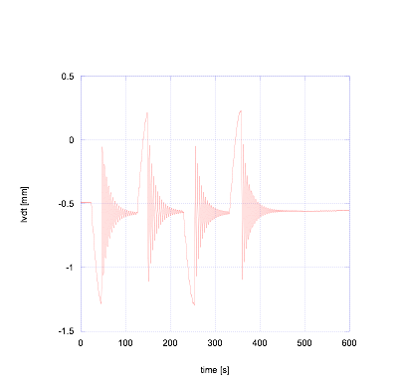
Hysteresis wash-out
If we lift the pendulum to a certain height,
abruptly cut the force,
and let it oscillate
we observe no hysteresis
EMAS=0

Slide 49
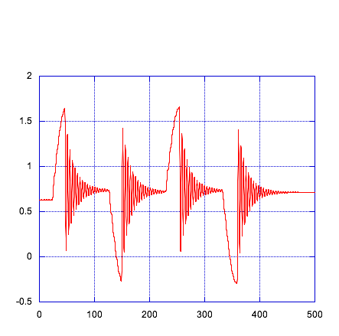
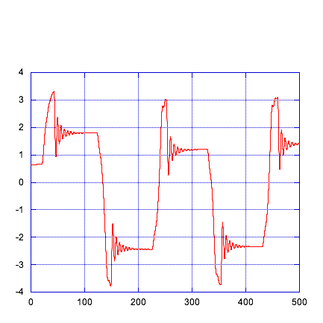
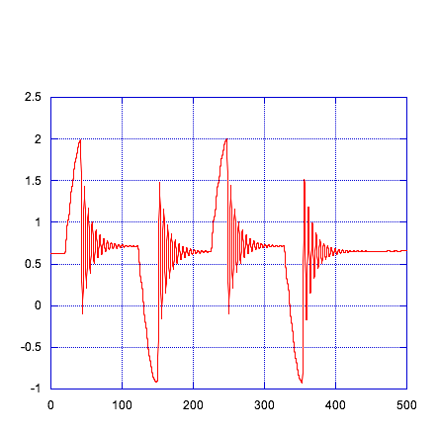
Hysteresis wash-out vs. Q-factor
Oscillations wash-out hysteresis
At low Q there are not enough oscillations to wash out hysteresis
Some “drag” hysteresis appears as the system gets close to instability
EMAS = 0 EMAS = -1 EMAS = -2
Res.freq. = 247 mHz Res.freq. = 213 mHz Res.freq. = 186 mHz
Q = 4.61 Q = 3.52 Q = 1.63
Hysteresis ~ 0.0 Hysteresis ~ 0.0 Hysteresis ~ 3.5V

Slide 50
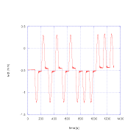
If we lift the pendulum to a certain height,
Slowly reduce the force,
Without letting it oscillate
we observe hysteresis
Alternated sign excitations produce hysteresis
Same sign excitations give no hysteresis
EMAS = 0

Slide 51
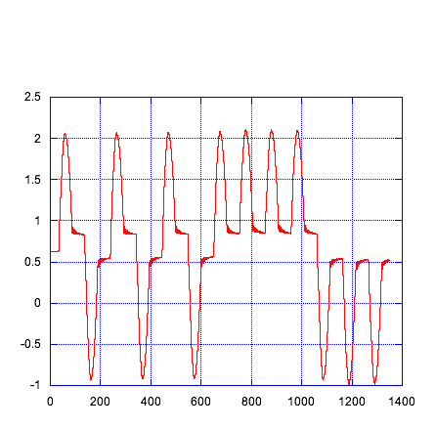
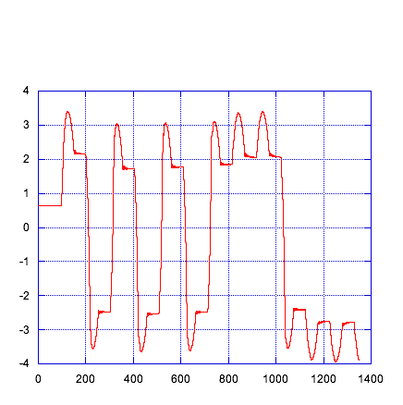
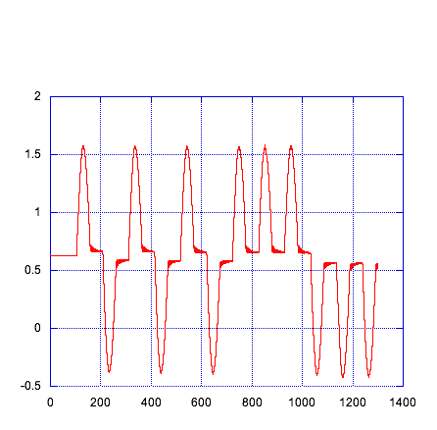
Hysteresis vs. frequency
Hysteresis amplitude grows with low frequency tune
Much more than what could be expected from
lowering of elastic constant K
EMAS = 0 EMAS = -1 EMAS = -2
Res.freq. = 247 mHz Res.freq. = 213 mHz Res.freq. = 186 mHz
K =156 N/m K = 116 N/m K = 89 N/m
Hysteresis = 0.07V Hysteresis = 0.27V Hysteresis = 4.25V

Slide 52
Dissipation and stiffness dependence from amplitude
We studied the movement of the resonant peaks of the LVDT signal versus frequency, using data taken with swept sine of different excitation amplitudes.
The experiment was repeated for EMAS gain 0 and -2
The total elastic constant of the system is :
movement of dislocations inside the material, when the material is subjected to stress + crystal lattice elasticity
The experiment was repeated for EMAS gain 0 and -2

Slide 53
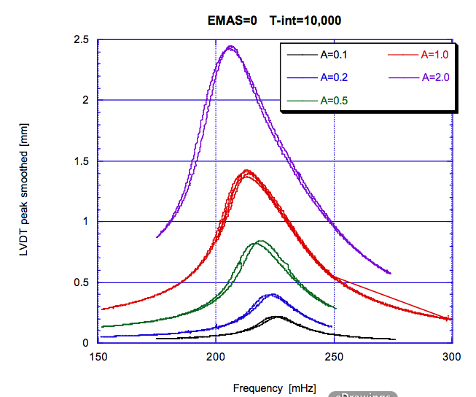
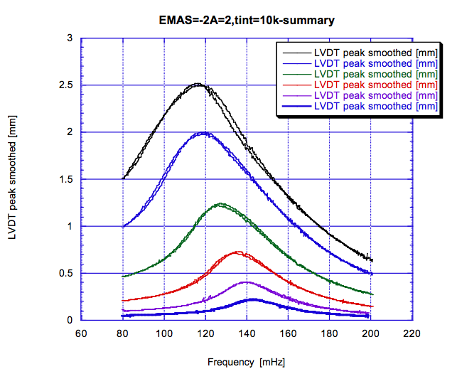
Amplitude/Frequency dragging
Higher amplitudes induce lower frequencies
Same effect for different filter tunes ! !

Slide 54
We consider =
We are assuming here that the entangled dislocations contribute to the elasticity constant and that, changing the stress, some of them can be disentangled, thus reducing the effective Young modulus .
usual spring constant
oscillation amplitude
interpreted as the variation of the elastic constant of the spring due to the progressive mobilization of the dislocations

Slide 55
The frequency becomes amplitude dependent if the number of disentangled dislocation is proportional to the excitation amplitude :
The idea is that for growing excitation amplitudes, the K will decrease, thus decreasing the resonant frequency
Fitting the data with the previous equation…

Slide 56
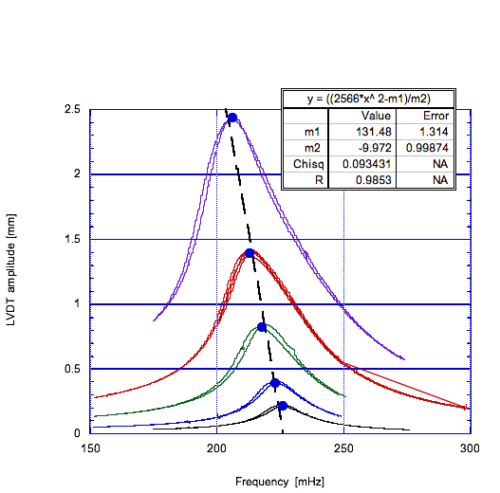
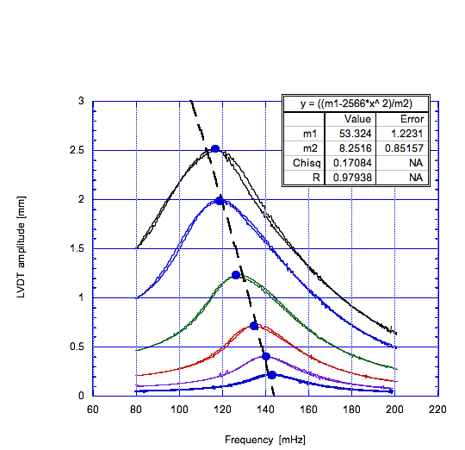
EMAS -2
EMAS 0

Slide 57
These fits match decently the data:
It is a very surprising result
We cross checked it in the time domain

Slide 58
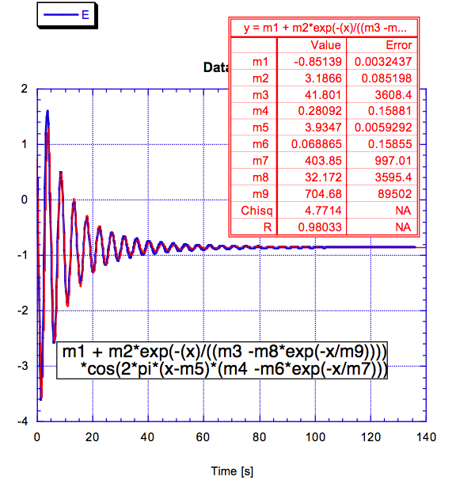
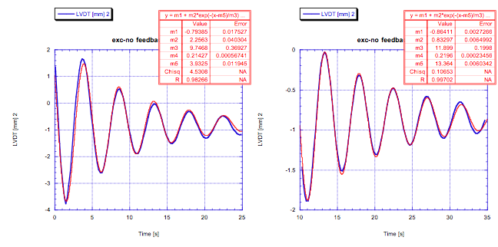
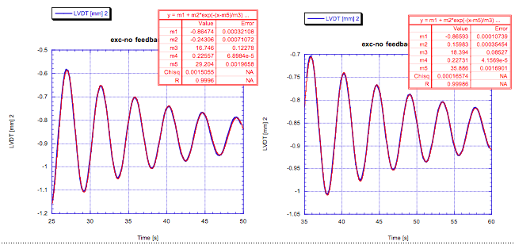
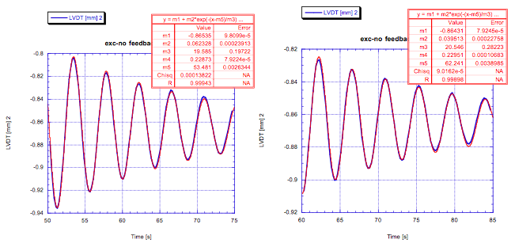



looking for a similar effect in ringdowns
Fitted Several ringdown plots with a sliding window

Slide 59
we found that the the same function does not fit this data
we repeated the analysis with the function
And found very good fit with an exponent compatible with 0.5.
Exponent value=1
Bad fit

Slide 60


Returning to the original data and using the same function
we find an excellent fit , again compatible with a 0.5 exponent
Emas 0
Emas -2

Slide 61

This plot is obtained by leaving the exponent as a free parameter in all our data and data analysis methods. Almost every value of the amplitude exponent is compatible with 0.5 within 1 standard deviation!

Slide 62


Remarkably, the same thing happens with the lifetime of the ring down oscillation… the fit requires a o.5 exponent for the changing losses

Slide 63


Using the resonant width, we calculated the lifetime of the swept sine for different amplitudes and different EMAS gain.
We fitted the lifetimes vs. amplitude to figure out the value of the exponent of the amplitude.

Slide 64


The result is roughly compatible with 0.5, but with large errors
we fitted the data forcing the 0.5 exponent of the amplitude, and we still have a good results.

Slide 65
Conclusions…
The observed effects are compatible with a progressive disentanglement of dislocations
The freed dislocations reduce the stiffness of the spring and increase the observed dissipation, possibly in a viscous manner
The amplitude of both effects, and therefore of the disentangled dislocations, appear to be proportional to the square root of the strain

Slide 66
Fractal behavior of elasticity
Entanglement and disentanglement of dislocations is an intrinsically fractal behavior (likeshifting sands).
The observed 1/f Filter Transfer Function would be easily explainable
Excess 1/f noise could be expected as well
The excess noise found in tiltmeters could be explained
Excess noise in suspended mirrors?

Slide 67

LF Instability and run off
We observed that below 150 mHz the system is unstable.
Perturbations internal or external drive the system to run off
For lower frequency smaller perturbations are sufficient to destabilize the system
Run-off
The Run-off is a “slow” process
Instability region

Slide 68
To explore the LF instabilities we scanned the system with increasing negative EMAS gain
At constant vertical position setting and no excitation

Slide 69

Fast EMAS gain ramp :
Spring deviation from the set point versus the resonant frequency
Beginning of instability region
Mathematical instability
The system runs off well before the mathematical instability
Small offsets are amplified by fast EMAS ramps and generate premature runoff

Slide 70

Slower EMAS ramp and Faster position integrator time constant
result in run off at lower frequencies
Beginning of instability region
Mathematical instability

Slide 71
What causes the run-off?
We interpreted the run-off as a temporary loss of restoring forces due to mobilization of entangled dislocations by an external or internal excitation

Slide 72


What causes the run-off?
In absence of perturbations
the spring stays stable with
resonant frequencies well below 100 mHz
EMAS=-3.52
F=63 mHz

Slide 73
How to stop a run-off?
If a perturbation and/or a runoff are detected in time:
the spring can be re-stabilized by backing off the EMAS gain for the time necessary (seconds) to re-settle the dislocations
then the EMAS gain can be ramped up again

Slide 74

Runoff recovery
An external perturbation triggers run-off
As runoff is detected EMAS gain backs-off
EMAS ramps back to nominal
103 mHz

Slide 75

Run-off recovery
Night-time no run-off is generated
Day-time several run-offs are triggered and recovered
103 mHz

Slide 76
Advantages to operate inside the instability regime
Maximal attenuation transfer function
Critically damped response, all oscillations and excitations from payload automatically absorbed

Slide 77
Conclusions
We have discovered anomalous dissipation mechanism connected with an equally anomalous stiffness reduction.
These effects appear connected with the fractal behavior foreseen for entangled dislocations.
This theory can explain the 1/f transfer function discovered by Stochino, but can predict also LF 1/f noise in the springs.

