Slide 1
HLTS Kickoff Presentation Derek Bridges Bobby Moore July 7, 2011

Slide 2
HLTS Description
HLTS vs. HSTS – optic diameter
265 mm vs. 150 mm
Suspends recycling mirror optics (PR3, SR3)
Total mass: 93.64 kg (~206 lb)
Suspended mass: 36.50 kg (~80 lb)
Nonsuspended mass: 11.58 kg (~26 lb)
Structure mass: 45.56 kg (~100 lb)
Total quantity: 8
LLO: 3 (1 PR3, 1 SR3, 1 spare)
LHO: 5 (1 PR3, 1 F-PR3, 2 SR3, 1 spare)

Slide 3
D070537 – HLTS Structure
Vendor: Industrial Manufacturing Products
Structural Weldment
SSTL tubes and plates
3 – welded correctly
4 – 1 piece too thick (2 long, 2 short)
1 – 4 pieces too thick (2 long + 2 short)
Mounting Pads
Aluminum
Fly cut to achieve correct height
Matched to front/back of each weldment

Slide 4
HLTS Suspension
Triple pendulum suspension
All masses suspended using music wire
Two stages of isolation from maraging steel blades
2 Upper Blades (on Rotational Adj.)
4 Lower Blades (on Upper Mass)
Sensing and control
Upper Mass – 6 BOSEMs
Intermediate Mass – 4 AOSEMs
Bottom Mass – 4 AOSEMs

Slide 5
D070326 – Rotational Adjuster
Adjustments:
Angled blade clamps
0° to 3.5° by 0.5°
Blade shims
0.0 mm to 2.0 mm by 0.5 mm
Push/pull screws (yaw)
Assembly ID:
D070328 S/N

Slide 6
D070340 – Upper Wire Assy.
Properties:
2 wires per HLTS
Wire diameter – 0.024 in (≈ 0.61 mm)
Wire length – 202.5 mm (≈ 7.972 in)
Distance between clamps
Assembly ID:
D020652 S/N

Slide 7
D070335 – Upper Mass Assy.
Assembly ID:
D020605 S/N
Adjustments:
Angled blade clamps
0° to 3.5° by 0.5°
Roll offset
Pitch offset (coarse/fine)
Upper Wire C-Clamp (pitch)
Additional mass, top/bottom (vertical)

Slide 8
D070393 – Int. Wire Assy.
Properties:
4 wires per HLTS
Wire diameter – 0.0134 in (≈ 0.34 mm)
Wire length – 203.6 mm (≈ 8.016 in)
Distance between clamps
Assembly ID:
D030149 S/N

Slide 9
D070334 – Int. Mass Assy.
Assembly ID:
D070336 S/N
Adjustments:
Mass Changer (vertical)
Additional mass amount (vertical)
Additional mass position (roll/pitch)

Slide 10
D080181 – Int. Mass Changer
Features:
100g, 300g collars – aluminum
Use SSTL SHCS
500g, 700g, 900g collars – SSTL
Use Ag-plated SSTL SHCS
Assembly ID:
D030155 S/N

Slide 11
D070436 – Lower Loop Wire Assy.
Assembly ID:
D030148 S/N
(lower number)
Properties:
1 assembly per HLTS
2 wires per assembly
Wire diameter – 0.0106 in (≈ 0.27 mm)
Wire length – 36.694 in (≈ 932 mm)
Distance between clamps

Slide 12
D070337 – Bottom Mass Assy.
Assembly ID:
D070338 S/N
Features:
Primary prism – SSTL
Glass optics use sapphire
Positioning – 1 mm above centerline
Secondary prism – SSTL
Glass optics also use SSTL (same part)
Positioning to be determined

Slide 13
D070308 – Top Blade Guard
Assembly ID:
D070310 S/N

Slide 14
D080726 – EQ Stop, Long Mount
Features:
Metal configuration
Rounded-end SHCS
Glass configuration
Rounded-end SHCS with a glass-tipped cap
Assembly ID:
D070460 S/N

Slide 15
D080727 – EQ Stop, Long Mount
Features:
Metal configuration only
Rounded-end SHCS
Top and bottom sides of Intermediate Mass Assy.
Assembly ID:
D070322 S/N

Slide 16
D1002821 – EQ Stop, Bottom Mass, Lower
Features:
Left and right sides
Metal configuration
Rounded-end SHCS
Glass configuration
Rounded-end SHCS with a glass-tipped cap
Assembly ID:
D1002823 S/N

Slide 17
D070319 – EQ Stop, Bridge
Features:
Metal configuration
Rounded-end SHCS
Glass configuration
Rounded-end SHCS with a glass-tipped cap
Assembly ID:
D070321 S/N

Slide 18
D1002133 – Mounting Bracket, Coil Holder
Assembly ID:
D1002135 S/N
Vertical
Longitudinal
(along Structure)
Transverse
(along Coil Holder)

Slide 19
D080677 – Coil Holder
Assembly ID:
D070449 S/N

Slide 20
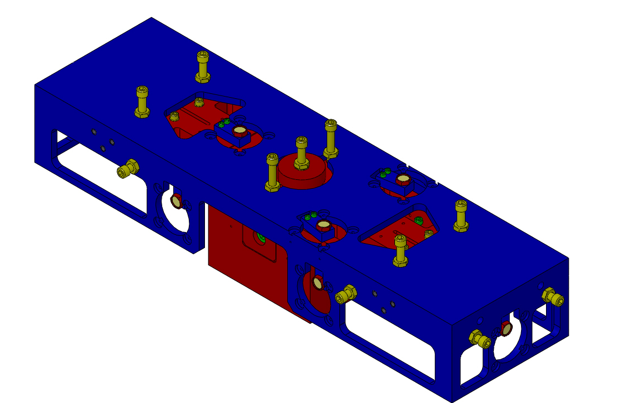
Coil Holder/Upper Mass Assy.
Cartridge installation
Coil Holder brackets on structure
Upper Mass locked to Coil Holder
Upper, Int. Wires attached
BOSEMs, flags, lower additional mass not installed

Slide 21
D0902024 – Upper AOSEM Alignment Assy, Int. Mass
Transverse
(along structure)
Vertical
Assembly ID:
D0901492 S/N
Longitudinal
(similar to BOSEM)

Slide 22
D0901551 – Lower AOSEM Alignment Assy., Int. Mass
Longitudinal
(similar to BOSEM)
Vertical
Assembly ID:
D0901492 S/N
Transverse
(along structure)

Slide 23
D0901552 – Upper AOSEM Alignment Assy., Bottom Mass
Vertical
(along structure)
Transverse
Assembly ID:
D0901549 S/N
Longitudinal
(similar to BOSEM)

Slide 24
D0901553 – Lower AOSEM Alignment Assy., Bottom Mass
Longitudinal
(similar to BOSEM)
Vertical
Assembly ID:
D0901549 S/N
Transverse
(along structure)

Slide 25
D080265 – Upper Blade Bake Fixture
Rotational Adjusters assembled in fixture
Assembly ID:
D080268 S/N

Slide 26
D0900665 – Library of Clamps, Upper Blade
2 Upper Blades per HLTS
Angled blade clamps
0° to 3.5° by 0.5°
Library should be entered into ICS as a storage load, not an assembly load

Slide 27
D0900681 – Library of Clamps, Lower Blade
4 Lower Blades per HLTS
Angled blade clamps
0° to 3.5° by 0.5°
Library should be entered into ICS as a storage load, not an assembly load

Slide 28
D0900594 – Upper Wire Jig
Assembly ID:
D0900595 S/N

Slide 29
D0900630 – Intermediate Wire Jig
Assembly ID:
D0900633 S/N

Slide 30
D0901419 – Lower Loop Wire Jig
Assembly ID:
D0901433 S/N

Slide 31
D0901461 – Magnet Placement Fixture, Intermediate Mass
Assembly ID:
D0902060 S/N

Slide 32
D0902444 – Positioning Standoff
Assembly ID:
D0902445 S/N

Slide 33
D0901460 – Magnet Placement Fixture, Bottom Mass

Slide 34
D1100356 – Optic Base Assy.
Shared with HSTS
Assembly ID:
D0902064 S/N

Slide 35
D0902087 – Positioning Standoff
Assembly ID:
D0902068 S/N

Slide 36
D0902459 – Sapphire Prism Placement Fixture
New EP30 glue – prism glued from top down, not from side

Slide 37
D0902658 – Optic Holder
Shared with HSTS
Assembly ID:
D0902460 S/N

Slide 38
D0902661 – Sapphire Prism Bonding Jig
Test of prototype jig (shown) revealed problems
Redesign features
Replace micrometers and spring plunger (metal tips) with PFA-tipped SHCS
Modify location markings on bonding template to reference flat face of optic
Assembly ID:
D0902665 S/N

Slide 39
HLTS Assembly Sequence
1. Structural Weldment
2. Mounting Pads
3. Rotational Adjusters
4. Top Blade Guards
5. Int. Mass & Barrel EQ Stops
6. Upper Mass/Coil Holder
7. Intermediate Mass
8. Int. Mass AOSEMs
9. Lower Loop Wire
10. Bottom Mass
11. Bottom Mass EQ Stops & AOSEMs,
BOSEMs and Flags

