Slide 1
LIGO (Laser) Safety Document Tree
LIGO-M950046 (LIGO Safety Program)
LIGO-M960001 (LIGO Laser Safety Plan)
LIGO-M980242 (LIGO Observatory Operational Safety & Environmental Protection Manual)
LIGO-M090241 (LIGO Basic Laser Training)
LIGO-M1000228 (LLO Laser Safety Plan)
LIGO-M020131 (LHO Plan)
LIGO-Mxxxxxxx (MIT Plan)
LIGO-Mxxxxxxx (CIT Plan)
LIGO-G0901007 (Basic Laser Training Presentation)
LIGO-M1000229 (LLO 35W PSL SOP)
LIGO-T080247 (PSL FMEA)
LIGO-M1200126 (LLO TMS 130mW Alignment LaserSOP)
LIGO-Q0900010 (Blank Basic Laser Certificate)
LIGO-M1000230 (LLO 35W TCS SOP)
LIGO-E080120 (eLIGO TCS Hazard Analysis)
LIGO-M1200279 (LLO Input Mode Cleaner Commissioning SOP)
LIGO-Q0900011 (Basic Laser Quiz Question Bank)
LIGO-M1000231 (LLO 100W HPLF SOP)
LIGO-Mxxxxxxx (HPLF FMEA)
LIGO-G1101139 (Wave Plate Lockout-Tagout)
LIGO-M090287 (Example Template for Laser SOPs)
LIGO-M1000232 (LLO Photon Calibrator SOP)
LIGO-Mxxxxxxx (CrystaLaser FMEA)
LIGO-M1000233 (LLO CrystaLaser SOP)
LIGO-Mxxxxxxx (Photon Calibrator FMEA)
LIGO-Mxxxxxxx (Advanced Laser Training)
LIGO-M1000234 (700mW Lightwave NPRO SOP)
LIGO-Mxxxxxxx (NPRO 700mW FMEA)
LIGO-M1000235 (200mW JDSU NPRO SOP)
LIGO-Mxxxxxxx (NPRO 200mW FMEA)
LIGO-Gxxxxxxx (Advanced Laser Training Presentation)
LIGO-M1000295 (40mW Fermionics Diode Laser SOP)
LIGO-Mxxxxxxx (Fermionics FMEA)
LIGO-M1100038 (200 W PSL Installation SOP)
LIGO-Mxxxxxxx (200 W PSL Installation FMEA)
LIGO-Mxxxxxxx (Audit Program)
LIGO-G1000017 (LLO Laser Training Addendum)
LIGO-Q0900011 (Basic Laser Quizzes)
LIGO-M1100305 (LLO Silica Fiber Welding Machine SOP)
Q0900011
(Basic Laser Quizzes)
LIGO-Mxxxxxxx (LLO Laser Inventory)
LIGO-Mxxxxxxx (LLO Authorization List)

Slide 2
LIGO (Non-laser) Safety Document Tree
LIGO-M950046 (LIGO Safety Program)
LIGO-M960001 (LIGO Laser Safety Plan)
LIGO-M980242 (LIGO Observatory Operational Safety & Environmental Protection Manual)
LIGO-M0900136 LIGO Laboratory Restricted Work Alone Policy
LIGO-M1000366 LLO Lockout/Tagout Policy
LIGO-M1000358 LLO O-Ring Installation and Flange Assembly Procedure
LIGO-M1000368 LLO Beam Tube Enclosure Entry and Egress Procedure
LIGO-M1000359 LLO Beam Tube Module Vent Procedure
LIGO-M1000363 LLO Mobile Clean Room Relocation Procedure
LIGO-M1000366 LLO Lockout-Tagout Procedure
LIGO-M1000362 LLO HAM Access Door Removal Procedure
LIGO-M1000364 LLO GNB Valve Operating Procedure
LIGO-M1000365 LLO Snake Bite, Spider Bite, and Insect Sting Procedure
LIGO-M1000350 LLO Beam Tube Module Pump Down Procedure
LIGO-M1000351 LLO Technical Power Usage and Safety Guide
LIGO-M1000352 LLO Machine Shop Safety Rules
LIGO-M1000353 LLO Vacuum Pump Cart Connection Procedure
LIGO-M1000354 LLO Site Security Procedures
LIGO-M1000355 LLO Conflat Flange Assembly Procedure
LIGO-M1000356 LLO Isolatable Volume Pump Down Procedure
LIGO-M1000357 LLO Spool Manifold Removal Procedure
LIGO-M1000367 LLO Gantry Crane Rules
LIGO-M1100264 Guidelines for Work at a LIGO Observatory
LIGO-E1000043 HLTS Assembly and Installation Hazard Analysis
LIGO-E1000603 LIGO BSC iLIGO PISI De-Install

Slide 3
Pertinent LIGO (Laser) Safety Document Tree
LIGO-M950046 (LIGO Safety Program)
LIGO-M960001 (LIGO Laser Safety Plan)
LIGO-M980242 (LIGO Observatory Operational Safety & Environmental Protection Manual)
LIGO-M090241 (LIGO Basic Laser Training)
LIGO-M1000228 (LLO Laser Safety Plan)
LIGO-M020131 (LHO Plan)
LIGO-Mxxxxxxx (MIT Plan)
LIGO-Mxxxxxxx (CIT Plan)
LIGO-G0901007 (Basic Laser Training Presentation)
LIGO-M1000229 (LLO 35W PSL SOP)
LIGO-T080247 (PSL FMEA)
LIGO-M1200126 (LLO TMS 130mW Alignment LaserSOP)
LIGO-Q0900010 (Blank Basic Laser Certificate)
LIGO-M1000230 (LLO 35W TCS SOP)
LIGO-E080120 (eLIGO TCS Hazard Analysis)
LIGO-M1200279 (LLO Input Mode Cleaner Commissioning SOP)
LIGO-Q0900011 (Basic Laser Quiz Question Bank)
LIGO-M1000231 (LLO 100W HPLF SOP)
LIGO-Mxxxxxxx (HPLF FMEA)
LIGO-G1101139 (Wave Plate Lockout-Tagout)
LIGO-M090287 (Example Template for Laser SOPs)
LIGO-M1000232 (LLO Photon Calibrator SOP)
LIGO-Mxxxxxxx (CrystaLaser FMEA)
LIGO-M1000233 (LLO CrystaLaser SOP)
LIGO-Mxxxxxxx (Photon Calibrator FMEA)
LIGO-Mxxxxxxx (Advanced Laser Training)
LIGO-M1000234 (700mW Lightwave NPRO SOP)
LIGO-Mxxxxxxx (NPRO 700mW FMEA)
LIGO-M1000235 (200mW JDSU NPRO SOP)
LIGO-Mxxxxxxx (NPRO 200mW FMEA)
LIGO-Gxxxxxxx (Advanced Laser Training Presentation)
LIGO-M1000295 (40mW Fermionics Diode Laser SOP)
LIGO-Mxxxxxxx (Fermionics FMEA)
LIGO-M1100038 (200 W PSL Installation SOP)
LIGO-Mxxxxxxx (200 W PSL Installation FMEA)
LIGO-Mxxxxxxx (Audit Program)
LIGO-G1000017 (LLO Laser Training Addendum)
LIGO-Q0900011 (Basic Laser Quizzes)
LIGO-M1100305 (LLO Silica Fiber Welding Machine SOP)
Q0900011
(Basic Laser Quizzes)
LIGO-Mxxxxxxx (LLO Laser Inventory)
LIGO-Mxxxxxxx (LLO Authorization List)

Slide 4
LLO Laser Safety During aLIGO Installation
EMPHASIS on Policy
Read the SOP for your laser-of-interest.
A diagram of the laser setup must be approved by the LSO.
Work rules are found in M1100264. There are no exceptions.
There is no work without a work permit (Ref: M950046).
ALL laser activity must be coordinated with the on-duty control room operator. (Carry a phone.)
Live laser activity without a prior transition to laser hazard is not permitted.
The RLO is simultaneously responsible for BOTH PSL and LDR hazard zones.
M0900136 – Restricted Work Alone Policy is enforced.
M1000336 – Lockout/Tagout Policy is enforced. (Note: An alog entry is now required.)

Slide 5
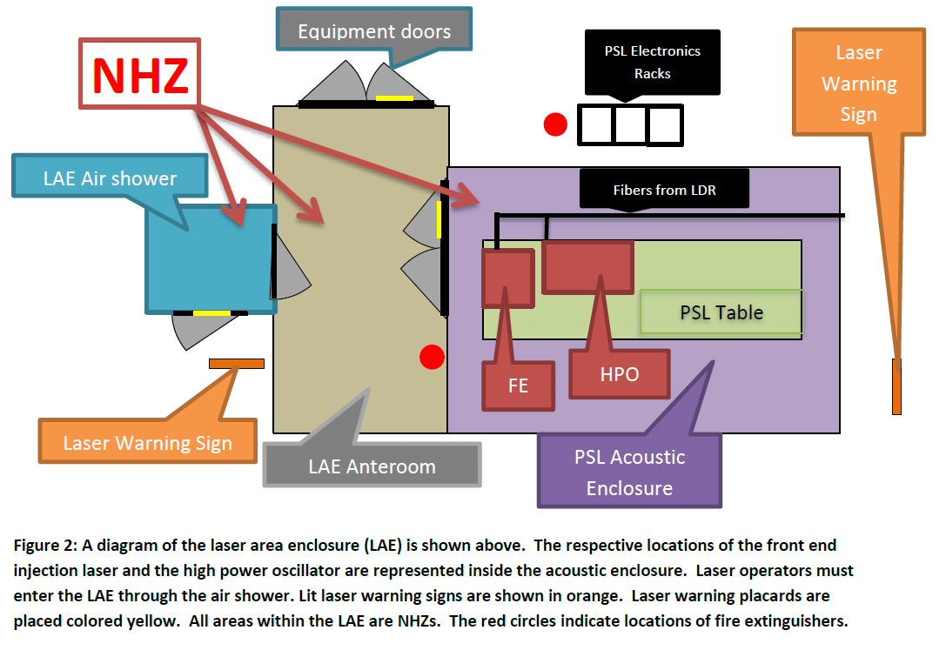
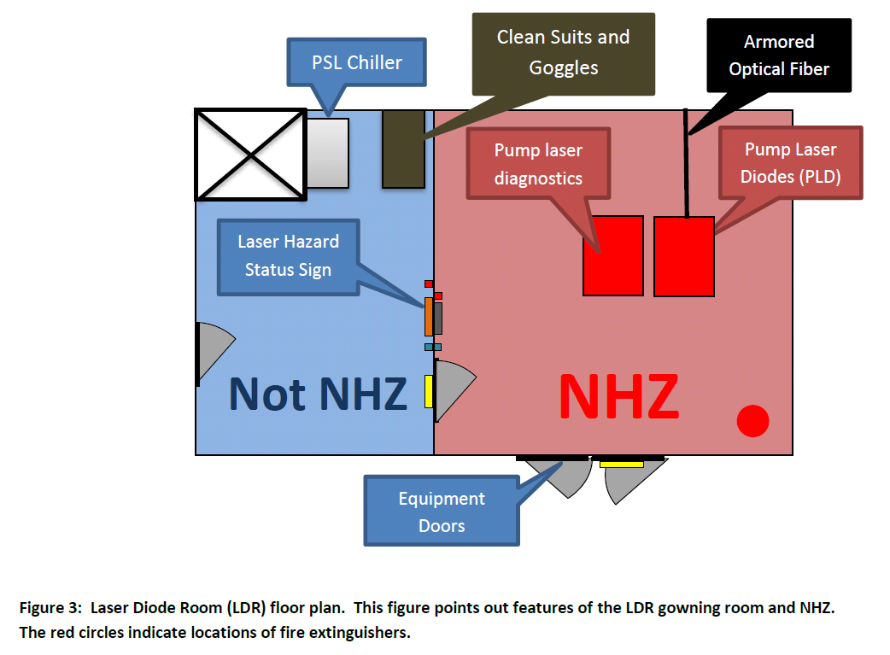
LLO Laser Safety During aLIGO Installation
EMPHASIS on Environment
NHZ fire extinguishers
Warning sign locations
Appropriate protective eyewear
PSL
LDR
Reference: M1100038

