Slide 1
Advanced LIGO Active Seismic Isolation
Jeff Kissel, for the Seismic Team
Det.Char. Telecon, April 7 2011
G1100431

Slide 2
What I’ll squeeze into an hour
A Bird’s Eye View
A Few Scary Pictures
The Jargon
The Requirements and Sensors
HEPI
HAM-ISI
BSC-ISI
The Philosphy of Control
What you can do to help
Who to bug when you’re confused
What channels matter to you

Slide 3
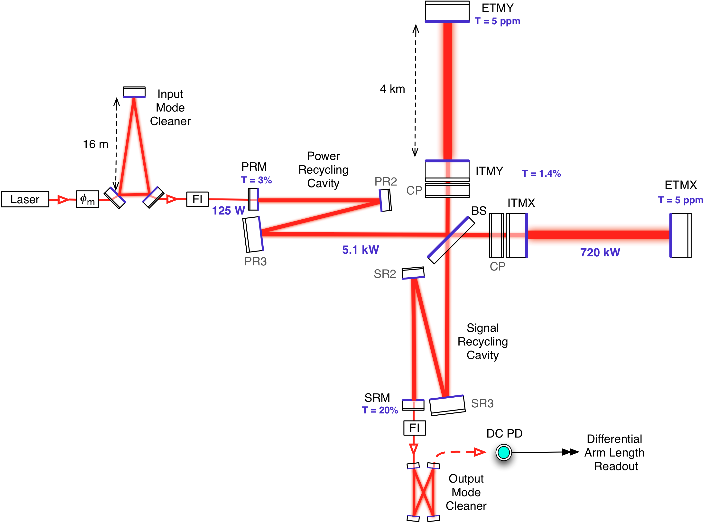
aLIGO (Simplified) Interferometer Layout

Slide 4
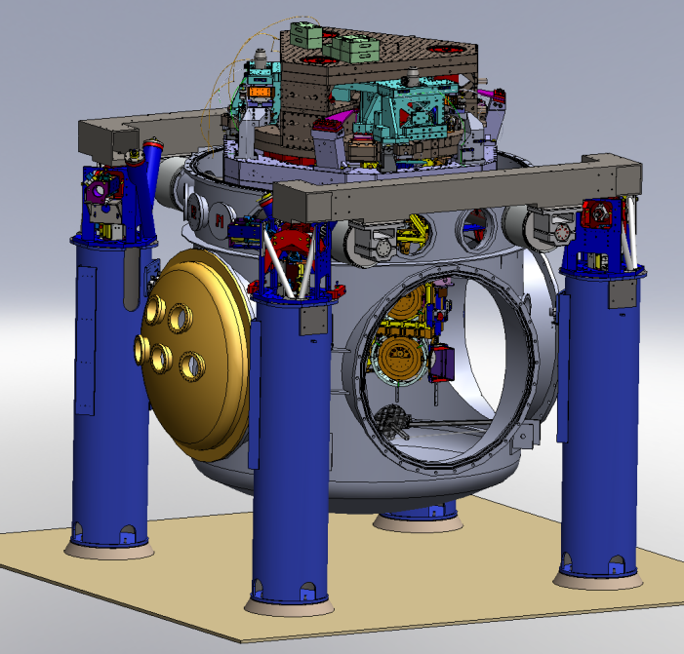
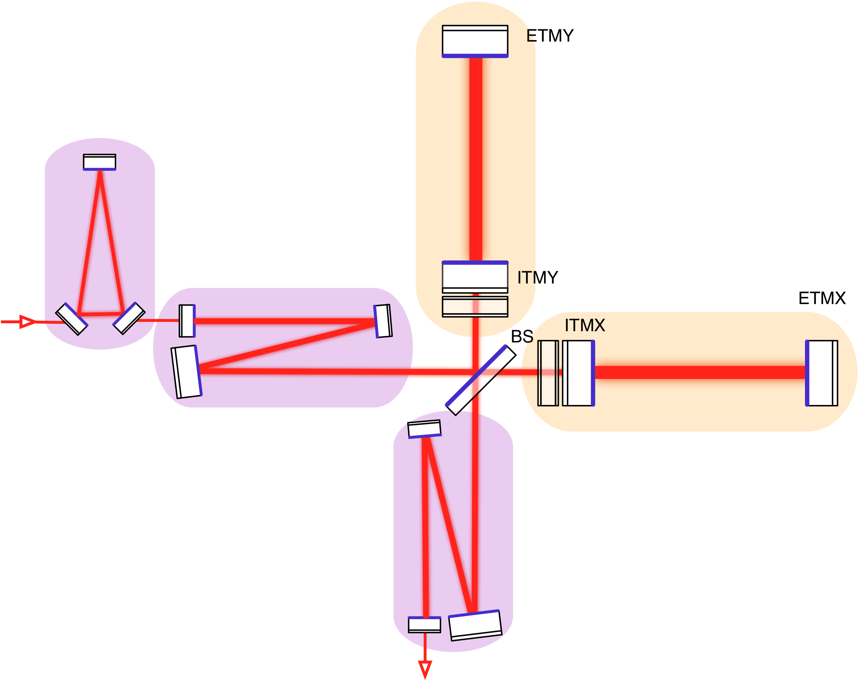
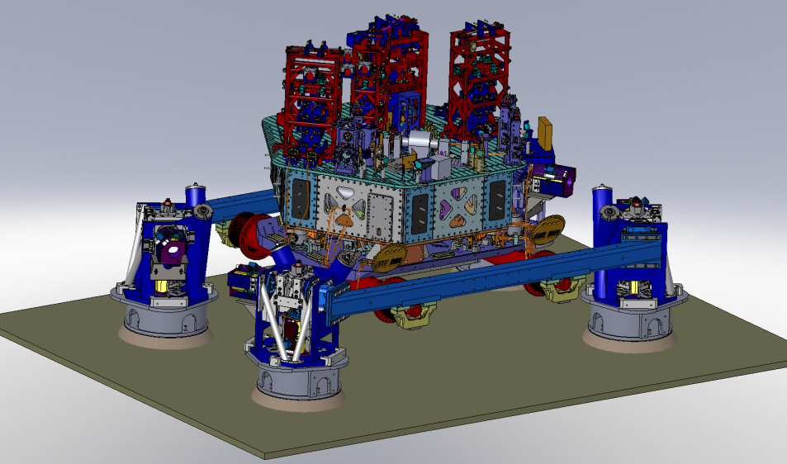
aLIGO Seismic Isolation
Core Optics
7 Stages
Active Isolation
1 external stage (BSC HEPI)
2 internal stages (BSC ISI)
Passive Isolation
4 stages
(Quadruple Pendulums)
Auxiliary Optics
5 Stages
Active Isolation
1 external stage (HAM HEPI)
1 internal stage (HAM ISI)
Passive Isolation
3 stages
(Triple Pendulums)

Slide 5
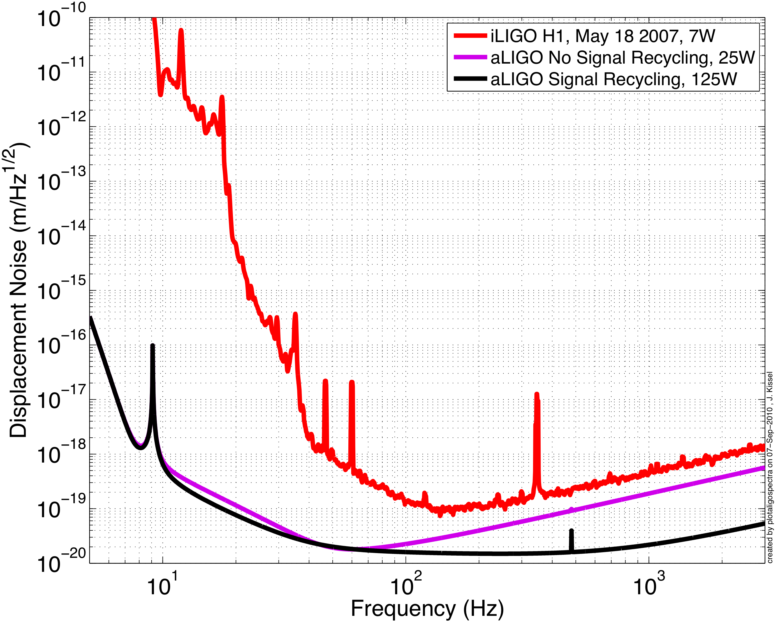
What does it buy us?
Possible Intermediate Configuration:
- No Signal Recycling
- 25 W Input Power
Demonstration of aLIGO
suspensions and seismic isolation:
7 orders of magnitude less
displacement at 10 Hz
Predicted Binary Neutron Star Range: ~145 Mpc
Event Rate:

Slide 6
An aLIGO Corner Station

Slide 7
An aLIGO HAM Chamber
z
x
y
HAM2 (Chamber hidden for clarity)

Slide 8
An aLIGO BSC Chamber
z
x
y
BSC2

Slide 9
What does each chamber need?
PRCL HAM ISIs
don’t amplify motion
too much here
“SRCL”
HAM ISIs
Get a factor of
~10 at 0.15 Hz
Get a factor of
~50 or ~1000 at 1Hz
“PRCL” HAM ISI
Get a factor of
10 or more or ~1000 at 10Hz
Get as much as you
can here!

Slide 10
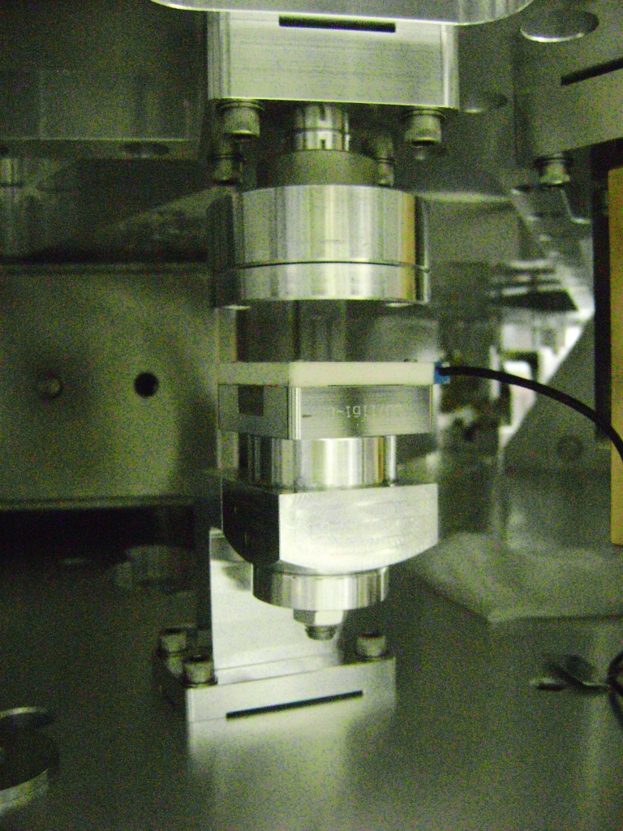
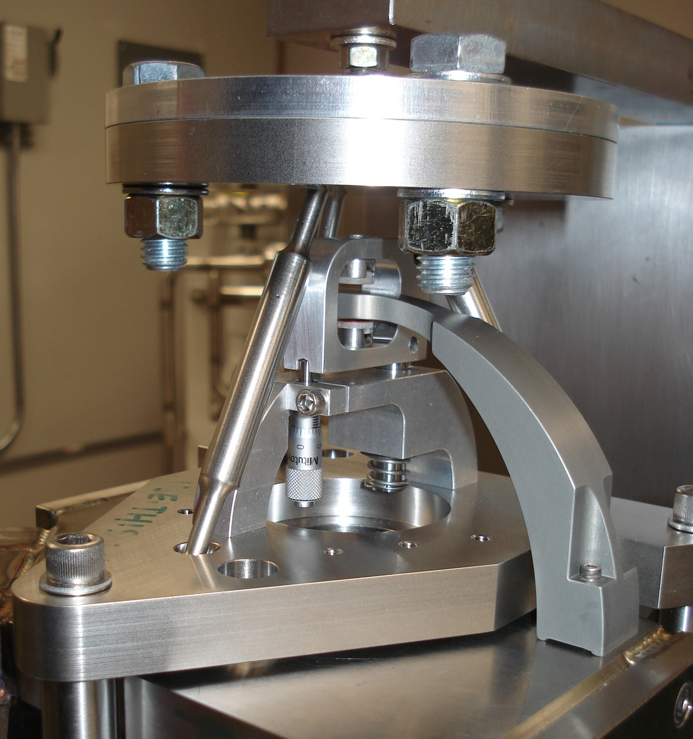
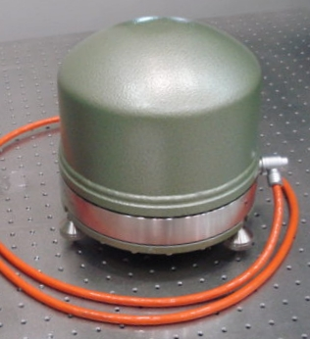
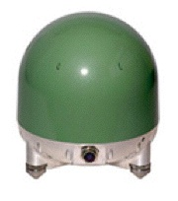
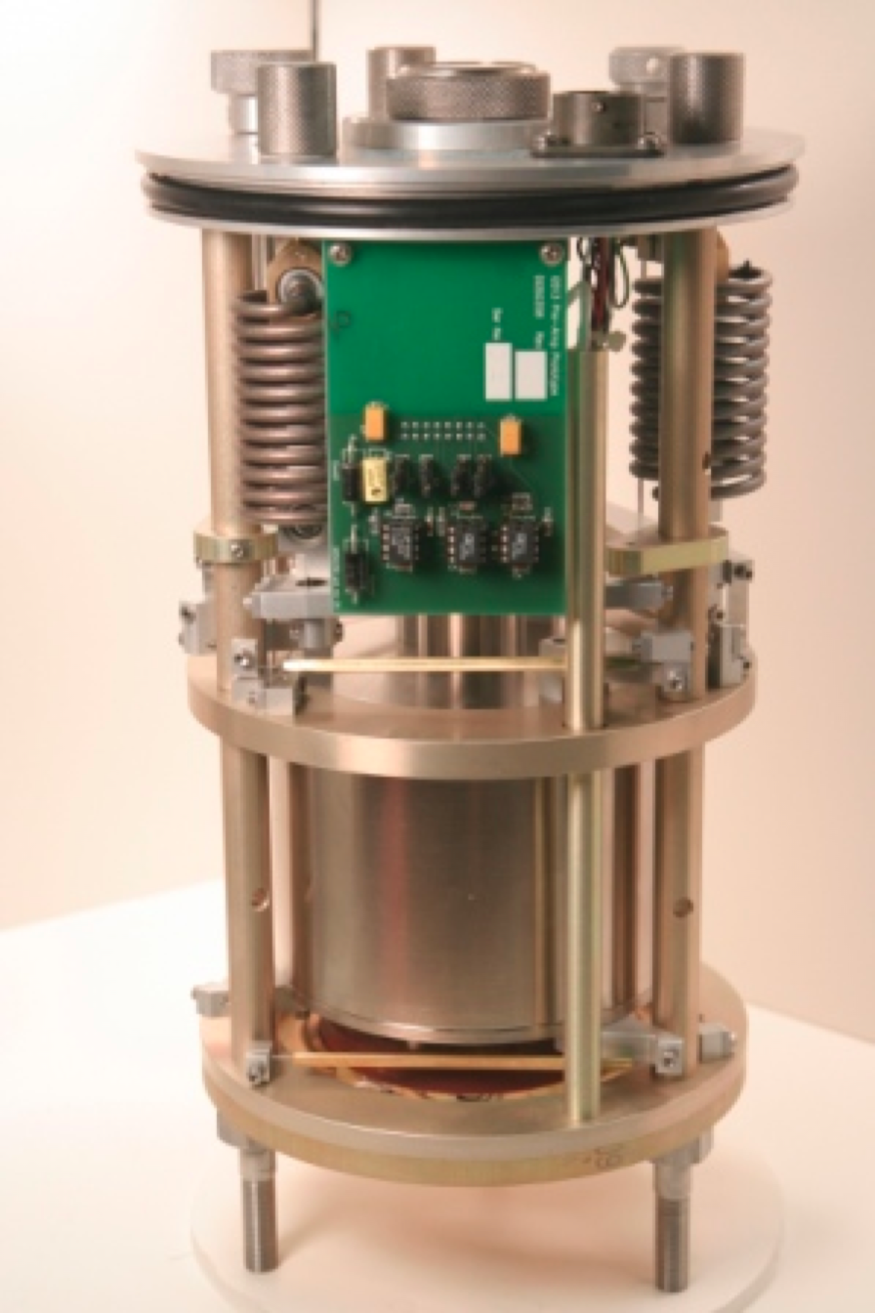
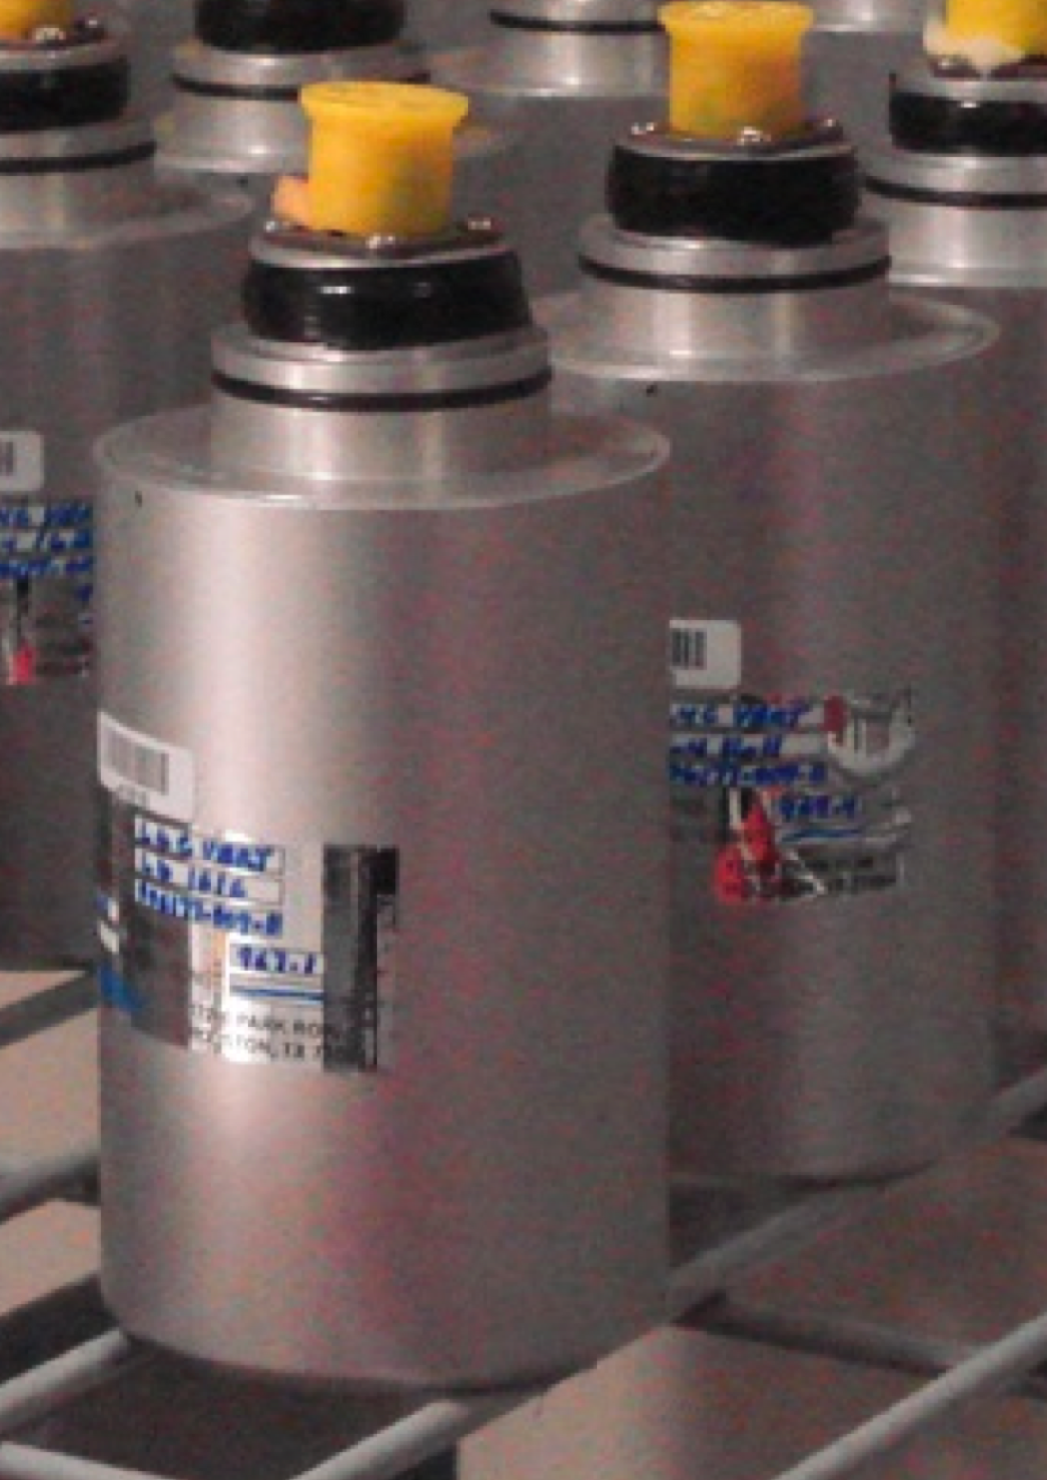
SEI Sensors and Their Noise
“Low” Frequency
IPS
Kaman’s Inductive Position Sensors
Used On: HEPIs
Used For: ≤ 0.5 Hz Control, Static Alignment
Used ‘cause: Reasonable Noise, Long Range
CPS
MicroSense’s Capacitive Displacement Sensors
Used On: HAM-ISIs and BSC-ISIs
Used For: ≤ 0.5 Hz Control, Static Alignment
Used ‘cause: Good Noise, UHV compatible
DC
10 mHz
STS2
Strekheisen’s STS-2
Used On: HEPIs
Used For: 0.01 ≤ f ≤ 1Hz Control
Used ‘cause: Best in the ‘Biz below 1 Hz, Triaxial
T240
Nanometric’s Trillium 240
Used On: BSC-ISIs
Used For: 0.01 ≤ f ≤ 1Hz Control
Used ‘cause: Like STS-2s, Triaxial, no locking mechasim -> podded
GS13
GeoTech’s GS-13
Used On: HAM-ISIs and BSC-ISIs
Used For: ≥ 0.5 Hz Control
Used ‘cause: awesome noise above 1Hz,
no locking mechanism -> podded
1 Hz
L4C
Sercel’s L4-C
Used On: All Systems
Used For: ≥ 0.5 Hz Control
Used ’cause: Good Noise, Cheap,
no locking mechanism -> podded
800 Hz
“High” Frequency

Slide 11
SEI Sensors and Their Noise

Slide 12
Some Jargon
Plant, Controller, Open Loop Gain
Plant – Platforms response to ground motion as a function of frequency (as measured displacement and inertial sensors when driven by actuators ) – looks like a simple pendulum!
Controller – digial filters used to shape sensor displacement singals into actuaction force signals
Open Loop Transfer Function – the product of the plant times the controller, used as a measure of control loop stability
Plant
Controller
Position ~ Displacement
You’ll here the seismic crew use these interchangably; “The position sensors” the “displacement sensors” – are subtly different, but realize they serve the same function in aLIGO SEI
Inertial sensor = Geophone = Seismometer
Again, used interchangibly, all “the same thing” with subtle differences, but all serve the same function in aLIGO SEI

Slide 13
Some More Jargon
Super Sensor – The combined inertial and displacement signals of all sensors on one stage of isolation, serves as error signal for isolation loops
Blend Filters “Blends” – The set of digital filters on the inertial sensor (high pass) and displacement sensor (low pass)
Blend Frequency – The frequency at which high pass and low pass blends cross over (important for performance)
Damping loops
Inertial Sensors only
Only reduces Q of blade-spring/wire-flexure pendulum resonances
Small bandwidth around resonances
Unconditionally stable
Isolation loops
Uses Super Sensor
Bandwidth from ~25 Hz down to DC
High performance, unconditionally stable

Slide 14
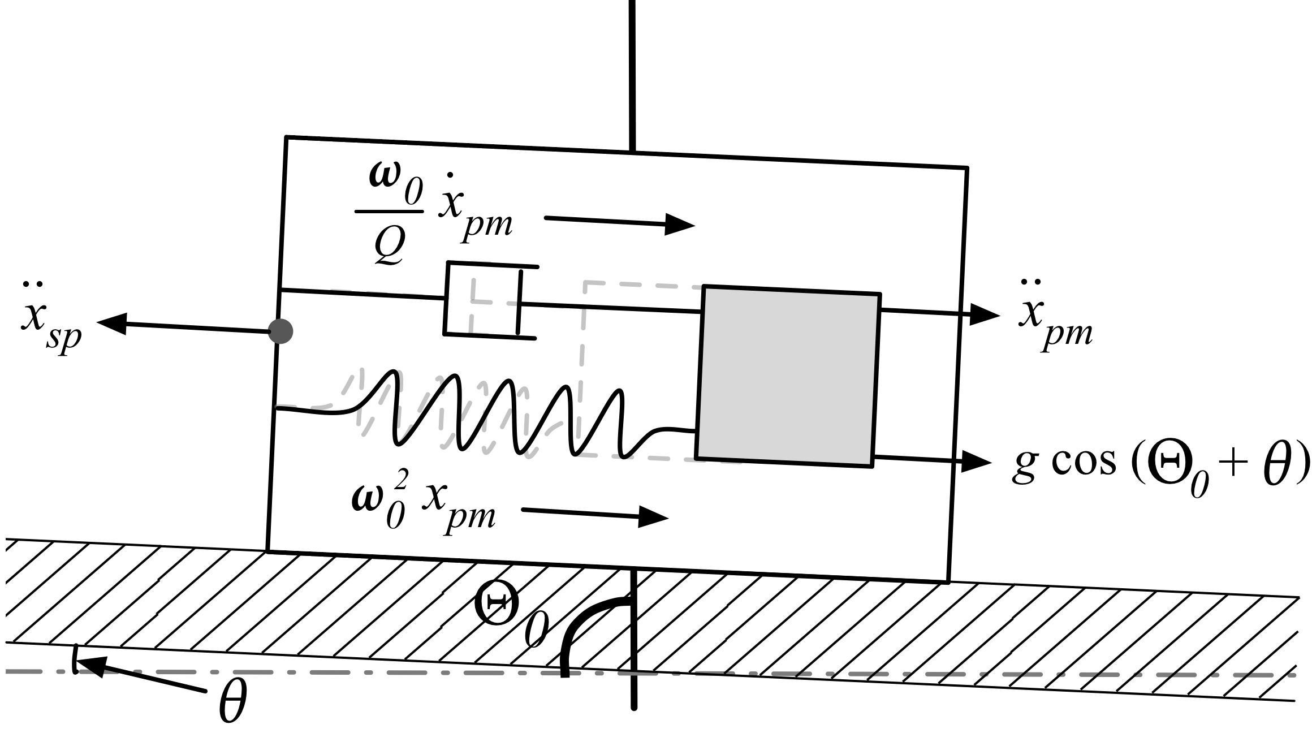
Some More Jargon
Feedback
Feedforward
Sensor Correction
“Reactive”
“Predictive”
“Corrective”
SC
FF
Plant
Plant
Plant
FB
FB
Tilt – Horizontal Coupling
Fundamental property of a horizontal inertial sensor
Effect dominant at low frequency
(< 0.5 Hz)

Slide 15
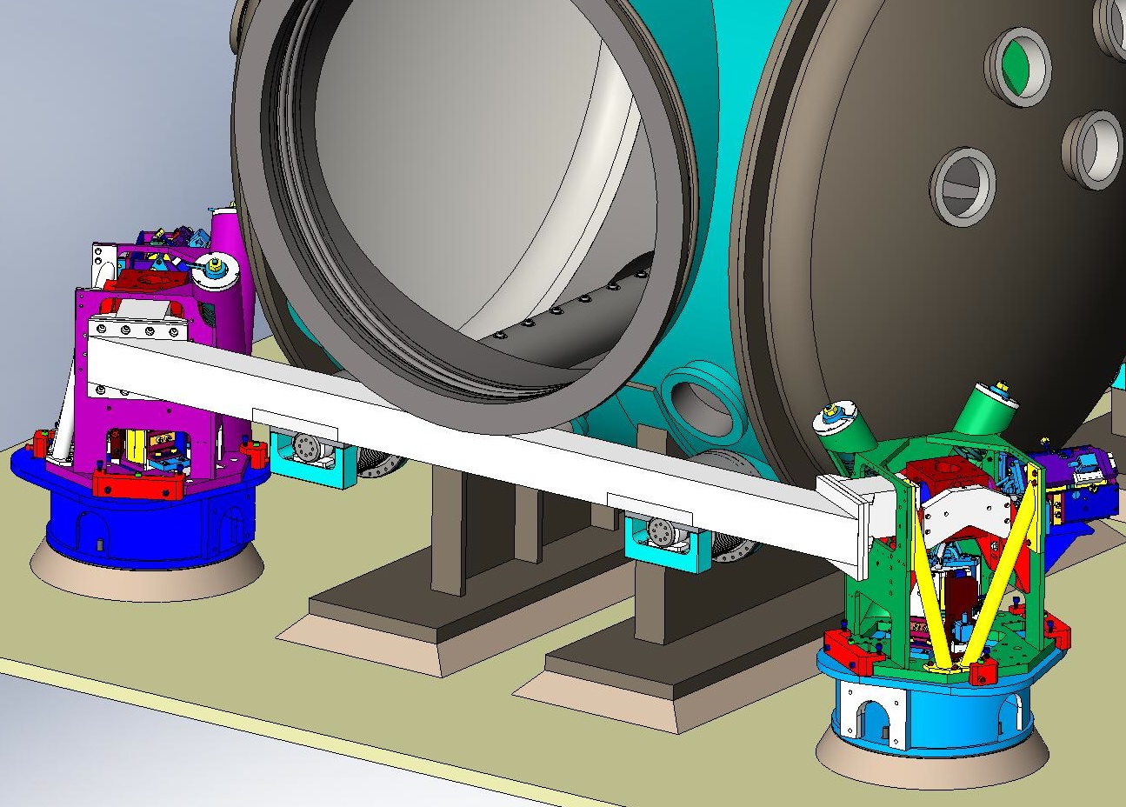
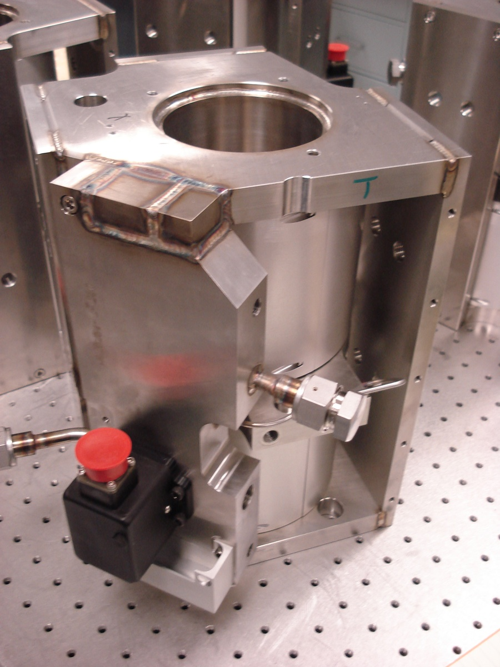
The External Pre-Isolators (HEPI)
BSC HEPI (Core Optics)
HAM HEPI (IOO Optics)
Single stage systems
8 DOF motion per stage
Over-damped coil springs in compression
Active isolation 8 and 8 on-board Position and Inertial Sensors, with 8 hydraulic actuators
L4C
IPS
Position Sensor
f = ~1 Hz
Hydraulic
Actuators
Inertial
Sensor

Slide 16
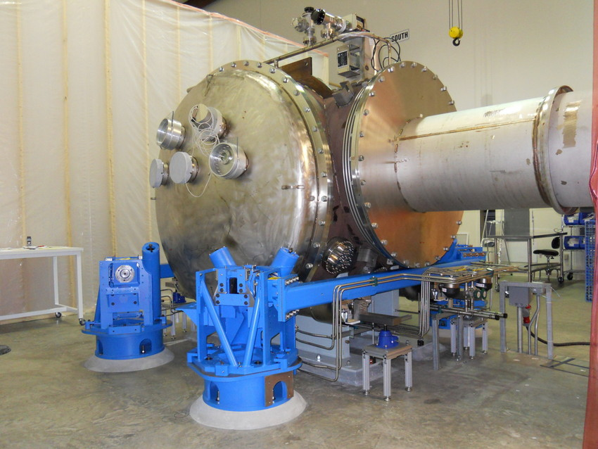
Where stuff is on HEPI
L4C
ACT
IPS
Position Sensor
f = ~1 Hz
Hydraulic
Actuators
Inertial
Sensor
Euler Springs

Slide 17
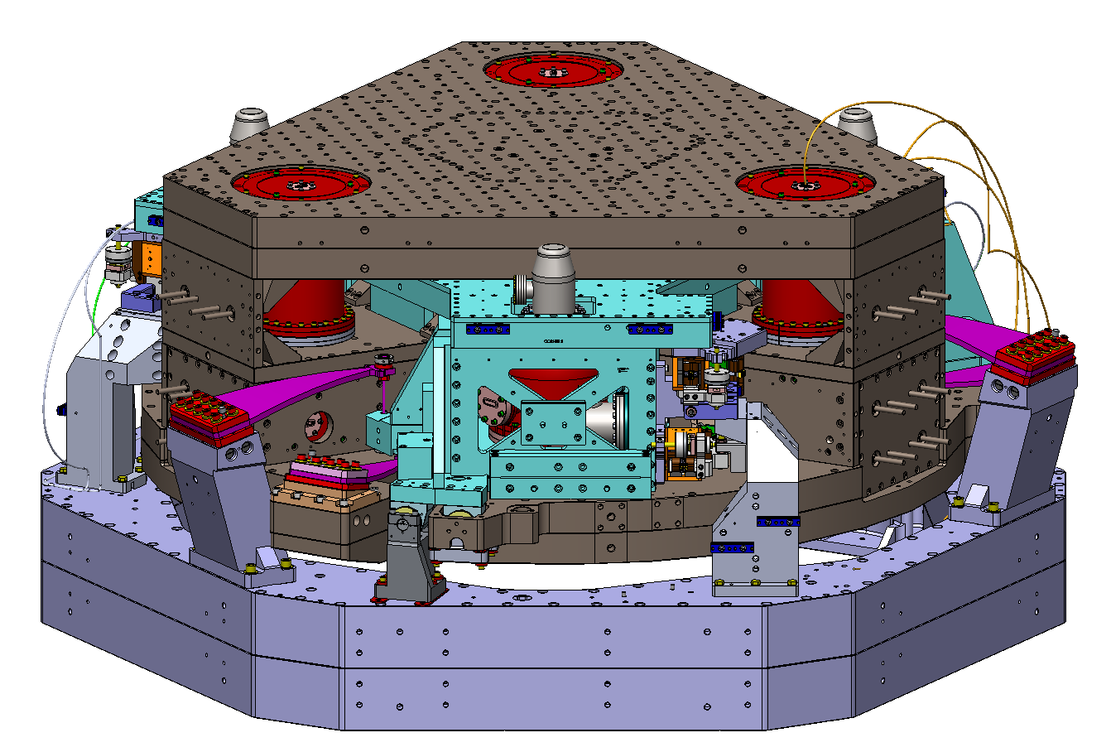
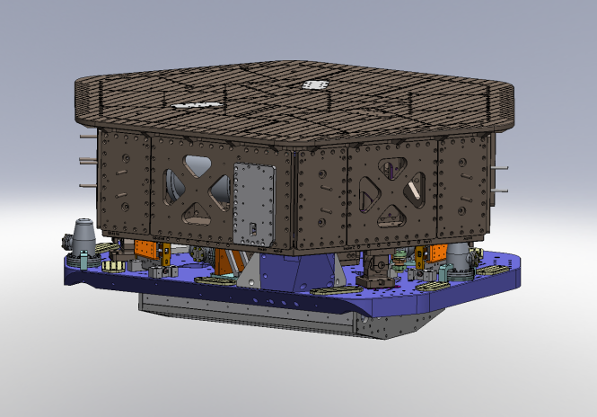
The In-vacuum Seismic Isolators (ISI)
BSC ISI (Core Optics)
HAM ISI (IOO Optics)
Two-stage system
6 DOF motion per stage
Passive isolation 2 x 3 Blade springs + wire flexure systems
Fundamental modes ~ 1Hz
Active isolation 12 and 15 on-board Displacement and Inertial Sensors, with 12 EM Coil actuators
Single-stage System
6 DOF motion single stage system
Passive isolation 3 Blade springs + wire flexure systems
Fundamental modes ~ 1Hz
Active isolation 6 and 6 on-board Displacement and Inertial Sensors, with 6 EM Coil actuators

Slide 18
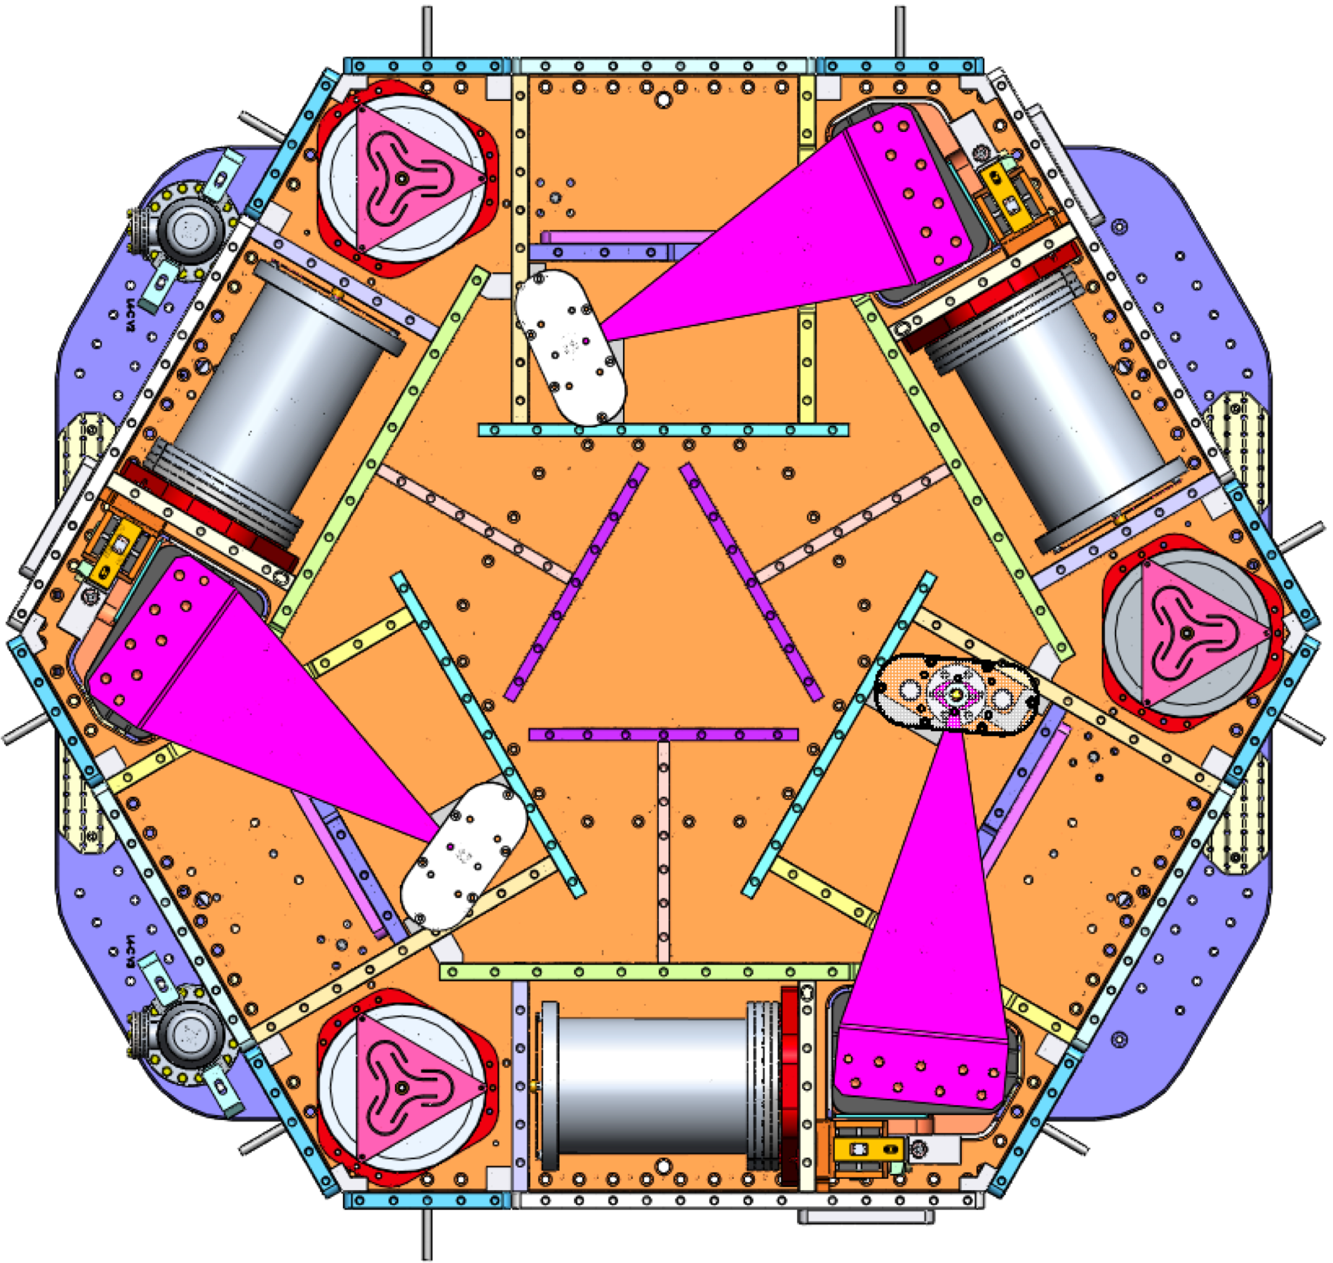
Where stuff is on a HAM-ISI
CPS
GS13
Displacement
f = ~1 Hz
Sensor
Inertial
Sensor
STAGE 1 (ST1)
SRCL HAM-ISIs will have “extra” L4Cs on the support stage (ST0) for feed-forward use around 10 Hz
L4C
f = ~1 Hz
STAGE 0 (ST0)

Slide 19
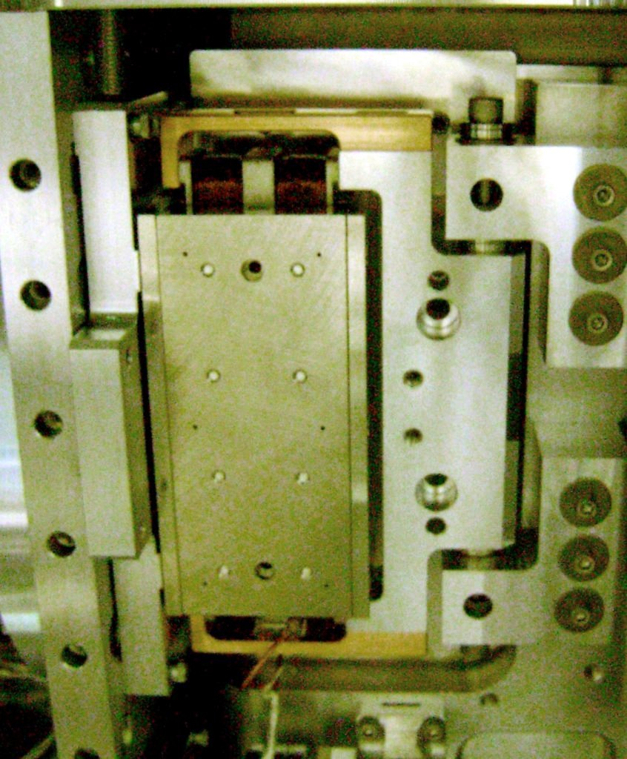
Where stuff is on a BSC-ISI
STAGE 2 (ST2)
STAGE 1 (ST1)
STAGE 0 (ST0)
L4C
T240
GS13
f = ~1 Hz
f = ~5 mHz
f = ~1 Hz
Inertial Sensors
Inertial Sensor
CPS
ACT
Displacement
One corner’s ST0-1 and ST1-2
position sensors and actuators
Electromagnetic
Sensor
Actuators

Slide 20
Colocated vs. Euler vs. Cartesian Bases
V
V2
Y
Y
H2
H1
RY
Z
T
V1
RZ
X
P
RX
R
L
V3
H3
Aligned with the Sensors
H1, H2, H3, V1, V2, V3
Aligned with the Beam
Longitudinal, Transverse, Vertical,Roll, Pitch, Yaw
Aligned with the IFO arms
X, Y, RZ, RX, RY, Z

Slide 21
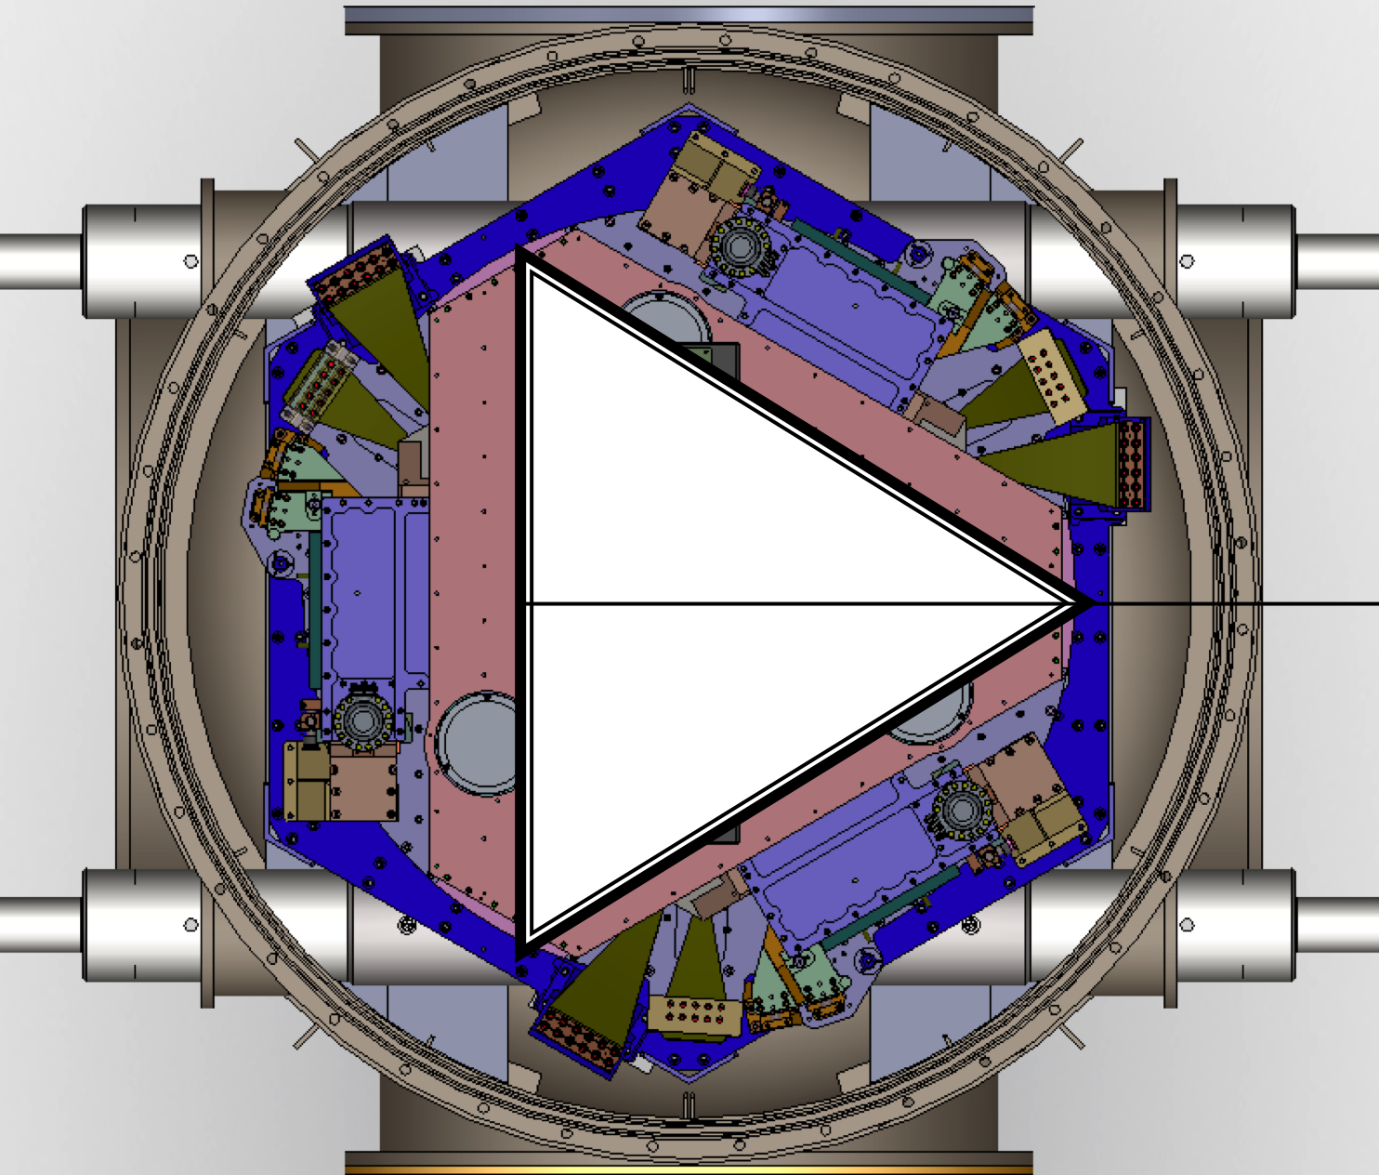
How are the Colocated and Cartesian Bases Related?
BSC6
HAM12
BSC10
HAM11
HAM10
Y
HAM9
HAM8
BSC8
BSC1
BSC4
X
HAM2
HAM3
BSC2
BSC3
BSC7
BSC9
BSC5
HAM4
Check out “Advanced LIGO BSC and HAM ISI Conventions”
G1000125 for more details
Chamber Name
Channel Prefix
Simulink Model Name
Dedicated Folder name in the Seismic SVN Repository
HAM5

Slide 22
Each Stage of Isolation In Theory

Slide 23
Each Stage of Isolation In Practice Example

Slide 24
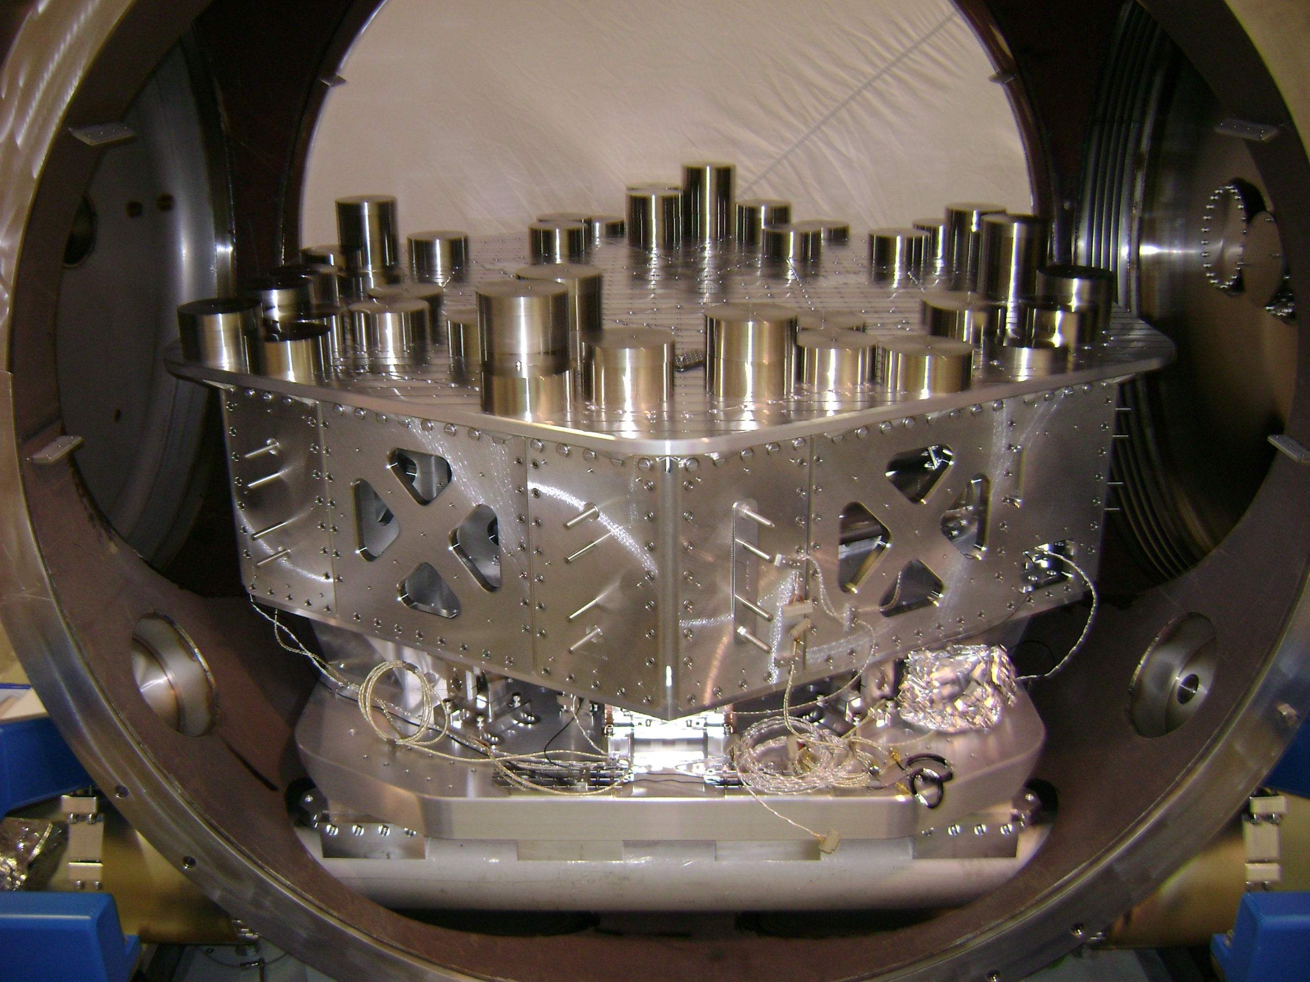
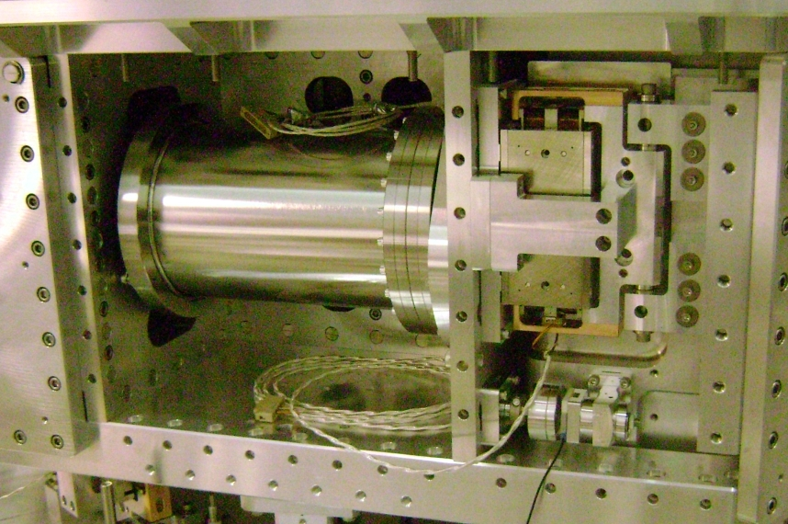
Active Isolation – The Basic Control Loop
Displacement Sensors
CPSINF
CPS2CART
CPSALIGN
Blend Filters
Isolation Filters
CART2ACT
OUTF
Super
Sensor
BLND
ISO
GS13INF
GS132CART
Damping Filters
Inertial Sensors
DAMP
Software
Hardware
Analog
Whitening
Actuators
Analog
De-Whitening
Ground Motion
On Board Sensors
HAM ISI “Plant”

Slide 25
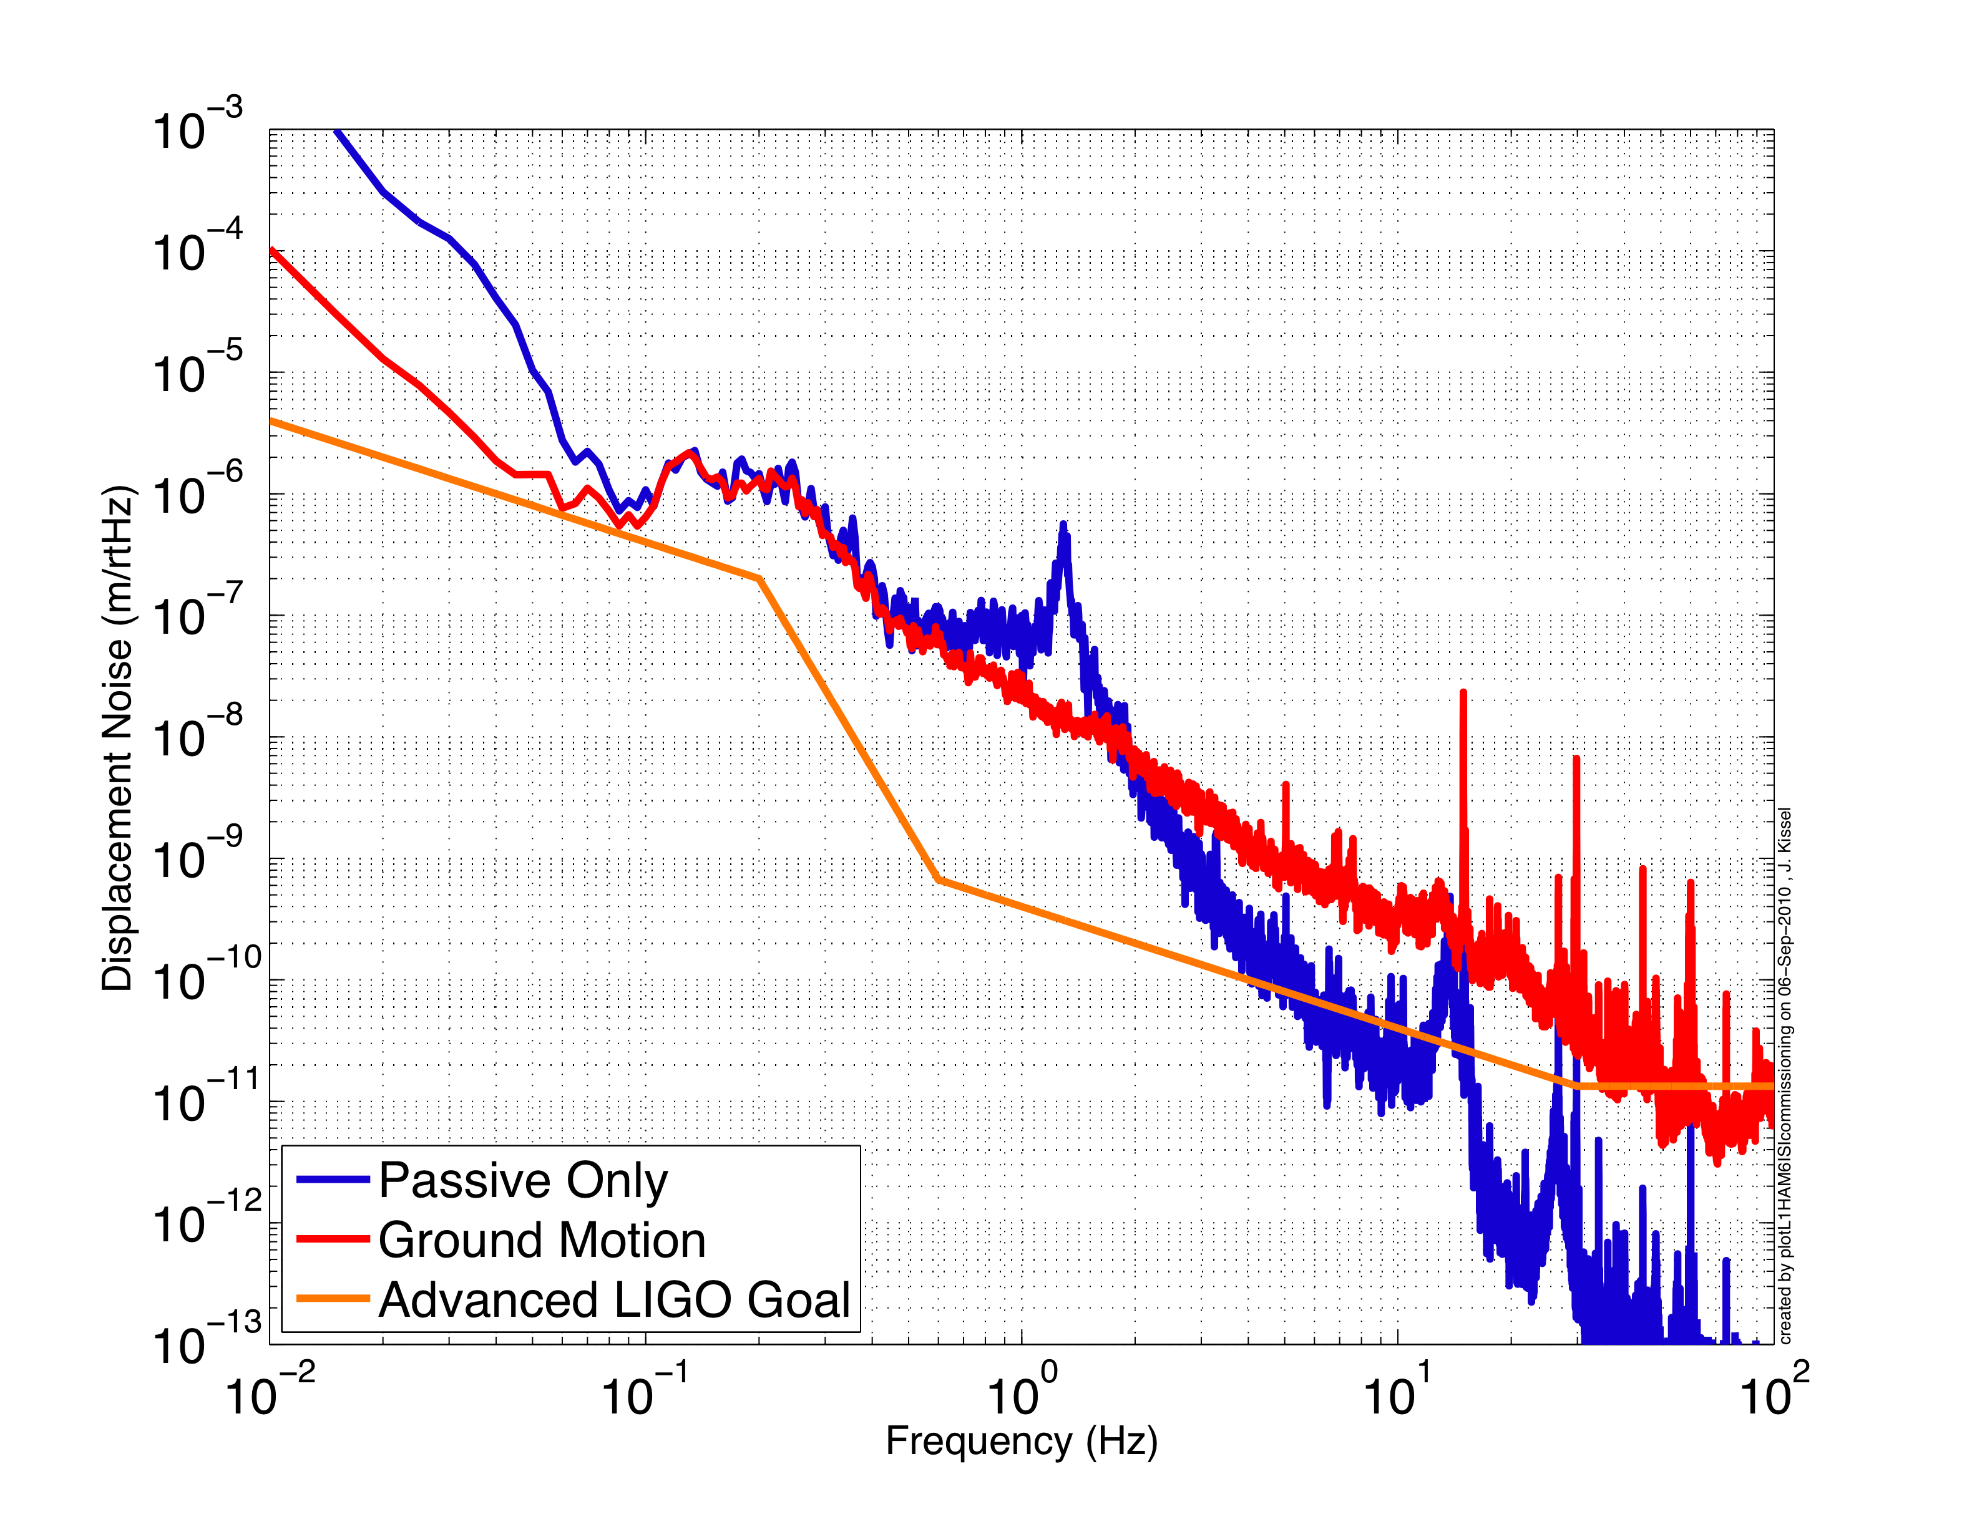
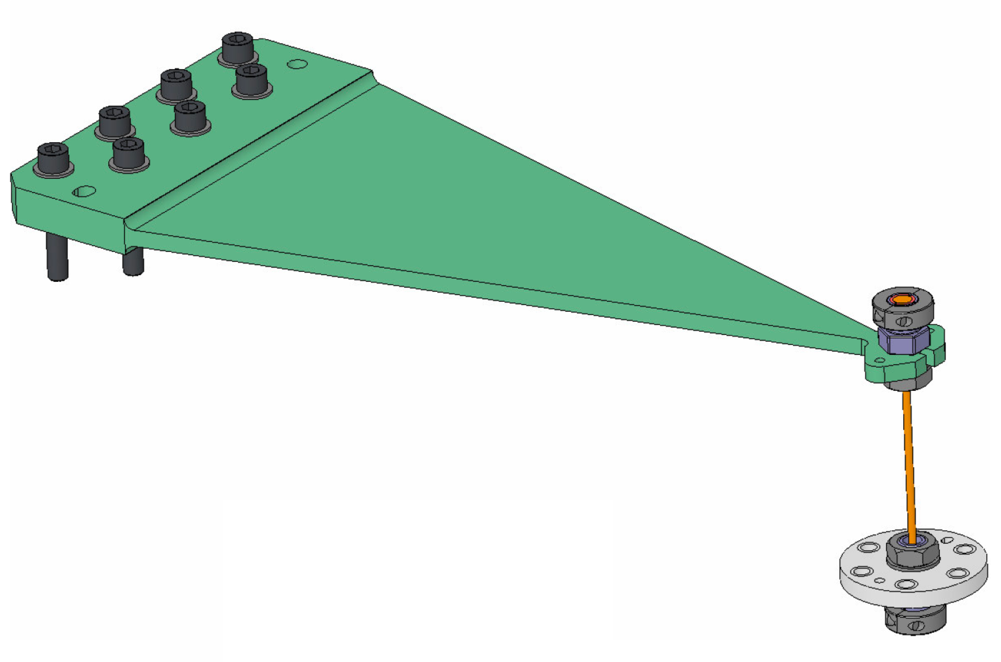
Active Isolation – Successive Loop Closure

Slide 26
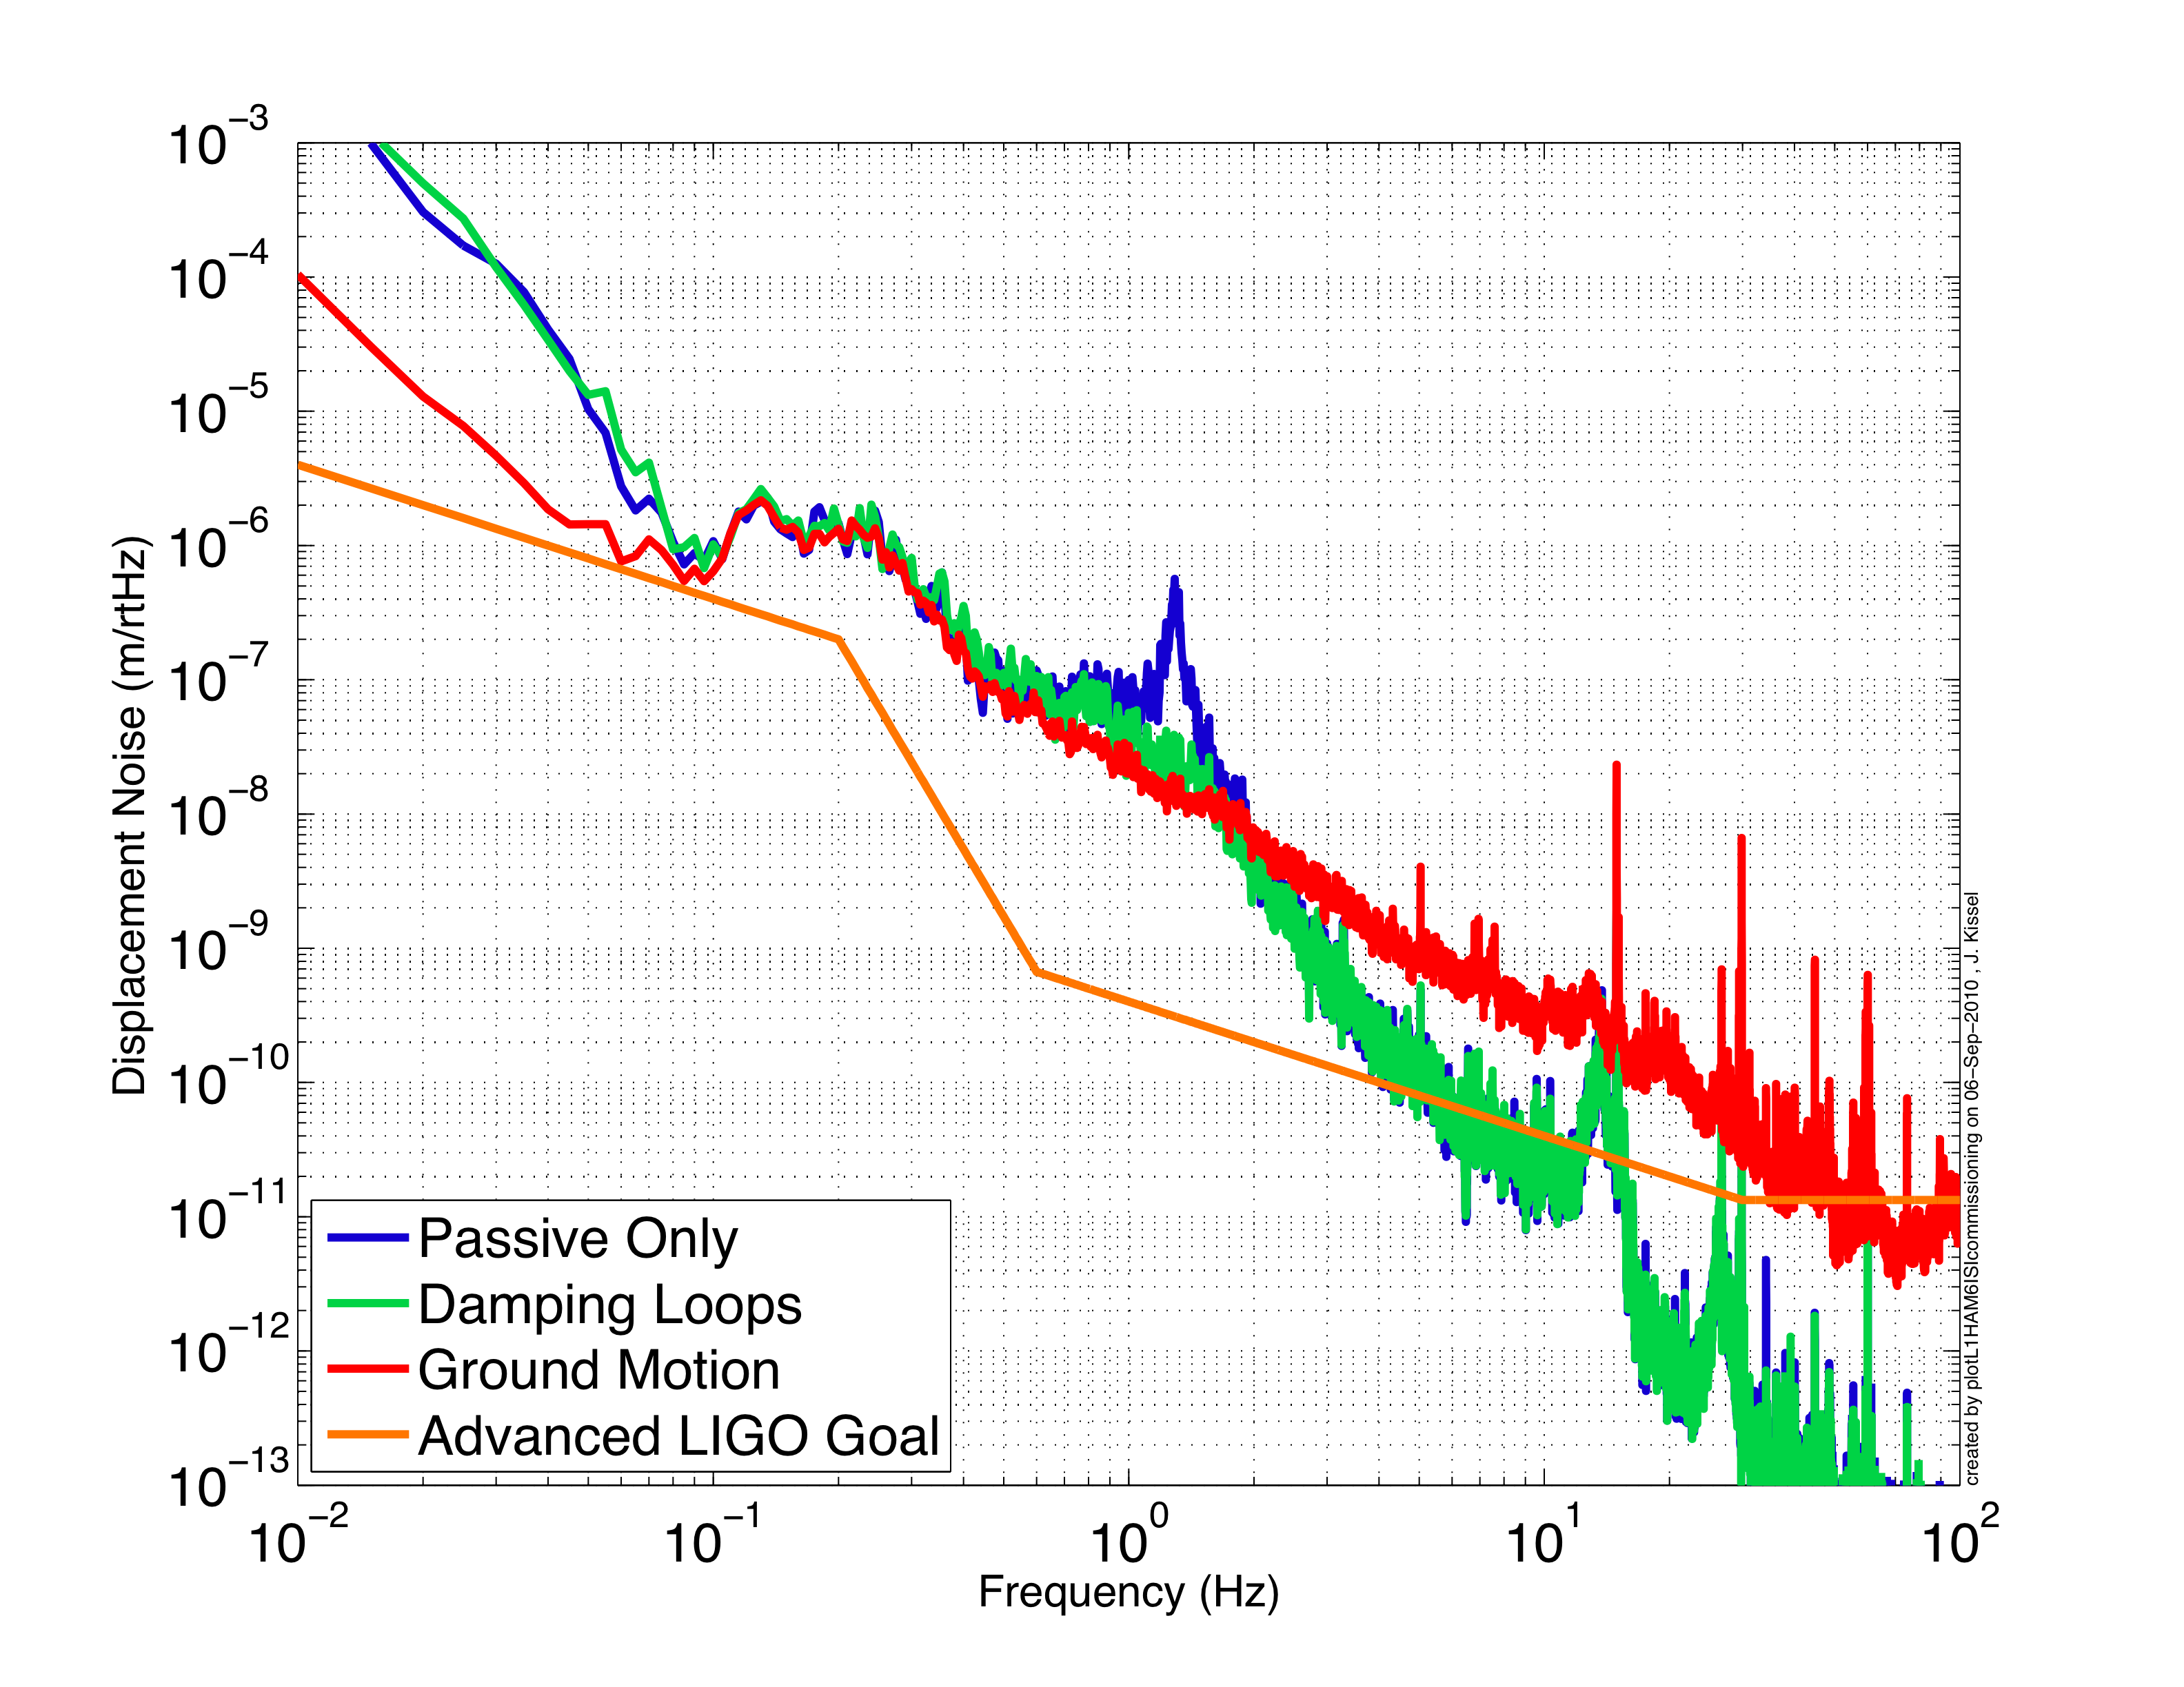
Active Isolation – Successive Loop Closure

Slide 27
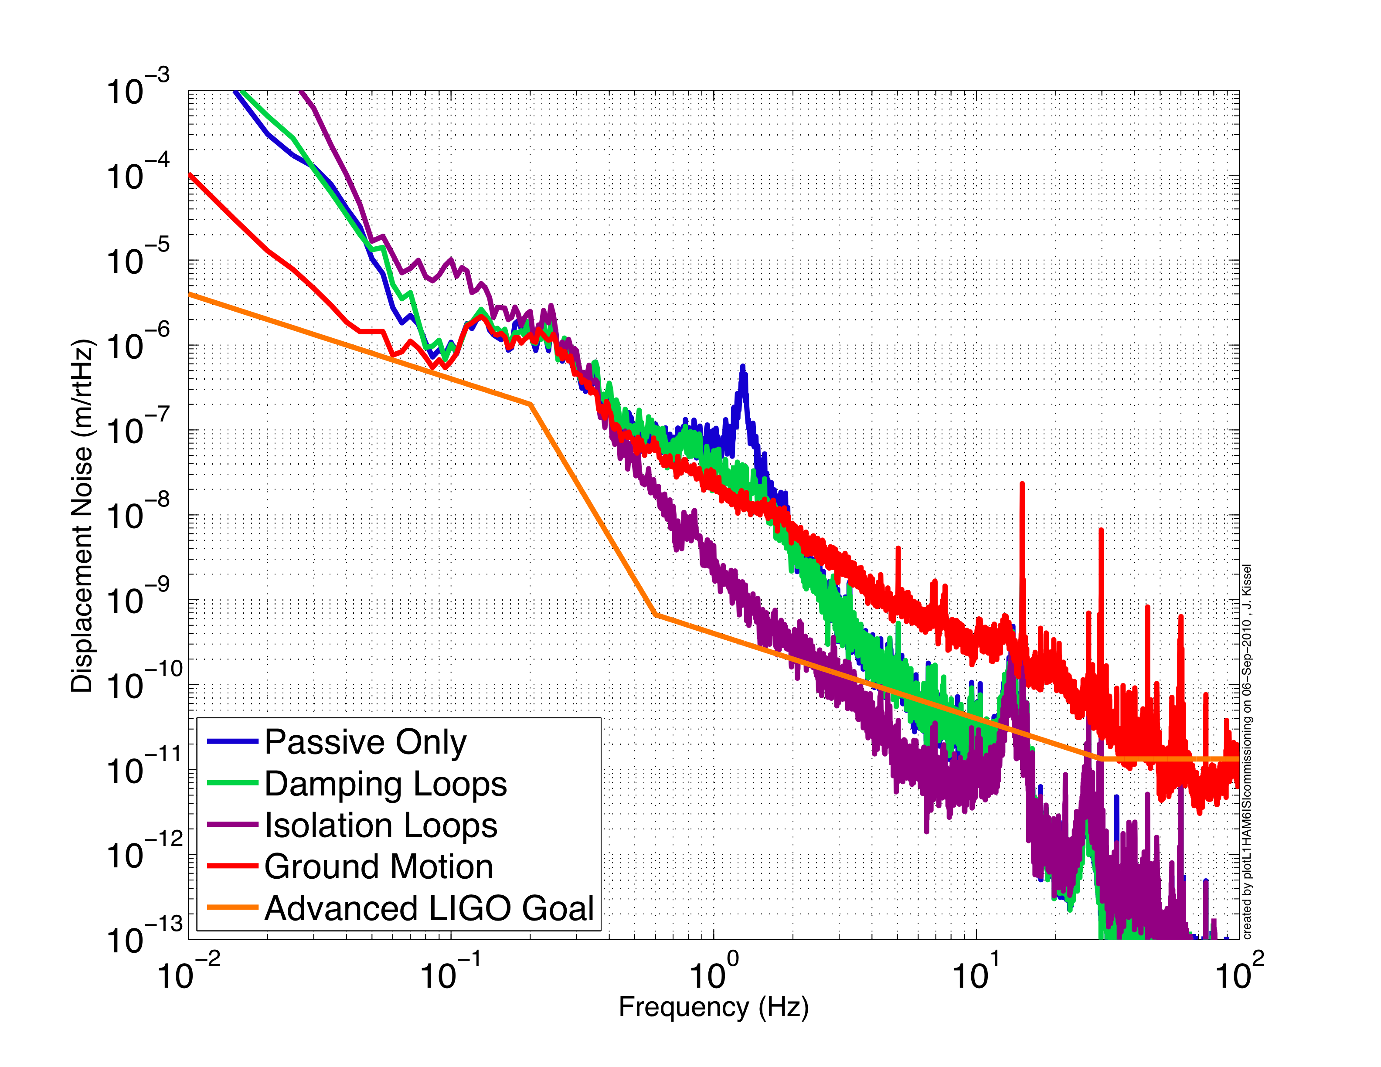
Active Isolation – Successive Loop Closure

Slide 28
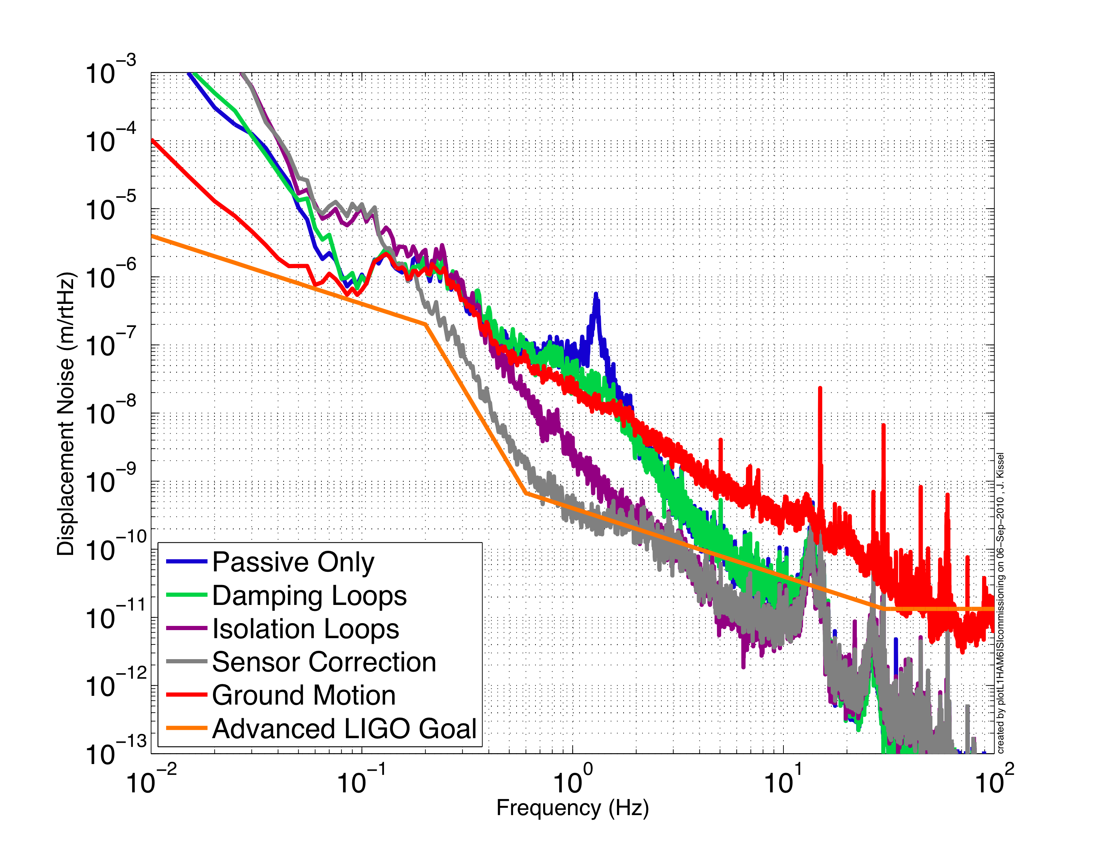
Active Isolation – Successive Loop Closure

Slide 29
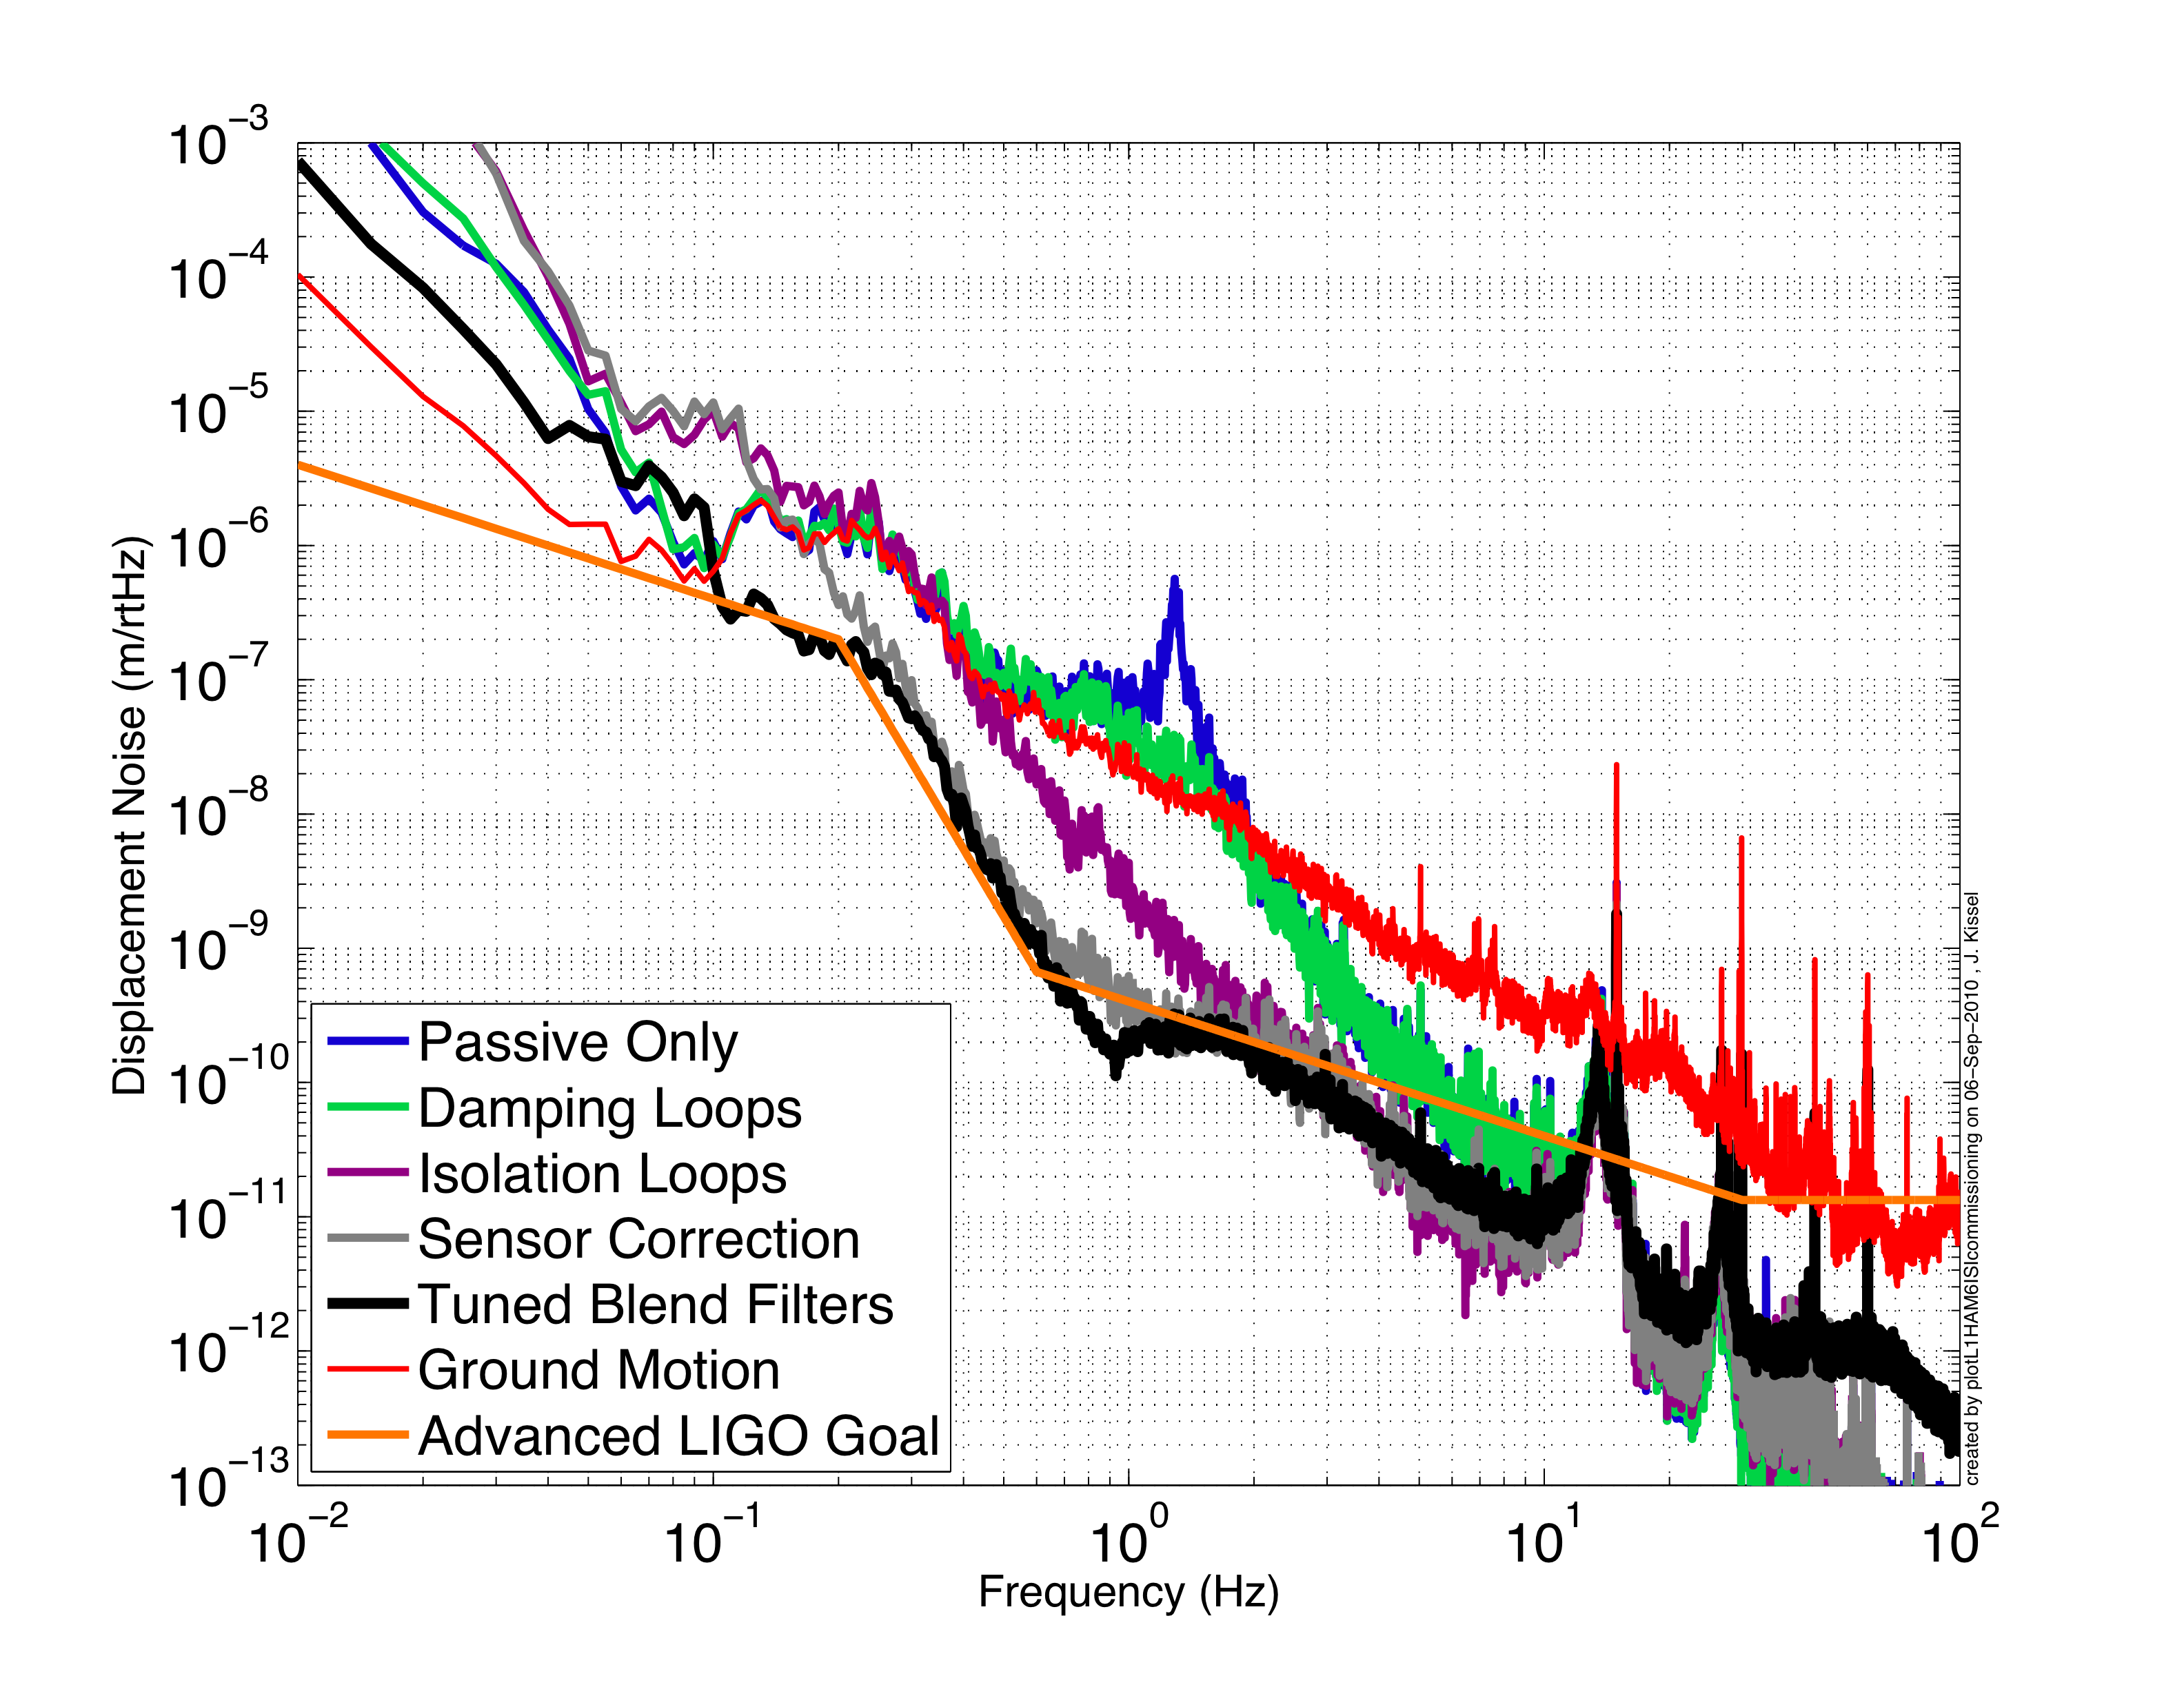
Active Isolation – Successive Loop Closure

Slide 30
Who to bug when you’re confused
Brian Lantz – Lead Scientist for all SEI (Stanford)
Fabrice Matichard – Lead Mechanical Engineer (MIT)
Ken Mason – Lead Mechanical Engineer (MIT)
Rich Mittleman – Scientist (MIT)
Jeff Kissel – Post-Doc (MIT)
Celine Ramet – Engineer (LLO)
Vincent Lhuillier – Engineer (LHO)
Ben Abbott – Engineer (CalTech)
BLantz@stanford.edu
fabrice@ligo.mit.edu
kmason@ligo.mit.edu
richard@ligo.mit.edu
jkissel@ligo.mit.edu
cramet@ligo-la.caltech.edu
lhuillier_v@ligo-wa.caltech.edu
babbott@ligo.caltech.edu

Slide 31
What you can do to help
Some Ideas…
Gather information on how the ground motion and platforms behave over month/year timescales
Generalize eLIGO HAM6ISI NoiseBudget for all aLIGO Seismic Platforms
Study platform glitchy-ness by implementing an OmegaGram on in-loop channels
Help us write some general-user software (especially if you like perl!)
Gather long term info on pod pressure
Just ask! Suggestions welcome!

Slide 32
What Channels Matter to You
Things you should ask yourself before you look:
Where is the sensor?
Is the “sensor” composed of many sensors?
Is it an in-loop sensor?
At what frequency can I trust this sensor?
Is it calibrated into physical units?
If yes – over what frequency range to I trust the calibration?
If no – what is the calibration?

Slide 33
What Channels Matter to You
Channels will have the following basic naming convention:
[IFO]:[Sub-system]-[Chamber/Optic]-[Isolation Stage]-[Filter Bank Function]-[Degree of Freedom]-[Standard Extension]
[IFO] = H1, H2, or L1
[Sub-system] = ISI for BSC-ISI and HAM-ISI, SEI for HEPI
[Chamber/Optic] = For HAM Chambers, always by chamber; for BSC Chambers always by Core Optic
[Isolation Stage] = ST0, ST1, ST2 for Stage 0, Stage 1, and Stage 2 (May not exist for HEPI and HAM-ISIs which only have one stage of isolation)
[Degree of Freedom] = Colocated basis: H1, H2, H3, H4, V1, V2, V3, V4
Cartesian basis: X, Y, RZ, RX, RY, Z
Euler Basis: L, T, V, R, P, Y
[Standard Extensions] = IN1_DAQ, IN2_DAQ, OUT_DAQ

Slide 34
Some Good Reading Material
Brian’s NSF Review <G0900312>
Brian’s “Simple Platform” Calculation <T080119>
Brian’s Sensor Noise Document <T0900450>
Brian’s Tilt Paper <P080073>
Jeff/Fabrice’s ISI Orientation Drawings <G1000125>
Jeff’s Electronics Cartoon <D1001575>
Ben’s Electronics Schematics
Fabrice’s BSC-ISI Prototype Paper <P1000029>
Fabrice’s BSC-ISI FDR Presentation <G0901006>
Lantz’s HAM ISI Training <G0900421>
Jeff’s Thesis (Chaps 4 and 5) <P1000103>
Shyang’s Thesis <P0900021>
Corwin’s Thesis <T020047>

