Slide 1
Actuator Sizing of a Quad Pendulum for Gravitational Wave Detectors
Brett Shapiro
Kamal Youcef-Toumi
Nergis Mavalvala
ACC 2011 – San Francisco
June 29
Massachusetts Institute of Technology
Notes:
My name is Brett Shapiro and I am going to speak to you about the sizing of actuators for a quadruple pendulum used in advanced gravitational waves

Slide 2


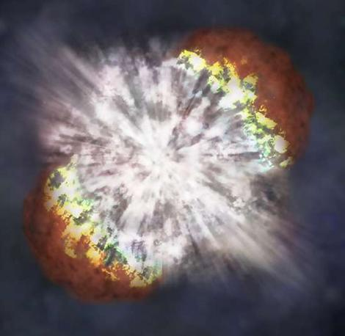
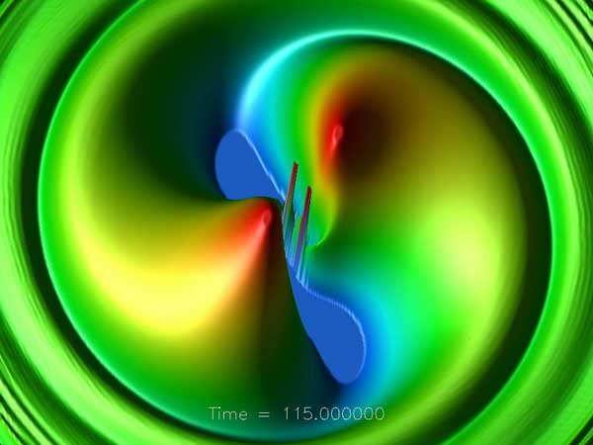
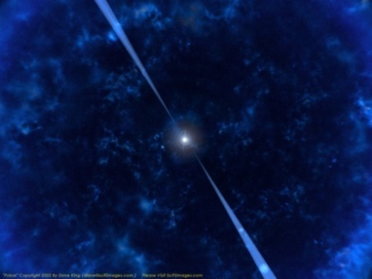
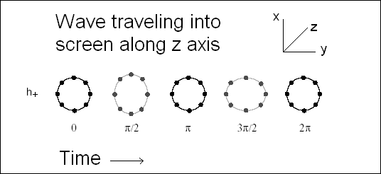
Gravitational Waves
Supernova
Merging Black Holes
Pulsar
Wave of strain amplitude h
Supernovae
  Asymmetry required
Coalescing Binaries
  Black Holes or Neutron Stars
  Mergers
Pulsars
    Asymmetry required
Stochastic Background
(Big bang, etc.)
Notes:
But first what are gravitational waves?
GWs are a phenomenon predicted by Einstein’s theory of General Relativity.
Produced from accelerating mass, analogous to accelerating charges producing EM.
Weakly interacting, so only very energetic massive events such as supernovae, merging black holes, or pulsars can be reasonably detected.
Considering a ring of particles, the GW stretches one axis, and compresses the other, oscillating at the waves frequency.
Amount of stretch is analogous to mechanical strain, grows proportionally to the size of the object.
No direct measurements to date.

Slide 3
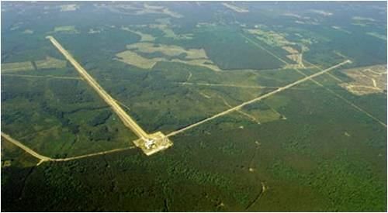


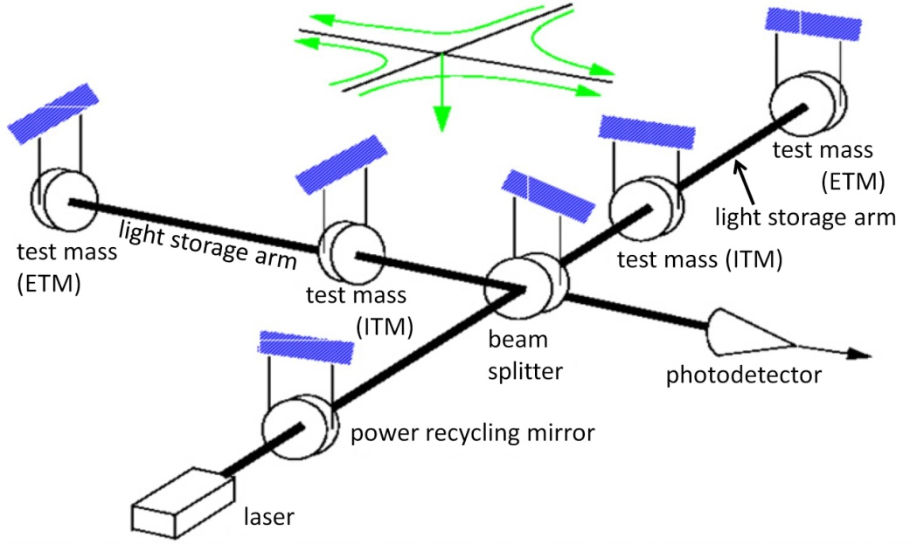
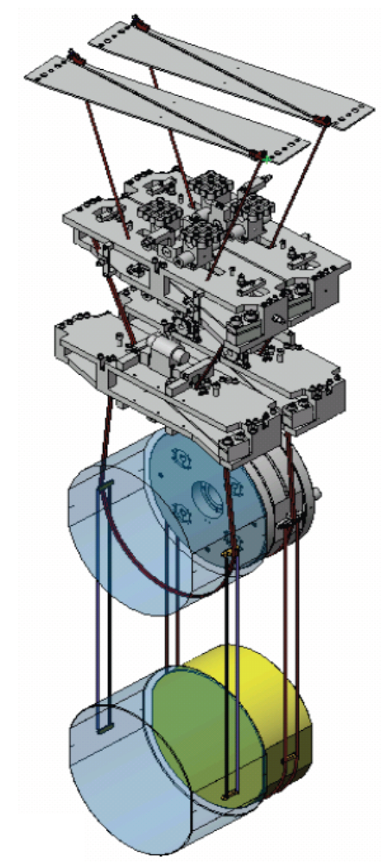
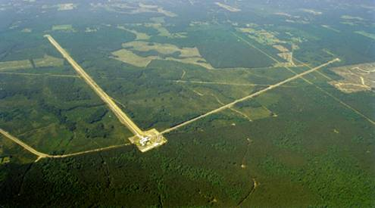
The Laser Interferometer
Gravitational-wave Observatory (LIGO)
Funded by
Quadruple Pendulum Locations
Hanford, WA
4 km and long interferometers at 2 sites in the US
Michelson interferometers with
Fabry-Pérot arms
Optical path enclosed in vacuum
Sensitive to displacements around 10⁻¹⁹m_{rms}
Livingston, LA
Notes:
LIGO stands for …
Is a national observatory attempting to be the first group to directly detect these waves
2 observatories …
built in the configuration of a Michelson interferometer with 2, 4 km perpendicular arms
The ends of each arm contain a mirror that represent one of the test particles in the conceptual ring
The interferometer measure the length difference between the 2 arms.
With 4 km arms LIGO has to be sensitive to 10^-19 m_rms, 10^-9 smaller than a proton
Mirrors suspended as pendulums to isloate them from ground vibration

Slide 4
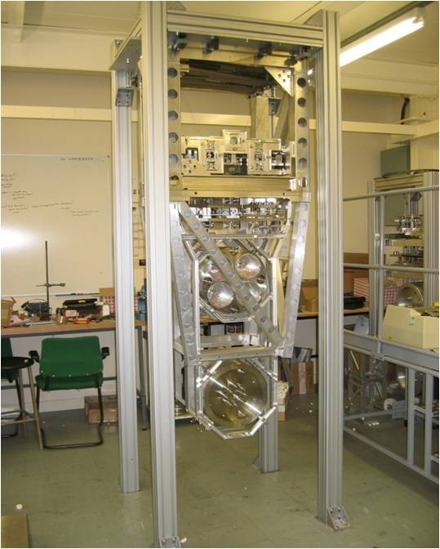
Quadruple Pendulum
Prototype quad pendulum
≈2 m
Test Mass
40 Kg
Copyright Science and Technology Facilities Council (UK)
Notes:
Quadruple pendulum used to isolate the mirrors at the 2 ends of each arm
Consists of a 2 m tall hanging chain of 4 masses/stages.
Bottom is the mirror the mirror, 40 kg
Picture on the left as an early all metal prototype, right is a solidworks model

Slide 5
Quadruple Pendulum (Quad) Isolation
x₄(s)/x_{g}(s)
x_{g}(t)
K1
K1
0.5M
steep roll off!
K2
K2
0.5M
K3
K3
M
K4
K4
M
x₄(t)
Notes:
* 4 stages because resonances occur only about 1 decade or less before the 10 Hz GW band and we need isolation of 7 orders of magnitude

Slide 6
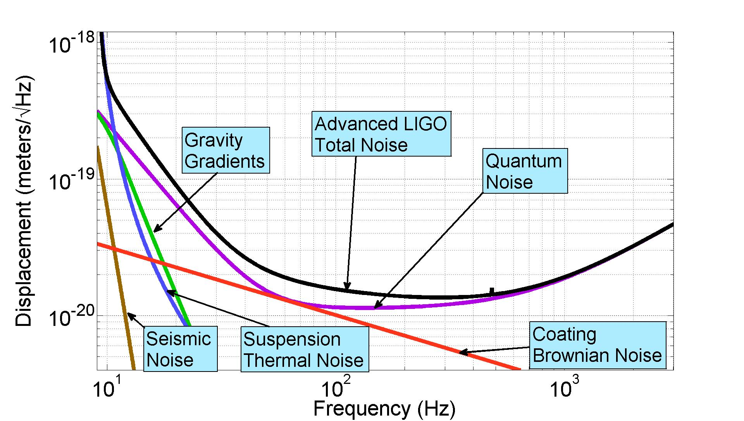
Advanced LIGO Sensitivity
Notes:
Quad pendulum is one part in achieving LIGO’s required sensitivity. It tackles low frequency seismic/ ground vibrations.
Various other high frequency

Slide 7
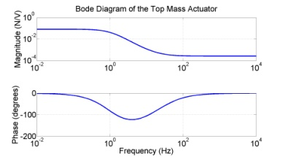
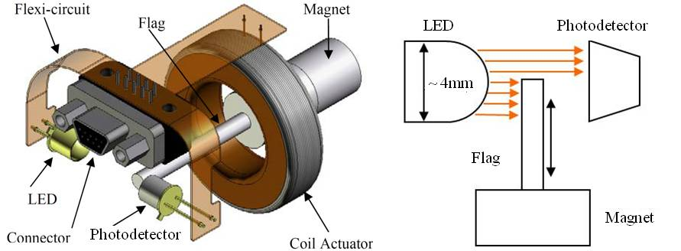
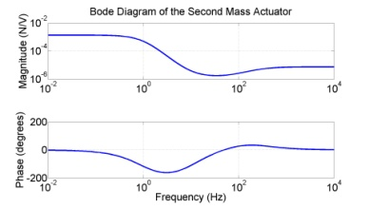
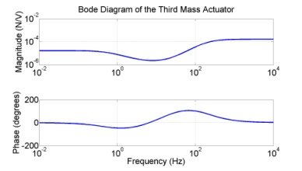
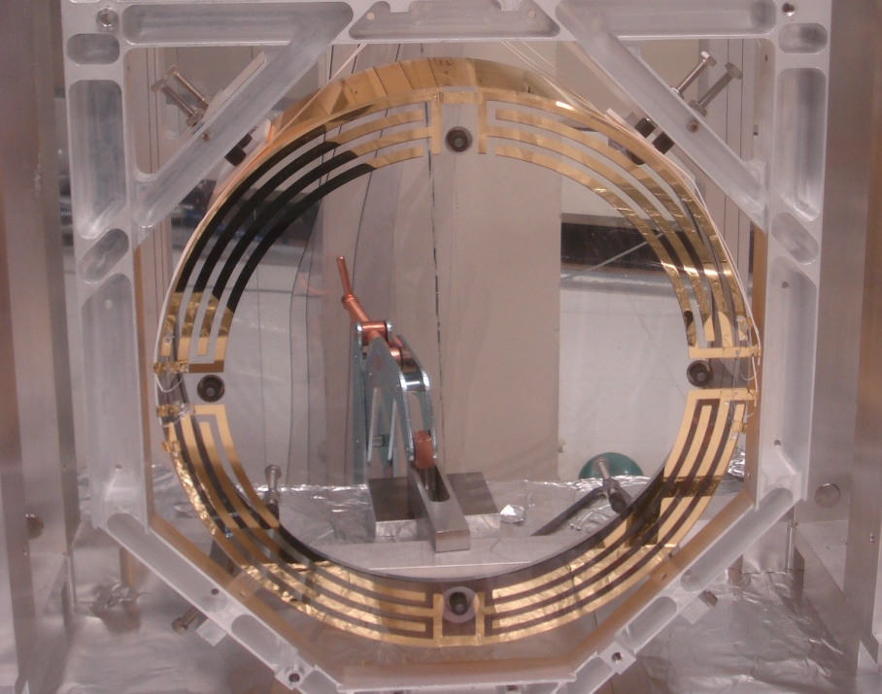
Quad Pendulum Actuators
Goal is to determine whether the actuators have enough drive to position the mirror.
Electromagnetic actuator
u₁
205 mN DC
u₂
3.4 mN DC
Electrostatic actuator
u₃
0.043 mN DC
u₄
0.095 mN
Notes:
Quad already has actuator designs proposed for use.
Top 3 stages use electromagnetic actuators, which have their own frequency responses.
Frequency responses are designed to maximize dynamic range while minimizing electronic noise.
Bottom actuator uses an electrostatic actuator
All actuators are used because the bigger/stronger/noisier one are placed higher up the chain furthest from the mirror.
Thus any control structure must be hierarchical where smaller high frequency forces are placed lower down.
Before we can say whether these designs are sufficient we must know something about the control requirements.

Slide 8
Outline
Gravitational Waves and LIGO
Quadruple Pendulum
Control of the Quad Pendulum
Actuator Sizing
Conclusion

Slide 9
Optical Arm Cavity Control
Pendulum 2
Pendulum 1
High resolution means a limited operating point.
u₁
Goal:
Actuator size considerations
Large enough to position mirrors
Small enough to limit noise, cost, and complexity
u₂
u₃
Incident beam
100 W
(4+ ) km
u₄
Laser
Reflected beam
Cavity Resonant beam
800 kW
1064 nm
near infrared
Photodiode
Error Signal
Control Law
Actuation
Notes:
To simplify the interferometer control this figure represents just one of the two arms.
Hi resolution sensors tend to have small operating ranges, and LIGO is no exception.
To get the required sensitivity the mirrors must be controlled within a relative displacement of 10^-15 m_rms
The actuators must be large enough to position the mirrors within this tolerance, but small enough to not contribute unnecessarily to noise, cost, or complexity.
The cavity error signal is only approximately linear when the light has maximum constructive interference in this optical cavity. This only occurs at displacements within 0.1% if the wavelenth. For the strict displacement sensitivity required by LIGO, the signal is ‘linear enough’ only within 10^(-9) of a wavelength. LIGO user 1.064 micron laser light.

Slide 10

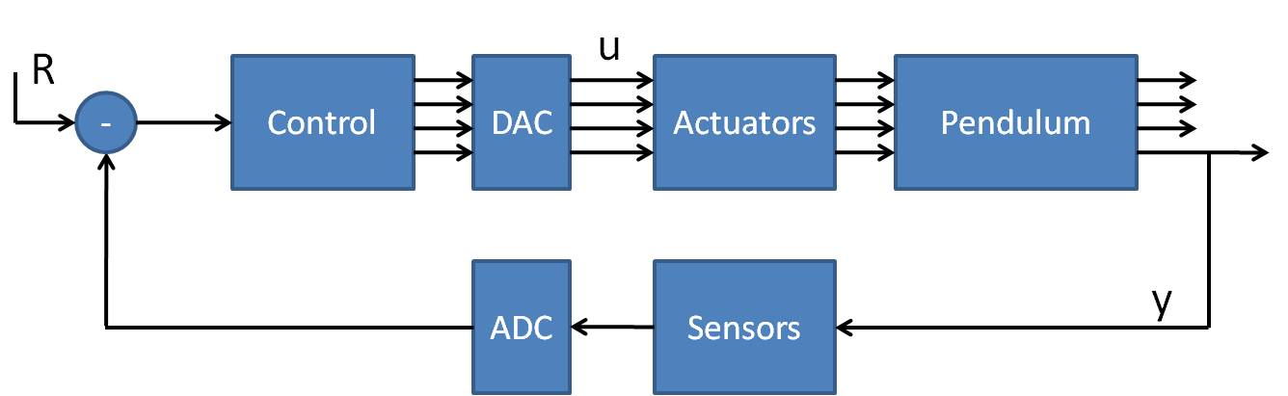
Optical Arm Cavity Control
Pendulum 2
Pendulum 1
DAC saturates at ± 10V
What is the minimum size for each actuator,
without considering an infinite set of possible feedback designs?
u₁
u₂
Standard tracking diagram
u₃
R
u₄
± 10V
Notes:
Since only one mirror is being actuated (end mirror), we can simplify the control further by thinking of the control problem as a tracking one where the active mirror simply follows the passive one.
In a simplified block diagram this assumes all the relative displacement originates from the passive pendulum, while the actuated one is otherwise still.
Now that we understand the control, we want to establish what the minimum size required for each actuator

Slide 11
Disturbance Spectrum
LIGO sensitivity spectrum
Goal:
Notes:
For that we need to know what the tracking signal is.
This is what it is predicted to look like.
It comes directly from the LIGO sensitivity spectrum shown earlier, but extended down to lower frequencies.
To get the RMS to the required limit we need to more or less know everything below this line.

Slide 12
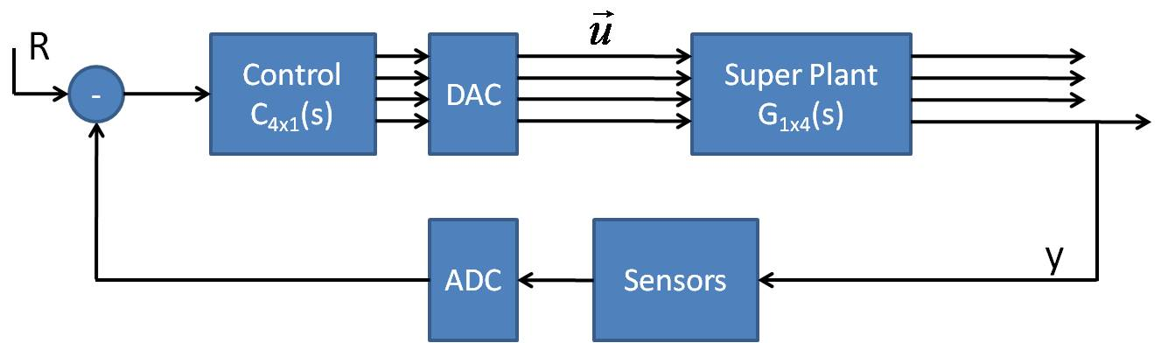
Arm Control Block Diagram
± 10V
†
†
† -> Moore-Penrose pseudoinverse
Notes:
Our goal is to make the output y = R.
Since we have more actuators than tracking signals there is no unique control solution.
However, we can ‘solve’ directly using the pseudoinverse, which has a nice property that the resulting solution is the least squares solution.
However, this is only a feedforward result, not feedback.
But we can show that we can still show that this result can be approximated with feedback.
The feedback output TF is …
The feedback control effort TF is …

Slide 13
Minimum SISO Actuation
Actuator | RMS (V) | Saturation Probability (p)
1st | 3.05 X 10⁹ | 1
Actuator | RMS (V) | Saturation Probability (p)
1st | 3.05 X 10⁹ | 1
2nd | 1.27 X 10¹² | 1
Actuator | RMS (V) | Saturation Probability (p)
1st | 3.05 X 10⁹ | 1
2nd | 1.27 X 10¹² | 1
3rd | 6.29 X 10⁶ | 1
Actuator | RMS (V) | Saturation Probability (p)
1st | 3.05 X 10⁹ | 1
2nd | 1.27 X 10¹² | 1
3rd | 6.29 X 10⁶ | 1
4th | 3.82 | 0.0087766

Slide 14
Minimum Least Squares Actuation
†
†
The relative magnitudes between curves quantifies the relative ‘effectiveness’ of an actuator.
Pseudoinverse guides feedback design.
Actuator | RMS (V, 10 V max) | Saturation Probability (p)
1st | 3.29 X 10⁻³ | 0
2nd | 1.00 X 10⁻⁴ | 0
3rd | 2.09 X 10⁻⁶ | 0
4th | 0.569 | 3.3 X 10⁻⁶⁹
Notes:
* Running these numbers shows that the least squares result on its own meets the requirements well within the limits.

Slide 15
Conclusions
The pseudoinverse of the combined plant TF shows the actuators have enough range with reasonable margin.
Also shows which actuator is most effective at each frequency.
No feedback design is required.
The pseudoinverse can guide feedback design.

Slide 16



























































LIGO Scientific Collaboration
University of Michigan
University of Minnesota
The University of Mississippi
Massachusetts Inst. of Technology
Monash University
Montana State University
Moscow State University
National Astronomical Observatory
of Japan
Northwestern University
University of Oregon
Pennsylvania State University
Rochester Inst. of Technology
Rutherford Appleton Lab
University of Rochester
San Jose State University
Univ. of Sannio at Benevento,
and Univ. of Salerno
University of Sheffield
University of Southampton
Southeastern Louisiana Univ.
Southern Univ. and A&M College
Stanford University
University of Strathclyde
Syracuse University
Univ. of Texas at Austin
Univ. of Texas at Brownsville
Trinity University
Tsinghua University
Universitat de les Illes Balears
Univ. of Massachusetts Amherst
University of Western Australia
Univ. of Wisconsin-Milwaukee
Washington State University
University of Washington
Australian Consortium
for Interferometric
Gravitational Astronomy
The Univ. of Adelaide
Andrews University
The Australian National Univ.
The University of Birmingham
California Inst. of Technology
Cardiff University
Carleton College
Charles Sturt Univ.
Columbia University
CSU Fullerton
Embry Riddle Aeronautical Univ.
Eötvös Loránd University
University of Florida
German/British Collaboration for
the Detection of Gravitational Waves
University of Glasgow
Goddard Space Flight Center
Leibniz Universität Hannover
Hobart & William Smith Colleges
Inst. of Applied Physics of the Russian Academy of Sciences
Polish Academy of Sciences
India Inter-University Centre
for Astronomy and Astrophysics
Louisiana State University
Louisiana Tech University
Loyola University New Orleans
University of Maryland
Max Planck Institute for Gravitational Physics

Slide 17
Back Ups

Slide 18
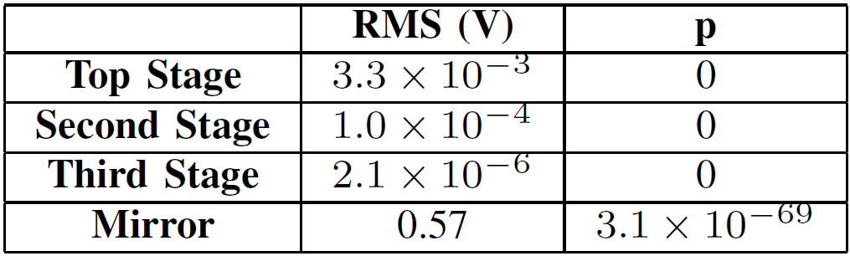
Example Feedback Loop Gains
Crossover Frequencies
1st: 5 Hz
2nd: NA
3rd: 50 Hz
4th: 500 Hz
Actuator | Feedforward RMS (V) | Feedback RMS (V) | Saturation Probability (p)
1st | 3.29 X 10⁻³ | 3.7 X 10^-3 | 0
2nd | 1.00 X 10⁻⁴ | 0 | 0
3rd | 2.09 X 10⁻⁶ | 2 X 10^-2 | 0
4th | 0.569 | 8 X 10^-5 | 0

Slide 19
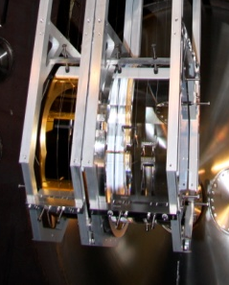
Location of Quadruple Pendulums

Slide 20
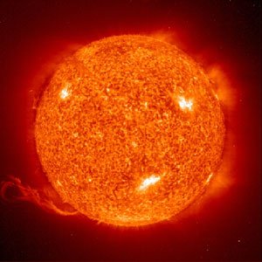
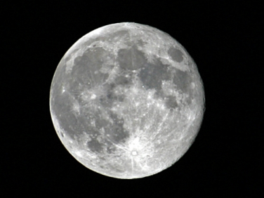
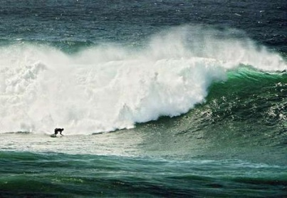

Seismic Noise
Tides - ≈ 10⁻⁵ Hz
Microseismic peak - ≈ 0.1 to 0.3 Hz
Anthropogenic Noise - ≈ 1 to 10 Hz
BU

Slide 21
Thermal Noise
System in thermal equilibrium
x(t)
b
k
m
b = dissipation factor (damping)
T = Temperature (Kelvin)
k_{b} = Boltzmann’s Constant
Mean energy:
(equipartition function)
BU

Slide 22
Quantized Optical Noise
Discrete Photons in laser beam
Laser light consists of a finite (and uncertain) numbers of photons.
The momentum transfer onto the test mass from a random distribution of photons produces radiation pressure noise.
The random distribution of photons arriving at the photodetector produces shot noise.
Laser
Test Mass
Photodetector
BU

Slide 23
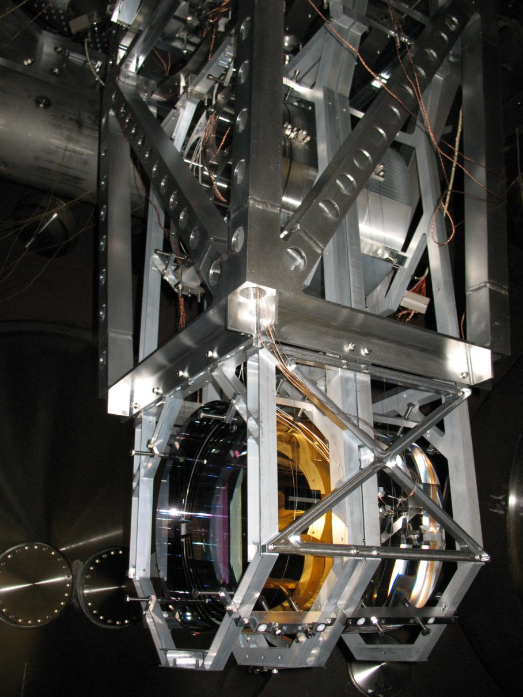
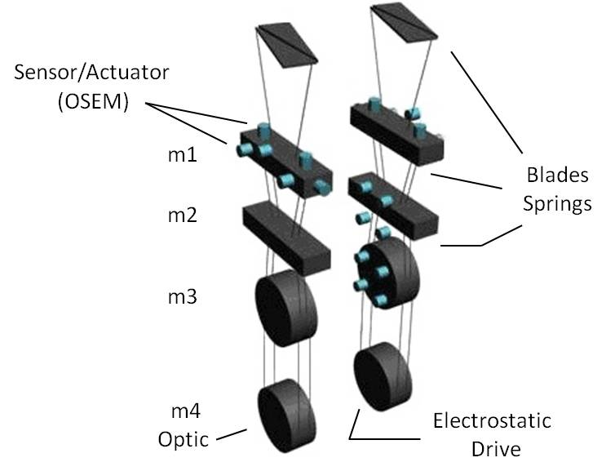
Actuators

Slide 24
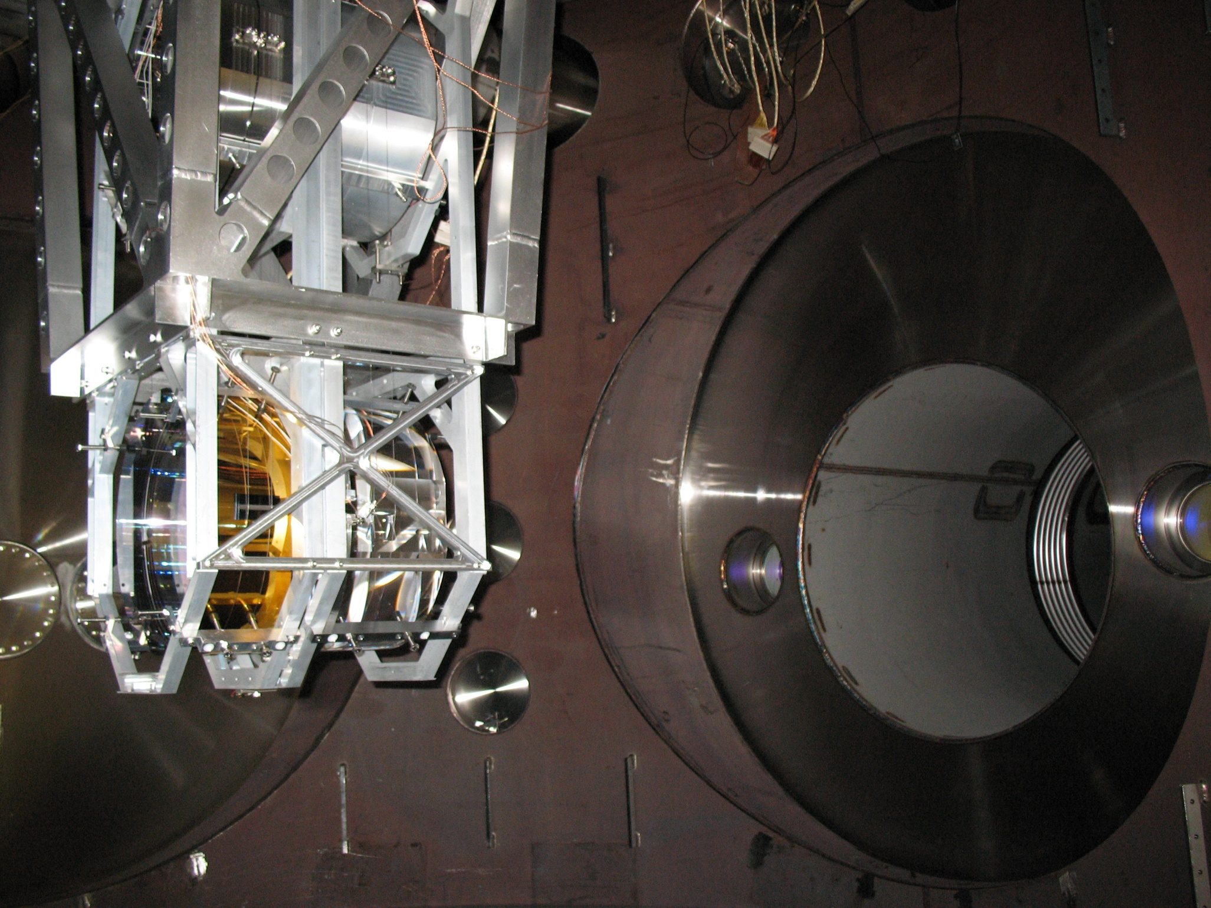

Slide 25
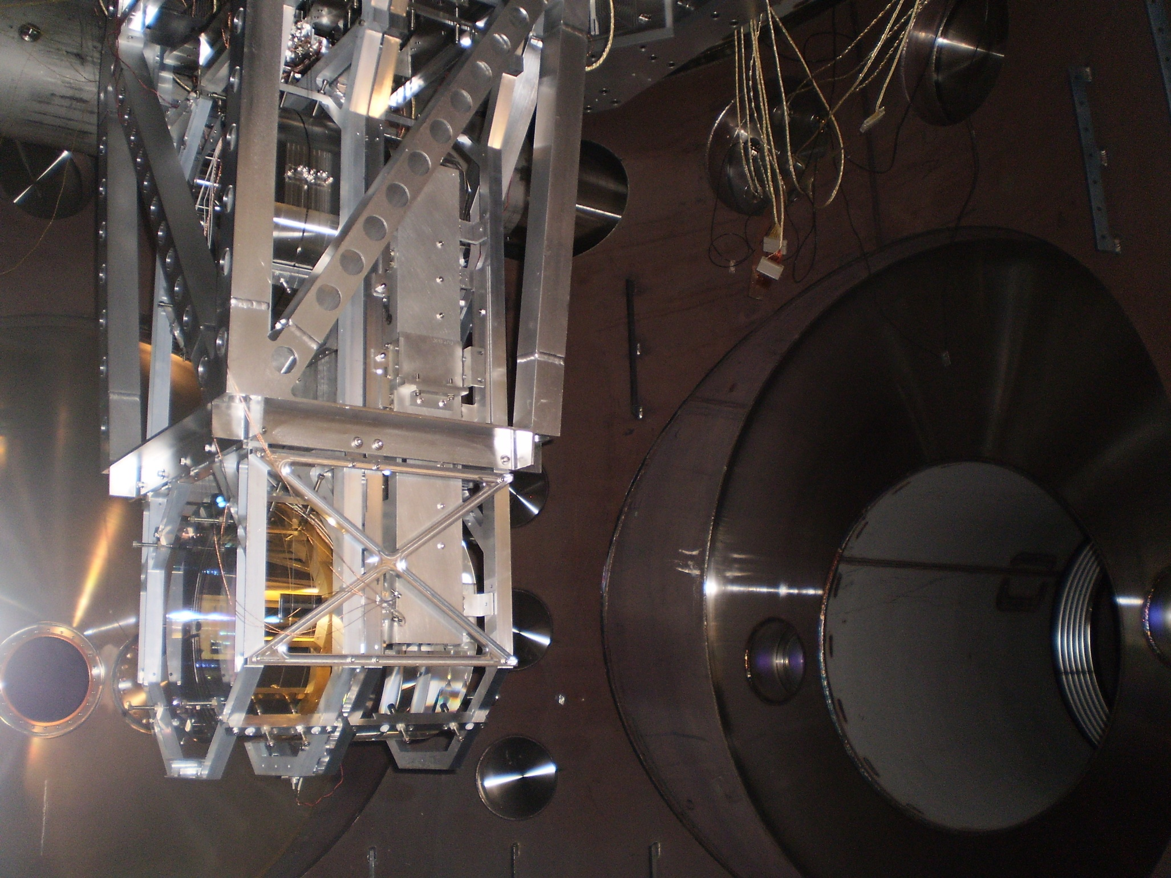

Slide 26

Advanced LIGO Schedule
2010
2011
2012
2013
2014
2015
Installation
Pre-assembly happening now
Testing
Likely first science run
Other observatories around the world collecting data during this time.

Slide 27
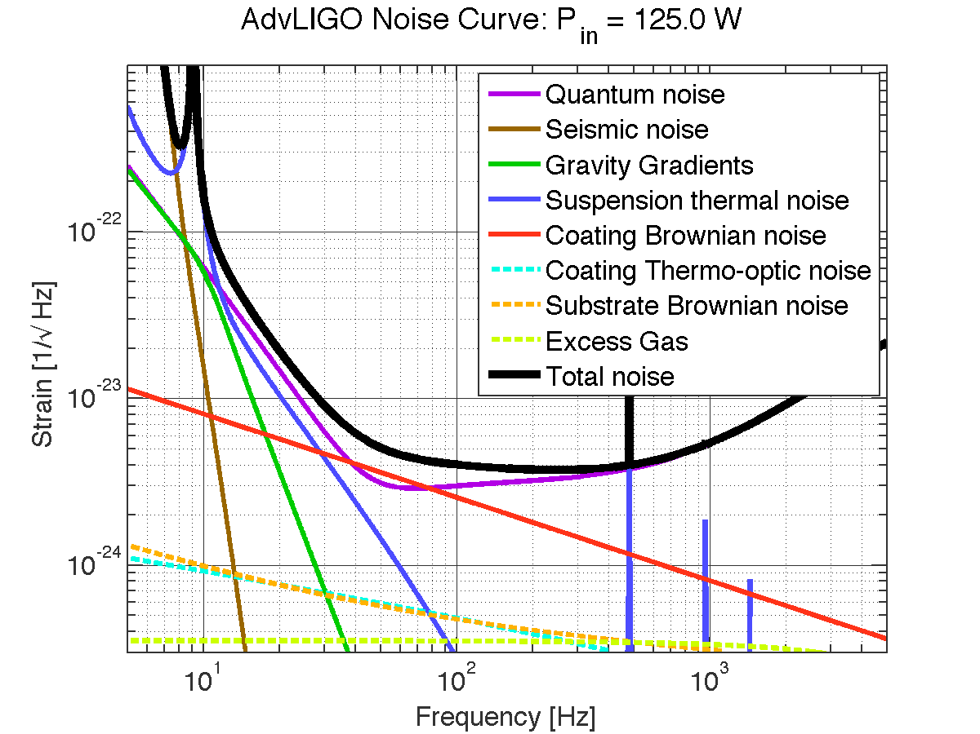
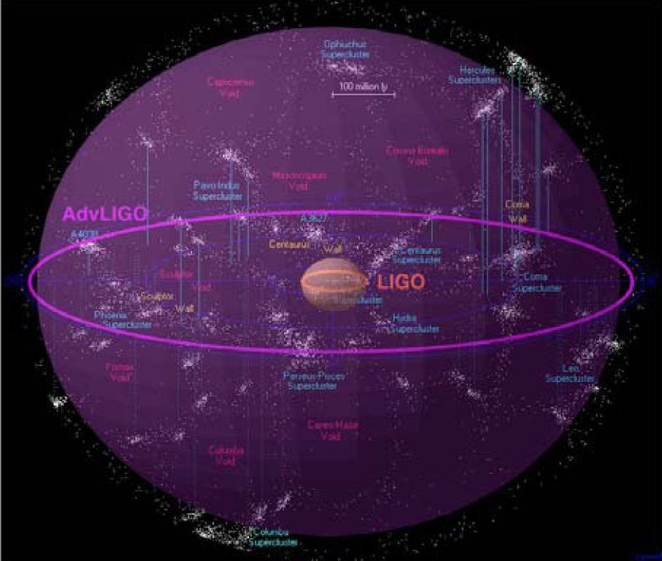
Advanced LIGO
Quantum noise limited in much of band
Thermal noise in most sensitive region
About factor of 10 better sensitivity
Expected sensitivity
  Neutron star inspirals to about
    200 Mpc, ~40/yr
  10 M_{O} black hole inspirals to
  775 Mpc, ~30/y
LIGO infrastructure designed for a progression of instruments
  Nominal 30 year lifetime
All subsystems to be replaced and upgraded
  More powerful laser – from 10W to 180 W
  Larger test masses – from 10 kg to 40 kg
  More aggressive seismic isolation
  Lower thermal noise coatings
Advanced LIGO Astronomical Reach

Slide 28
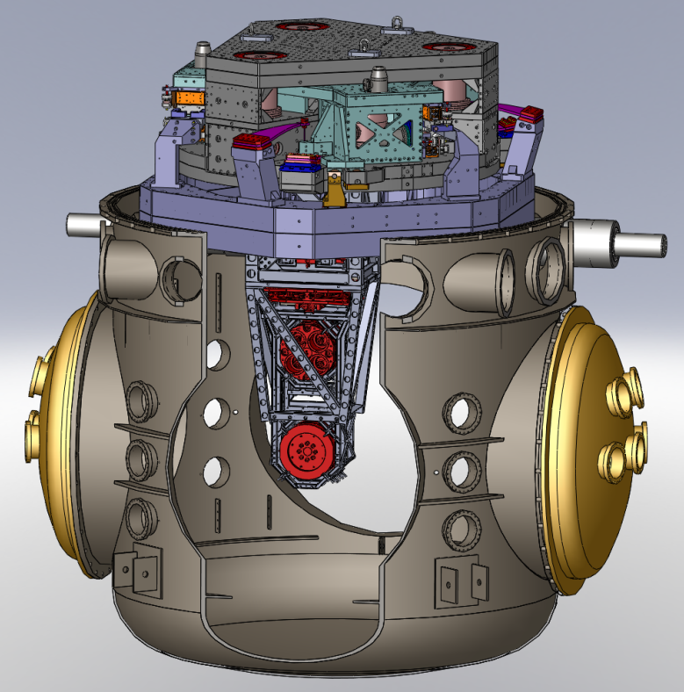
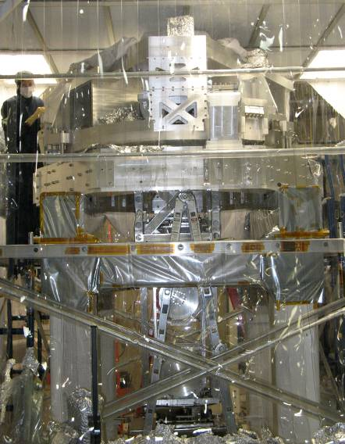
Seismic Isolation
Overall Isolation 9 to 10 orders of magnitude at 10 Hz.
ISI and Quad in LIGO Vacuum Chamber
Prototype ISI and Quad at MIT
7 cascaded stages of seismic isolation
  External Hydraulic Pre-Isolator (HEPI). Active isolation up to 10 Hz.
  2 stage Internal Seismic Isolation (ISI). Active isolation up to 30 Hz, passive above.
  4 stage Quadruple Pendulum (Quad). Mirror is the final stage. Passive isolation above 1 Hz.

Slide 29
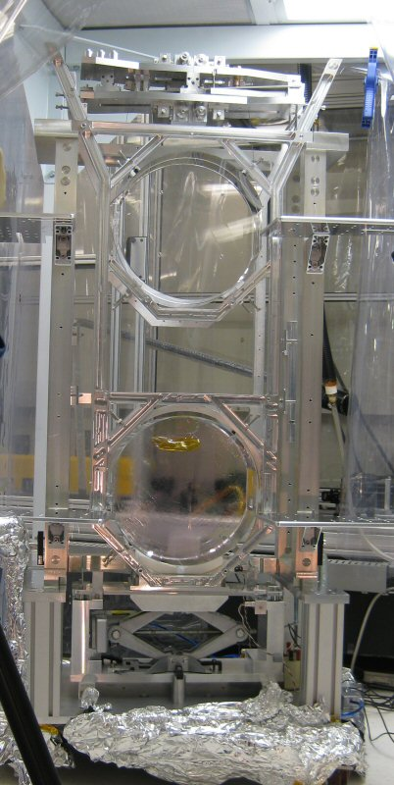
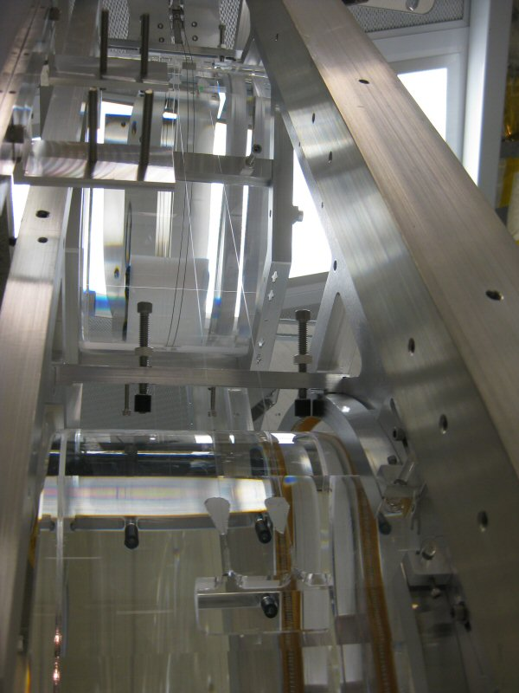
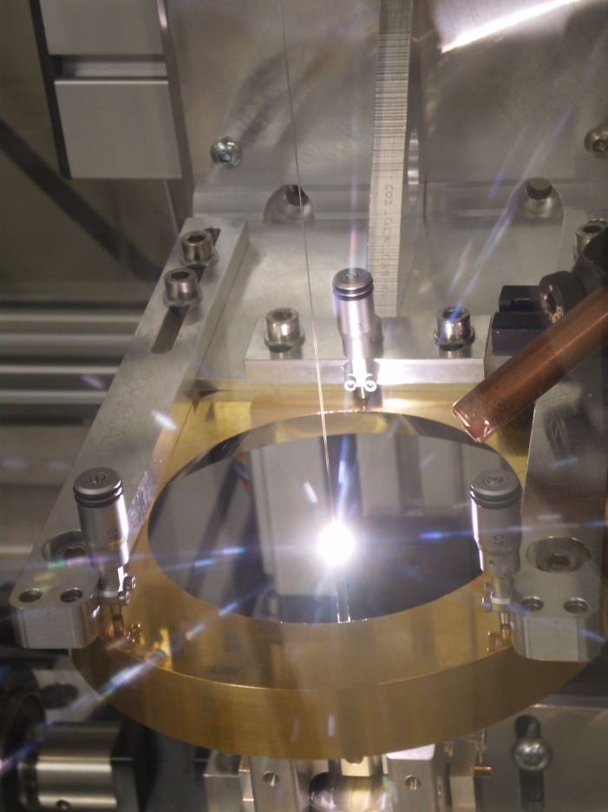
Mirrors Suspend from Glass Fibers
Developed by the University of Glasgow
Suspension thermal noise suppressed by suspending low loss fused silica test masses from fused silica fibers.
0.6m long, 400 µm diameter silica fibers pulled from 3 mm diameter stock and laser welded between the two silica lower stages of the quadruple pendulum.

Slide 30
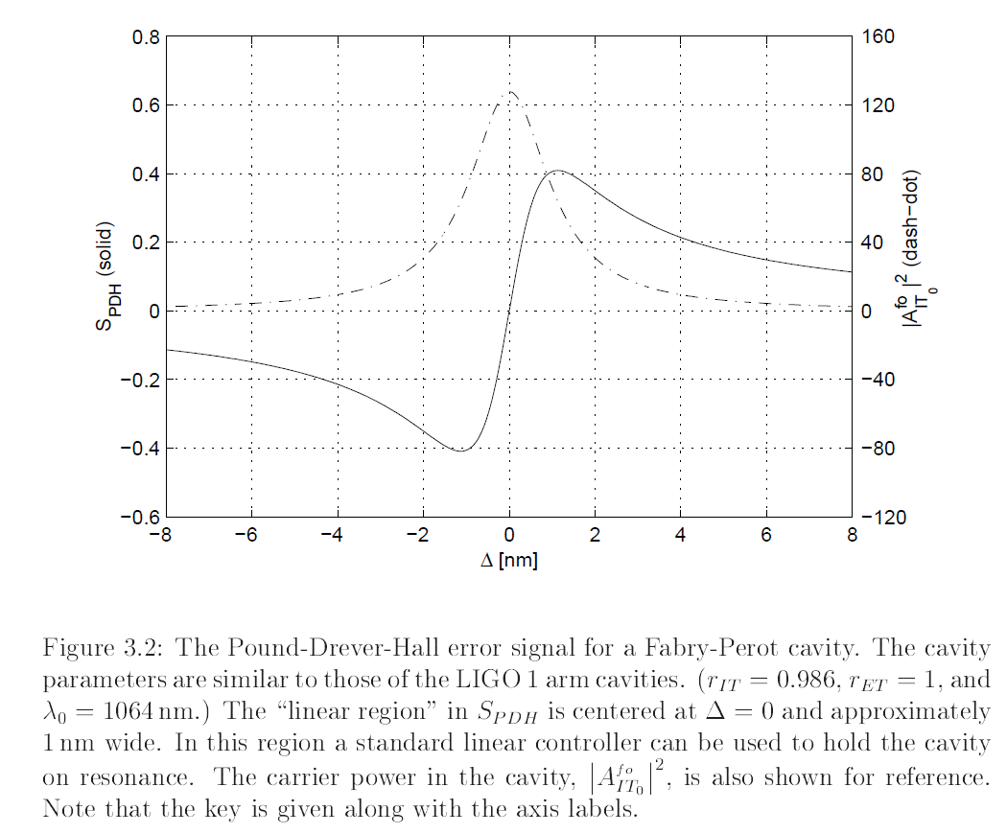
Cavity Error Signal
Light Intensity
Error signal
Matt Evans. Lock Acquisition in Resonant Optical Interferometers. PhD Thesis. 2002

Slide 31
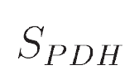
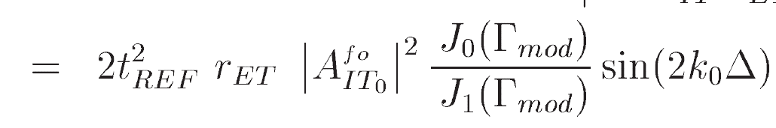
Cavity Error Signal
error signal light power mirror displacement
Matt Evans. Lock Acquisition in Resonant Optical Interferometers. PhD Thesis. 2002

Slide 32
R
Control
DAC
Actuators
Pendulum
-
ADC
Sensors
y
R
Control
C_{4x1}(s)
DAC
Super Plant
G_{1x4}(s)
-
ADC
Sensors
y

Slide 33
Notes
GW calibration
Find more up to date solid works model
References

Slide 34
Notes
Move actuators sooner
Concise way to explain 10^-15
Move quad before sensitivity
Maybe 1 BD
Write out notes for each slide

Slide 35
Use lighter background
Put on flashdisk
Clarify LIGO figure
Expand mirror to quad for transition

