Slide 1
D1101363 Accelerometer Interface
LIGO-D070013 2U Chassis
On/Off Switch, LED, and Power Connector
Isotron 4416B
Isotron 4416B
Isotron 4416B
Isotron 4416B
12VDC Power Regulator
Isotron 4416B
Isotron 4416B
Isotron 4416B
Isotron 4416B
Isotron 4416B
Isotron 4416B
Isotron 4416B
Isotron 4416B
Isotron 4416B
Isotron 4416B
Isotron 4416B
Isotron 4416B
16-Channels Input/Output BNC Connectors

Slide 2
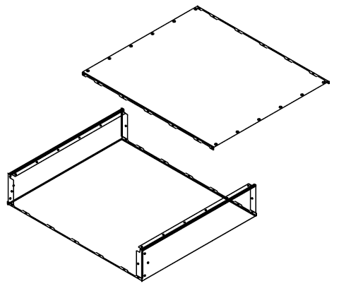
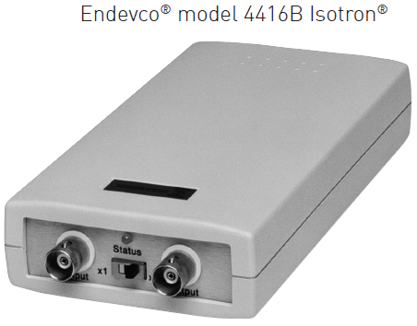
D1101363 Accelerometer Interface
D070013 2U Chassis

Slide 3
D1101363 Accelerometer Interface

