Slide 1
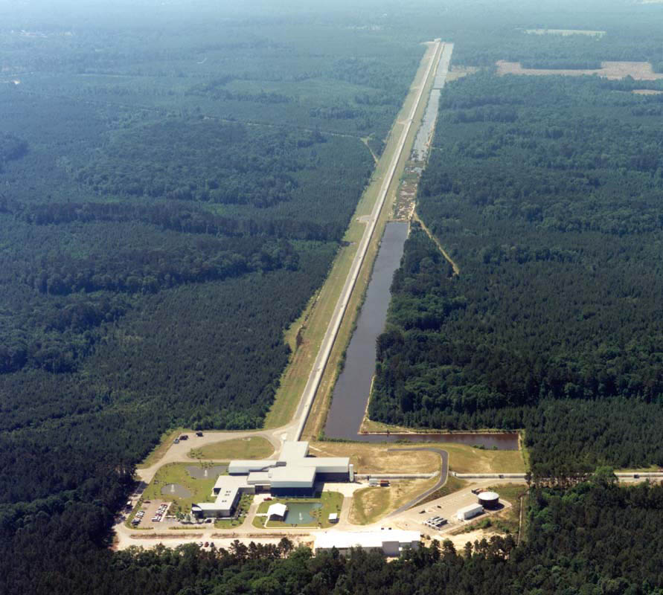
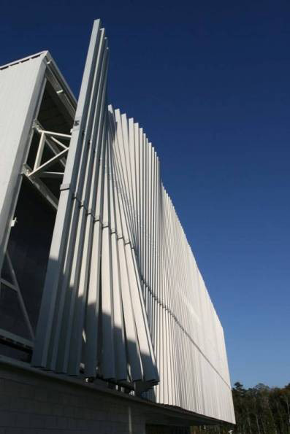
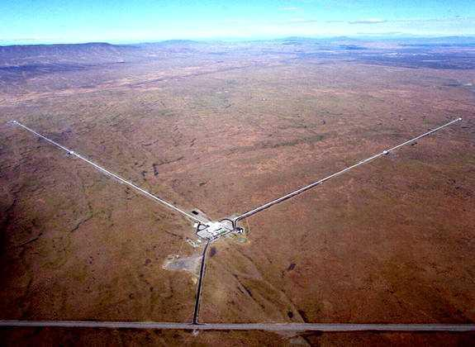
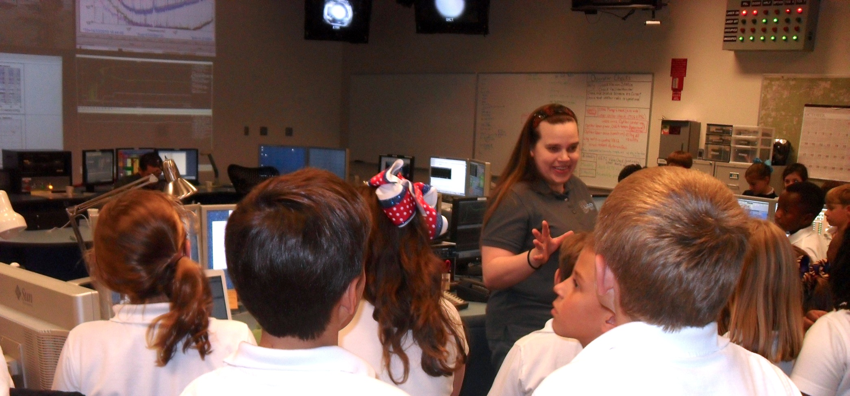
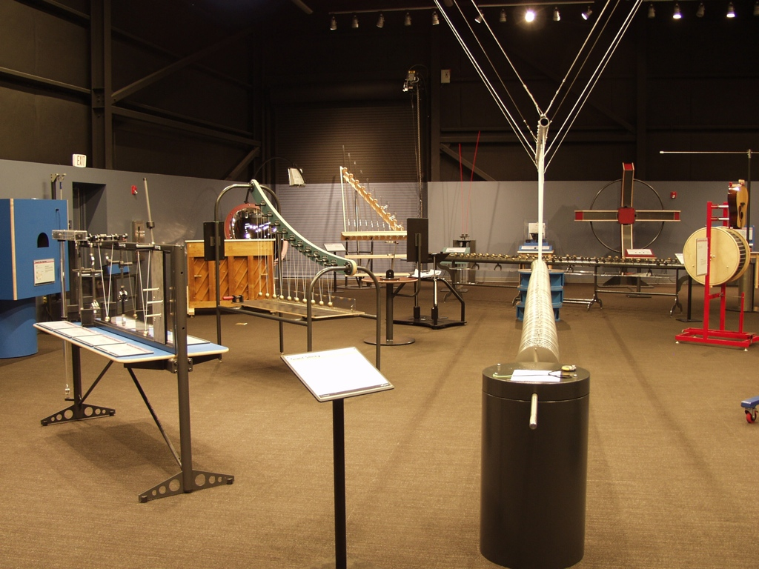
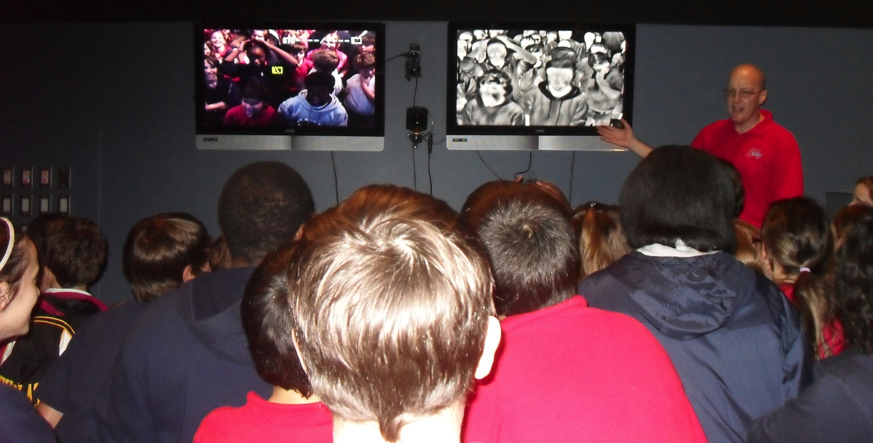
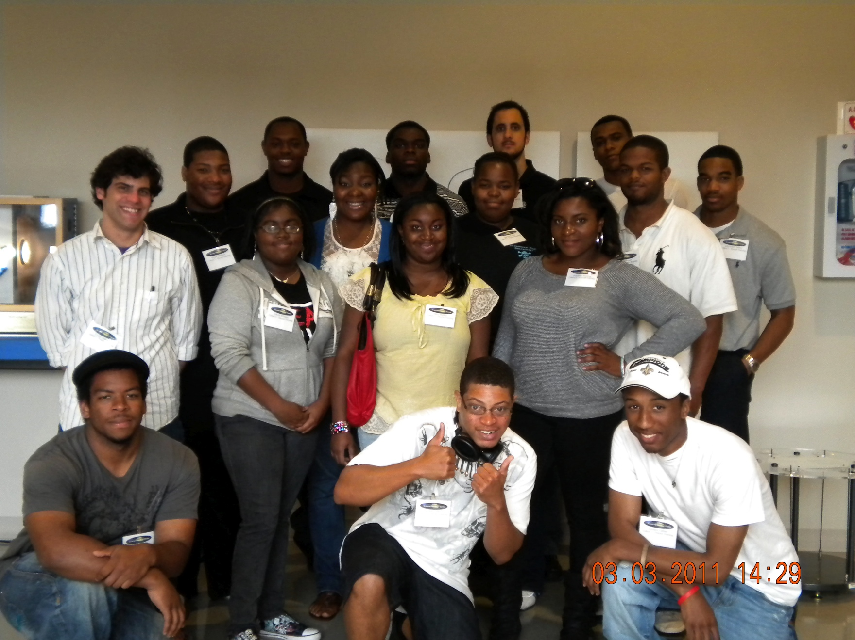
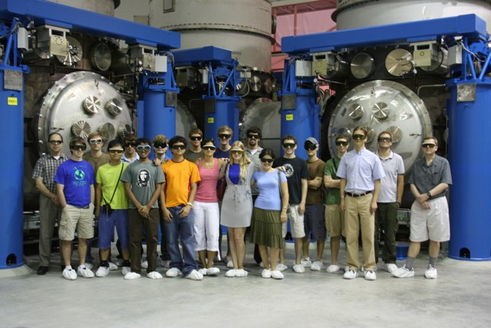
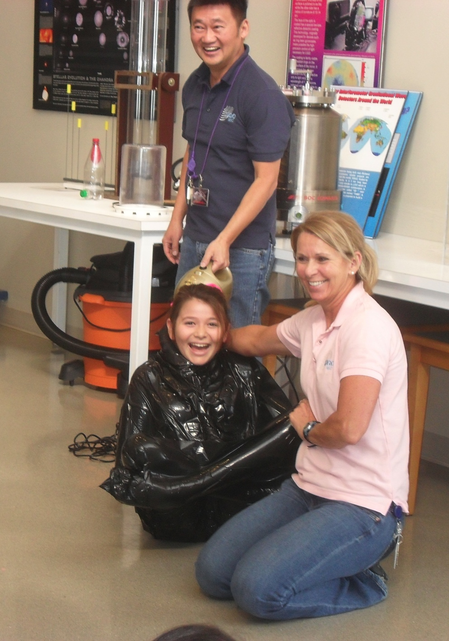
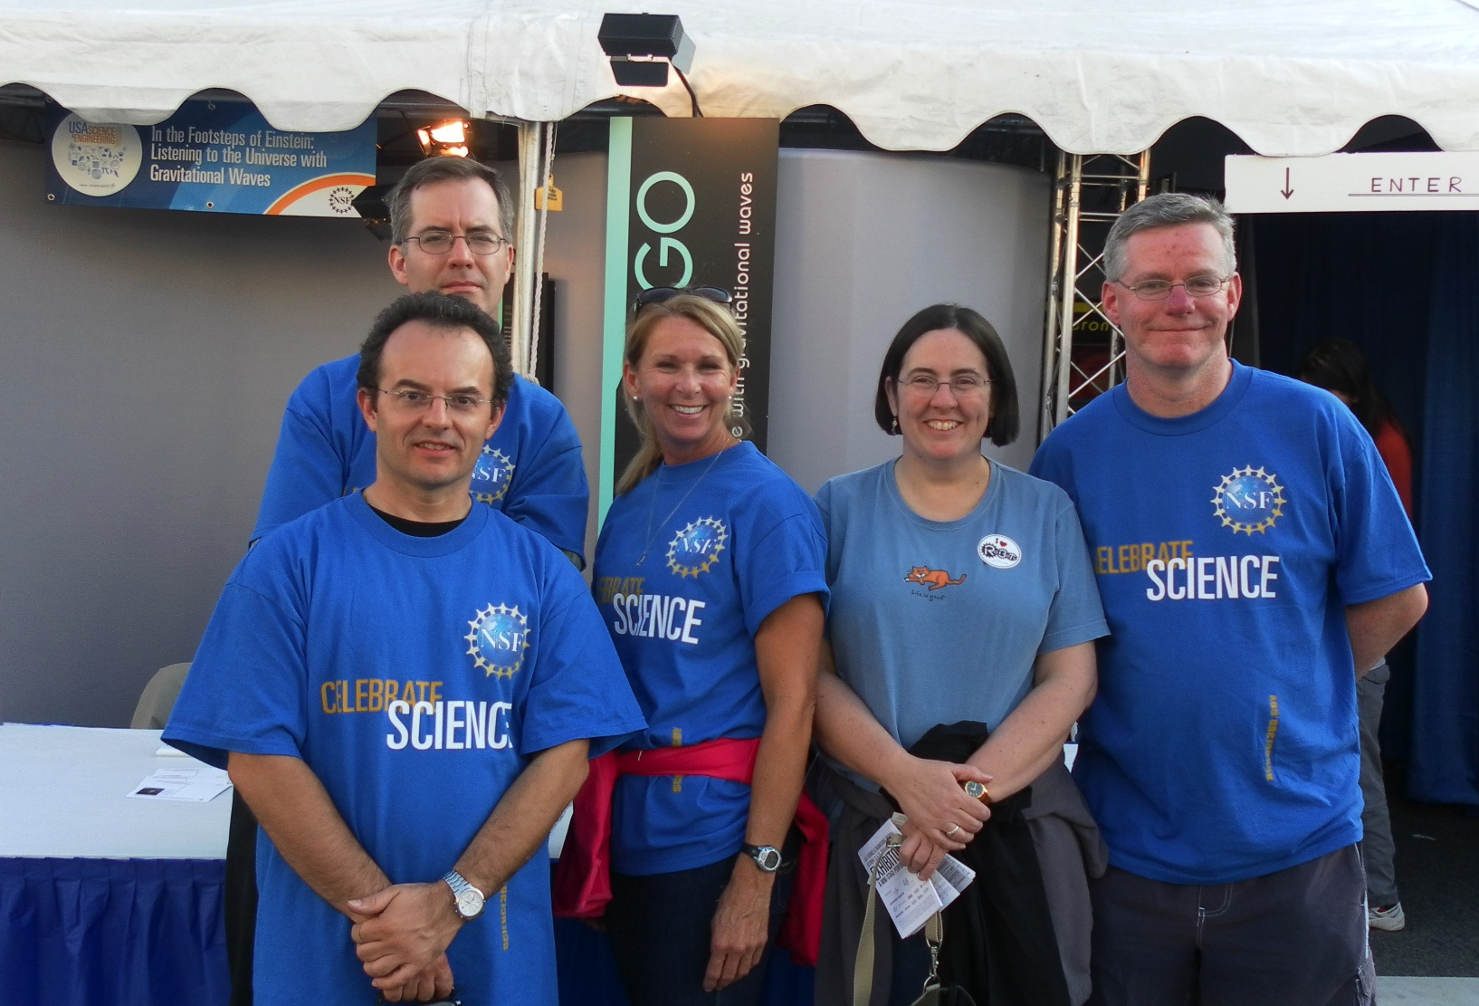
LIGO Educational Outreach: The Science Education Center
and the Education and Public Outreach Group
Amber L. Stuver & Kathy Holt
LIGO Livingston Observatory
Abstract
This poster focuses on the SEC’s work with its community and its contributions to the EPO group’s efforts.
Images: Top – LIGO Livingston Observatory; Bottom – LIGO Hanford Observatory
LIGO Science Education Center (SEC):
Mission & Structure
Leverage the scale, technology and science backdrop of the observatories to create rich visitor experiences:
Student field trips integrate hands-on standards-based activities with explorations of LIGO science and technology.
Teacher professional development programs emphasize science inquiry along with key LIGO science concepts.
Programs for the general public address a variety of interests and ages.
Outreach programs are built on partnerships.
LIGO (Laser Interferometer Gravitational-wave Observatory) is active in education and outreach on many levels to expose students, teachers and the public to LIGO concepts and scientists. The LIGO Science Education Center (SEC) located on-site at the Livingston, LA observatory serves the community with its exhibit hall and tours of the facility. The LIGO Observatory in Hanford, WA serves its community as well with on- and off-site activities and tours. The LIGO Scientific Collaboration (LSC), composed of over 800 scientists in more than 60 institutions in the United States and around the world, also provides outreach on national and local scales through their Education and Public Outreach (EPO) group.
Left: The Wave Wall attached to the front of the SEC produces moving waves in the wind.
Left: Amber Stuver, a scientist, gives a tour of the LIGO Control Room where students see science in action and interact with scientists.
SEC Partnerships
The SEC operates through partnerships to fund the educational activities through the National Science Foundation, to provide staff and teacher training in inquiry-based teaching methods and exhibit hall exhibits through the Exploratorium, to coordinate educational activities with local schools through the Louisiana Board of Regents LaSIP, and to expose underrepresented STEM undergraduate students to LIGO science and train them as museum docents (who also serve as role models for our young visitors through Southern University – Baton Rouge.
Right: William Katzman, SEC Lead, shows students what they look like in visible and IR light in the Exhibit Hall.
Image: View of a portion of the SEC Exhibit Hall
Programs
Middle/High School Students
The SEC provides inquiry-based student field trips for middle school and high school students 4 days a week (during the school year). Trips include a viewing of Einstein’s Messengers (a 20 minute documentary about LIGO and gravitational waves), an inquiry-based classroom activity, a tour of the LIGO Control Room to see science in action and interaction with scientists, and free time to explore the Exhibit Hall.
Teacher Professional Development (PD)
Two types of foci are provided in PD programs: “snacks” and inquiry.
“Snacks” programs provide teachers with information and materials to construct small scale classroom demonstrations that are inexpensive, made with common items and mirror an exhibit at the SEC.
Inquiry programs provide experience focused on the facilitation of inquiry-based activities in their classrooms.
Public Visitors
Public open houses, advertised as “Science Saturdays”, occur every third Saturday of the month and can attract over 300 visitors at a time. These feature a monthly theme with hands-on activities, viewings of the Einstein’s Messengers documentary, tours of the control room by a scientist, and free time to explore the Exhibit Hall.
Undergraduates
Tours for undergraduates are available upon request and feature extended time interacting with LIGO scientists, in-depth tours of the facility along with viewing the Einstein’s Messengers documentary and free time in the Exhibit Hall.
Docents
In cooperation with Southern University - Baton Rouge (SUBR), undergraduate students in STEM and education majors are trained and serve as docents explaining exhibits to visitors. Docents are trained on the SUBR campus in their local “Inquiry Laboratory” (complete with 6 exhibits) as well as on-site at the SEC. They represent a step in the pathway to being a scientist and serve as role models to students from underrepresented groups in the STEM fields. In 2011, 17 new docents are being trained and several alumni have gone on to graduate study.
Summer Research Programs
Select undergraduate physics and astronomy majors participate in the Summer Undergraduate Research Fellowship (SURF) through Caltech and work with scientists at Caltech or one of the LIGO Observatories. All participants usually travel to the LIGO Livingston Observatory and the SEC. While visiting, they receive a tour of the facility, explore the Exhibit Hall, and then present the research they performed. We also are open to other Research Experiences for Undergraduate (REU) programs.
Images: Left – 2011 Docents-in-training; Right: SURF students touring the LIGO instrumentation
Right: SEC staff members, Tien Huynh-Dinh and Kathy Holt, demonstrate the properties of a vacuum by shrink wrapping a student.
SEC Visitor Statistics
In FY11, the SEC has served 11,873 through:
201 programs
7,926 on-site contacts
3,454 off-site contacts
493 pre- and in-service teacher contacts through professional development programs (not included in bulleted numbers above)
In addition, the SEC has also produced 13 outreach focused conference presentations or published articles.
LSC Education & Public Outreach
The SEC also participates in the LIGO Scientific Collaboration (LSC) Education and Public Outreach (EPO) group which organizes outreach activities on local and national scales. Locally, members present talks and other programs appropriate for the community around their institution. Nationally, the EPO group has received funding from the NSF for exhibits at the World Science festival in New York, NY and most recently at the US Science and Engineering Festival in Washington, DC (where the EPO group will be exhibiting again in 2012). These exhibits are now traveling to science centers across the country.
Image: EPO group members at the US Science and Engineering Festival, 2010. Front: Marco Cavaglia (U. Miss.); Back (L to R): Dennis Ugolini (Trinity), Kathy Holt (LIGO Livingston), Kathleen McCloud (NSF), Martin Hendry (U. Glasgow)
This document is in the LIGO DCC as LIGO-G1100839-v1.

