Slide 1
An Overview of Control Theory and Digital Signal Processing
Luca Matone
Columbia Experimental Gravity group (GECo)
LHO Jul 18-22, 2011
LLO Aug 8-12, 2011
LIGO-G1100863

Slide 2
Syllabus (tentative)
Day | Topic | Textbooks
1 | Control theory: Physical systems, models, linear systems, block diagrams, differential equations, feedback loops, cruise control example, MATLAB implementation. | Chau, Pao C. Process Control: A First Course with MATLAB®. Cambridge University Press, 2002. ISBN 0-521-00255-9. Ingle, Vinay K. and John G. Proakis. Digital Signal Processing using Matlab®. Brooks/Cole 2000. ISBN 0-534-37174-4. Smith, Steven W. The Scientist and Engineer’s Guide to Digital Signal Processing. California Technical Publishing 1999. http://www.dspguide.com/
2 | Control theory: Laplace transform and its inverse , transfer functions, partial fraction expansion, first-order and second-order systems, dynamic response, bode plots, stability criteria, MATLAB implementation.
3 | Control theory: robustness, typical compensators, noise suppression, one arm cavity lock example, MATLAB implementation and time-domain simulations with SIMULINK.
4 | DSP: Discrete-time signals and systems, impulse response, system stability, convolution and correlation, differential to difference equations, the Z transform, the Discrete-time Fourier Transform (DTFT), the Discrete Fourier Transform (DFT), MATLAB implementation.
5 | DSP: The Fast-Fourier Transform (FFT), power spectral density, sampling theorem, aliasing, analog-to-digital transformations, digital filtering, FIR filters, IIR filters, moving average filter, filter design, ADC and DACs, MATLAB implementation.

Slide 3
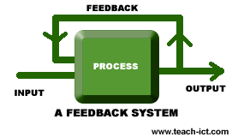
Objective
Control System
Manages and regulates a set of variables in a system
  SISO – single-input-single-output
  MIMO – multiple-input-multiple-output
A quantity is measured then controlled
Requirements
  Bandwidth
  Rise time
  Overshoot
  Steady state error
  …

Slide 4
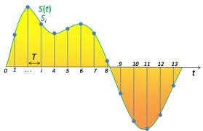
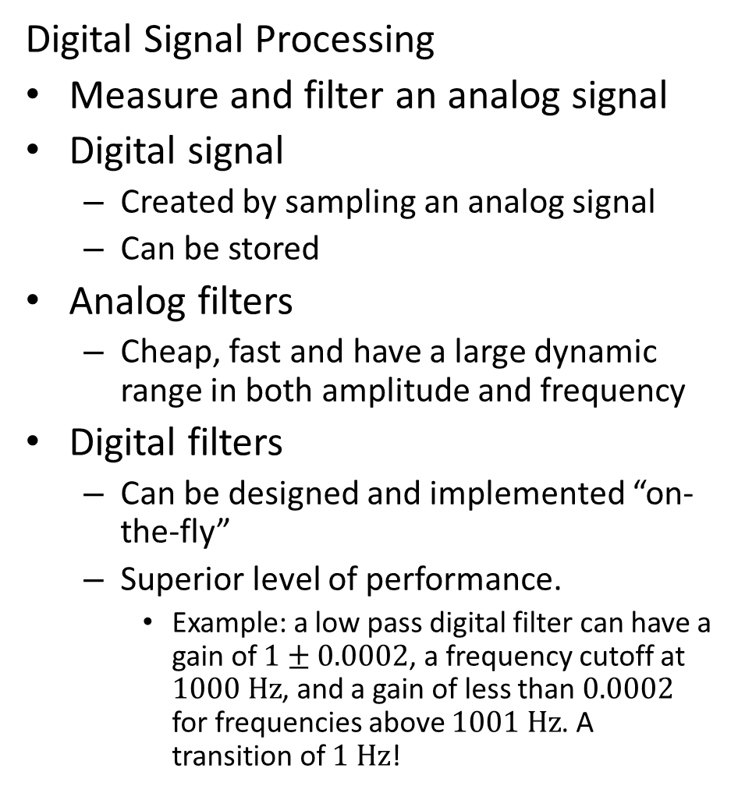
Objective
Digital Signal Processing
Measure and filter an analog signal
Digital signal
  Created by sampling an analog signal
  Can be stored
Analog filters
  Cheap, fast and have a large dynamic range in both amplitude and frequency
Digital filters
  Can be designed and implemented “on-the-fly”
  Superior level of performance.
    Example: a low pass digital filter can have a gain of $1±0.0002$, a frequency cutoff at $1000 \text{Hz}$, and a gain of less than $0.0002$ for frequencies above $1001 \text{Hz}$. A transition of $1 \text{Hz}$!

Slide 5
Control Theory 1
Given a physical system
  Objective: sense and control a variable in the system
Examples
  As basic as
    a car’s cruise control (SISO) or
  Not so basic as
    Locking the full LIGO interferometer (MIMO)

Slide 6
Example: Cruise Control
Direction of motion
Objective
  Car needs to maintain a given speed
Physical system includes
  car’s inertia
  friction
Normal force (n)
Friction force (f_{fr})
Force from engine (f)
Weight (mg)
Force or free body diagram: allows to analyze the forces at play

Slide 7
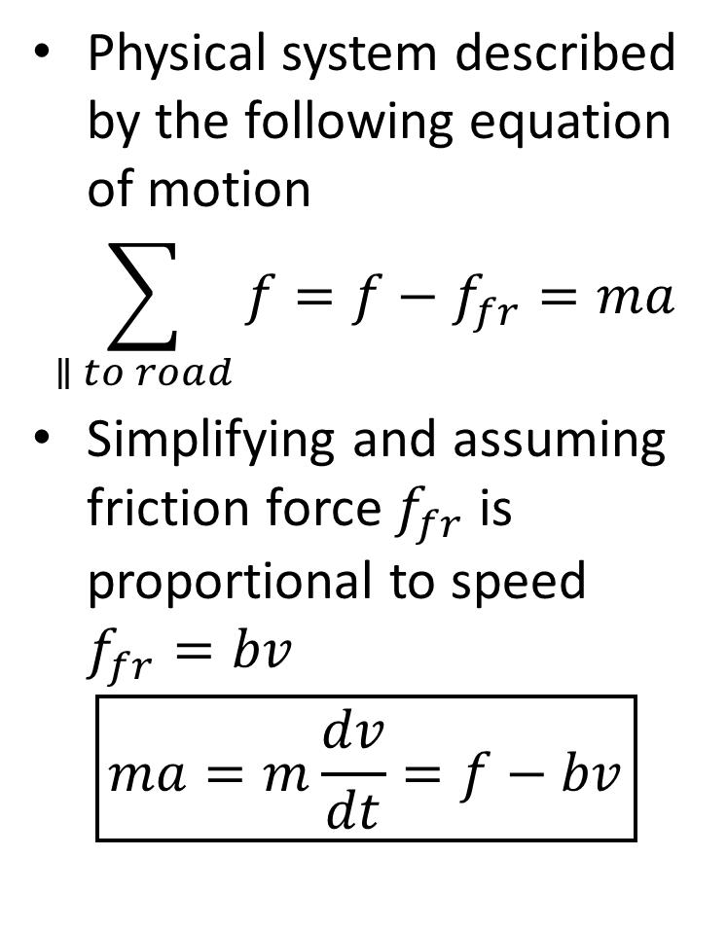
Physical model
Physical system described by the following equation of motion
$$\sum_{∥ to road}{f}=f−f_{fr}=ma$$
Simplifying and assuming friction force $f_{fr}$ is proportional to speed $f_{fr}=bv$
$$\boxed{ma=m\frac{dv}{dt}=f−bv}$$
Direction of motion
Normal force (n)
Friction force (f_{fr})
Force from engine (f)
Weight (mg)

Slide 8
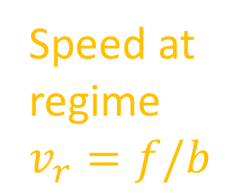
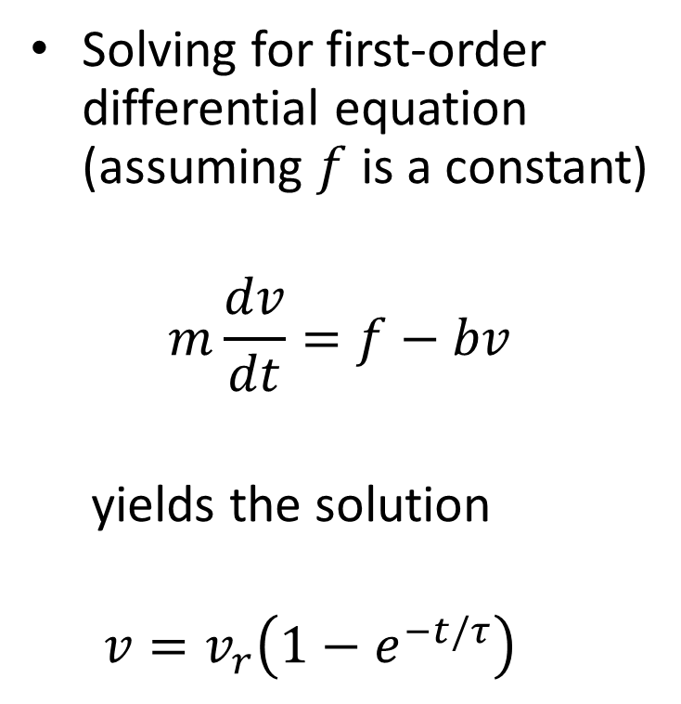
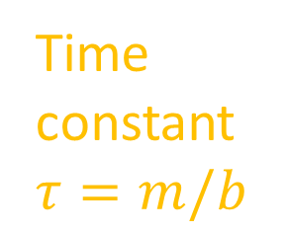
First-order differential equation
Direction of motion
Solving for first-order differential equation (assuming $f$ is a constant)
$$m\frac{dv}{dt}=f−bv$$
  yields the solution
  $$v=v_{r}\left(1−e^{−t/τ}\right)$$
Friction force (f_{fr})
Engine force (f)
Speed at regime$v_{r}=f/b$
Time constant $τ=m/b$

Slide 9
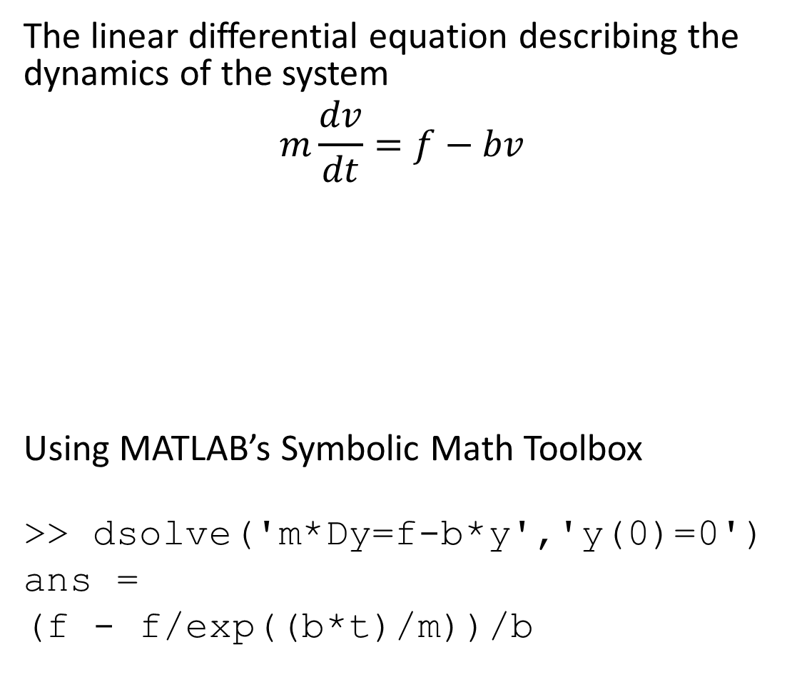
MATLAB implementation
  The linear differential equation describing the dynamics of the system
  $$m\frac{dv}{dt}=f−bv$$
Using MATLAB’s Symbolic Math Toolbox
>> dsolve('m*Dy=f-b*y','y(0)=0')
ans =
(f - f/exp((b*t)/m))/b
Direction of motion
Friction force (f_{fr})
Engine force (f)

Slide 10
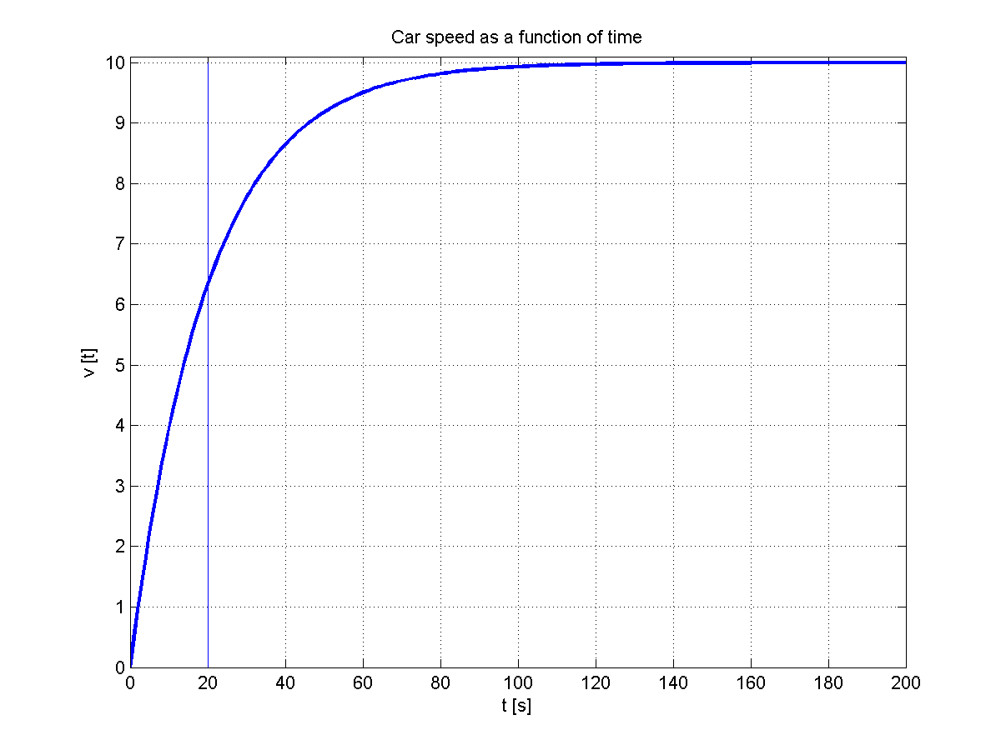
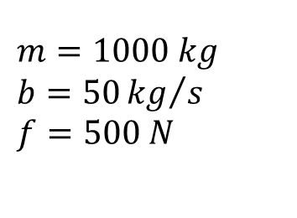



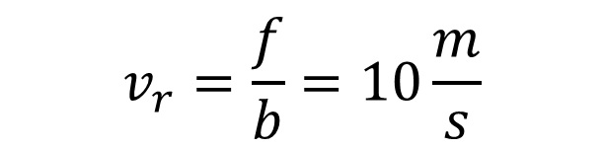
Results: $v=v_{r}∙\left(1−e^{−t/τ}\right)$
$$m=1000 kg$$
$$b=50{kg}/s$$
$$f=500 N$$
$$v_{r}=\frac{f}{b}=10\frac{m}{s}$$
cruise_timedomain.m
$$v\left(τ\right)=63\%∙v_{r}$$
$$τ=\frac{m}{b}=20 s$$

Slide 11
Block diagram: representing the physical system
To illustrate a cause-and-effect relationship
A single block represents a physical system
Blocks are connected by lines
  Lines represent how signals flow in the system
In general, a physical system G has signal x(t) as input and signal y(t) as output
G is the transfer function of the system
x(t)
y(t)
G

Slide 12
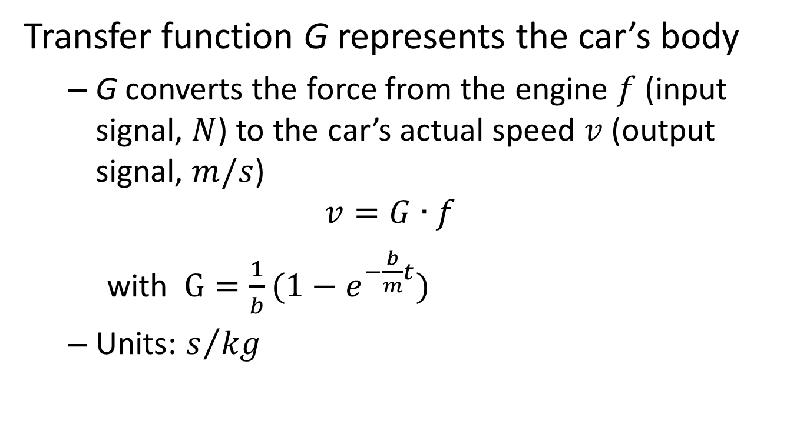
Car’s body
Transfer function G represents the car’s body
  G converts the force from the engine $f$ (input signal, $N$) to the car’s actual speed $v$ (output signal, $m/s$)
  $$v=G∙f$$
    with $G=\frac{1}{b}(1−e_{}^{−\frac{b}{m}t})$
  Units: $s/{kg}$
f(t)
v(t)
G

Slide 13
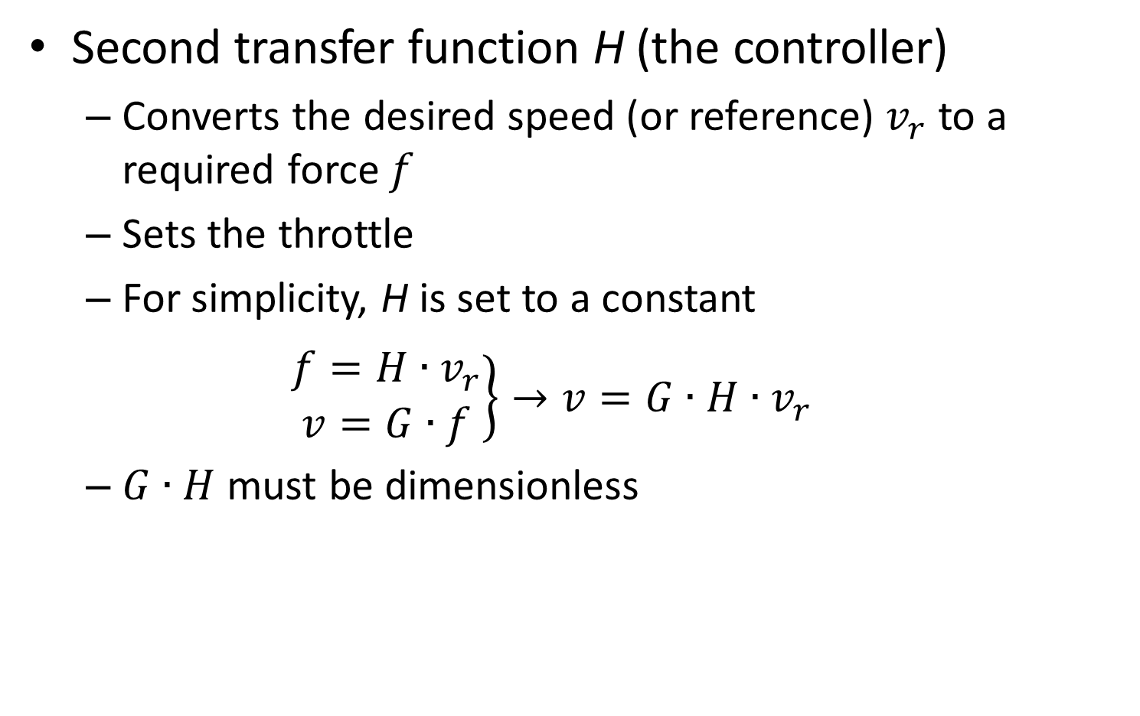
Setting the desired speed
Second transfer function H (the controller)
  Converts the desired speed (or reference) $v_{r}$ to a required force $f$
  Sets the throttle
  For simplicity, H is set to a constant
  $\left.\begin{matrix}f=H∙v_{r} \\ v=G∙f\end{matrix}\right\}→v=G∙H∙v_{r}$
  $G∙H$ must be dimensionless
v_{r}
f
v
H
G

Slide 14
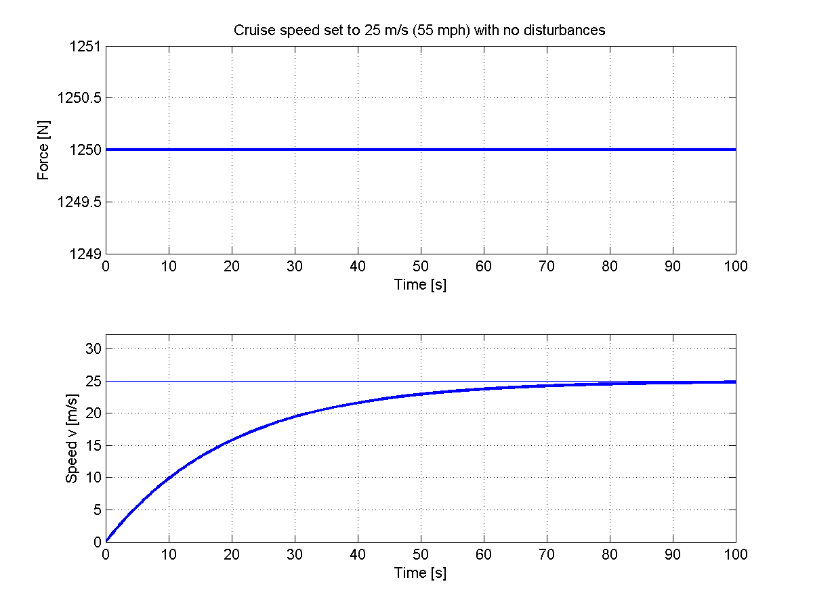

Plotting results
With $H=b$ the actual speed is the reference: $v=v_{r}$
Simulate: setting desired speed to 25 m/s (55 mph)
Generated force by controller H
Resulting speed v
cruisefeedback_timedomain.m
Desired speed v_{r}

Slide 15
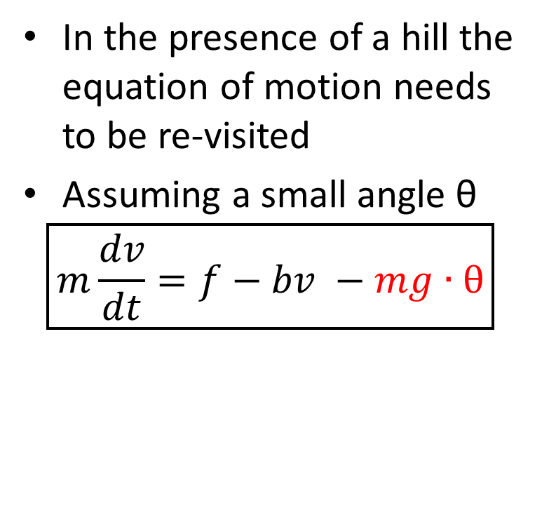
Introducing a disturbance – a hill
In the presence of a hill the equation of motion needs to be re-visited
Assuming a small angle θ
$$\boxed{m\frac{dv}{dt}=f−bv −mg∙θ}$$
Direction of motion
Force from engine (f)
Weight (mg)
Friction force (f_{fr})
θ
Added term

Slide 16


Introducing a disturbance – a hill
Assuming $f$ and $θ$are constants
$$m\frac{dv}{dt}=f−bv−mg∙θ$$
$$v=G∙\left(f−mg∙θ\right)$$
Direction of motion
Force from engine (f)
Weight (mg)
Friction force (f_{fr})
ϑ
Added term

Slide 17


Modifying the block diagram
$$v=G∙f$$
$$v=G∙\left(f−K∙θ\right)$$
θ
$$K=mg$$
K
v_{r}
f
-
v
+
H
G
Summation junction

Slide 18
Modifying the block diagram
$$v=G∙f$$
$$v=G∙\left(f−K∙θ\right)$$
θ
$$K=mg$$
K
v_{r}
f
-
v
+
H
G
Summation junction

Slide 19
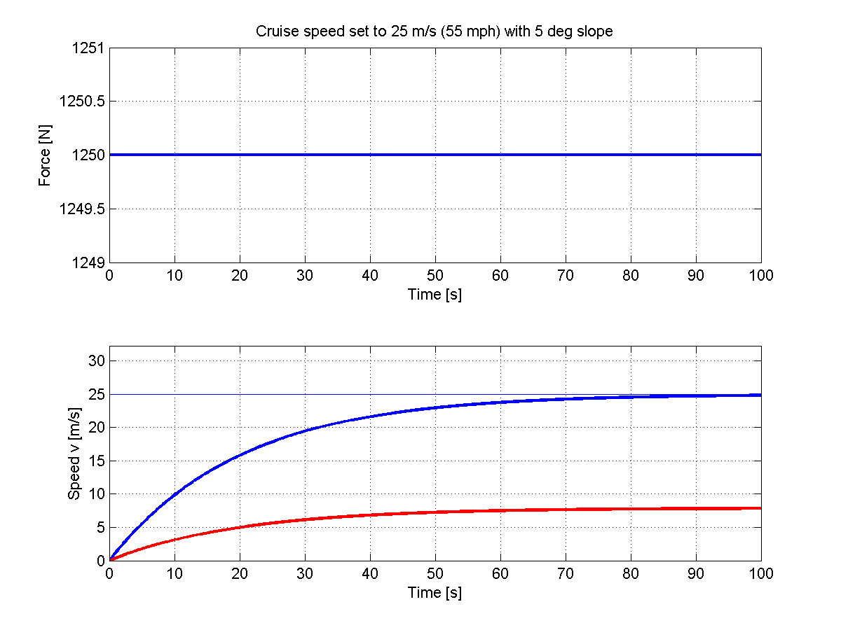

Plotting results
Setting desired speed to 25 m/s and slope of $θ=5°$
Generated force by controller H
Resulting speed v
cruisefeedback_timedomain.m
Problem!
Desired speed

Slide 20

Negative Feedback
Let’s measure the car’s speed and
Correct for it by feeding back into the system a measure of the actual speed $v$
θ
K
Error signal
-
e
v
+
v_{r}
f
+
H
G
-
c
Correction signal

Slide 21


Negative Feedback
Let’s measure the car’s speed and
Correct for it by feeding back into the system a measure of the actual speed $v$
θ
Error signal e: the difference between the desired speed and the measured speed. If null, then $v=v_{r}$
K
e
f
-
v
+
+
v_{r}
H
G
-
c
Correction signal c: in this case it is just a measure of the actual speed

Slide 22
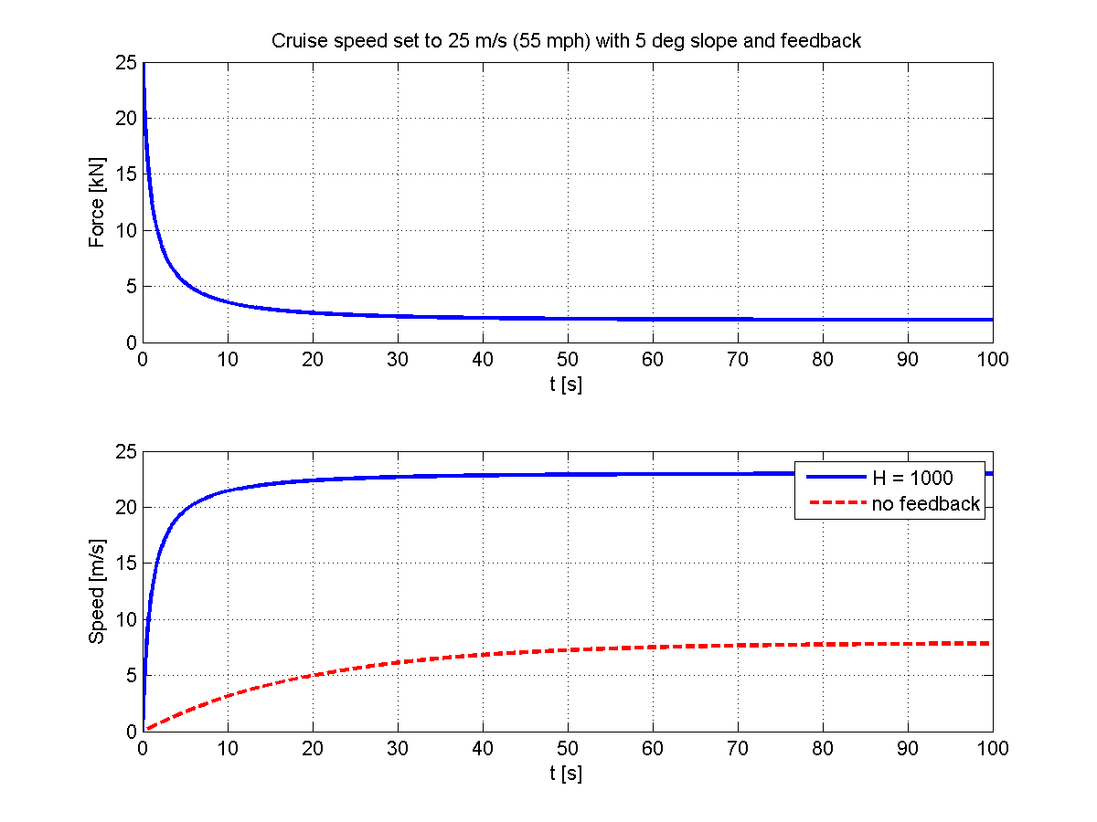
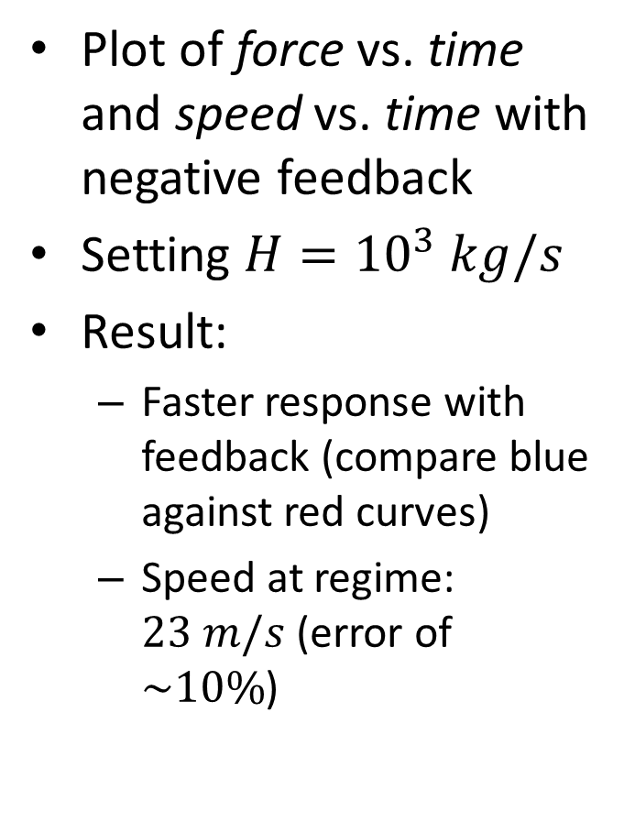
Negative feedback
Plot of force vs. time and speed vs. time with negative feedback
Setting $H={10}^{3} kg/s$
Result:
  Faster response with feedback (compare blue against red curves)
  Speed at regime: $23 m/s$ (error of $\sim 10\%$)
cruisefeedback_timedomain2.m

Slide 23
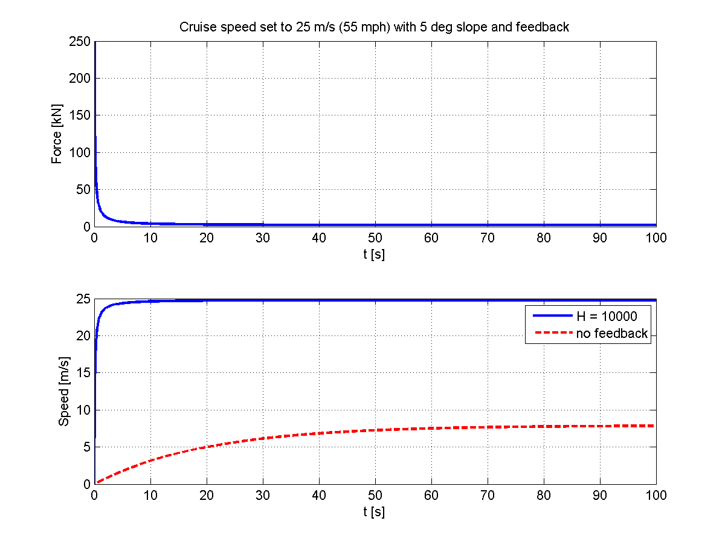
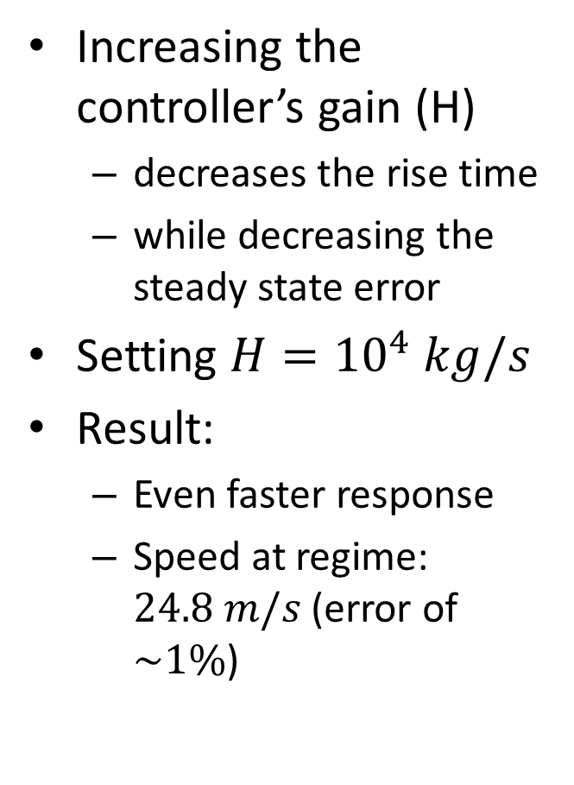
Negative feedback
Increasing the controller’s gain (H)
  decreases the rise time
  while decreasing the steady state error
Setting $H={10}^{4} kg/s$
Result:
  Even faster response
  Speed at regime: $24.8 m/s$ (error of $\sim 1\%$)
cruisefeedback_timedomain3.m
Yes but… how does it work?

Slide 24




Signal flow and block diagrams
$$v=G∙(f−K∙θ)$$
$$f=H∙e$$
$$e=v_{r}−c$$
θ
K
v_{r}
+
e
f
-
v
+
H
G
-
c
$$c=v$$

Slide 25


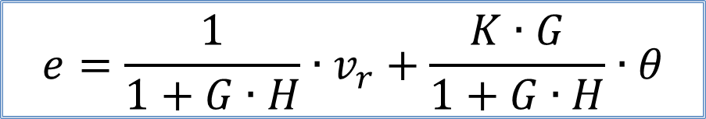


$$e=v_{r}−c$$
$$=v_{r}−v$$
System’s open loop gain (dimensionless)
$$=v_{r}−G∙\left(f−K∙θ\right)$$
$$=v_{r}−G∙\left(H∙e−K∙θ\right)$$
θ
$$e=\frac{1}{1+G∙H}∙v_{r}+\frac{K∙G}{1+G∙H}∙θ$$
K
v_{r}
+
e
f
-
v
+
H
G
-
c

Slide 26
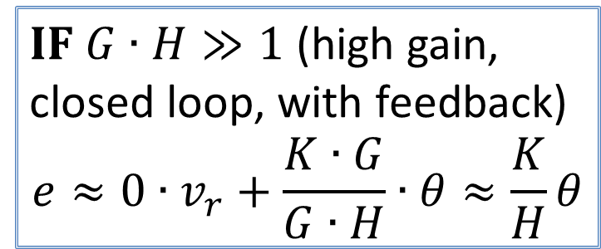
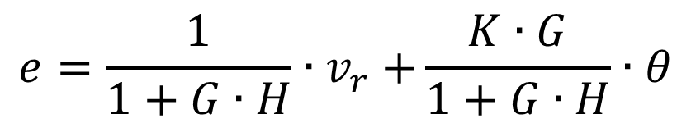
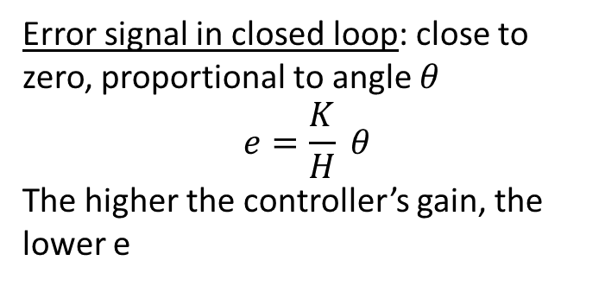
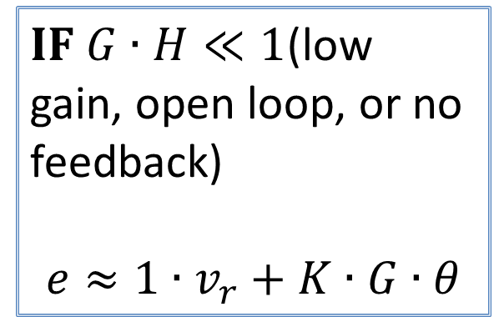
$$e=\frac{1}{1+G∙H}{∙v}_{r}+\frac{K∙G}{1+G∙H}∙θ$$
$IF G∙H≫1$ (high gain, closed loop, with feedback)
$$e≈0∙v_{r}+\frac{K∙G}{G∙H}∙θ≈\frac{K}{H}θ$$
$IF G∙H≪1$(low gain, open loop, or no feedback)
$$e≈1∙v_{r}+K∙G∙θ$$
θ
Error signal in closed loop: close to zero, proportional to angle $θ$
$$e=\frac{K}{H} θ$$
The higher the controller’s gain, the lower e
K
v_{r}
+
e
f
-
v
+
H
G
-
c

Slide 27



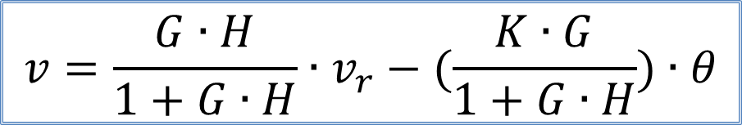
$$v=G∙H∙e−K∙G∙θ$$
$$={G∙H∙(v}_{r}−v)−K∙G∙θ$$
$$=G∙H∙v_{r}−G∙H∙v−K∙G∙θ$$
With no feedback
$$v=G∙H∙v_{r}−K∙G∙θ$$
θ
$$v=\frac{G∙H}{1+G∙H}∙v_{r}−(\frac{K∙G}{1+G∙H})∙θ$$
K
v_{r}
+
e
f
-
v
+
H
G
-
c

Slide 28
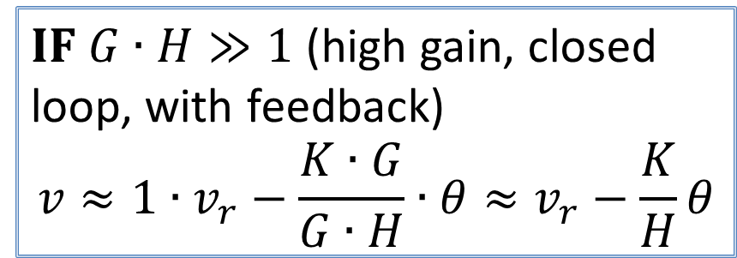
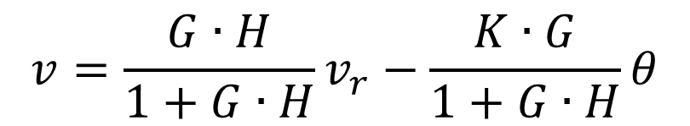
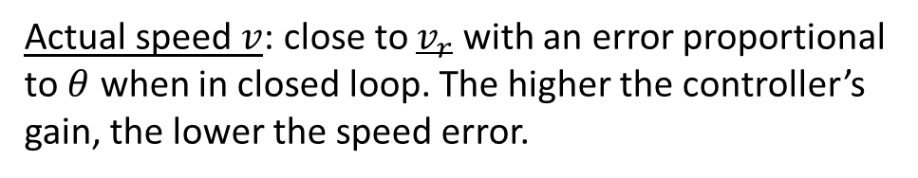
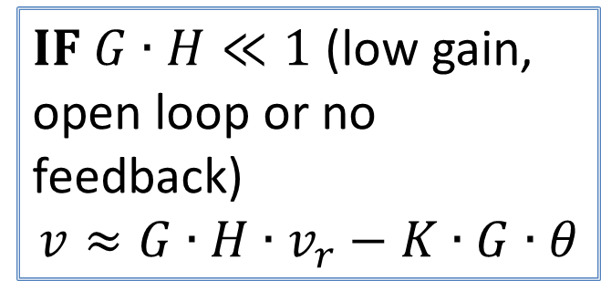
$$v=\frac{G∙H}{1+G∙H}v_{r}−\frac{K∙G}{1+G∙H}θ$$
$IF G∙H≪1$ (low gain, open loop or no feedback)
$$v≈G∙H∙v_{r}−K∙G∙θ$$
$IF G∙H≫1$ (high gain, closed loop, with feedback)
$$v≈1∙v_{r}−\frac{K∙G}{G∙H}∙θ≈v_{r}−\frac{K}{H}θ$$
θ
Actual speed $v$: close to $v_{r}$ with an error proportional to $θ$ when in closed loop. The higher the controller’s gain, the lower the speed error.
K
v_{r}
+
e
f
-
v
+
H
G
-
c

Slide 29
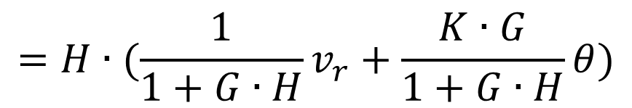

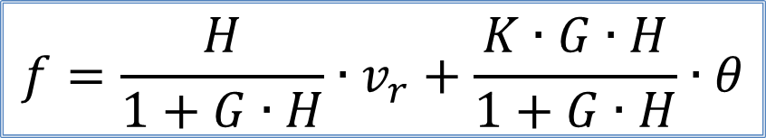
$$f=H∙e$$
$$=H∙(\frac{1}{1+G∙H}v_{r}+\frac{K∙G}{1+G∙H}θ)$$
θ
$$f=\frac{H}{1+G∙H}∙v_{r}+\frac{K∙G∙H}{1+G∙H}∙θ$$
K
v_{r}
+
e
f
-
v
+
H
G
-
c

Slide 30
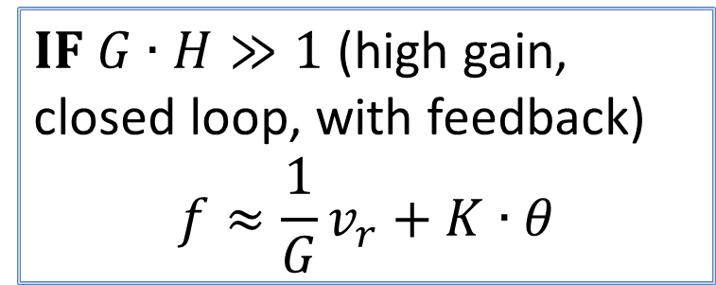
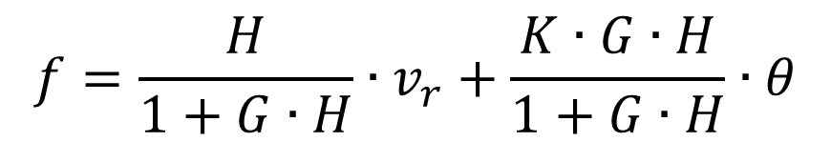
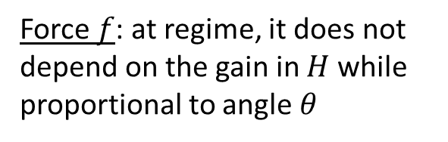
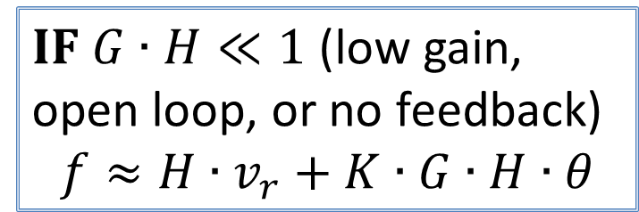
$$f=\frac{H}{1+G∙H}∙v_{r}+\frac{K∙G∙H}{1+G∙H}∙θ$$
$IF G∙H≫1$ (high gain, closed loop, with feedback)
$$f≈\frac{1}{G}v_{r}+K∙θ$$
$IF G∙H≪1$ (low gain, open loop, or no feedback)
$$f≈H∙v_{r}+K∙G∙H∙θ$$
θ
Force $f$: at regime, it does not depend on the gain in $H$ while proportional to angle $θ$
K
v_{r}
+
e
f
-
v
+
H
G
-
c

Slide 31
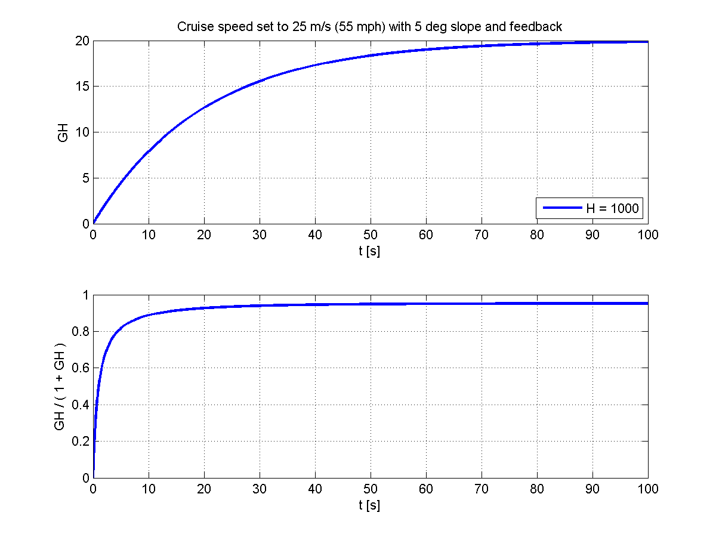
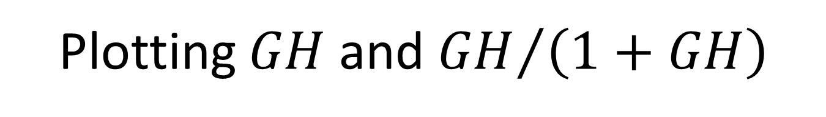
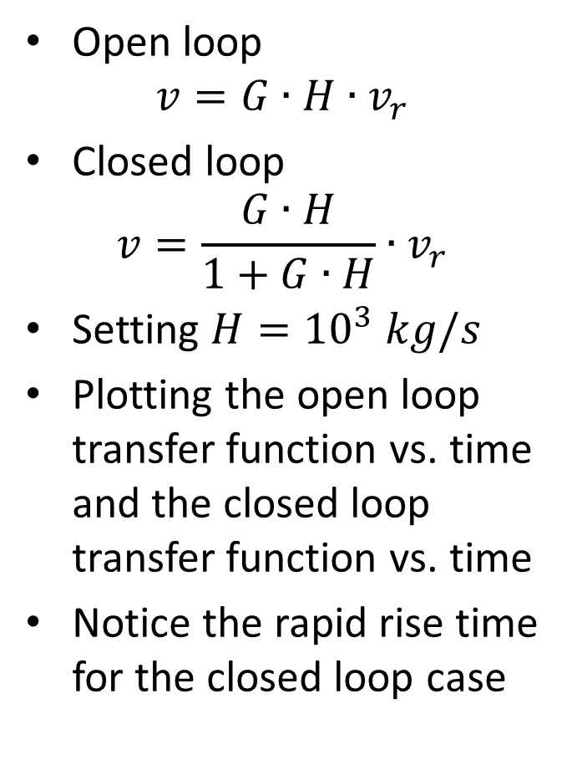
Plotting $GH$ and ${GH}/{\left(1+GH\right)}$
Open loop
$$v=G∙H∙v_{r}$$
Closed loop
$$v=\frac{G∙H}{1+G∙H}∙v_{r}$$
Setting $H={10}^{3} kg/s$
Plotting the open loop transfer function vs. time and the closed loop transfer function vs. time
Notice the rapid rise time for the closed loop case
cruisefeedback_timedomain2.m

Slide 32
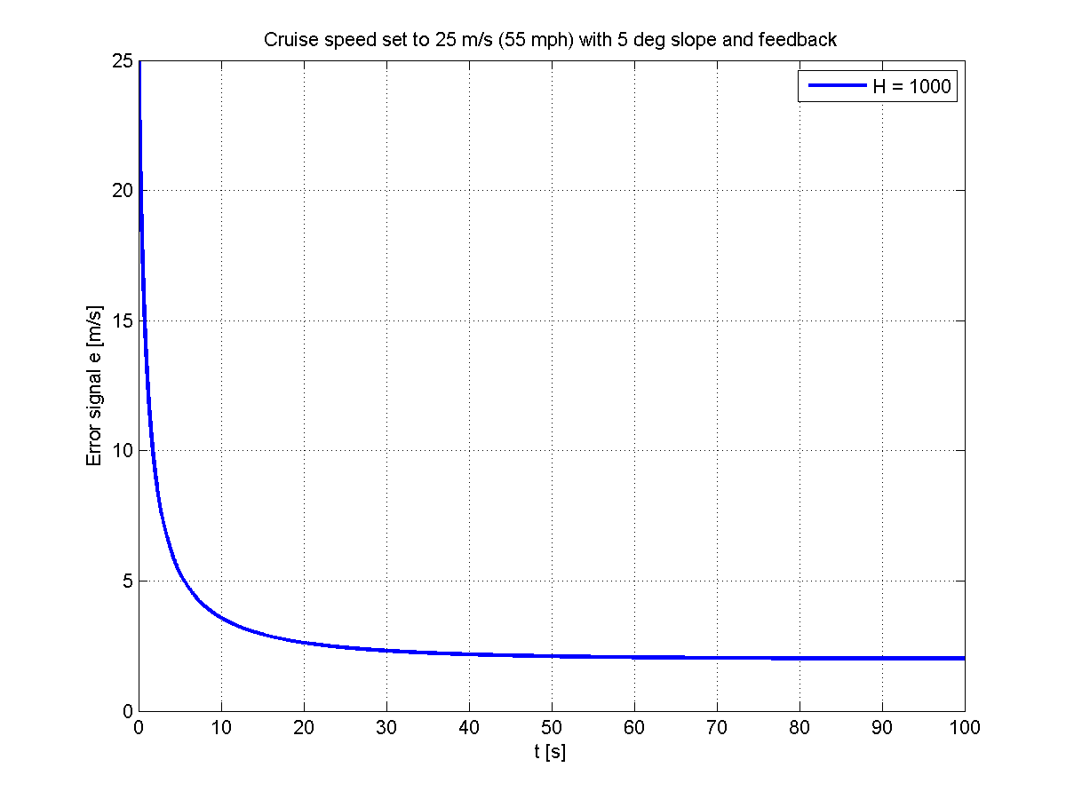
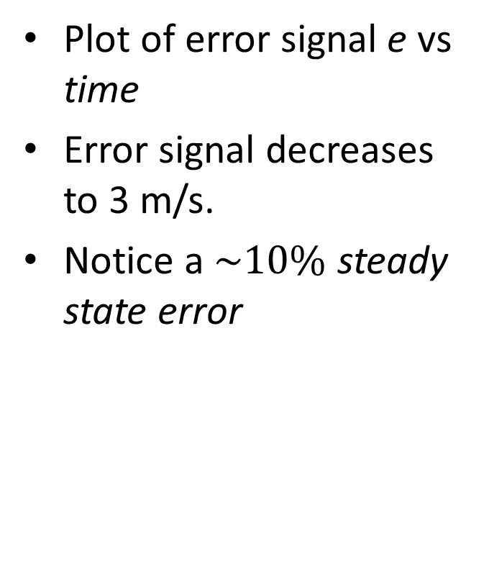
The error signal e
Plot of error signal e vs time
Error signal decreases to 3 m/s.
Notice a $\sim 10\%$ steady state error
cruisefeedback_timedomain2.m

Slide 33
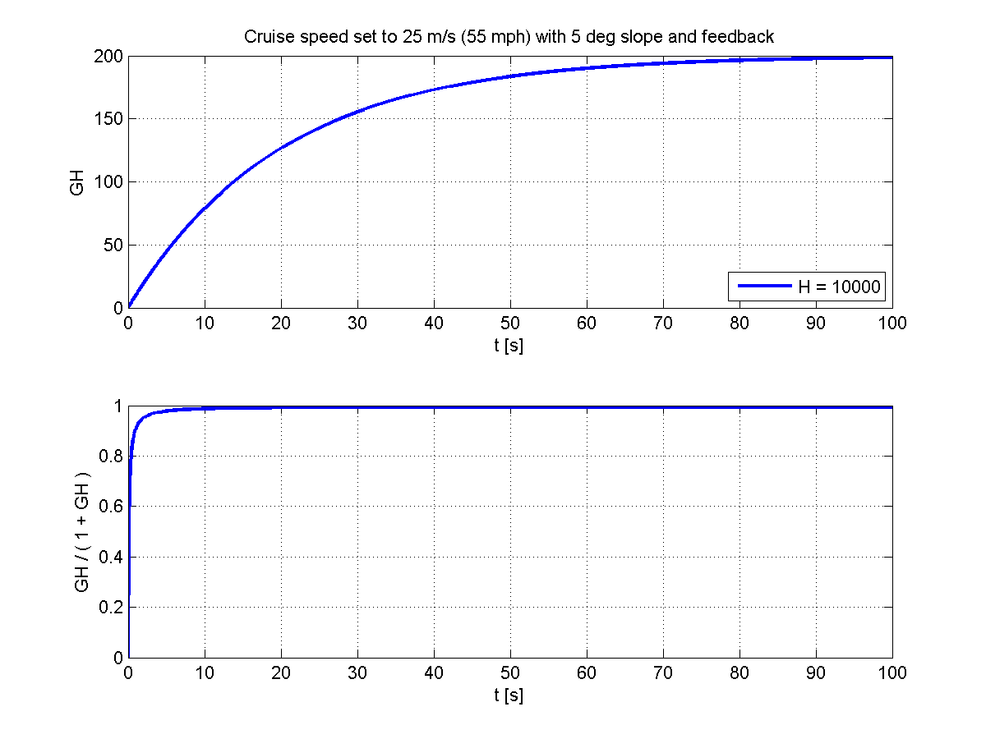

Open and closed loop TF with
$H={10}^{4} kg/s$

Slide 34


Error signal e with
$H={10}^{4} kg/s$

Slide 35

Cruise control example
First-order differential equation
Simplest controller: simply a gain with no time constants involved
How to handle more complicated problems?

Slide 36





Block diagram reduction
x
P₁
P₂
y
x
P₁P₂
y
x
$$+$$
P₁
y
$$±$$
P₁ ±P₂
y
x
P₂
x
$$+$$
y
P₁
$$∓$$
$$\frac{P_{1}}{1±{P_{1}P}_{2}}$$
y
x
P₂

Slide 37


Practice
Determine the output C in terms of inputs U and R.
U
R
+
+
C
+
$$G_{1}$$
$$G_{2}$$
-

Slide 38





Practice
Determine the output $C$ in terms of inputs $U_{1}, U_{2}$ and $R$.
U₁
R
+
+
C
$$G_{1}$$
$$G_{2}$$
+
+
+
$$H_{1}$$
$$H_{2}$$
+
U₂

Slide 39









More practice
(a)
$$G_{2}$$
R
+
+
$$G_{1}$$
+
+
C
Determine C/R for the following systems.
$$H_{1}$$
(c)
(b)
$$G_{2}$$
$$G_{2}$$
+
C
R
+
+
+
$$G_{1}$$
$$G_{1}$$
+
C
R
+
+
+
$$H_{1}$$
$$H_{1}$$

Slide 40




How do we MEASURE the OL TF of a system when the loop is closed?
Add an injection point in a closed loop system
Inject signal $x$ and read signal $y_{1}$ (just before the injection) and $y_{2}$ (right after the injection)
Solve for the ratio $\frac{y_{1}}{y_{2}}$
$$x$$
+
+
$$y_{1}$$
$$y_{2}$$

Slide 41

So far…
Control theory builds on differential equations
Block diagrams help visualize the signal flow in a physical system
The cause-and-effect relationship between variables is referred to as a transfer function (TF)
The system’s open-loop TF is the product of transfer functions
  cruise control example: $G∙H$
  Two cases: $G∙H≪1$ and $G∙H≫1$
MATLAB implementation
  Functions used: dsolve

Slide 42
Laplace Transforms
The technique of Laplace transform (and its inverse) facilitates the solution of ordinary differential equations (ODE).
Transformation from the time-domain to the frequency-domain.
Functions are complex, often described in terms of magnitude and phase

Slide 43

Linear systems
To map a model to frequency space
  System must be linear
  Output proportional to input
Given system P
  Input signals: $x_{1}$ and $x_{2}$
  Output signals (response): $y_{1}$ and $y_{2}$
System P is linear
  If input signal: ${a x}_{1}+b x_{2}$
  Then output signal: $a{ y}_{1}+b{ y}_{2}$
  Superposition principle
x
y
P

Slide 44

Example
Is $y=\frac{dx}{dt}$ a linear system?
  Knowing that $y_{1}=\frac{dx_{1}}{dt}$ and $y_{2}=\frac{dx_{2}}{dt}$
  If input is $c_{1}x_{1}+c_{2}x_{2}$, output is
    $$\frac{d}{dt}\left(c_{1}x_{1}+c_{2}x_{2}\right)=$$
    $$c_{1}\frac{d}{dt}x_{1}+c_{2}\frac{d}{dt}x_{2}=$$
    $$c_{1}{ y}_{1}+c_{2} y_{2}$$
  System is linear

Slide 45

Example
Is $y=x^{2}$ a linear system?
  Knowing that $y_{1}={\left(x_{1}\right)}^{2}$ and$y_{2}={\left(x_{2}\right)}^{2}$
  If input is $c_{1}x_{1}+c_{2}x_{2}$, output is
    $${\left(c_{1}x_{1}+c_{2}x_{2}\right)}^{2}≠c_{1}{ y}_{1}+c_{2} y_{2}$$
  System is not linear

Slide 46

In general
Output
$$a_{n}\frac{d^{n}y}{dt^{n}}+a_{n−1}\frac{d^{n−1}y}{dt^{n−1}}+…+a_{0}y=b_{m}\frac{d^{m}x}{dt^{m}}+b_{m−1}\frac{d^{m−1}x}{dt^{m−1}}+…+b_{0}x$$
$$\sum_{i=0}^{n}{a_{i}D^{i}y\left(t\right)=\sum_{i=0}^{m}{b_{i}D^{i}x\left(t\right)}} n≥m$$
Input
For a stable system

Slide 47


Laplace Transform L
Transforms a linear differential equation into an algebraic equation
Tool in solving differential equations
Laplace transform of function f
$$F\left(s\right)=\text{L}\left[f(t)\right]$$
Laplace inverse transform of function F
$$f(t) ={\text{L}}^{−1}\left[F(s)\right]$$
where $s=jω$ is the transform variable
Imaginary unit
$$2πf$$

Slide 48






Time domain ↔ Laplace domain
$$y(t)$$
$$f(t)$$
$$f={dy}/{dt}$$
Input
Output
$$Y(s)$$
$$F(s)$$
$$G(s)$$

Slide 49
Laplace Transform L
$$F\left(s\right)=\text{L}\left[f(t)\right]=\int_{0}^{∞}{f(t)e^{−st}dt}$$
$$f\left(t\right)={\text{L}}^{−1}\left[F(s)\right]=\frac{1}{2πj}\int_{−jω}^{+jω}{F(s)e^{st}ds}$$

Slide 50

(Some) Laplace transform pairs
 | $$f(t)$$ | $$F(s)$$
Unit step | $$u(t)$$ | $$1/s$$
Unit ramp | $$t$$ | $$1/{s^{2}}$$
Exponential | $$e^{at}$$ | $$1/{\left.\left(s−a\right)\right.}$$
Sinusoid | $$sin⁡(ω_{0}t)$$ | $$ω/{\left.\left(s^{2}+{ω_{0}}^{2}\right)\right.}$$
 | $$\left(1/a\right)\left(1−e^{−at}\right)$$ | $$1/{\left.s\left(s+a\right)\right.}$$
SHO | $$\frac{ω_{0}}{\sqrt{1−δ^{2}}} e^{−δω_{0}t}×$$ $$×sin{(\sqrt{1−δ^{2} }ω_{0}t)}$$ | $$\frac{{ω_{0}}^{2}}{s^{2}+2δω_{0} s+{ω_{0}}^{2}}$$

Slide 51

Laplace transform properties
Linearity
$$\text{L}\left[c_{1}f_{1}\left(t\right)+c_{2}f_{2}\left(t\right)\right]=c_{1}F_{1}\left(s\right)+c_{2}F_{2}\left(s\right)$$
Derivatives
  First-order: $\text{L}\left[\frac{df(t)}{dt}\right]=sF(s)$
  Second-order: $\text{L}\left[\frac{d^{2}f(t)}{{dt}^{2}}\right]=s^{2}F(s)$
Integral
  $$\text{L}\left[\int_{0}^{t}{f\left(t\right)dt}\right]=\frac{1}{s}F(s)$$

Slide 52
Solution to ODEs
Laplace transform the system’s ODE
Solve the algebraic equation in s
Inverse transform back to the time domain

Slide 53




Transfer Function $G\left(s\right)$
$$\sum_{i=0}^{n}{a_{i}D^{i}y\left(t\right)=\sum_{i=0}^{m}{b_{i}D^{i}x\left(t\right)}}$$
Using derivative property
$$\sum_{i=0}^{n}{a_{i}s^{i}Y\left(s\right)=\sum_{i=0}^{m}{b_{i}s^{i}X\left(s\right)}}$$
Algebraic equation in s, the ratio of 2 polynomials in s
$$G\left(s\right)=\frac{Y(s)}{X(s)}=\frac{\sum_{i=0}^{m}{b_{i}s^{i}}}{\sum_{i=0}^{n}{a_{i}s^{i}}}$$
Transfer function $G\left(s\right)$ relates input $X\left(s\right)$ to output $Y\left(s\right)$.

Slide 54


Transfer Function $G\left(s\right)$
The roots of the numerator are referred to as zeros.
Transfer function $G\left(s\right)$ can be defined by
The coefficients of s or
Its poles and zeros
$$G\left(s\right)=\frac{Y(s)}{X(s)}=\frac{\sum_{i=0}^{m}{b_{i}s^{i}}}{\sum_{i=0}^{n}{a_{i}s^{i}}}$$
The roots of the denominator are referred to as poles.

Slide 55



Let’s apply it to the cruise control example: transfer function $G$ (the car’s body)
Direction of motion
$$\left.m\frac{dv(t)}{dt}\right.=\left.f(t)−bv(t)\right.$$
$$m s V\left(s\right)=F\left(s\right)−b V(s)$$
$$V\left(s\right)=G\left(s\right) F\left(s\right) \text{where} G\left(s\right)=\frac{1/m}{s+b/m}$$
Friction force (f_{fr})
Engine force (f)
f(t)
v(t)
G(t)
F(s)
V(s)
G(s)
Pole at $−b/m$

Slide 56


Dynamic response: using lookup tables to inverse transform
Laplace inverse transform using lookup tables
$$\frac{1}{\left.s \left(s+a\right)\right.}$$
$$\frac{1}{a}\left(1−e^{−at}\right)$$
Input: step function, amplitude $F_{0}$
$$f\left(t\right)=F_{0} u(t)$$
$$F\left(s\right)=\text{L}\left[f(t)\right]={F_{0}}/s$$
The response (in frequency space) is
$$V\left(s\right)=G\left(s\right)∙F\left(s\right)=\frac{1/m}{s+b/m}∙\frac{F_{0}}{s}$$
The time-domain response is
$$v\left(t\right)={\text{L}}^{−1}\left[V(s)\right]=={\text{L}}^{−1}\left[\frac{F_{0}}{m}∙\frac{1}{s (s+b/m)}\right]$$

Slide 57


Dynamic response: using lookup tables to inverse transform
Laplace inverse transform using lookup tables
$$\frac{1}{\left.s \left(s+a\right)\right.}$$
$$\frac{1}{a}\left(1−e^{−at}\right)$$
$$v\left(t\right)={\text{L}}^{−1}\left[\frac{F_{0}}{m}∙\frac{1}{s (s+b/m)}\right]=\frac{F_{0}}{m}∙{\text{L}}^{−1}\left[\frac{1}{s (s+b/m)}\right]$$
$$v\left(t\right)=\frac{F_{0}}{b} \left[1−e^{−\frac{b}{m}t}\right]$$
Pole $a=\frac{1}{τ}$

Slide 58



First-order system step response
$$G\left(s\right)=\frac{p}{s+p}$$
63 %
$p=5 rad/s, τ=0.2 s$
firstorder.m
Pole p

Slide 59

MATLAB implementation
The step response of transfer function
$$G\left(s\right)=\frac{5}{s+5}$$
>> G=tf(5, [1 5]);
>> step(G);

Slide 60


Partial fraction expansion
Reduce a complex function to a collection of simpler ones
Then use lookup table
$$F\left(s\right)=\frac{Q(s)}{P(s)}=\sum_{i}{\frac{α_{i}}{s+a_{i}}}$$
$$f\left(t\right)={\text{L}}^{−1}\left[\frac{α_{1}}{s+a_{1}}\right]+…+{\text{L}}^{−1}\left[\frac{α_{n}}{s+a_{n}}\right]=α_{1} e^{−a_{1}t}+…+α_{n} e^{−a_{n}t}$$
$$f\left(t\right)=\sum_{i=0}^{n}{α_{i} e^{−a_{i}t}}$$
Order m
$$m≤n$$
Order n

Slide 61

Comments
$$F\left(s\right)=\sum_{i}{\frac{α_{i}}{s+a_{i}}} f\left(t\right)=\sum_{i=0}^{n}{α_{i} e^{−a_{i}t}}$$
Poles of F(s) determine the time evolution of f(t)
Zeros of F(s) affect coefficients
Poles closer to origin → larger time constants

Slide 62



Example
Find $f(t)$ of the Laplace transform
$$F\left(s\right)=\frac{\left(6s^{2}−12\right)}{s^{3}+s^{2}−4s−4}$$
Sol: Using MATLAB
>> [R,P,K]=residue([6 0 -12],[1 1 -4 -4])
R =
3.0000
1.0000
2.0000
P =
-2.0000
2.0000
-1.0000
K =
[]
$$F\left(s\right)=\frac{3}{s+2}+\frac{1}{s−2}+\frac{2}{s+1}$$
$$f\left(t\right)=3 e^{−2t}+e^{2t}+2 e^{−t}$$

Slide 63








Example: LRC circuit
$$L$$
$$R$$
$$v_{in}(t)$$
$$C$$
$$v_{out}(t)$$
$$v_{in}\left(t\right)=v_{L}\left(t\right)+v_{R}\left(t\right)+v_{C}\left(t\right)$$
$$=L\frac{d}{dt}i(t)+R i(t) +\frac{1}{C}\int_{0}^{t}{i\left(τ\right)dτ}$$
$$=L D i\left(t\right)+R i\left(t\right)+\frac{1}{C}\frac{1}{D}i(t)$$

Slide 64




Example: LRC circuit
$$L$$
$$R$$
$$v_{in}(t)$$
$$C$$
$$v_{out}(t)$$
$$v_{in}(t)=L D i\left(t\right)+R i\left(t\right)+\frac{1}{C}\frac{1}{D}i(t)$$
$$i\left(t\right)=C\frac{d }{dt}v_{out}\left(t\right)=C D v_{out}\left(t\right)$$
$$v_{in}\left(t\right)=\left(L C D^{2}+R C D+1\right) v_{out}(t)$$

Slide 65



Example: LRC circuit
$$L$$
$$R$$
$$v_{in}(t)$$
$$C$$
$$v_{out}(t)$$
$$v_{in}\left(t\right)=\left(L C D^{2}+R C D+1\right) v_{out}(t)$$
$$\text{L}$$
$$V_{in}\left(s\right)=\left(L C s^{2}+R C s+1\right) V_{out}(s)$$

Slide 66

LRC circuit: transfer function
$$V_{out}\left(s\right)=\frac{1}{L C s^{2}+R C s+1}∙V_{in}\left(s\right)$$
Setting L = 1 H, C = 1 F and R = 1 Ω
$$V_{out}\left(s\right)=\frac{1}{s^{2}+ s+1}∙V_{in}\left(s\right)$$

Slide 67

LRC circuit: dynamic response to step
Setting the input to a step of amplitude 1 V
$$V_{in}\left(s\right)=\frac{1}{s}$$
The unit step response is
$$V_{out}\left(s\right)=\frac{1}{s^{2}+s+1}∙\frac{1}{s}=\frac{1}{s^{3}+s^{2}+s}$$

Slide 68

LRC circuit: dynamic response to step
$$V_{out}(s)=\frac{1}{s^{3}+s^{2}+s}=\sum_{i}{\frac{α_{i}}{s+a_{i}}}$$
Using MATLAB for the solution
  >> n = [1];
  >> d = [1 1 1 0];
  >> [α, a, k] = residue(n, d);
$$v_{out}\left(t\right)=α_{1} e^{a_{1}t}+α_{2} e^{a_{2}t}+α_{3} e^{a_{3}t}$$
Coefficient vector for polynomial at numerator
Coefficient vector for polynomial at denominator

Slide 69

Plotting results of two methods
  >> y=α.'*exp(a*t);
  >> plot(t, y, 'bo');
OR
  >> y2=step(1,[1 1 1],t);
  >> plot(t, y2, ‘r.’);

Slide 70


Second-order system step response
Overshoot
Period of oscillation
Note: often the response of a high-order system is similar to the second-order one
secondorder.m
Settling time: time to settle to ±5% of final value (determined by the $e^{−δωt}$ term)

Slide 71

Verify the following
$$F\left(s\right)=\frac{6s^{2}−12}{s^{3}+s^{2}−4s−4}$$
$$f\left(t\right)=2e^{−t}+3e^{−2t}+e^{2t}$$
$$F\left(s\right)=\frac{6s}{s^{3}+s^{2}−4s−4}$$
$$f\left(t\right)=3e^{−t}−6e^{−2t}+3e^{−3t}$$
$$F\left(s\right)=\frac{s+5}{s^{2}+4s+13}$$
$$f\left(t\right)=2e^{−t}−3e^{−2t}+e^{2t}$$

Slide 72

Back to cruise control: system’s step response
$$V(s)=\frac{G∙H}{1+G∙H}∙V_{r}(s)$$
$$\text{where} G\left(s\right)=\frac{1/m}{s+b/m} \text{and} H\left(s\right)=K_{gain}$$
θ
K
+
e
f
+
-
v
v_{r}
H
G
-
c

Slide 73

Step response
$$V\left(s\right)=\frac{G∙H}{1+G∙H}∙\frac{1}{s}=\frac{{K_{gain}}/m}{s^{2}+\frac{(b+K_{gain})}{m}s}$$
$$v\left(t\right)=\frac{K_{gain}}{K_{gain}+m} \left(1−e^{−t/τ}\right) with τ=\frac{m}{b+K_{gain}}$$

Slide 74

Back to cruise control
  >> n = [k/m];
  >> d = [1 (b+k)/m 0];
  >> [α, a, k] = residue(n, d);
  >> y=α.'*exp(a*t);
  >> plot(t, y, 'bo');
OR

Slide 75
Back to cruise control
  >> G = tf([1/m],[1 b/m]);
  >> H = k;
  >> CL = G * H / (1 + G * H);
  >> [y, t] = step(CL);
  >> plot(t, y, 'b.');

Slide 76

Transfer function, poles and zeros
It is convenient to express a transfer function G(s) in terms of its poles and zeros:
$$G\left(s\right)=\frac{Q(s)}{P(s)}=k∙\frac{\left(s−z_{1}\right)∙\left(s−z_{2}\right)… \left(s−z_{m}\right)}{\left(s−p_{1}\right)∙\left(s−p_{2}\right)… \left(s−p_{n}\right)}$$
k is the gain of the transfer function

Slide 77

Summary of pole characteristics
Real distinct poles (often negative)
$$\frac{c_{i}}{s−p_{i}} ↔{ c}_{i}e^{p_{i}t}$$
Real poles, repeated m times (often negative)
$$\left[\frac{c_{i,1}}{s−p_{i,1}}+\frac{c_{i,2}}{{\left(s−p_{i,2}\right)}^{2}}+…+\frac{c_{i,3}}{{\left(s−p_{i,3}\right)}^{3}}+\frac{c_{i,m}}{{\left(s−p_{i,m}\right)}^{m}}\right]$$
↕
$$\left[c_{i,1}+c_{i,2}t+\frac{1}{2!}c_{i,3}t^{2}+…+\frac{c_{i,m}}{\left(m−1\right)!}t^{m−1}\right]∙e^{p_{i}t}$$

Slide 78

Summary of pole characteristics
Complex-conjugate poles
$$\frac{c_{i}}{s−p_{i}} +\frac{{\left(c_{i}\right)}^{∗}}{s−{\left(p_{i}\right)}^{∗}} ↔{ c}_{i}e^{p_{i}t}+{\left(c_{i}\right)}^{∗}e^{{\left(p_{i}\right)}^{∗}t}$$
often re-written as a second-order term
$$\frac{ω^{2}}{s^{2}+2δω s+ω^{2}} ↔ \text{\sim } e^{αt}∙\sin\left(βt+φ\right)$$
Poles on imaginary axis
  Sinusoid
  Pole at zero: step function
Poles with a positive real part
  Unstable time-domain solution

Slide 79
Summary
The Laplace transform is a tool to facilitate solving for ODEs.
Systems need to be linear
No need to do the transform (integral)
  Use transform pairs, transform tables
  Laplace transform properties: linearity, derivatives and integrals.
Once in the Laplace domain, a TF is simply the ratio of two polynomials in s. Carry out algebra to solve the problem.
No need to do the inverse transform
  Use transform pairs, transform tables
  For high-order TFs, use the partial-fraction expansion to reduce the problem to simpler parts
IMPORTANT:
  Poles of a transfer function determine the time evolution of the system
  Poles with a real positive part correspond to unstable and unphysical systems
  The system TF needs to have poles with a negative real part
MATLAB implementation
  Functions used: step, residue, tf

Slide 80
Solutions

Slide 81



Practice
Determine the output C in terms of inputs U and R.
Sol:
$$C=\left(\frac{G_{2}}{1+G_{1}G_{2}}\right)∙\left(G_{1} R+U\right)$$
U
R
+
+
C
+
$$G_{1}$$
$$G_{2}$$
-

Slide 82





Practice
Determine the output $C$ in terms of inputs $U_{1}, U_{2}$ and $R$.
Sol:
$$C=\left(\frac{1}{1−G_{1}G_{2}H_{1}H_{2}}\right)∙\left(G_{1} G_{2} R+G_{2}U_{1}+G_{1}G_{2}H_{1}U_{2}\right)$$
U₁
R
+
+
C
$$G_{1}$$
$$G_{2}$$
+
+
+
$$H_{1}$$
$$H_{2}$$
+
U₂

Slide 83

More practice
(a)
$$G_{2}$$
Determine C/R for the following systems. Sol:
$\frac{C}{R}=\frac{G_{1}+G_{2}}{1−G_{1}H_{1}−G_{2}H_{2}}$
$\frac{C}{R}=\frac{G_{1}+G_{2}}{1−G_{1}H_{1}}$
$\frac{C}{R}=\frac{G_{1}+G_{2}\left(1−G_{1}H_{1}\right)}{1−G_{1}H_{1}}$
R
+
+
$$G_{1}$$
+
+
C
$$H_{1}$$
(c)
(b)
$$G_{2}$$
$$G_{2}$$
+
C
R
+
+
+
$$G_{1}$$
$$G_{1}$$
+
C
R
+
+
+
$$H_{1}$$
$$H_{1}$$

Slide 84

How do we MEASURE the OL TF of a system when the loop is closed?
Add an injection point in a closed loop system
Inject signal $x$ and read signal $y_{1}$ (just before the injection) and $y_{2}$ (right after the injection)
Solve for the ratio $\frac{y_{1}}{y_{2}}$
$$x$$
+
Sol: $\frac{y_{1}}{y_{2}}=−G_{OL}$
+
$$y_{1}$$
$$y_{2}$$

Slide 85
Partial-fraction examples
Denominator: has distinct, real roots
  Example 2.4, 2.5, 2.6
Denominator: complex roots
  Example 2.7, 2.8
Denominator: repeated roots
  Example 2.9

Slide 86

Practice: verify the following
$$F\left(s\right)=\frac{6}{(s+1)(s+2)(s+3)}$$
$$f\left(t\right)=3e^{−t}−6e^{−2t}+3e^{−3t}$$
$$F\left(s\right)=\frac{s+5}{s^{2}+4s+13}$$
$$f\left(t\right)=\sqrt{2}e^{−2t}\sin{(3t+\frac{π}{4})}$$
$$F\left(s\right)=\frac{2}{{\left(s+1\right)}^{3}\left(s+2\right)}$$
$$f\left(t\right)=2\left[\left(1−t+\frac{t^{2}}{2}\right)e^{−t}−e^{−2t}\right]$$

