Slide 1
To recap
A system’s TF is a complex function
Represented in terms of its magnitude and phase
Bode plots
plot of magnitude and phase
Bode plots of complex TFs can be expressed in terms of simpler terms
Stability criteria:
The feedback control system is stable if and only if all the poles of the closed loop transfer function $G_{CL}$ have a negative real part. Otherwise the system is unstable.

Slide 2
To recap
Stability in terms of the open loop gain
A closed loop system is stable if the unity gain frequency is lower than the ${−180}^{0}$ crossing.
Rule of thumb: the system is (almost always) stable if $\left|G_{OL}\right|∝\frac{1}{f}$ at the unity gain frequency
How close to instability is a system?
Gain and phase margin
Typical compensators
Phase-lag
Phase-lead
“Boost”

Slide 3
SIMULINK
Simulating systems in the time-domain
Let’s refer back to the cruise control example
Parameters used previously
$H=1000N/{\left(m/s\right)}$
$G=\frac{1/m}{s+b/m}$
$m=1000 kg$
$b=50 kg/s$
$$e=\frac{1}{1+G∙H}v_{r}+\frac{K∙G}{1+G∙H}θ$$
θ
K
v_{r}
+
e
f
+
-
v
H
G
$$G_{OL}\left(s\right)=\frac{1}{s+2π∙8 \text{mHz}}$$
-
c

Slide 4
OL TF bode plot
cruise_freqdomain.m
UGF @160 mHz
$$8 \text{mHz}$$
$$G_{OL}\left(s\right)=\frac{1}{s+2π∙8 \text{mHz}}$$

Slide 5
Building the model
First we need to model the response of the car $v$ to an input force $f$.
This was previously described by transfer function $G$
$G$ was derived from
$$m\frac{dv}{dt}=f−bv$$
SIMULINK simulates this differential equation

Slide 6
Building the model
Type simulink at the MATLAB prompt
>> simulink
The “Simulink Library Browser” window opens.
File → New → Model
The model window opens

Slide 7
Building the model
The relationship between $v$ and ${dv}/{dt}$ is simply $v=\int{\frac{dv}{dt}dt}$. Add the Integrator block by selecting it and dragging it to the model window. The integrator block is in the simulink library browser under the continuous section.
Extend the signal in and signal out lines, double click on top of each line and label them as $v$ and ${dv}/{dt}$

Slide 8
Building the model
Re-arranging terms $\frac{dv}{dt}=\frac{1}{m}\left(f−bv \right)$: the change in velocity is $1/m$ times $\left(f−bv \right)$. In the library browser, under the math operations section, select and drag the Gain block.
Connect its output to the integrator’s input.
Double-click on the gain block, set the gain value to $1/m$, and click ok.
Double-click right under the gain block and label it as $1/m$.

Slide 9
Building the model
Under the math operations section, select and drag the Add block.
Connect the add block with the gain block
Double-click the add block and change the sign as shown in figure $\left(f−bv \right)$.
One input to the add block will be the engine force $f$ while the other will be the friction force $−bv$

Slide 10
Building the model
Add another Gain block, and change its orientation by selecting it, clicking on Format → Flip block
Double-click on it, set the gain to $b$ and click ok.
Double-click right under the block and re-name it as $b$.
Connect the output of the integrator to the input gain block $b$.
Connect the output of gain block $b$ with the negative input of the add block.

Slide 11
Building the model
In the library browser, under the sources section, select and drag the Step block.
Connect the step block to the add block.
Double-click on the step block and set the final value to 500 (the same value we had used before)
In the Sinks section, select Scope and drag it to the window. Connect it to the output of the step block.
Select and drag a second scope and connect it to the integrator’s output
We are ready for the simulation
$$\frac{dv}{dt}=\frac{1}{m}\left(f−bv \right)$$

Slide 12
Results
At the MATLAB prompt set the parameters
>> f=500;b=50;m=1000;
Under the Simulations tab, click Configuration parameters, set the end time to 100 and click ok.
Under the Simulations tab, click Start.
Once the simulation is finished, double-click on each scope, and graphing windows appear (you probably need to autoscale)
The time evolution is identical to the one we had obtained before.
cruiseG.mdl

Slide 13
Results
SIMULINK is a time-domain simulation and handles linear and non-linear systems. The frequency-domain analysis presented so far can only handle linear models. To produce bode plots we need to linearize the model.
Erase the two scopes and the step block.
In the Sources section, add an In block and connect it to the add block.
In the Sinks section, add an Out block and connect it to the output of the integrator.
Save the model as “SubsystemG.mdl”
At the MATLAB prompt type the commands on the right which reproduce the $G$ transfer function we were using before
>> [A,B,C,D]=linmod('subsystemG');
>> [num,den]=ss2tf(A,B,C,D);
>> H=tf(num,den)
Transfer function:
0.001
--------
s + 0.05
Note: A, B, C, D is a state space representation of the system

Slide 14
Implementing feedback
Create a new model calling it “cruise_control.mdl”
Select and drag from the library the Ports & Subsystems → Subsystem block.
Double-click on the subsystem block, erase the contents
Double-click on the subsystemG.mdl model, select all and copy. Paste in the subsystem block.

Slide 15
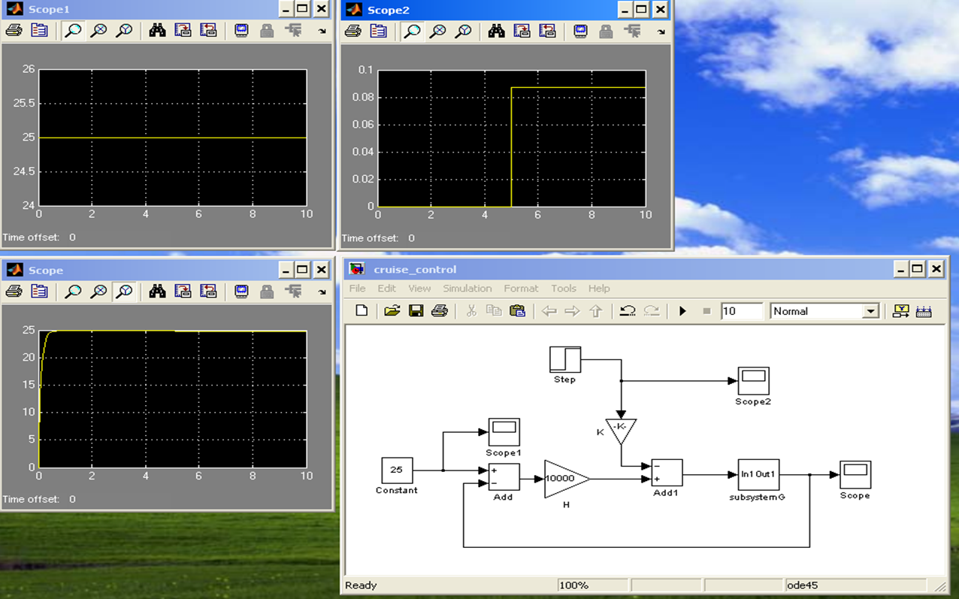
Implementing feedback
cruise_control.mdl

Slide 16
Let’s setup a SIMULINK model of the accelerometer shown before
Position y is with respect of the case, the case’s position is x. What is the transfer function between the input acceleration $A (a={d^{2}x}/{dt^{2}})$ and the output y?
$$−B\frac{dy}{dt}−ky=M \frac{d^{2}}{dt^{2}}\left(y−x\right)$$
y
B
M
k
x

Slide 17
Rule of thumb
For a system represented by an nth order input/output ordinary differential equation it is necessary to integrate the highest derivative n times to obtain the output.
Rearranging terms
$$\frac{d^{2}y}{dt^{2}}=\frac{1}{M}\left(−B\frac{dy}{dt}−ky+Ma\right)$$

Slide 18
The model
acc.mdl

Slide 19
Results
>> m=1;k=1;B=1;
>> [A,B,C,D]=linmod('acc');
>> [num,den]=ss2tf(A,B,C,D);
>> H=tf(num,den)
Transfer function:
1
-----------
s^2 + s + 1
Which confirms our previous finding.

Slide 20
Model the following LRC circuit
$$L$$
$$R$$
$$V_{1}(t)$$
$$C$$
$$V_{2}(t)$$
$$V_{1}\left(t\right)=L\frac{d}{dt}i\left(t\right)+R i\left(t\right)+V_{2}\left(t\right)$$
$$i\left(t\right)=C \frac{dV_{2}(t)}{dt}$$

Slide 21
Model the following LRC circuit
$$L$$
$$R$$
$$V_{1}(t)$$
$$C$$
$$V_{2}(t)$$
$$V_{1}\left(t\right)=L\frac{d}{dt}i(t)+R i(t) +V_{2}(t)$$
$$i\left(t\right)=C \frac{dV_{2}(t)}{dt}$$
$${\ddot{V}}_{2}\left(t\right)=\frac{1}{LC}\left(V_{1}−RC {\dot{V}}_{2}−V_{2}\right)$$

Slide 22
Digital Signal Processing 1
Moving to the digital world
Two classes of signals
Analog
Discrete
Analog signal
Denoted with $x(t)$
$t$ represents time in seconds
Discrete signal
Number sequence $x(n)$
$n$ is an integer, represents discrete instances in time
digsig.m

Slide 23
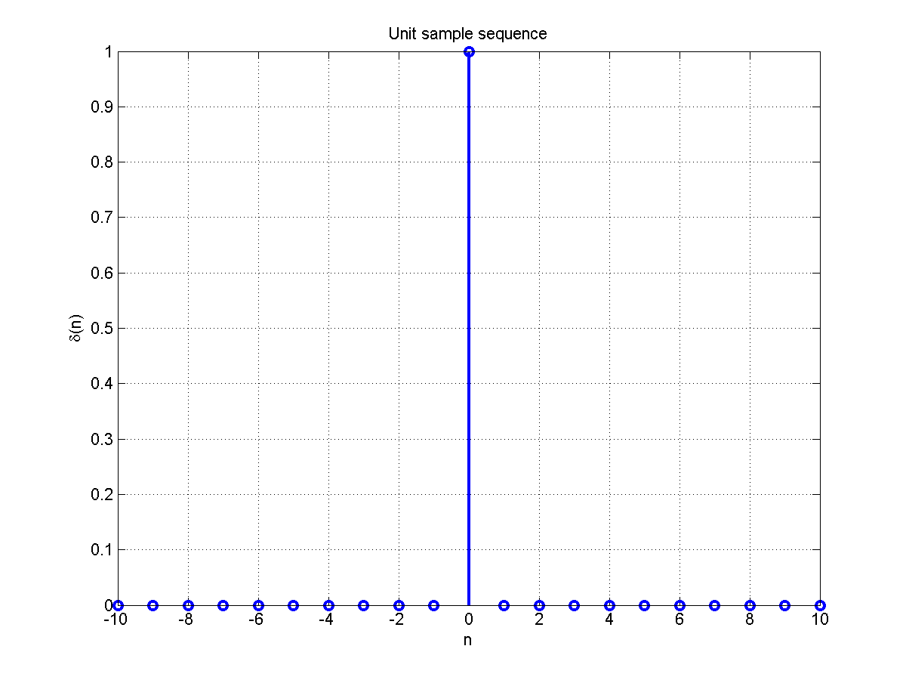
Types of sequences
Unit sample sequence
$$δ\left(n−n_{0}\right)=\left\{\begin{aligned}1, n=n_{0} \\ 0, n≠n_{0}\end{aligned}\right.$$
sequences.m

Slide 24
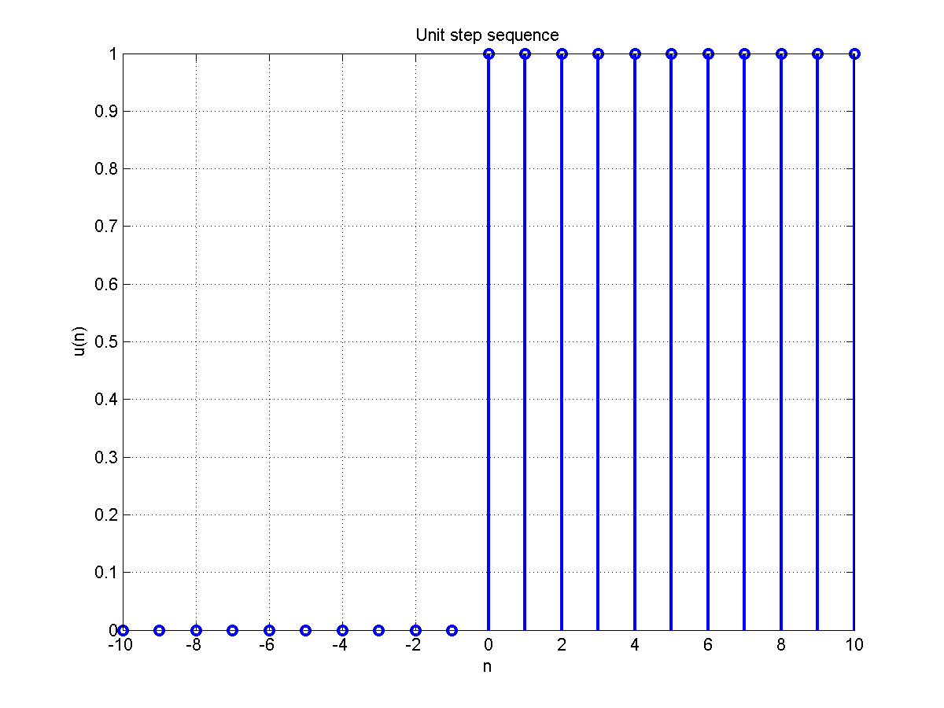
Types of sequences
Unit step sequence
$$u\left(n−n_{0}\right)=\left\{\begin{aligned}1, n≥n_{0} \\ 0, n<n_{0}\end{aligned}\right.$$
sequences.m

Slide 25
Discrete systems
Linear time-invariant (LTI) system L
$y\left(n\right)=\text{L}\left[x\left(n\right)\right]$
Satisfies the principle of superposition
$$\text{L}\left[a_{1}x_{1}\left(n\right)+a_{2}x_{2}(n)\right]==a_{1}\text{L}\left[x_{1}\left(n\right)\right]+a_{2}\text{L}\left[x_{2}\left(n\right)\right]$$
The input-output pair, $x(n)$ and $y(n)$, is invariant to a shift $k$
$$y\left(n−k\right)=\text{L}\left[x\left(n−k\right)\right]$$

Slide 26
Discrete systems
Any sequence $x\left(n\right)$ can be written in terms of scaled and delayed unit sample sequences
$$x\left(n\right)=\sum_{k=−∞}^{∞}{x\left(k\right) δ\left(n−k\right)}$$
The response of an (LTI) system can then be re-written as
$$y\left(n\right)=\text{L}\left[x\left(n\right)\right]=\text{L}\left[\sum_{k=−∞}^{∞}{x\left(k\right) δ\left(n−k\right)}\right]=\sum_{k=−∞}^{∞}{x\left(k\right)}\text{L}\left[δ\left(n−k\right)\right]$$

Slide 27
Discrete systems
$$y\left(n\right)=\sum_{k=−∞}^{∞}{x\left(k\right)}\text{L}\left[δ\left(n−k\right)\right]=\sum_{k=−∞}^{∞}{x\left(k\right)} h\left(n−k\right)$$
$h\left(n\right)$ is the unit sample or impulse response of LTI system
Convolution
$$y\left(n\right)=x\left(n\right)⋆h\left(n\right)=\sum_{k=−∞}^{∞}{x\left(k\right)} h\left(n−k\right)$$

Slide 28
Let’s compute the convolution between two sequences
Let’s define $x\left(n\right)=\left\{1,2,3\right\}$ and $y\left(n\right)=\left\{3,2,1\right\}$ and let’s determine $z\left(n\right)=x(n)⋆y(n)$
For $n=0$
$$z\left(0\right)=\sum_{k=−∞}^{+∞}{x\left(k\right)y(−k)}$$
$$=3$$
k
-4
-3
-2
-1
0
1
2
3
4
5
x(k)
-
-
-
-
1
2
3
-
-
-
y(k)
-
-
-
-
3
2
1
-
-
-
-k
4
3
2
1
0
-1
-2
-3
-4
-5
y(-k)
-
-
1
2
3
-
-
-
-
-
x(k)y(-k)
-
-
-
-
3
-
-
-
-
-
3

Slide 29
Let’s compute the convolution between two sequences
Let’s define $x\left(n\right)=\left\{1,2,3\right\}$ and $y\left(n\right)=\left\{3,2,1\right\}$ and let’s determine $z\left(n\right)=x(n)⋆y(n)$
For $n=1$
$$z\left(1\right)=\sum_{k=−∞}^{+∞}{x\left(k\right)y(1−k)}$$
$$=8$$
k
-4
-3
-2
-1
0
1
2
3
4
5
x(k)
-
-
-
-
1
2
3
-
-
-
y(k)
-
-
-
-
3
2
1
-
-
-
1-k
5
4
3
2
1
0
-1
-2
-3
-4
y(1-k)
-
-
-
1
2
3
-
-
-
-
x(k)y(1-k)
-
-
-
-
2
6
-
-
-
-
8

Slide 30
Let’s compute the convolution between two sequences
Let’s define $x\left(n\right)=\left\{1,2,3\right\}$ and $y\left(n\right)=\left\{3,2,1\right\}$ and let’s determine $z\left(n\right)=x(n)⋆y(n)$
Using MATLAB to confirm results
>> conv([3 2 1],[1 2 3])
ans =
3 8 14 8 3
n | $$z\left(n\right)=x(n)⋆y(n)$$
0 | 3
1 | 8
2 | 14
3 | 8
4 | 3

Slide 31
Stability
An LTI system $\text{L}$is stable if and only if its impulse response is absolutely summable
$$\sum_{−∞}^{+∞}{\left|h(n)\right|<∞}$$

Slide 32
Correlation of sequences
The correlation between two sequences $x(n)$ and $y(n)$ is defined as
$$r_{x,y}\left(l\right)=\sum_{n=−∞}^{∞}{x\left(n\right)y(n−l)}=x(l)⋆y(−l)$$
where
$r$ is the correlation (degree to which the two signals are similar) and
$l$ is the lag.

Slide 33
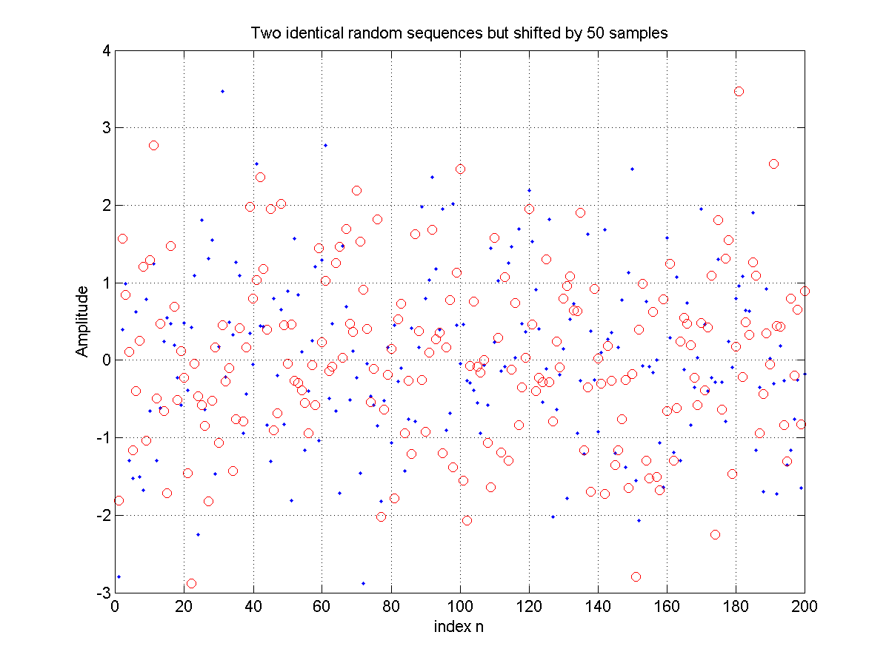
Example
Generating two identical random sequences, one of them shifted by 50 samples.
conv_example2.m

Slide 34
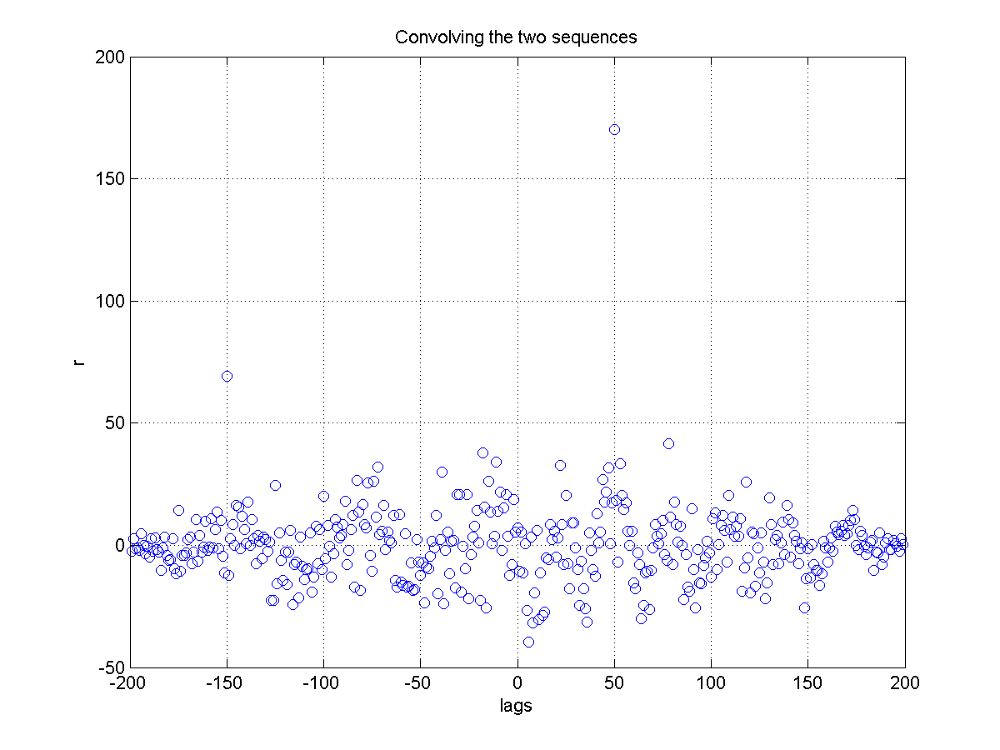
Example
Taking the correlation between them using MATLAB’s xcorr command we find highest correlation at lag 50.
conv_example2.m

Slide 35
Example
Using MATLAB’s xcorr or conv command.
>> [r,lags]=xcorr(x,y);
>> plot(lags,r,'bo')
or
>> r2=conv(x,fliplr(y),'same');
conv_example2.m

Slide 36
Exercise
In a certain concert hall, echoes of the original audio signal $x(n)$ are generated due to reflections at the walls and ceiling. The audio signal experienced by the listener $y(n)$ is a combination of $x(n)$ and its echoes. Let
$$y\left(n\right)=x\left(n\right)+∝x(n−k)$$
where k is the amount of delay in samples and $∝$ is its relative strength.
Estimate the delay $k$ assuming the original signal is a Sine-Gaussian
$$x\left(n\right)=\sin\left(0.05 π n\right)e^{−\frac{{\left(n−n_{0}\right)}^{2}}{τ^{2}}}$$
with $n_{0}=200$, $τ=50$ and $∝=50\%$.

Slide 37
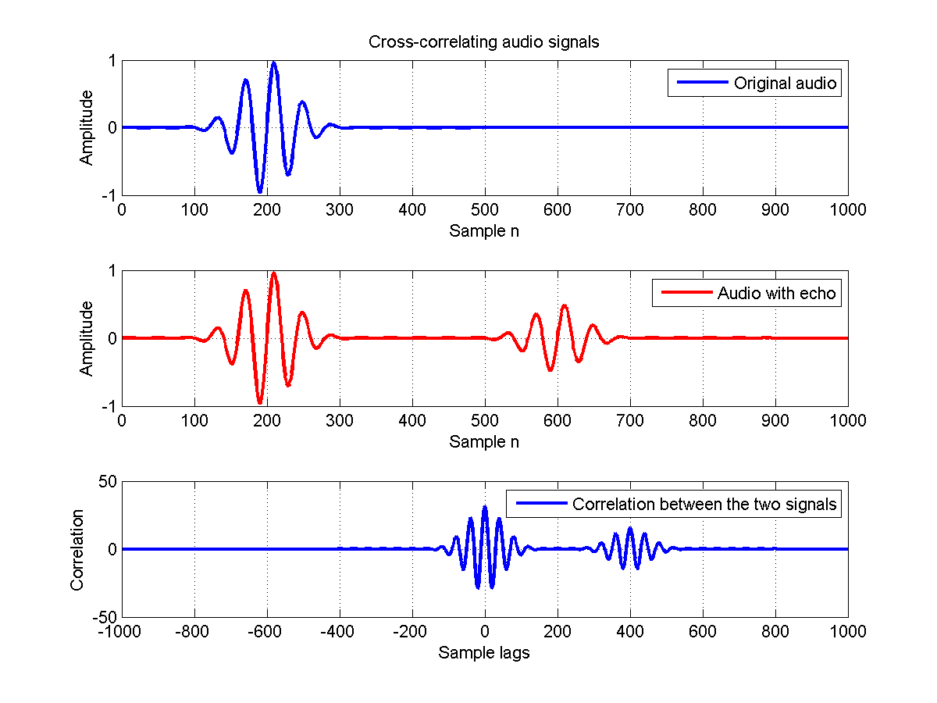
ex28.m

Slide 38
Signal Energy
The energy of a sequence $x(n)$ is given by
$$ℰ_{x}=\sum_{−∞}^{∞}{{\left|x(n)\right|}^{2}}$$

Slide 39
Differential to difference equations
In the analog world:
$$y\left(t\right)=\frac{dx(t)}{dt}$$
x(t)
$$d/{dt}$$
y(t)

Slide 40
Differential to difference equations
In the digital world:
$$y\left(t\right)=\frac{dx(t)}{dt}=\lim_{∆t→0}{\frac{x\left(t\right)−x\left(t−∆t\right)}{∆t}}$$
In the limit $F_{s}→∞$
$$≅\frac{x\left(t\right)−x(t−∆t)}{∆t}$$
$$y\left(n\right)=x\left(n\right)−x\left(n−1\right) (∆t=1)$$
The original differential equation is approximated by a difference equation

Slide 41
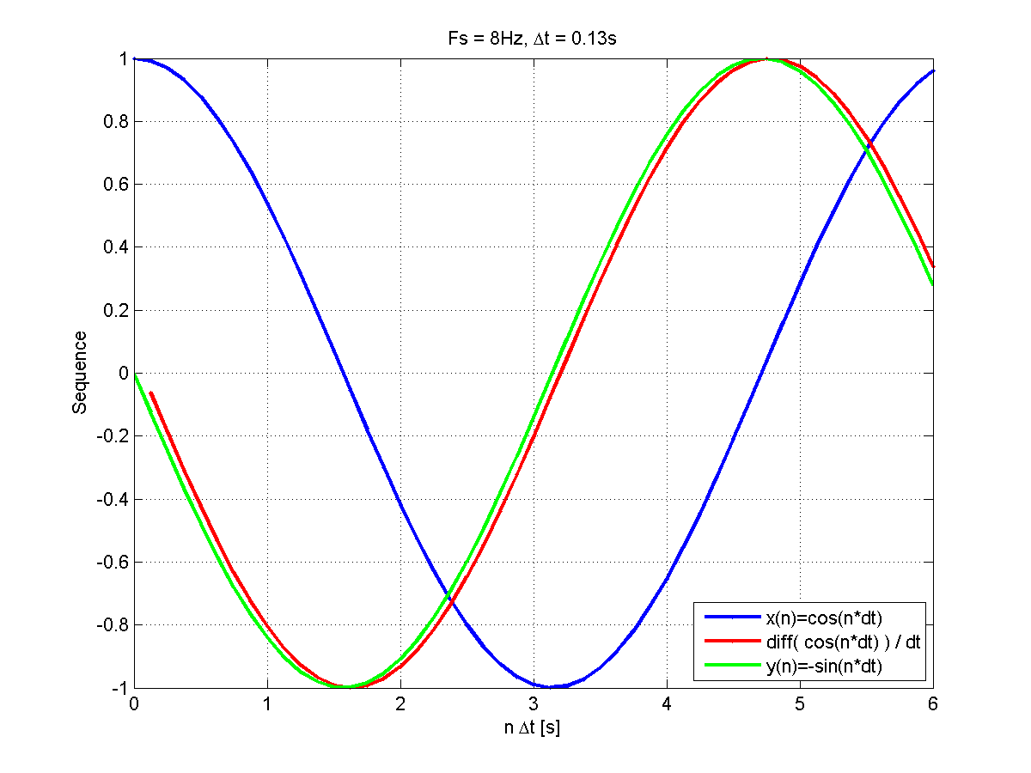
>> diff(x)
$$y\left(t\right)=\frac{dx(t)}{dt}$$
$$y\left(n\right)=x\left(n\right)−x\left(n−1\right)$$
$$x\left(n\right)=cos⁡(n)$$
In the limit $F_{s}→∞$
difference.m
$$y\left(n\right)=−sin⁡(n)$$

Slide 42
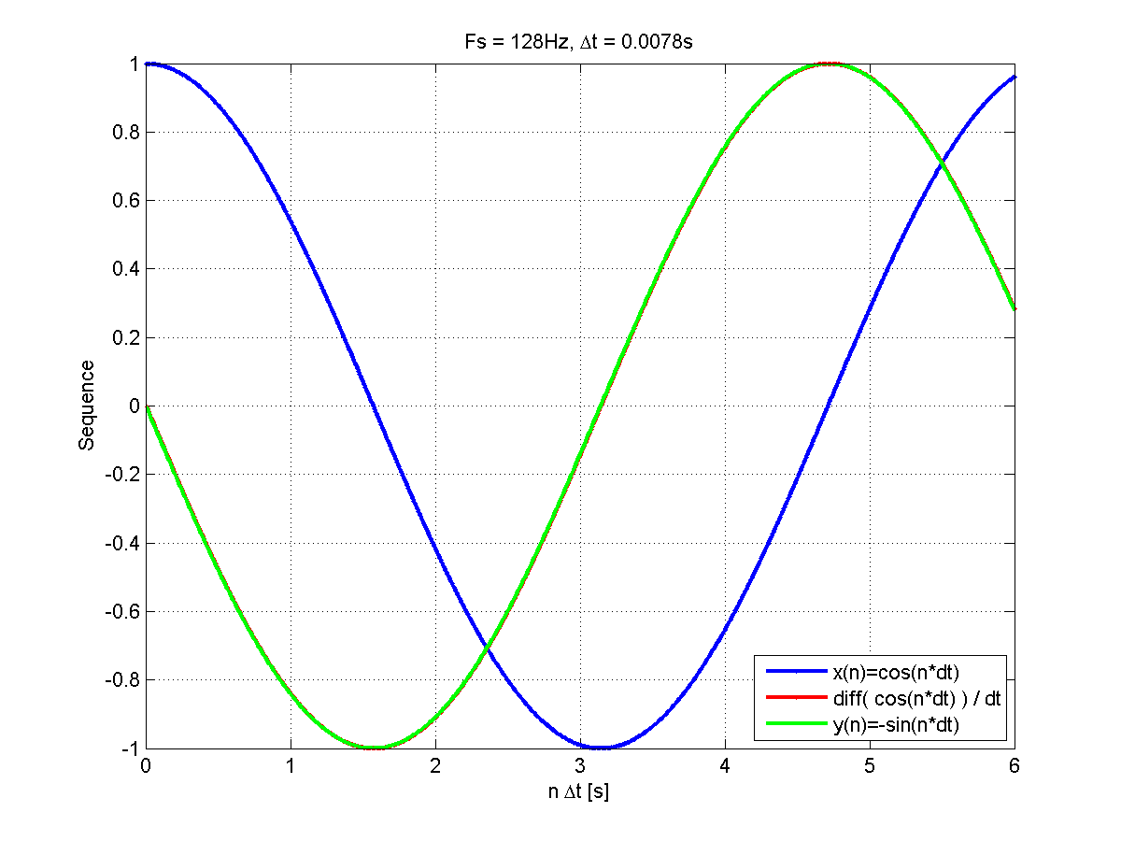
>> diff(x)
$$y\left(t\right)=\frac{dx(t)}{dt}$$
$$y\left(n\right)=x\left(n\right)−x\left(n−1\right)$$
$$x\left(n\right)=cos⁡(n)$$
In the limit $F_{s}→∞$
difference.m
$$y\left(n\right)=−sin⁡(n)$$

Slide 43
Difference equations
In general, a difference equation is of the form
$$\sum_{k=0}^{N}{a_{k} y\left(n−k\right)=\sum_{m=0}^{M}{b_{m}x\left(n−m\right)}}$$
where $x(n)$ is the input sequence
$y(n)$ is the output sequence and
$a_{k}$ and $b_{m}$ are the coefficients of $y(n)$ and $x(n)$ respectively.
The MATLAB filter command solves the difference equations numerically – filtering input sequence $x(n)$
>> y = filter(b, a, x)

Slide 44
Impulse response $h(n)$
To generate the impulse response of an LTI system described by the difference equation
$$\sum_{k=0}^{N}{a_{k} y\left(n−k\right)=\sum_{m=0}^{M}{b_{m}x\left(n−m\right)}}$$
use the filter command:
>> h = filter(b, a, delta)
By plotting $h$ you can visualize if the system is stable

Slide 45
Example
An LTI system is described by the following difference equation
$$y\left(n\right)−y\left(n−1\right)+0.9 y\left(n−2\right)=x(n)$$
Plot the impulse response $h$ for $0≤n≤100$ and determine if system is stable.

Slide 46
Example
An LTI system is described by the following difference equation
$$y\left(n\right)−y\left(n−1\right)+0.9 y\left(n−2\right)=x(n)$$
Plot the impulse response $h$ for $0≤n≤100$ and determine if system is stable.
Generating the delta function with MATLAB
>> x = zeros(1,100);
>> x(1) = 1;
>> plot(x,'bo-')
ex29.m

Slide 47
Example
An LTI system is described by the following difference equation
$$y\left(n\right)−y\left(n−1\right)+0.9 y\left(n−2\right)=x(n)$$
Plot the impulse response $h$ for $0≤n≤100$ and determine if system is stable.
Generating the response
>> b=1;
>> a=[1 -1 0.9];
>> h=filter(b,a,x);
>> plot(h,'bo-')
System is stable
ex29.m

Slide 48
Exercise
An LTI system is described by the difference equation
$$y\left(n\right)−0.5 y\left(n−1\right)+0.25 y\left(n−2\right)=x\left(n\right)+2 x\left(n−1\right)+x(n−3)$$
Plot its impulse response $h$ and determine the stability of the system.

Slide 49
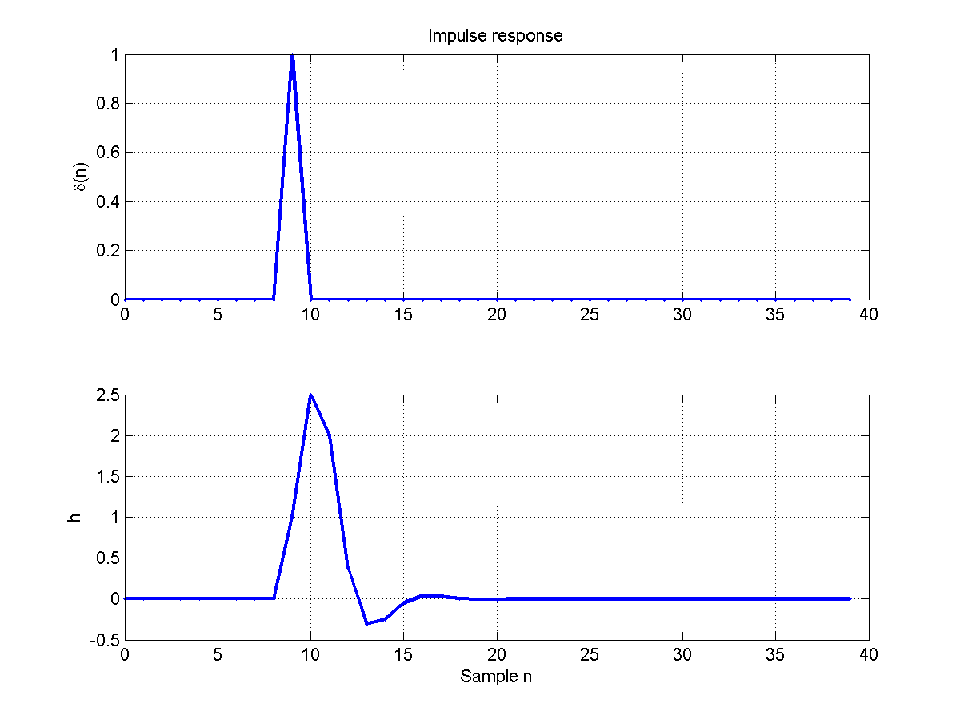
ex216.m
Generating the response
>> b=[1 2 0 1];
>> a=[1 -0.5 0.25];
>> h=filter(b,a,$δ$);
>> plot(h,'b-')

Slide 50
Cruise control case
Direction of motion
Physical system described by the following equation of motion
$$\sum_{road}{f}=f−f_{fr}=ma$$
Simplifying and assuming friction force is proportional to speed
$$\boxed{m\frac{dv}{dt}=f−bv}$$
Normal force (n)
Friction force (f_{fr})
Force from engine (f)
Weight (mg)

Slide 51
In the digital world
$$m\frac{dy(t)}{dt}=x\left(t\right)−by\left(t\right)$$
$$1050 y\left(n\right)−1000 y\left(n−1\right)=x\left(n\right) (∆t=1)$$

Slide 52
Numerical solution
In the limit $F_{s}→∞$
difference2.m

Slide 53
Numerical solution
In the limit $F_{s}→∞$
difference2.m

Slide 54
Summary
SIMULINK – time domain simulation, can handle non-linear systems.
Tutorial
A suggestion for re-writing the differential equation is given in order to facilitates designing the model
Analog to digital
Signals to sequences
Impulse response of a system $h$
$$y\left(n\right)=\sum_{k=−∞}^{∞}{x\left(k\right)}\text{L}\left[δ\left(n−k\right)\right]=\sum_{k=−∞}^{∞}{x\left(k\right)} h\left(n−k\right)$$
Convolution and correlation
$$z\left(n\right)=x(n)⋆y(n)$$
$$r_{x,y}\left(l\right)=x(l)⋆y(−l)$$
Condition of stability
$$\sum_{−∞}^{+∞}{\left|h(n)\right|<∞}$$
Differential to difference equations
General form of a difference equation
MATLAB’s filter to numerically solve difference equations
Impulse response can be determined by using the filter command and setting the input to a delta sequence.

