Slide 1
So far
We have introduced the Z transform
The digital equivalent of the Laplace transform
It facilitates the solving of difference equations
It allows to easily evaluate the system’s response
It is critical in designing linear filters
The Discrete-time Fourier Transform (DTFT)
$z=e^{jω}$ in the $\text{Z}$ transform
Mapping into frequency space
The Discrete Fourier Transform (DFT)
The sampling of the DTFT in the frequency domain
FFT: Fast Fourier Transform
Algorithm for the efficient computation of DFTs
Sampling principle
The signal’s bandwidth $F_{0}$ must be less than the Nyquist frequency $F_{n}=F_{s}/2$ in order to avoid aliasing

Slide 2
Digital Signal Processing 3
Digital Filters
An LTI system to frequency select or discriminate
Two classes
Finite-duration impulse response (FIR) Filters
Infinite-duration impulse response (IIR) Filters

Slide 3
FIR filter
The filter’s unit impulse response is of finite duration
Its response settles to zero in a finite time
There is no “feedback”
Difference equation
$$y\left(n\right)=\sum_{m=0}^{M}{b_{m}} x\left(n−m\right)$$
Also referred to as recursive or moving average filters.

Slide 4
IIR filter
The filter’s unit impulse response is of infinite duration
Difference equation
$$\sum_{k=0}^{N}{a_{k}} y\left(n−k\right)=x\left(n\right)$$
Output is recursively computed from previous computed values → infinite duration response

Slide 5
FIR filter example: Moving Average (MA)
In general
$$y\left(n\right)=\sum_{i=0}^{N}{b_{i}} x\left(n−i\right), b_{i}=\frac{1}{N+1}$$
For $N=1$
$$y\left(n\right)=\frac{1}{2} x\left(n\right)+\frac{1}{2} x\left(n−1\right)$$

Slide 6
To the Z domain
Recall: when an LTI system is represented by the difference equation
$$y\left(n\right)+\sum_{k=1}^{N}{a_{k} y\left(n−k\right)=\sum_{l=0}^{M}{b_{l} x\left(n−l\right)}}$$
Then
$$H\left(z\right)=\frac{\sum_{l=0}^{M}{b_{l}} z^{−l}}{1+\sum_{k=1}^{N}{a_{k}} z^{−k}}$$

Slide 7
System function $H\left(z\right)$
Coefficients a and b are
$$a_{0}=1, b_{0}=b_{1}=1/2$$
$$H\left(z\right)=\frac{1}{2} \left(1+z^{−1}\right)=\frac{1}{2} \left(\frac{z+1}{z}\right)$$
With a pole at the origin, and a zero at -1.

Slide 8
MA_example.m
>> a=1; b=[1/2 1/2];
>> zplane(b,a)

Slide 9
Recall: difference equation and the filter command
In general, a difference equation is of the form
$$y\left(n\right)+\sum_{k=1}^{N}{a_{k} y\left(n−k\right)=\sum_{l=0}^{M}{b_{l} x\left(n−l\right)}}$$
The MATLAB filter command solves the difference equations numerically
Given the input sequence $x(n)$, the output sequence $y(n)$ is computed using
>> y = filter(b, a, x)

Slide 10
Let’s apply the filter to a data stream
Step function imbedded in noise is shown to the right.
Let’s apply the N=2 moving average filter
>> a=1;
>> b=[1/2 1/2];
>> y = filter(b, a, x);
MA_example.m

Slide 11
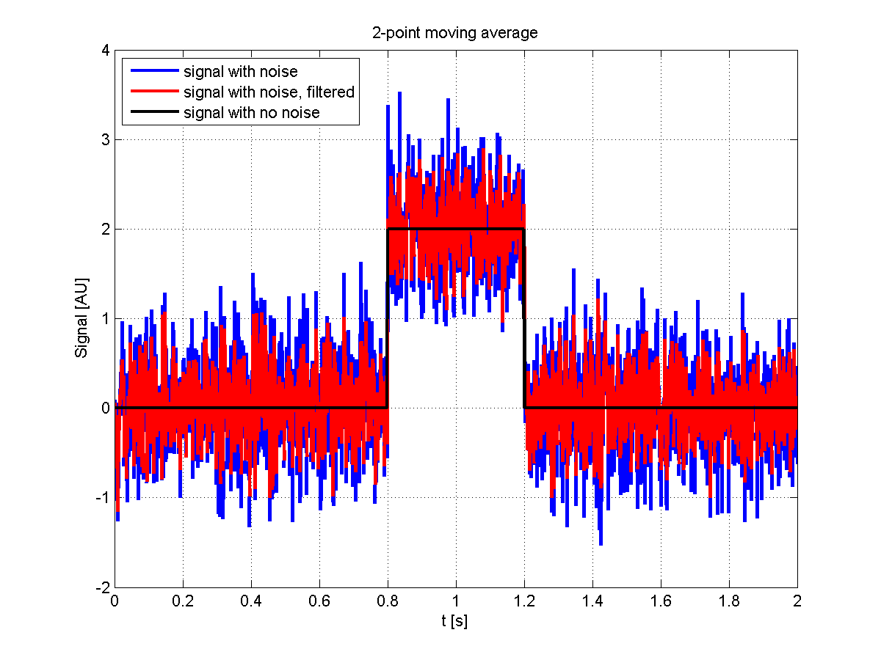
MA_example.m

Slide 12
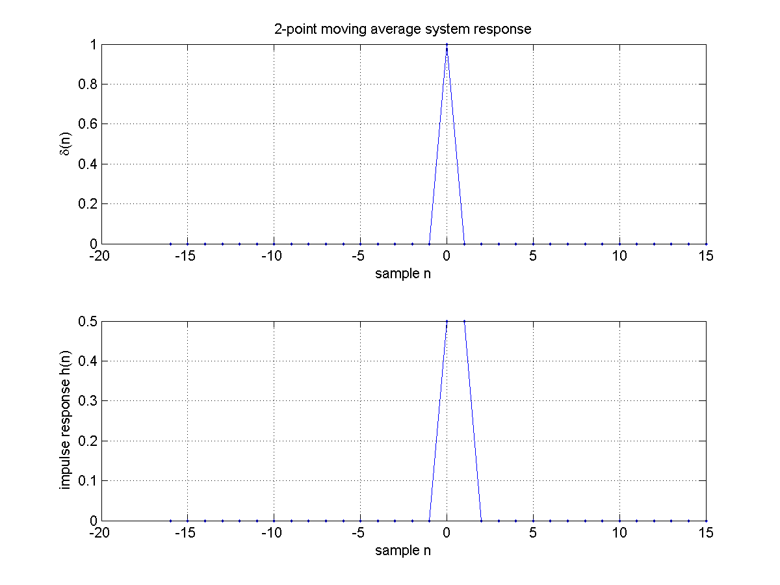
The impulse response function $h$
$$a_{0}=1, b_{0}=b_{1}=1/2$$
MA_example.m
>> h = filter(b, a, delta)

Slide 13
The impulse response function $h$
From the filter command
$$h\left(0\right)=h\left(1\right)=\frac{1}{2}$$
The system’s response
$$y\left(n\right)=\sum_{i=0}^{N}{b_{i}} x\left(n−i\right)=\sum_{i=0}^{N}{b_{i}} δ\left(n−i\right) \text{with} b_{i}=\frac{1}{N+1}$$
$$h\left(n\right)=b_{n}$$

Slide 14
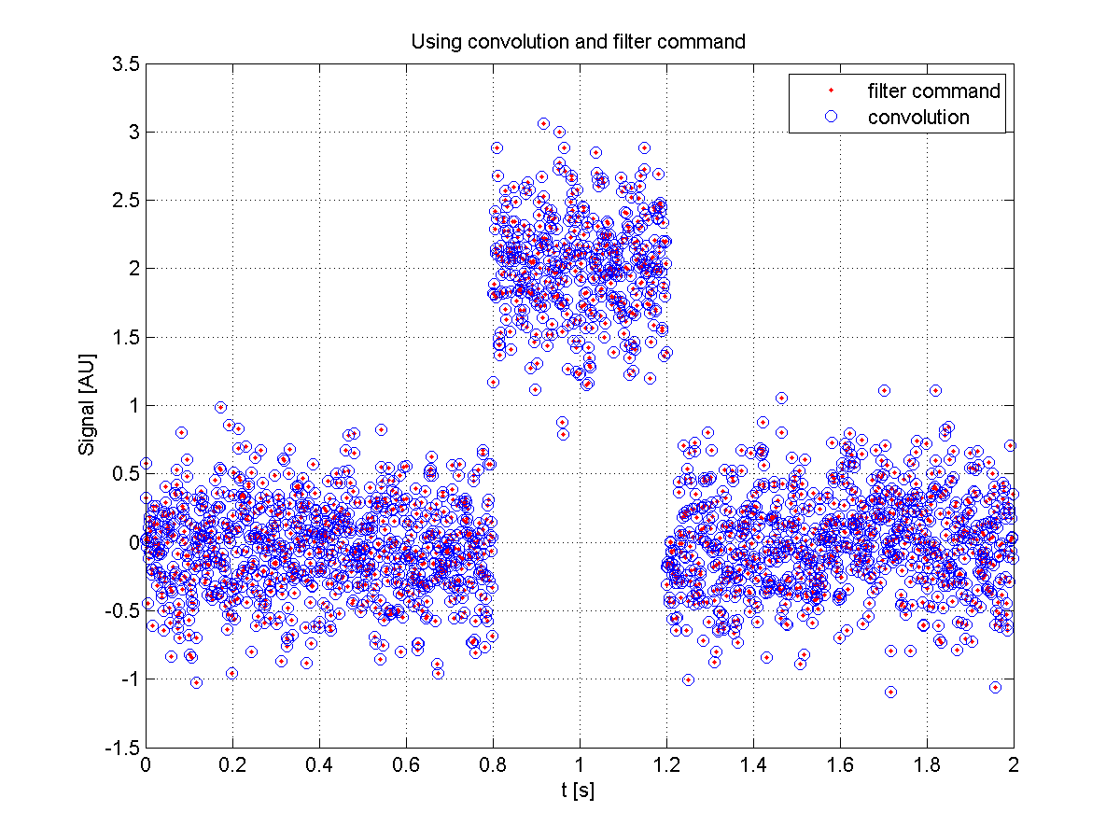
Comparing the filter output with convolution
MA_example.m
>> y = conv(x,h,’same’)

Slide 15
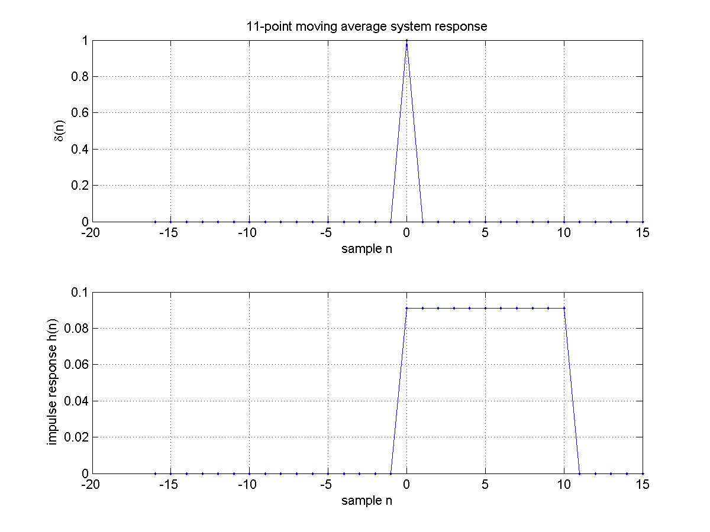
Increasing filter order
MA_exampleB.m

Slide 16
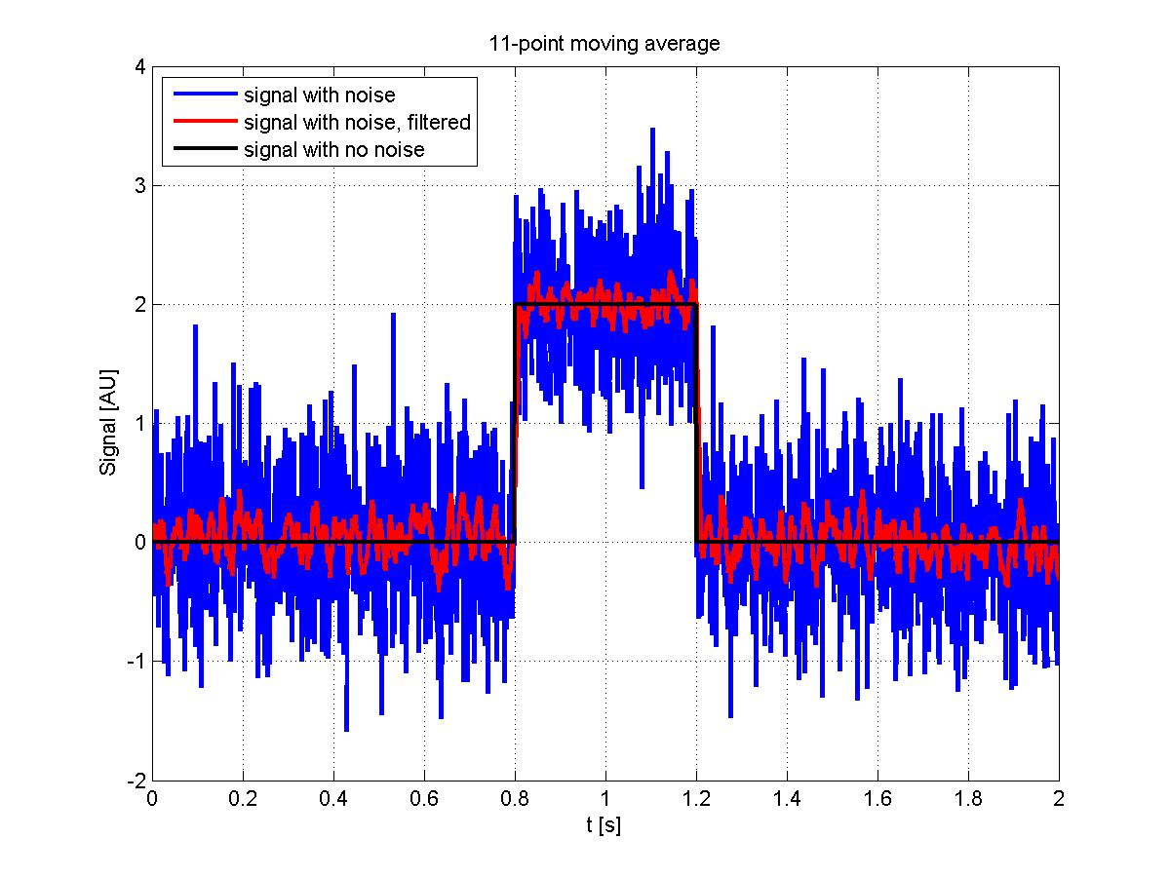
Increasing filter order
MA_exampleB.m

Slide 17
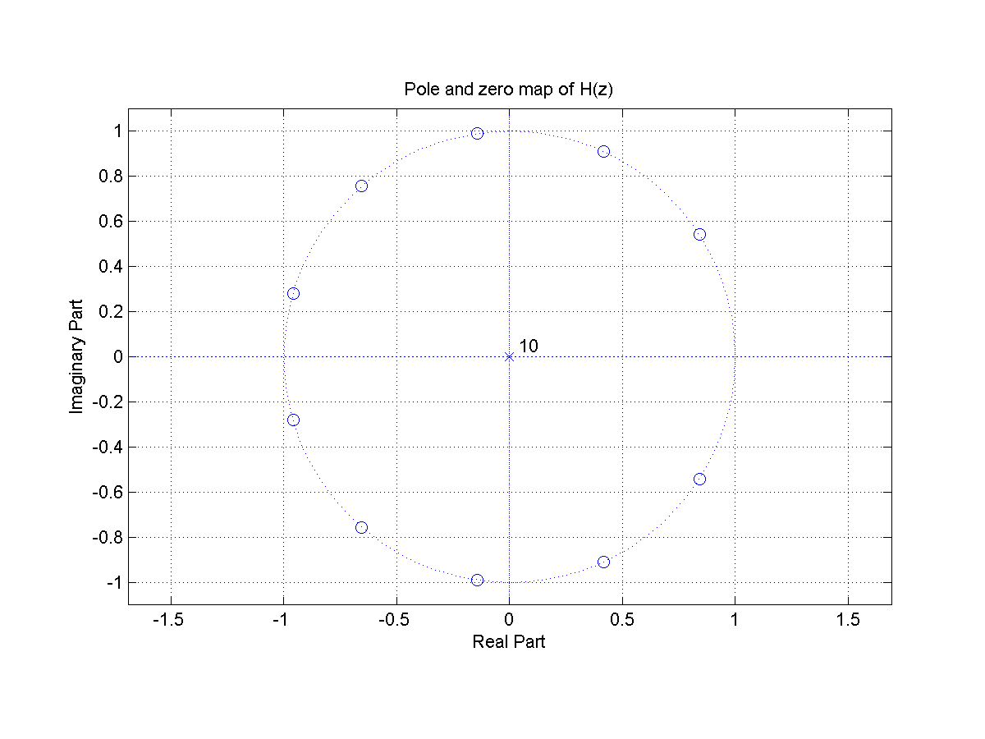
Increasing filter order
MA_exampleB.m

Slide 18
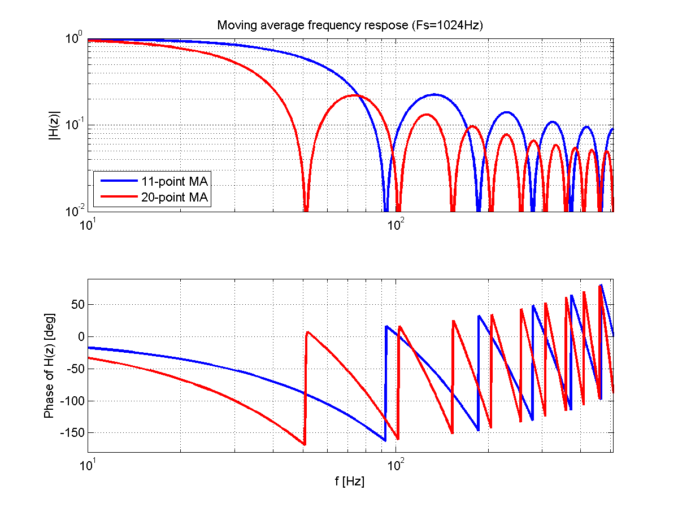
Frequency response of moving average filter
MA_exampleB.m
>> [H, f]= freqz(b,a,1000,Fs)

Slide 19
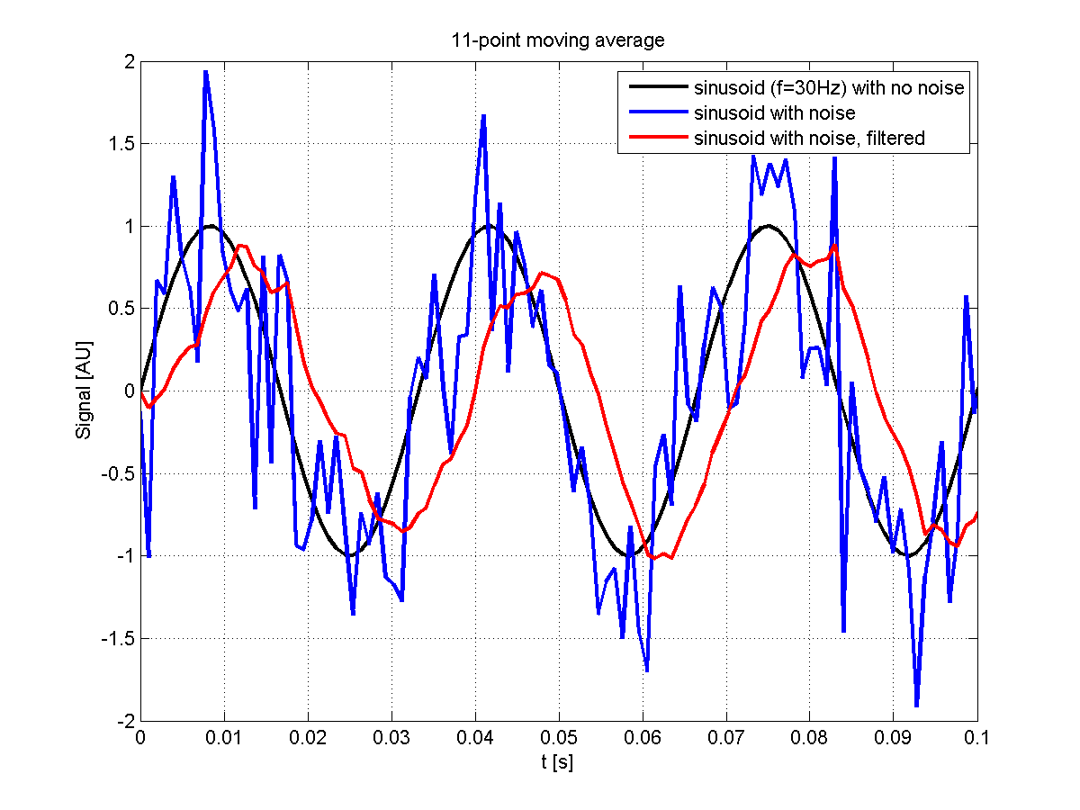
Suppression but with phase delay
MA_exampleC.m

Slide 20
Analog-to-digital filter transformation
First, we design an analog filter that satisfies the specifications.
Then we transform it into the digital domain.
Many transformations are available
Impulse invariance
Designed to preserve the shape of the impulse response from analog to digital
Finite difference approximation
Specifically designed to convert a differential equation representation to a difference equation representation
Step invariance
Designed to preserve the shape of the step response
Bilinear transformation
Most popular technique
Preserves the system’s function representation from analog to digital

Slide 21
Filter stability in the analog and digital domain
Analog domain
(s-plane)
Digital domain
(z-plane)
$$\text{Im}\left(s\right)$$
$$\text{Im}\left(z\right)$$
Region of stability
$$\left|z\right|=1$$
$$\text{Re}\left(s\right)$$
$$\text{Re}\left(z\right)$$
Poles must have a negative real part
Poles are inside the unit circle $\left|z\right|=1$
21

Slide 22
Bilinear transformation
Analog domain
(s-plane)
Digital domain
(z-plane)
$$\text{Im}\left(s\right)$$
$$\text{Im}\left(z\right)$$
$$\left|z\right|=1$$
$$\text{Re}\left(s\right)$$
$$\text{Re}\left(z\right)$$
Mapping between the two stability regions
22

Slide 23
Bilinear transformation
Analog domain
(s-plane)
Digital domain
(z-plane)
$$\text{Im}\left(s\right)$$
$$\text{Im}\left(z\right)$$
Sampling time $T_{s}$
$$\left|z\right|=1$$
$$\text{Re}\left(s\right)$$
$$\text{Re}\left(z\right)$$
$$s=\frac{2}{T_{s}}∙\frac{1−z^{−1}}{1+z^{−1}}$$
$$z=\frac{1+sT_{s}/2}{1−sT_{s}/2}$$
23

Slide 24
Transformation example
Transform
$$H_{a}\left(s\right)=\frac{s+1}{s^{2}+5s+6}$$
into a digital filter with sampling $T_{s}=1 s$.
Sol.
$$H\left(z\right)=H_{a}\left(\frac{2}{0.1}∙\frac{1−z^{−1}}{1+z^{−1}}\right)=\frac{3+2z^{−1}−z^{−2}}{20+4z^{−1}}$$

Slide 25
Transformation example
bilinearexample.m

Slide 26
Transformation example
bilinearexample3.m

Slide 27
Filter Design
Filter specifications
Constraints on the suppression factor
Constraints on the phase response
Constraints on the impulse response
Constraints on the step response
FIR or IIR
Filter order
Typical filters
Low pass, High pass, Band pass and Band stop

Slide 28
FIR or IIR?
Advantages of FIR filters over IIR
Can be designed to have a “linear phase”. This would “delay” the input signal but would not distort it
Simple to implement
Always stable
Disadvantages
IIR filters are better in approximating analog systems
For a given magnitude response specification, IIR filters often require much less computation than an equivalent FIR

Slide 29
Low pass (LP) filter specifications
LP filter
low frequencies pass, high frequencies are attenuated.
Include
target magnitude response
phase response, and
the allowable deviation for each
Transition band
frequency range from the passband edge frequency to the stopband edge frequency
Ripples
The filter passband and stopband can contain oscillations, referred to as ripples. Peak-to-peak value, usually expressed in dB.

Slide 30
High pass (HP) filter specifications
HP filter
High frequencies pass, low frequencies are attenuated.

Slide 31
Band pass (BP) filter specifications
BP filter
a certain band of frequencies pass while lower and higher frequencies are attenuated.

Slide 32
Band stop (BS) filter specifications
BS filter
attenuates a certain band of frequencies and passes all frequencies not within the band.

Slide 33
A few types of IIR filters
Butterworth
Designed to have as flat a frequency response as possible in the passband
Chebyshev Type 1
Steeper roll-off but more pass band ripple
Chebyshev Type 2
Steeper roll-off but more stop band ripple
Elliptic
Fastest transition

Slide 34
Comparison
Sampling frequency set to 16384 Hz
Filter order set to 10, cutoff set at 1 kHz
Difficult comparison: specifications for each filter can be very different
filter_plots.m

Slide 35
Comments
Chebyshev filter has a steeper roll-off with respect to the Butterworth filter
The elliptical filter has the fastest roll-off
Elliptical’s attenuation factor at high frequency is constant, unlike the others.
Elliptical has the least phase delay with respect to the others
Notice: the performance of a FIR window filter of 10th order is also shown. For it to achieve the same performance as the others, the filter order must be increased significantly
filter_plots.m

Slide 36
Comments
The Butterworth filter has a flattest response when compared to the others.
There is a trade off
The faster the roll-offs, the greater the ripples
filter_plots.m

Slide 37
MATLAB’s fdatool
Filter Design and Analysis Tool
Allows you to design (visually) a digital filter
Can export the filter into different formats
Filter coefficients
MATLAB’s transfer function object
…
>> fdatool

Slide 38
MATLAB’s fdatool
Exporting
Coefficients a, b
Transfer function object Hd
Second-order-sections sos
The system function H(z) can be factored into second-order-sections. The system is then represented as a product of these sections.
Assuming input signal x, the output y:
y = filter(Hd,x)
y = filter(b,a,x)
y = sosfilt(sos,x)

Slide 39
Sampling: Analog-to-Digital conversion
Transforms analog signal to digital sequence
Main components of an A/D converter
$$T_{s}$$
$$∆$$
$$x_{a}\left(t\right)$$
$$x\left(n\right)$$
c$\left(n\right)$
C/D
Quantizer
Encoder
Bit stream $c\left(t\right)$: corresponds to discrete time sequence $x\left(n\right)$
Analog signal $x_{a}\left(t\right)$: real valued function of a continuous variable $t$

Slide 40
Sampling: Analog-to-Digital conversion
Transforms analog signal to digital sequence
Main components of an A/D converter
Quantization interval $∆$: amplitude is integer multiple of $∆$ (determined by the number of bits)
$$T_{s}$$
$$∆$$
$$x_{a}\left(t\right)$$
$$x\left(n\right)$$
c$\left(n\right)$
C/D
Quantizer
Encoder
Sampler C/D: continuous-to-discrete converter or an ideal A/D converter:
$$x\left(n\right)=x_{a}\left(nT_{s}\right)$$
Quantizer: maps continuous range of possible amplitudes into a discrete set of amplitudes

Slide 41
Sampling: Analog-to-Digital conversion
Transforms analog signal to digital sequence
Main components of an A/D converter
$$T_{s}$$
$$∆$$
$$x_{a}\left(t\right)$$
$$x\left(n\right)$$
c$\left(n\right)$
C/D
Quantizer
Encoder
Encoder: produces a sequence of binary codewords

Slide 42
Sampling: Analog-to-Digital conversion
Anti-aliasing filter
Signals in physical systems will never be exactly bandlimited, aliasing can occur
(Analog) lowpass at the Nyquist frequency.
This minimizes signal energy above the Nyquist frequency, minimizing aliasing
$$T_{s}$$
$$x_{a}\left(t\right)$$
$${\tilde{x}}_{a}\left(t\right)$$
$$x\left(n\right)$$
AA
C/D

Slide 43
Sampling: Analog-to-Digital conversion
Anti-aliasing filter
Signals in physical systems will never be exactly bandlimited, aliasing can occur
Analog lowpass filter that minimizes signal energy above the Nyquist frequency
$$T_{s}$$
$$x_{a}\left(t\right)$$
$${\tilde{x}}_{a}\left(t\right)$$
$$x\left(n\right)$$
AA
C/D

Slide 44
And back: Digital-to-Analog conversion
Two steps involved
Conversion to rectangular pulses
Pulses cause multiple harmonics above the Nyquist frequency
This excess noise is reduced with an (analog) low pass filter (or reconstruction filter)
$$x\left(n\right)$$
Convert to impulses
$$x_{s}\left(t\right)$$
$$x_{a}\left(t\right)$$
LP filter

Slide 45
Thank You!!

