Slide 1

Results from TOBAs
Cross correlation analysis to search for a Stochastic Gravitational Wave Background
University of Tokyo
Ayaka Shoda
M. Ando, K. Okada, K. Ishidoshiro,
W. Kokuyama, Y. Aso, K. Tsubono

Slide 2
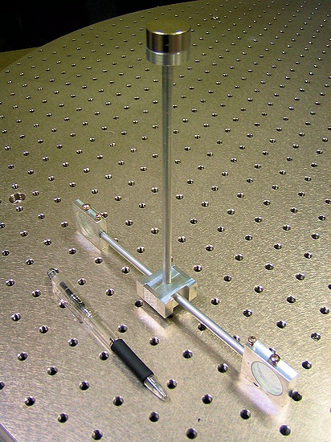
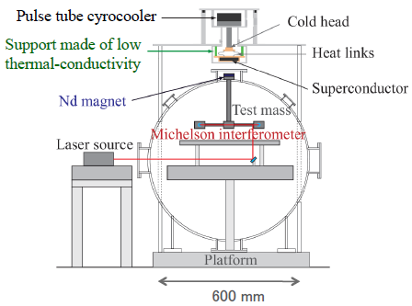
Prototype TOBA
20-cm small torsion bar
Suspended by the flux pinning effect
of the superconductor
Rotation monitor:
laser Michelson interferometer
Actuator: coil-magnet actuator
20cm

Slide 3
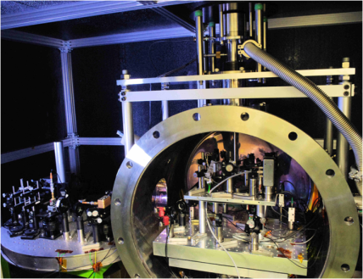
Prototype TOBA
Superconductor
Interferometer
Test mass
Laser source

Slide 4
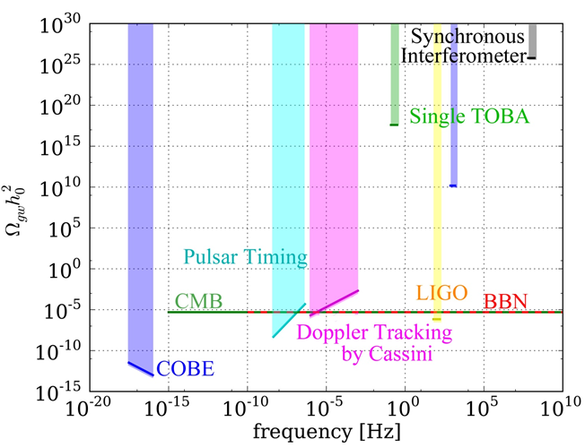
Previous Result
Upper limit on a stochastic GW background
For the detection of a stochastic gravitational-wave background,
simultaneous observation is necessary.

Slide 5
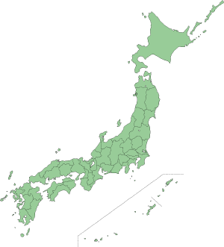
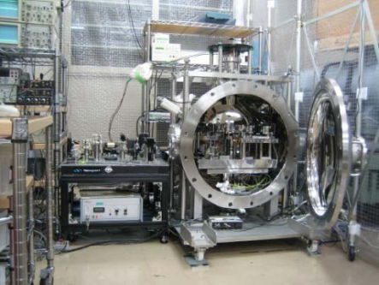
Simultaneous Observation
Kyoto
Tokyo
Tokyo
Kyoto
~370km
DATE: 21:30 – 7:30, Oct. 29, 2011
Sampling frequency: 500 Hz,
the direction of the test mass:
north-south

Slide 6
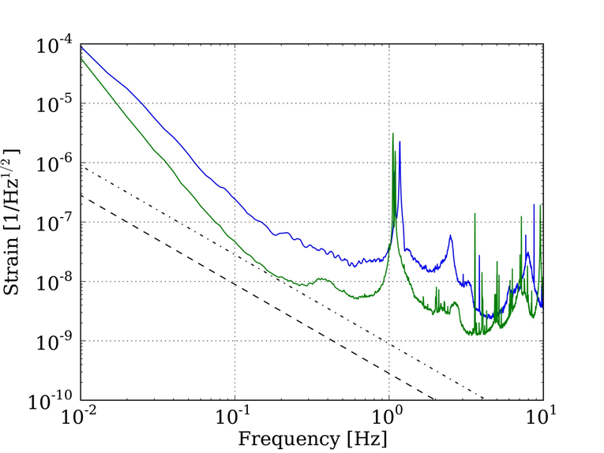
Data Quality
Equivalent Strain Noise Spectra
Magnetic coupling
Seismic
Tokyo
Kyoto

Slide 7
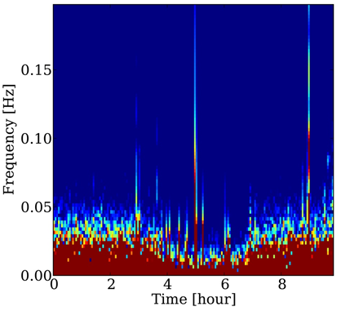
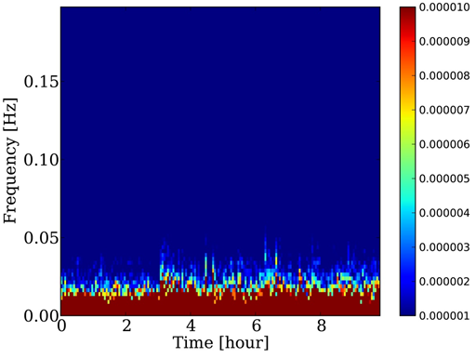
Data Quality
Spectrogram
Tokyo
Kyoto
×10⁻⁶
10
9
8
7
6
5
4
3
2
1
Glitches
→The data should
be selected

Slide 8
Cross Correlation Analysis
Concept
difficult to predict the waveform of a stochastic GW background
Search the coherent signal
on the data of the two detectors.
Correlation Value
: The signal of i-th detector
: The optimal filter
(Weighting function)

Slide 9
Cross Correlation Analysis
Data selection
Calculate the cross correlation value
Detection test
Set the upper limit
Divide the time series data into 200sec long segments
Delete 10% of the segments whose noise level is worst
Choose the analyzed frequency band as
0.035 – 0.84 Hz
If not detected
Inject mock signals into the real data and calculate
the detection efficiency

Slide 10
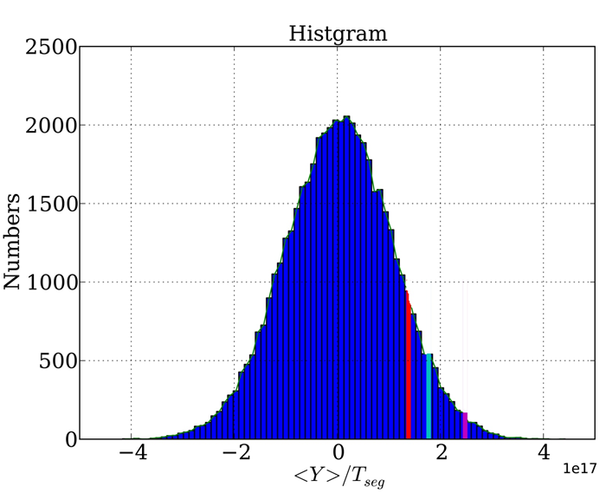
Result
Histogram and Cross correlation value
Detection threshold
for false alarm rate 5%
NO SIGNAL

Slide 11
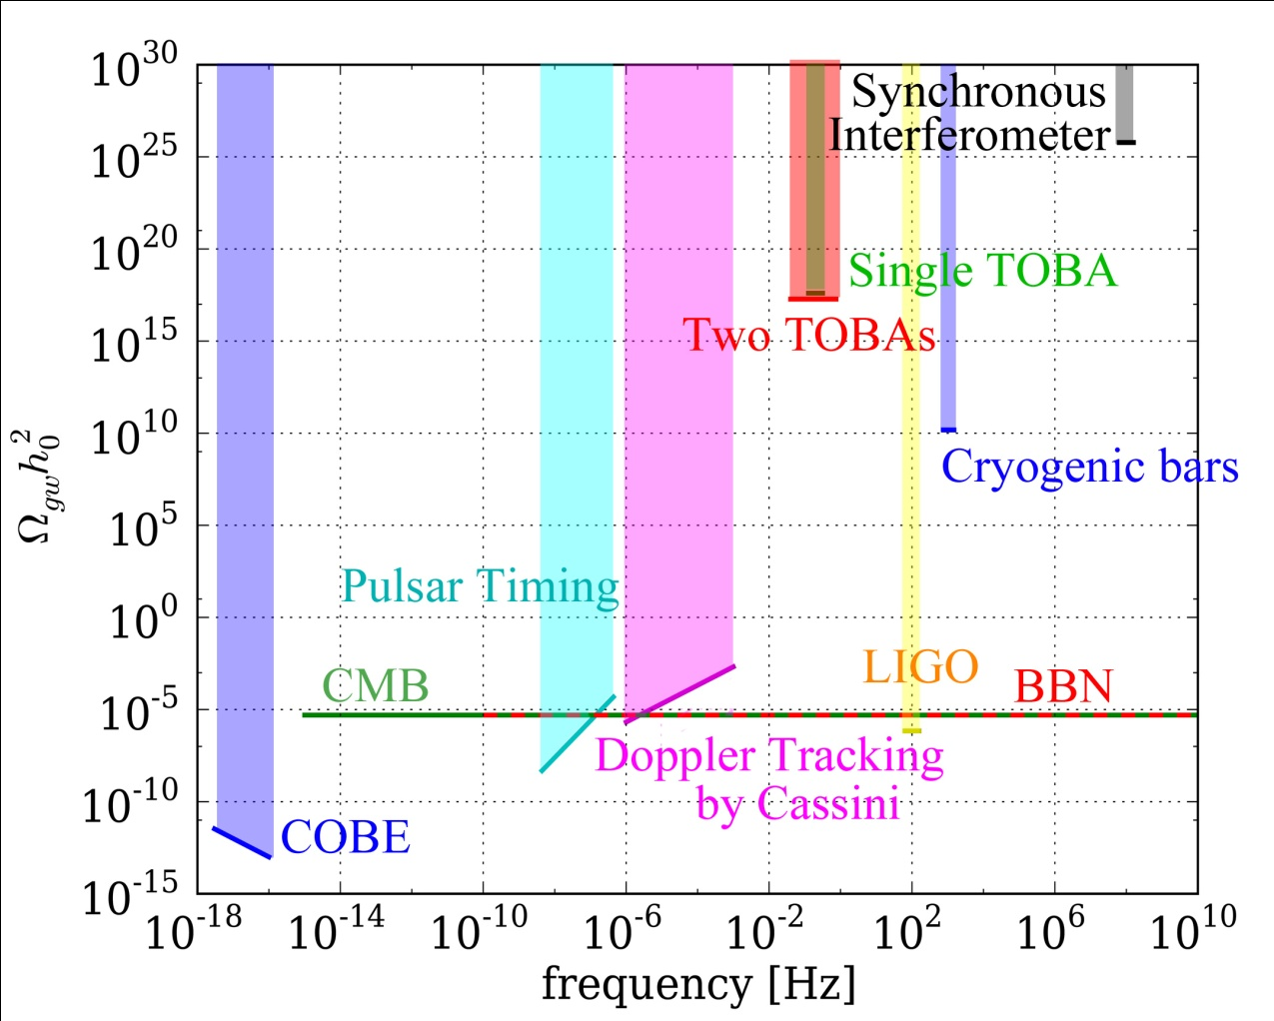
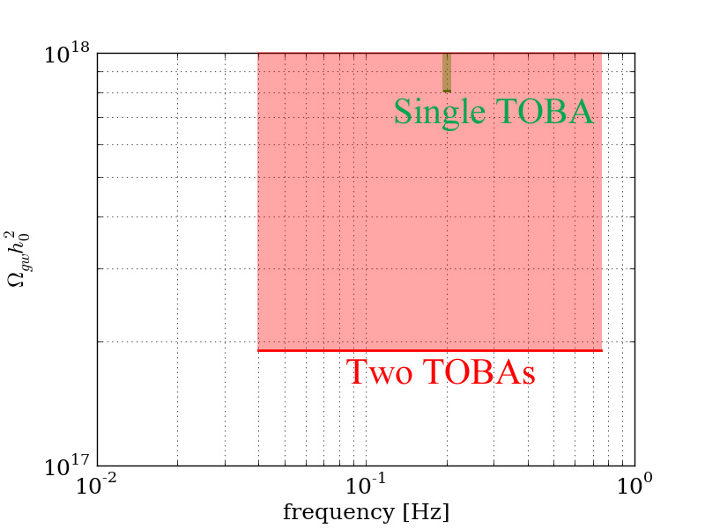
Result –upper limit
95 % confidence upper limit
Extend explored
frequency band
4 times better
NEW!!

Slide 12
Summary
Established the pipeline of the cross correlation analysis with TOBAs
The stochastic GW background signal is not detected.
Update the upper limit on a stochastic GW background at 0.035~0.840 Hz:

Slide 13
Backup slides

Slide 14
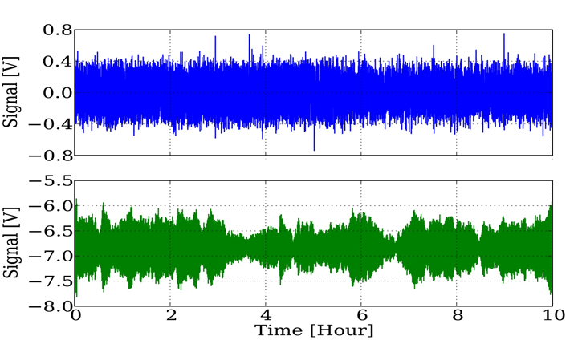
Data Selection
Tokyo
Kyoto
Time
segment
Divide time series data into several segments
Remove the segments in which RMS is big
Calculate cross correlation with the survived segments

Slide 15
Cross Correlation Value
Optimal Filter
：a filter which maximizes the signal-to-noise ratio
P_{i} ( f ): PSD of i-th detector
Overlap reduction function
: a function which represents the difference of
response to the GWs between two detectors
In the case of TOBAs,
same as the interferometer’s one
In this case,

Slide 16
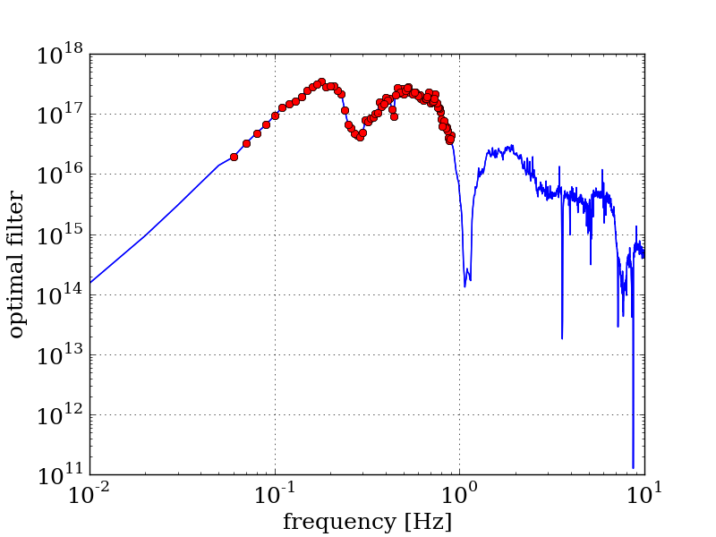
Optimal filter
Optimal filter =
big when the sensitivity to a stochastic GW background is good
The frequency band where the optimal filter is the biggest is chosen as
the analyzed frequency band.

Slide 17
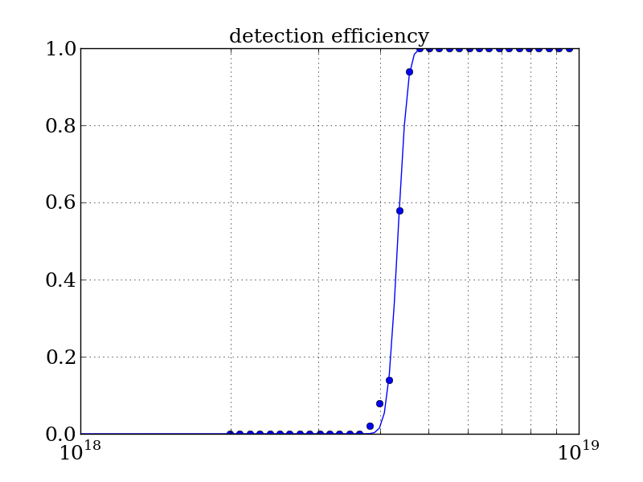
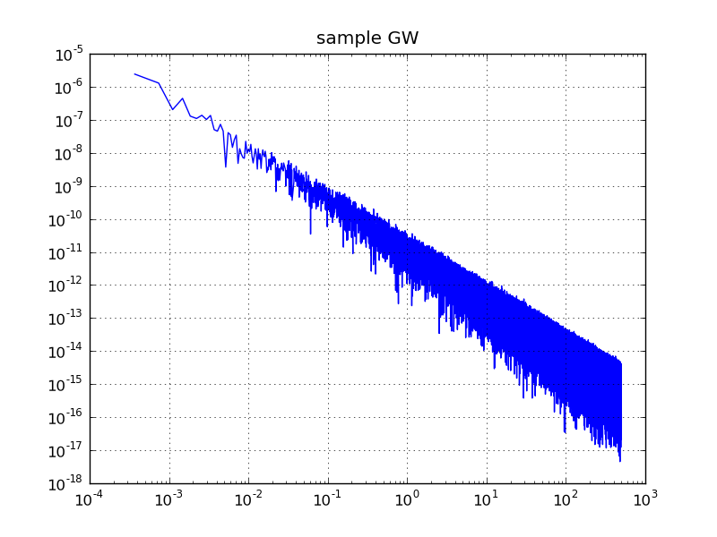
Upper Limit
How big a stochastic GW background can we detect if it would come to
this data set?
Mock signal
Receiver operating characteristic
0.95
Make a mock signal of a stochastic GW background
Inject the signal into the observational data
Perform same analysis as explained above
Detection efficiency
95% confidence
upper limit
Repeat 1-3 to compute the rate at
which we detect the mock signal.
The amplitude of injected signals
Detection efficiency

Slide 18
Parameter Tuning
There are some parameters whose optimal values are depend on the data quality
The length of the segments
The amount of the segments removed by data selection
The bandwidth of the analyzed frequency band
→200 sec
→10 %
→0.8 Hz
Determined
by the time shifted data.
The values which make the upper limit calculated with time shifted data best is used.

Slide 19
Summary of Analysis

Slide 20
Data selection
The indicator of the noise level = Whitened RMS
whitening
Avoid making the result
intentionally better
The analyzed frequency
band is excluded from
RMS calculation

Slide 21
Cross correlation anlysis
signal
GW signal
noise
Cross correlation
value
Noise is reduced
Fourier transformation
Cross correlation
value

Slide 22
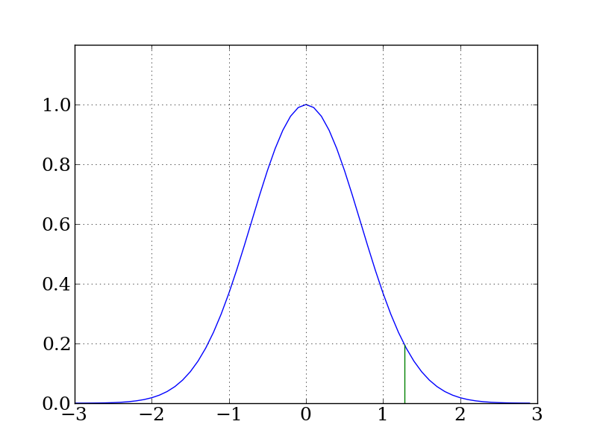
Detection Criteria
By the Neuman-Peason criterion,
Probability distribution of <Y>/T_{seg}
∝Histogram of <Y>/T_{seg} calculated
with time shifted data
z_{α}
α
α
<Y>/T_{seg}
α: false alarm rate
Note: we do not know the sign of the two signal.
Signal is present
Signal is absent

Slide 23
Signal detection
How to decide :
Calculate with diversely time shifted data
Histogram of calculated
＝Histogram of when the signal is absent.
No
GW signal
with
GW signal
z_{α}
α: false alarm rate
β: false dismissal rate
<Y>/T_{seg}

Slide 24
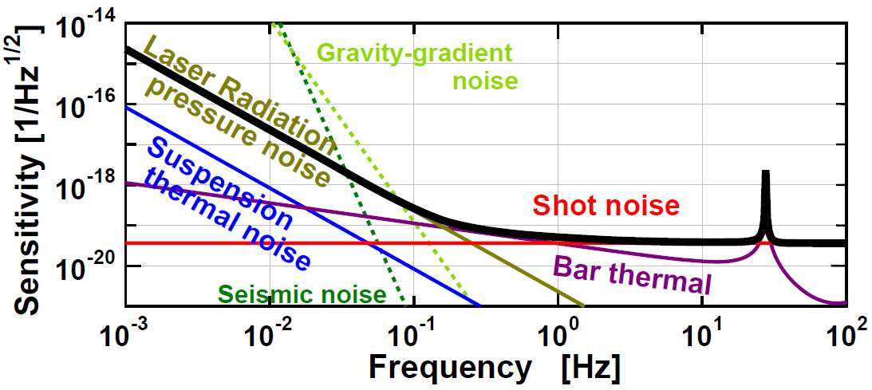
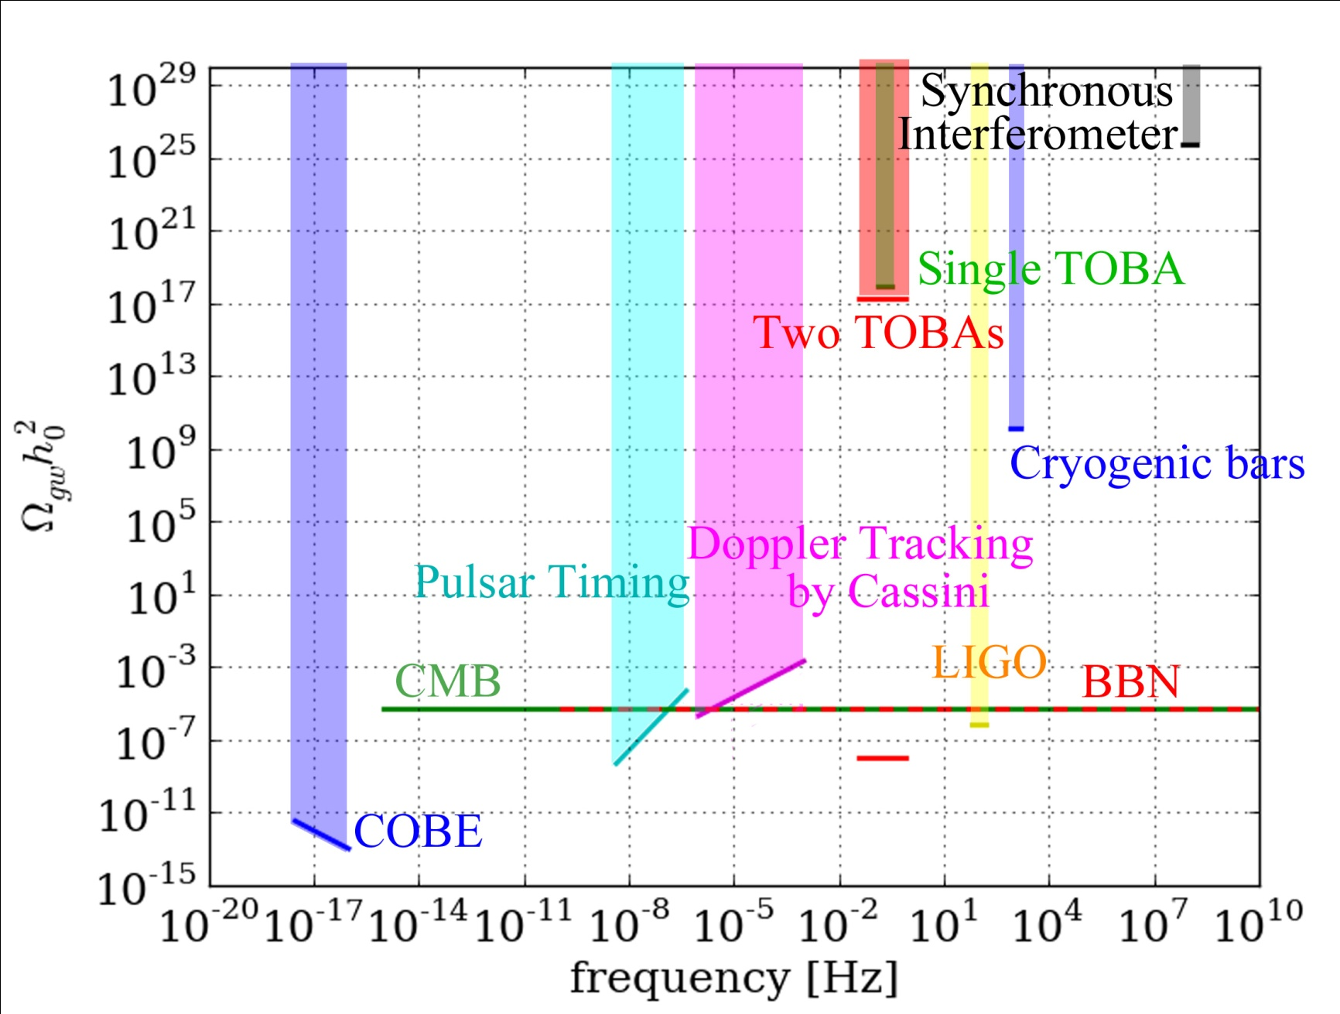
Future plan
Big TOBA
This cross correlation analysis
1 year observation

