Slide 1
Status of Ground-Based Gravitational-wave Interferometers
July 11, 2012
Daniel Sigg
LIGO Hanford Observatory
Astrod 5, Bangalore, India

Slide 2
Abstract
We present the status of ground based gravitational wave detectors. All observatories are currently in the process of installing second generation instruments with the intend to introduce the era of detection. The regular observations of sources will require a worldwide network of detectors for reliably localizing the sky position. The LIGO project and the implications of LIGO-Indigo will be discussed in detail.

Slide 3

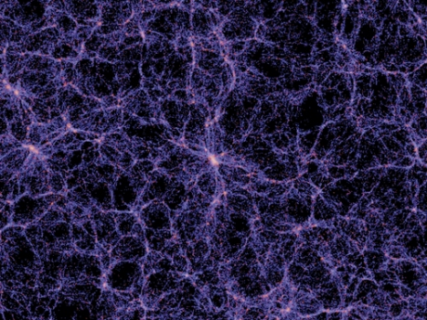
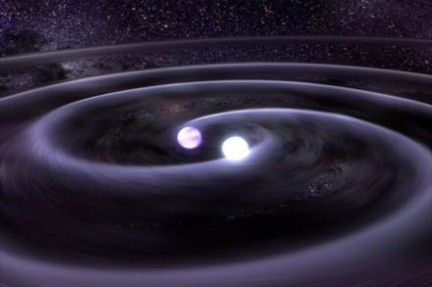
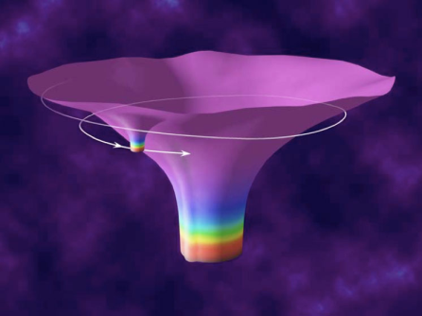

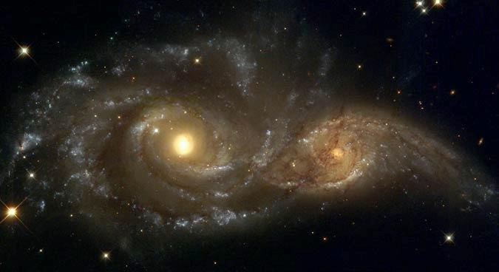

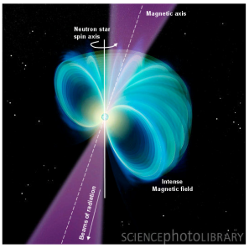
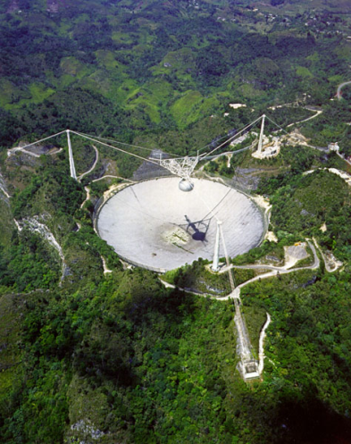

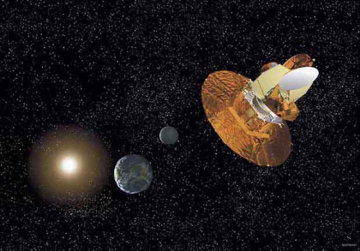
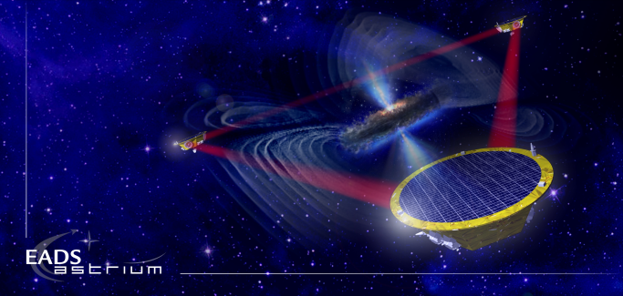
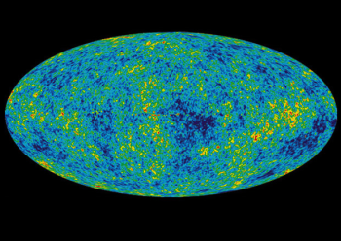
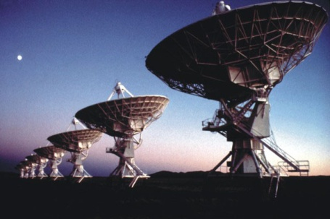
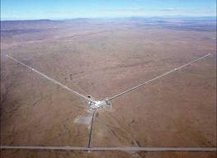
Gravitational Waves
?
?
?
BH and NS Binaries
Supernovae
Cosmic Strings
Relic radiation
?
?
Extreme Mass Ratio
Inspirals
?
Supermassive BH Binaries
Binaries coalescences
Spinning NS
10⁻¹⁶ Hz
10⁻⁹ Hz
10⁻⁴ Hz
10⁰ Hz
10³ Hz
Inflation Probe
Pulsar timing
Space detectors
Ground interferometers
?

Slide 4
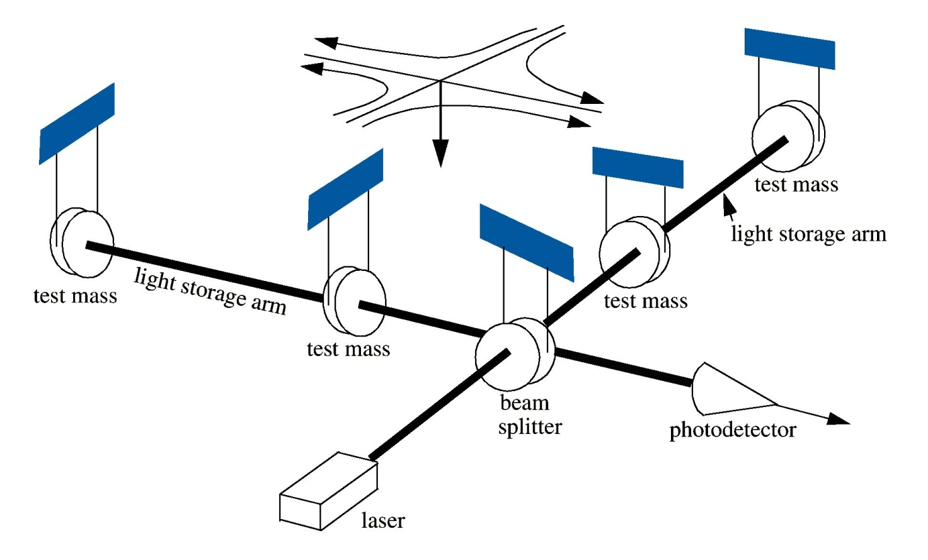
Gravitational Wave Signal and Fundamental Noise Sources
Vibrational Noise
Ground motion
Acoustic
Quantum Noise
Shot Noise
Radiation Pressure Noise
Thermal Noise
Test masses
Suspensions
Coatings
Laser Noise
Frequency Noise
Intensity Noise

Slide 5
Sensitivity Sixth Science Run

Slide 6

Results from Initial Detectors:
Some highlights from LIGO and Virgo
Several ~year long science data runs by LIGO and Virgo
Since 2007 all data analyzed jointly
Limits on GW emission from known msec pulsars
  Crab pulsar emitting less than 2% of available spin-down energy in gravitational waves
Limits on compact binary (NS-NS, NS-BH, BH-BH) coalescence rates in our local neighborhood (~20 Mpc)
Limits on stochastic background in 100 Hz range
  Limit beats the limit derived from Big Bang nucleosynthesis
Virgo

Slide 7
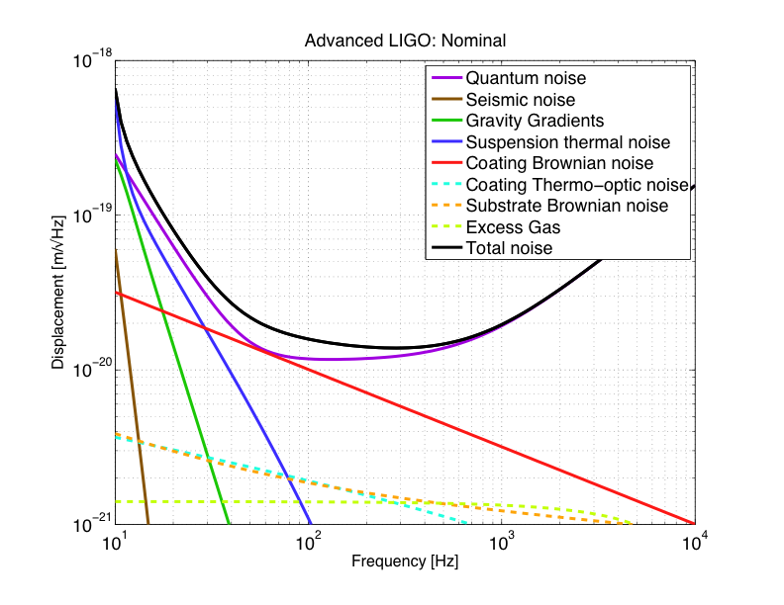
Advanced LIGO Sensitivity
Radiation pressure noise
Initial LIGO
Shot noise
Standard quantum limit

Slide 8
The Advanced LIGO Detector
Input mode cleaner:
stabilizes frequency
and cleans laser mode
4 km
Arm cavities:
Fabry-Perrot cavities store light to effectively increase length
800kW
4 km
Laser
800kW
Laser:
200W - 1064nm
Power recycling mirror: reflects light back coming from the beam splitter, increasing power in the arm cavities
Input
Test
Mass
End
Test
Mass
Signal recycling mirror: amplifies readout signal
Homodyne Readout

Slide 9
Advanced LIGO PSL
Designed and contributed by Albert Einstein Institute
Higher power: 10W -> 180W
Better stability
  10x improvement in intensity and frequency stability

Slide 10
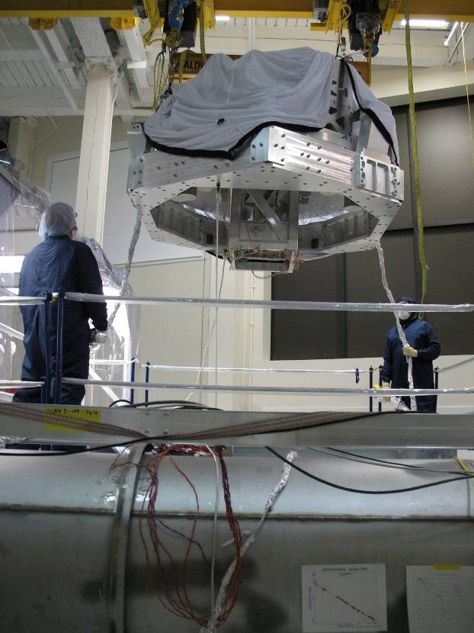
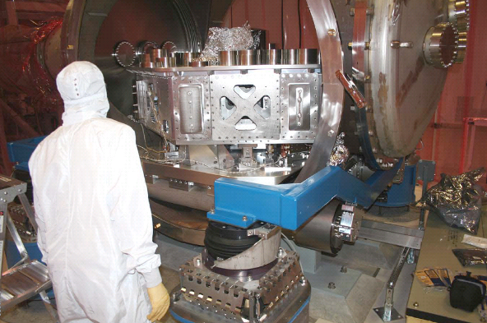
Advanced LIGO Seismic Isolation
Two-stage six-degree-of-freedom active isolation
  Low noise sensors, low noise actuators,
  Digital control system to blend outputs of multiple sensors,
  tailor loop for maximum performance

Slide 11
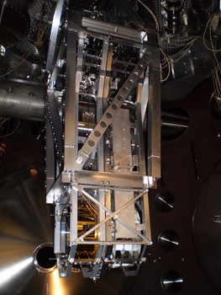
Advanced LIGO Suspensions
UK designed and contributed test mass suspensions
Silicate bonds create quasi-monolithic pendulums using ultra-low loss fused silica fibers to suspend interferometer optics
  Pendulum Q ~10⁵ -> ~10⁸
Electrostatic actuators for alignment and length control

Slide 12
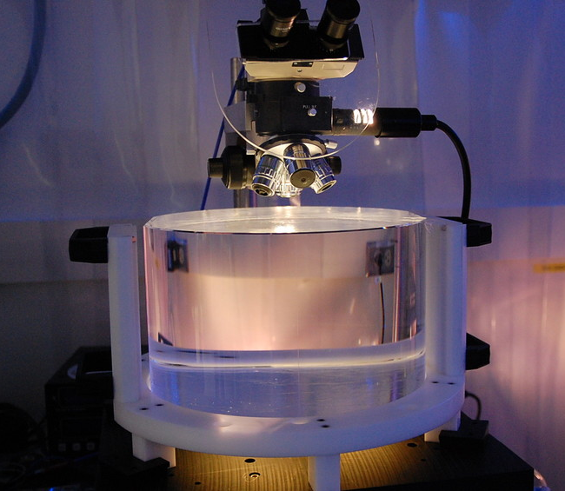
Advanced LIGO Mirrors
Larger size
  11 kg -> 40 kg
Smaller figure error
  0.7 nm -> 0.35 nm
Lower absorption
  2 ppm -> 0.5 ppm
Lower coating thermal noise

Slide 13
Current Progress
You Are Here
July 2014
Install
Single arm cavity
DE-Install
Store H2 for India
H2
L1
Install
PSL/
IO table
Install
IMC
Install
Rec’ld vertex MICH
Full interferometer
H1
Squeeze Test
Install
PSL/
IO table
Install
IMC
Install
Rec’ld vertex MICH
Full Interferometer

Slide 14
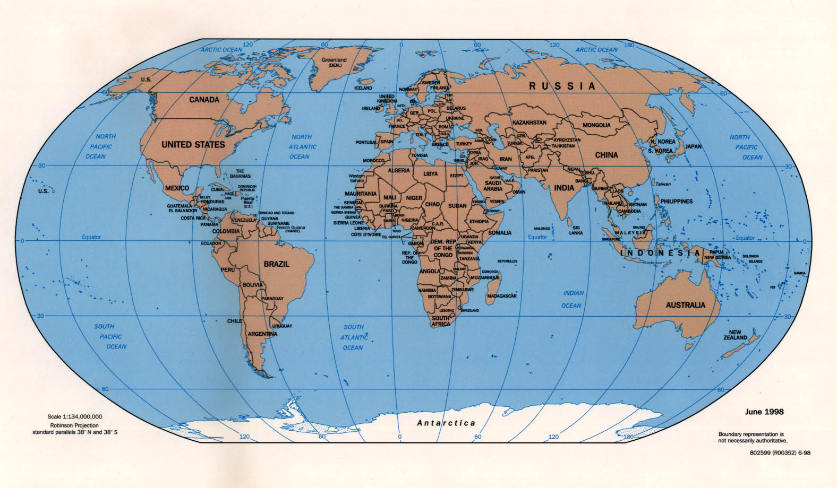
Global Network
GEO
Virgo
LIGO
KAGRA
LIGO-India

Slide 15
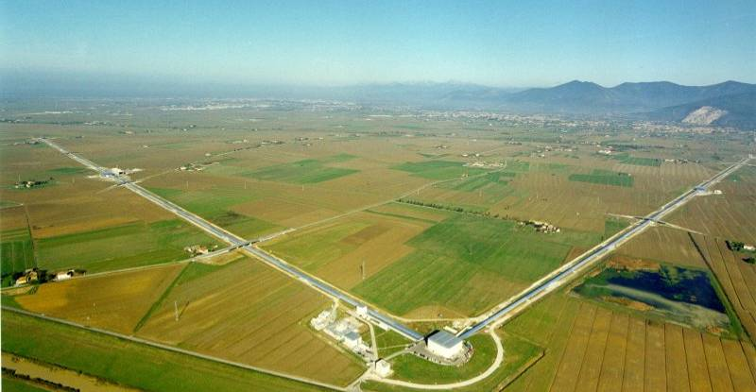
VIRGO
Virgo
  European collaboration, located near Pisa
  Single 3 km interferometer, similar to LIGO in design and specification
  Advanced seismic isolation system (“Super-attenuator”)
Advanced Virgo
  Similar in scope and schedule to Advanced LIGO
Joint observations with LIGO since May 2007

Slide 16
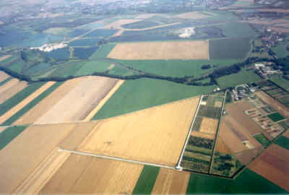
GEO
GEO Collaboration
  GEO as a whole is a member of the LIGO Scientific Collaboration
  GEO making a capital contribution to Advanced LIGO
GEO600
  Near Hannover
  600 m arms
  Signal recycling
  Fused silica suspensions
GEO-HF
  Up-grade underway
  Pioneer advanced
  optical techniques

Slide 17
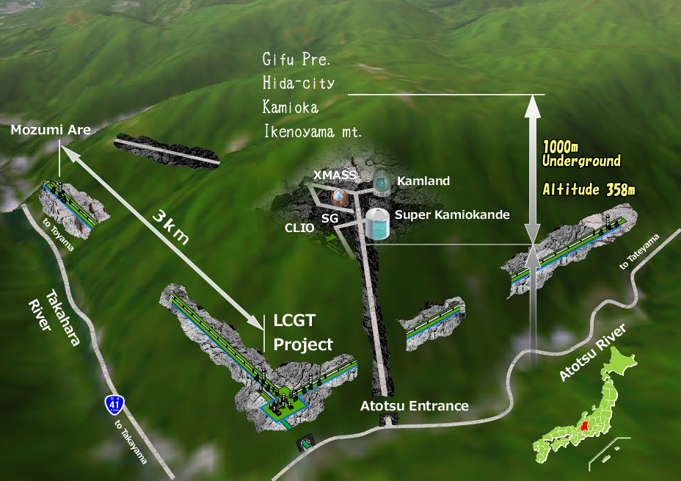
KAGRA
Project approved July 2010
  Lead institution: Institute for Cosmic Ray Research
  Other participants include University of Tokyo, National Astronomical Observatory of Japan, KEK, …
Key Design Parameters
  Underground
  Sapphire test masses
  cooled to <20K
  150W Nd:YAG laser
  Five stage low frequency
  (soft) suspension
  Promises sensitivity
  similar to
  Advanced LIGO

Slide 18
LIGO-India Concept
A direct partnership between LIGO Laboratory and IndIGO collaboration to build an Indian interferometer
  LIGO Lab (with its UK, German and Australian partners) provides components for one Advanced LIGO interferometer from the Advanced LIGO project
  India provides the infrastructure (site, roads, building, vacuum system), “shipping & handling,” staff, installation & commissioning, operating costs
LIGO-India would be operated as part of LIGO network to maximize scientific impact
Awaiting formal approval by the Governments

Slide 19
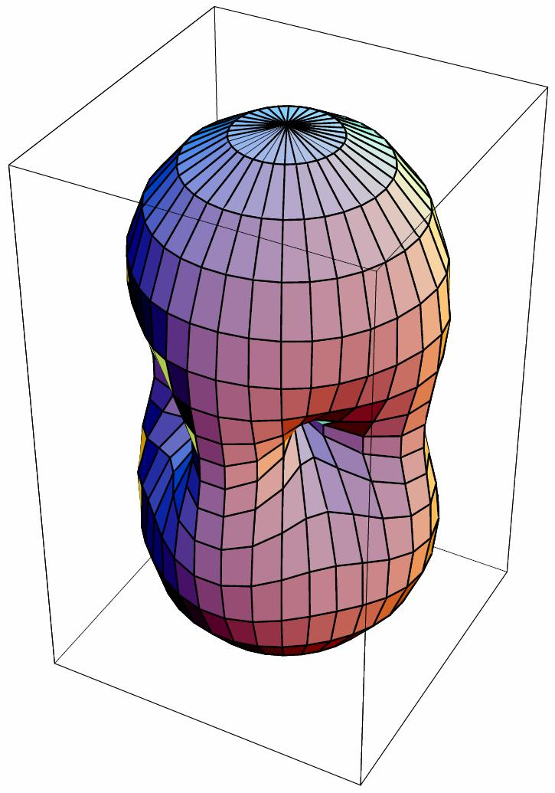
Why a Global Network?
Source Localization
  Sky position is determined by
  triangulation from the arrival times
Polarization
  Requires a three dimensional array
Worldwide coincidence greatly
increases confidence
Sky position and polarization
measurement are required to
extract maximum science!

Slide 20
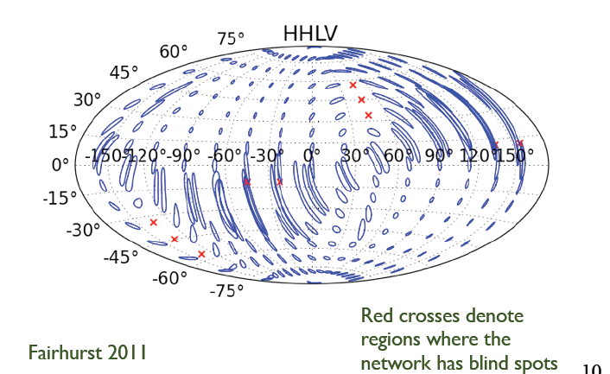
LIGO-Virgo Network

Slide 21
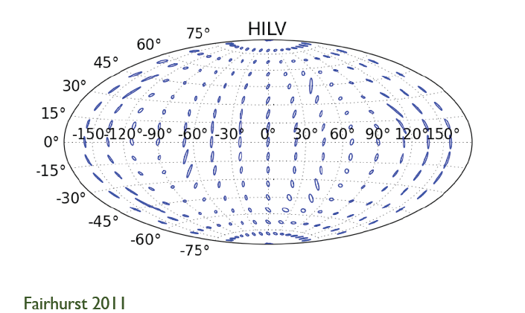
India-LIGO-Virgo Network

Slide 22
Final Thoughts
We are on the threshold of a new era of gravitational wave astrophysics
First generation detectors have broken new ground in optical sensitivity
  Initial detectors have proven technique
Second generation detectors are being installed
  Will expand the “Science” (astrophysics) by factor of 1000
In the next decade, emphasis will be on the network
  Groundwork has been laid for operation as a worldwide network
  India could play a key role

Slide 23
