Slide 1
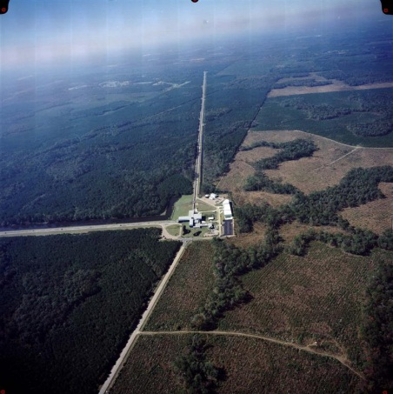
Shortcuts/Hotkeys/Macros – How I do stuff faster
G1200697-v1
Bobby J Moore II
Caltech – Laser Interferometer Gravitational-Wave Observatory (LIGO)
LIGO was constructed by the California Institute of Technology (CIT) and Massachusetts Institute of Technology (MIT) with funding from the National Science Foundation (NSF)

Slide 2
Bobby J Moore II
Studied Drafting and Design Technology at NWF State College
New Orleans/Baton Rouge SolidWorks User Group (NOBRSWUG)
Started using SolidWorks around 2005, CSWP

Slide 3
What will we cover today?
I help with the design effort at LIGO and do most of the drafting for the suspension team. I will point out things I do on a daily basis that makes working faster.
Online support
Windows 7
Default Shortcuts
Custom shortcuts
Assemblies
Parts
Drawings

Slide 4
Online support
http://www.3dcontentcentral.com/
https://forum.solidworks.com/
http://www.solidworks.com/sw/communities/read-solidworks-blogs.htm
http://grabcad.com/
Notes:
D0902201

Slide 5
Windows 7
Adding a shortcuts folder.
Add a library.
Pin to taskbar/start-men.
Accelerator keys.
Ctrl+tab, Alt+tab, Windows+tab.
Right-click SW icon on taskbar.
Hoover over SW icon to pick which file.
Windows shake.
Window snap.
Start menu search.
Open file search bar.
Sync a network folder – “Always available offline”.
Notes:
D0902201

Slide 6
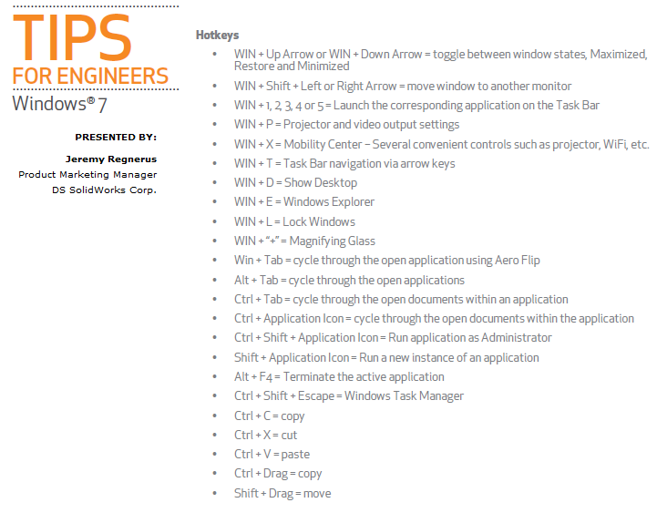
Notes:
D0902201

Slide 7
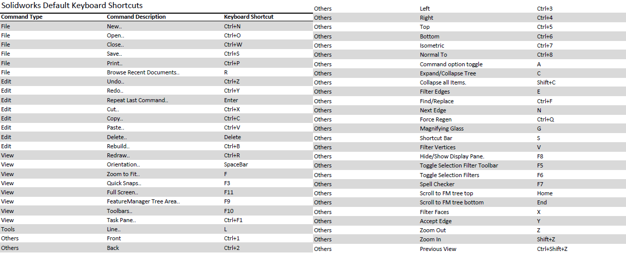
Default shortcuts
Notes:
D0902201

Slide 8
Assemblies
Open sub-assemblies
Pin when inserting new parts/assembly.
Copy with mates.
Using macros to mate.
Dissolve sub-assemblies.
Ctrl-copy parts from one assembly to another.
See shared mates.
Insert a specific part configuration into an assembly from ConfigurationManager.
Mate key, know how it reacts.
Right-click to rotate part for alignment.
Tab key to hide parts.
Insert custom drawing view.
Mulitmates (turn on multimates)
Copy exploded views between configurations (D1000045).
Quickies/other:
Hotkeys (Enter to exit/redo, Shift+C for collapse tree, Z to zoom, )
S-key
Mouse gestures
Notes:
D0902201, ¼-20 x .875” SHCS, NAS620-C416, ¼-20 x .5” helicoil

Slide 9
Parts
Look at a part in a certain orientation.
Instant 3D.
Enter in metric values when working in imperial.
Ctrl-drag a reference plane.
Ctrl-drag a feature into part.
All of your sketch tools.
Double-click a surface to have a feature end “up to surface”
Customize material.
Link text to properties.
Freeze bar.
Change units from status bar.
Comparing parts.
Quickies/other:
Hotkeys (Enter to exit and redo, Line, arc, line, Dimensions using shift, mirror how it works, Ctrl+7, F-9)
S-key
Mouse gestures
Notes:
D0902201

Slide 10
Drawings
Adding balloons to things you can’t see.
Exploded view when x,y,z isn’t normal.
Create isometric section view. (right-click a section view and select isometric section view).
Editing your template to include custom information.
Adding custom views to drawings.
Moving views to another sheet (and copy).
Auto dimension.
Auto balloon.
Ctrl-copy a balloon arrow.
Open part from BOM.
View multiple drawing sheets by adding a new window (Window → new window).
Dimensioning slots with shift .
Adjust row height on BOM.
Snap note to rectangle center.
Centerline.
Knowing <MOD-CL> language.
Link property values to balloon.
Quickies/other:
Hotkeys (Enter to exit and redo, Ctrl-spacebar/enter, Ctrl+a – save as - .pdf, View previous and next sheet, F
for fit to screen, F-9)
S-key
Mouse gestures
Notes:
D0902201

Slide 11
Notes:
D0902201

