Slide 1
Thesis Title: Adaptive Modal Damping of Advanced LIGO Suspensions
Brett Shapiro
Thesis Defense – Mechanical Engineering, 20 April 2012
Thesis committee:
Kamal Youcef-Toumi (chair, supervisor)
Nergis Mavalvala (supervisor)
Jean-Jacques Slotine
Richard Mittleman

Slide 2
Abstract
Motivation: Observe gravitational waves from astrophysical sources (supernovae, pulsars, black hole mergers, etc) using the LIGO observatories.
Problem: Active control to suppresses time varying ground disturbances. This control introduces additional noise. Optimal control requires tuning the trade-off as the disturbances evolve.
1. Many of the LIGO control loops contain non-negligible sensing noise
2. Seismic disturbances evolves in time
3. LIGO optical cavities have a small finite linear operating range
Solution: An adaptive algorithm to constantly monitor and tune the performance of this control. Applied to the method of modal damping. Adaptation optimized for astrophysical sources.

Slide 3
Outline
LIGO and gravitational waves
Seismic (vibration) isolation
Problems and challenges
Method of adaptive modal damping
Experimental results
Simulated results

Slide 4


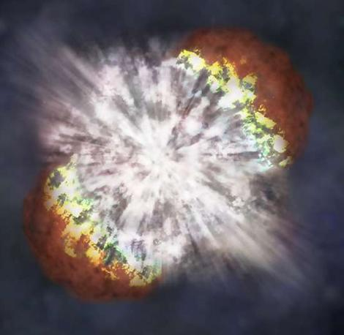
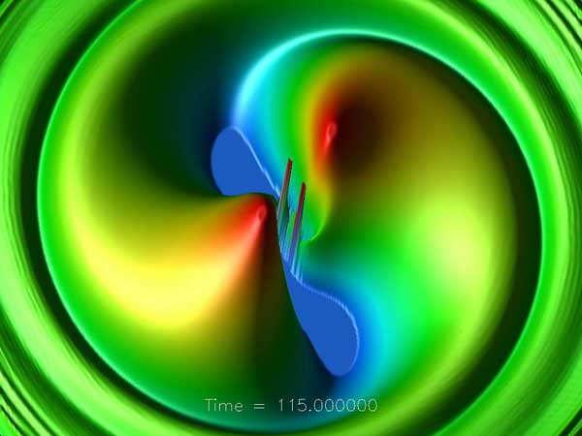
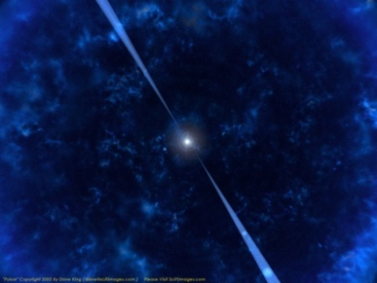
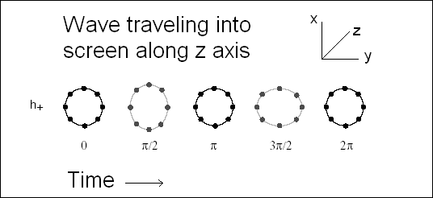
Gravitational Waves
Supernova
Merging Black Holes
Pulsar
Wave of strain amplitude h
Supernovae
  Asymmetry required
Coalescing Binaries
  Black Holes or Neutron Stars
  Mergers
Pulsars
    Asymmetry required
Stochastic Background
(Big bang, etc.)

Slide 5


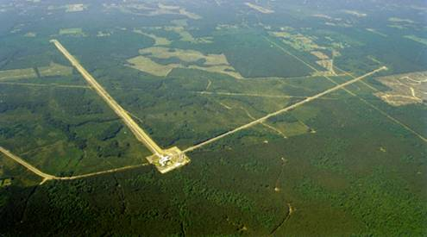
The Laser Interferometer
Gravitational-wave Observatory (LIGO)
Funded by
ETM
Test Masses
:
fused silica
4 km
34
cm diam x
,
20
cm thick
Input
Mode
Cleaner
40
kg
,
T = 3%
ITM
PRM
CP
Laser
Φ
m
FI
ITM
ETM
125 W
BS
815 kW
5.7 kW
Not to scale
Hanford, WA
Advanced LIGO configuration
Under construction until ≈2015
Upgrade to Initial LIGO
SRM
FI
PD
GW readout
Output
Mode
Cleaner
3, 4 km interferometers at 2 sites in the US
Michelson interferometers with Fabry-Pérot arms
Optical path enclosed in vacuum
Sensitive to strains around 10⁻²² -> 10⁻¹⁹m_{rms}
LIGO Budget ≈ $60 Million per year from NSF.
Operated by MIT and Caltech.
Livingston, LA

Slide 6
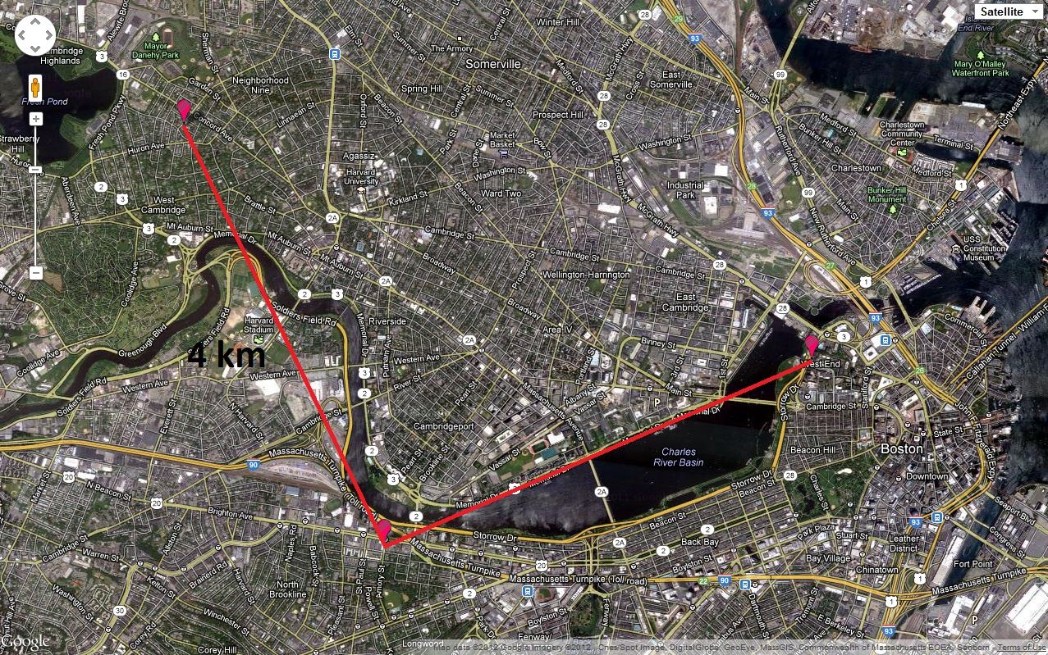
If we put LIGO in Cambridge, MA
Porter Square
Harvard
MGH
MIT
Kenmore Square
LIGO spans 16 km². Cambridge, MA covers 16.65 km² (wikipedia http://en.wikipedia.org/wiki/Cambridge,_Massachusetts).

Slide 7



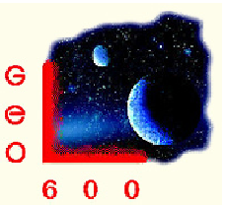





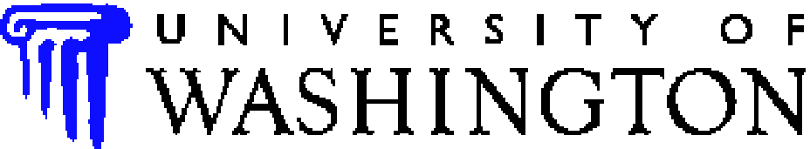

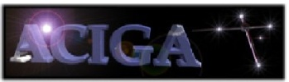















































LIGO Scientific Collaboration
University of Michigan
University of Minnesota
The University of Mississippi
Massachusetts Inst. of Technology
Monash University
Montana State University
Moscow State University
National Astronomical Observatory
of Japan
Northwestern University
University of Oregon
Pennsylvania State University
Rochester Inst. of Technology
Rutherford Appleton Lab
University of Rochester
San Jose State University
Univ. of Sannio at Benevento,
and Univ. of Salerno
University of Sheffield
University of Southampton
Southeastern Louisiana Univ.
Southern Univ. and A&M College
Stanford University
University of Strathclyde
Syracuse University
Univ. of Texas at Austin
Univ. of Texas at Brownsville
Trinity University
Tsinghua University
Universitat de les Illes Balears
Univ. of Massachusetts Amherst
University of Western Australia
Univ. of Wisconsin-Milwaukee
Washington State University
University of Washington
Australian Consortium
for Interferometric
Gravitational Astronomy
The Univ. of Adelaide
Andrews University
The Australian National Univ.
The University of Birmingham
California Inst. of Technology
Cardiff University
Carleton College
Charles Sturt Univ.
Columbia University
CSU Fullerton
Embry Riddle Aeronautical Univ.
Eötvös Loránd University
University of Florida
German/British Collaboration for
the Detection of Gravitational Waves
University of Glasgow
Goddard Space Flight Center
Leibniz Universität Hannover
Hobart & William Smith Colleges
Inst. of Applied Physics of the Russian Academy of Sciences
Polish Academy of Sciences
India Inter-University Centre
for Astronomy and Astrophysics
Louisiana State University
Louisiana Tech University
Loyola University New Orleans
University of Maryland
Max Planck Institute for Gravitational Physics

Slide 8
Projected Sensitivity for Advanced LIGO

Slide 9

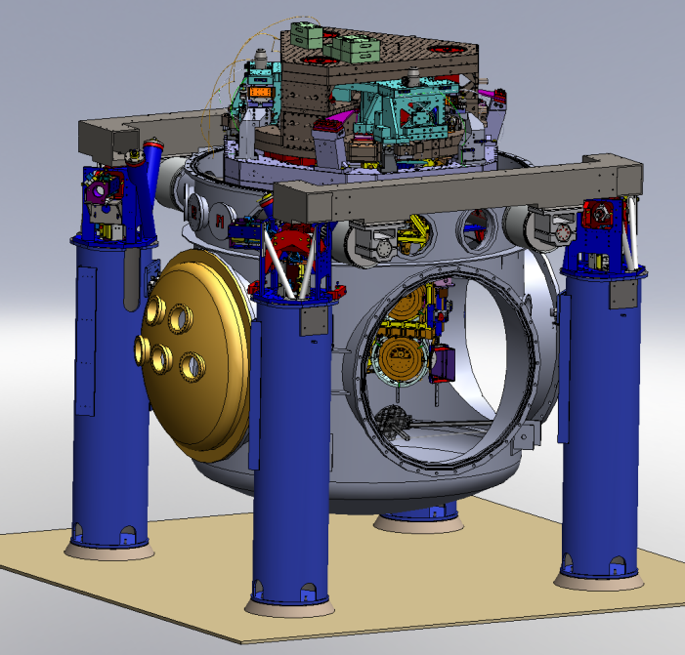
Suspensions and Seismic Isolation
Advanced LIGO test mass isolation
active isolation platform (2 stages of isolation)
hydraulic external pre-isolator (HEPI) (one stage of isolation)
quadruple pendulum (four stages of isolation) with monolithic silica final stage
Ref: LIGO-G1000469-v1; Kissel PhD thesis

Slide 10
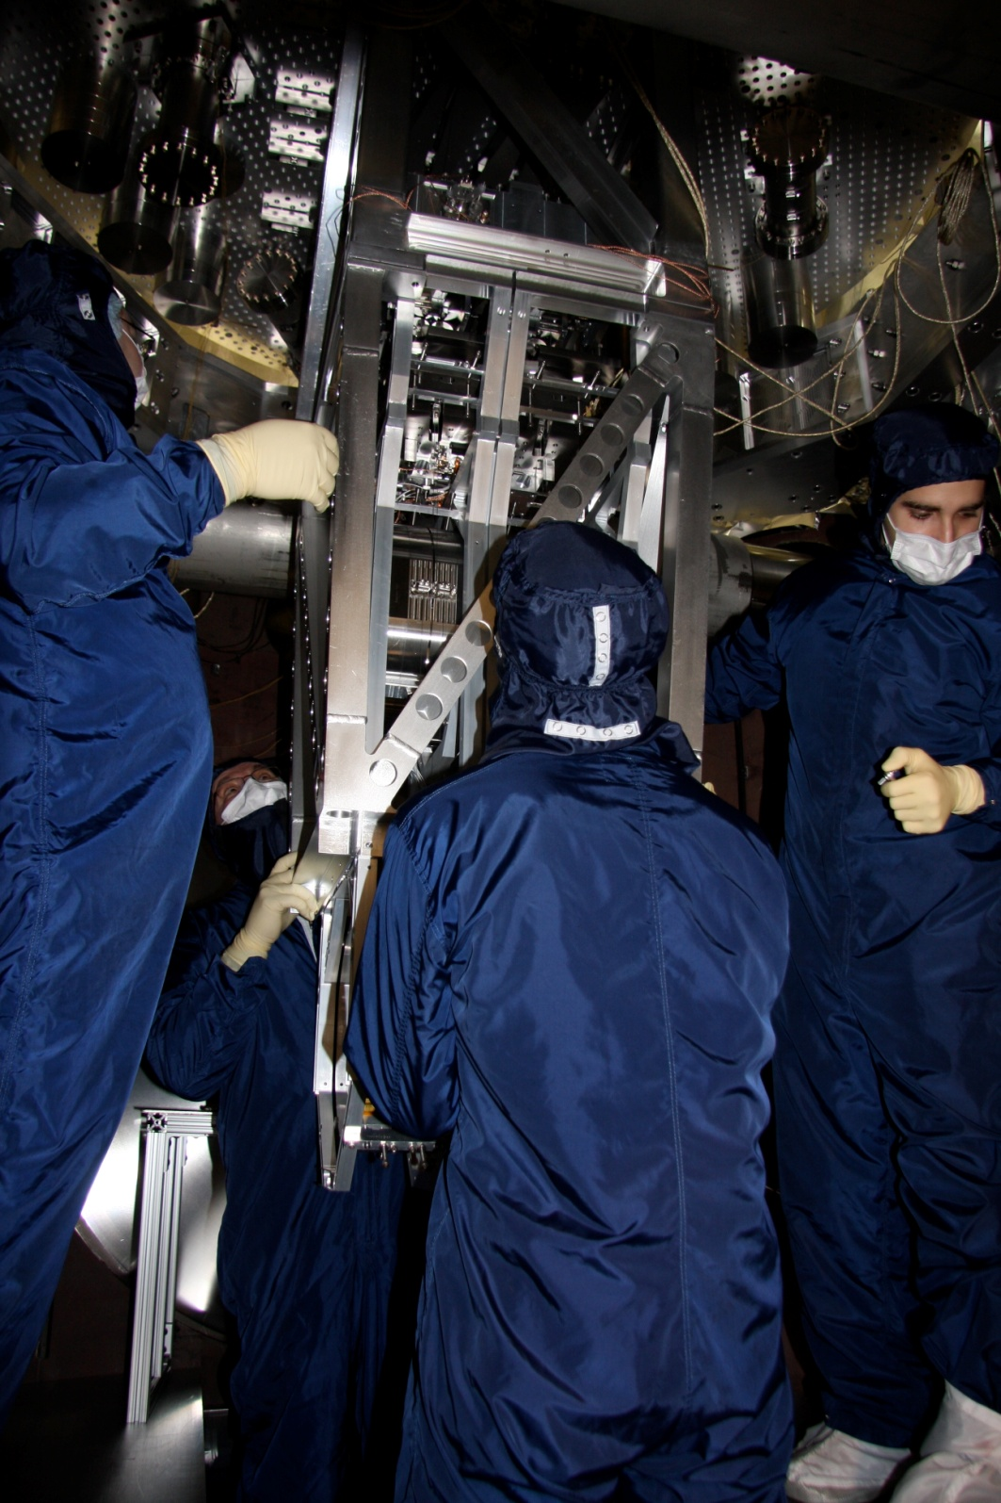
active isolation platform (2 stages of isolation)
quadruple pendulum (four stages of isolation)
Installing prototype quad pendulum with glass optic on metal wires, Jan 2009 at MIT.

Slide 11
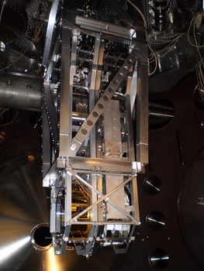
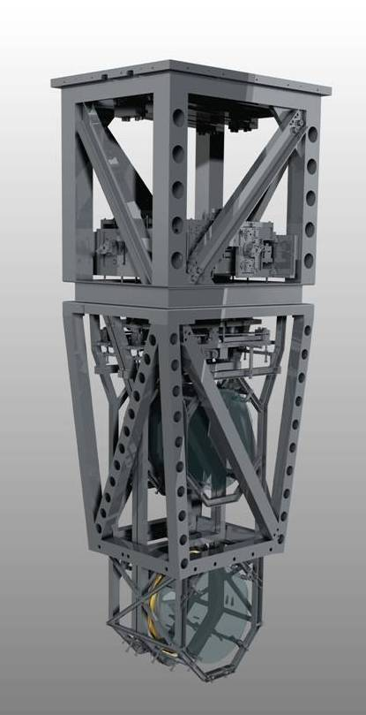
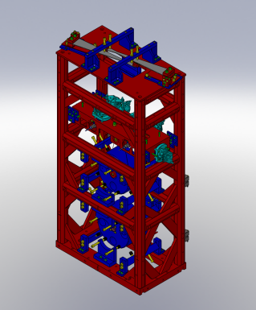
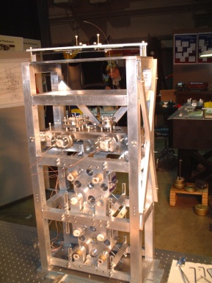
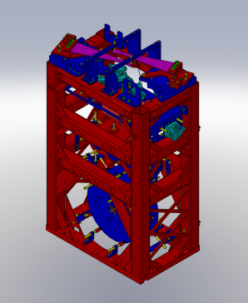
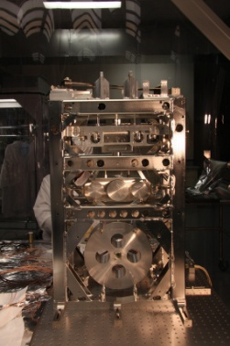
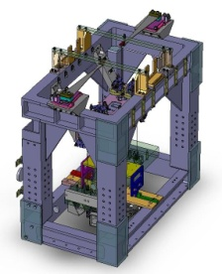
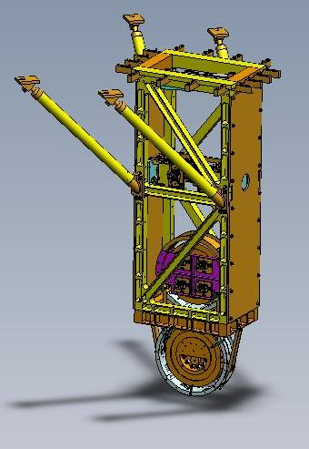
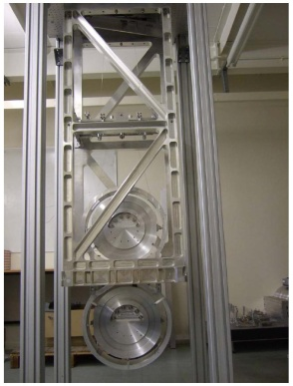
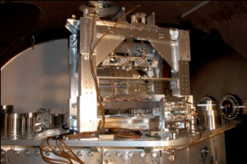
Five Pendulum Designs
ETM
Test Masses
:
fused silica
4 km
34
cm diam x
,
20
cm thick
Input
Mode
Cleaner
40
kg
,
T = 3%
ITM
PRM
Laser
Φ
m
FI
CP
ITM
ETM
125 W
BS
815 kW
5.7 kW
SRM
FI
PD
GW readout
Output
Mode
Cleaner
Ref: G1100434

Slide 12
Quadruple Pendulum
Reaction Chain
Main (test) Chain
Purpose
Test mass (stage 4) isolation.
the test mass consists of a 40 kg high reflective mirror
Stage 1
Control
Damping –stage 1
Cavity length - all stages
Sensors/Actuators
BOSEMs at stage 1 & 2
AOSEMs at stage 3
Opt. levs. and interf. sigs. at stage 2
Electrostatic drive (ESD) at stage 4
Stage 2
Stage 3
Stage 4

Slide 13
Multi-stage Isolation Performance
1/f²
1/f⁴
1/f⁶
Each stage provides 1/f² isolation
1/f⁸
Terminology: peaks are called resonances or modes

Slide 14
Control: Problems and Challenges
Schematic view of one of LIGO’s 4 km Fabry-Perot cavity arms
Problem 1
Pendulum 2
Pendulum 1
Variable seismic disturbances
u₁
Problem 2
Active damping + sensor noise
u₂
u₃
Cavity length control
Goal:
2.85 kW
Incident beam
4 km ± ΔL
u₄
Laser
Reflected beam
Cavity Resonant beam
125 W
≈ 800 kW
Problem 3
Upconversion
Photodiode
Error Signal:
Control Law
Actuation

Slide 15
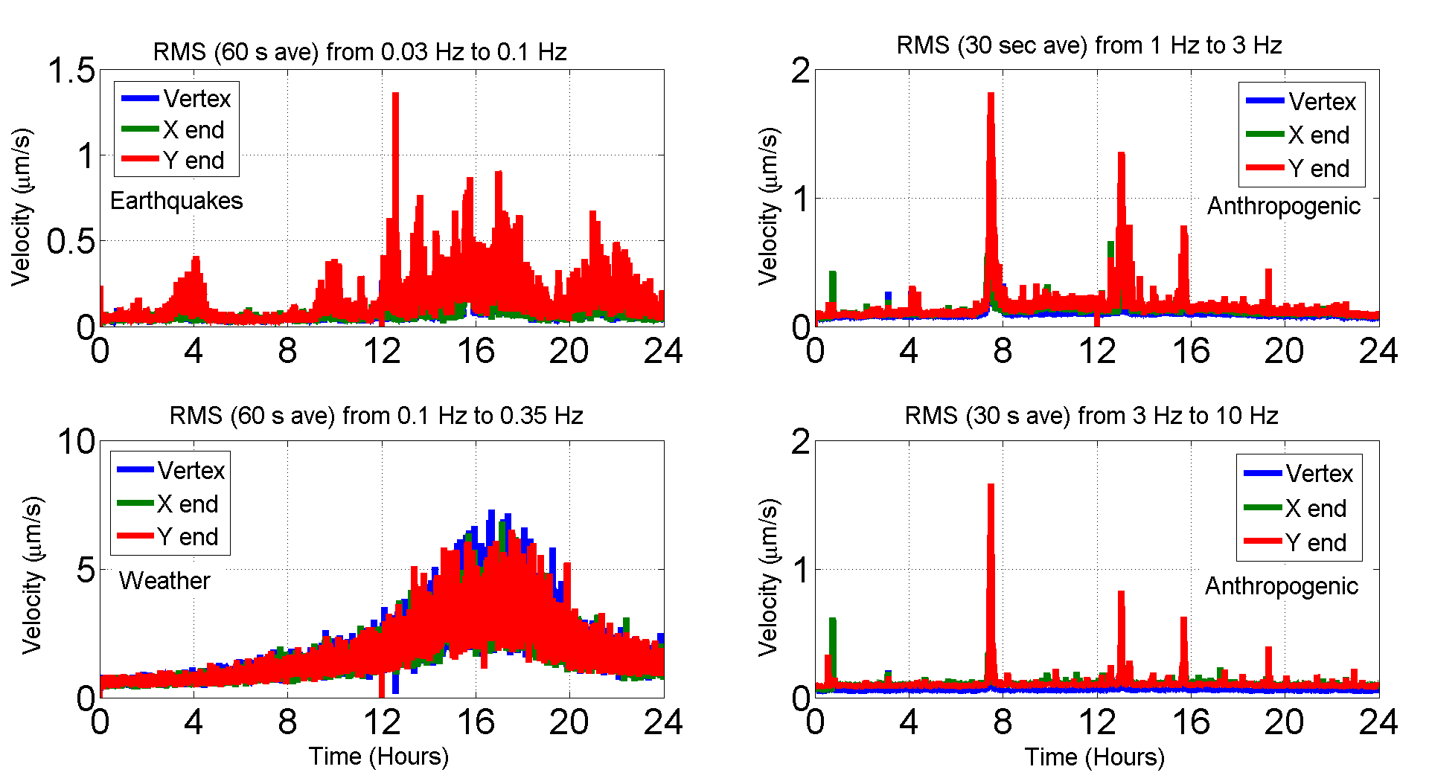
Problem 1: Nonstationary Disturbance
Seismic disturbance at Livingston Observatory on November 21, 2009

Slide 16
Problem 2: Damping Sensor Noise

Slide 17
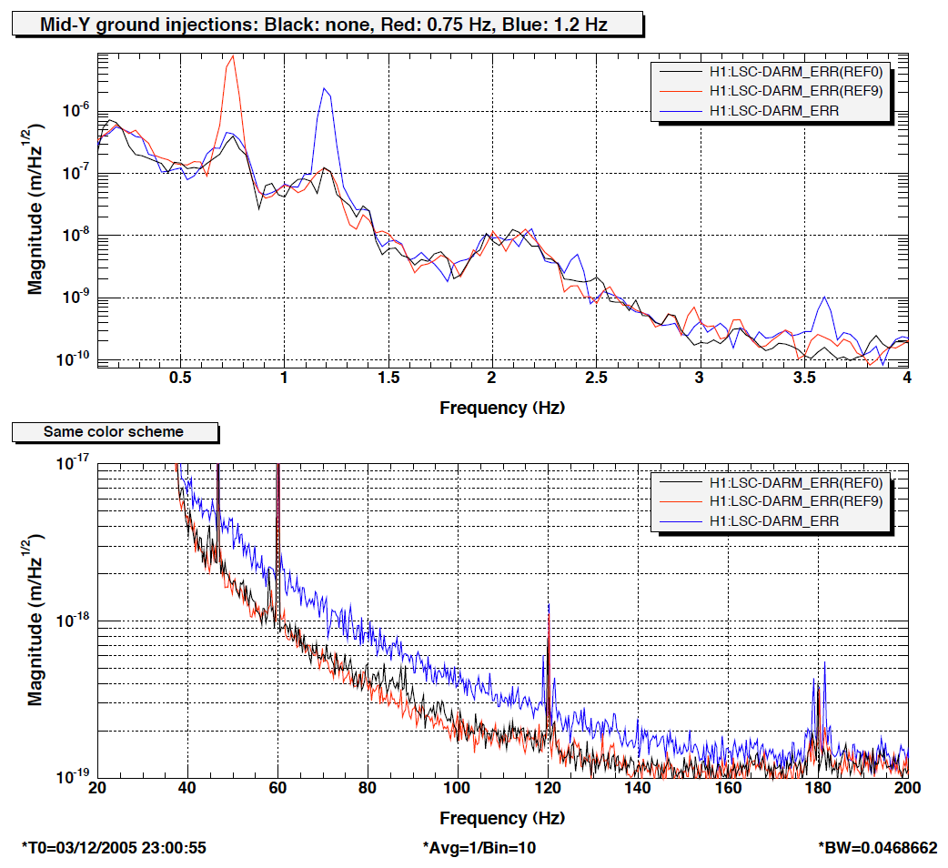
Problem 3: Seismic Upconversion
Feb. 2006
Large seismic disturbances
Mechanisms for upconversion:
1. Laser beams falling off mirrors
2. Laser scattering off vacuum walls and other objects
3. Interferometer readout method
4. Creak in pendulum springs
5. Actuator nonlinearities
6. ?
7. etc
Upconversion
Courtesy Sam Waldman

Slide 18
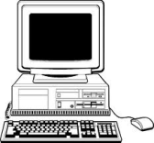
Experimental Setup at MIT
Quadruple Pendulum
Problem 2
Triple Pendulum
Variable seismic disturbances
Active damping
Problem 1
Active damping + sensor noise
Incident beam
16 m + ΔL
Laser
Cavity Resonant beam
Reflected beam
Actuation
Problem 3
Upconversion
Photodiode
Error Signal
(PDH)
Control Law
computation

Slide 19
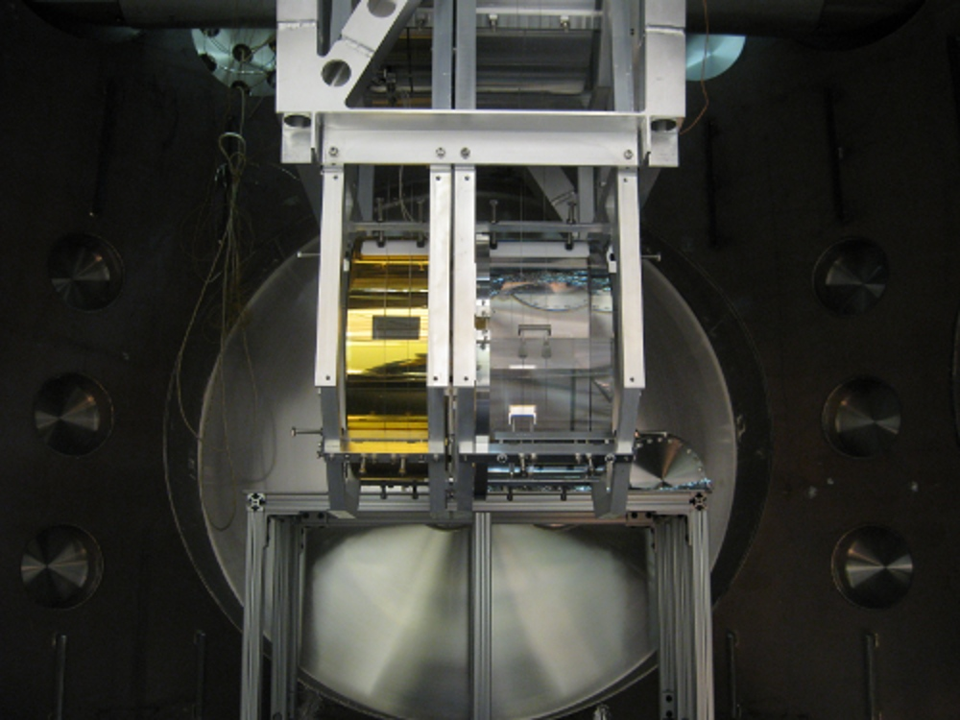
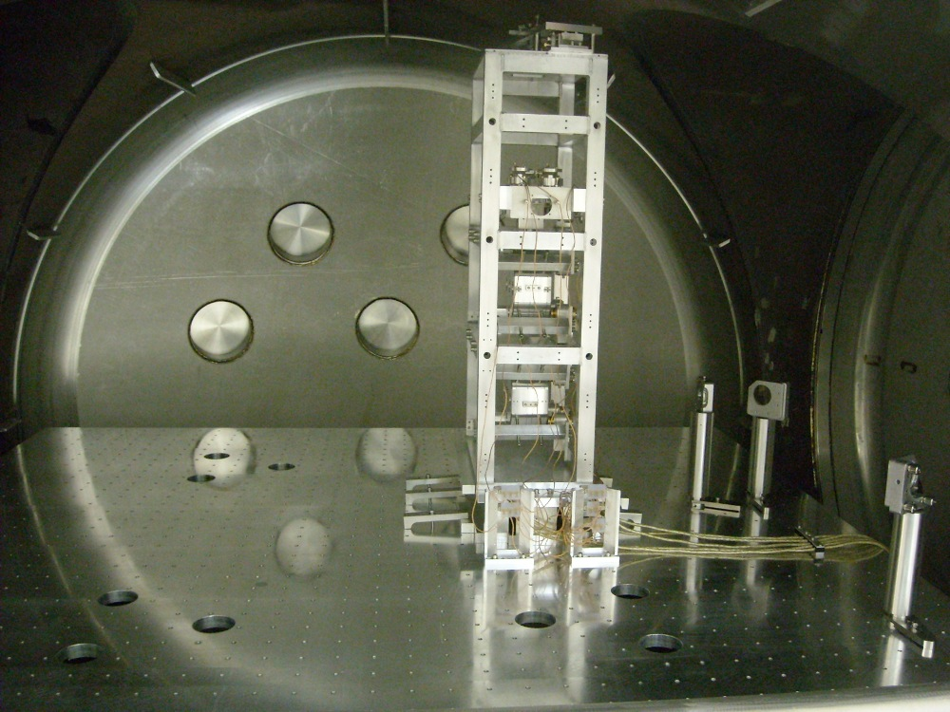
Experimental Setup at MIT
Quadruple Pendulum Mirror
Triple Pendulum
1064 nm light
Laser
photodiode
16 meters
Shaking table
50 ppm light transmission through quad mirror
1% light transmission through triple mirror

Slide 20
Measured Displacement Spectrum
triple pendulum resonances (modes): 1.3 Hz, 2.8 Hz
ΔL

Slide 21
Measured Displacement Spectrum
pendulum resonances
nonlinear upconversion
ΔL

Slide 22
Measured Displacement Spectrum
pendulum resonances
sensor noise amplification
ΔL

Slide 23
Modal Damping with State Estimation
= pendulum
eigenvector matrix
= Cartesian coordinates
= estimated modal coord.
= Cartesian damping forces
= modal damping forces
mode damping filter
mode damping gain
Triple
Pendulum
Cartesian
Coordinates
(coupled
dynamics)
Estimator
Modal Damping
Modal
Coordinates
(decoupled
dynamics)

Slide 24
Modal Feedback
,
,
,

Slide 25

Cavity Control with Modal Damping
Top mass measurement
Modal Damping
Triple
Non-stationary
disturbance
+
Top mass damping force
Sensor noise
Bottom mass force
Cavity Control
Cavity error signal

Slide 26


Cavity Control with Adaptive M.D.
Top mass measurement
Modal Damping
Triple
Non-stationary
disturbance
Cost
Adapt
+
Top mass damping force
Sensor noise
Bottom mass force
Damping gains
Cavity Control
Cavity error signal
Weighting of relevant information
Gauss-Newton stepping of modal damping gain values

Slide 27
Ex. Cost Function Used in Exper.
(simulation)
D
Notes:
M_{RMS} = measured modal amplitude
M₀ = constant scaling term
ζ₀ = highest value where sensor noise is negligible.
In this case, D = 0.53, M₀ = 15, and ζ₀ = 5e-4.
D = seismic amplitude at the modal frequency.

Slide 28
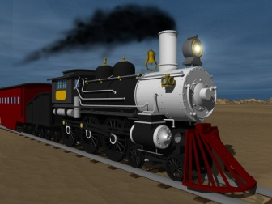
Measured Response to a Test ‘Train’
Adaptation on
ΔL
Lock loss
Test train
True disturbance
Notes: 1st , no adapt and lock loss; 2nd, 30 sec quicksteps; 3rd, 15 sec quicksteps.

Slide 29
Measured Response to a ‘Test’ Train
Adaptation on
Notes: 1st , no adapt and lock loss; 2nd, 30 sec quicksteps; 3rd, 15 sec quicksteps.

Slide 30
Cavity Displacement Spectrum
Disturbance Frequencies
Sensor noise amplification
Nonlinear Upconversion

Slide 31
Simulation of LIGO cavity with AMD
Stage 1 measurement
Modal Damping
Pend.
Non-stationary
disturbance
Cost
Adapt
+
Stage 1 damping force
Sensor noise
Damping gains
4 km
Interferometer signal w/ nonlinear model
To model the impact of AMD on LIGO’s sensitivity to gravitational wave sources.
Assumption that
Removes nonlinearity

Slide 32
Simulated Disturbance and Noise
100% max disturbance in simulation

Slide 33
Relative Noise Scaling
Upconversion with 100% max disturbance and minimum damping
Max sensor noise amplification

Slide 34
Optimization Goal

Slide 35
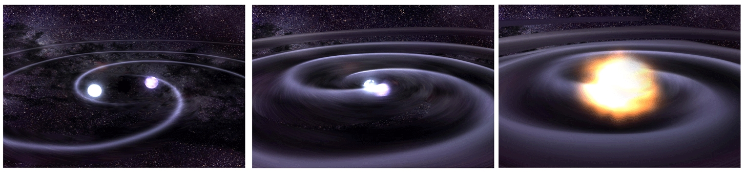

GW Source: Binary Inspiral
Detectable inspiral range r
1, 2
Patrick Sutton - T030276
Duncan Brown PhD thesis
Inspiral volume:
c = speed of light in vacuum
G = gravitational constant
M_{i} = mass of orbiting object
N² = detector noise power spectral density
ρ = desired signal to noise ratio (typically ρ = 8)
ISCO: Innermost Stable Circular Orbit

Slide 36
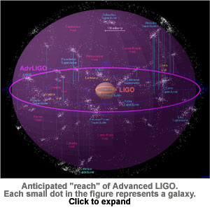
Visible Universe vs Binary Mass
Increasing seismic amplitude with no damping
Volume α (range)³
Percent of Maximum Inspiral Volume r³
Click for more info

Slide 37
Visible Universe vs Binary Mass
Increasing damping with nominal low seismic amplitude
Percent of Maximum Inspiral Volume r³

Slide 38
Combining Seismic and Sensor Noise
Visible Universe for two 150 Solar Mass Inspiraling Black Holes
Optimal point
Sensor noise
upconversion
Note: , Q = quality factor

Slide 39
Optimal Damping for Max Seismic with Adaptation

Slide 40
AMD Inspiral Simulation Results
With Adaptive Damping
Maximum Damping
Minimum Damping
Seismic % of max |  |  |  |  | 150 SM volume
0 | 0.00054 | 0.00055 | 0.00051 | 0.00050 | 3051 (100%)
50 | 0.00059 | 0.0051 | 0.016 | 0.0042 | 2982 (97.7%)
75 | 0.00073 | 0.0089 | 0.029 | 0.0090 | 2915 (95.5%)
100 | 0.00091 | 0.014 | 0.046 | 0.016 | 2796 (91.6%)
100 | 0.20 | 0.20 | 0.20 | 0.20 | 473 (15.6%)
100 | 0.00050 | 0.00050 | 0.00050 | 0.00050 | 3.05 (0.1%)
Optimal Damping
Maximum Damping
Minimum Damping

Slide 41
Binary Neutron Star Inspiral Sensitivity
10 Hz: 16000 cycles to merger
20 Hz: 5000 cycles to merger
More cycles (orbits) to merger means more data to estimate the source properties.
Merger

Slide 42
AMD Conclusions
AMD has the power to select modal damping gains in real-time that are optimal to the detection of high mass black hole inspirals (> 75 SM) for a range of disturbances.
Lower mass inspirals benefit by extending observation time.
The same gains are also optimal for the stochastic background, pulsars, and supernovae. However, these sources are insensitive to the lowest frequencies, so constant maximum damping is likely to be more reliable.
This work explored adaptive damping for the quad pendulum, but similar adaption could be useful in other LIGO control loops.
Practical application of this work depends on the behavior of the true Advanced LIGO interferometers still under construction.

Slide 43
Thesis Contributions, 1-2
Adaptive algorithm for modal damping (AMD)
  Adaptation optimizes the response in real-time to changing environmental conditions.
  Switching of step rates, estimation time scales, and step sizes based on the measured proximity of these statistics to the optimal solution.
  Easily adapted to other aspects of interferometer control.

Slide 44
Thesis Contributions, 2-2
Optimization of AMD for astrophysical sources
Optimization and limitations of modal damping
  Optimal state estimation (ACC 2011)
  Maximum achievable closed loop damping
Modeling – procedure for identifying most important measurements and parameter uncertainties of quadruple pendulum.
Actuator sizing – min. least squares actuation required when driving many DOFs (ACC2012)

Slide 45
Acknowledgements
Committee
  Nergis Mavalvala
  Richard Mittleman
  Jean-Jacques Slotine
  Kamal Youcef-Toumi
LIGO-MIT
Lisa Barsotti
Matt Evans
Jeff Kissel
Myron MacInnis
David Shoemaker
Sam Waldman
Marie Woods
LIGO-Suspensions Group
Mark Barton
Norna Robertson
Janeen Romie
Ken Strain
National Science Foundation
MIT
Scott Hughes
Family
Mom
Dad
Nina
Darren
Jamie

Slide 46
Backups
LIGO spans 16 km². Cambridge, MA covers 16.65 km² (wikipedia).

Slide 47
Problem 1: Nonstationary Disturbance
Ref: T0900312-v1, plot L1:SEI-ITMX_GEO_SEN_X

Slide 48
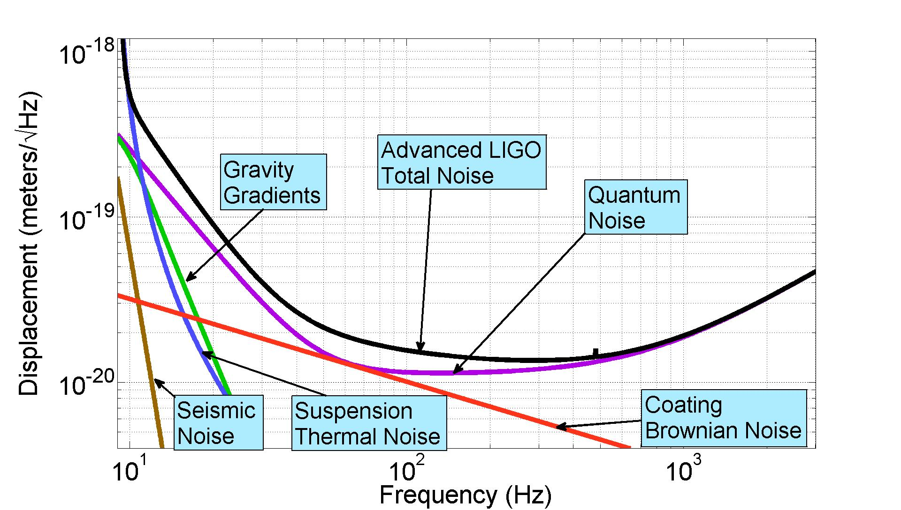
Projected Sensitivity for aLIGO
GW band: 10 Hz to 8 kHz
Adapted from Gregg Harry. “Advanced LIGO: the next generation of gravitational wave detectors” . Classical and Quantum Gravity, vol. 27, April 2010

Slide 49
Inspiral Range vs Binary Mass
Increasing seismic amplitude with no damping
Increasing amplitude
Decreasing frequency
1 pc = 3.26 ly

Slide 50
AMD Inspiral Simulation Cost Functions
Sensor noise cost =
Total cost per mode
Modal amplitude cost =
measured modal displacement amplitude. Model behavior ->
modal cost scale factor
modal closed loop damping ratio
minimum closed loop damping ratio
mode index
i
Table I: Adaptive modal damping cost function parameters.
Parameter | Mode 1 | Mode 2 | Mode 3 | Mode 4
 | 0.0005 | 0.0005 | 0.0005 | 0.0005
M_{RMS} with & max seis | 1.45*10⁻⁸ | 6.54*10⁻⁹ | 1.17*10⁻⁸ | 2.00*10⁻⁹
M₀ | 2*10⁻⁸ | 10⁻⁹ | 8*10⁻¹⁰ | 5*10⁻¹⁰
M_{RMS}/M₀ | 0.725 | 6.54 | 14.625 | 4

Slide 51
AMD Inspiral Simulation Results
Table II: Optimal damping values determined by the selected cost function parameters.
Seismic % of max |  |  |  |  | 150 SM volume
0 | 0.00054 | 0.00055 | 0.00051 | 0.00050 | 3051 (100%)
50 | 0.00059 | 0.0051 | 0.016 | 0.0042 | 2982 (97.7%)
75 | 0.00073 | 0.0089 | 0.029 | 0.0090 | 2915 (95.5%)
100 | 0.00091 | 0.014 | 0.046 | 0.016 | 2796 (91.6%)
100 | 0.20 | 0.20 | 0.20 | 0.20 | 473 (15.6%)
100 | 0.00050 | 0.00050 | 0.00050 | 0.00050 | 3.05 (0.1%)

Slide 52
Stochastic Sensitivity
Poor low frequency sensitivity from high detector noise.
Poor high frequency sensitivity from ≈ 0.01 s time delay between detectors separated by 3000 km.
T = 1 year
Ref: Bruce Allen. The Stochastic Gravity-wave Background: Sources and Detection. 1996.

Slide 53
Stochastic Overlap Reduction Function
γ(f)

Slide 54
Backups: Science from Observations
Binary black holes
  Probe nonlinear dynamics of spacetime curvature during merger phase.
  GW scattering during inspiral phase.
  Characterize number of neutron star and/or black hole binaries
  Characterise ringdown phsase after merger
  Test Hawking’s law that the event horizon must increase in area
  Naked singularity test

Slide 55
Backups: Science from Observations
Stochastic background
  Observe early universe from 10⁻²² sec after Big Bang. Currently, CMB observations only get us to about 100,000 years after big bang (≈35 orders of magnitude improvement).
  Quantify background from incoherent sum of many weak/distant sources such as binaries, supernovae, etc.

Slide 56
Backups: Science from Observations
Inspirals
  Quantity in Milky Way
  Neutron star structure
  Neutron star ellipticity (how big are the mountains)
  Neutron star quakes
  Theory of maximum spin rate of X-ray binaries due to GW emmission
Supernovae
  Evolution of stellar collapse - no complete models exist.

Slide 57
Backups: GW Signal Calibration
Cavity Displacement (Eq. 1):
Solving for the GW (Eq. 2):
Calibrated cavity signal (effectively open loop)
If GW is much greater than everything else on the right hand side of (2), then the calibrated signal is approximately GW.
Notes:
Yes it does but one can approach it in a few ways:
Introduce the GW effects as part of the system state and use an observer to estimate it.
- see what ‘s behind the box … x is multiplied by the (1 + PC) and if we focus on a frequency range, say through a band pass filter, one can attenuate all other signals
And recover , in principle, the effects of GWs. See next slide

Slide 58
Simulation of LIGO cavity with AMD
Stage 1 measurement
Modal Damping
Pend.
Non-stationary
disturbance
Cost
Adapt
+
k₁
Stage 1 damping force
k₂
Sensor noise
Damping gains
4 km
Real-time tuning optimizes pendulum damping for:
Nonstationary disturbance
Sensor noise
Nonlinear interferometer response
A. Laser beams falling off mirrors
B. Laser scattering off vacuum walls and other objects
C. Interferometer readout method
D. Creak in suspension springs
E. etc
Interferometer signal w/ nonlinear model
Assumption that
Removes nonlinearity

Slide 59
Backups: Boosted Experimental Noise

Slide 60
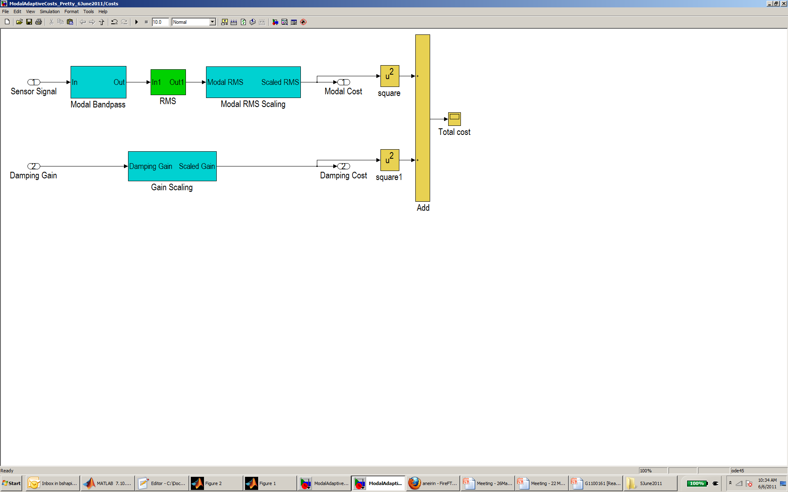
Cavity Control with Adaptive M.D.
Top mass measurement
Modal Damping
Triple
Non-stationary
disturbance
Cost
Adapt
+
k₁
Top mass damping force
k₂
Sensor noise
Bottom mass force
Damping gains
Cavity Control
Cavity error signal
The cost box measures the performance values we care about and scales them to get the costs:
1. Modal Amplitudes
2. Noise Amplification
- directly proportional to damping gain
Modal amplitude
Sensor noise amplification

Slide 61
Cost Input 1: Modal Amplitudes
(arbitrary magnitude)
Simulated Undamped Top Mass Displacement Measurement (arbitrary magnitude)
Mode 1
Mode 2
Modal amplitude
Cost Box
Sensor noise amplification

Slide 62
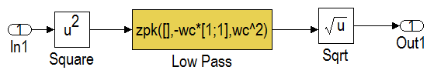
Modal Amplitude Variance Estimation
Band-passed modal signal
Modal amplitude
Cost Box

Slide 63
Cost Input 2: Noise Amplification
Modal amplitude
Cost Box
Sensor noise amplification
For frequencies ≥ 10 Hz :
mode 1 damping force
stationary sensor noise
linear in k_{i}
Since the sensor noise amplification for a given mode is directly proportional to its damping gain, the damping gain, rather than a measured noise term is used for this calculation. This is a quicker and more accurate estimate then measuring the noise directly like the modal amplitude.

Slide 64
Gauss-Newton Adaptation
Recursive damping gain equation
pseudoinverse
Optimal
Notes
= i_{th} mode damping gain at time step n. Each time step is 30 to 60 sec.
= pseudoinverse of the i_{th} mode Jacobian descent matrix at time step n (model based).
[
]
(Modal amplitude gradient wrt k_{i})
(modal noise amp. gradient wrt k_{i})
= cost vector of the i_{th} mode at time step n.
[
]
(scaled modal amplitude)
(scaled modal noise amplification)
= step size of the i_{th} mode damping gain at time step n.

Slide 65
Adaptive Step Sizes and Step Rates
step size and time boundary layer, factor of 2 above the sensor noise.
Big α, short time step
Small α, long time step
current damping gain
Notes:
If the measured modal amplitude is above the moving boundary layer, the adaptation takes large, quick steps with short RMS time constants to respond to sudden seismic events quickly.
When the modal amplitude goes below the line, the adaptation takes small slow steps with long RMS time constants to converge accurately to the optimal damping solution.

Slide 66
Measured Response to a Seismic Square Wave: Modal RMS
Adaptation on
Ground
Notes: 3, 30 sec quicksteps steps; 3, 15 sec quicksteps steps; all 60 sec slow steps.

Slide 67
Measured Response to a Seismic Square Wave: Damping Gains
Notes: 3, 30 sec quicksteps steps; 3, 15 sec quicksteps steps; all 60 sec slow steps.

Slide 68
Ex. Train Passing Through Livingston
21 Nov 2009, 5 am
10 min

Slide 69
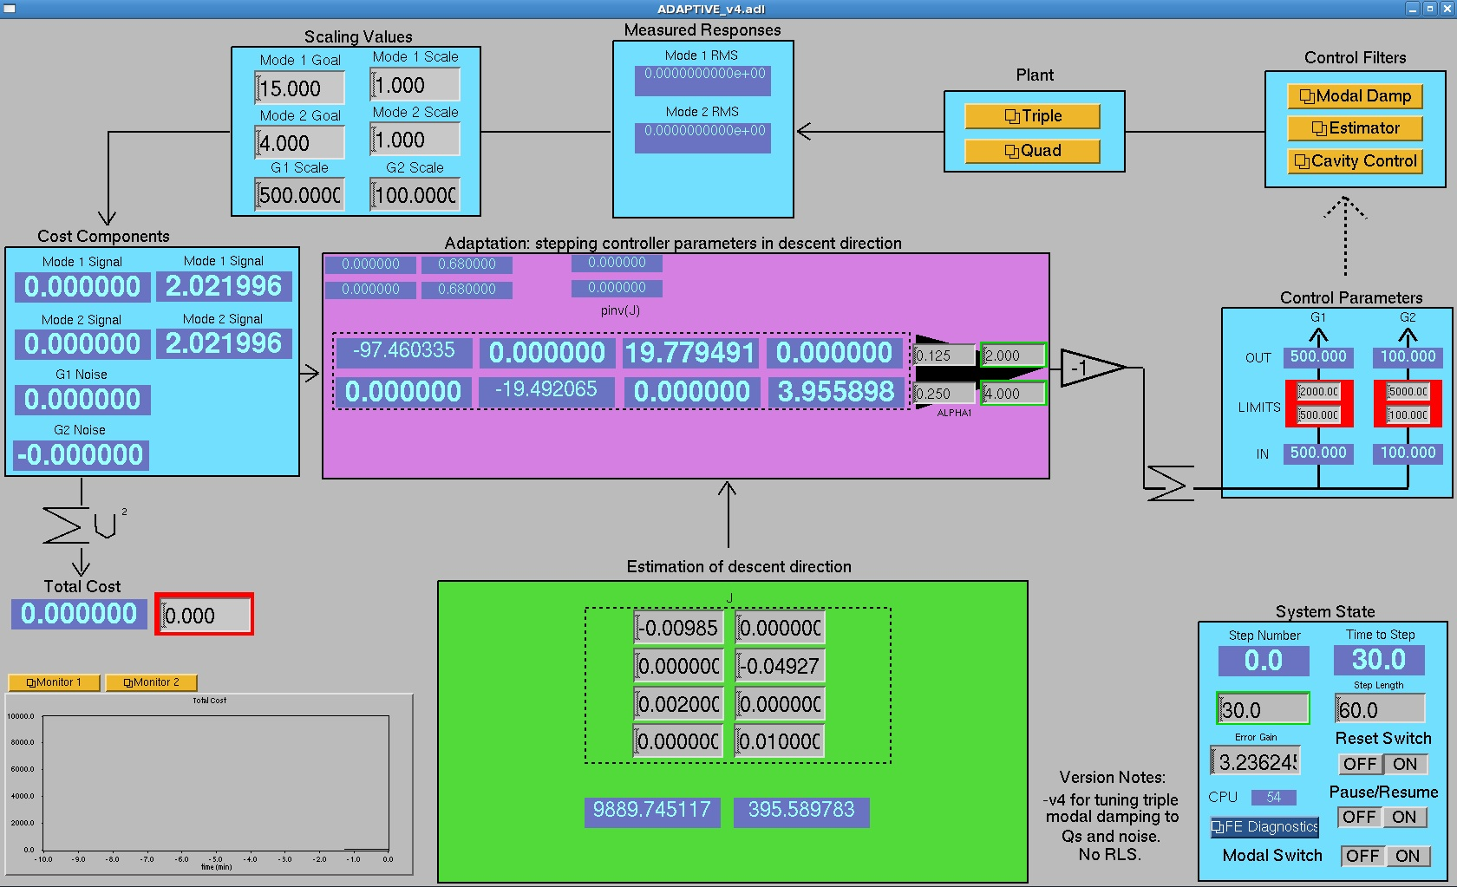
Backups: Adaptive Damping Interface Screen

Slide 70
Projected Sensitivity for aLIGO
GW band: 10 Hz to 8 kHz
Adapted from Gregg Harry. “Advanced LIGO: the next generation of gravitational wave detectors” . Classical and Quantum Gravity, vol. 27, April 2010

Slide 71
Problem 3: Cavity Signal
“Linear region”
PDH signal
The PDH signal for a 4 km aLIGO Fabry-Perot cavity with mirror power transmissions of 1.4% and 7.5 ppm. The cavity finesse is 445. The linear region between the dashed lines is 1 nm wide.
F = cavity finesse = 445
λ = laser wavelength = 1064 nm
C = arbitrary electronic scaling

Slide 72
Backups: PDH and Resonant Cavity Power

Slide 73
Backups: Cost Scaling Details

Slide 74
Backups: Cost Scaling Details
<- equal trade off ->
Damping Gain Scaling
Modal RMS Scaling

Slide 75
Backups: Cost Scaling Details
<- progressive trade off ->
Damping Gain Scaling
Modal RMS Scaling
Progressive trade off anticipates cavity lock loss for large amplitude disturbances.

Slide 76
Backups: Cost Scaling Details
<- progressive trade off ->
Damping Gain Scaling
Modal RMS Scaling
Progressive trade off anticipates cavity lock loss for large amplitude disturbances.
erf() removes the pole and reduces the aggressiveness.

Slide 77
Backups: Cost Scaling Details
<- progressive trade off ->
Damping Gain Scaling
Modal RMS Scaling
Progressive trade off anticipates cavity lock loss for large amplitude disturbances.
erf() removes the pole and reduces the aggressiveness.
Subtracting 1 from the gain scaling simply provides a ‘0’ cost target gain.

Slide 78
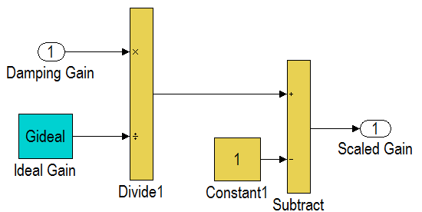
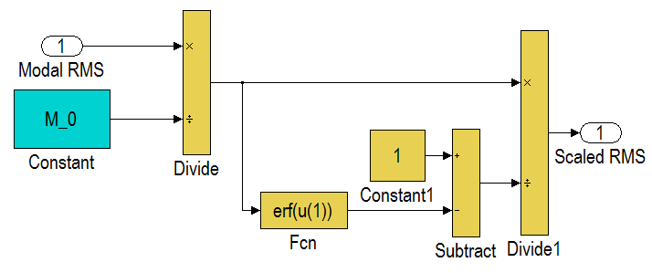
Backups: Cost Box Details
RMS Filter
Damping Gain Scaling
Modal RMS Scaling

Slide 79
Backups: Measurement of modal RMS dependence of damping gain (Jacobian Measurement)

Slide 80
Backups: Jacobian Measurement
Mode 1 RMS as a function of k₁
75/sqrt(k₁)
k₂ = 1000
Mode 1 RMS
k₁

Slide 81
Backups: Jacobian Measurement
Mode 2 RMS as a function of k₂
30/sqrt(k₂)
k₁ = 500
Mode 2 RMS
k₂

Slide 82
Backups: Jacobian Measurement
Mode 2 RMS as a function of k₁
k₂ = 1000
Mode 2 RMS
k₁

Slide 83
Backups: Jacobian Measurement
Mode 1 RMS as a function of k₂
k₁ = 500
Mode 1 RMS
k₂

Slide 84
Backups: Driven Seismic Amplitudes

Slide 85
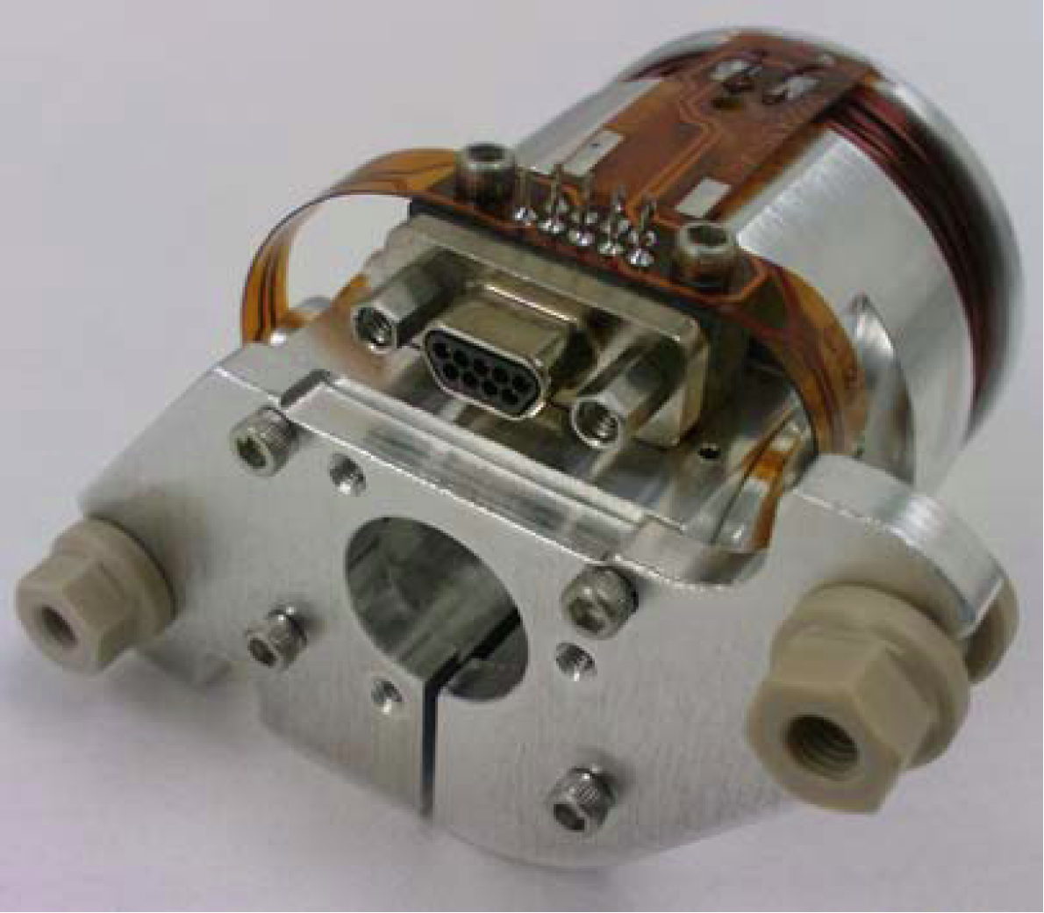
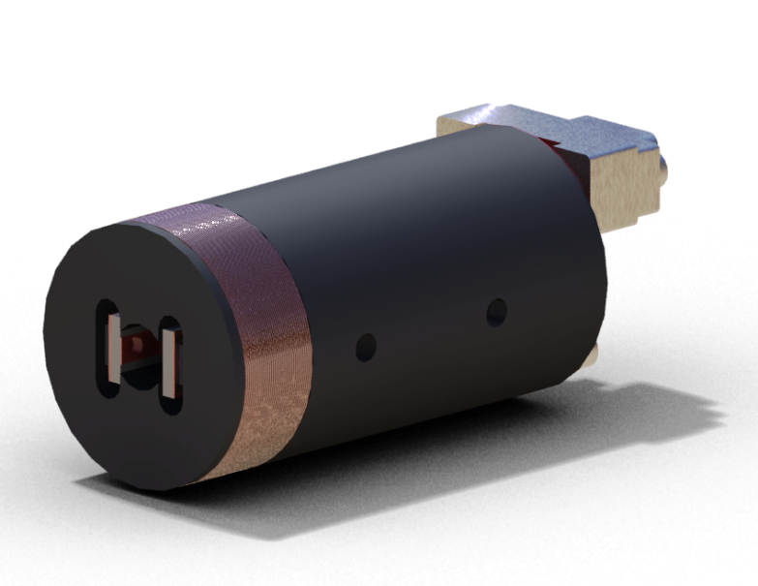
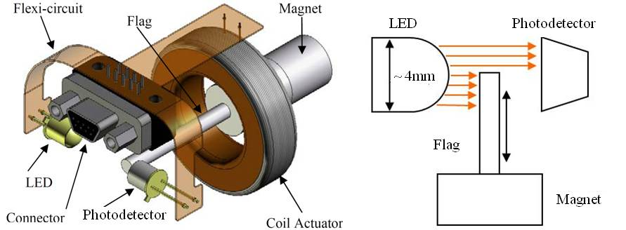
Backups: Optical Sensor ElectroMagnet (OSEM)
Birmingham OSEM (BOSEM)
Advanced LIGO OSEM (AOSEM)
- modified iLIGO OSEM
Magnet Types (M0900034)
BOSEM – 10 X 10 mm, NdFeB , SmCo
10 X 5 mm, NdFeB, SmCo
AOSEM – 2 X 3 mm, SmCo
    2 X 6 mm, SmCo
    2 X 0.5 mm, SmCo
BOSEM Schematic

Slide 86
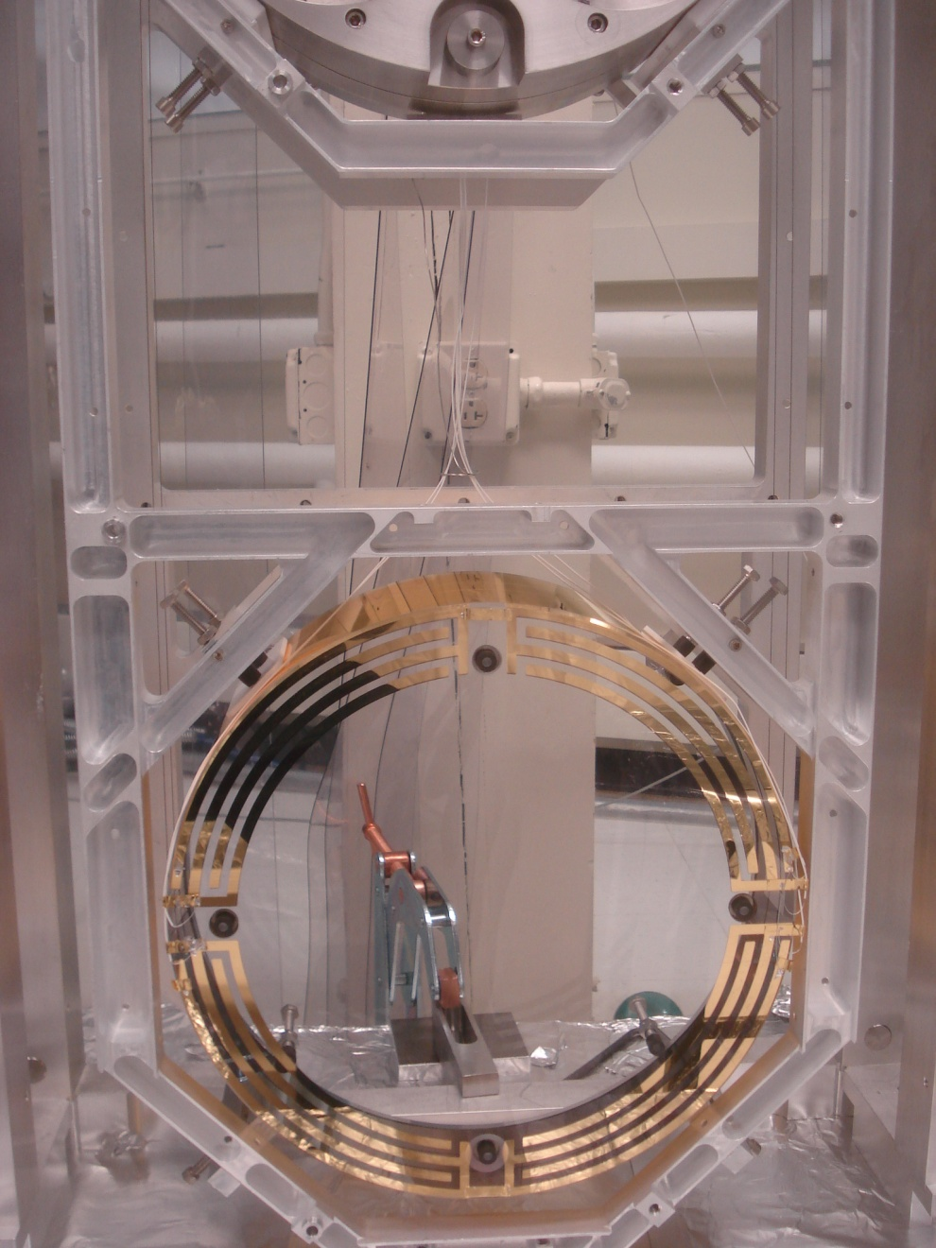
Backups: Quadruple Suspension ESD
Reaction Chain
Main (test) Chain
The electrostatic drive (ESD) acts directly on the test ITM and ETM test masses.
± 400 V (ΔV 800 V)
  ≈ 100 μN
Each quadrant has an independent control channel
Common bias channel over all quadrants
UR
UL
LR
LL

Slide 87
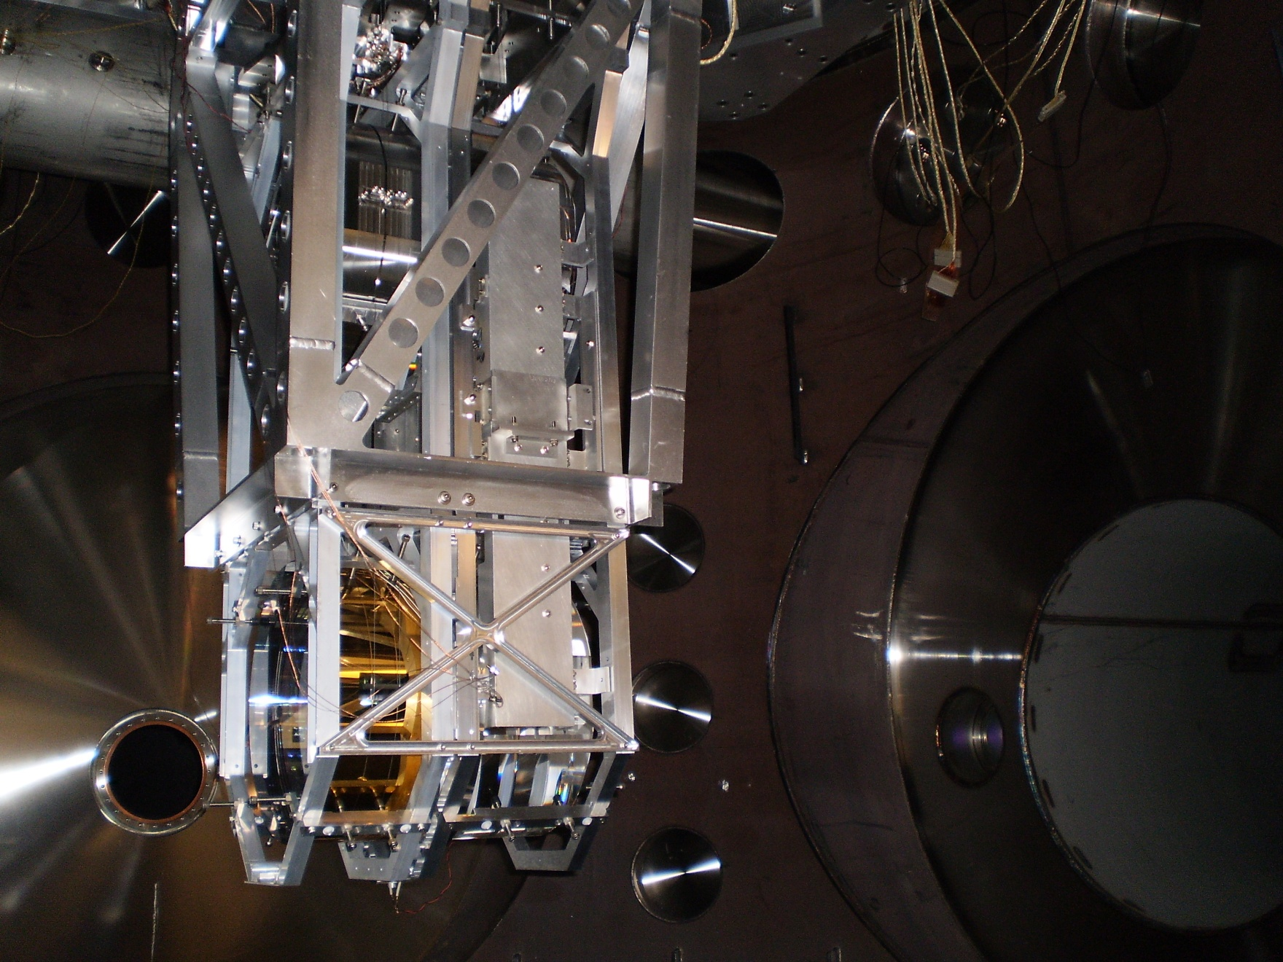
Backups: Quadruple Suspension
MIT monolithic quad in BSC
June 2010

Slide 89
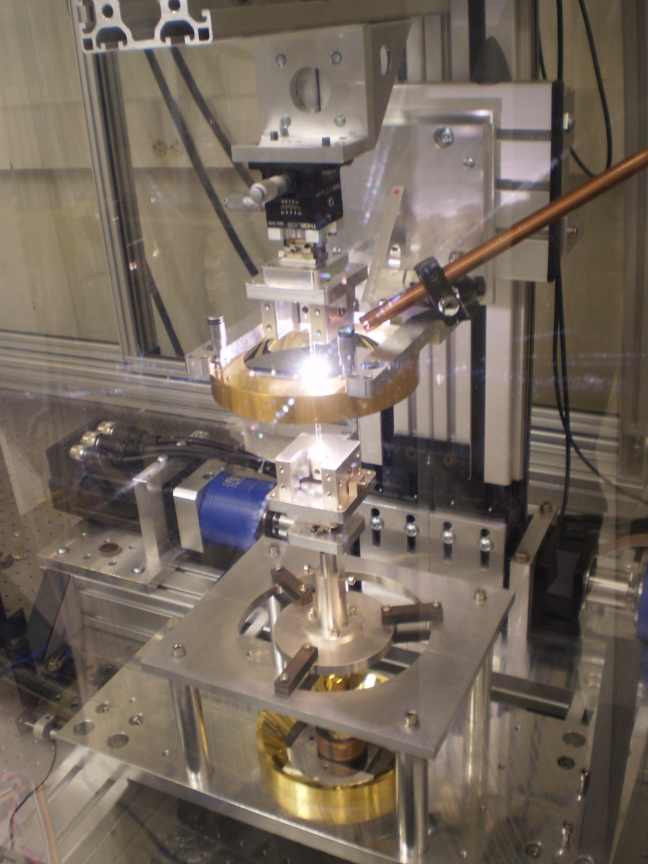
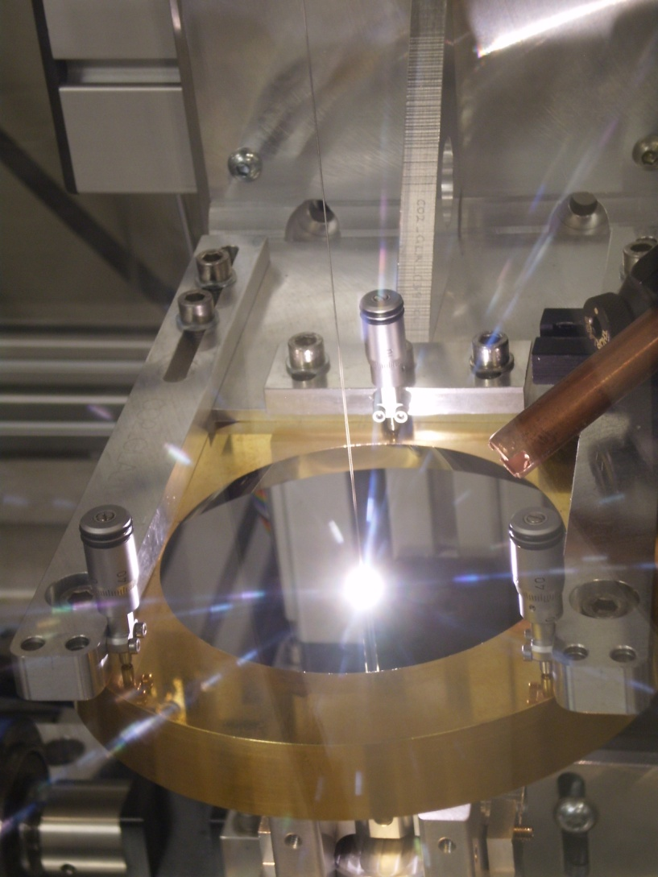
Pulling Fibers

Slide 90
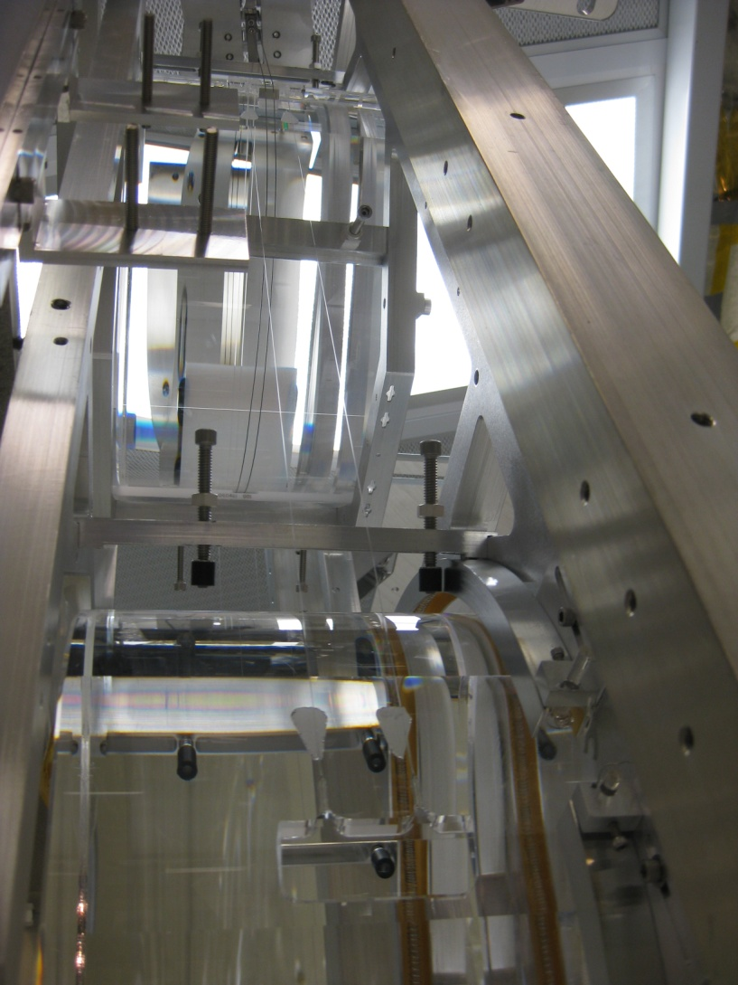
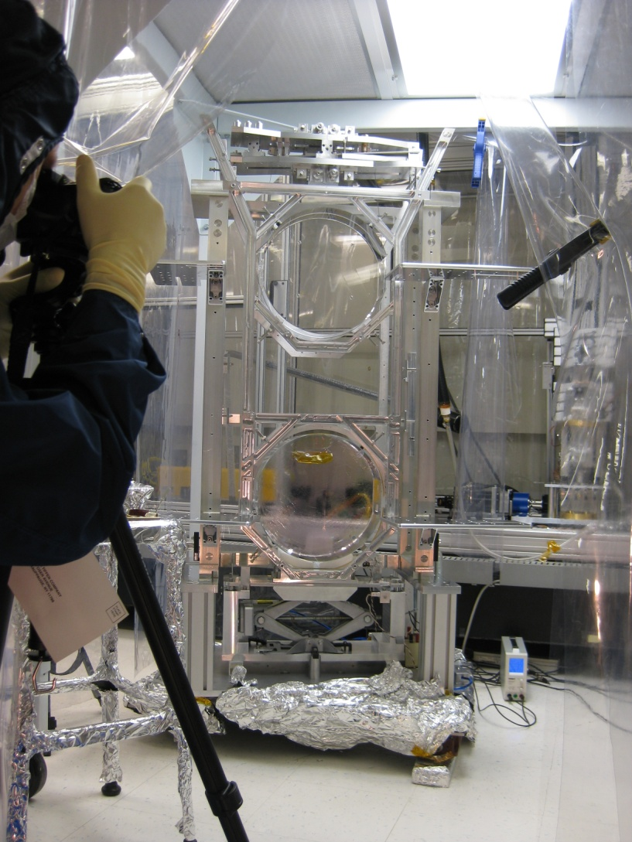
Quad Monolithic Stages

Slide 91
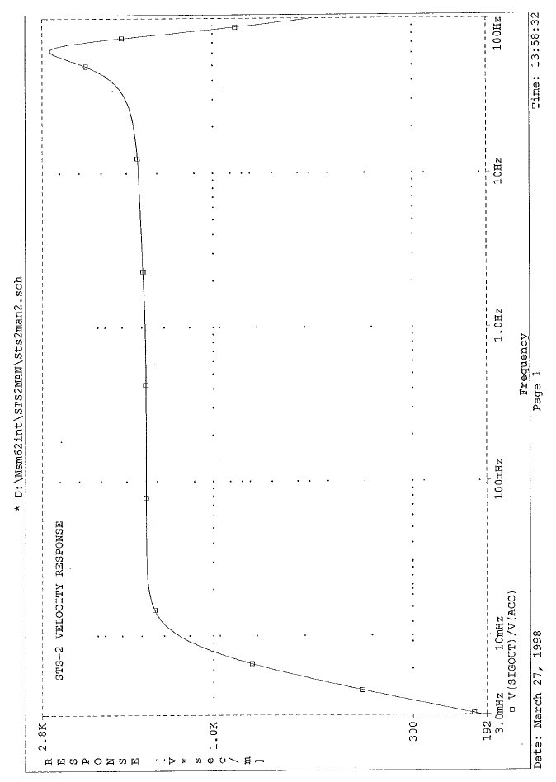
Streckeisen STS-2 Seismometer
Ref: http://www.passcal.nmt.edu/content/instrumentation/sensors/broadband-sensors/sts-2-bb-sensor

Slide 92
Scratch
LIGO GW sources with sound files
http://www.ligo.org/science//GW-Burst.php

