Slide 1
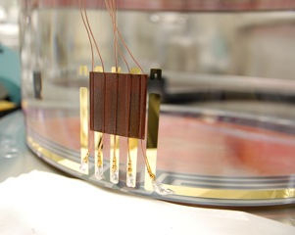
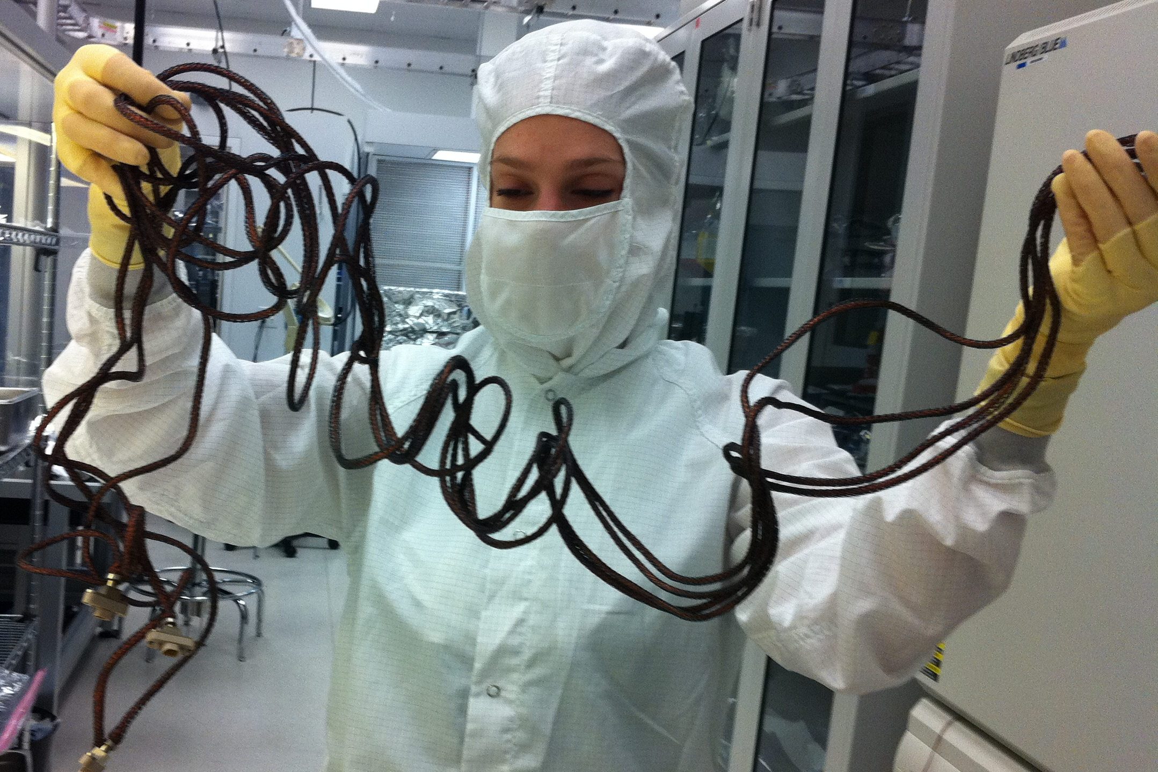
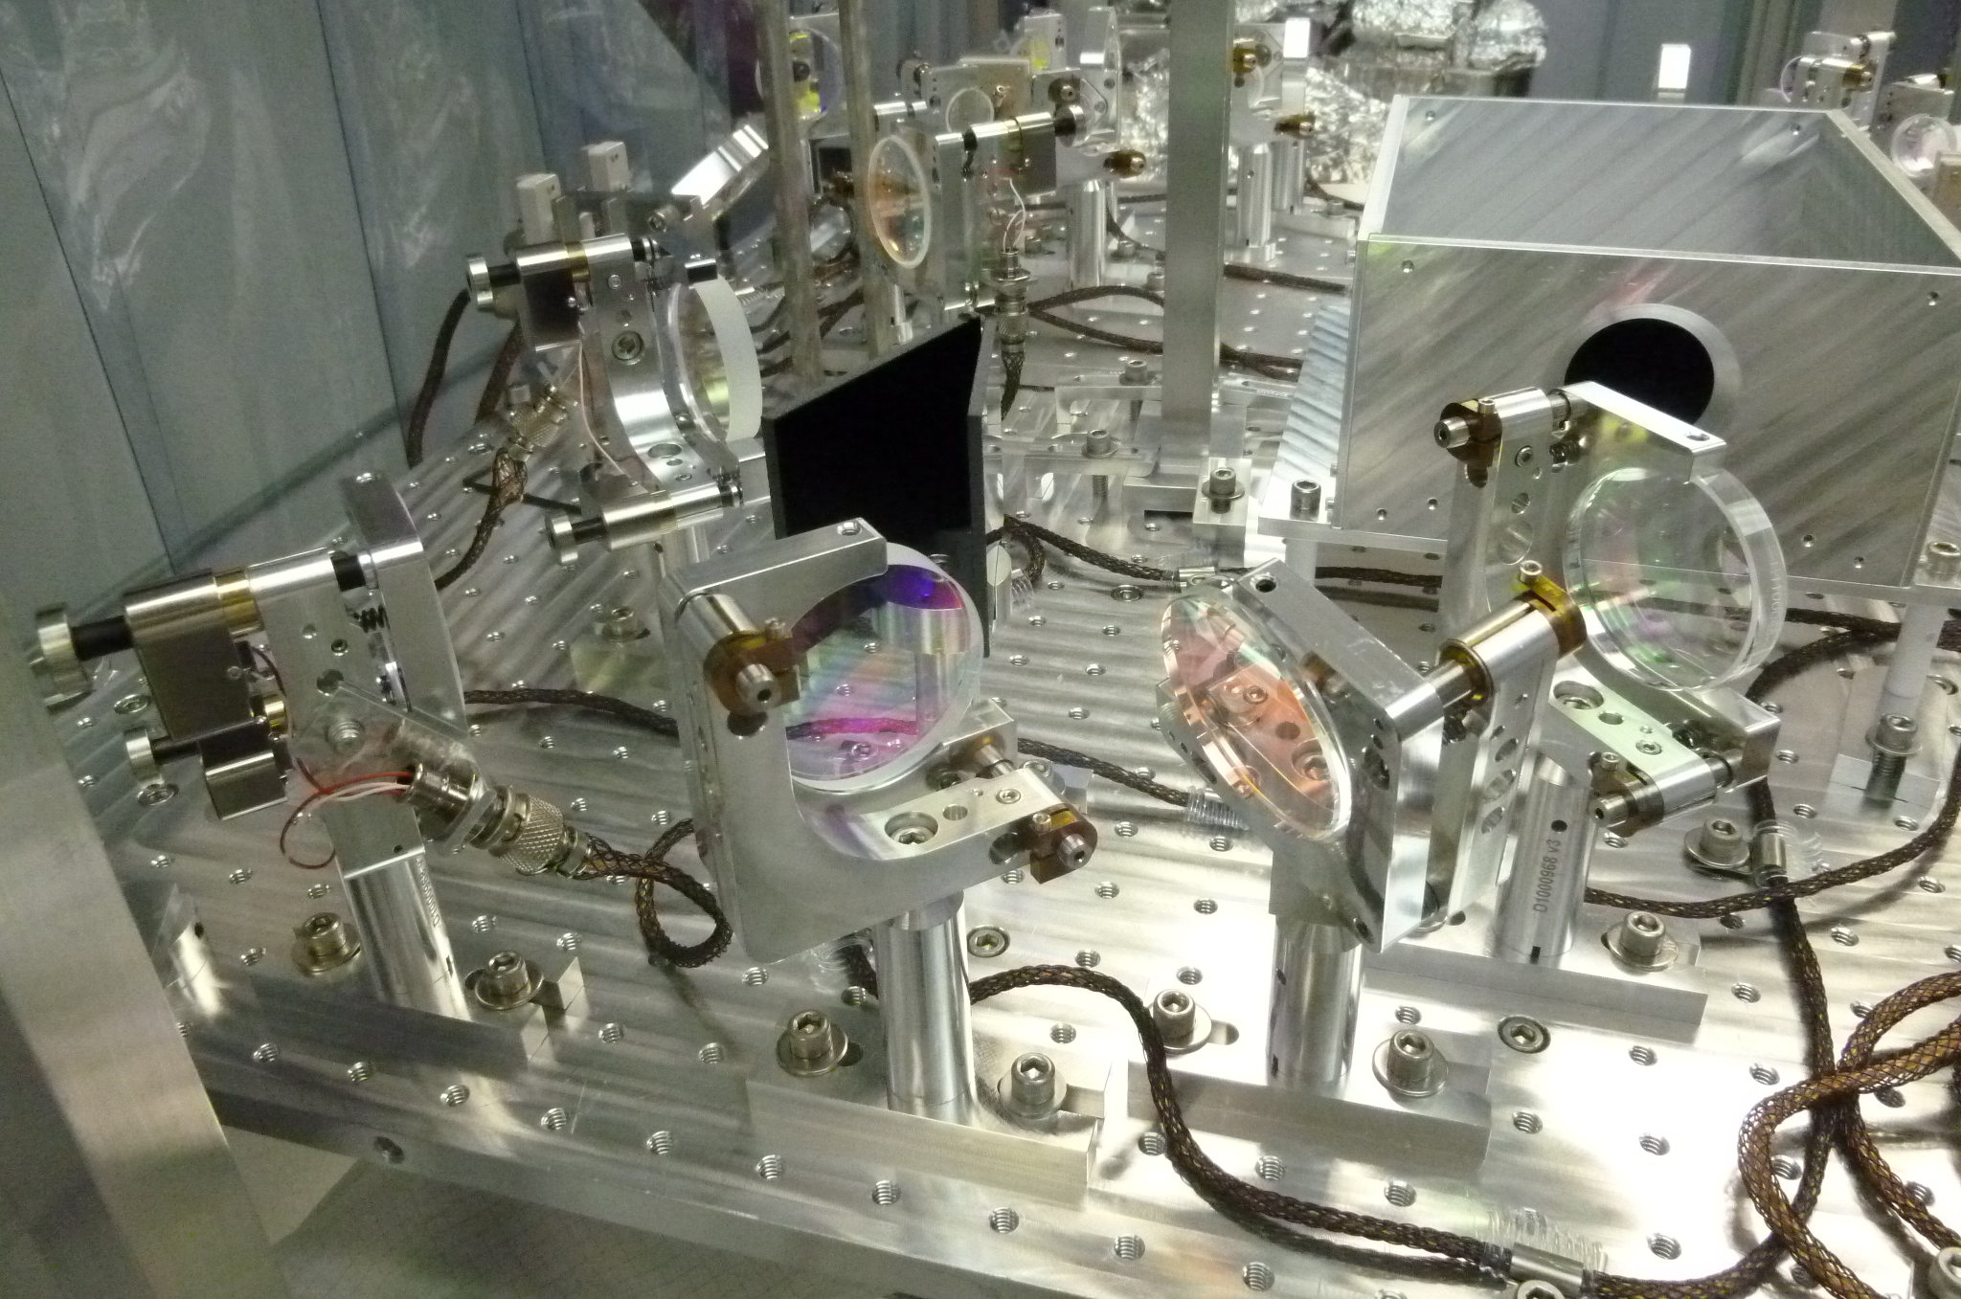
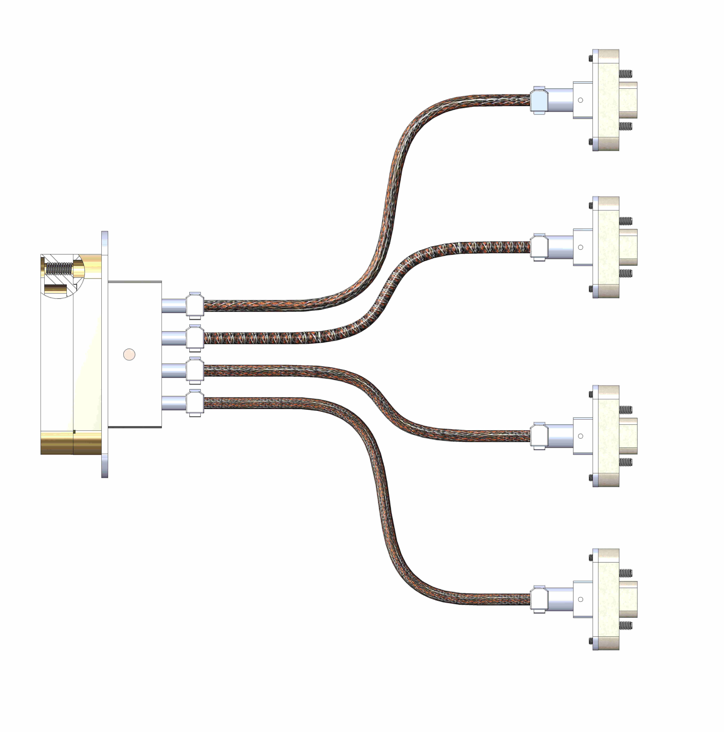
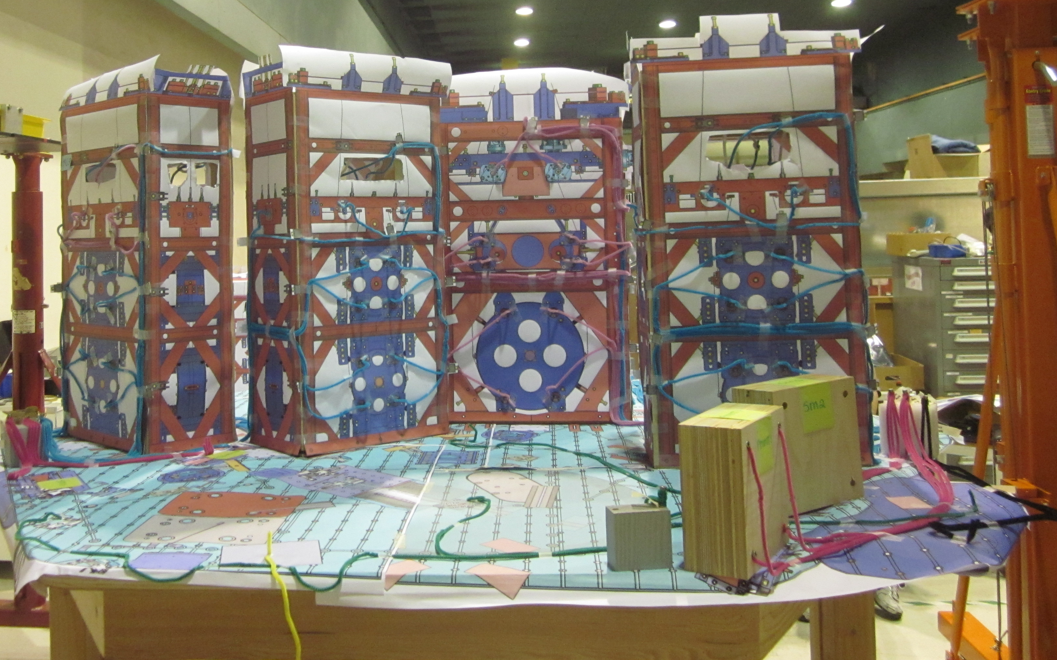
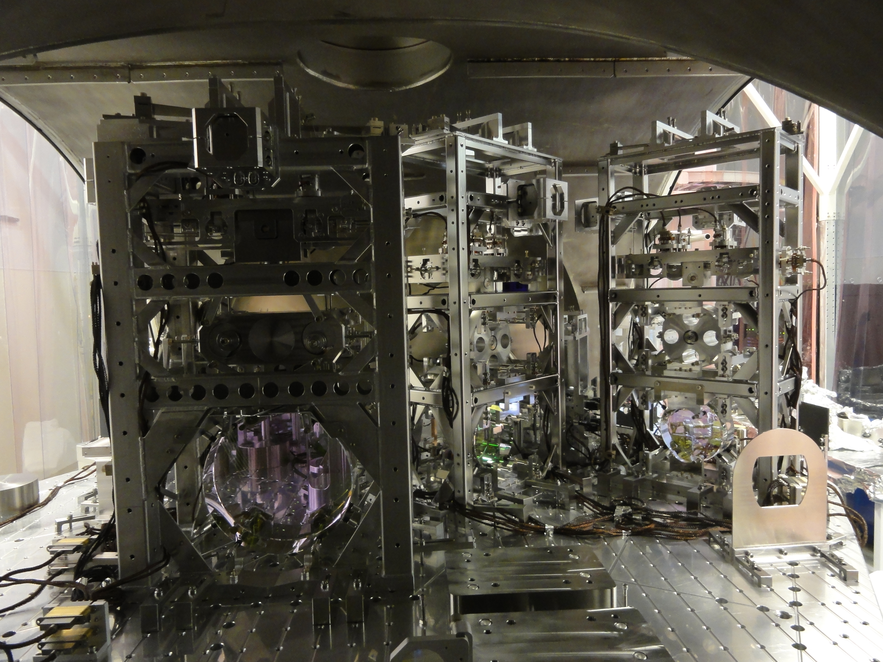
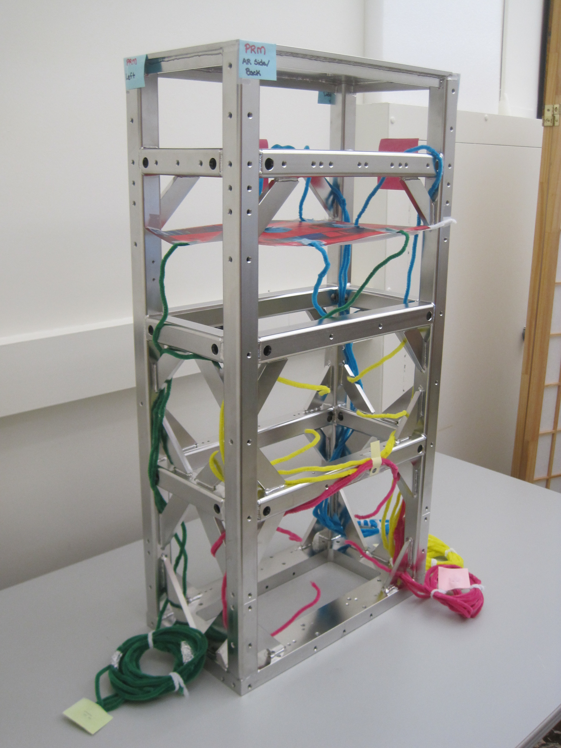
In-Vacuum Cables – Lessons From Advanced LIGO Assembly & Installation
Kaitlin Gushwa, LIGO Laboratory, California Institute of Technology
Introduction
Advanced LIGO in-vacuum cables:
Suspensions
Optical shadow sensor/electromagnetic actuators for
local (damping of pendulum modes) and global control.
Core Optics Electrostatic Drive (ESD).
Seismic
Motion sensing in 6 DOF.
Applying forces in feedback loops to reduce sensed
motion.
Interferometer Sensing & Control (ISC):
Length sensing and control (radio-frequency photodetectors).
Alignment sensing (wavefront sensors).
Clean and Bake
Observations
Shrunken/melted PEEK overbraid.
Bubbled Nickel plating.
Loss of flexibility (“memory”).
Small particulates (“salty”).
ESD cable soldered to optic
Birmingham Optical Sensor Electromagnetic Motor
Melted PEEK
Bubbled plating
Cable with memory
Changes
Reduced bake temp to 120°C for PFA, 180°C for Kapton.
Added Gold over Nickel plating.
Loaded loosely into oven.
Salty cables
Transmission Monitor Suspension Telescope assy cables
Potential Source of Noise
Shorts to ground caused by:
Shield protruding past overbraid, contacting conductor.
Sharp edge spearing through open overbraid weave,
contacting copper.
Mitigation:
Lace cables through gussets, reducing overall contact with conductors.
Secure cables with Aluminum strips.
“Origami” metal band-aids cover sharp edges.
Use cables with loose braid on SUS top stage before lower stage, i.e. least critical location.
Design
Facts
1,800+ cables for 3 IFO’s
59 types per IFO
DSUB25 Connector
Gold over electro-less Nickel selectively metalized PEEK Victrex 450GL30
Contact
Beryllium Copper Alloy C17300, Gold over Nickel
Helicoil
Nitronic60
Backshell
SSTL
Clamping Band
SSTL
Twisted Pairs of Wire
PFA/Kapton Insulated Copper
Overbraid
PEEK Victrex Carbon Loaded
Example: Suspension PFA insulated “quadrapuss” cable
Hardware
SSTL
Shield
Copper Braid
microD9 Connector
PEEK Victrex 450GL30
Loose copper braid (manufacturing)
Tight routing/clamping (handling)
Sharp notches on suspensions (manufacturing)
Strip blunts gusset notch
Layout Optimization
Limited real estate space.
Overlapping subsystem cable paths.
Majority of cables already purchased.
Main obstacle: avoiding beam path.
Created scale mock-ups of seismic table and suspensions.
Used pipe cleaner “cables” to optimize route along table and up suspensions.
HAM2 Wooden Mock-Up
Left Side View (Rotated 90 Deg CCW)
PRM Suspension Model
Iso View Left - Back
HAM2 Solidworks Drawing
Iso View Front - Left
Livingston HAM2 Chamber (In Progress)
Right Side View (Rotated 180 Deg CCW)
LIGO-G1200915-v1

