Slide 1
The “Go to High Power” Button aLIGO TCS: Latest Results
Aidan Brooks
LIGO Seminar. Friday 21st Sept. 2012
G1201041-v2

Slide 2
GW from Mergers
Inspiral
Chirp: low to mid-frequencies
Merger
Higher frequencies
Ringdown

Slide 3
C.D Ott (LIGO 3 Strawman workshop)

Slide 4
Increase the power … but …
Tens kW
Hundreds kW
CP
ITM
ETM
RM
Absorbed power
800kW incident ×
0.5ppm absorption
= 0.4W absorbed

Slide 5
Thermal lens and deformation
Tens kW
Hundreds kW
CP
ITM
ETM
RM
Absorbed power leads to …
2. Thermal lens and surface deformation:
phase front/wavefront of an incident electric field will be distorted
A e^{iθ}
A e^{iθ’}

Slide 6
Spatial mode distortion
Absorbed power leads to …
2. Thermal lens and surface deformation
3. Control signals deteriorate
- due to spatial distortion in resonant modes
No distortion
Distorted phase
Resonant field distribution
Resonant field distribution

Slide 7
Increasing fraction of GW signal is lost
Absorbed power leads to …
2. Thermal lens and surface deformation
3. Control signals deteriorate
4. Sensitivity and duty cycle suffer
More GW signal is lost as power increases!
Limit = no more than 5% loss
800kW = full aLIGO

Slide 8
Increase the power (and squeeze)
Tens kW
Hundreds kW
CP
ITM
ETM
RM
Apply compensation to fix lensing
Absorbed power leads to …
2. Thermal lens and surface deformation
3. Control signals deteriorate
4. Sensitivity and duty cycle suffer
5. Need compensation system

Slide 9
The solution
Self-heating heats the CENTRE of the test masses
TCS heats in an ANNULAR way to remove the thermal lens
Front
+
=
Side
+
=

Slide 10
Thermal Compensation SYSTEM (TCS)

Slide 11
Interferometer Layout
High power FP arms are most relevant to TCS

Slide 12
aLIGO TCS Overview
4: OAT
Sensors + actuators
Hartmann Sensor
SLED
1: RH
ALS laser
3: HWS
Hartmann
Sensor
ring heater
ring heater
2: CO2P
CP
ITM
ETM
RM
Actuator + diagnostic
CO2 laser projector
With tunable heating profile

Slide 13
Ring Heater

Slide 14
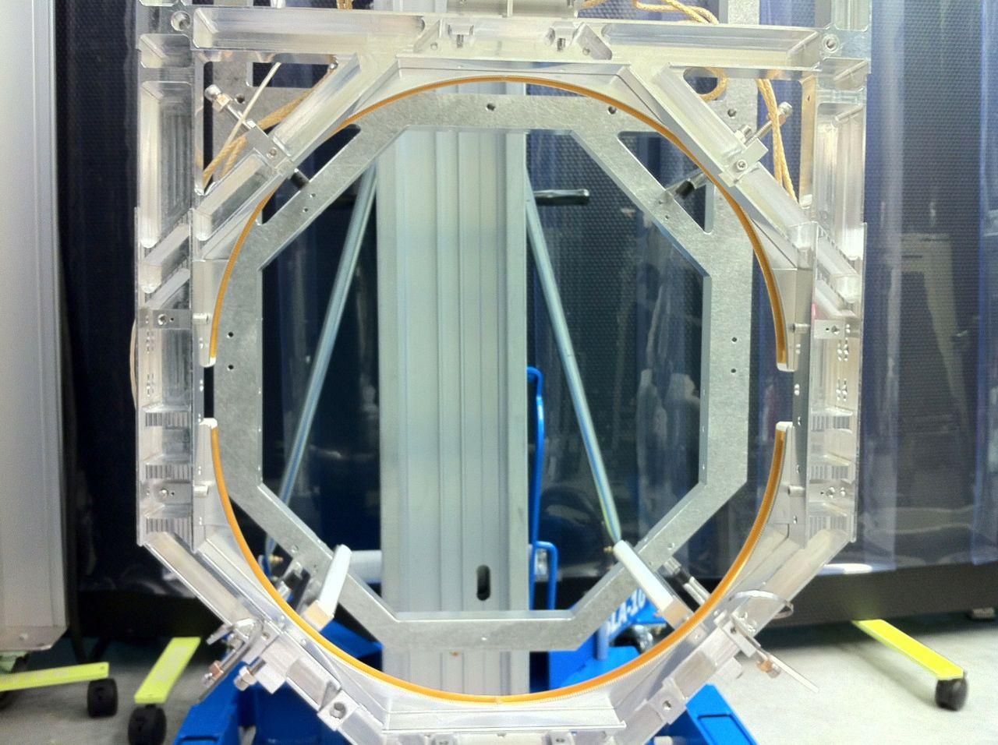
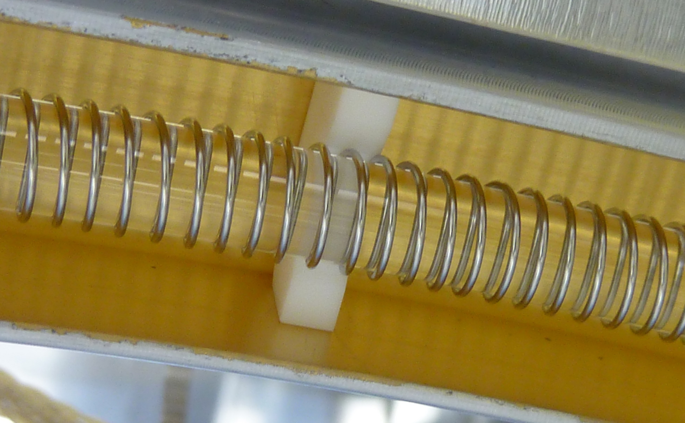
Ring Heater Overview
Ring heater encircles the ITM
Nichrome wire carrying current wrapped around glass torus
Surrounded by golden shield
Radiatively heats the barrel
More ANNULAR heating
Thermo-elastic deformation of ITM surface increases curvature
Helps reduce the total substrate thermal lens

Slide 15
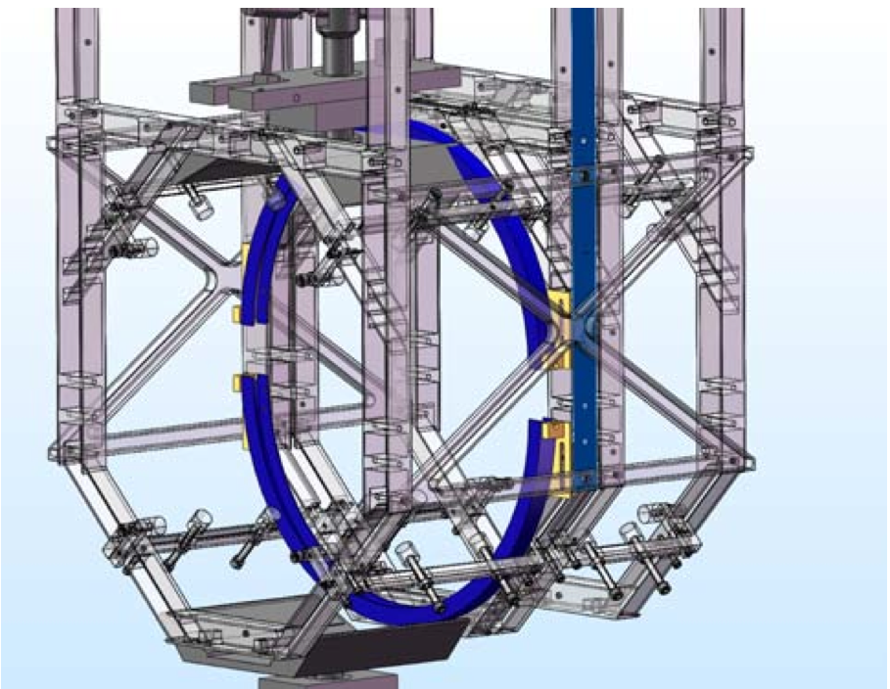
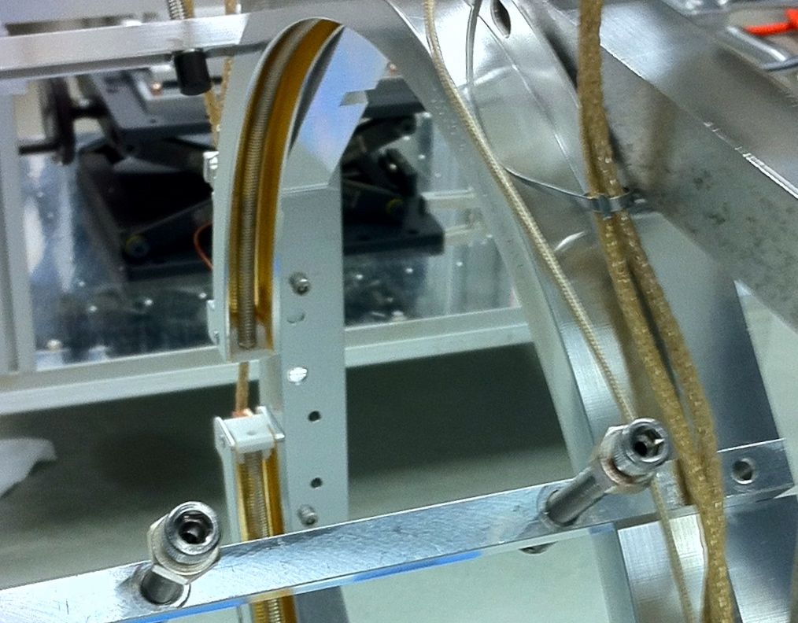
Ring Heater: Upper and Lower Segments
Two segments
Enables “easy” removal
Heating not 100% axially symmetric
ITM

Slide 16
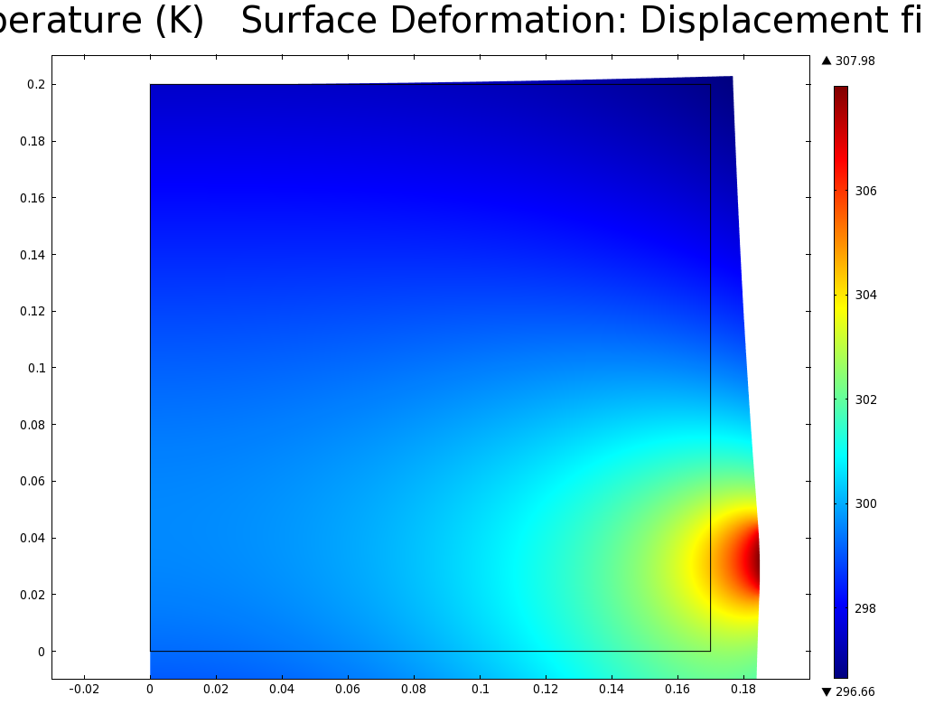
Temperature distribution and thermo-elastic deformation
200
Height (mm)
Parameter | Value
Max. power | 40 W
Avg. ΔT in optic | 0.5 K/W
Curvature change | ~ 10⁻⁶ m⁻¹W⁻¹
Max. RoC change | ~ 150m
Surface astigmatism | < 0.1 nm
100
306
0
0
80
160
Radius (mm)
304
Temperature (K)
302
300
Pros
Surface change almost completely quadratic (no higher order terms)
Cons
Very long time constant
298
Test Mass

Slide 17
Residual Surface Deformation at Full Interferometer Power
Surface deformation
Self heating
Ring Heater
Flattened
RMS = 1.8nm
~10ppm “scattered”

Slide 18
CO2 Projector

Slide 19
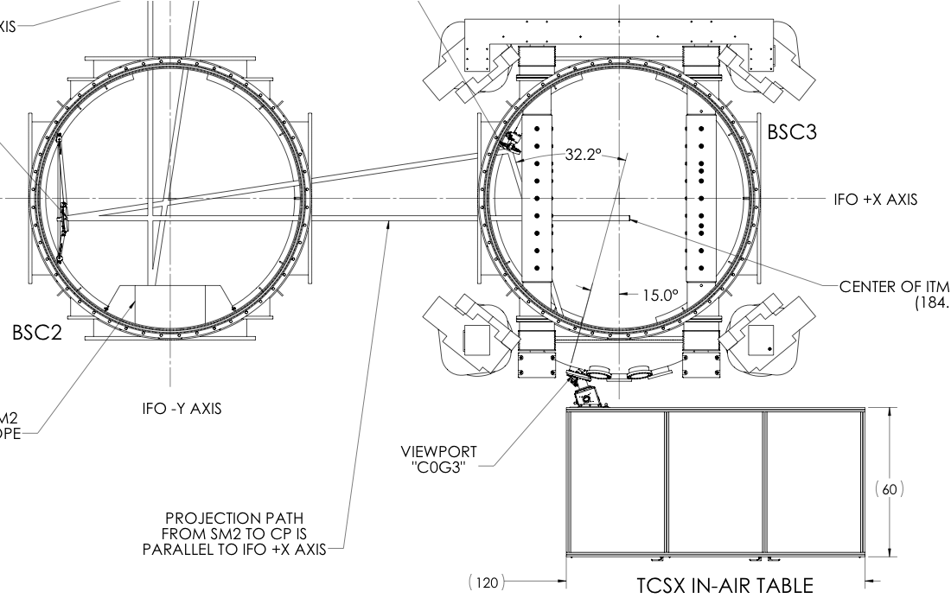
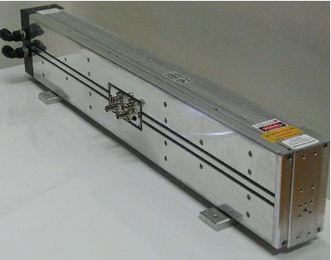
aLIGO CO2 Projector
CO₂ laser beam passes under BS
BS
CP + ITM
Annular heat profile
Beam shaping: what beam shape, how to get it?
Stability: Access Laser – 10 days, no glitches
Intensity noise: latest measurements

Slide 20
Thermal Lens: Correct the RH+Self Residual
Surface deformation
Substrate thermal lens
Self heating
Self heating
Ring Heater
Ring Heater
Flattened
RMS = 1.8nm
RH residual thermal lens

Slide 21
Optical Path Distortion (Thermal Lens) and Scatter
Maximum allowed
OPD = 3.8nm RMS

Slide 22
Optimum Beam Shape Calculator
[nm]
[nm]
RH residual thermal lens
TL_{RH}(x,y)
Non-flat residual lens:
ε_{res}(x,y)
Flat Lens:
TL = k
Transfer fn:
[nm]/[W/m^2]
RMS = 2 nm
CO2 Heating Profile: H(x,y)
[W/m^2]
Gain
[W/m^2]/[nm]
Solves for flat wavefront
Doesn’t solve for DC level of wavefront: need another loop for this (to minimize total power)

Slide 23
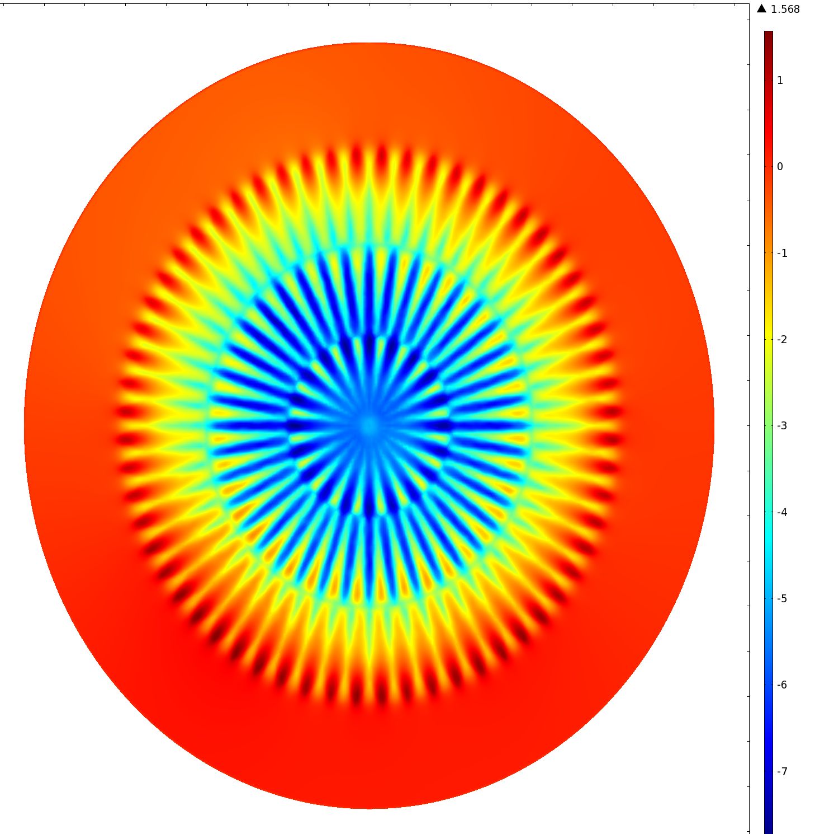
And we get …
nm
1
0
-1
-2
-3
-4
-5
-6
-7
Optimum heating profile
H(x,y) (P = 4.7W)
Masked beam profile
Mask
CO2 beam profile
Thermal Lens from difference
OPD = 2.1nm RMS

Slide 24
Laser Noise couples to Displacement Noise
Thermo-elastic expansion of the compensation plate
Couples to displacement noise
Measure and stabilize intensity noise
CP
ITM
eLIGO PD
aLIGO PD
CO2 laser projector table

Slide 25
Access Laser Intensity Noise

Slide 26
HWS

Slide 27
HWS overview
SLED
1. wavefront distortion, W(x,y), accumulated here
Probe beam
P
Hartmann
Sensor
P’
imaging & demagnifying telescope
CP
2. wavefront distortion, W’(x,y), measured here
ITM

Slide 28
HWS specifications
HWS wavefront error on 8mm × 8mm region
Parameter | Value
CCD size | 12.3 mm × 12.3 mm
Magnification | 17.5 ×
Spatial resolution | 7 mm × 7 mm @ ITM
Wavefront sensitivity | 1.3 nm RMS
Speed | 1 Hz
Defocus sensitivity (~1 hour time scale) | ~ 3 × 10⁻⁹ m⁻¹ (ΔRoC = 1.2 cm)
Defocus sensitivity (~10 day time scale) | ~ 3 × 10⁻⁷ m⁻¹ (ΔRoC = 1.2 m)
-2.4 nm
-1.2 nm
0.0 nm
1.2 nm

Slide 29
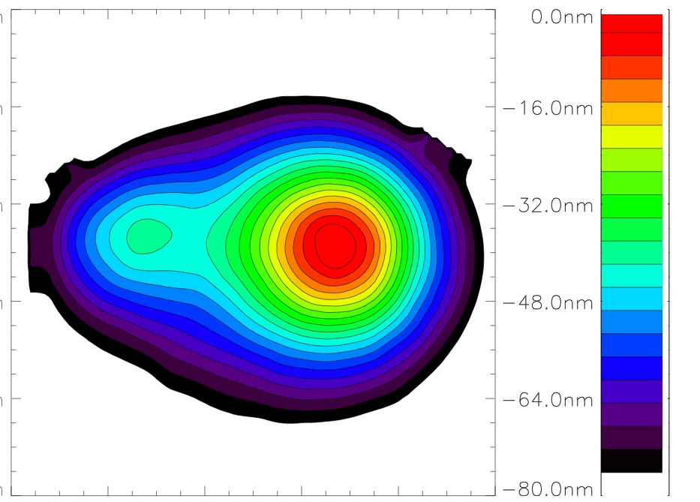
Wavefront analysis
Wavefront map
Developed with The University of Adelaide
2D wavefront map
Good for humans
Difficult to quantify
Parameterize wavefront
Decompose into optical aberrations
Prism, defocus (curvature), spherical aberration, etc.
Store timeseries
Wavefront distribution
Broadcast/store 2D wavefront map?
Software development?
θ_{x}(t)
θ_{y}(t)
S(t)
SA(t)

Slide 30
One Arm Test

Slide 31
One Arm Test
Objectives:
Test ETM HWS
Noise (target < 10nm RMS)
Measure RH thermal lens
Test Ring Heater
Cavity response
Hartmann Sensor
ALS laser
ITM
ring heater
ETM
RM

Slide 32
HWS Noise Floor
RMS ~ 7nm

Slide 33
Ring Heater COMSOL model
ETM HR surface deformation
S_{HR}
Glass temperature = NiCr temperature set from data
ETM substrate thermal lens
HWS beam
S_{HWS}
ETM
RM
Ring heater & shield
Surface deformation

Slide 34
HWS thermal lens measurement Running ETM RH at 6.3W
No fitting
Why different time constants? Model?

Slide 35
A word on Higher Order Modes
Resonate at a frequency offset from TEM00
Frequency set by:
Cavity length
Curvature of mirrors
Hartmann Sensor
ALS laser
ITM
ring heater
f
ETM
RM

Slide 36
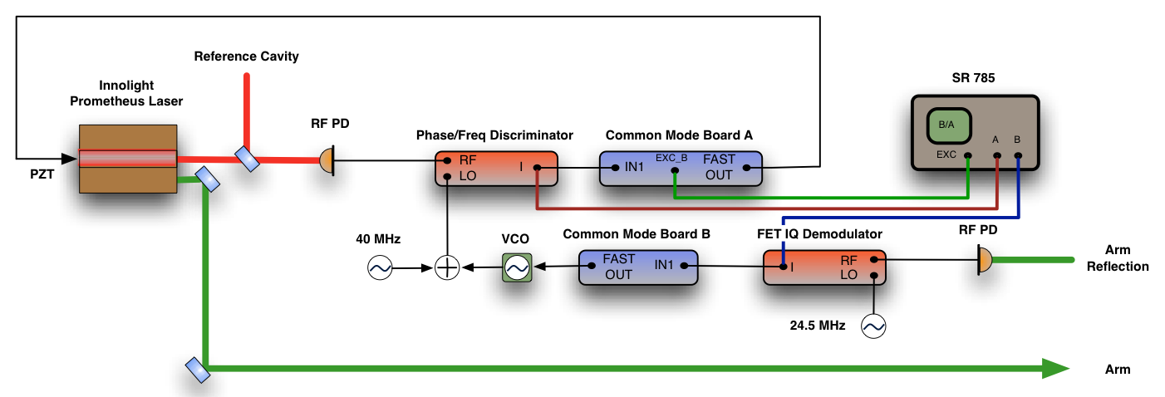
Cavity scan
Acoustic sideband injected into Common Mode locking electronics
Look at phase of cavity reflection for HOM resonances
Measure ROC change, ΔR = c Δf

Slide 37
Nominal Cavity scan

Slide 38
Cavity scan + Ring Heater TEM10 frequency shift: 6.3W
Δf = 278 Hz ± 35 Hz
Δf_{HWS} = 235 Hz ± ??

Slide 39
Cavity G-factor measurements Calculated Radius of Curvature
Ring Heater performing better than model predicts: why?
?

Slide 40
Open Issues
Compensation pattern in CO2 laser to fix astigmatic thermal lens from RH
What is the alignment drift of the Hartmann sensor?
How are we going to compensate non-uniform thermal lenses?
Excess noise in HWS in OAT?
Ring Heater COMSOL model?
HIFO and TCS testing
Locking and TCS?
Interface and MEDM screens

Slide 41
Install Status
Component | H1-X | H1-Y | L1-X | L1-Y | I1
ITM RH | Q1 2013 | Installed* | Q4 2012 | Installed
ETM RH | Q2 2013 | Installed* | Q1 2013 | Q1 2013
ETM HWS | Q3 2013 | Installed | Q2 2013 | Q2 2013
ITM HWS (in-vac) | Q4 2012 |  | Q4 2012
ITM HWS (in-air) | Q4 2012 - Q1 2013 |  | Q4 2012 - Q1 2013
CO2 (in-vac) | Q1 2013 – Q2 2013 |  | Q4 2012
CO2 (in-air) | Q2 2013 – Q3 2013 |  | Q1 2013 – Q2 2013
*This lot of RH were installed for H2, have been shifted to H1, and are to be replaced in the future (~Q1 2014),
when the associated TM is replaced with the intended aLIGO optic

Slide 42
Summary
All subsystems passed review
Ring Heater and HWS installed and tested for OAT
HWS met OAT RMS target
Ring Heater is behaving (largely) as expected
Installation is on track
Push the button as soon as possible!

Slide 43
Acknowledgements
CIT: Alastair Heptonstall, Mindy Jacobson, Alexander Lynch, Steve O’Connor, Zhenhua Shao, Phil Willems, Ayodele Cole
LHO: Cheryl Vorvick, Thomas Vo, Daniel Sigg, Keita Kawabe, Bram Slagmolen, Alberto Stochino, Jax Sanders, Elli King
LLO: Chris Guido
UF: Chris Muller, Guido Mueller
AU: Peter Veitch, Jesper Munch, Won Kim

Slide 44
AdvanceD LIGO OPtics

Slide 45
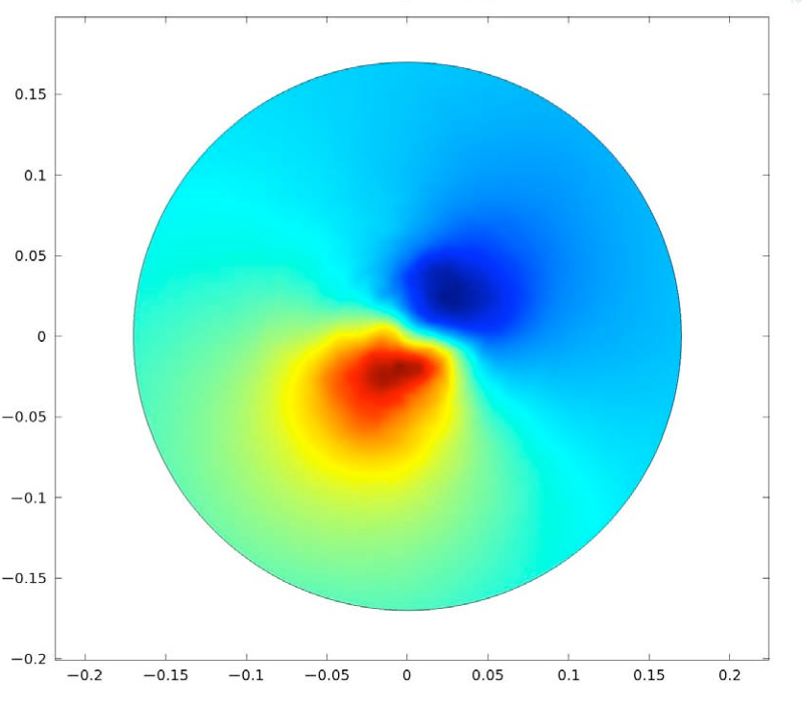
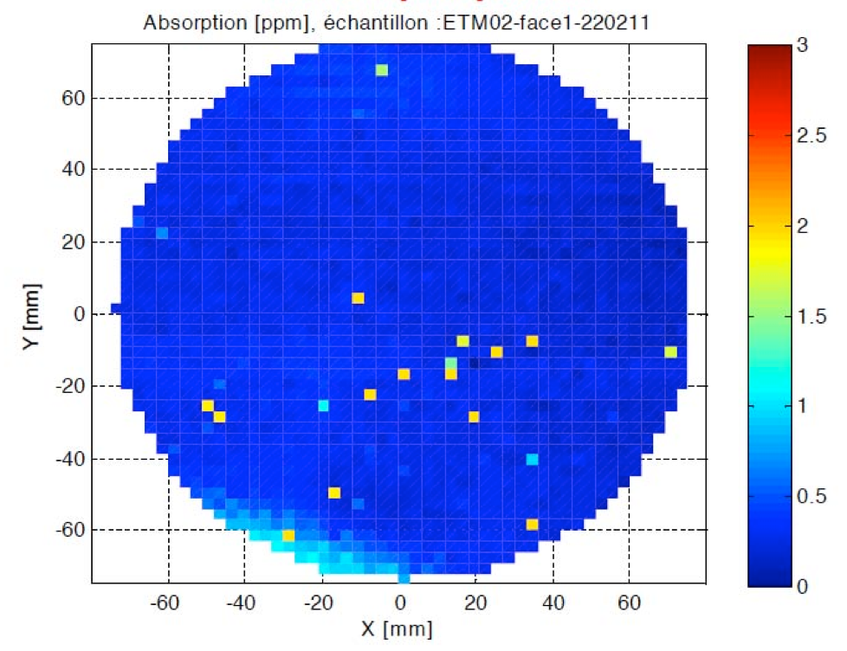
ETM02 – Coating Absorption [T1100250]

Slide 46
Relative Intensity Noise

Slide 47
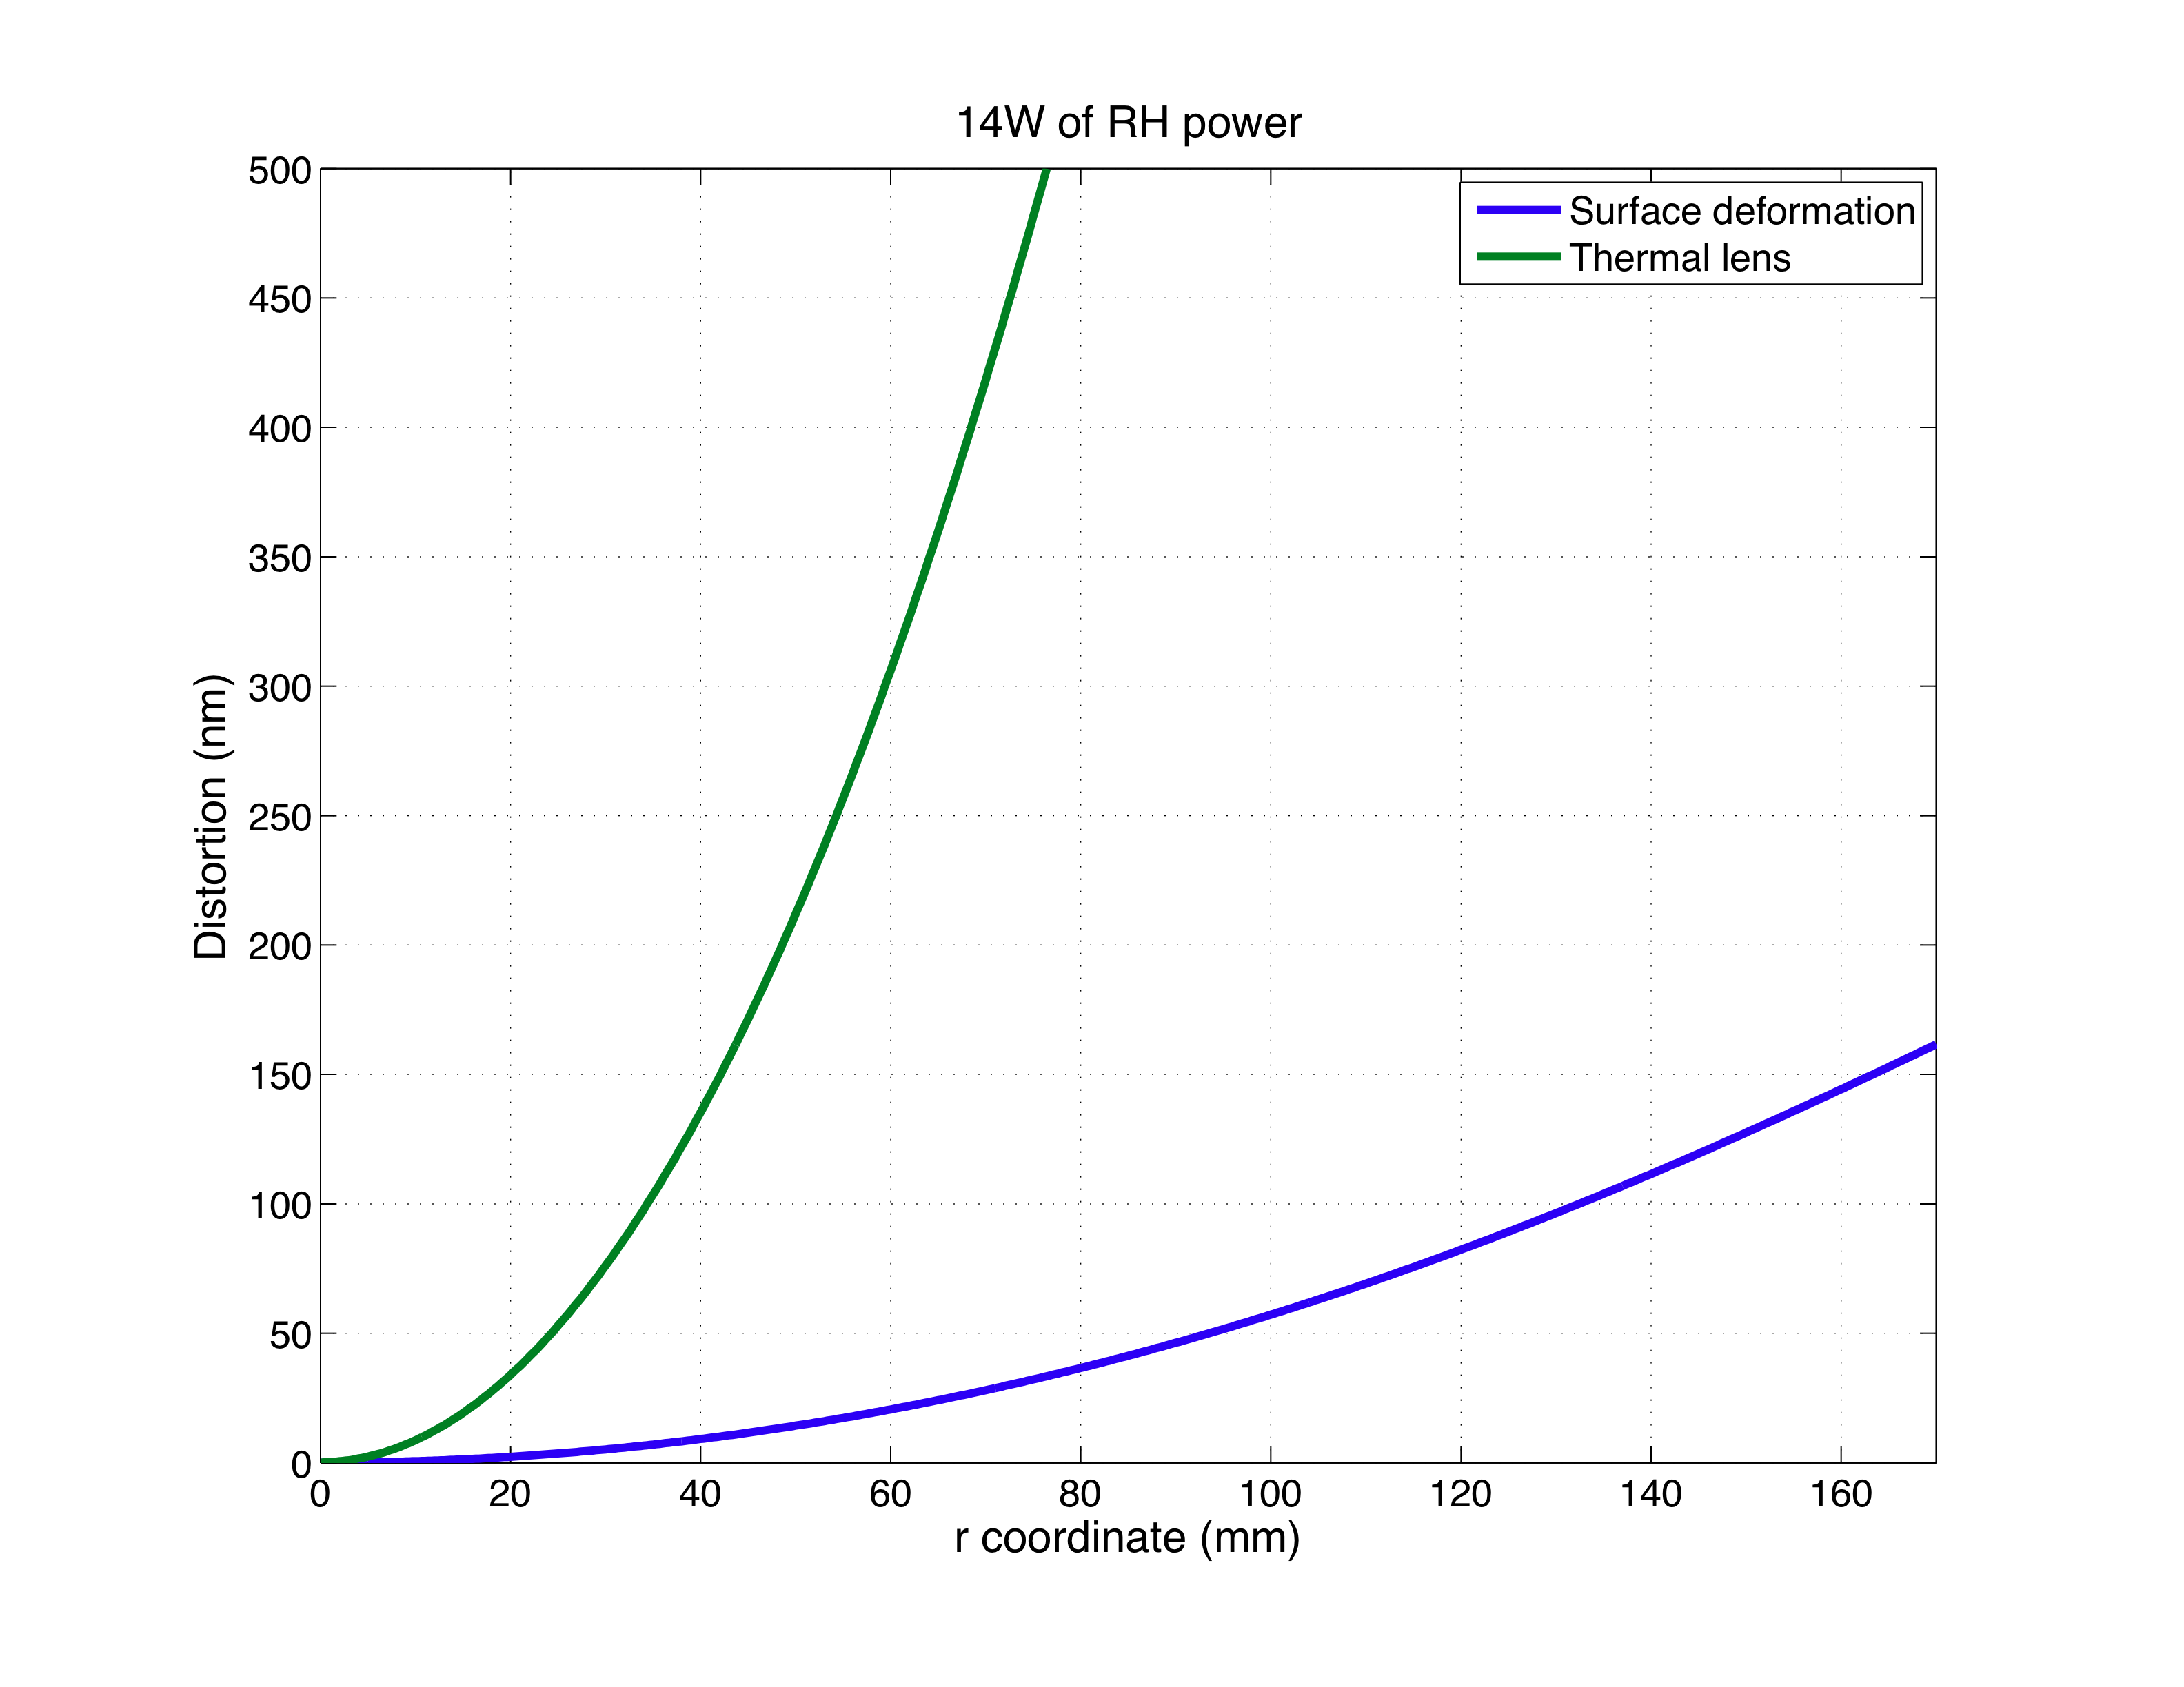
Thermo-elastic deformation and thermo-refractive lens

Slide 48
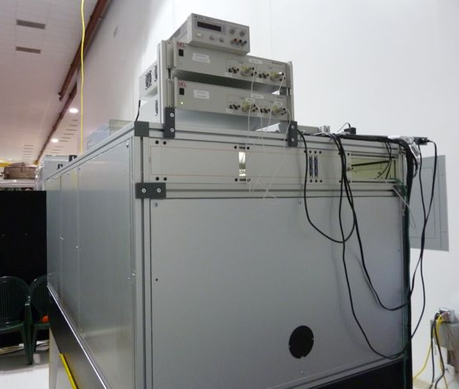
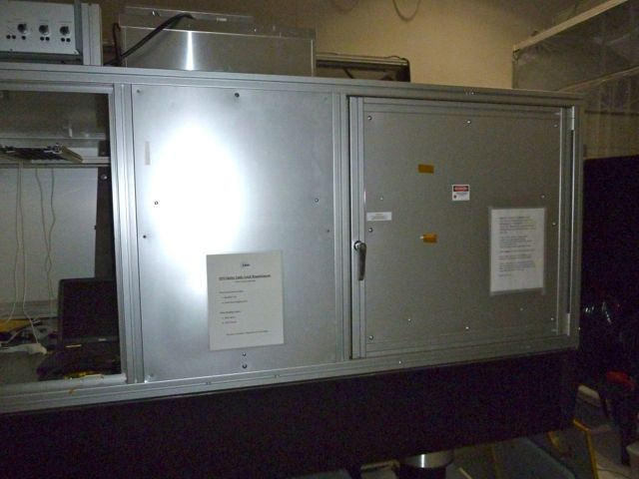
Safety and Cleanliness
HEPA filtered enclosure
Clean
Contains laser beam

Slide 49
Scatter vs Optical Path Distortion (OPD) size
0.1% scatter limit

Slide 50
Test mass pitch change [T1100184]
Parameter | Value
Test mass pitch | 8.1 μrad/W
Thermo-elastic expansion shifts center of gravity of TM
Power dependent pitch results

Slide 51
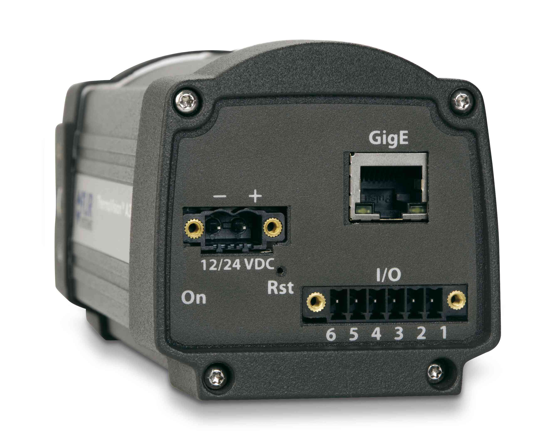
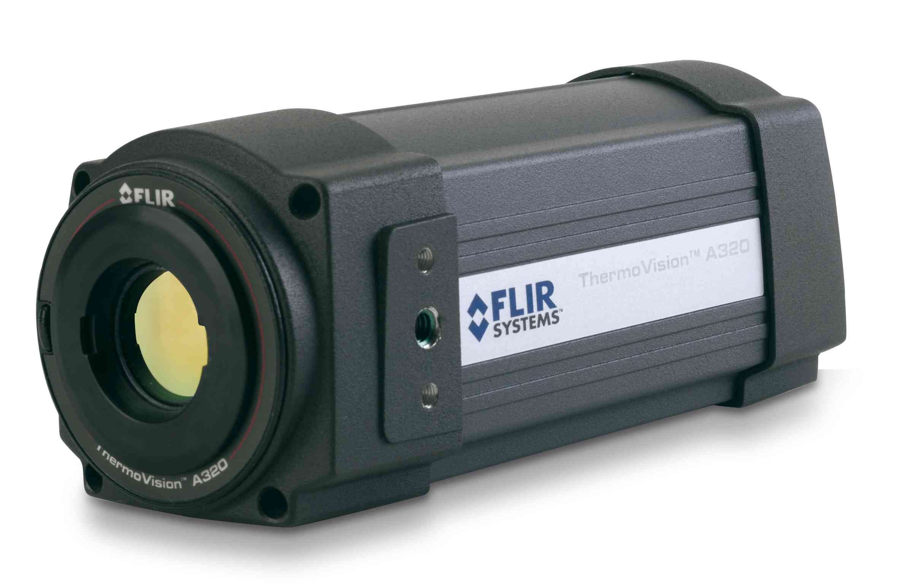
Beam profiler and projector
GigE connector
pico-motor
steering
continuous monitoring
To ITM
pick-off
screen at conjugate plane of ITM

Slide 52
Optical injection
HWSY: injected through SR2 onto interferometer (IFO) axis
HWSX: injected off BS_AR
Large core optic SR3: primary mirror of telescope
to HWS
to ITMX
to ITMY
to HWS

Slide 53
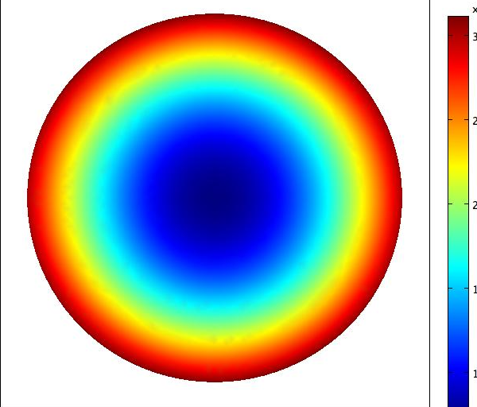
Non-uniformity in Ring Heater [G1001160]
Surface deformation
Substrate thermal lens
300nm
9μm
7μm
200nm
5μm
3μm
100nm
1μm
diam. = 340mm
diam. = 340mm
Surface astigmatism: Zernike Z_{2,2} coefficient for RH = 0.7nm
< 3nm Core Optics specification for polishing

Slide 54
Monitor the spots
CCD
HWS gives “spatial measurement of wavefront change”
Two dimensional
Discrete (~1000 points per CCD)
Directly measures wavefront gradient changes
Breaks wavefront into rays
propagate normal to gradient
creates spot pattern on CCD
measures spot displacement
Proportional to gradient change
Centroid calculation depends on intensity

Slide 55
Time constants
D = thermal diffusivity (8.4 × 10⁻⁷ m²s⁻¹ for fused silica)
Δx = characteristic scale
Heating | Scale | Time constant
Self | ~ 54 mm | ~ 1150 s
CO2: Annulus 1 | ~ 80 mm | ~ 2500 s
CO2: Annulus 2 | ~ 125 mm | ~ 6000 s
Ring heater | ~ 170 mm | ~ 11500 s
Increase start-up power to reduce time constants (factor of 2 or 3)

Slide 56
aLIGO CO2 Projector
CP
Annular heat profile
ITM
CO2 laser projector table
Beam shaping – what beam shape, how to get it?
Stability – why is this an issue
Intensity noise – latest measurements

Slide 57
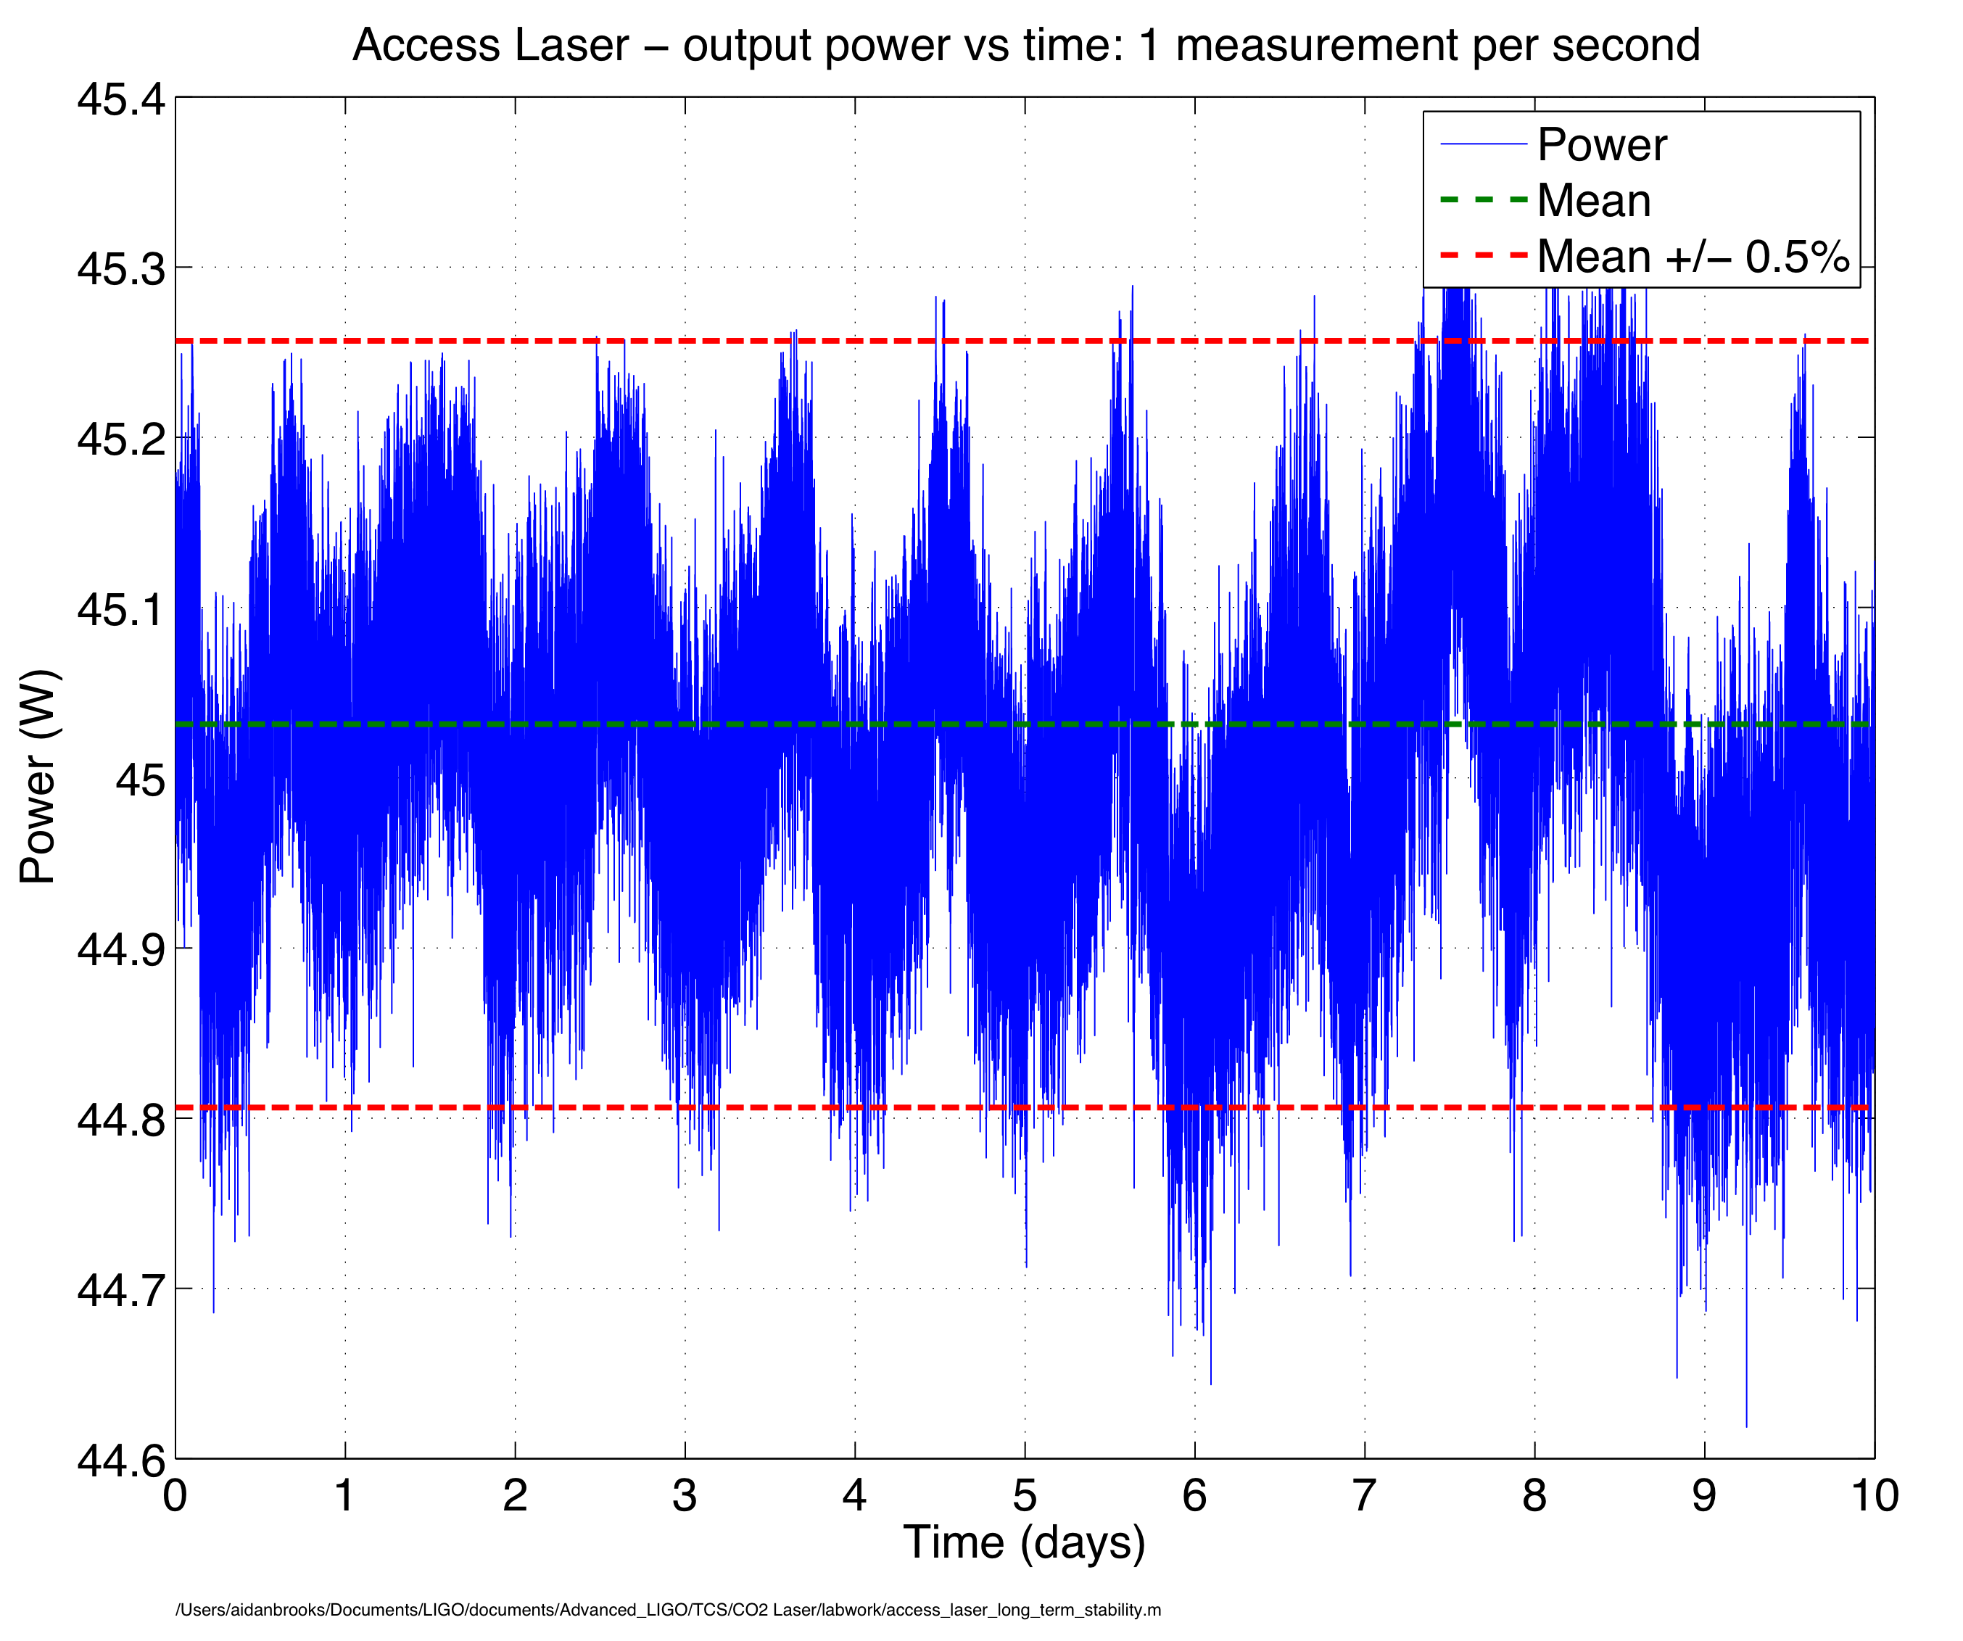
aLIGO CO2 Laser stability
10 days running with zero glitches
± 0.5% variation

Slide 58
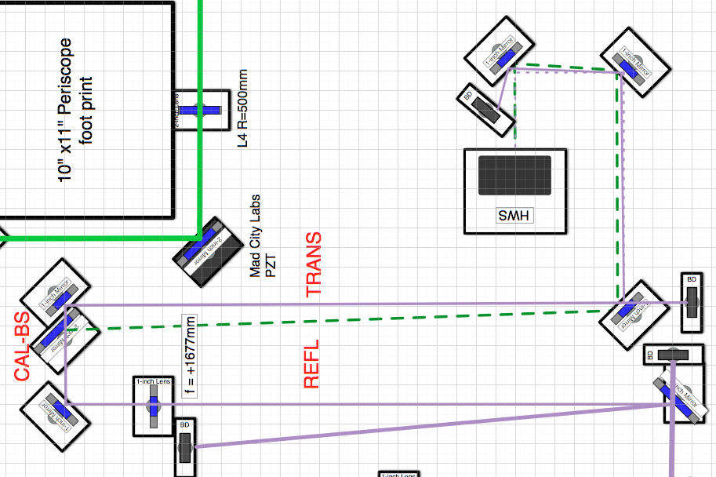
HWS lever arm calibration

Slide 59
HWS lever arm calibration

