Slide 1
Squeezed Light Techniques for Gravitational Wave Detection
January 16, 2013
Daniel Sigg
LIGO Hanford Observatory
Talk at Stanford University

Slide 2
Abstract
Several kilometer long interferometers have been built over the past decade to search for gravitational waves of astrophysical origins. For the next generation detectors intra-cavity powers of several 100 kW are envisioned. The injection of squeezed light, a specially prepared quantum state, has the potential to further increase the sensitivity of these detectors. The technology behind squeezed light production has taken impressive steps forward in recent years. As a result a series of experiments is underway to prove the effectiveness of squeezed light and to make quantum technology a valid upgrade path for gravitational wave detectors.

Slide 3

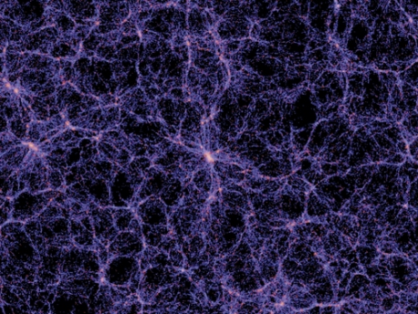
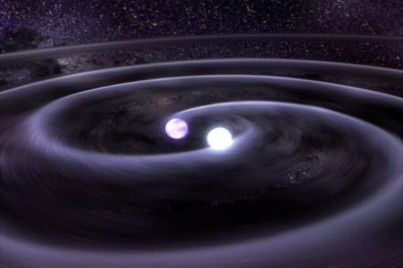
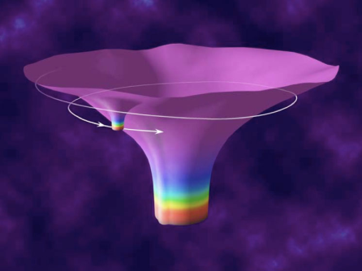

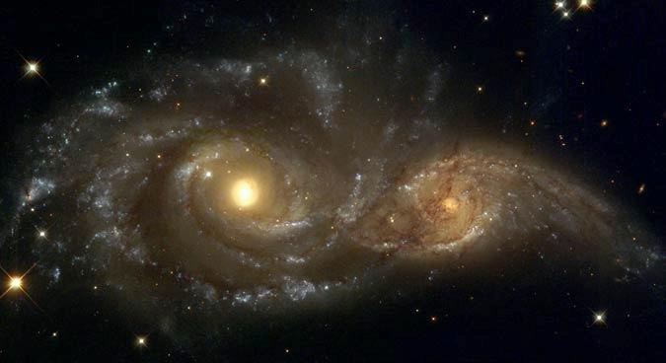

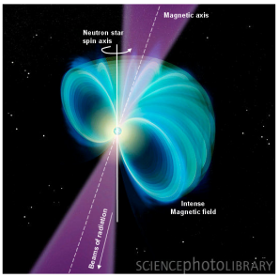
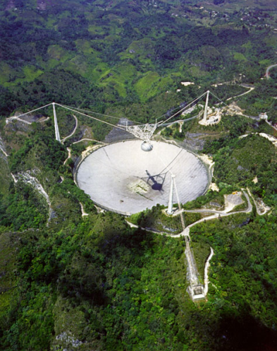

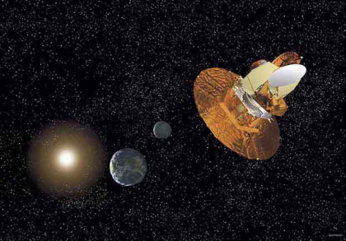
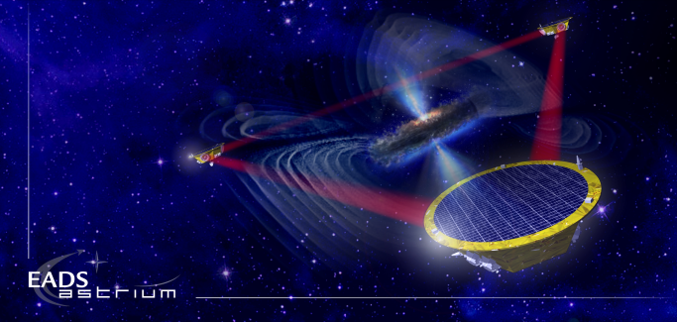
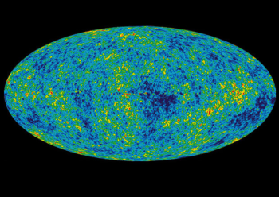
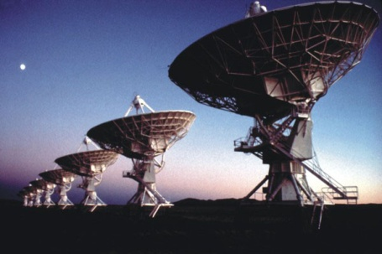
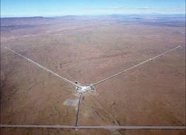
Gravitational Waves
?
?
?
BH and NS Binaries
Supernovae
Cosmic Strings
Relic radiation
?
?
Extreme Mass Ratio
Inspirals
?
Supermassive BH Binaries
Binaries coalescences
Spinning NS
10⁻¹⁶ Hz
10⁻⁹ Hz
10⁻⁴ Hz
10⁰ Hz
10³ Hz
Inflation Probe
Pulsar timing
Space detectors
Ground interferometers
?

Slide 4
Sensitivity Sixth Science Run

Slide 5
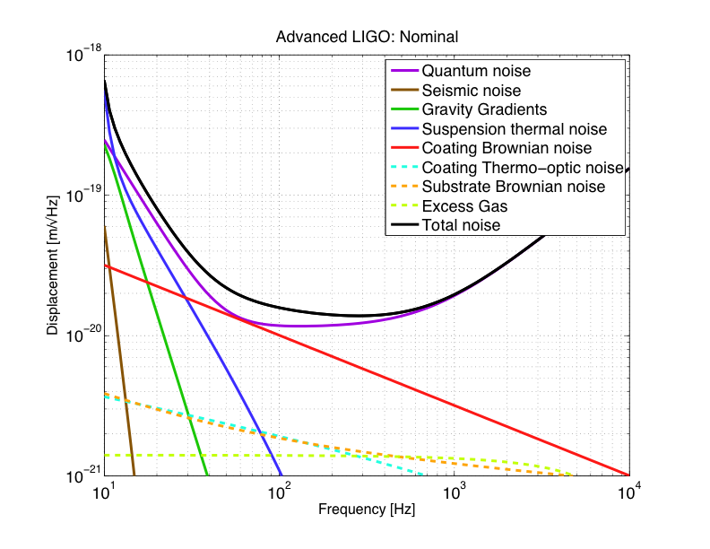
Advanced LIGO Sensitivity
Radiation pressure noise
Initial LIGO
Shot noise
Standard quantum limit

Slide 6
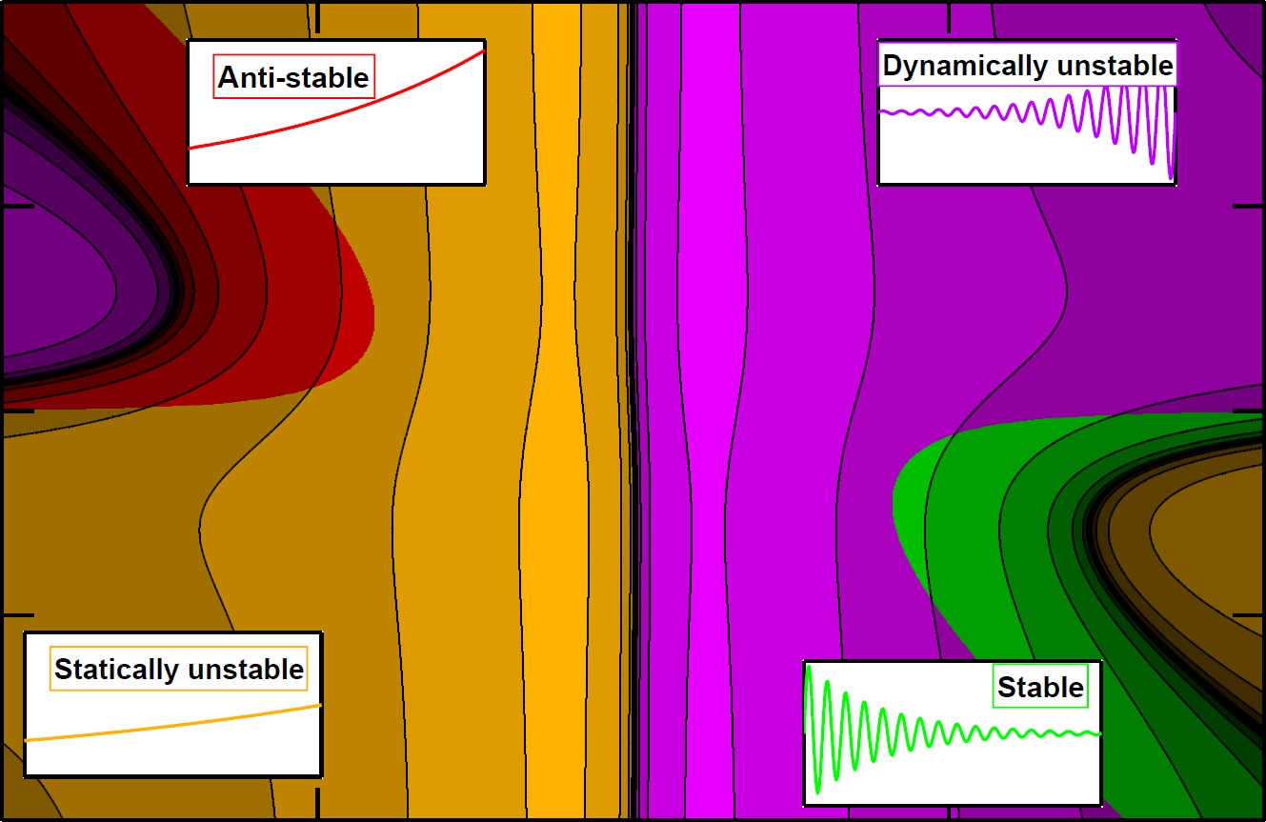
Optical Springs
2
1
subcarrier ~ 5% of carrier
Subcarrier detuning (HWHM)
0
–1
Corbitt et al.,
PRL 98, 150802 (2007)
– 2
– 5
–2.5
0
2.5
5
Carrier detuning (HWHM)

Slide 7
Towards the
Quantum Ground State
Abbott et al.
New J. Phys. 11, 073032 (2009)

Slide 8
The Advanced LIGO Detector
Input mode cleaner:
stabilizes frequency
and cleans laser mode
4 km
Arm cavities:
Fabry-Perrot cavities store light to effectively increase length
800kW
4 km
Laser
800kW
Laser:
200W - 1064nm
Power recycling mirror: reflects light back coming from the beam splitter, increasing power in the arm cavities
Input
Test
Mass
End
Test
Mass
Signal recycling mirror: amplifies readout signal
Homodyne Readout

Slide 9
Squeezed Light
Normal light
Amplitude squeezing
Phase squeezing
│E │
ϕ

Slide 10
Key Insights
Shot noise in a Michelson interferometer is due to vacuum fluctuations entering the dark port.
Quantum noise also produces photon pressure noise.
Injecting a specially prepared light state with reduced phase noise (relative to vacuum) into the dark port will improve the shot noise sensitivity.
Similarly, injecting light with reduced amplitude noise will reduce the photon pressure noise.
Non-linear optical effects can be used to generate a squeezed “vacuum” state.

Slide 11
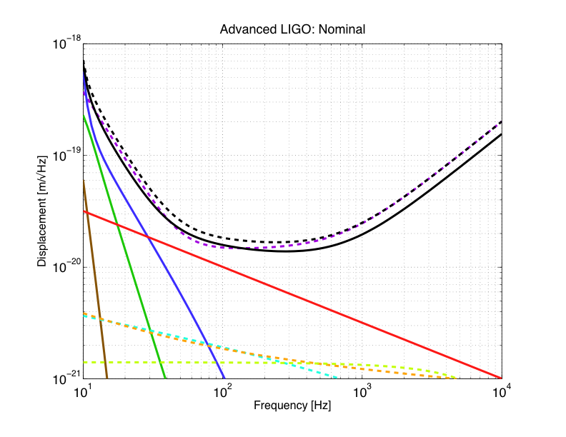
31 W + 6 dB of squeezing (10 dB of anti-squeezing, total losses ~20%)
31 W
125 W input power

Slide 12
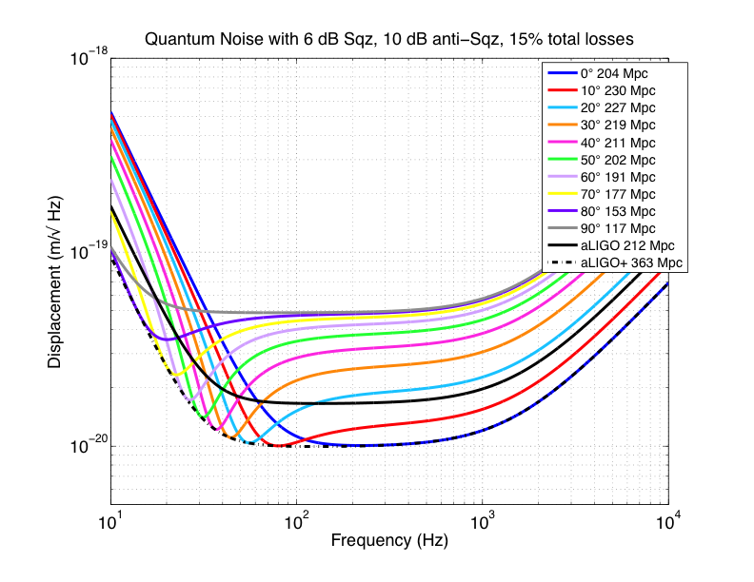

Slide 13
Experimental Confirmation at the GEO600 Detector
3.5 dB of squeezing
Abadie et al.
Nature Physics 7, 962 (2011)

Slide 14
The H1 Squeezer Experiment
Goals:
Demonstrate 3dB of squeezing at the initial LIGO sensitivity
Don’t degrade low frequency sensitivity
Risk mitigation for high power operations
Pathfinder for advanced LIGO squeezer
Potential show stoppers:
Back scattering
Stray light
Phase noise
Optical losses
Auxiliary servo noise
Alignment jitter
Stability

Slide 15
H1 Squeezer Experiment
ETM-Y
Interferometer Acronyms
PSL
- Pre-Stabilized Laser
- Vacuum System
IMC
- Input Mode Cleaner Cavity
PRM
- Power Recycling Mirror
Y
-Arm
BS
- Beam Splitter
(4km)
ITM
-
Arm Cavity Input Test Mass
ETM
-
Arm Cavity End Test Mass
ANU, AEI, MIT, LIGO collaboration
FI
- Faraday Isolator
OMC
- Output Mode Cleaner Cavity
PD
- Photodiode (Data Output)
ITM-Y
PRM
PSL
IMC
BS
ITM-X
ETM-X
PS
X-Arm (4km)
PLL1
FI
SHG
OPO
FI
Squeezed Light Source Acronyms
PS
MAIN
- Squeezing Main Laser
MAIN
AUX
- Squeezing
Auxiliary Laser
PLL
- Phase Lock Loop
PLL2
OMC
SHG
- Second Harmonic Generator
OPO
- Optical Parametric Oscillator
AUX
PS
- Phase Shifter
PD

Slide 16

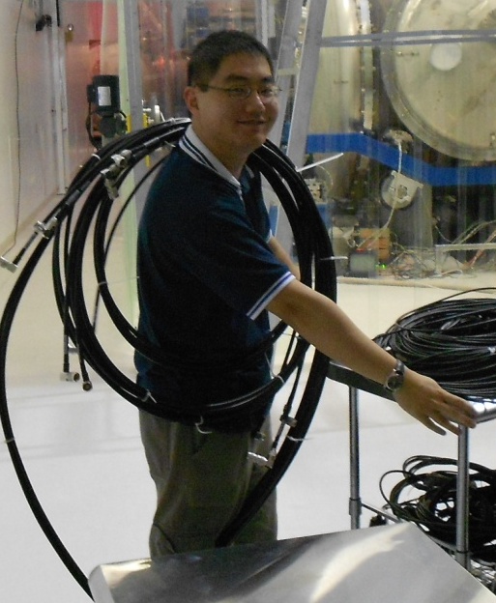
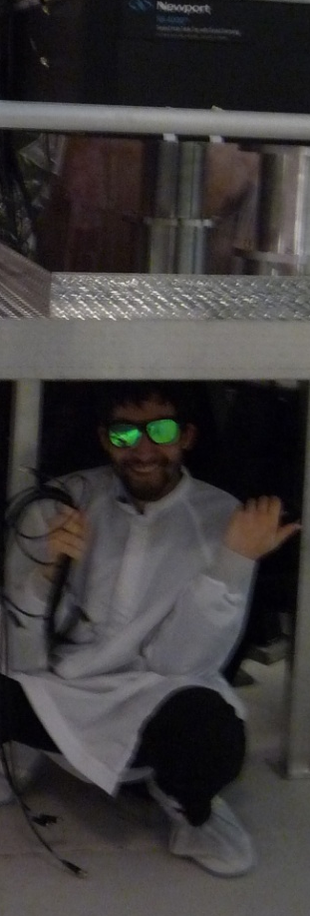
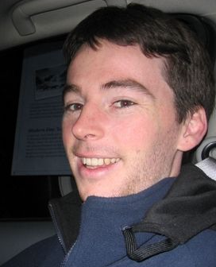
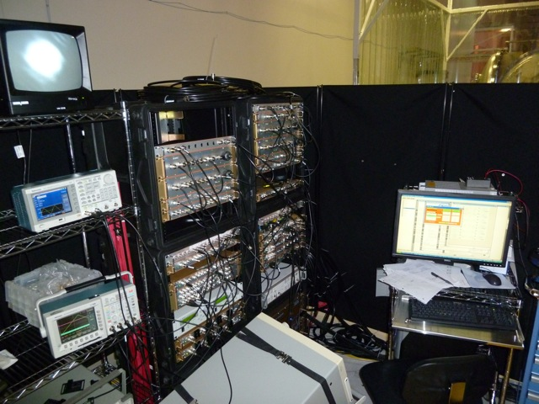
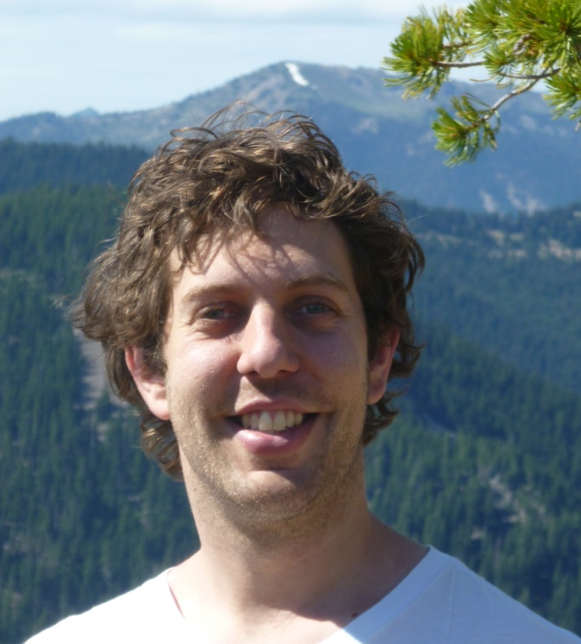
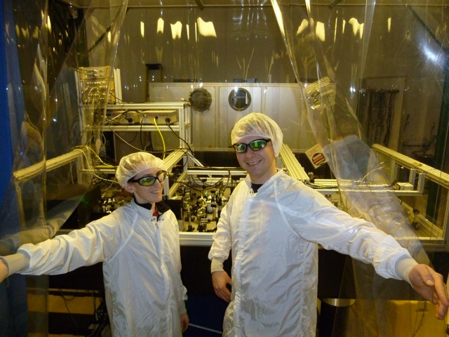
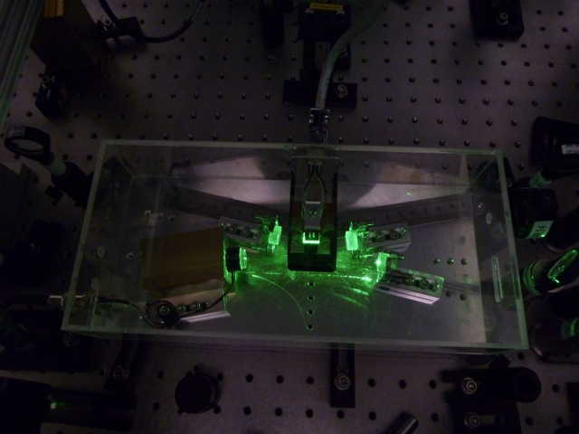
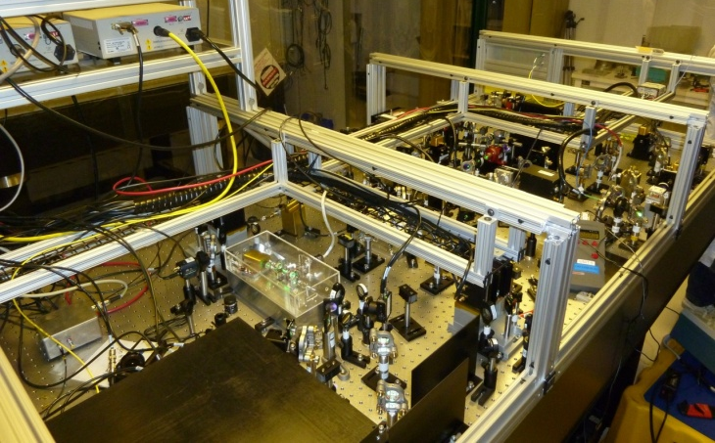
Squeezer at Hanford
Max(Columbia)
Electronics
Lab in corner station
Sheon (ANU)
Conor (ANU)
Michael (ANU)
Grant (Michigan)
Optics Table
The OPO
advanced LIGO
Sheila (MIT)
Alexander (AEI)
16
16

Slide 17
Non-Linear Gain
61% loss
5º phase noise
19% loss
1.3º phase noise

Slide 18
H1 Squeezed
2 dB of squeezing
Preliminary
Best ever sensitivity!

Slide 19
Outlook
GEO600/AEI will work on high performance squeezing and long term stability
ANU continues to optimize the ring-cavity OPO
R&D program at MIT to work on filter cavities and a low loss readout chain
Start a design for an advanced LIGO squeezer
Squeezed light sources will be the first upgrade to
advanced gravitational-wave interferometers

Slide 20
