Slide 1
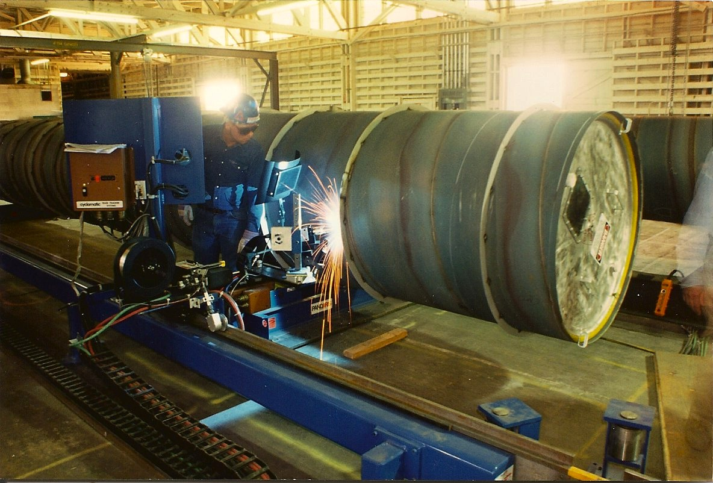
The LIGO Vacuum Equipment and Beam Tubes:
Retrospective and Prospective
Mike Zucker, LIGO Laboratory @ MIT
IUVSTA-LVD @ Institute for Plasma Research, Gandhinagar , India
19-22 March 2013

Slide 2
Outline
About LIGO and LIGO India
Vacuum Requirements & Constraints
Vacuum Equipment
Beam Tubes
Paths for Improvement

Slide 3
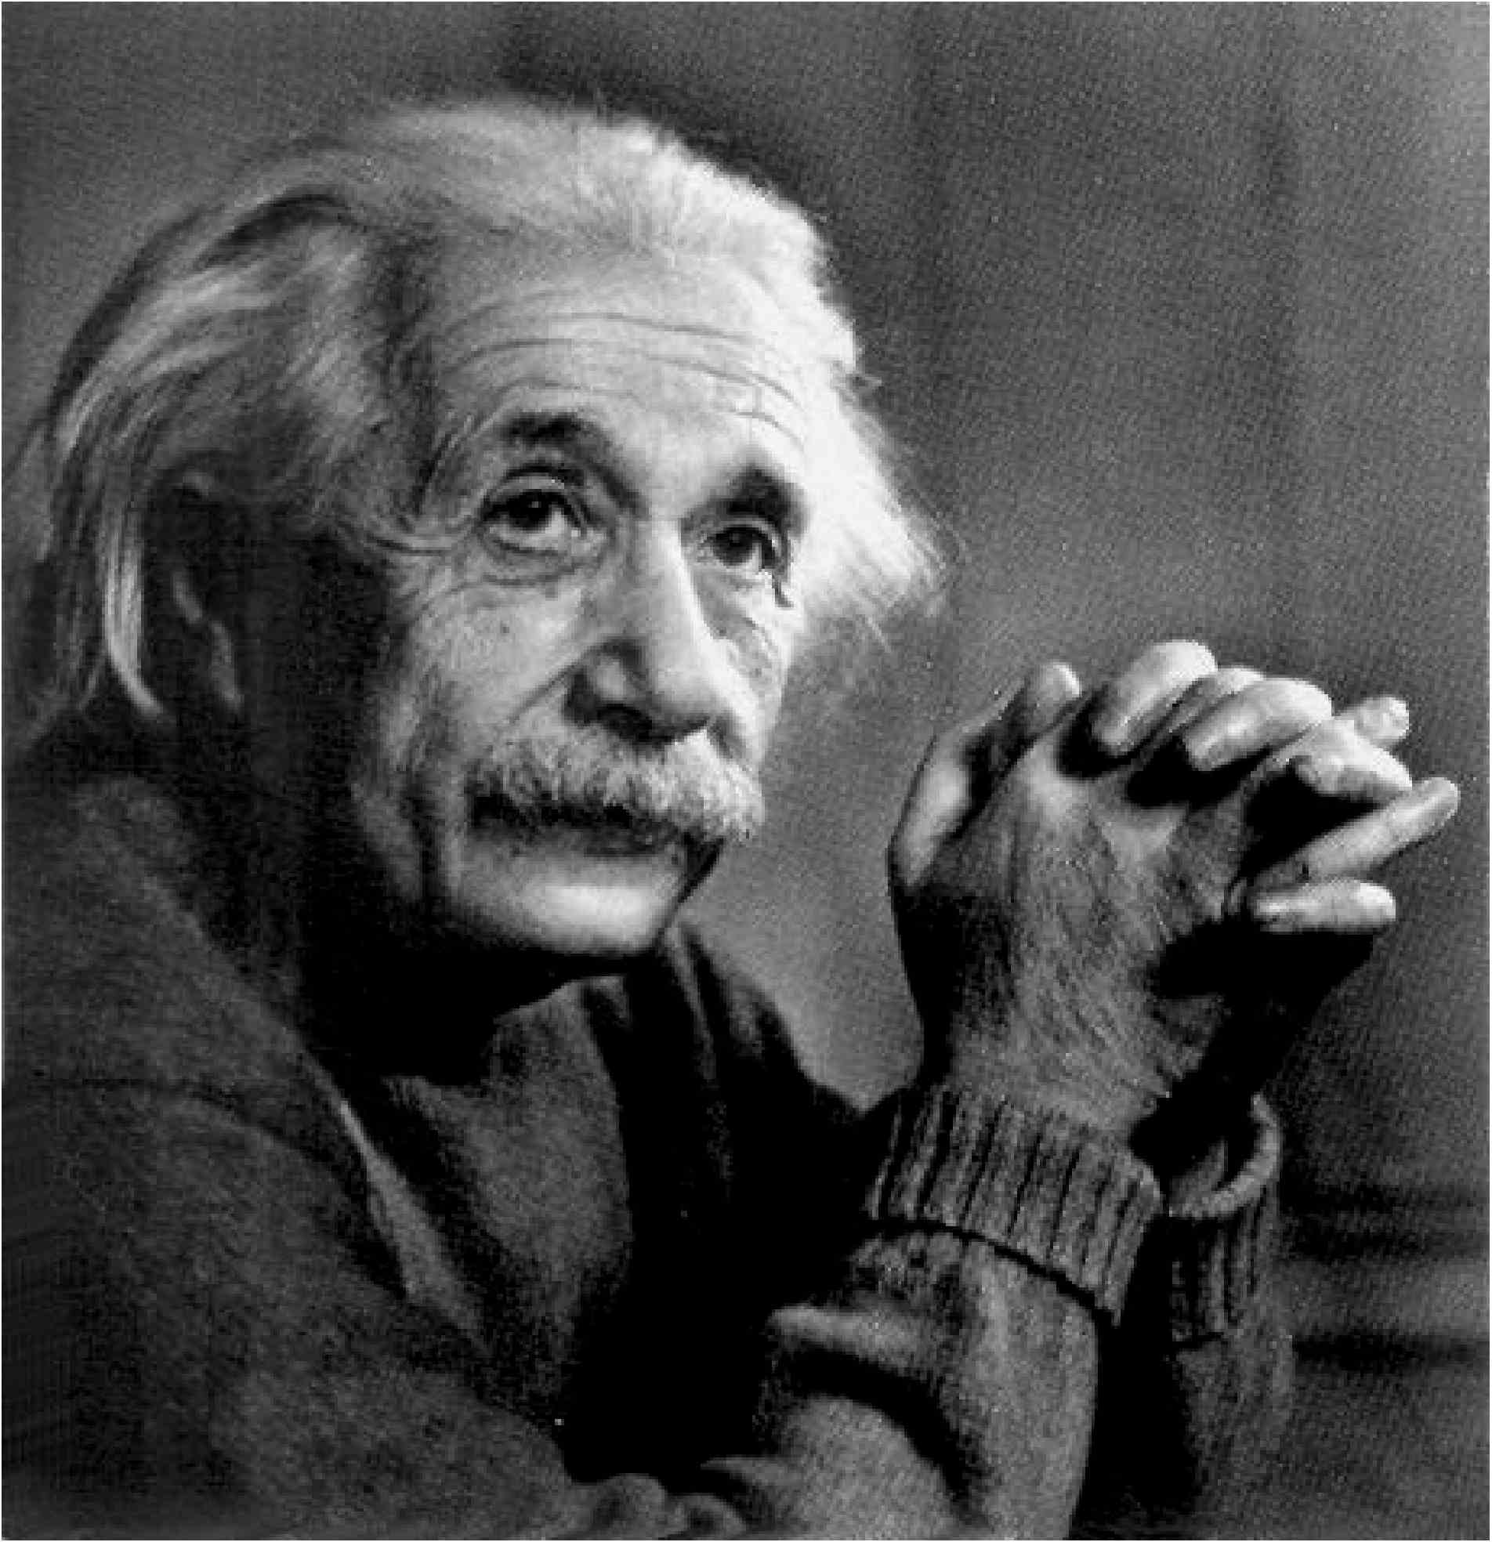
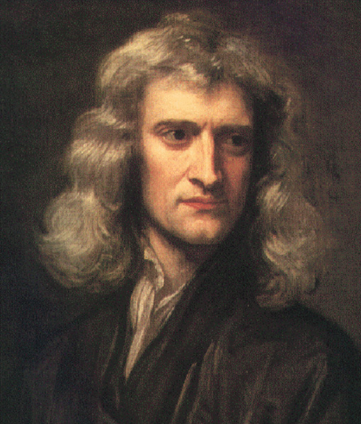
Why must there be gravitational waves?
Newton’s puzzle:
“instantaneous action at a distance”
G_{μν}= 8πΤ_{μν}
General Relativity
Spacetime itself is a medium
Geometry carries information

Slide 4
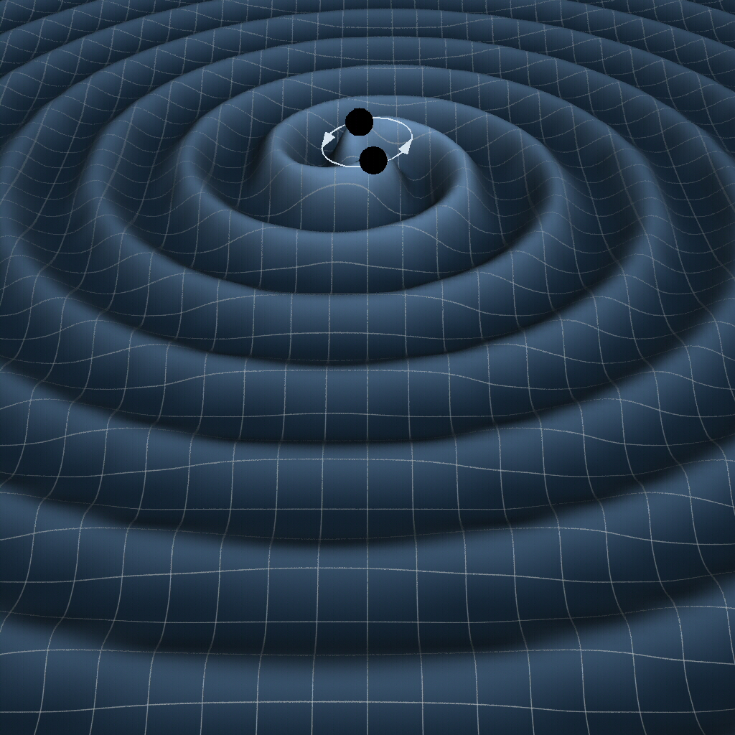
Gravitational Waves
Changes of matter anywhere ripple the geometry everywhere
K. Thorne (Caltech) , T. Carnahan (NASA GSFC)

Slide 5

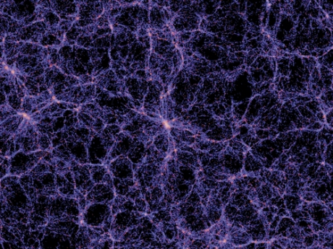
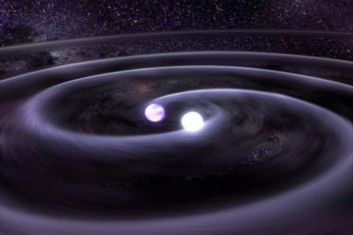
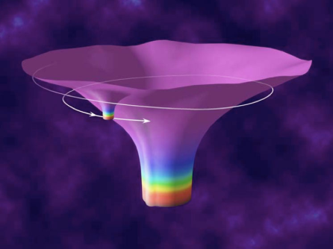

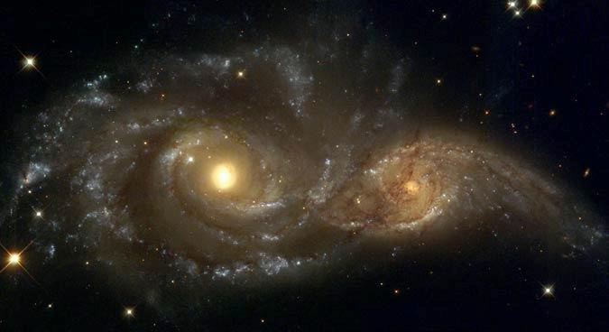

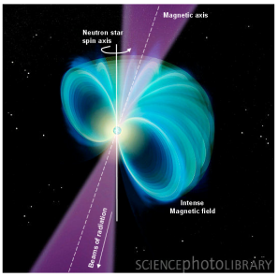
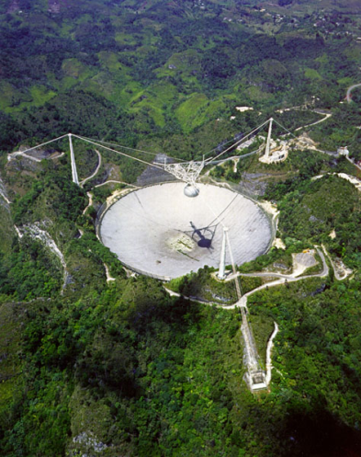
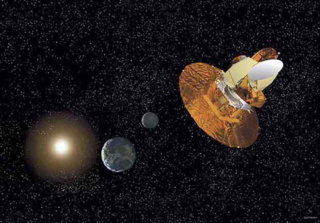

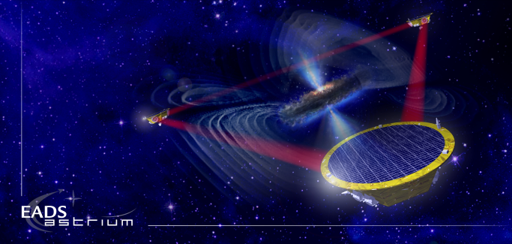
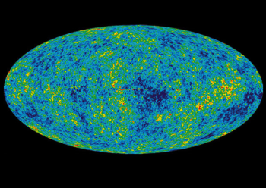
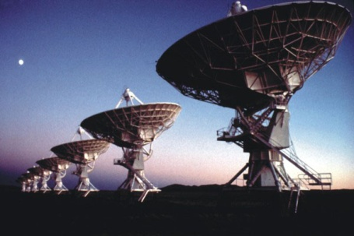
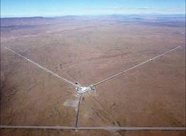
The GW Spectrum
BH and NS Binaries
Supernovae
Cosmic Strings
Relic radiation
Extreme Mass Ratio
Inspirals
Supermassive BH Binaries
Binaries coalescences
Spinning NS
10⁻¹⁶ Hz
10⁻⁹ Hz
10⁻⁴ Hz
10⁰ Hz
10³ Hz
Inflation Probe
Pulsar timing
Space detectors
Ground interferometers
Laser Interferometer
Gravitational Wave
Observatory

Slide 6
Some Expected Astrophysical Sources
Compact binary inspiral: “chirps”
  NS-NS, NS-BH, BH-BH
Supernovas or GRBs: “bursts”
  GW signals observed in coincidence
  with EM or neutrino detectors
Pulsars in our galaxy: “periodic waves”
  Rapidly rotating neutron stars
  Modes of NS vibration
Cosmological: “stochastic background”
  Probe back to the Planck time (10⁻⁴³ s)

Slide 7
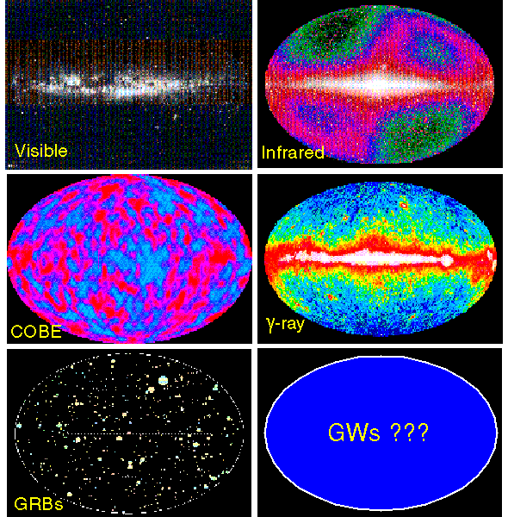
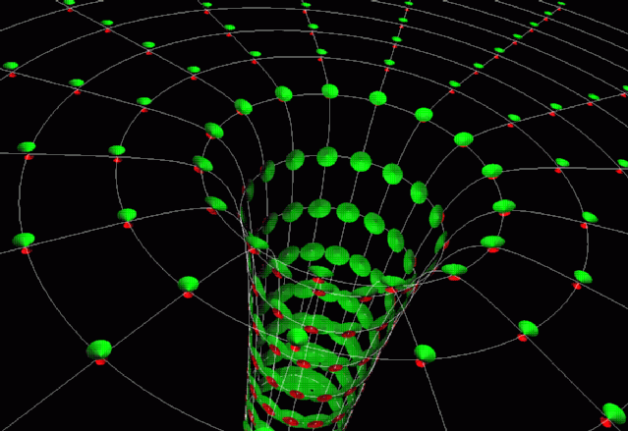
A New ‘Sense’- A New Universe
Gravitational Waves will provide complementary information, as different from what we know as sound is from sight.

Slide 8
Great promise, but a great challenge…
A wave’s strength is characterized by its strain
We can calculate the expected strain at Earth for, say, an orbiting binary system;
If we make our interferometer 4,000 meters long,

Slide 9

Laser Interferometer
Gravitational-Wave Detector
4 kilometer long “arm” cavities
1 Megawatt circulating laser power
Free-floating 40 kg quartz test mirrors
Nd:YAG LASER
Beamsplitter
Photodetector

Slide 10
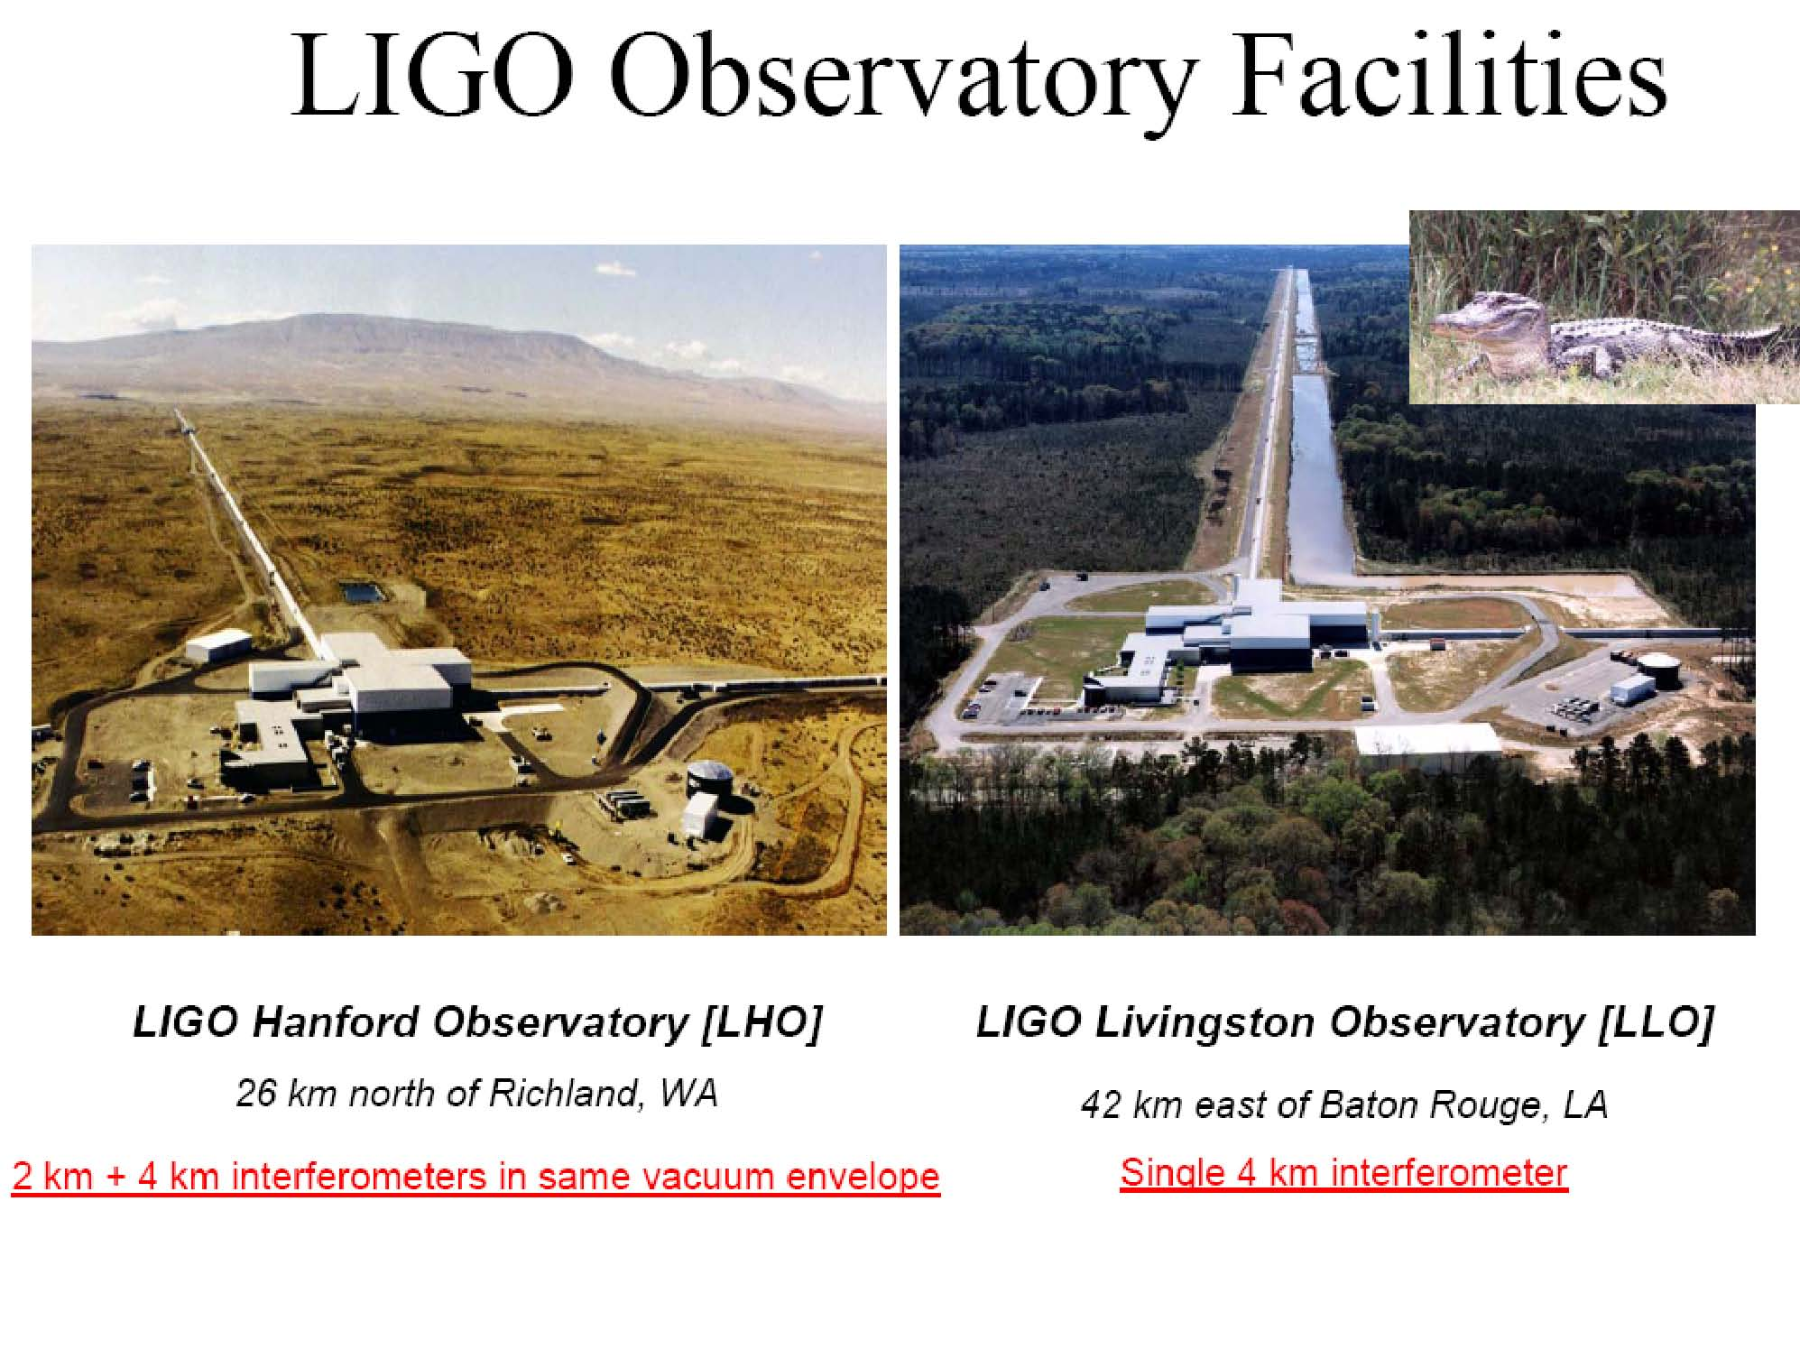
LIGO Observatory Sites

Slide 11








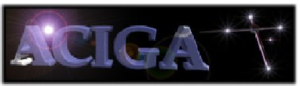






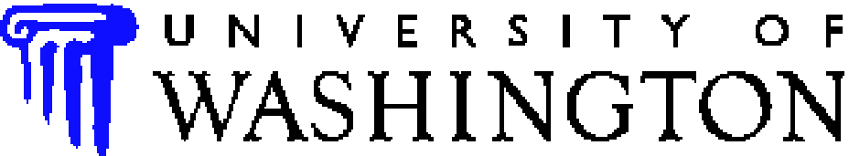


































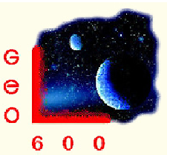








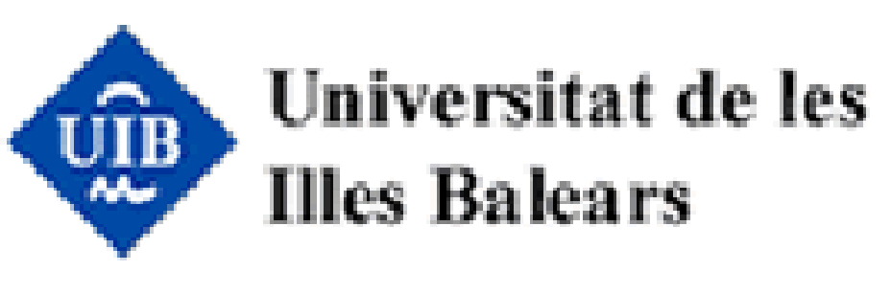













LIGO Scientific Collaboration
IUCAA

Slide 12
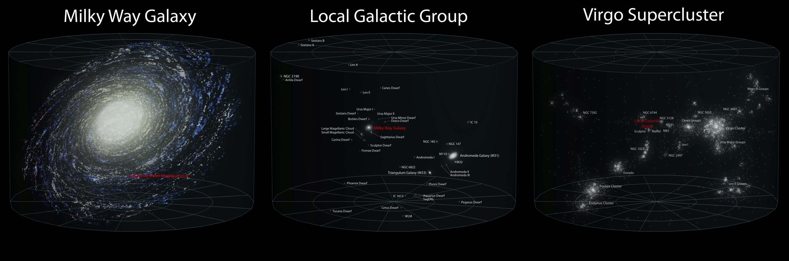

No Confirmed Detections Yet…
First generation detectors reached about 100 galaxies
Current predictions in range of
10⁻⁴ CBI yr⁻¹ galaxy⁻¹
Need better sensitivity!

Slide 13
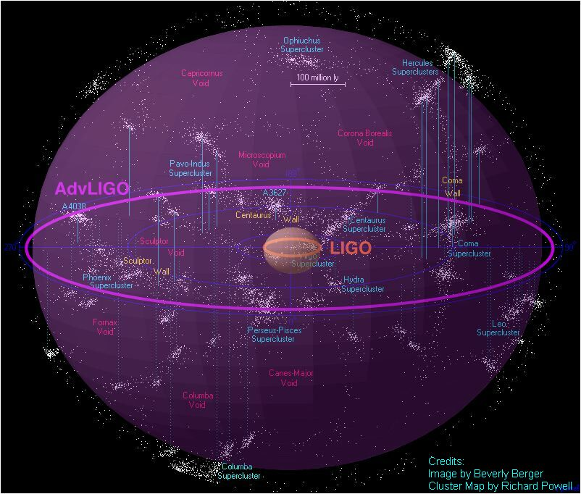
Advanced LIGO
Initial detectors completed in 2000
Design sensitivity achieved 2005
Ran ~ 2.5 years
  No confirmed detection
Facilities, vacuum system designed to be compatible with “ultimate” future interferometers
Advanced LIGO detector upgrade funded ‘08, now being installed
  Design 10x more sensitive
  1,000x greater observable volume (or event rate)

Slide 14

Advanced LIGO:
10x More Range
Advanced detectors will reach about 100,000 galaxies
Roughly 1 CBI event per month expected
Initial LIGO Range
Advanced LIGO Range

Slide 15
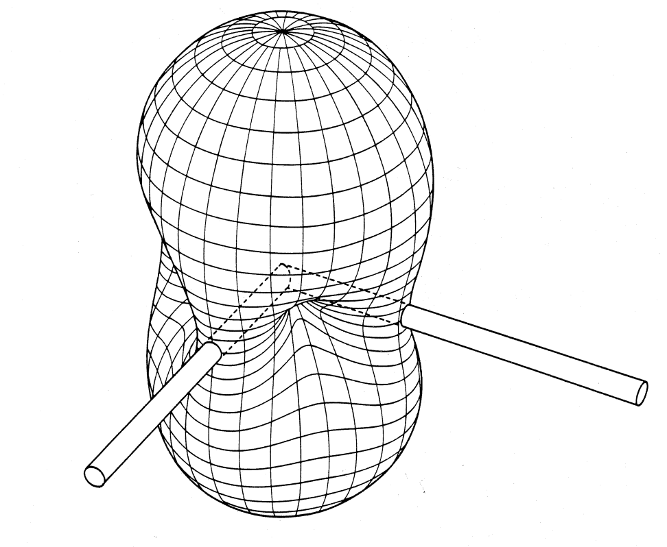
Source Localization and MultiMessenger Astrophysics
GW detectors are nearly omni-directional
Array working together can determine source location
  Analogous to “aperture synthesis” in radio astronomy
Accuracy tied to diffraction limit
ΔL = c δt
θ
1
2

Slide 16
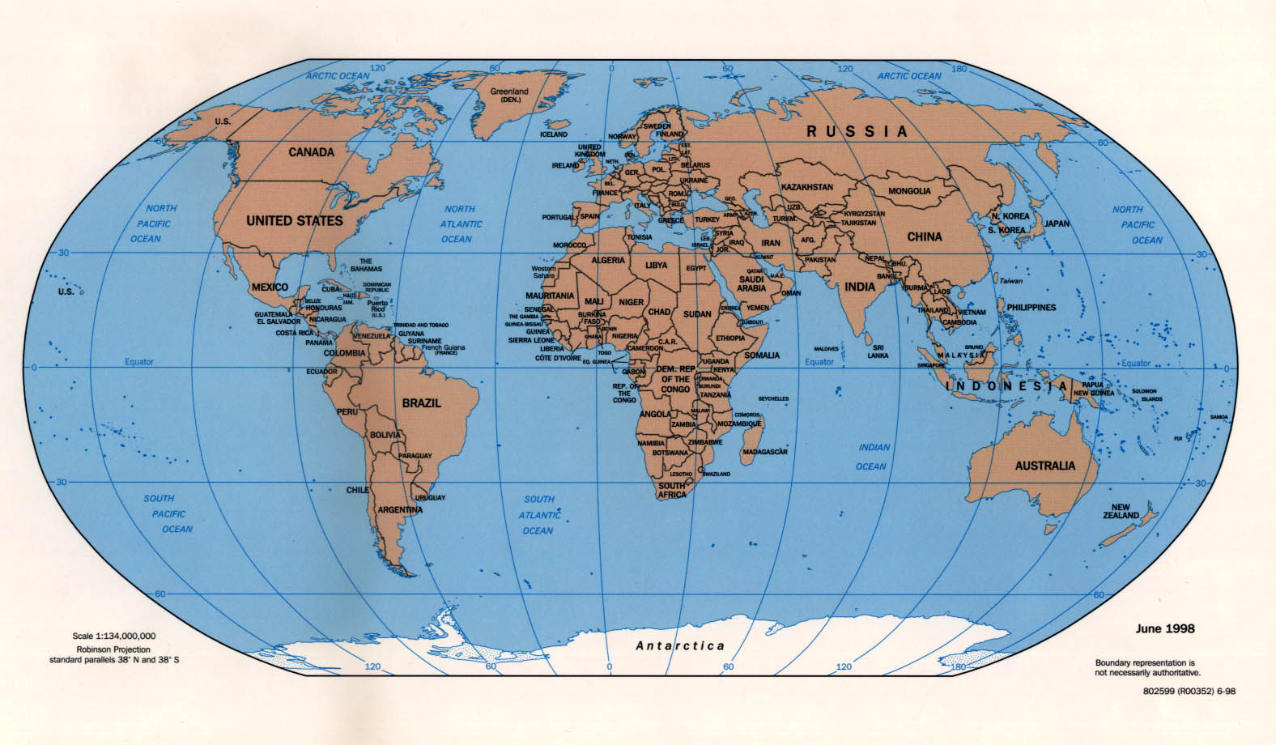
Future Global Detector Network
GEO
Virgo
LIGO
KAGRA
US, Europe and Japan detectors are close to co-planar—not optimal
India site out of plane breaks degeneracy, improving sky coverage
LIGO-India

Slide 17
A Network with LIGO India, LIGO US and Virgo
HLVI contains four 3-way networks
Baselines with India are1.5x longer
~ 4x better directionality (for given SNR)
B. S. Sathyaprakash et al, ‘Scientific benefits of moving one of LIGO Hanford detectors to India’, LIGO-T1200219-v1

Slide 18
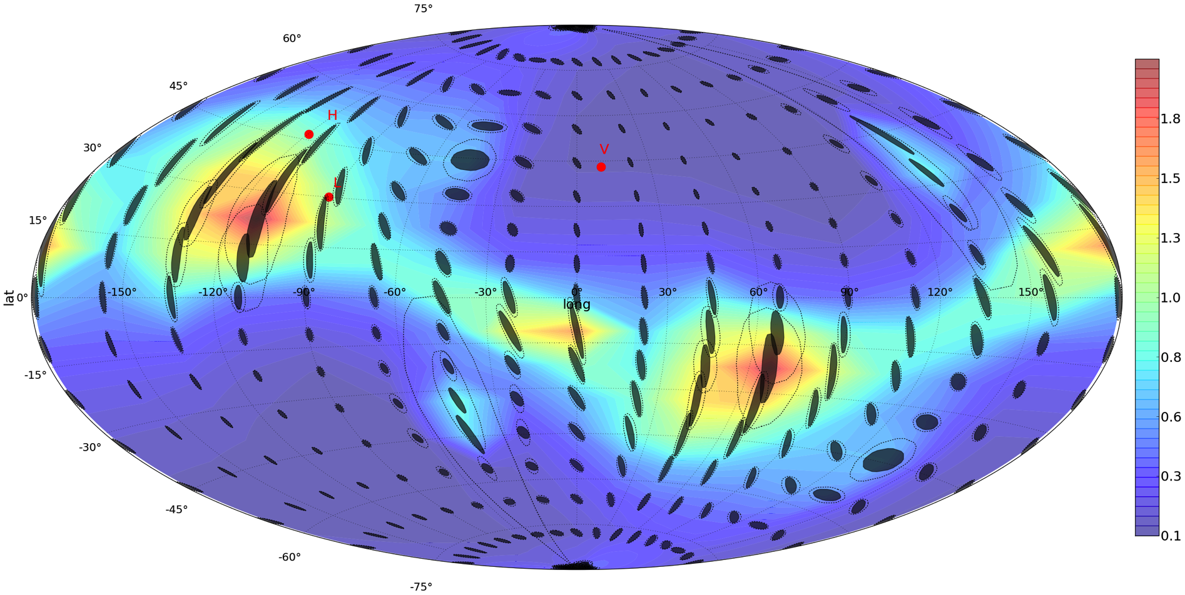
Timing Errors without LIGO-India

Slide 19
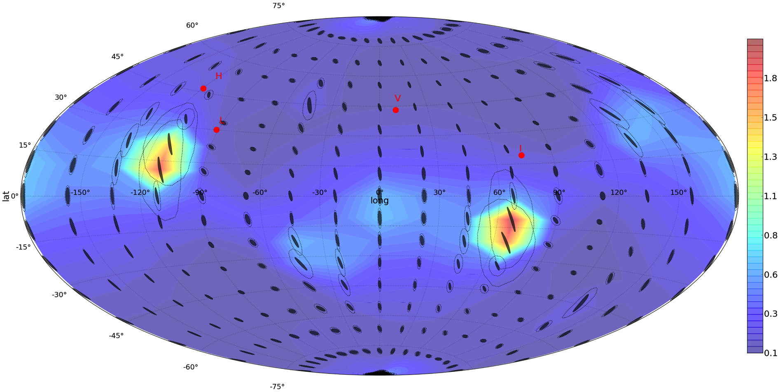
Timing Errors with LIGO-India

Slide 20
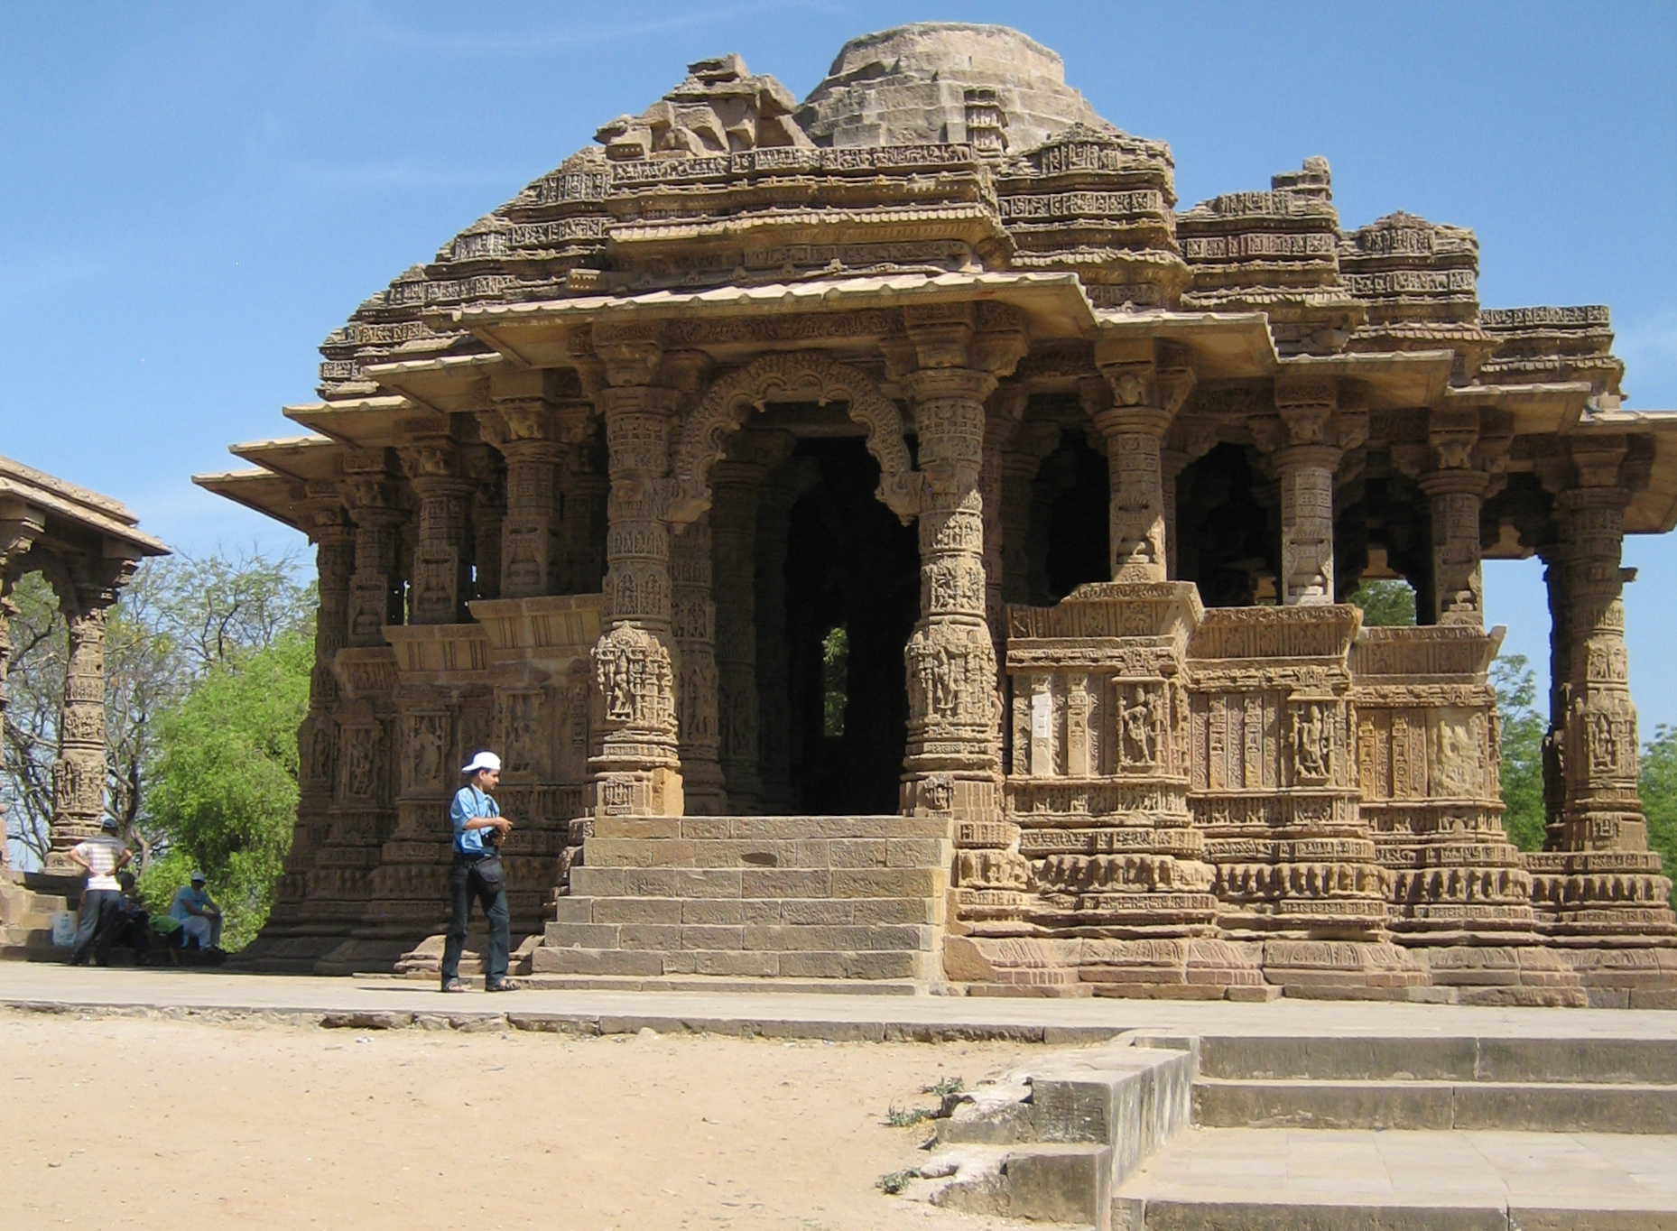
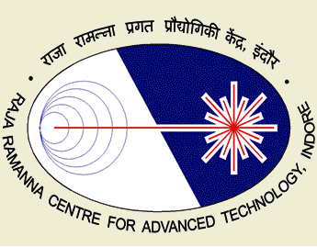

LIGO India Core Team
IPR, Gandhinagar – Facilities, Beam Tubes, Vacuum Equipment, Controls
RRCAT, Indore – Interferometer Optimization, Installation, Commissioning
IUCAA, Pune – Site survey, Astrophysical Data Analysis & Computing
LIGO-US WILL CONTRIBUTE COMPLETE INTERFEROMETER PLUS TECHNOLOGY TRANSFER AND TECHNICAL SUPPORT

Slide 21
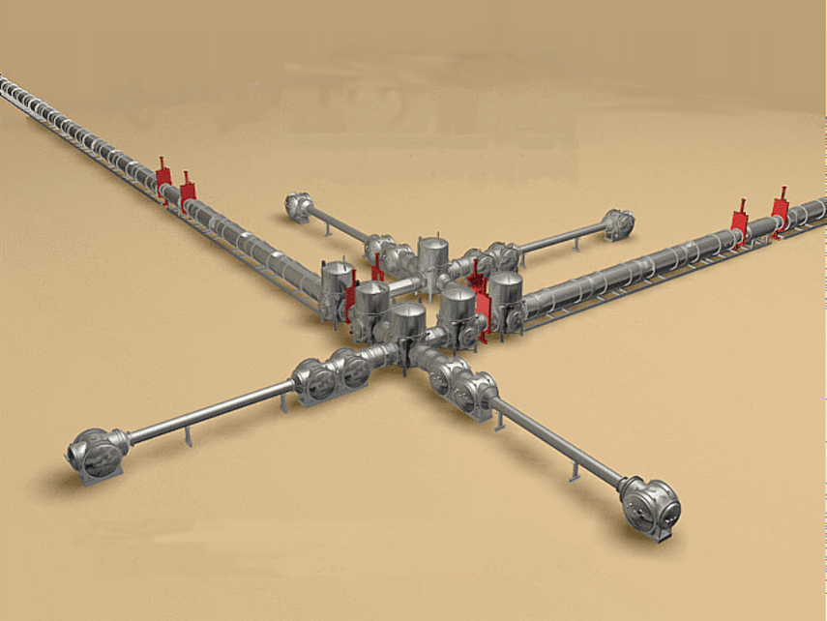
LIGO Vacuum Equipment

Slide 22
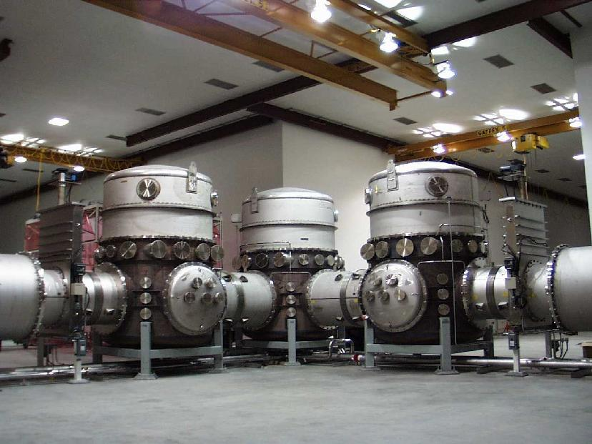

LIGO Really Has Two Vacuum Systems
“Vacuum Equipment:”
Chambers, pumps, instruments
  Houses detector apparatus
  Isolation (valves), access (doors)
  Electrical, mechanical, optical penetrations
  Pumping & instrumentation
  Somewhat “conventional”
  F:A ~ 10⁻² ls⁻¹cm⁻²
Beam tubes
  A long hole in the air;
      Never to be vented
  Highly “unconventional”
    20 million liters (per site)
    600 million cm² (per site)
    200 l/s char. conductance
    F:A ~ 10⁻⁵ ls⁻¹cm⁻²

Slide 23
LIGO Vacuum Requirements
(partial list)
Light scattering phase noise from residual gas
    Function of molecular polarizability, transit speed and partial pressure
    Primary goals for beam tubes:
      ➔P(H₂) < 10⁻⁹ Torr
      ➔P(H₂O) < 10⁻¹⁰ Torr
Contamination of optics
    Mirror absorption < 0.1 ppm
    Hydrocarbons: < 1 monolayer/10 years
      ➔Aggressive cleaning and vacuum bake of every component
    Particles: < one 10 µm particle on any mirror
      ➔ISO Class 5 or better cleanroom protocol for worker access, internal components, surface exposure
Vibration-free environment
      ➔No mechanical, turbo or closed-cycle cryo pumps in steady state operation
NB: Unlike accelerator, plasma, or aerospace applications, we have no radiation, thermal, or ion loading ; in LIGO outgassing is passive at ambient temperature

Slide 24
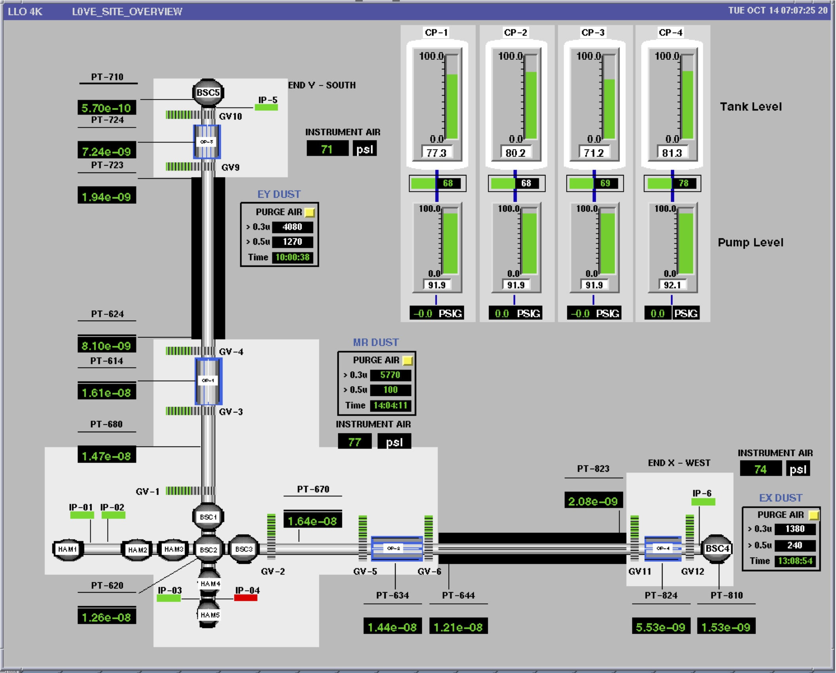
Vacuum System Schematic
10 m
~
4,000 m
~
50 m
~

Slide 25
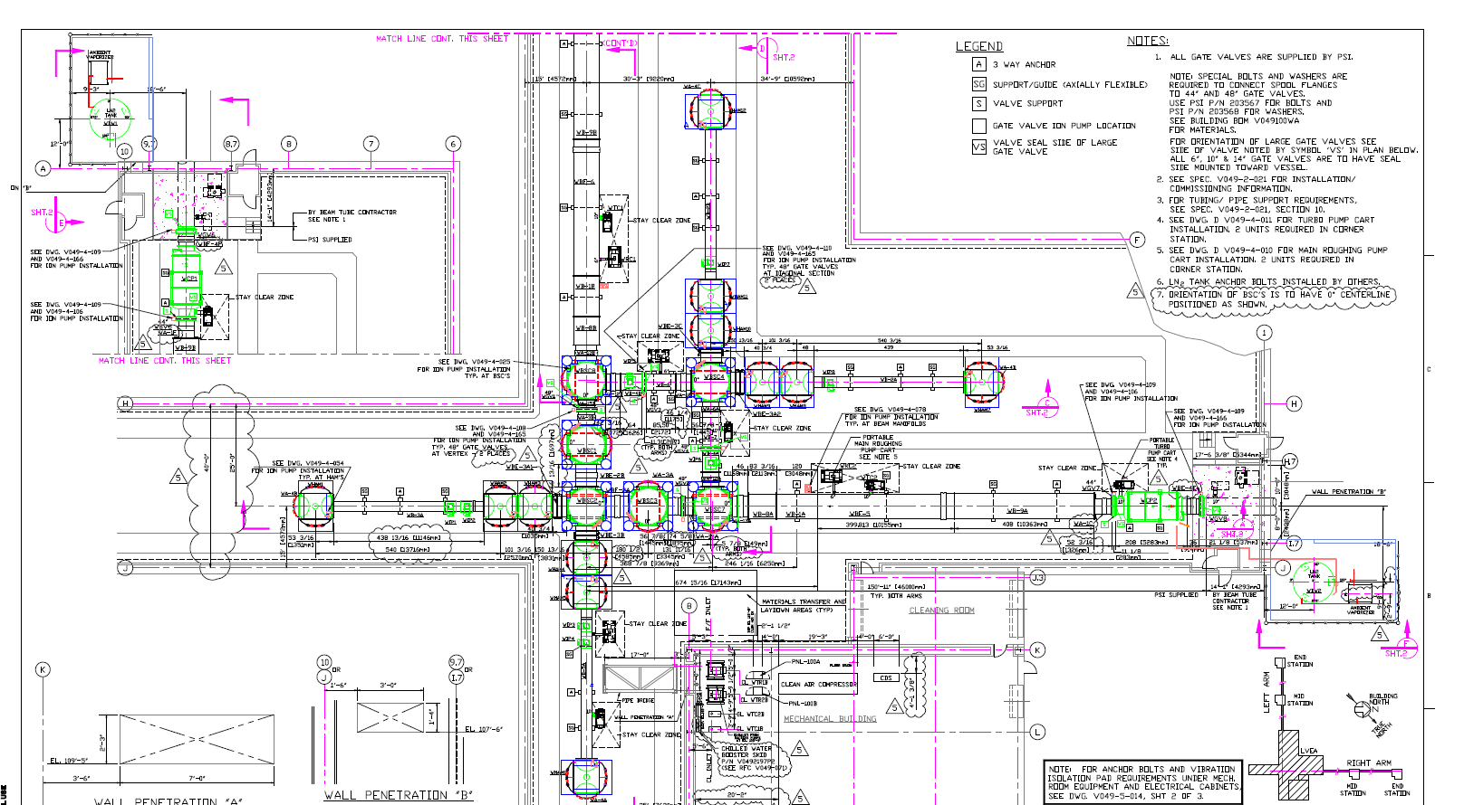
Corner Station Layout
50 m

Slide 26
End Station Arrangement
LN₂ storage
(outdoors)
Coaxial
LN₂ trap
1.4e5 l/s (H₂O)
ion pump
2500 l/s (N₂)
beamtube
BSC chamber
1.2m Ø gate valves

Slide 27
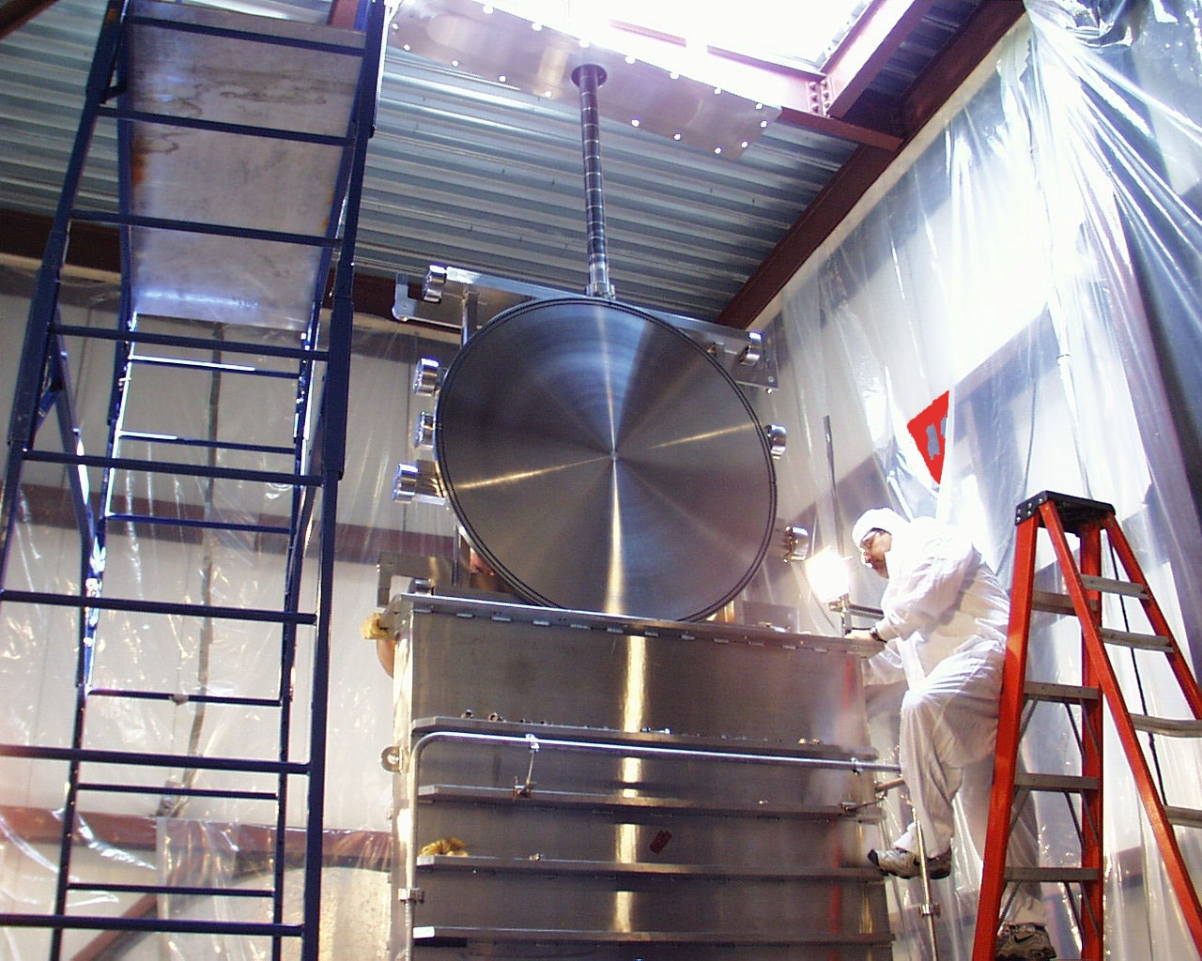
Beamtube Gate Valves
40” & 44” ID gate
valves to isolate
beamtubes,
sections, LN2 traps
Double O-ring gates & bonnet seals with pumped annulus*
Two actuator varieties: electric (ballscrew) and pneumatic (cylinder)
Custom design by GNB Corp.
* Principal volume is vulnerable when gate is open!

Slide 28
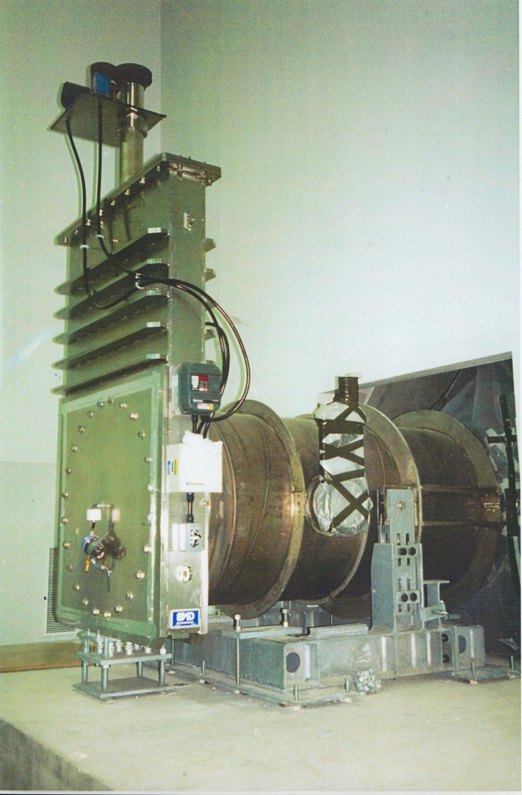
In US, we installed beam tubes first to allow time for bakeout
VE contractor supplied valves & pumps to tube contractor

Slide 29
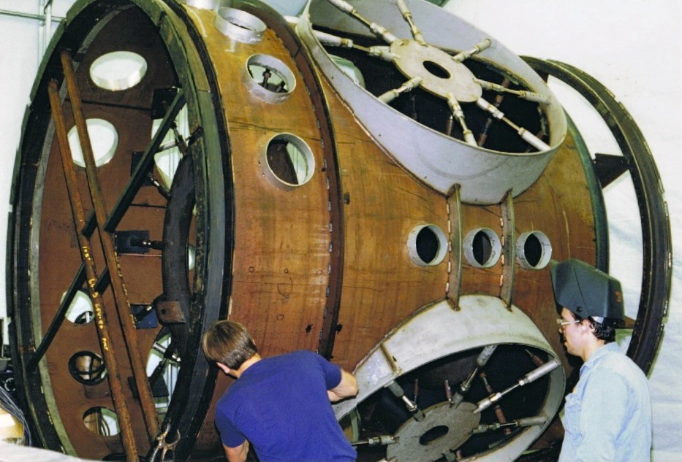
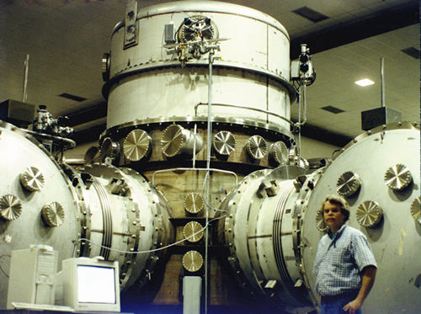
BSC chamber
(Basic Symmetric Chamber)
2.8m Ø x 5.5m h for large cavity optics
Upper third is a removable dome
Thin (10-15mm) 304L SS shell with welded stiffeners, F&D heads
Combination of GTAW and plasma welding
Major weldments stress-relieved*
  *NOTE SURFACE FINISH!
Ports < 35cm Ø: ConFlatTM
Ports > 35cm Ø: Dual O-ring
  Treated Viton elastomer
  DRY (no grease)
  Isolated pumped annulus between inner and outer seal
  Permeation and damage tolerant

Slide 30
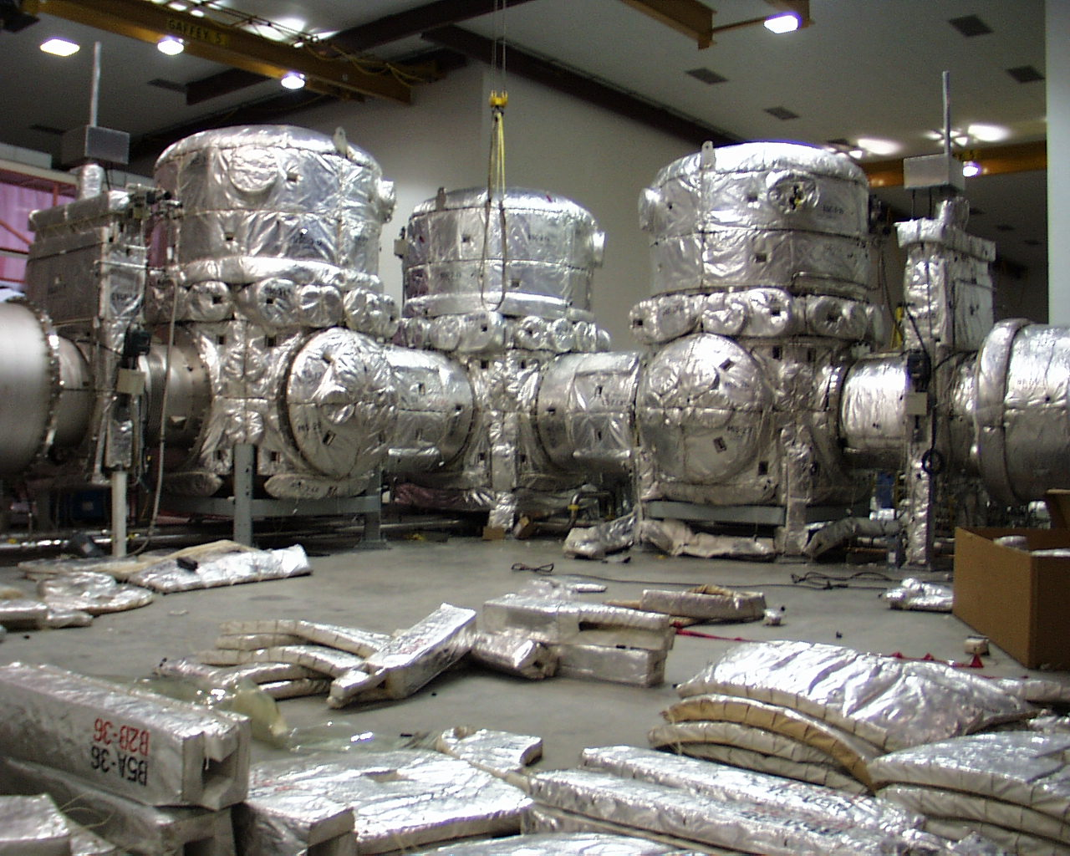
In Situ Chamber Bakeout

Slide 31
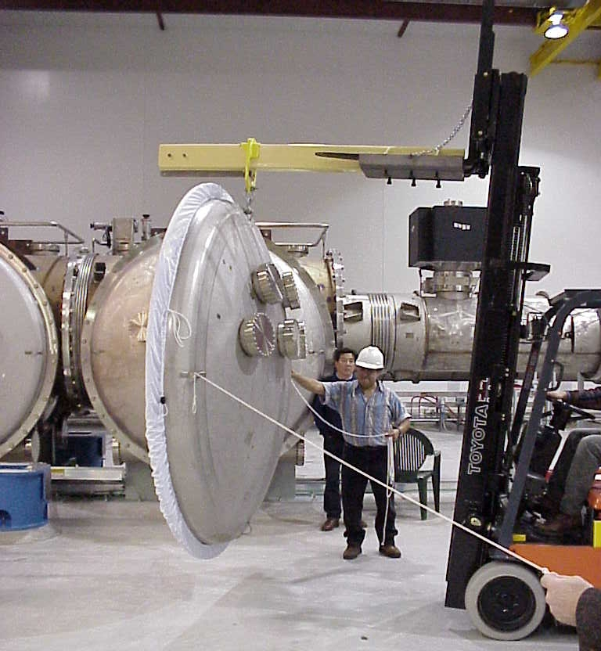
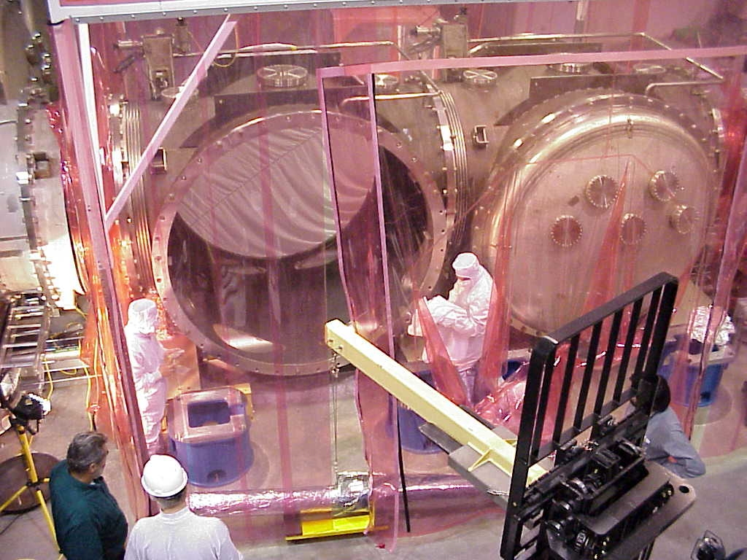
Particulate control: movable ISO Class 5 cleanrooms
Part of VE contract due to special features required for chamber access

Slide 32
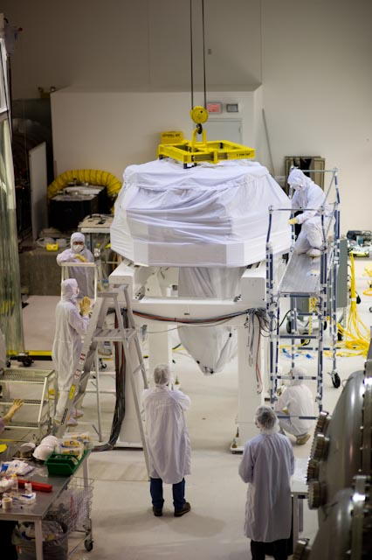
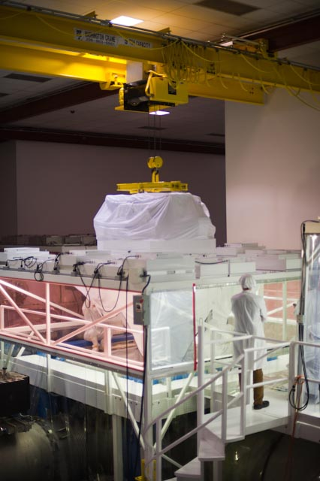
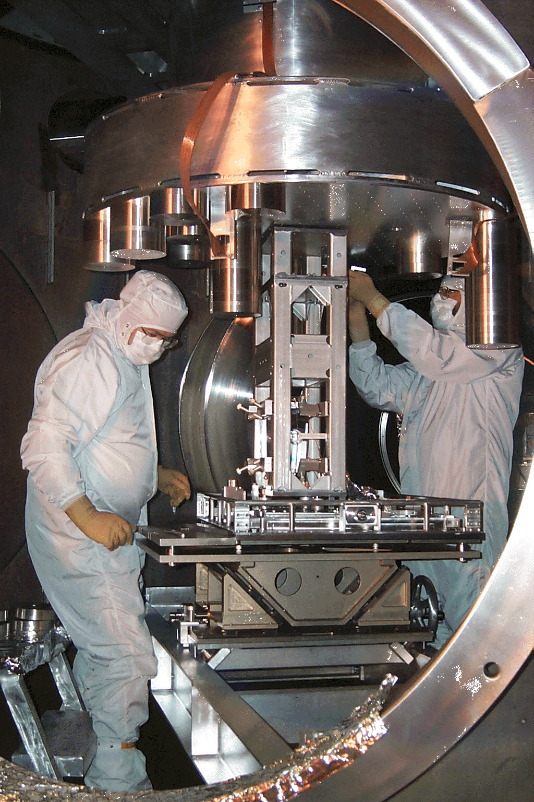
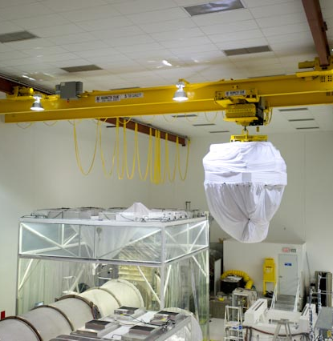
BSC Equipment Installation

Slide 33
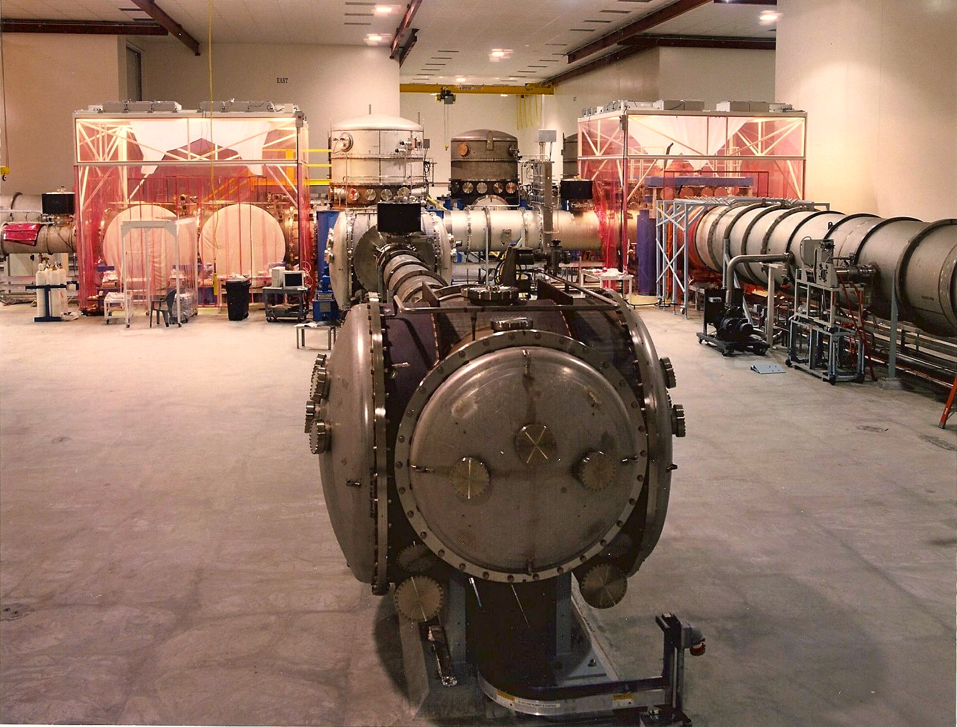
HAM chamber
(Horizontal Access Module)
House complex input/output optics
2.1m Ø x 2m w
More than 70% of area is removable access doors

Slide 34
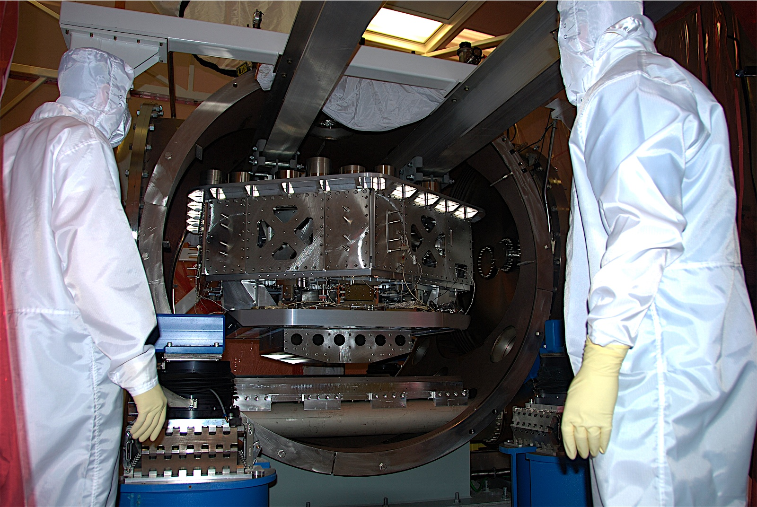
L1 ISI 1/31/08
Notes:
HAM ISI insertion in HAM6 at Livingston with guidance from Jeff Kissel (LSU, left) and Brian O’Reilly (LLO, right). March 2008.

Slide 35
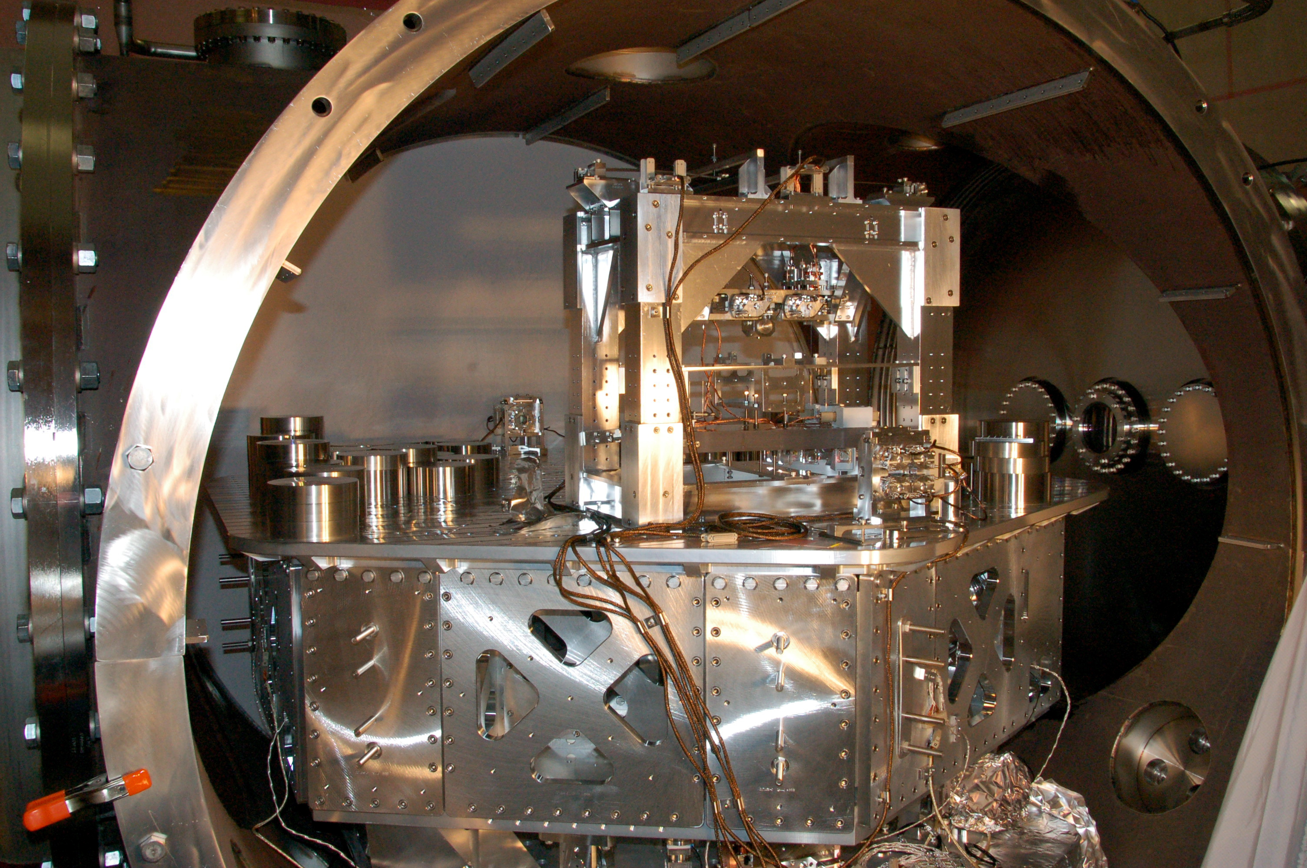
Notes:
L1 OMC in its double pendulum suspension, on the HAM ISI platform inside LHAM6, 3/14/2008 (photo credit: Sam Waldman)

Slide 36
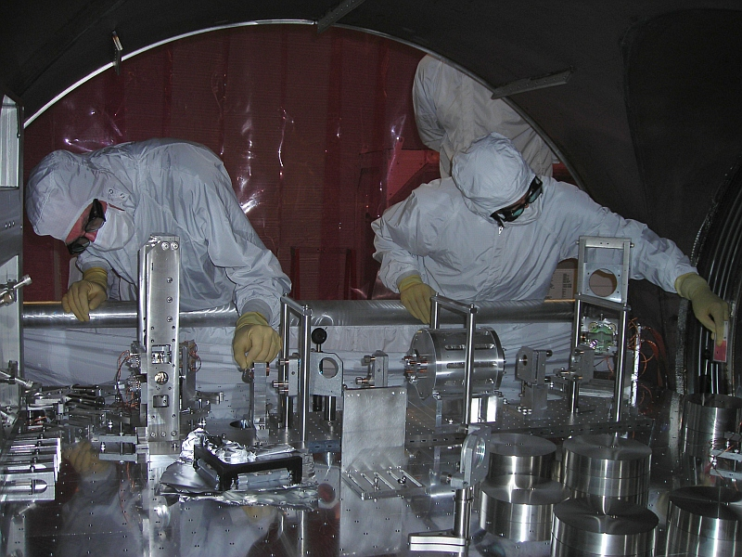

Slide 37
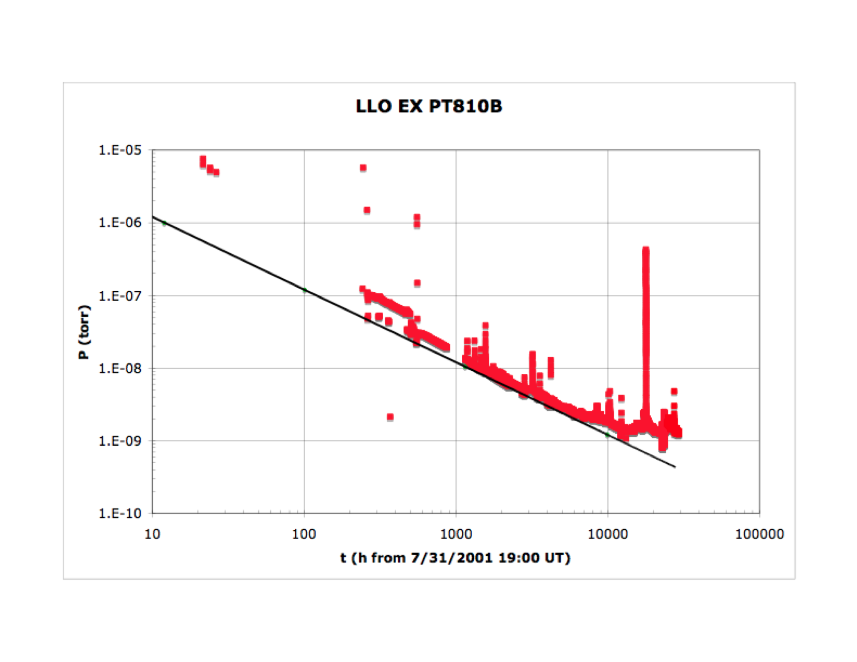
End Station Pressure Evolution after Backfill

Slide 38


Beam Tubes
304L SS, 3.2 mm thick with external stiffeners
raw coiled stock air baked 36h @ 455C to deplete hydrogen
  J_{H2} < 1e-13 Tl/s/cm²
  permits ultimate P without distributed pumps
  process developed by LIGO
prepared coil spiral-welded into 1.2m tube on modified culvert mill
16m sections cleaned, leak checked, and capped
FTIR analysis to confirm HC-free
sections field butt-welded together in travelling clean room
Over 50 linear km of weld—

Slide 39


Slide 40

Depleting H from raw SS before fabrication:
An economical alternative to high T vacuum bakeout
Raw SS
SS sheet from mill is baked in air 36 hours at 455 ºC
(Hotter treatment deemed inadvisable due to carbide formation)
Total dissolved hydrogen is reduced ~ 3x
Remaining H is tightly bound, high activation T
Care is required in welding to avoid re-introduction of H
H₂ Flux (A.U.)
After
Airbake
Sample Temperature (ºC)
data courtesy of Virgo

Slide 41

Cleaned with pressurized hot water and detergent
QA by FTIR sampling

Slide 42

Leak Test “Coffin”

Slide 43

Leak Test “Coffin”

Slide 44






Beam Tube Field Assembly
transport
position
field fitup
butt weld
leak check
next section

Slide 45

Tube
Assembly
Field butt weld made in movable shelter
Internal “dam” shields inside of weld with inert gas
Dam is later filled with He for leak test
Finally, garbed worker crawls in to remove dam & place optical baffles

Slide 46

Welding Shelter

Slide 47





I²R Bakeout to Desorb Water
Glass wool insulation
I_{DC} = 2,000 A
~ 3 weeks @ 160ºC
Final J_{H20} < 2e-17 Tl/s/cm²
Tubes never to be vented

Slide 48
How Often do you get a Second Chance??
Some Updates Under Study for LIGO India
Move to “conventional” large gate valve design ?
  Reduce cost with single 0-ring gate seal, metallic bonnet seal?
  Increase reliability with “standard product”?
  Reduce complexity of two actuator styles
Remove oxide from stress-relieved vessel walls?
  Oxide patina was good for suppressing IR scatter, good for vacuum performance, but began to flake off with age– had to be removed!
  Considering conventional treatments such as passivation or electropolish
Is spiral-welding still the most economical tube construction?
Are there alternative ways to achieve ultralow dissolved hydrogen?
Should we upgrade monitoring & instrumentation along tubes?
Should we consider 316L in place of 304L for higher corrosion resistance?
Should we consider flanging or other means to reversibly isolate tube sections after installation?

Slide 49
Cautionary Tale:
The LLO Y Beamtube Leak
Discovered only late last year, but…
Reconstruct t=0 in 2008, F = 2.5e-4 torr-liter/sec (!)
  Unnoticed due to sparse instrumentation, masked by detector outgassing
  Approximately 1e5 x specification; MUST BE REPAIRED
    Legacy of water vapor deposited since ‘08 may persist, even after repairs
Localized near Y midpoint by gradient methods
Followed by He MSLD test: VERY DIFFICULT ON THIS SIZE SYSTEM !
At least 4 distinct leaks discovered to date, in at least 3 zones
  Confirms this is no fluke or isolated defect, but a progressive problem
  Most likely a spectrum of sources will be found
  Largest breach is now sealed but about 1e-5 torr-liter/sec remains unaccounted for
Those discovered to date coincide with
  Welds (both a spiral weld and a stiffener fillet), plus
  Animal residues (mice or mud wasps; emit “corrosion accelerants”), plus
  Local history of persistent water incursion
Team (incl. yours truly) has been assigned to find, repair, prevent recurrence
  Outside metallurgical & welding specialists under contract
  Additional diagnostics on known leaks, representative fab samples
  Too soon to reliably bound full $ and schedule impact!

Slide 50



mouse latrine
evacuated temporary cover patch
mud dauber nest
pressure transient vs. distance for He injection

Slide 51


Slide 52
Final Remarks
LIGO facilities are among the largest high-vacuum systems ever built, and have stringent requirements
Novel and cost-effective methods were developed to meet these challenges successfully in the US
In trouble-free operation over a decade, LIGO is now installing second-generation instruments in Louisiana and Washington
A third identical interferometer was built and is now designated for India when the site is available
With benefit of hindsight, new technology, and Indian innovation, we believe the LIGO India vacuum system will be even better!

Slide 53

Thank you IUVSTA!
Thank you IPR!

Slide 54
--Reference Slides--

Slide 55

LIGO
Livingston Observatory

Slide 56

LIGO
Hanford Observatory

Slide 57

Limits to Sensitivity
First detectors reached design sensitivity in 2005
Now installing Advanced detectors
Vacuum requirement
<10⁻⁹ torr H₂
<10⁻¹⁰ torr H₂O

Slide 58



Residual Gas Index Fluctuation Noise
ρ = gas number density (~ pressure)
α = optical polarizability (~ index)
w = beam radius
v₀ = most probable thermal speed
L₀ = arm length
ΔL = arm optical path difference
Statistical model verified by interferometer experiment
S. Whitcomb and MZ, Proc. 7th Marcel Grossmann Meeting on GR, R. Jantzen and G. Keiser, eds. World Scientific, Singapore (1996).

Slide 59


Residual Gas Pressure Limits in Beam Tubes
To avoid optical phase noise in laser path

Slide 60


Slide 61


Slide 62

Pressure evolution for major species during 160ºC beam tube module bakeout

Slide 63


Slide 64


Slide 65

Vertex Pressure Evolution after Backfill

Slide 66
Large Flange Design
Dual “dry” o-ring
Pumped annulus between
(independent of main volume, except in open gate valve)
Seal faces single-point machined
Controlled circumferential 32 μinch “tooth” finish
Custom Viton (Flourel) cord formulation (55 gallon min. order)
Cleaned & baked after molding to remove volatile compounds and mold release wax

Slide 67


Pumping
All “dry” pumping
Initial evacuation by blowers & maglev turbomolecular pumps
Maintained by noble diode ion pumps and coaxial LN₂

Slide 68
80K LN₂ Cryopump
Special “low vibration” design
  LN2 reservoir suspended by compliant springs with Flourel dampers
  Dual-phase liquid delivery (horizontal vacuum-jacketed lines) maintain continuous liquid and vapor flow without slugging
  Sloped “chute” introduces new liquid to reservoir
  Reservoir shape & free surface area designed to preclude boiling
  Continuous level control (PID with differential pressure level sensor)
Low-emissivity aluminum cold surface
Low-emissivity tube liners reduce thermal flux
Outdoor storage dewars refilled periodically by truck delivery

Slide 69
Cryopump Design

