Slide 1
Cryogenic Test Masses for LIGO Upgrades
LIGO
Brett Shapiro
Stanford University

Slide 2
Summary
LIGO
Cryo test mass problem statement
Thoughts on LIGO III quad pendulum upgrades
Stanford experiments
Preliminary rapid cooling
Preview of upcoming experiments
Rapid cooling thoughts for LIGO III
List of problems to solve

Slide 3
Cyro Test Mass Problem Statement
* For LIGO III, reduce suspension and coating thermal noise by cooling the lower quad to 120 K (-153.15 C)
Get to 120 K in a timely manner
Then maintain 120 K
Include a warm-up scheme (don’t forget!)
Do not increase the test mass lossiness
Emissive coatings, heat links, thick sus fibers, etc
Do not compromise passive seismic isolation
Cables, hoses, links, etc
Keep about the same seismic isolation platforms (ISIs, HEPIs)
Limit the amount of extra weight on the ISI
Leave the rest of the BSC warm

Slide 4
Possible LIGO III Mechanical Upgrades
Advanced LIGO quad pendulum
Preliminary LIGO III quad pendulum
Reaction
chain
Reaction
chain
Main
chain
Main
chain
2.14 m
1.626 m
10 kg
20 kg
20 kg
20 kg
20 kg
40 kg
80 kg
40 kg
143 kg
Fused silica, 295 K
Silicon, 120 K
G1300196-v1

Slide 5
Why These Test Mass Changes?
Thermal elastic noise and CTE of silicon goes to zero at ≈120 K (and 18 K)
Silicon’s mechanical loss decreases at lower temperatures, silica’s increases
Silicon has high thermal conductivity – decreasing thermal lensing with high laser power
Higher mass reduces radiation pressure sensitivity and helps reduce thermal noise with less surface/volume ratio
References: [1] Strawman report – T1200031
[2] “Test mass materials for a new generation of gravitational wave detectors”; 2003; Rowan, Byer, Fejer, et al.

Slide 6
Possible LIGO III Cryogenic Upgrade
clamp
295 K
ISI stage 2
Vacuum flange
Flexible liquid nitrogen hose
(77 K = -196 C)
120 K
≈ 3 W at 120 K
Heat shield
77 K
1560 nm laser rather than 1064 nm
See also G1200246-v1

Slide 7
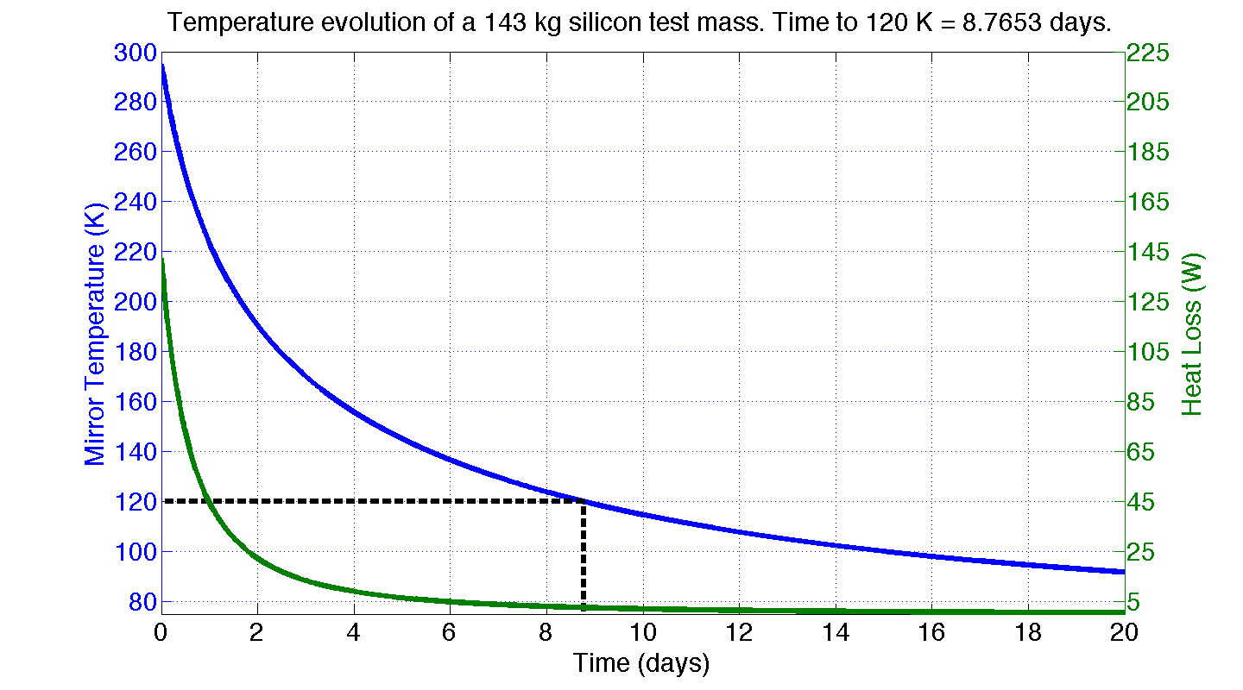
Test Mass Radiation Simulation
Ideal radiation shield:
Fully encloses test mass
77 K (liquid N₂)
Shield emissivity = 1
Test mass barrel emissivity = 0.5
Laser power = 0
Power α (Temperature)^4

Slide 8
A Lot of Heat to Remove
2.7 days to 120 K (295 K) at a constant 60 W
60 W
143 kg Test Mass:
14 MJ to get cold (warm)
Maybe there is another way to cool the test mass quickly

Slide 9
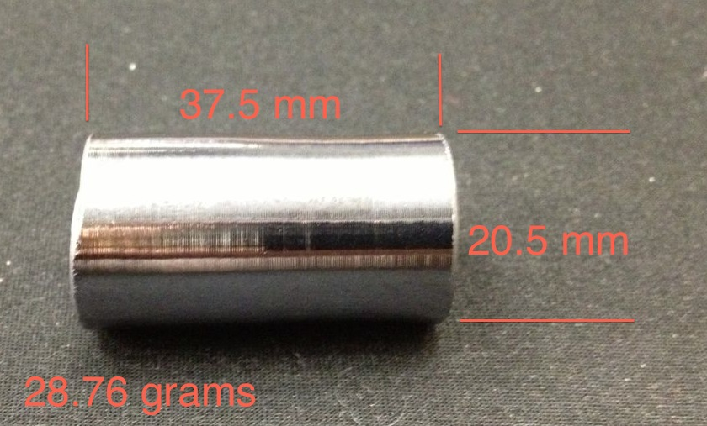
First Si Test Mass Prototype

Slide 10
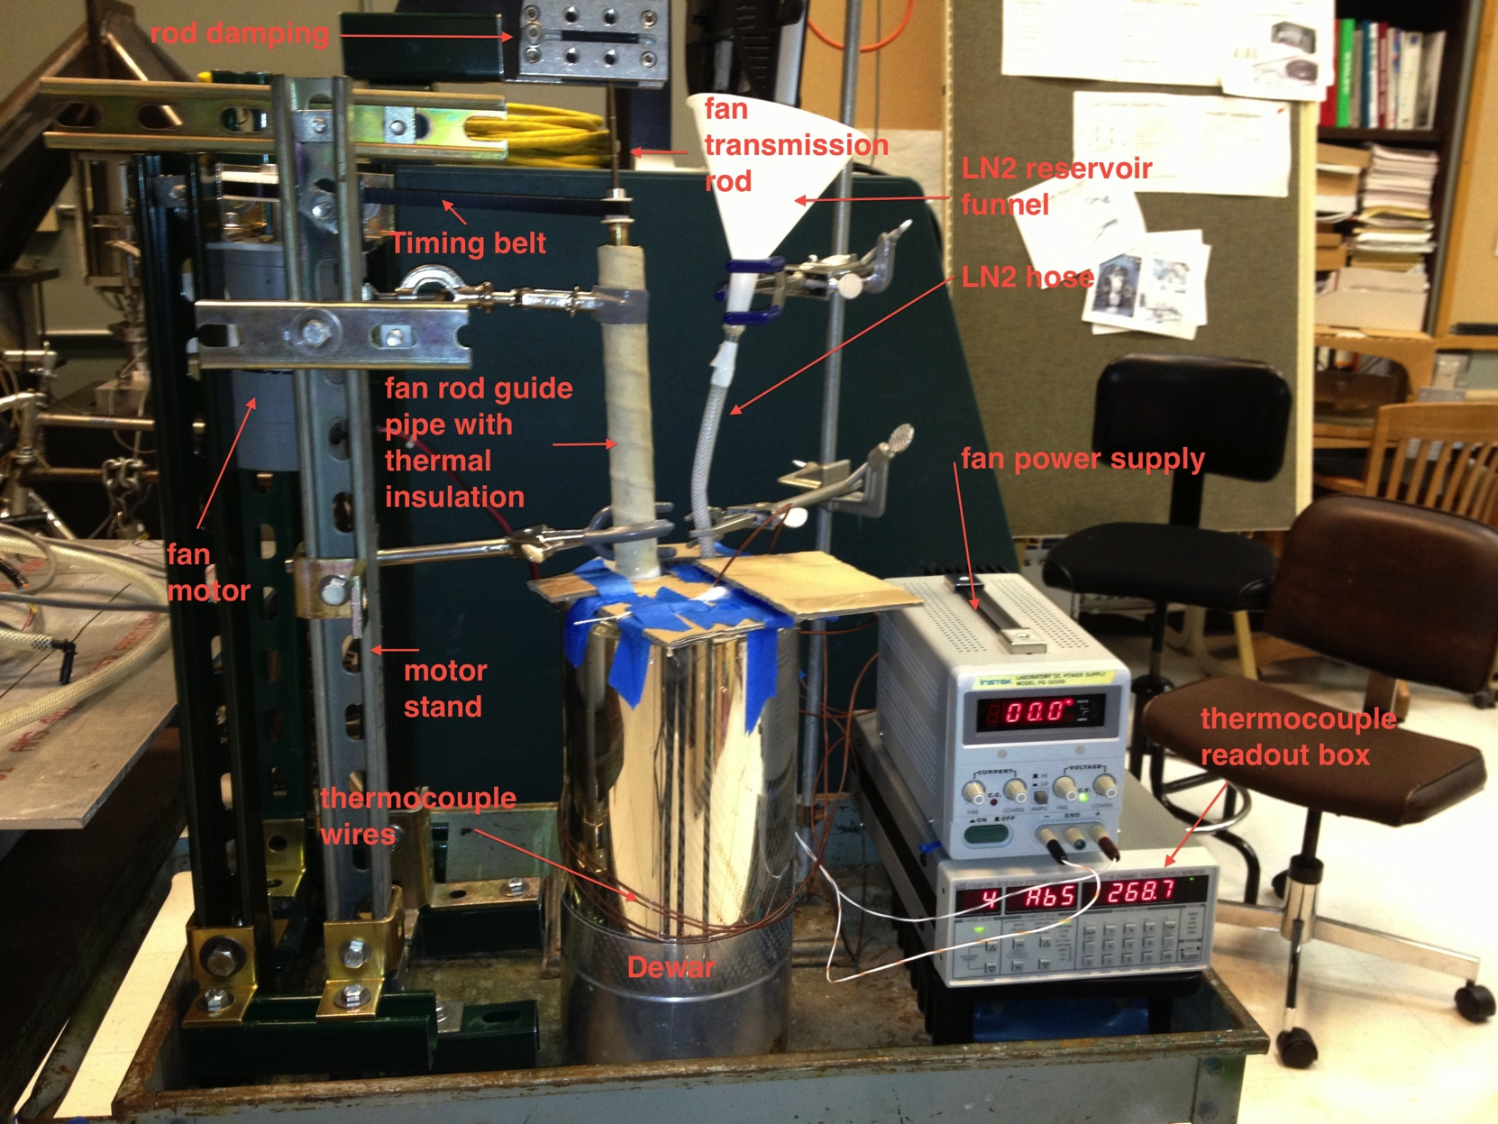
Preliminary Stanford Tests Last Year
Goals: 1. Test ways to cool objects using liquid nitrogen.
2. Compare results with models to see if we understand.
3. Get a feel for what liquid nitrogen will and will not do.

Slide 11
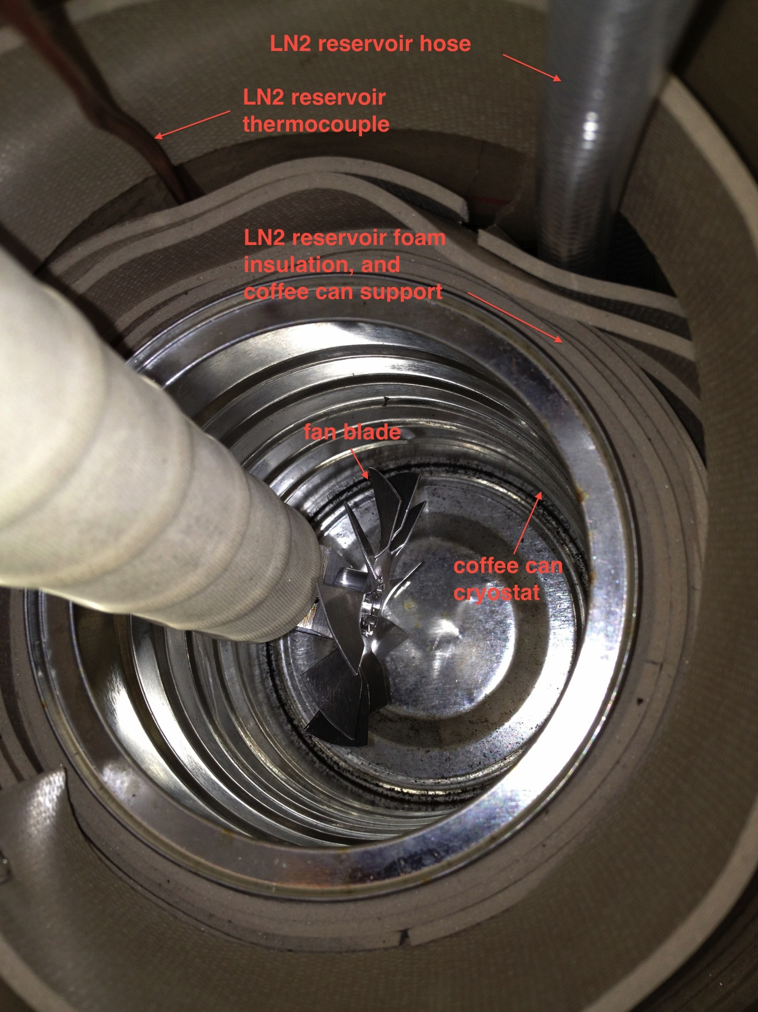

Slide 12
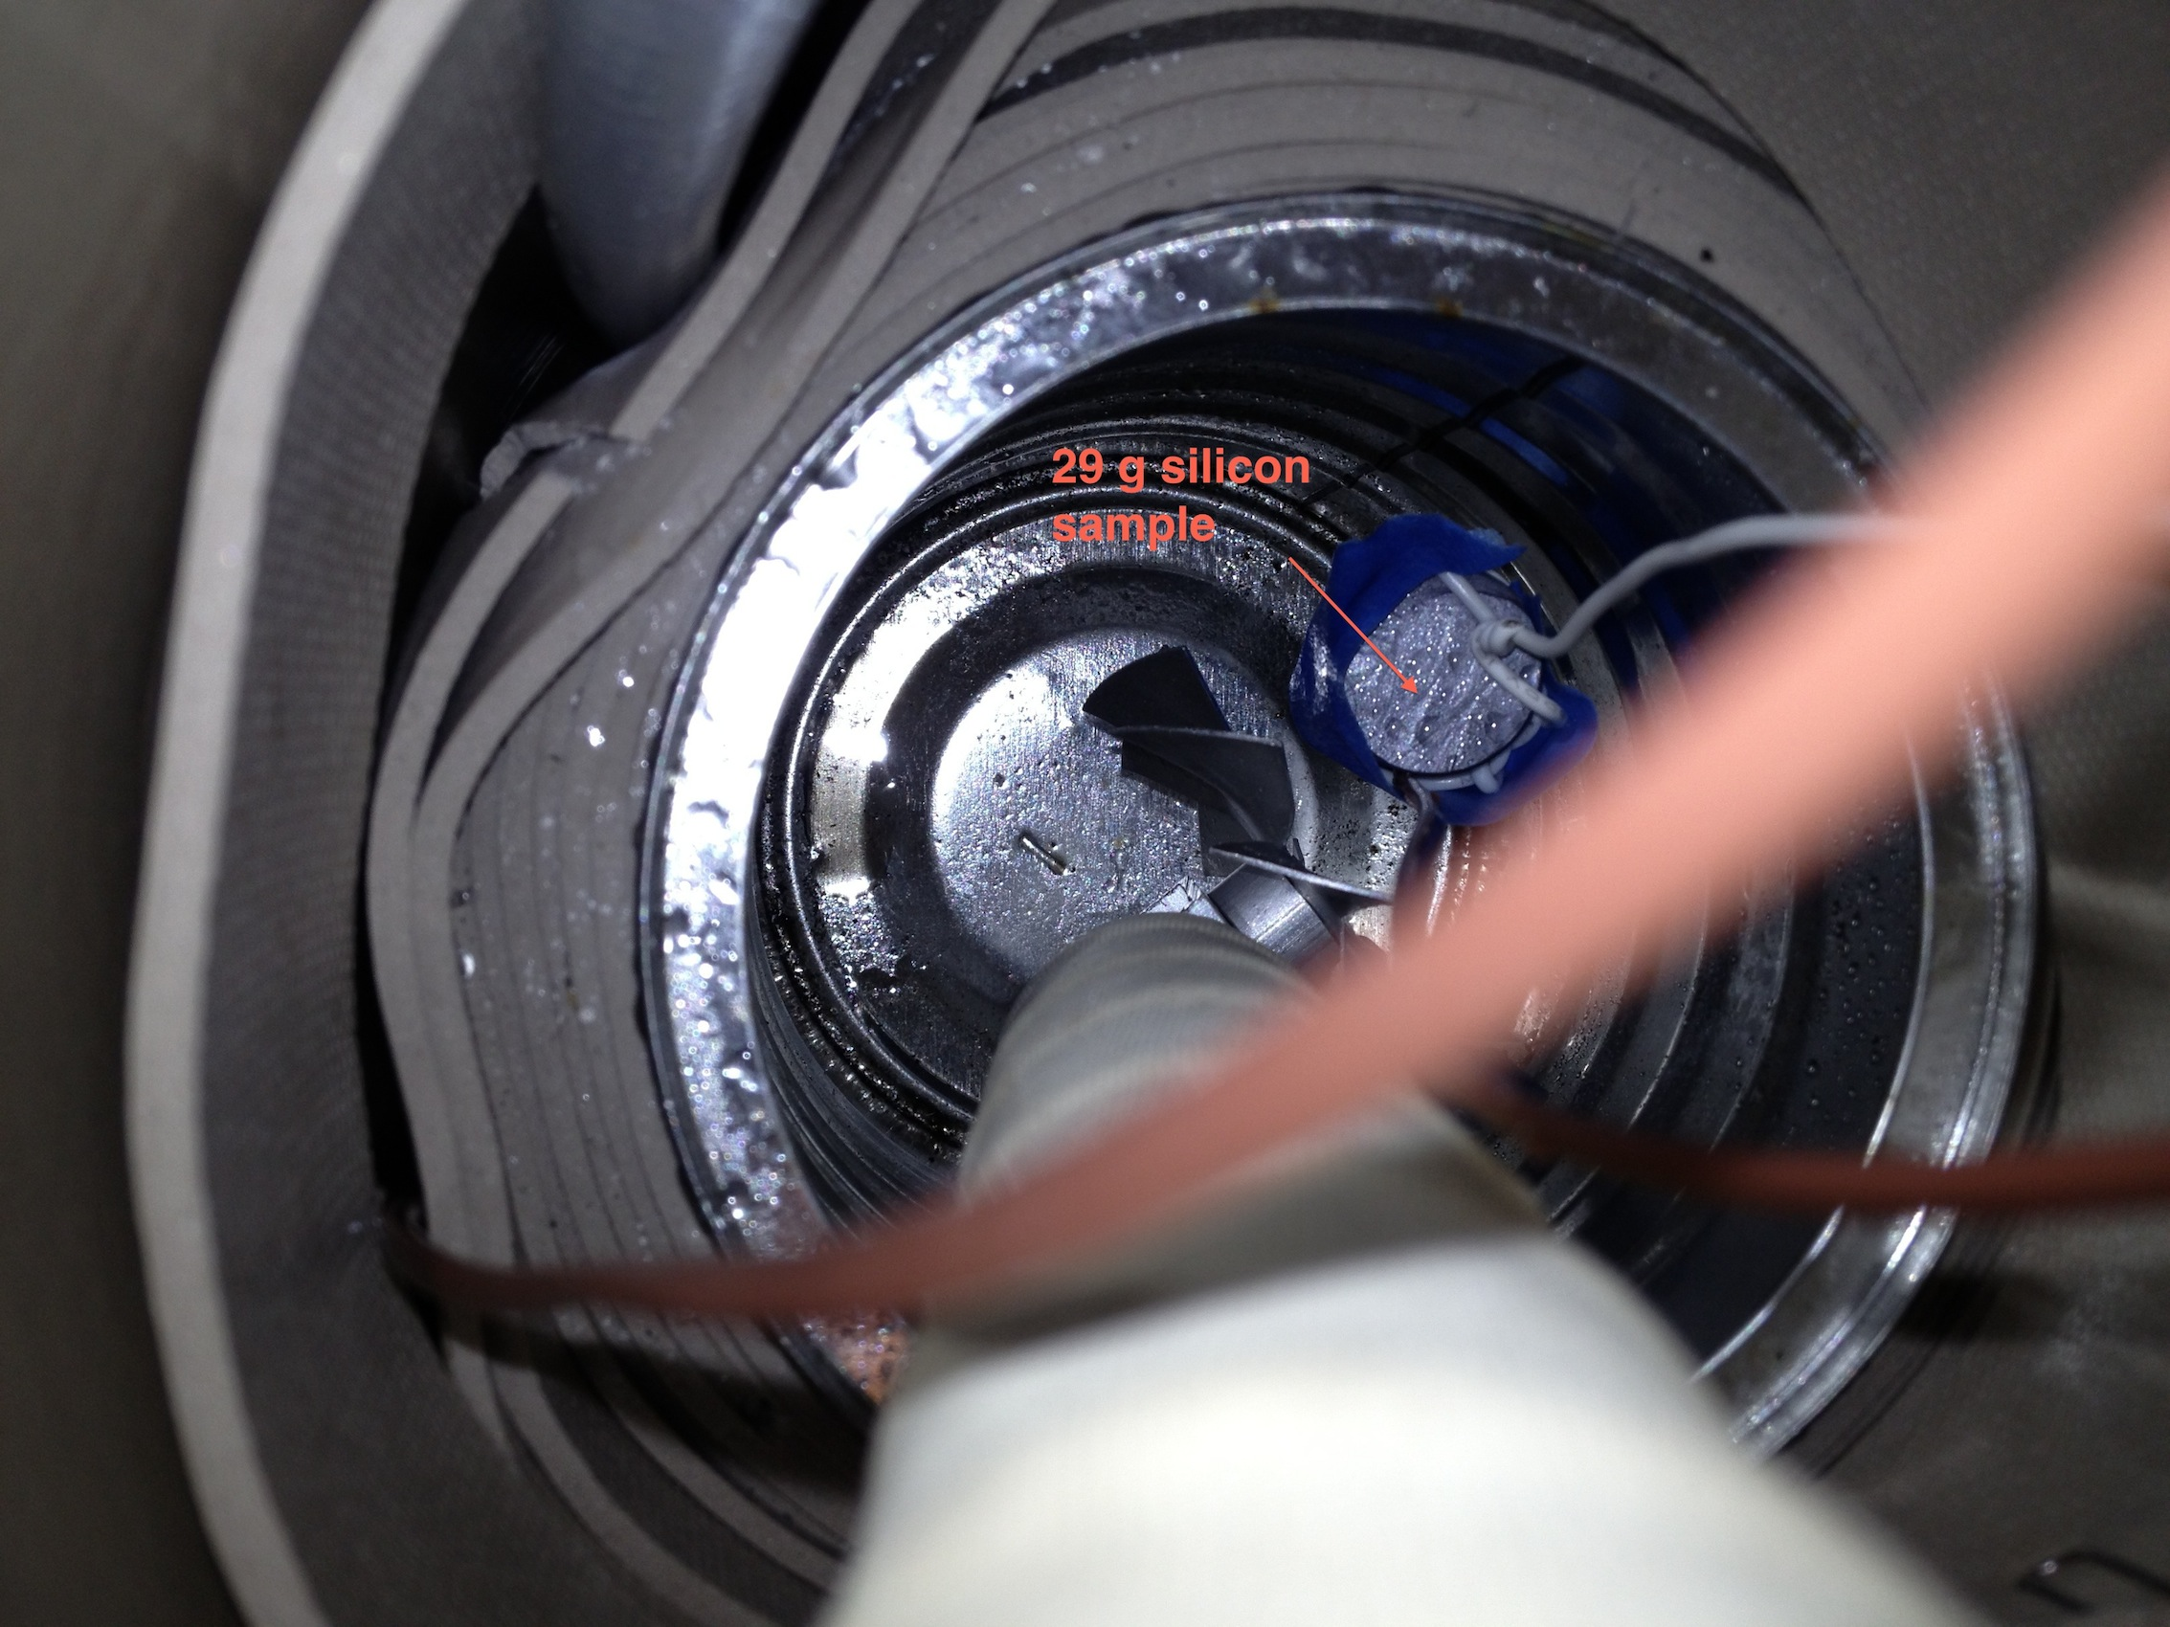

Slide 13
Heat conduction through Cu wires
29 g silicon sample
Copper heat conducting wires

Slide 14
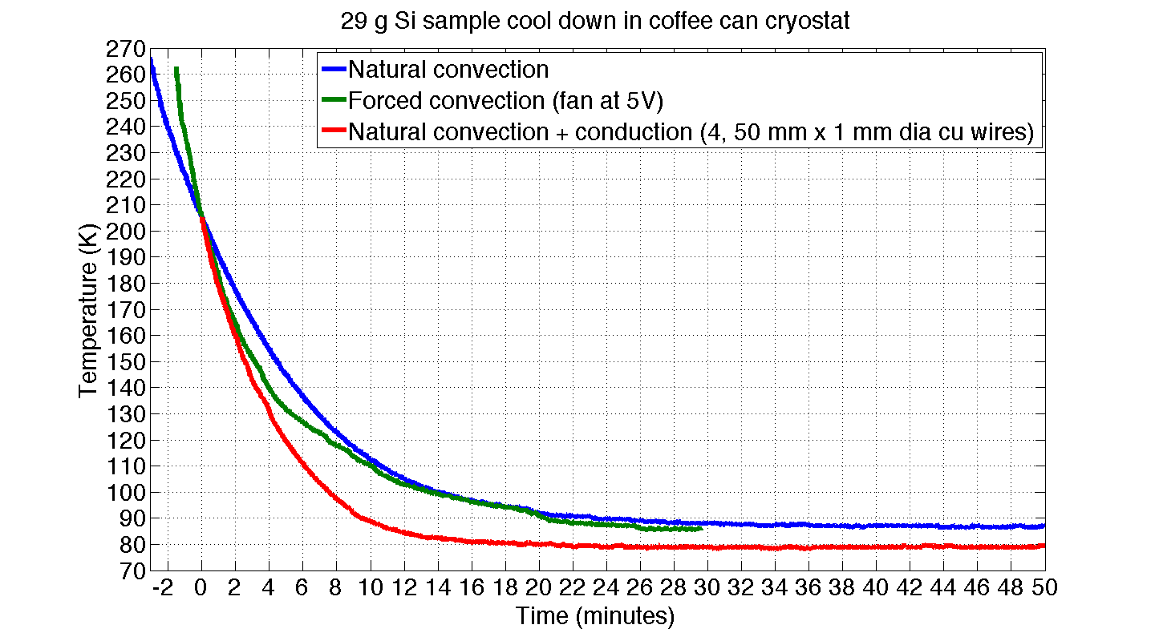
Measurements from Preliminary Setup

Slide 15
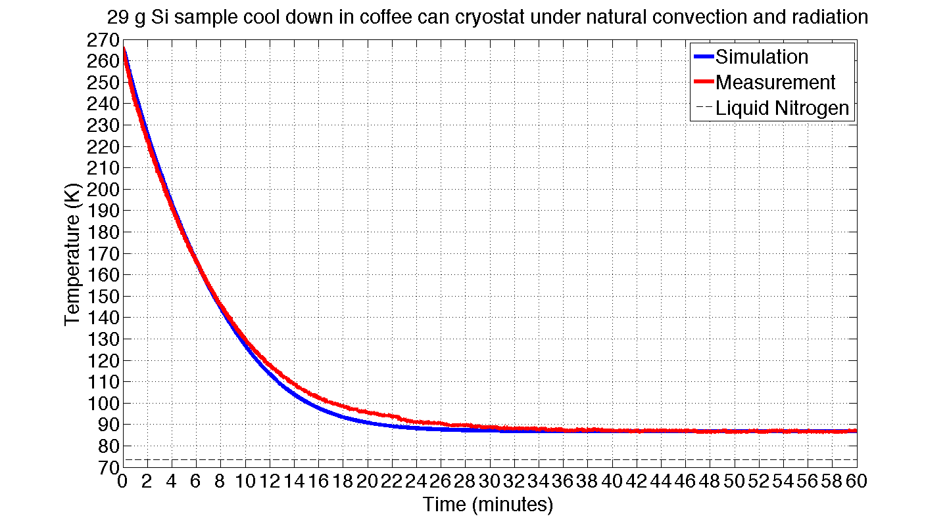
Simulation-Measurement Comparison

Slide 16
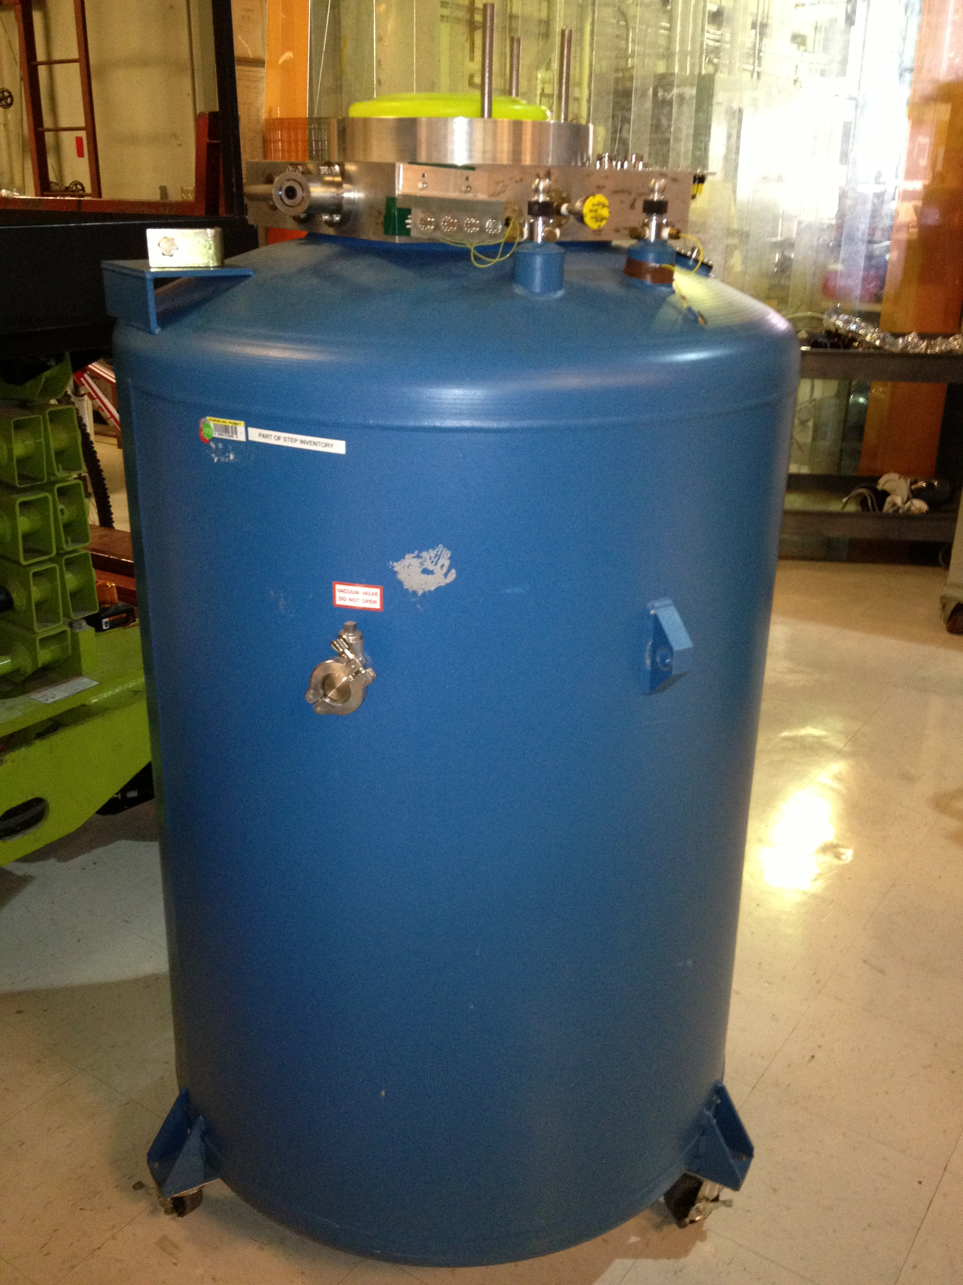
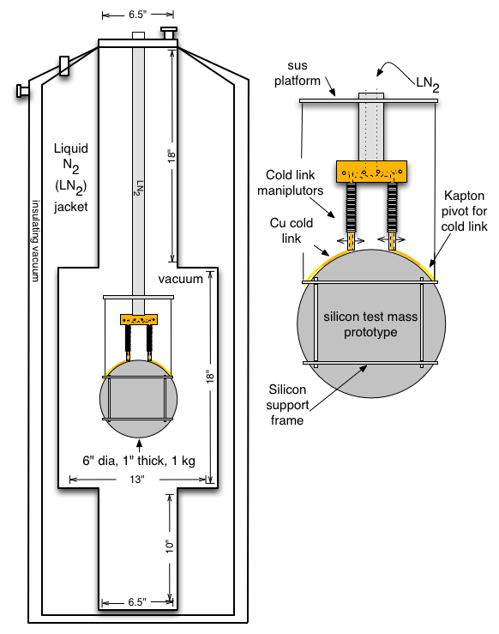
New Experimental Setup – Cold Links and Radiation

Slide 17
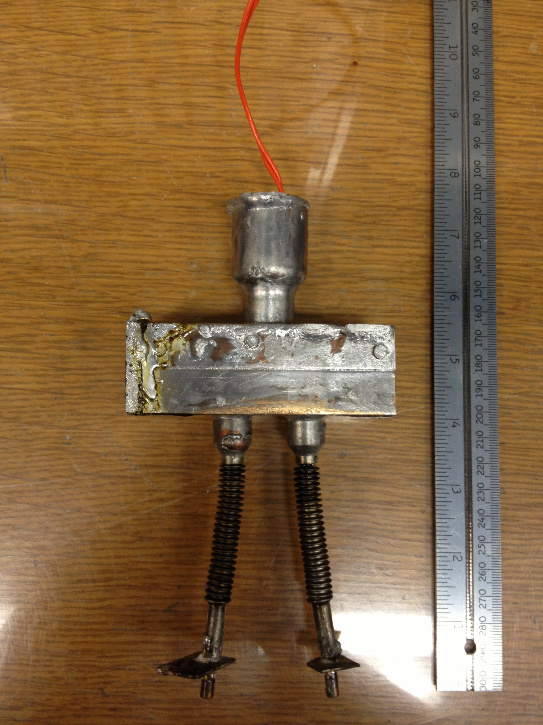
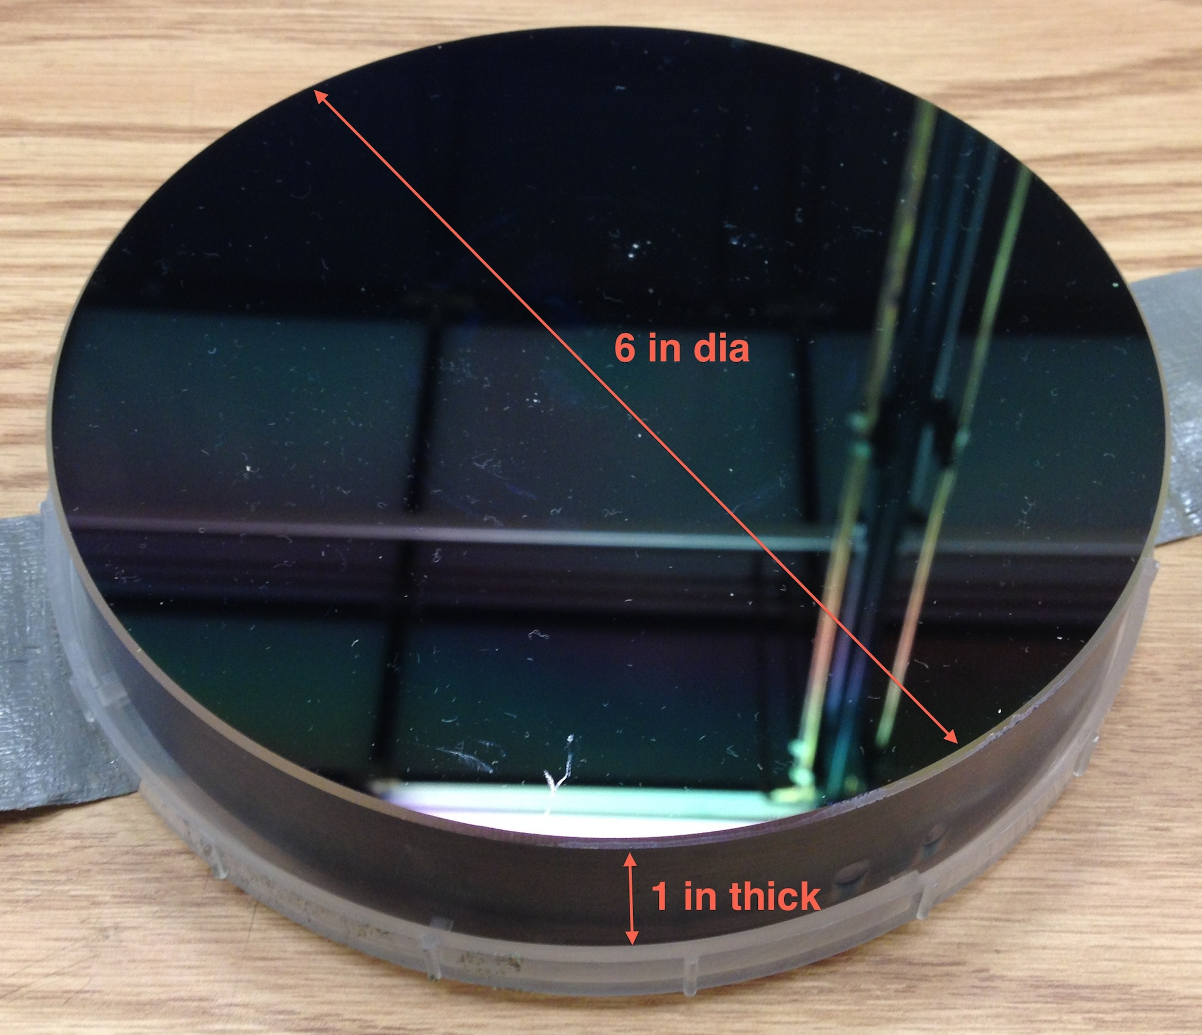
New Experimental Setup
Silicon ‘test mass’ prototype
Flexible cold link

Slide 18
List of Upcoming Experiments
Experiments - 1st set:
cold link (pincher) test
Comparison with models
Does residual air pressure enhance thermal conductivity?
radiative test
Emissive coatings
Measure of max heat input at 120 K.
Experiments - 2nd set:
suspension spring test to see if we can control the spring temp and Si temp simultaneously
Optical temperature measurement of Si - measure temperature dependent mode frequencies

Slide 19
LIGO III Movable Cold Link
Test mass front view
Test mass top view
flexible N2 pipe
cold link mover
flexible N2 pipe
Test mass
liquid N2 pipe
Cu alloy cold link
cold link mover
liquid N2 pipe
Cu alloy cold link

Slide 20
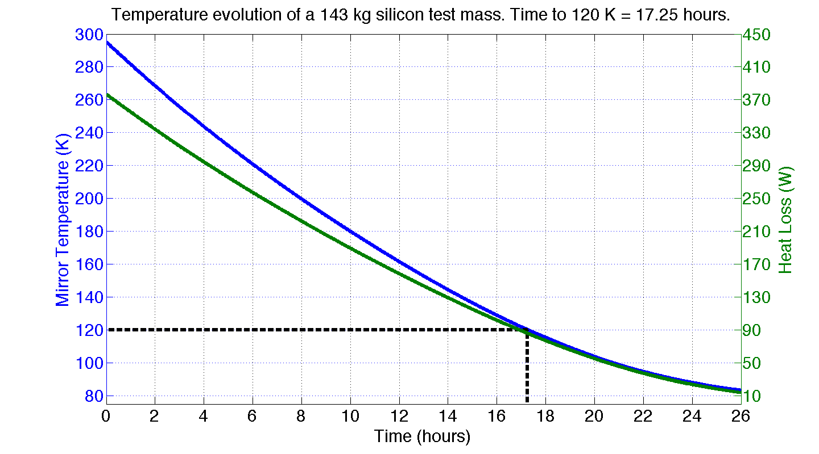
Simulation of Test Mass Cool Down
20 cold link loops:
50 mm diameter
50 mm wide
0.1 mm thick
77 K cold end
≈ 14 MJ
Power α (Temperature difference)

Slide 21
Other Problems To Solve
Liquid N₂ hoses flexible enough for ISI under vacuum
Temperature/height control of blade springs
Test mass temperature control
How to measure temperature?
Measure acoustic modes – Young’s modulus is temp. dependent
Infrared camera
Emissivity of optical coatings
Lossiness of emissive coatings
Good emissivity estimates/measurements of Si?
Power absorption in Si (ppm, W, etc)?
How noisy is bubbling nitrogen: seismic, Newtonian? Do boiling chips help?
Optical coating thermal noise at 120 K

Slide 22
LIGO Cryo Resources
Strawman website – https://nodus.ligo.caltech.edu:30889/wiki/doku.php?id=strawman
Strawman report - T1200031
Google doc - https://docs.google.com/spreadsheet/ccc?key=0AqRDYyFEjUXXdHpYc3dyTlh2TXNDem5oWkhvY0NudVE#gid=0

Slide 23
Conclusions
LIGO
LIGO folks and larger GW community thinking more seriously about cryo test masses
Experiments underway at Stanford to test cooling technology
Lots of problems to solve!

Slide 24
Backups
LIGO

Slide 25
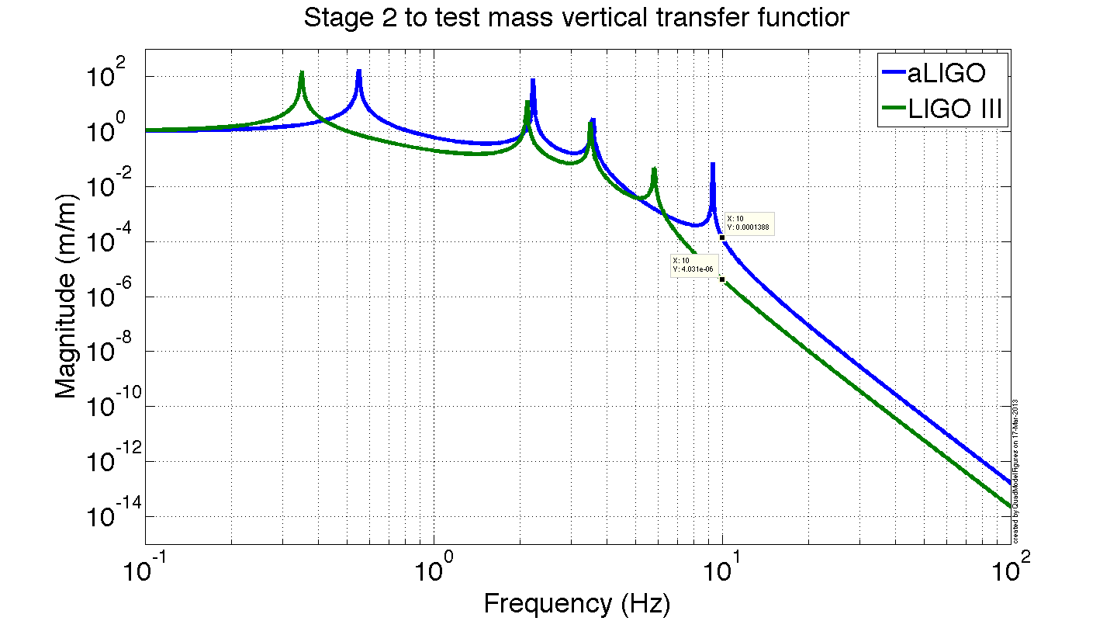
aLIGO vs LIGO III Quad TF

Slide 26
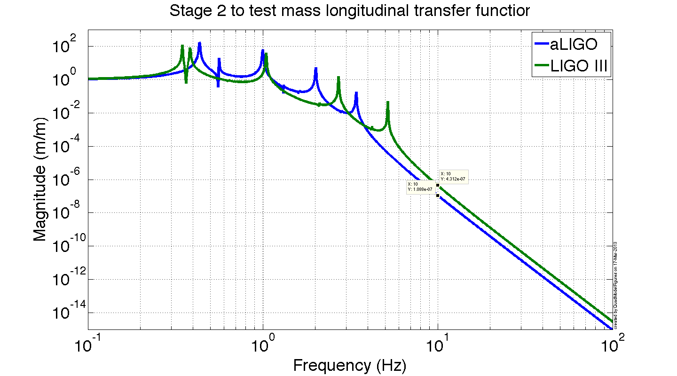
aLIGO vs LIGO III Quad TF

Slide 27
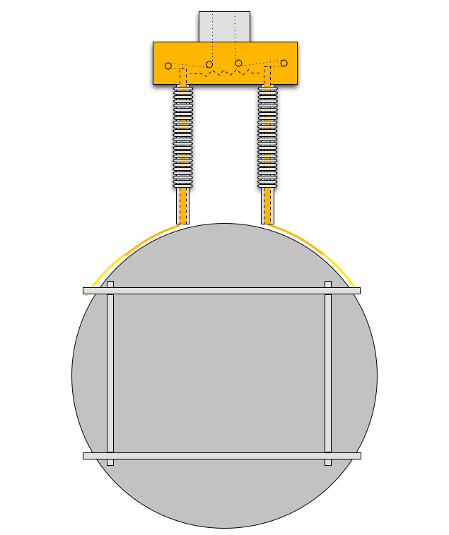
Cable roller bearing
Cold link manipulating cables
Pivoting copper rod
Extension spring
Copper strips
Flexible cold links
Insulating Kapton strips
Test mass support frame
Silicon ‘test mass’ prototype

Slide 28
Questions to Answer – G1200803
How do we get the cold to the test mass?
Long, flexible heat links running down the ISI and the suspension will have low thermal conductivity and may compromise isolation performance
Might bring N2 into BSC with vacuum proof hoses, but these will be even stiffer than heat links.
Heat pipes have excellent thermal conductivity, but are even stiffer still.
Radiative cooling bypasses at least some of the heat link issues, but can introduce scattering, parasitic modes, electrostatic coupling.
How much temp regulation and tolerance?
How to measure temp?
Measure acoustic modes – modulus of elasticity is temperature dependent
Use IR camera
How do heat links compromise performance?
Lossiness
Seismic isolation degradation
Thermal parameters of optical coatings
Lossiness of emissive coatings
Good emissivity estimates/measurements of Si?
Power absorption in Si (ppm, W, etc)?
Strength of Silicon fibers/ribbons?
What information are we missing?
Notes:
Alan says studying strength of Si. Minimum strength of 573 MPa

Slide 29
Reasons not to have open LN₂ in BSC
The mirror coatings may have a thermal shock issue
The nitrogen must be very clean before contacting the test mass.
Exposure to vacuum will cause liquid nitrogen to explode.

