Slide 1
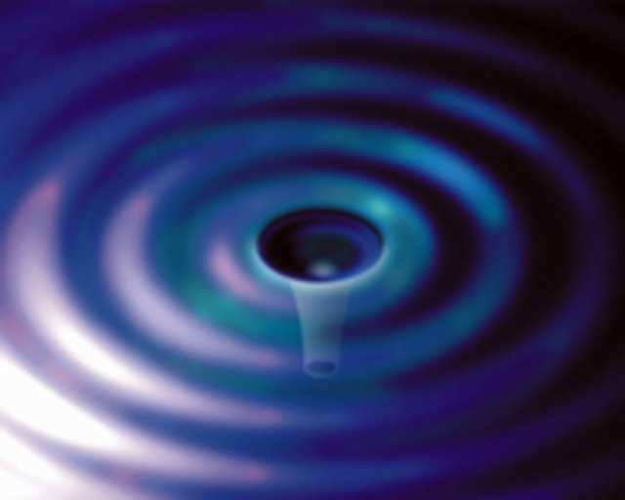
Mechanical Loss of TRA-DUCT 2902 Epoxy
Gregory Harry
American University
Jonathan Newport, Danika Balas, David Belyea,
Alexandra France, Steve Penn, Raymond Robie
LVC Meeting
Bethesda Maryland
March 18, 2013
LIGO-G1300207

Slide 2


Advanced LIGO Core Optics
Advanced LIGO test mass properties are expected to be major contributors to sensitivity across most frequency bands
High optical power is necessary for low quantum noise at mid and high frequencies
Thermal noise from mechanical loss in the test masses important at mid frequencies
Any changes to the test masses must be made carefully

Slide 3
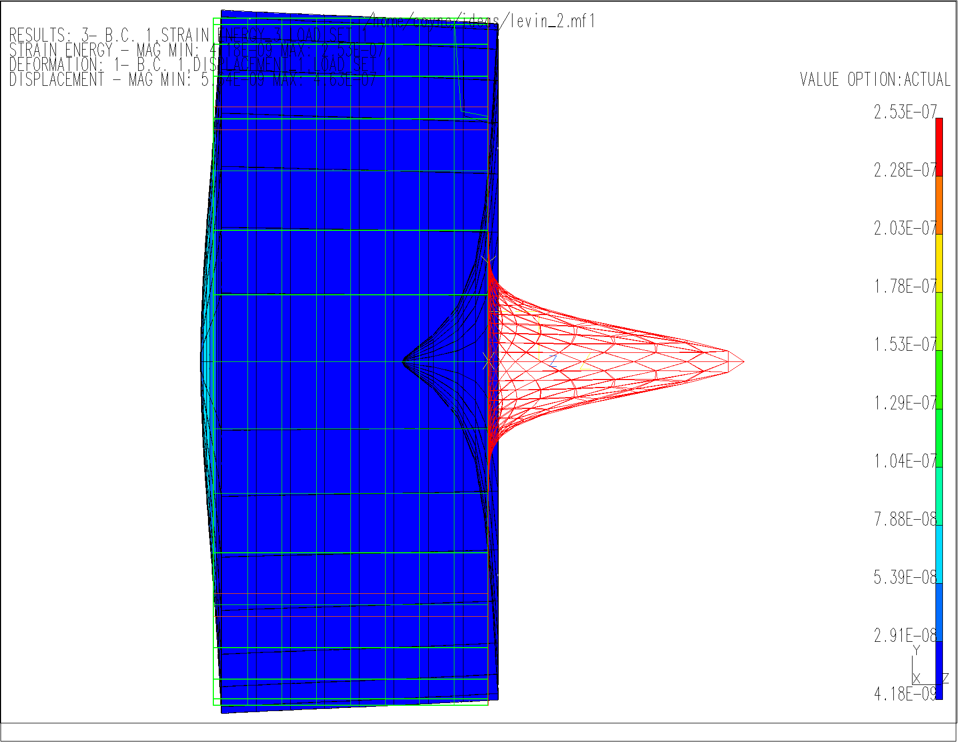
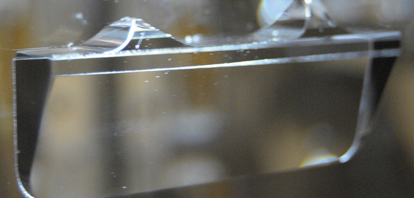
Test Mass Thermal Noise
Primary contributor to test mass thermal noise is mechanical loss in optical coatings
Large beam spot sizes reduce this thermal noise
  Employed in Advanced LIGO
  ETM 6.2 cm, ITM 5.5 cm
  Test mass radius 17 cm
Suspension must be connected to test masses
Silicate bonding used to reduce thermal noise
  Silicate bond still has high mechanical loss
  Keep area of bond small
  Bonding region far from readout beam location

Slide 4
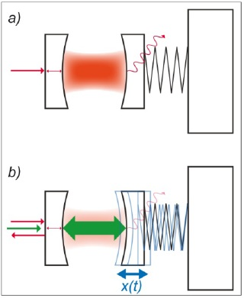
Parametric Instability
Exchange of energy between optical cavity modes and acoustic test mass modes
Radiation pressure from stored light can ring up acoustic modes to high amplitudes
High modal amplitudes can cause lock loss
Mitigation not part of Advanced LIGO project but considered for post-project upgrade
  See T1300176

Slide 5
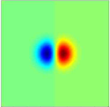
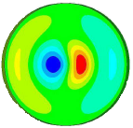
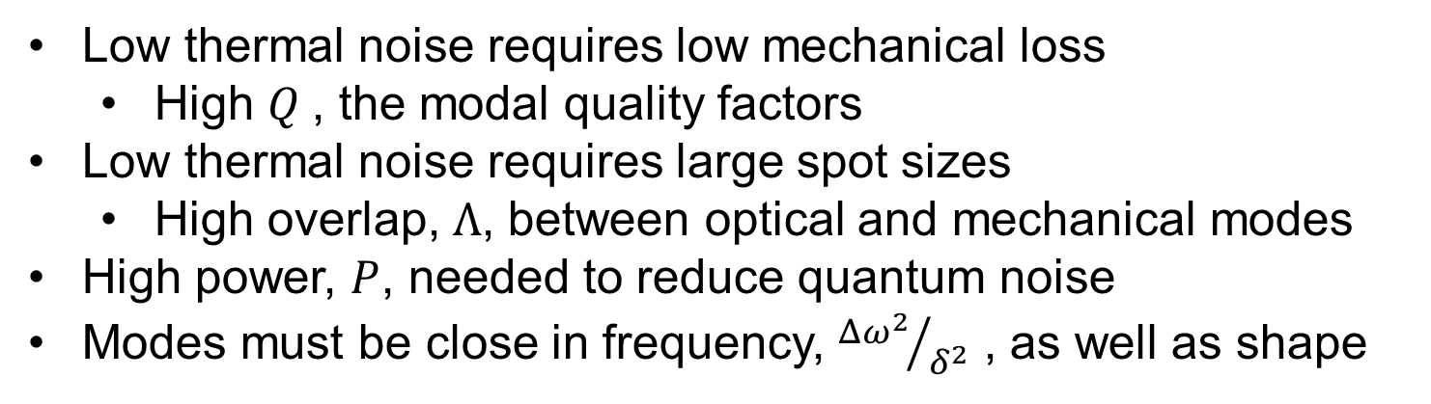
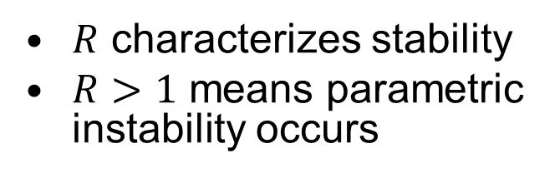
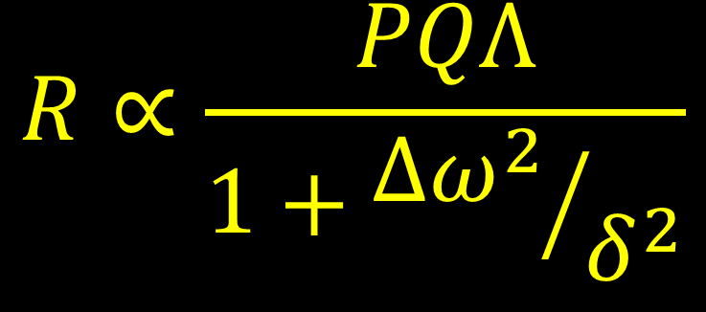
Instability Criteria
$$R∝\frac{PQΛ}{1+{Δω^{2}}/{δ^{2}}}$$
Optical
Mechanical
$R$ characterizes stability
$R>1$ means parametric instability occurs
Low thermal noise requires low mechanical loss
  High $Q$, the modal quality factors
Low thermal noise requires large spot sizes
  High overlap, $Λ$, between optical and mechanical modes
High power, $P$, needed to reduce quantum noise
Modes must be close in frequency, ${Δω^{2}}/{δ^{2}}$ , as well as shape

Slide 6
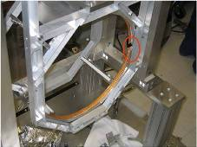
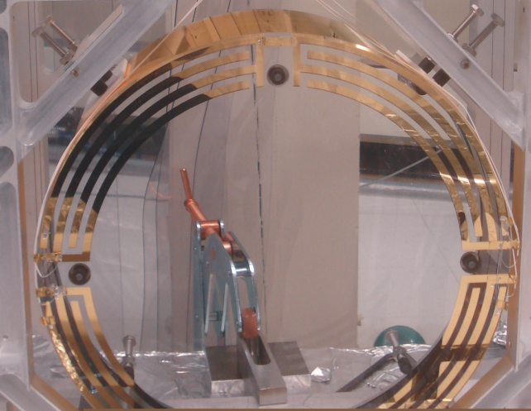
Mitigation of Parametric Instability
Mirror radius of curvature can be tuned using ring heaters
  Changes frequency of optical modes
  Ring heaters already in place
Electrostatic drive can be used to actuate on mechanical modes
  Damp out modes as they excite
  Electrostatic drive already in place
Attach mechanical mode dampers to test masses
  Reduce mechanical Q’s
  Dampers would need to be installed
T1300176 prioritizes these for post project upgrades as
  1- ring heater, 2- electrostatic drive, 3- dampers

Slide 7
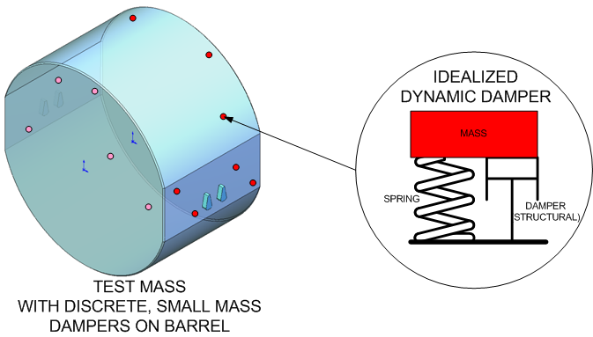
Mechanical Mode Damping
Dampers at specific frequencies attached at small number of places on test mass
Small number of dampers can lower Q on most problematic modes

Slide 8
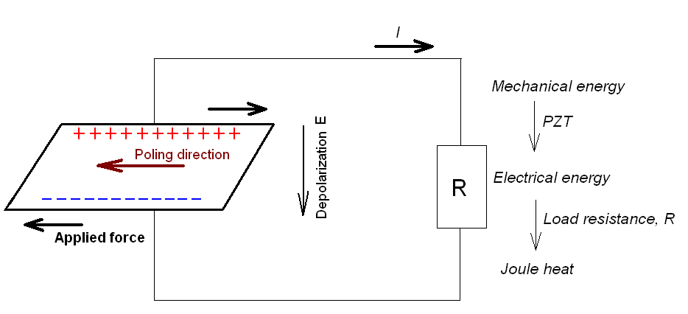
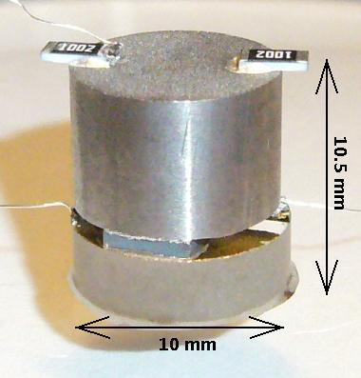
Mechanical Mode Damper Design
Reaction mass attached to piezoelectric crystals (PZTs)
  Resonant frequency tuned to test mass mode frequency
PZTs connected to silica base
PZTs stressed in shear during resonant motion
PZTs generate voltage when stressed
Resistor shunted across PZT to dissipate energy into heat
Epoxy used to connect PZT to base and reaction mass as well as base to test mass
  Silicate bonding not practical in a retrofit

Slide 9
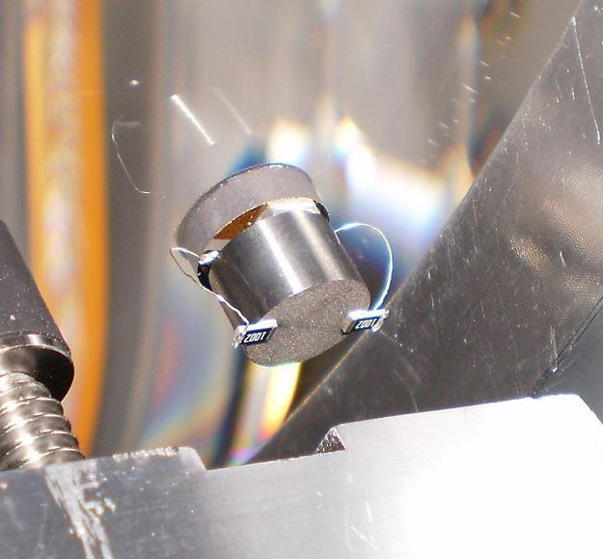
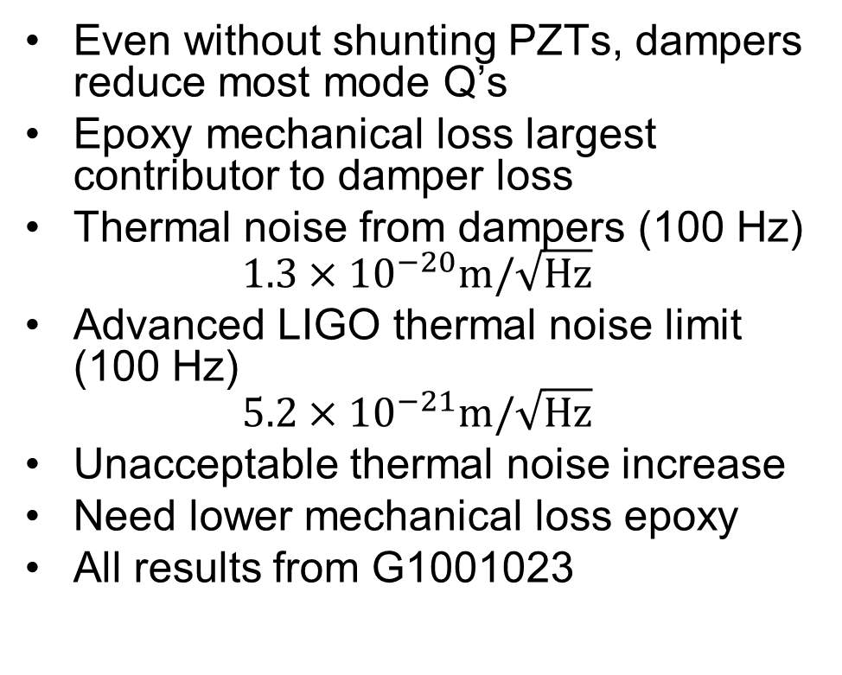
LASTI Results
Tests done at LASTI in 2010 by S. Gras and LASTI team
Two dampers connected to LASTI test mass
  Used EP30 epoxy
Even without shunting PZTs, dampers reduce most mode Q’s
Epoxy mechanical loss largest contributor to damper loss
Thermal noise from dampers (100 Hz)
$$1.3×10^{−20}m/\sqrt{\text{Hz}}$$
Advanced LIGO thermal noise limit (100 Hz)
$$5.2×10^{−21}m/\sqrt{\text{Hz}}$$
Unacceptable thermal noise increase
Need lower mechanical loss epoxy
All results from G1001023

Slide 10
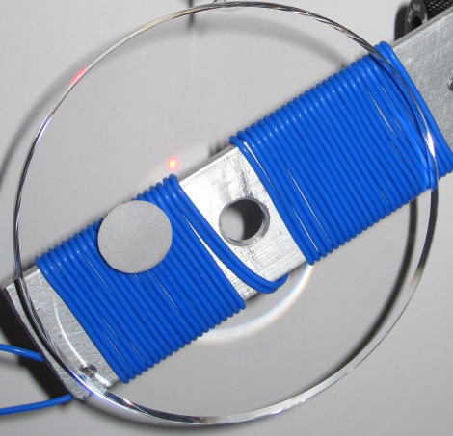
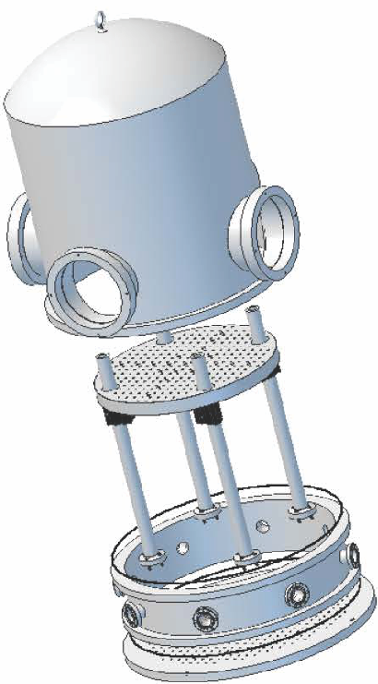
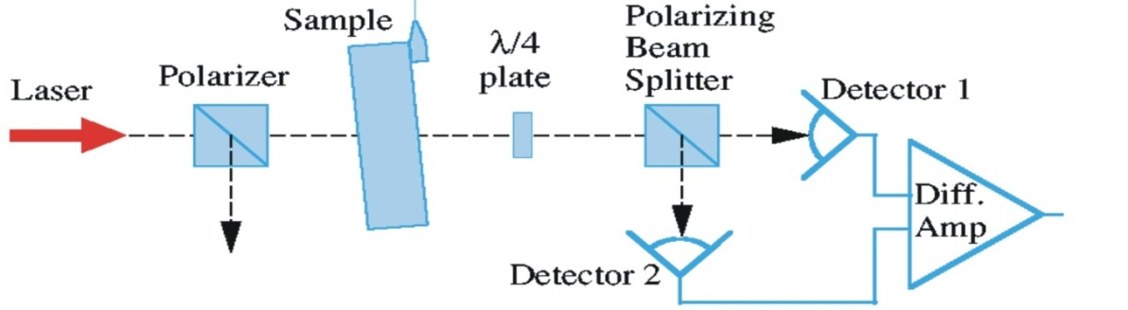
Epoxy Q Measurements
American University Q measuring apparatus
  Study epoxy mechanical loss
Silica sample with epoxy spot
Vacuum chamber to reduce air interaction
Capacitive comb excites modes of silica samples with epoxy
Birefringence readout sensitive to stress in samples
Measurements summer of 2012 limited by environmental coupling
  New, larger bell jar and support table installed fall 2012

Slide 11
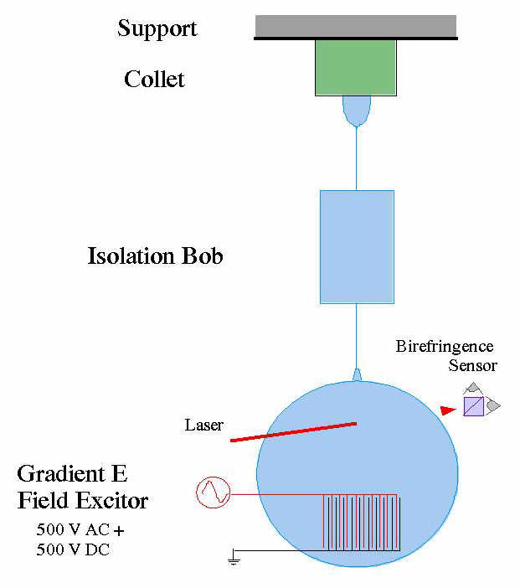
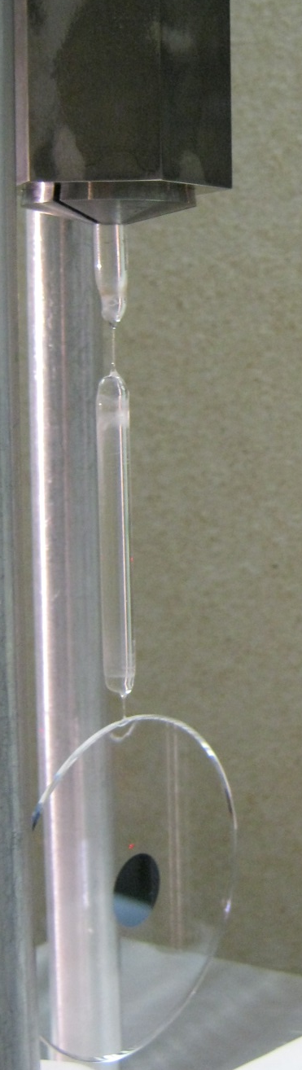
Sample Suspension
Monolithic silica suspension used to reduce mechanical loss
Intermediate bob between collet and sample reduce coupling to environment
Silica fibers between clamped bob and intermediate bob and sample
Fiber welded to silica sample mechanical loss
Hydrogen torch used to draw fibers and weld sample

Slide 12

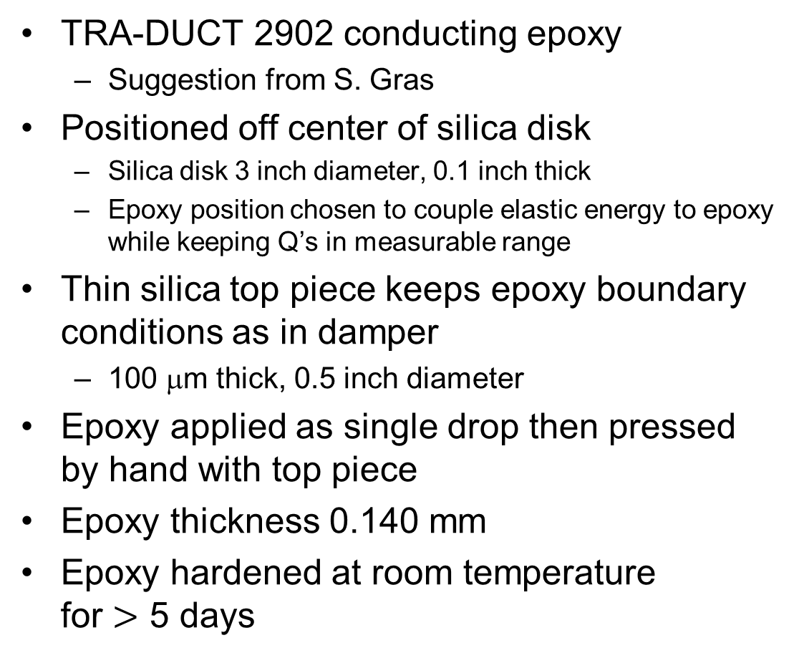
Epoxy Sample
TRA-DUCT 2902 conducting epoxy
  Suggestion from S. Gras
Positioned off center of silica disk
  Silica disk 3 inch diameter, 0.1 inch thick
  Epoxy position chosen to couple elastic energy to epoxy while keeping Q’s in measurable range
Thin silica top piece keeps epoxy boundary conditions as in damper
  100 μm thick, 0.5 inch diameter
Epoxy applied as single drop then pressed by hand with top piece
Epoxy thickness 0.140 mm
Epoxy hardened at room temperature for $>$ 5 days

Slide 13
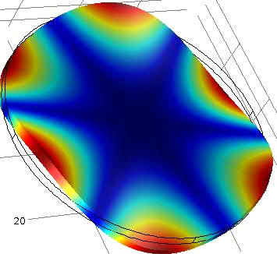
Finite Element Model
Finite element models of oscillations calculated to determine energy in epoxy
First 94 modes calculated
Epoxy properties from manufacturers data sheet
  Young’s modulus 260 MPa
  Density 3193 kg/m³
  Poisson ratio 0.4
Mode | FEA (Hz) | Exp. (Hz)
n=0, l=1 | 2682 | 2707.5
 | 2683 | 2981.5
n=1, l=0 | 4065 | 4137.5
n=0, l=3 | 6131 | 6157.6
 | 6133 | 6312.8
n=1, l=1 | 9384 | 9457.8
Shear | 36794 | 37071.2
 | 36818 | 37155.1
Shear and bulk elastic energy in epoxy calculated for each mode
>80% of energy in shear for all modes
  >98% in shear for all measured modes
Frequency predictions compared to experimental results
  Degenerate mode splitting not predicted
  Poor agreement not understood

Slide 14
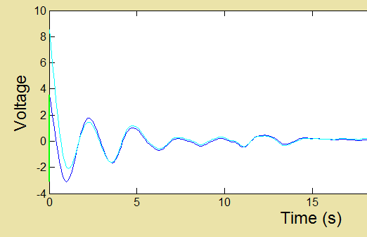
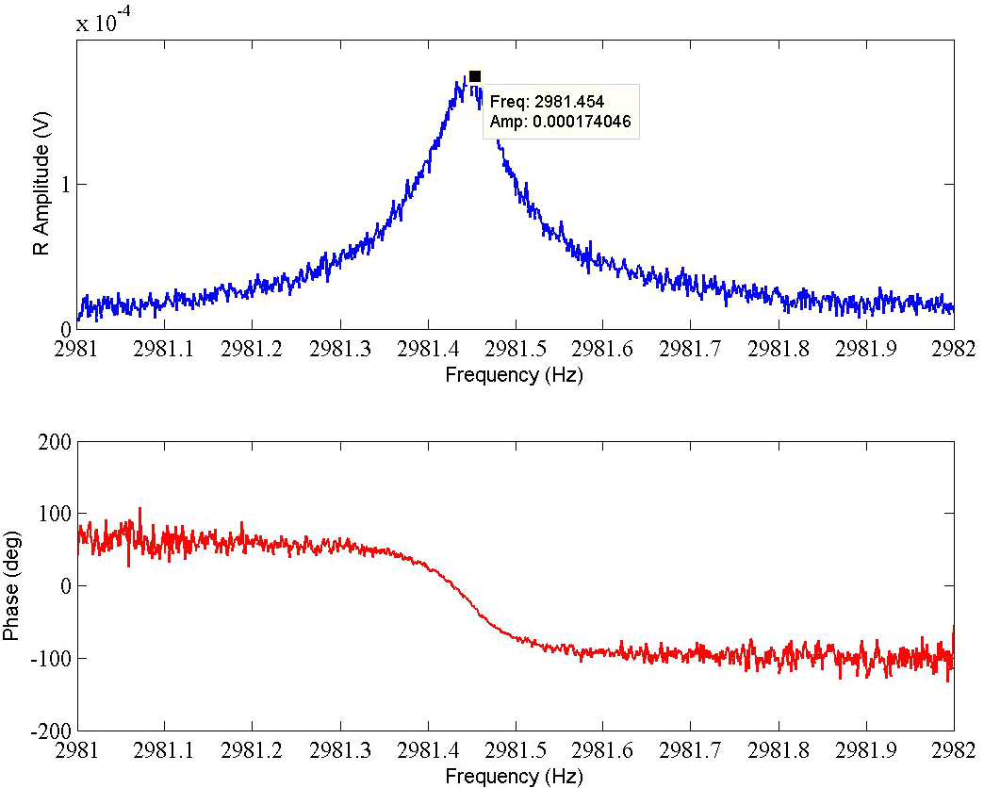
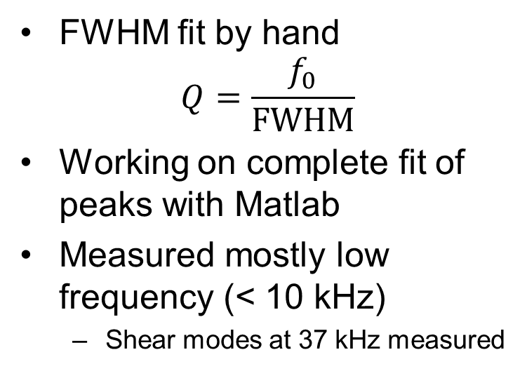
Q Measurements
Typical ringdown times ~ 2 second
  Too short for good fits
Frequency domain data collected from driving near modal frequencies
FWHM fit by hand
$$Q=\frac{f_{0}}{FWHM}$$
Working on complete fit of peaks with Matlab
Measured mostly low frequency (< 10 kHz)
  Shear modes at 37 kHz measured

Slide 15
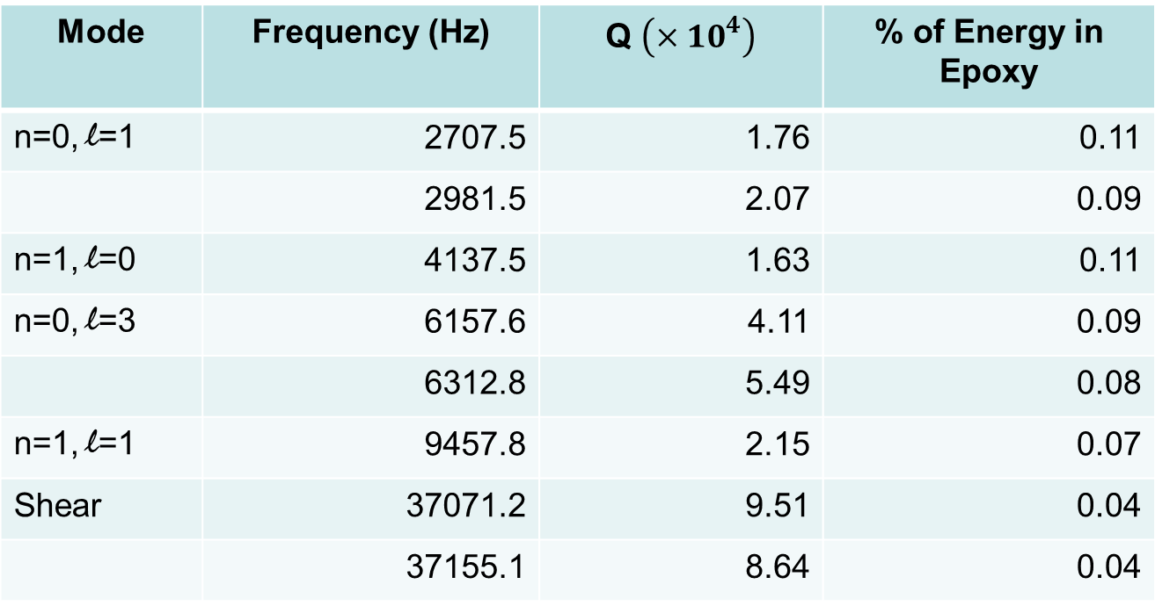
Q Results
Mode | Frequency (Hz) | Q $\left(×10^{4}\right)$ | % of Energy in Epoxy
n=0, l=1 | 2707.5 | 1.76 | 0.11
 | 2981.5 | 2.07 | 0.09
n=1, l=0 | 4137.5 | 1.63 | 0.11
n=0, l=3 | 6157.6 | 4.11 | 0.09
 | 6312.8 | 5.49 | 0.08
n=1, l=1 | 9457.8 | 2.15 | 0.07
Shear | 37071.2 | 9.51 | 0.04
 | 37155.1 | 8.64 | 0.04
Q of bare silica measured > 10 million
Not used in fitting for epoxy mechanical loss

Slide 16

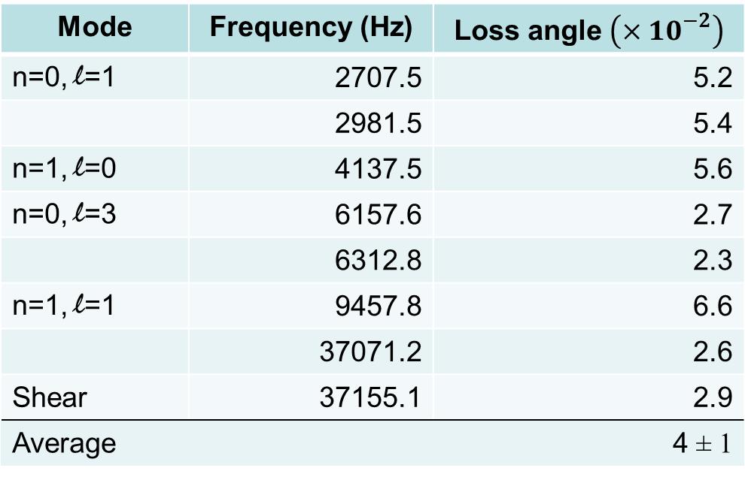
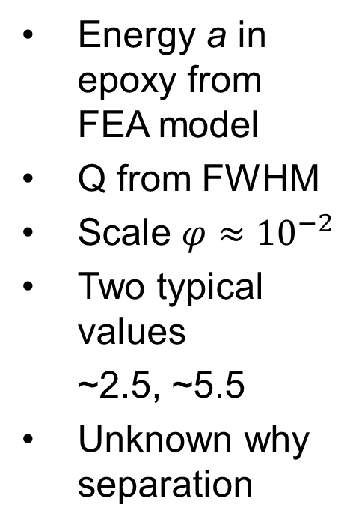
Loss Angle Calculation
$$φ_{epoxy}=\frac{1}{a Q}$$
Energy a in epoxy from FEA model
Q from FWHM
Scale $φ≈10^{−2}$
Two typical values
  ~2.5, ~5.5
Unknown why separation
Mode | Frequency (Hz) | Loss angle $\left(×10^{−2}\right)$
n=0, l=1 | 2707.5 | 5.2
 | 2981.5 | 5.4
n=1, l=0 | 4137.5 | 5.6
n=0, l=3 | 6157.6 | 2.7
 | 6312.8 | 2.3
n=1, l=1 | 9457.8 | 6.6
 | 37071.2 | 2.6
Shear | 37155.1 | 2.9
Average |  | 4 ± 1

Slide 17
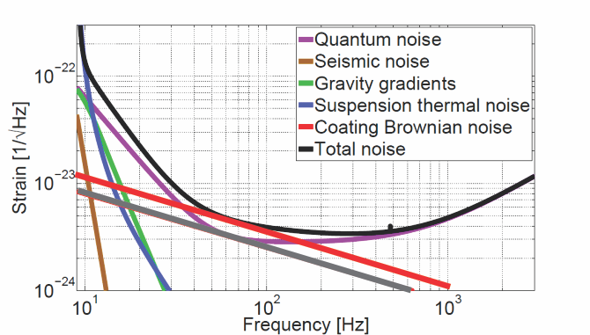
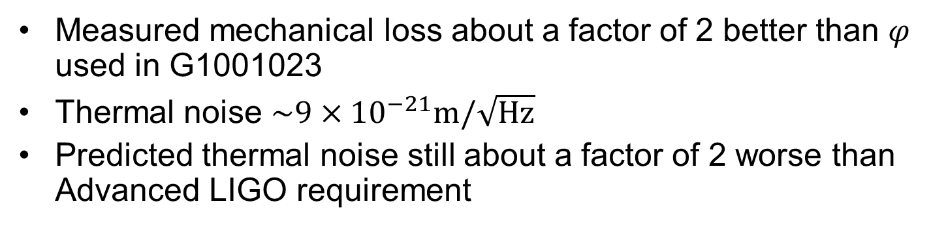
Thermal Noise Prediction
Measured mechanical loss about a factor of 2 better than $φ$ used in G1001023
Thermal noise $\sim 9×10^{−21}m/\sqrt{\text{Hz}}$
Predicted thermal noise still about a factor of 2 worse than Advanced LIGO requirement

Slide 18
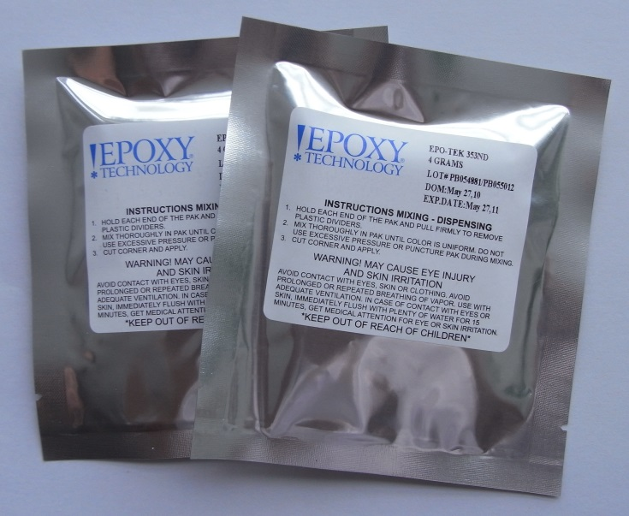
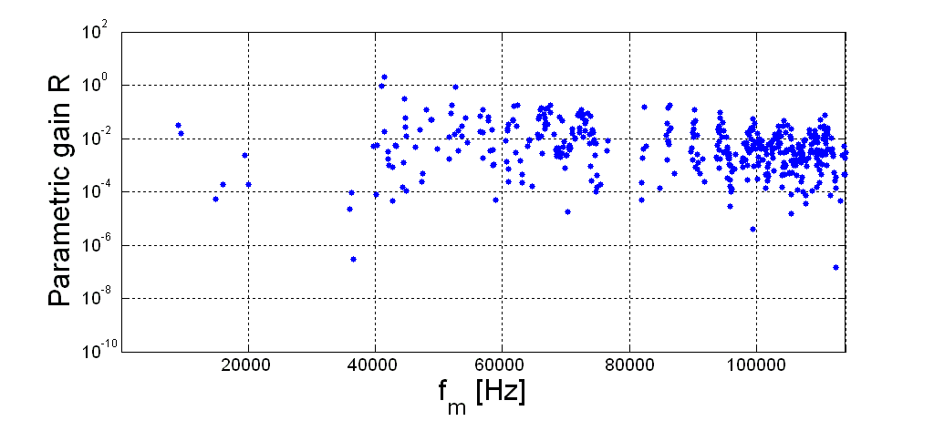
Future Plans
Epoxies
HYSOL TRA-BOND
  Used in LISA pathfinder
EPOTEK 353ND
  Glass transition, may be harder
MasterBond EP30-2
Natural Yacca gum from Australia
  Shown to have low mechanical loss
  Concerns about vacuum performance
unstable modes
Matlab fitting of complete peaks for Q’s
Higher frequency modes
Determine frequency dependence of loss
Bulk loss in addition to shear

Slide 19


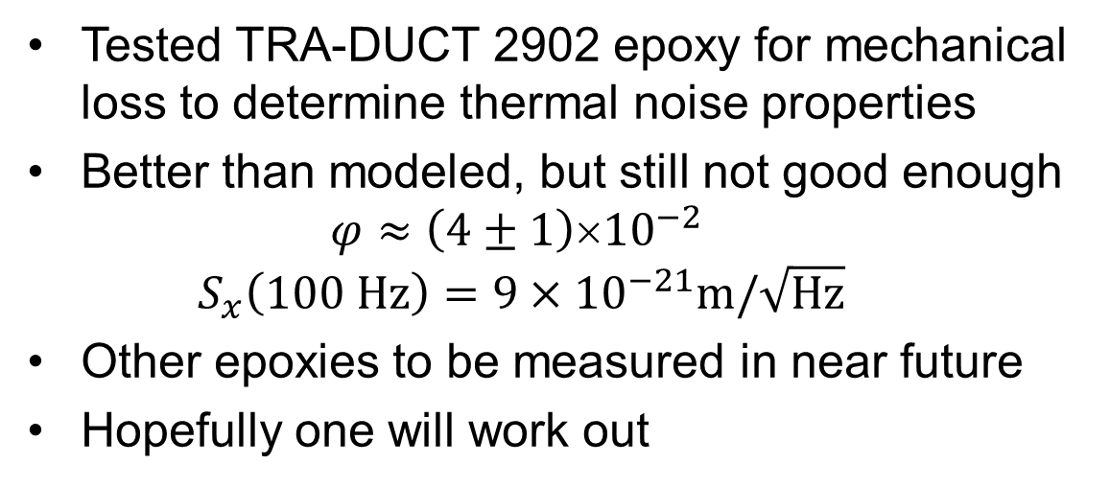
Conclusions
Parametric instability potentially problematic for Advanced LIGO
Mechanical mode dampers attached to test masses one possible solution
Epoxy to construct and attach dampers can increase thermal noise and reduce sensitivity
Optical
Mechanical
Tested TRA-DUCT 2902 epoxy for mechanical loss to determine thermal noise properties
Better than modeled, but still not good enough
  $$φ≈\left(4±1\right)×10^{−2}$$
  $${ S}_{x}\left(100 Hz\right)=9×10^{−21}m/\sqrt{\text{Hz}}$$
Other epoxies to be measured in near future
Hopefully one will work out

