Slide 1
Arm Length Stabilization at LHO
March 19, 2013
Daniel Sigg
LIGO Hanford Observatory

Slide 2
Setting it up
Linear operating region of detector very small
Each coupled degree-of-freedom makes it harder
Slow response due to long arm cavity storage time
Initial LIGO: Wait and catch
But: no or misleading information away from resonance
Critically depending on mirror velocity
Advanced LIGO: Arm length stabilization
Decouple arm cavities by locking from the end
Use a separate wavelength: doubled Nd:YAG at 532 nm
Recombined green light in the corner not depending on the recycling cavities

Slide 3
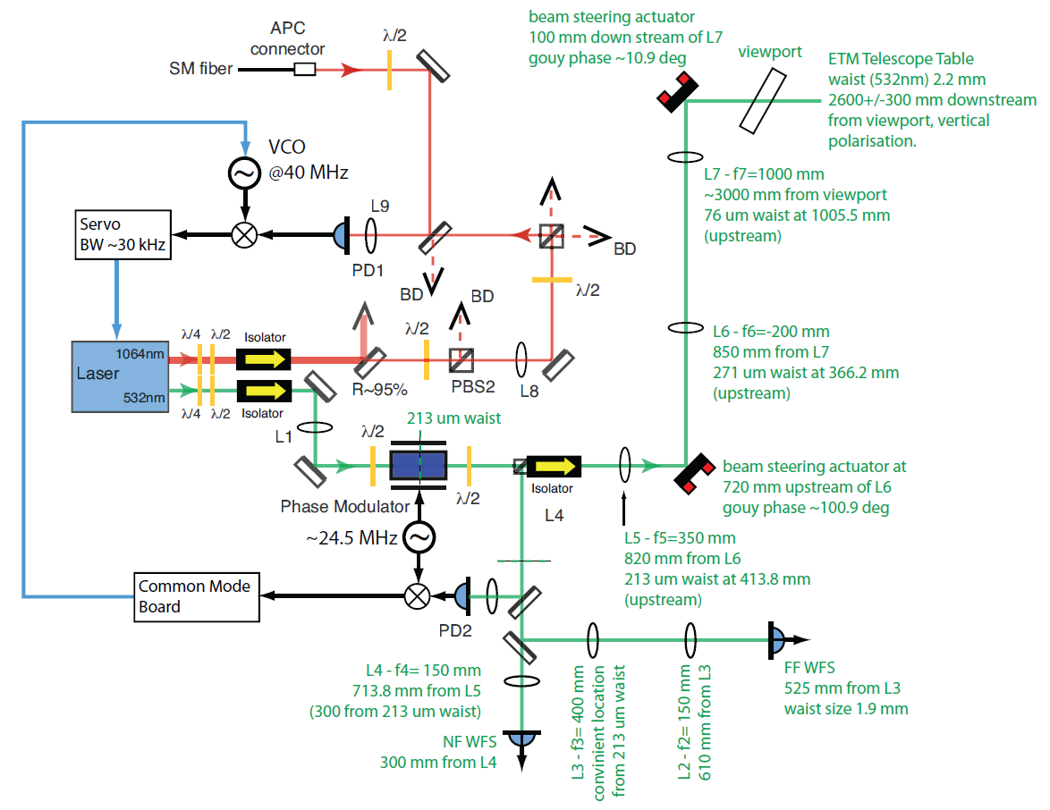

Slide 4
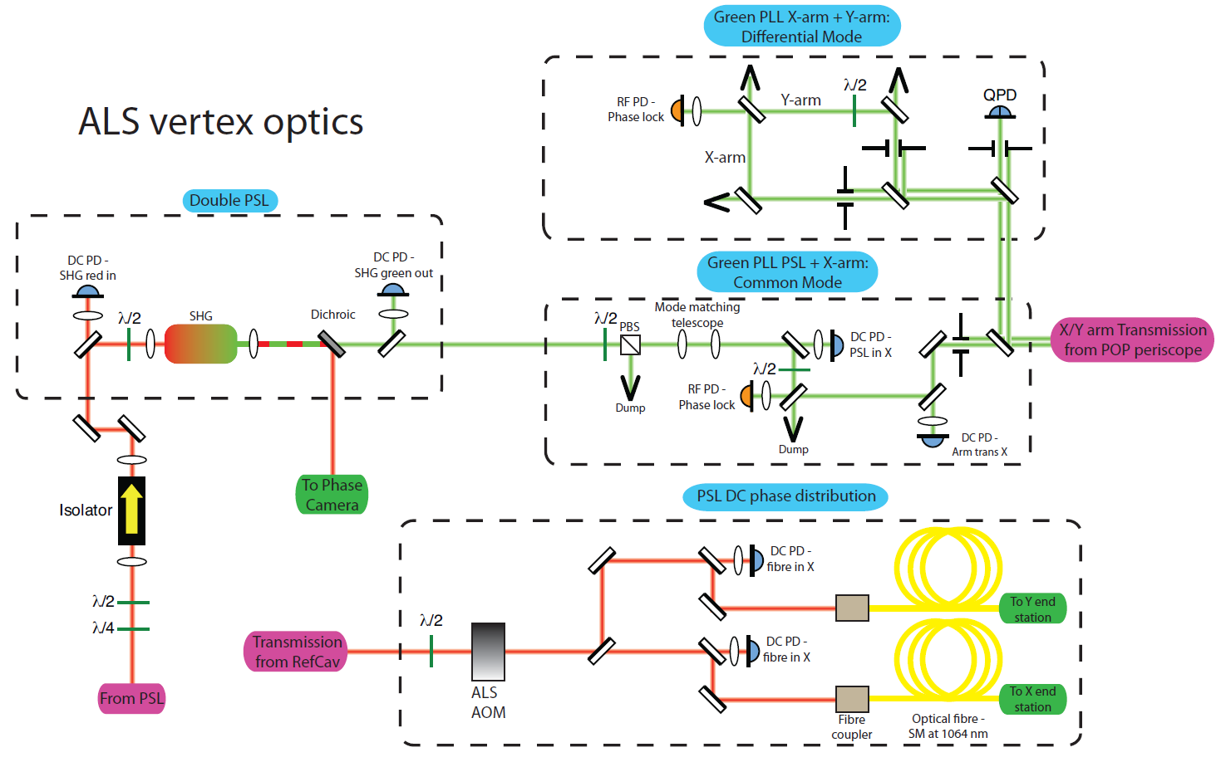

Slide 5
ALS Integration Plans at LHO
OAT (One arm test)
Subsystem readiness, in particular BSC SEI and SUS
Early experience with a long cavity
Basic functionality validated
No information on noise (not surprisingly)
Successfully completed in Fall 2012
HIFO-Y (Half Interferometer Y-arm)
Learn about stability between red and green locking
Starts now
HIFO-X(Y) (Both arm cavities)
Learn about relative stability of arm cavities
Starts this summer

Slide 6
Recommendations from OAT
Wavefront sensing not required for green beams
But, need automatic input steering for green beam
Additional hardware was required to support automation
Fiber polarization correction
Some additional photodiodes
Measure the PLL beat note
Automation requires more attention

Slide 7
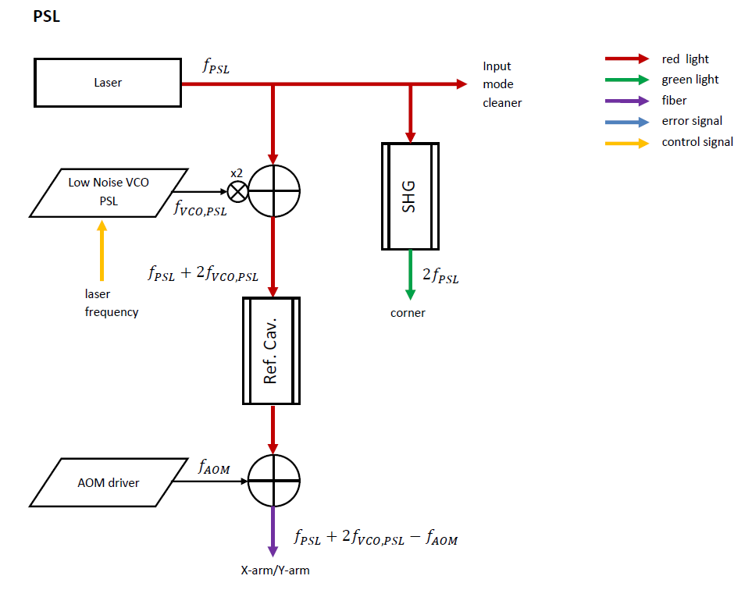
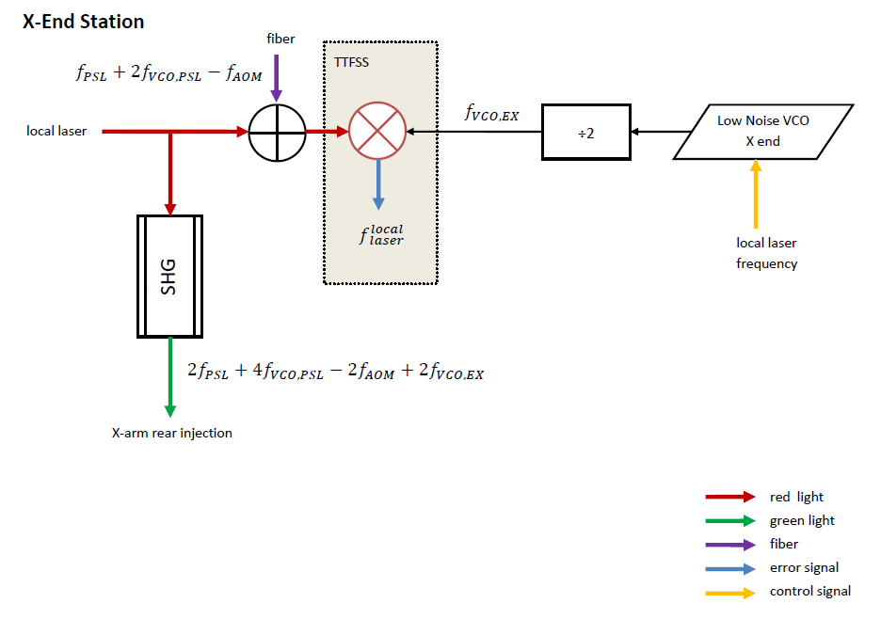
HIFO-Y Locking

Slide 8
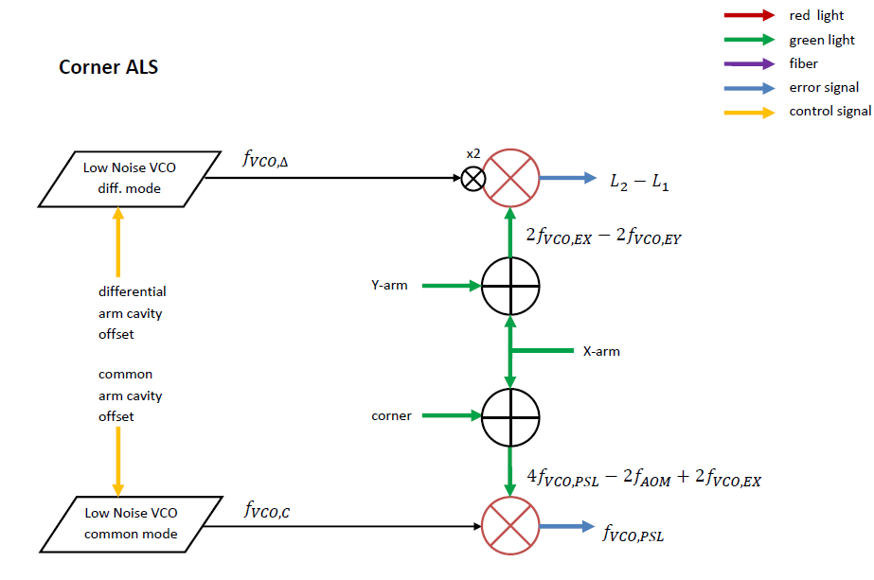
Corner ALS
HIFO-Y

Slide 9
Summary
One arm test has been successfully completed
HIFO-Y is underway
Establishing the basic functionality between different subsystems was straight forward with only small problems—a significant and refreshing improvement compared to the first steps of initial LIGO commissioning.

Slide 10
Documents
Design: T0900144
Part of Full Interferometer Integration
Plan: T1200437
OAT (One arm test)
Plan: T1100080
Result: L1200261
HIFO-Y (Half Interferometer Y-arm)
Plan: T1300174
Starts now
HIFO-X(Y) (Both arm cavities)
Starts this summer

Slide 11
