Slide 1


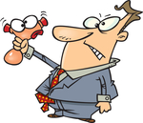
Detecting gravitational waves with Advanced LIGO: how, when, and what will come next
Lisa Barsotti
MIT-LIGO Laboratory
LIGO-G1300500-v1
University of Massachusetts Amherst - Apr 26, 2013

Slide 2

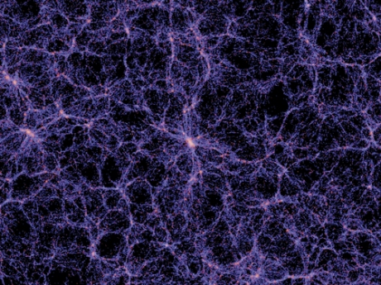
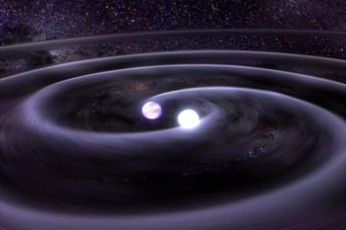
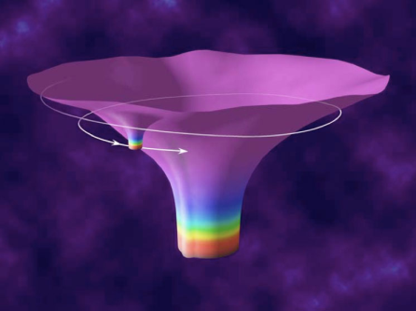

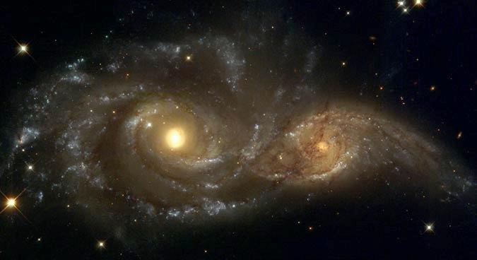

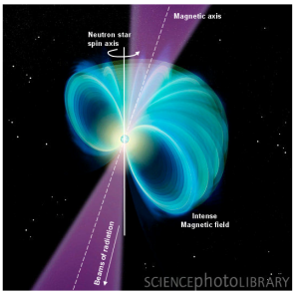
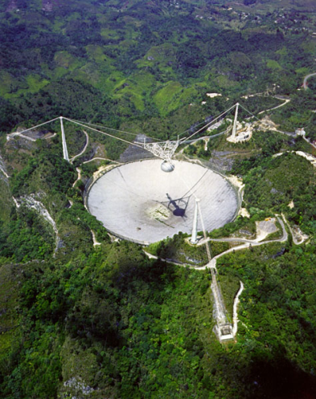

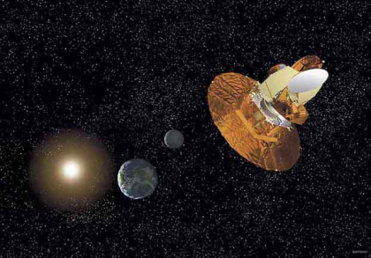
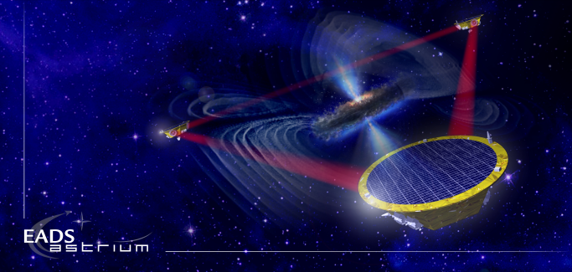
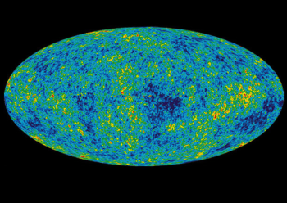
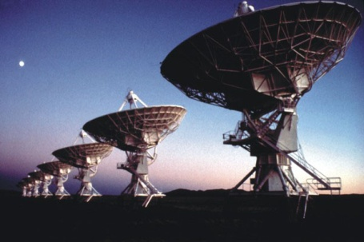
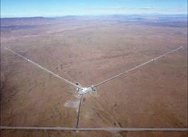
Gravitational Waves
BH and NS Binaries
Supernovae
Cosmic Strings
Relic radiation
Extreme Mass Ratio
Inspirals
Supermassive BH Binaries
Binaries coalescences
Spinning NS
10⁻¹⁶ Hz
10⁻⁹ Hz
10⁻⁴ Hz
10⁰ Hz
10³ Hz
Inflation Probe
Pulsar timing
Space detectors
Ground interferometers
?
Laser Interferometer
Gravitational Wave
Observatory

Slide 3
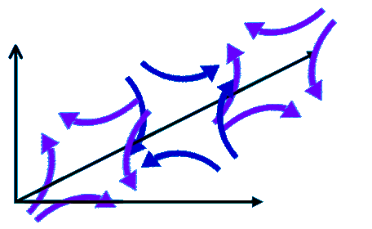
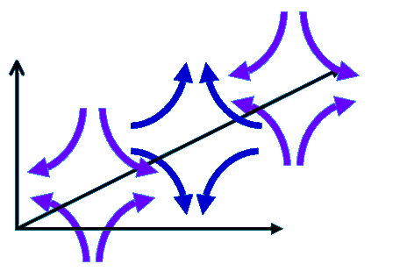
Gravitational Waves Detection: How
Astrophysical Sources
emitting gravitational waves
h is amplitude of gravitational waves, and it is expected to be SMALL
Gravitational waves: ripples in the space-time propagating at the speed of light
Difference in arm lengths
GW
Amplitude
LASER
Michelson Interferometer

Slide 4
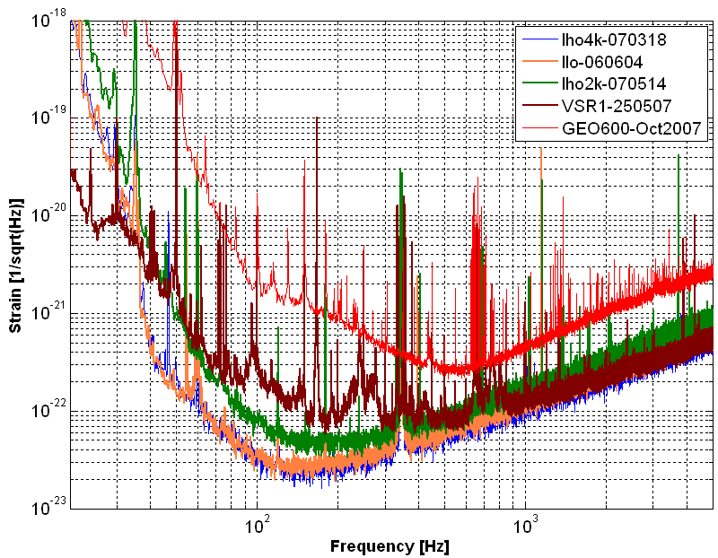
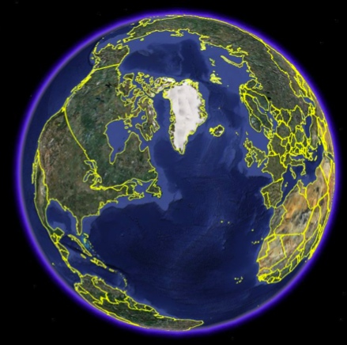
“First Generation” GW Detectors…
…NO DETECTION ☹
GEO
Need better detectors!
LIGO: L1
Virgo
LIGO: H1
LIGO: H2

Slide 5

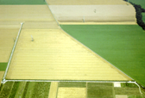


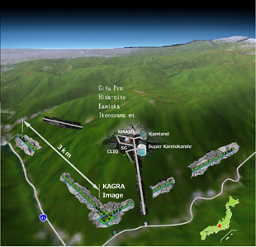
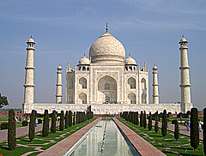
Global Network
The Upcoming Gravitational Wave Network
LIGO Hanford
GEO600
Virgo
KAGRA
LIGO
Livingston
LIGO
INDIA
5

Slide 6
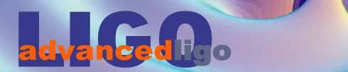
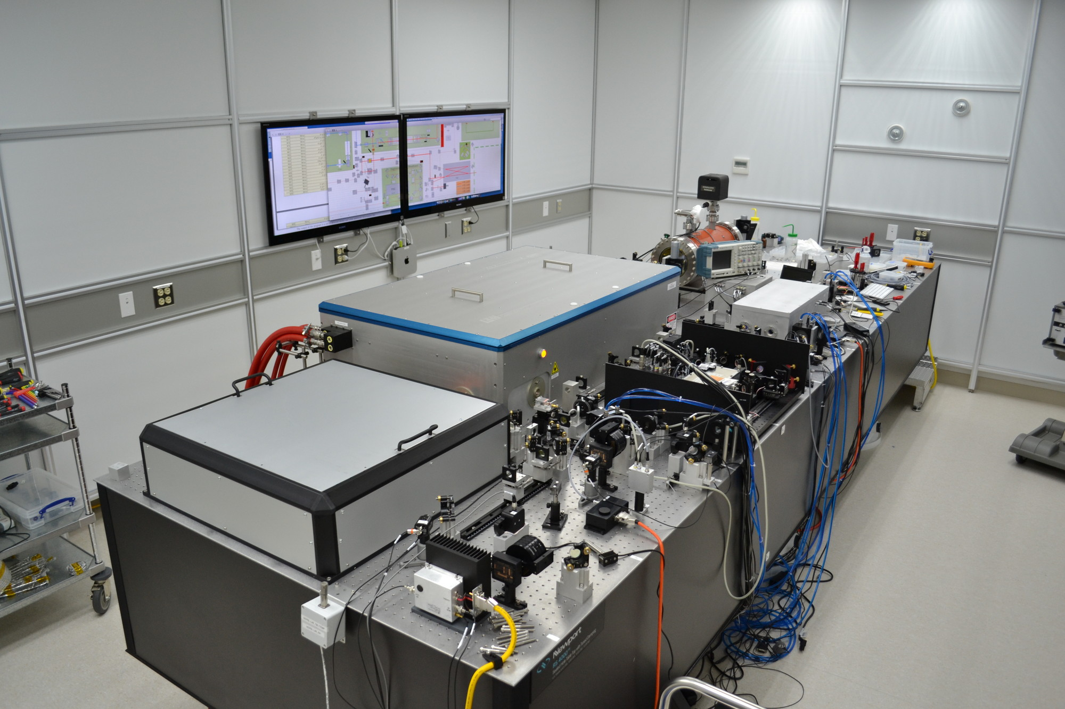
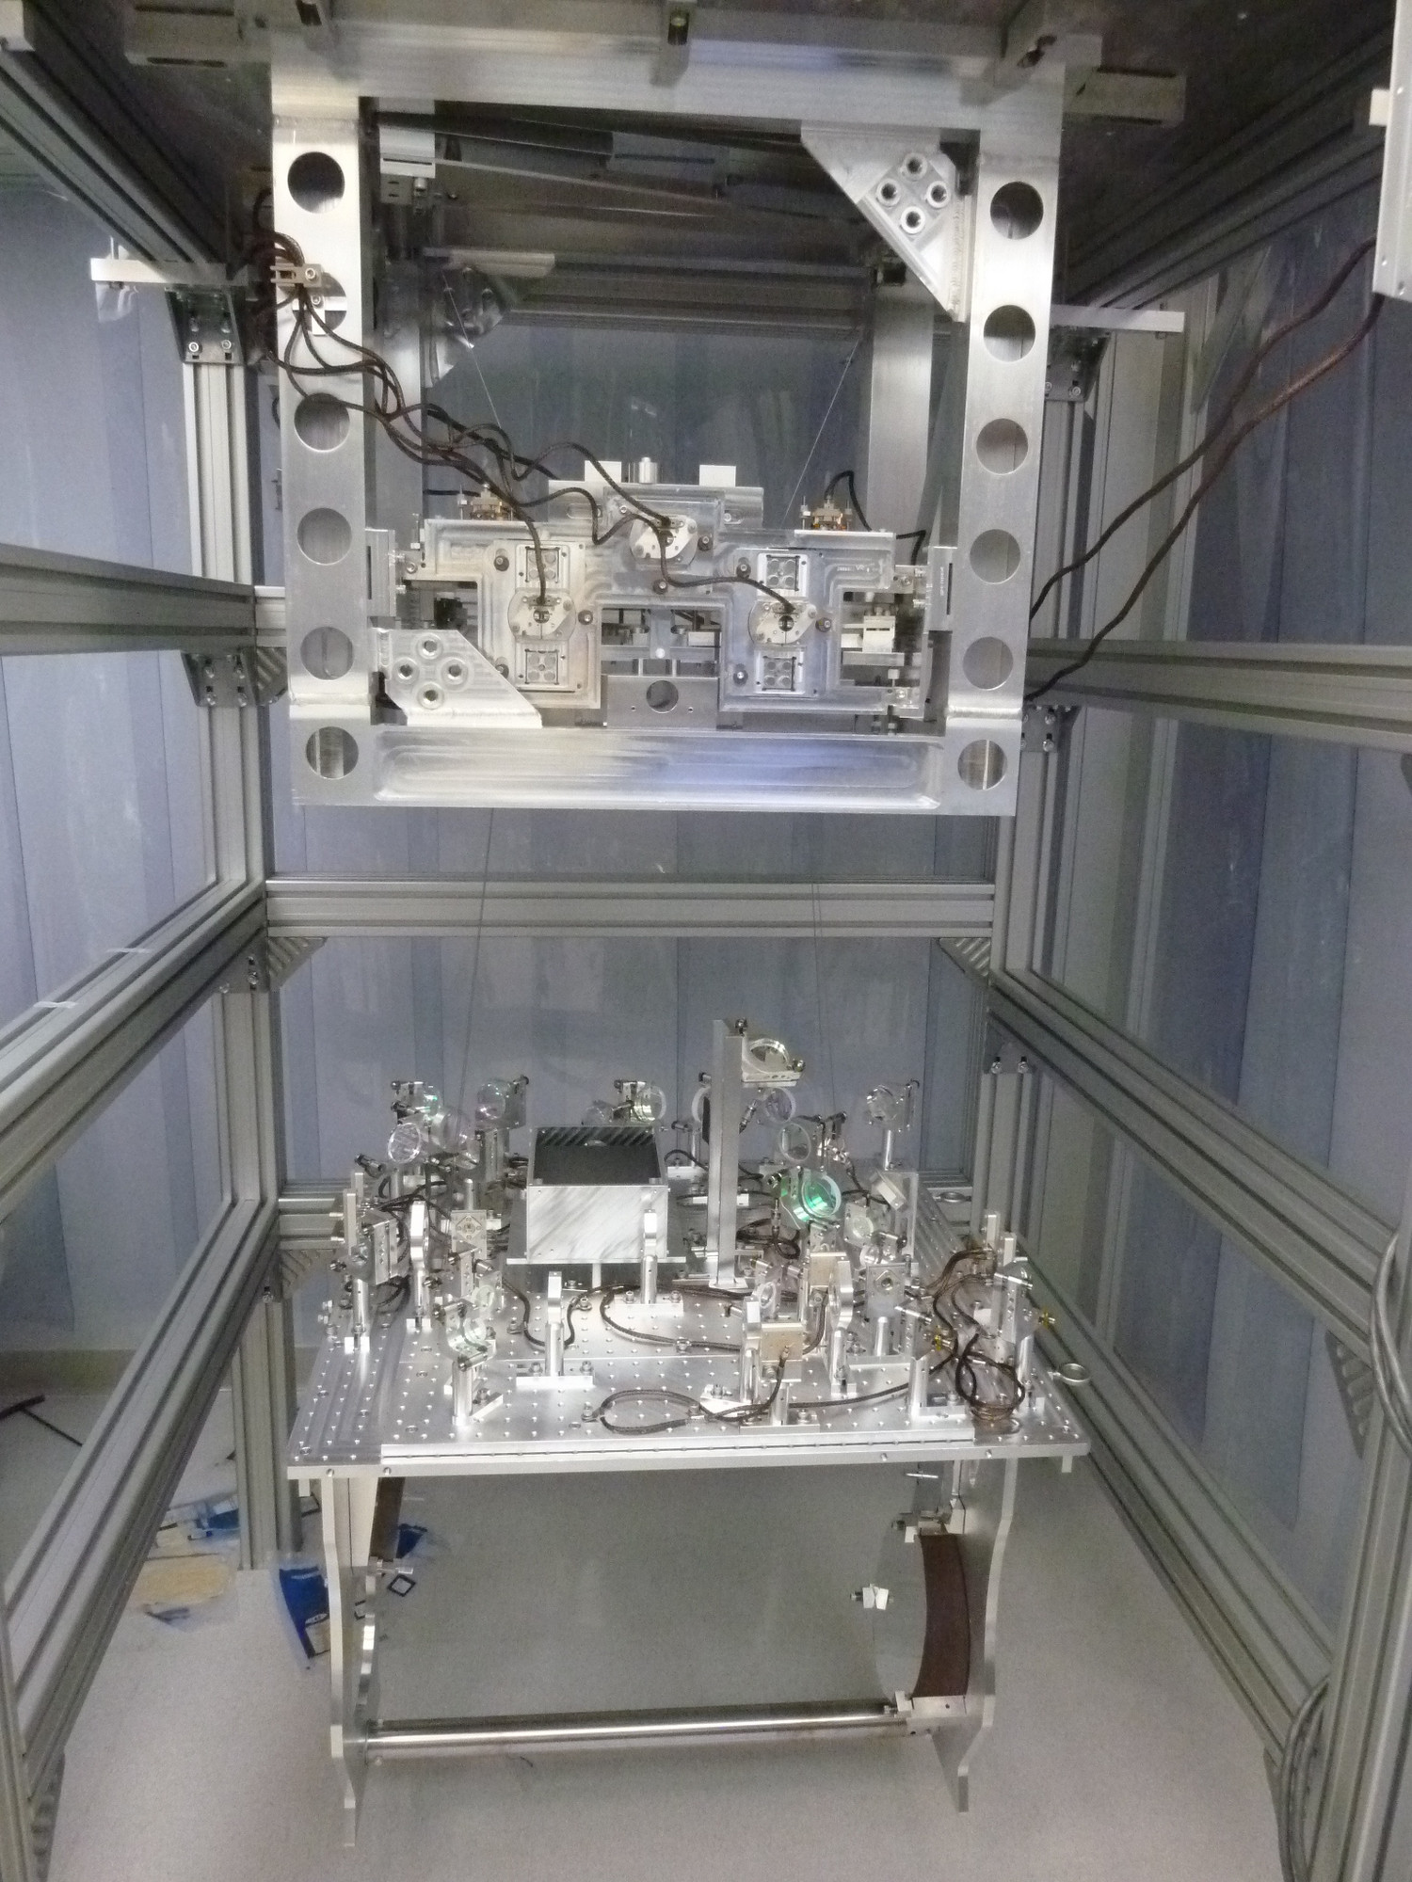
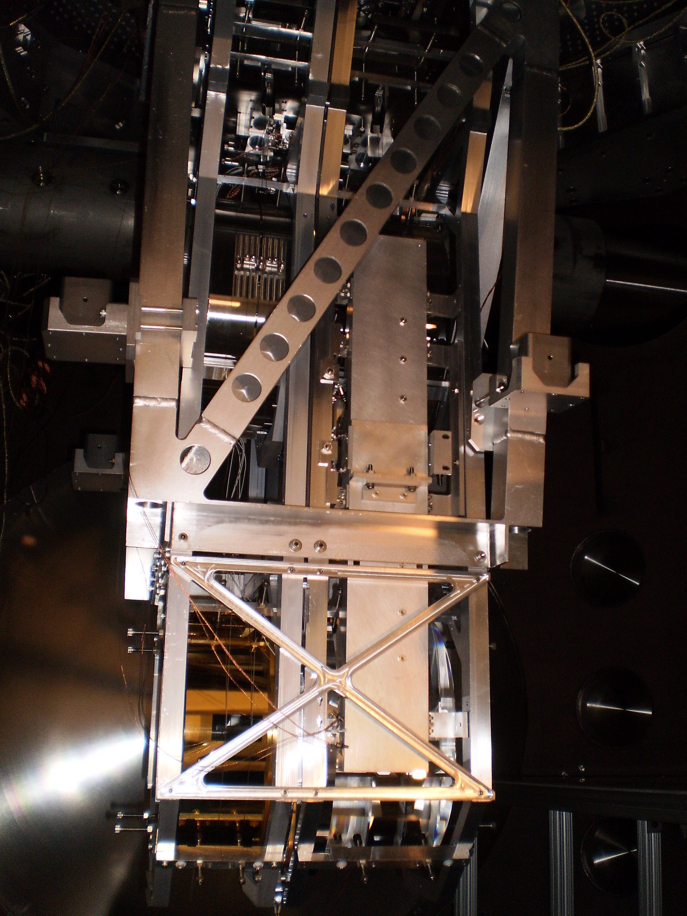

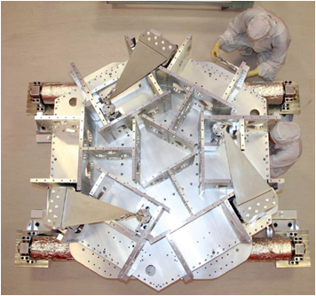
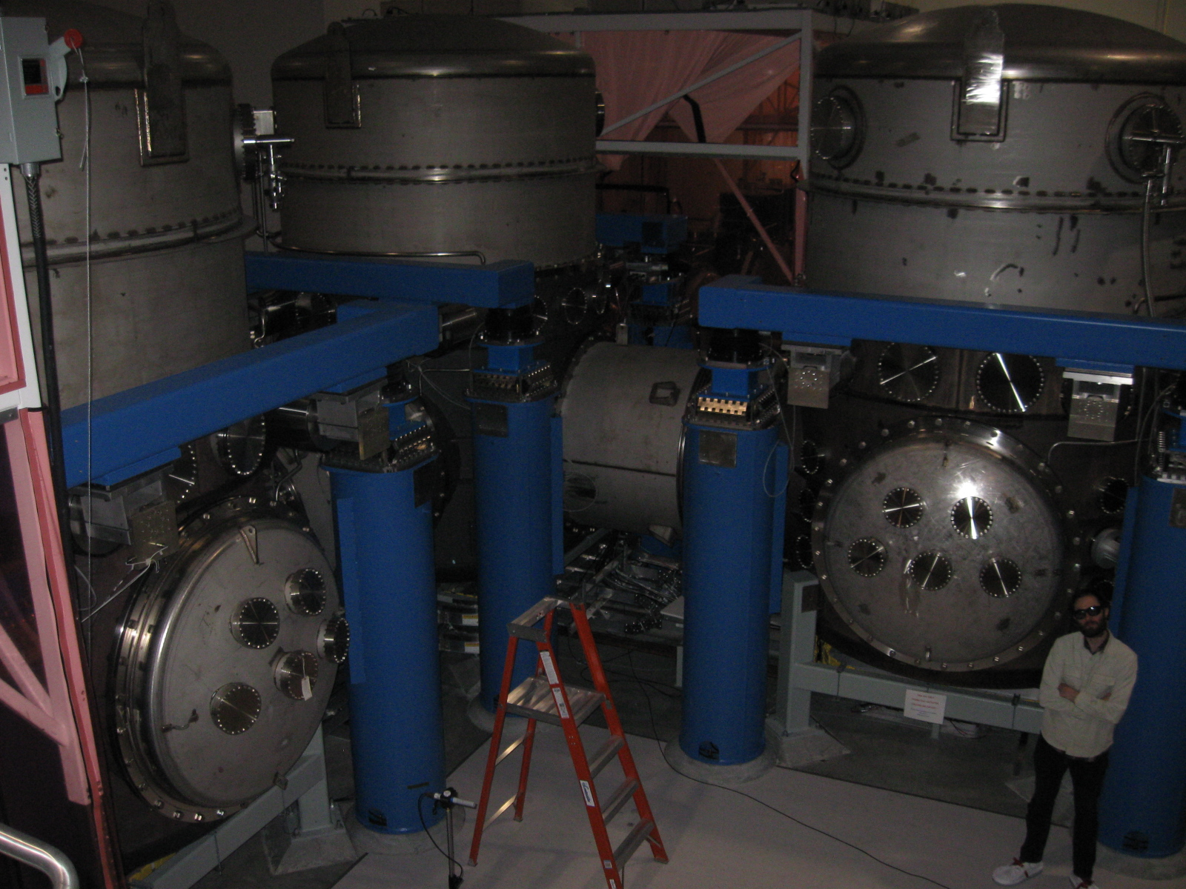
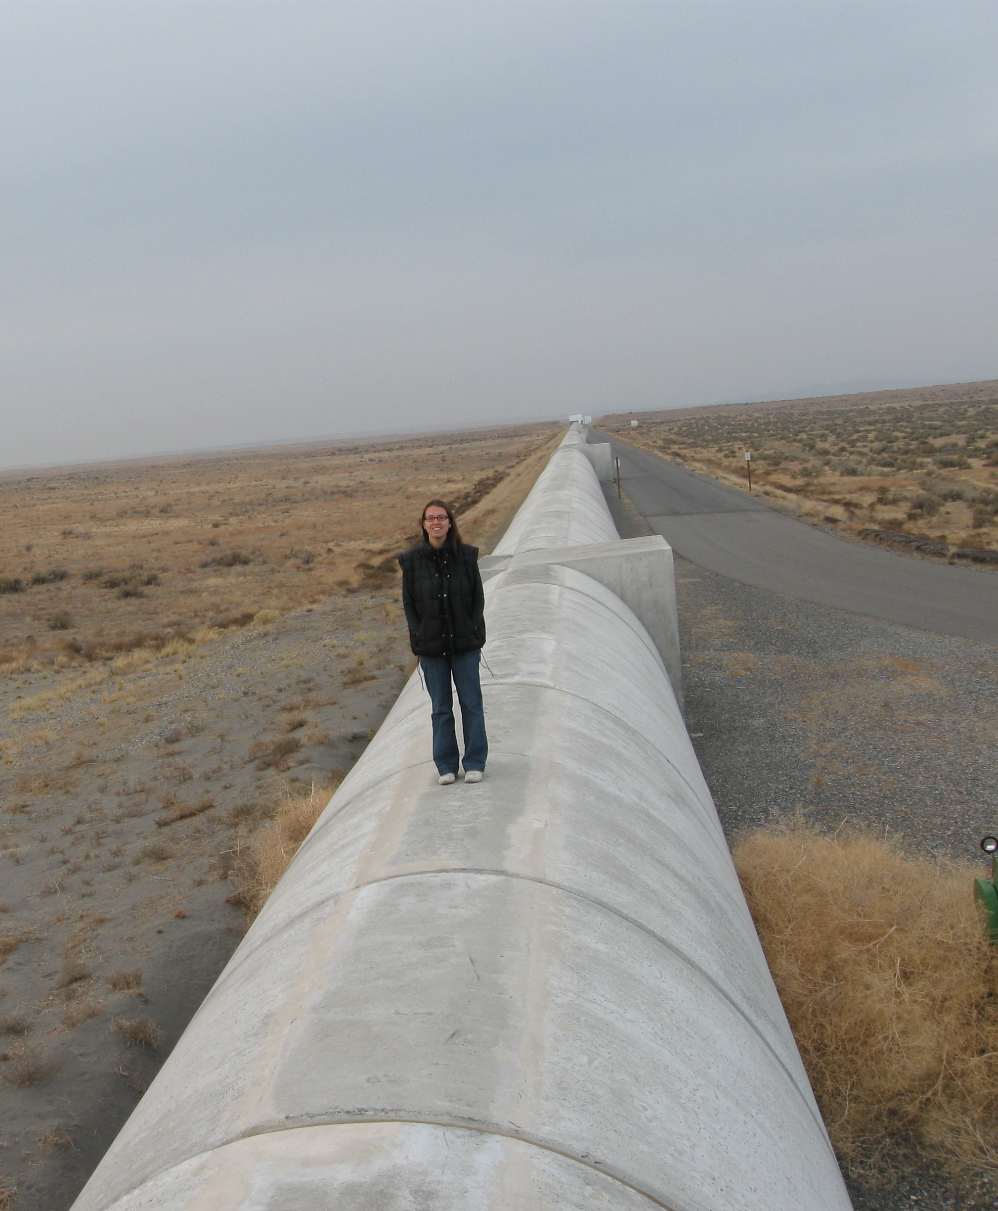
Advanced LIGO

Slide 7
Advanced LIGO Progress
One Arm Cavity Test
LHO
LLO
Input Mode Cleaner

Slide 8
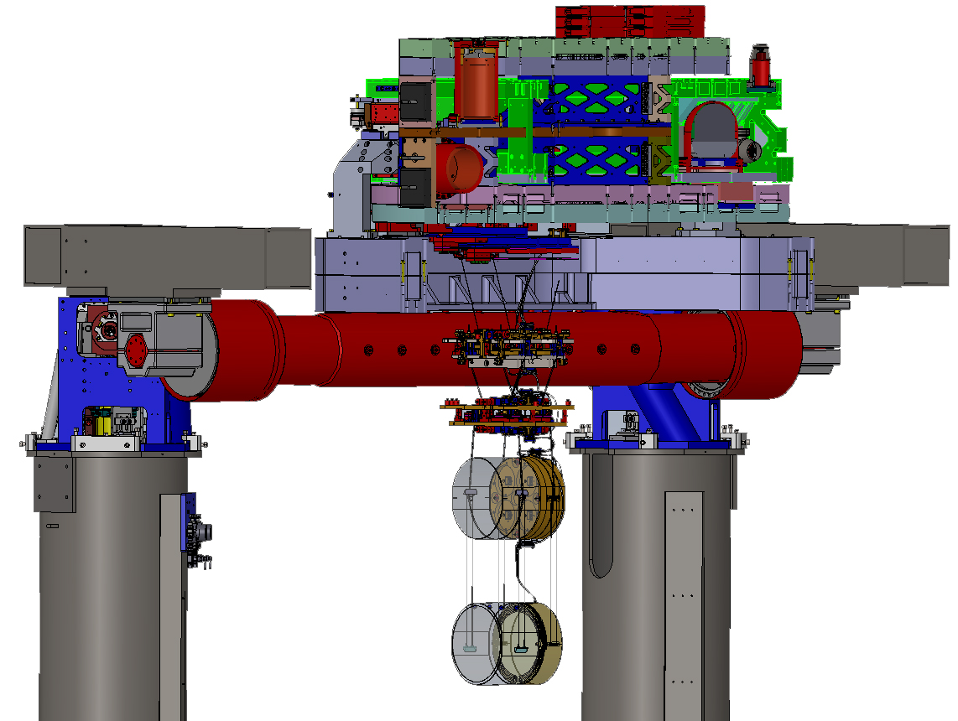
Highlights from Hanford:
Seismic noise transferred to the arm cavity suspensions
LHO
Seismic noise transferred to the suspensions
iLIGO
1000x
aLIGO so far
aLIGO target

Slide 9
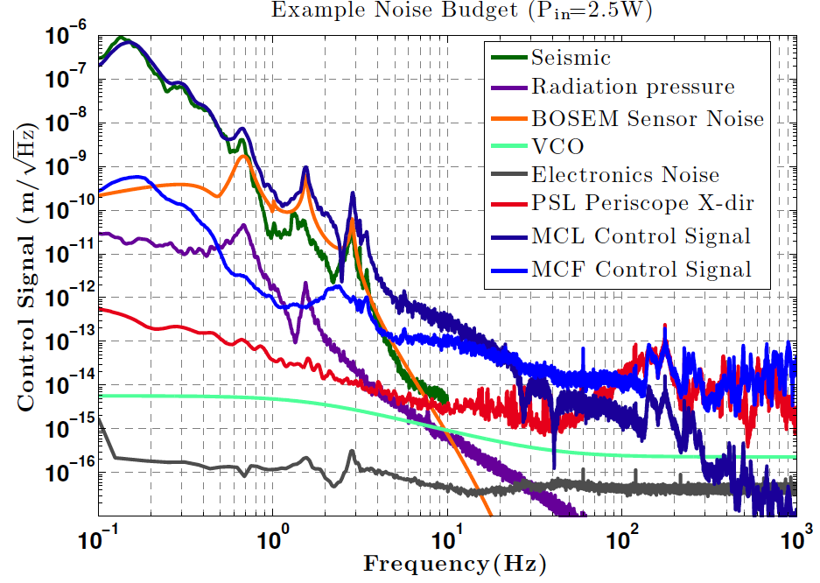
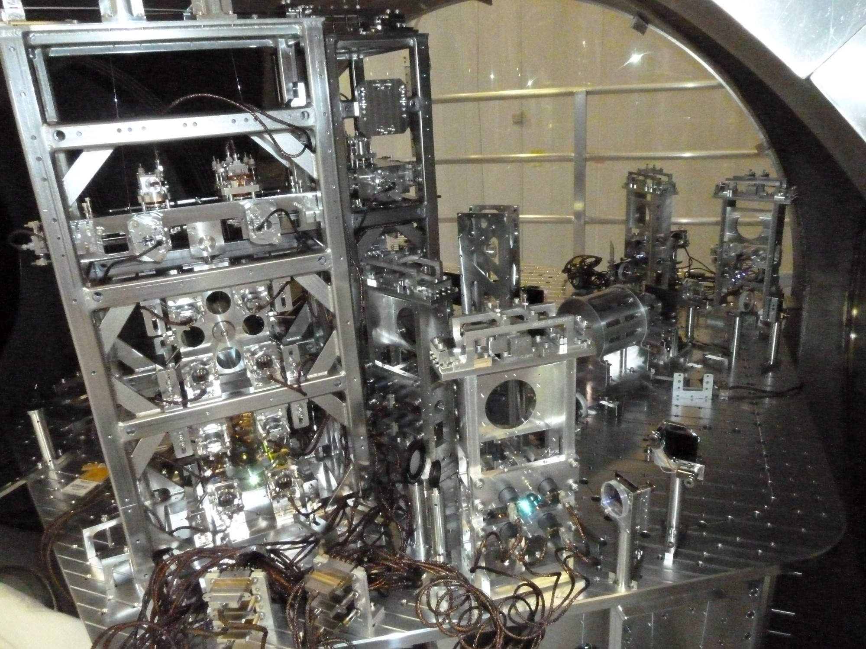
Highlights from Livingston: the Input Mode Cleaner
LLO
NOISE PERFORMANCE (MOSTLY) UNDERSTOOD

Slide 10
Advanced LIGO Livingston: Coming next
First look at noise performance with decent sensitivity
LLO
“Short” Interferometer
(everything except the arm cavities)

Slide 11
Advanced LIGO Hanford: Coming next
LHO
“Half” Interferometer
(first one arm, then the other)

Slide 12
Goal: Reach a scientifically interesting sensitivity as soon as possible

Slide 13
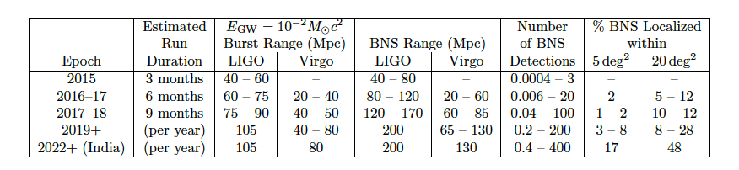
Advanced LIGO Detection Rates
http://arxiv.org/abs/1304.067
Neutron Star Binaries:
  Initial LIGO: ~15 Mpc → rate ~1/50yrs
  Advanced LIGO: ~ 200 Mpc
  “Realistic rate” ~ 40/year
In 2016 we should see something!
Class. Quant. Grav. 27, 173001 (2010)
Notes:
P0900125-v8

Slide 14
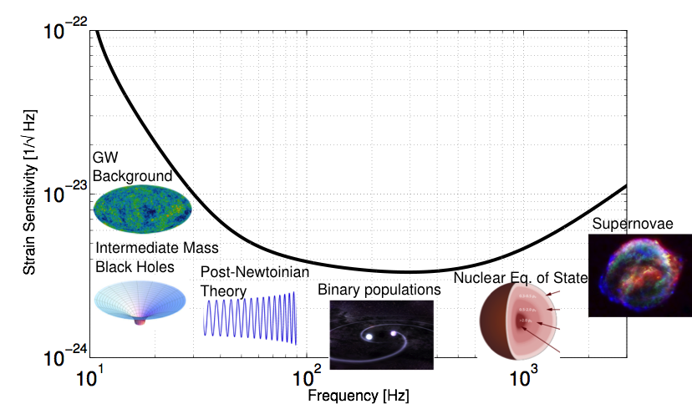
“More” and “New” science beyond Advanced LIGO
aLIGO design sensitivity
How can we push this curve down?

Slide 15
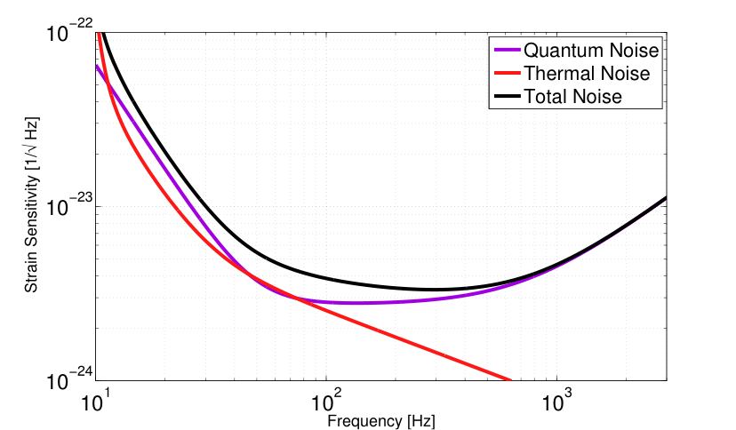
How can we go beyond aLIGO?
Reduce the noises!
SEISMIC
WALL
aLIGO design sensitivity

Slide 16
What is quantum noise?
m
SHOT NOISE:
Photon counting noise
RADIATION PRESSURE NOISE: Back-action noise caused by random motion of the mirrors
LASER
Photo-Detector
Measurement frequency
Notes:
h_shot, h_rad

Slide 17
“Standard Quantum Limit”
It doesn’t depend on the optical parameters of the interferometer, just on the quantum mechanics of a harmonic oscillator mass

Slide 18
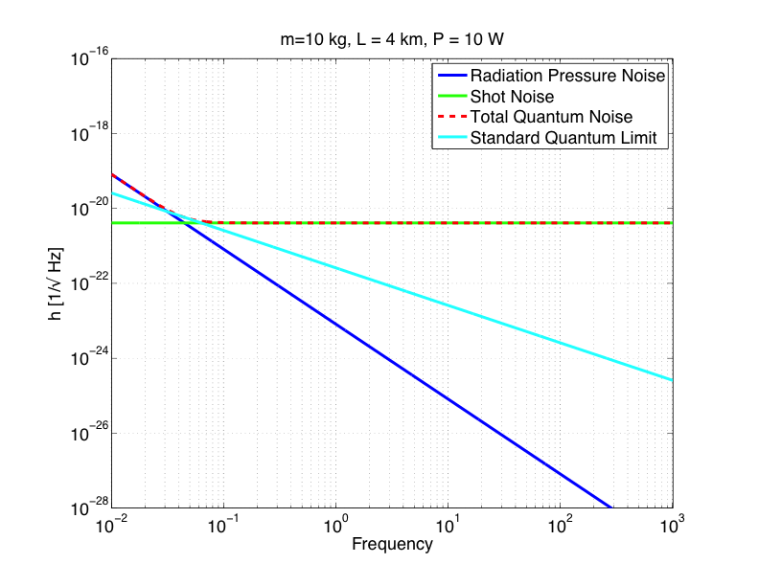
Simple Michelson, P = 10 W

Slide 19
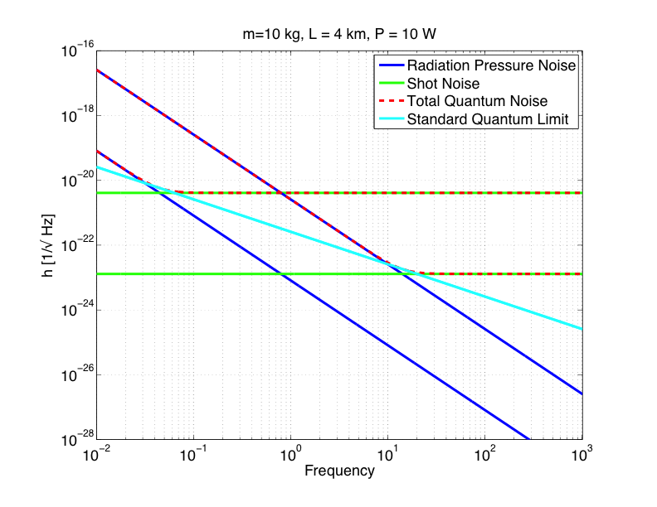
Simple Michelson, P = 1 MW
P = 1 MW

Slide 20
“Easy” approaches to minimize quantum noise
Make your interferometer as long as possible
Make your test masses as heavy as possible, and allow as much power in the arm until quantum noise is comparable to other noises

Slide 21
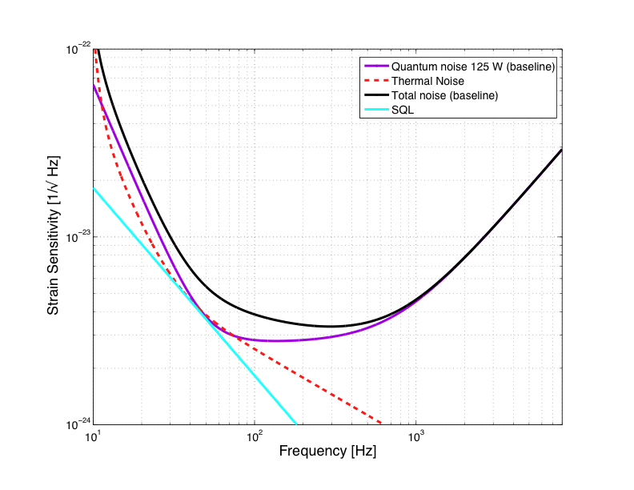
More Clever: Quantum Noise in aLIGO
More complex optical configuration than a simple Michelson
~ 800 kW of light stored in the arm cavities
SEISMIC
WALL
Notes:
Simplify equation

Slide 22
How we go beyond advanced LIGO
Make your interferometer longer!
  It is already 4 km, Ultra High Vacuum is not cheap
Heavier test masses, more power
  Already ~1 MW in the arm cavities, need to compensate for thermal effects and instabilities
(Even) more complex optical configuration which shapes the interferometer optical response
  D. E. McClelland, N. Mavalvala, Y. Chen, and R. Schnabel, “Advanced interferometry, quantum optics and optomechanics in gravitational wave detectors", Laser and Photonics Rev.5, 677-696 (2011)
Injection of squeezed states of vacuum

Slide 23
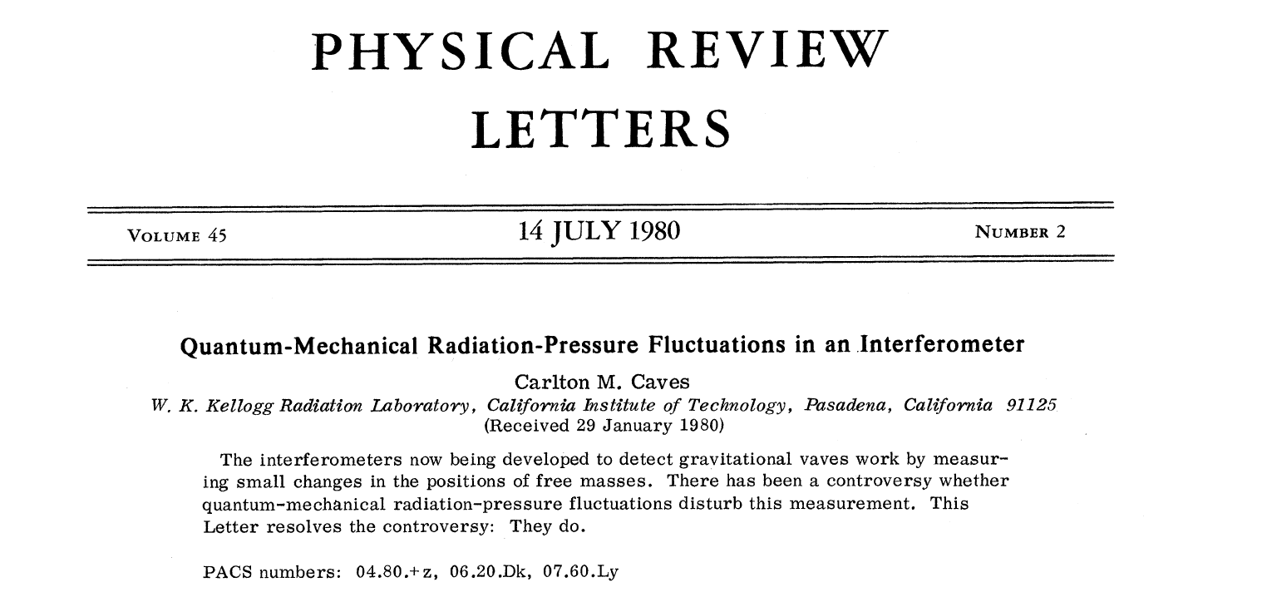
Where quantum noise REALLY comes from
Quantum noise comes from the quantization of the electromagnetic field → Zero-point fluctuations

Slide 24
Vacuum Getting Squeezed
When average amplitude of electromagnetic field is zero, the variance remains
Heisenberg uncertainty principle, quadratures associated with amplitude and phase
LASER
X1
Phase
X2
IFO Signal
∆X₁ ∆X₂ ≥1
Amplitude

Slide 25
Vacuum Getting Squeezed
Squeezed vacuum: less uncertainty in one of the two quadratures
Heisenberg uncertainty principle still holds
One can choose the relative orientation between the squeezed vacuum and the interferometer signal (squeeze angle)
LASER
Squeezed Field
Phase
C. M. Caves, Phys. Rev. Lett. 45, 75 (1980).
C. M. Caves, Quantum-mechanical noise in an interferometer. Phys. Rev. D 23, p. 1693 (1981).
IFO Signal
Amplitude

Slide 26
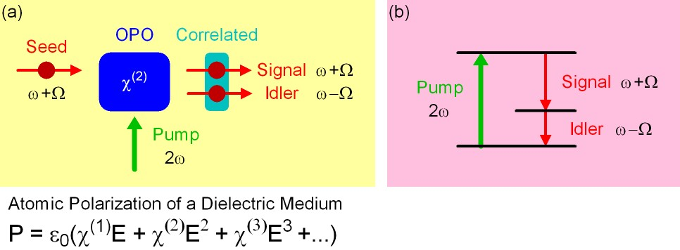
How to make squeezed fields…
…. in theory
Non linear medium with a strong second order
polarization component, pumped at 2w
Refractive index depends on intensity of light illumination
It creates correlation of upper and lower quantum sidebands
The OPO makes a “copy” of the quantum sideband, and it correlates the sidebands

Slide 27
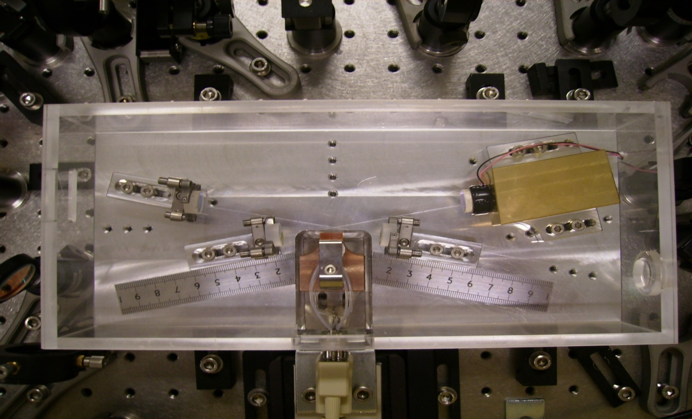
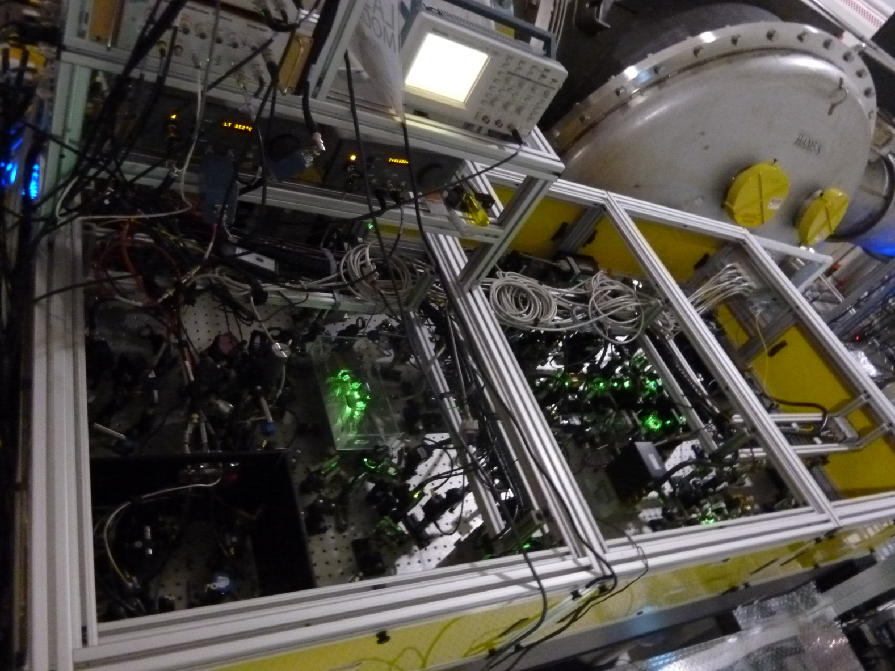
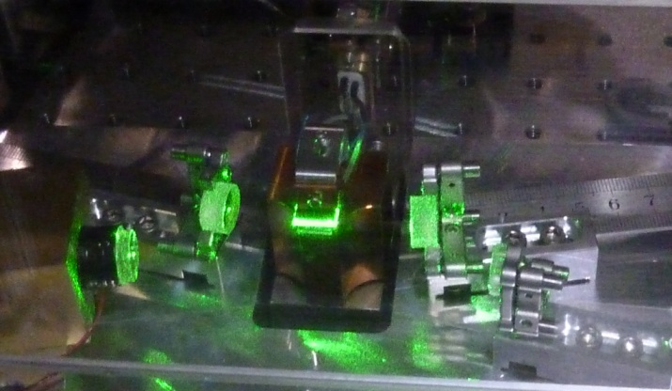
How to make squeezed fields..
…. in practice
The LIGO H1 Squeezer
World-wide effort in the last 10 years to make squeezing in the audio-frequency band

Slide 28
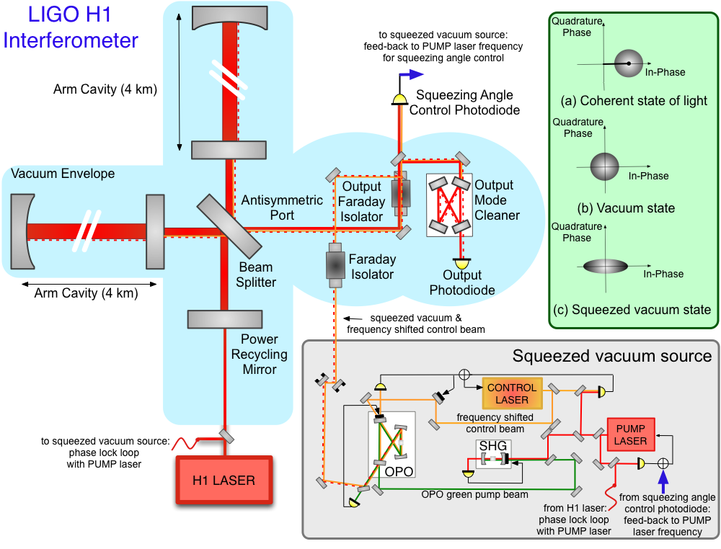
How to inject squeezed fields

Slide 29
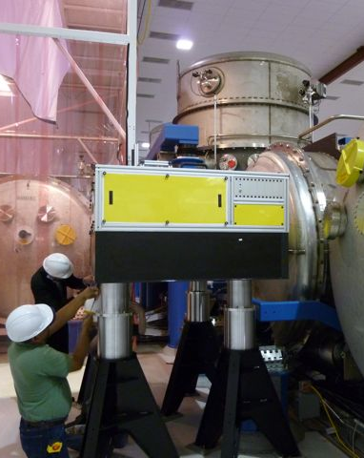
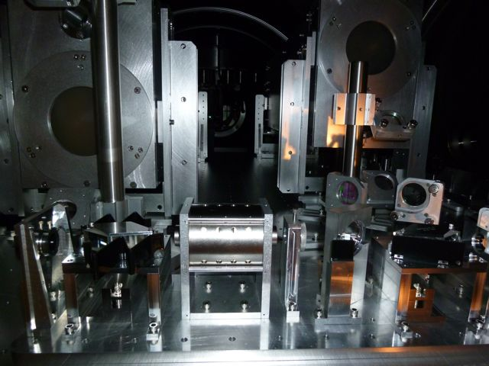
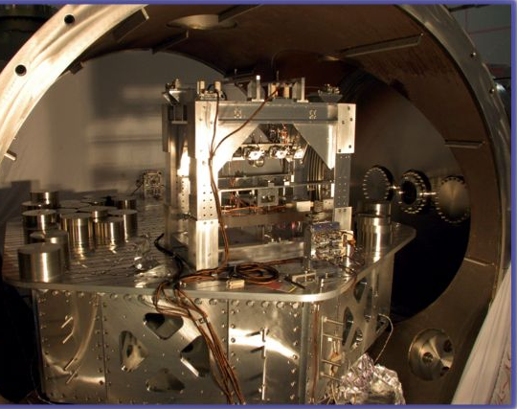
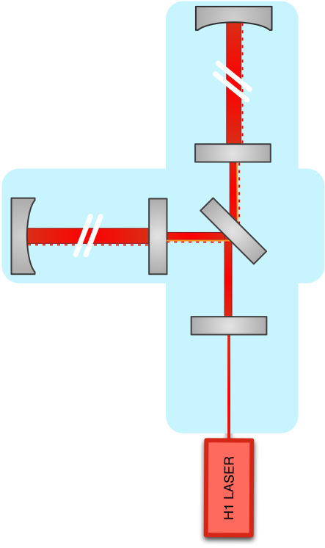
Squeezing injection into LIGO H1
End of 2011
right before aLIGO installation started
Output Faraday
Squeezer Table
Output Mode Cleaner

Slide 30
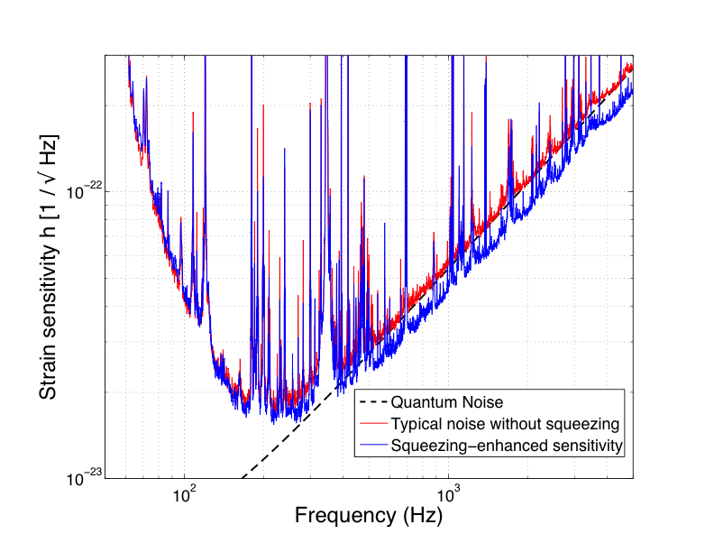
LIGO H1 Squeezing Experiment Results
from the LIGO Scientific Collaboration
PRELIMINARY
2.15 dB (28%) noise reduction

Slide 31
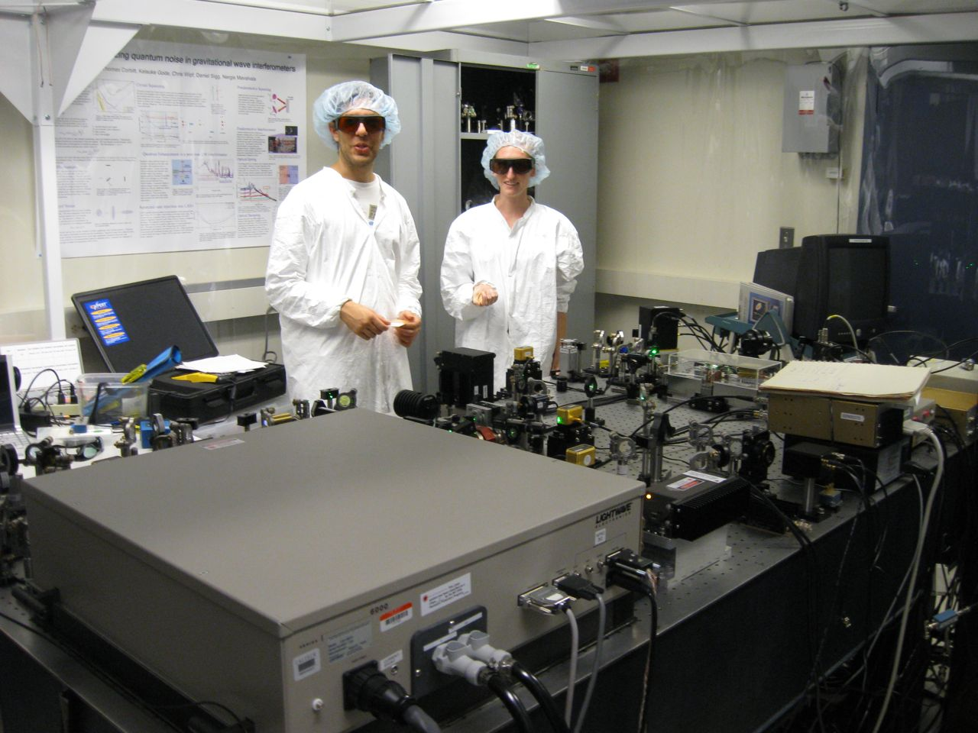
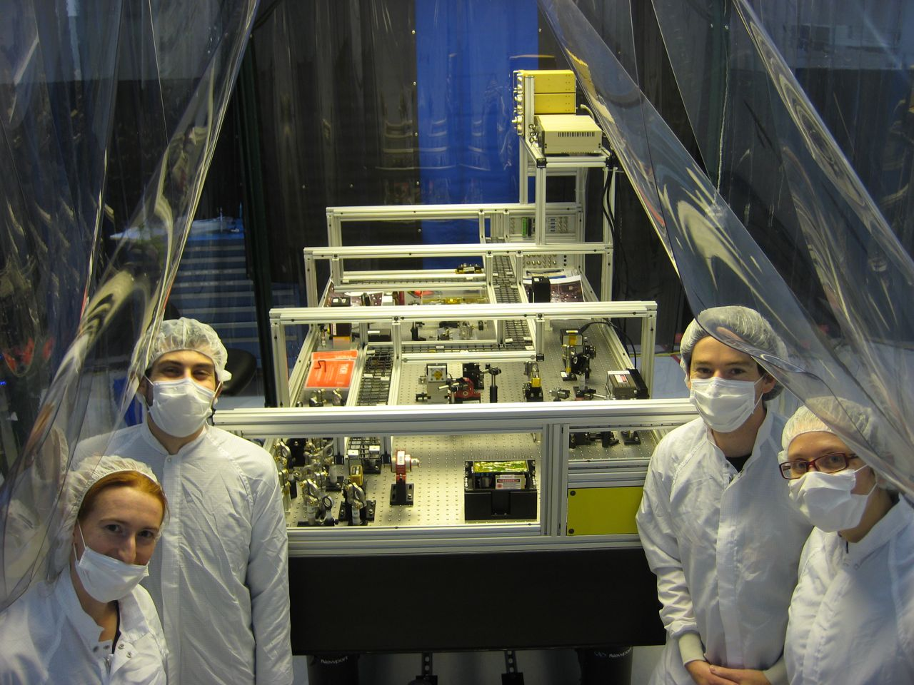
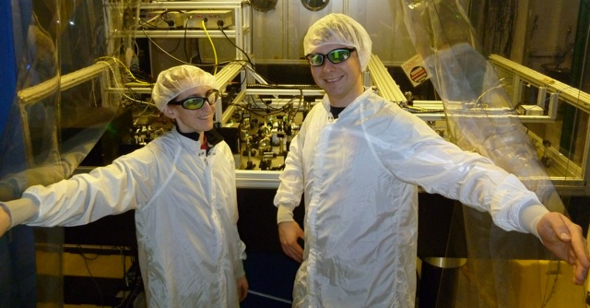
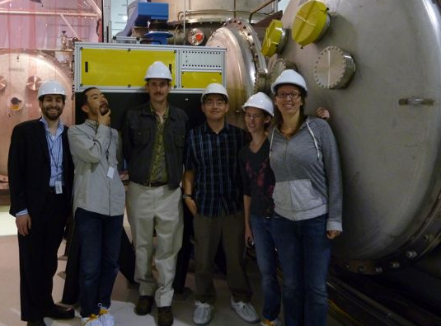
LIGO H1 Squeezing Experiment
LIGO Hanford Observatory (US)
Massachusetts Institute of Technology (US)
Australian National University (Australia)
Albert Einstein Institute (Germany)
MIT: Sheila Dwyer, L. Barsotti, Nergis Mavalvala, Nicolas Smith-Lefebvre, Matt Evans
LHO: Daniel Sigg, Keita Kawabe, Robert Schofield (Univ. Oregon), Cheryl Vorvick, Dick Gustafson (Univ Mitchigan), Max Factourovich (Columbia), Grant Meadors (Univ Mitchigan),
M. Landry and the LHO staff
ANU: Sheon Chua, Michael Stefszky, Conor Mow-Lowry, Ping Koy Lam, Ben Buchler, David McClelland
AEI: Alexander Khalaidovski, Roman Schnabel

Slide 32


Squeezing in GEO600 and LIGO H1
Abadie et al.,
Nature Physics 7, 962 (2011)
preliminary
from the
LIGO Scientific Collaboration
GEO data are courtesy of H. Grote

Slide 33

Limit to the amount of observed squeezing
Losses are very unforgiving!
GEO600
Largest Losses Sources:
Mode matching
Faradays
Output mode cleaner
LIGO H1

Slide 34

How about a
“Quantum-Enhanced Advanced LIGO”?
Do we want it? YES!
Rana Adhikari,
GWADW 2012
All current ideas for upgrading aLIGO
include 10 dB of squeezing
Do we know how to make it? ALMOST!

Slide 35


Projections for a
“Quantum-Enhanced Advanced LIGO”

Slide 36






What we really want:
Frequency Dependent Squeezing
High finesse detuned cavity which rotates the squeezing angle as function of frequency

Slide 37

Squeezing Experiments @ MIT
  FILTER CAVITY EXPERIMENT
  Measuring optical losses to determine Advanced LIGO filter cavity design
  Implementing practical filter cavity control scheme
  Characterizing technical noises
  Preparing for demonstration of audio-band frequency dependent squeezing
NEW aLIGO SQUEEZER SOURCE
  Working on a new design with an
  in-vacuum squeezer source cavity
Tomoki Isogai, John Miller,
Eric Oelker,
(Patrick Kwee)

Slide 38


For aLIGO, we could afford a “lossy” cavity
16m cavity, 10ppm losses round trip
In preparation

Slide 39

Beyond the “Standard Quantum Limit”

Slide 40

Squeezing Future
Near future goal: develop technology to achieve a factor of 2 (6 dB) broadband reduction in quantum noise
→ possible “first” major upgrade to aLIGO
Ultimately, what we want is a factor of 3 (10 dB), possibly more!, of broadband squeezing:
    Reduce total losses below 10% (low loss Faradays, adaptive mode matching, ..)
    improve control strategy of squeezed beam relative to the interferometer beam
GEO600, in preparation

Slide 41
How can we go beyond aLIGO?
Reduce the noises!
SEISMIC
WALL
aLIGO design sensitivity

Slide 42





Fluctuation-dissipation theorem to interpret thermal noise
Thermal fluctuations are closely related to mechanical loss (friction)
Wire Suspensions, Q ~ 100k
Fused Silica Test-Mass, 10kg
HEAT BATH
test mass (mirror)
TEMPERATURE
LOSS
Fluctuation-Dissipation Theorem
Callen and Welton, 1951
QUALITY FACTOR
Motion
inverse of fractional energy lost after one oscillation
Just reducing T is not enough, T and Q are not independent..for fused silica Q gets worse for lower T..

Slide 43


Where thermal noise comes from
SUSPENSION THERMAL NOISE

Slide 44


Long story short: Silicon test masses @ 120K
We don’t really know how to do this yet, a lot of R&D needed
Zero crossing of thermal expansion coefficient, very low intrinsic loss at 124K
Nicolas Smith, Rana Adhikari (Caltech)
Rai Weiss (MIT)

Slide 45

Where thermal noise comes from
COATING THERMAL NOISE

Slide 46


Optical Coating Research
Traditional materials (amorphous Silica/Tantala)
used for optical coatings have relatively low Q ~ few 10⁴
High Q optical coatings has been a major research subject for many years, small improvement
Recent results on new crystalline materials show order of magnitude higher Q
AlGaAs Coatings, grown on GaAs substrate,
lifted and bonded onto optic (any material)
→ Need to scale it to a BIG test mass

Slide 47

One Possible Target for
“third” generation detectors (@1550nm)
Squeezing @1550nm
+ More Power+ Heavier Masses

Slide 48
Conclusions
Advanced LIGO is happening!
Installation & commissioning progressing well, great effort to go on-line as soon as possible
Scientific data in 2015, first detection (hopefully) in 2016
We think we can make even a better detector in a few years…
… but critical instrument science R&D needs to happen now to make that possible!

Slide 49
Thank you!
Slide Credits:
Nicolas Smith, Peter Fritschel, Jeff Kissel, Anamaria Effler, Matthew Evans, Gabriela Gonzales, Sheila Dwyer

Slide 50
Spare slides

Slide 51

2005-2010 Scientific Data Taking

Slide 52

Advanced LIGO configuration
Arm cavities, power and signal recycling cavity
Up to ~800 kW of light stored in the arms

Slide 53


Need more sensitive detectors..
”Advanced” Detectors, 10x more range
Advanced detectors will reach about 100,000 galaxies
Events happen once every 10,000 years per galaxy…
Roughly 1 per month!
(considering only NS-NS mergers)
Initial LIGO Range
Advanced LIGO Range

Slide 54
What we call “commissioning”: from installation to science data
Understand and fix an entanglement of noise coupling mechanisms
HIGH POWER
ALIGNMENT
OPTICS QUALITY
STRAY LIGHT
Noise
THERMAL EFFECTS
THERMAL EFFECTS

Slide 55

Nothing comes cheap: losses again..
Losses in a filter cavity, if too high, make the filter cavity useless…
Per-round-trip loss depends on the beam spot size
(big beam size → higher scatter losses), which depends on L
1 ppm/m

Slide 56

Something like this, maybe.…
FROM IFO
Just a cartoon!
Not a conceptual design yet!

Slide 57


aLIGO + Squeezing: NS-NS and BH-BH Ranges

Slide 58


aLIGO + Frequency Dependent Squeezing:
Predicted Ranges

Slide 59




Bow-tie cavity OPO design at ANU (2008)
H1 Squeezer assembling at MIT (2009-2010)
H1 Squeezer parts shipped to LHO
(Oct 2010)
Squeezing in H1
(Oct 3 – Dec 4)
H1 Recovery
(Sept 2011)
H1 Squeezer Installation (Summer 2011)

Slide 60

Lessons Learned (III)
Need better isolation from back scattering
(it was ok for LIGO H1, it won’t be enough for aLIGO)
Impact of backscattered-light in a squeezing-enhanced interferometric gravitational-wave detector, S. Chua et al.
(in preparation)

Slide 61


2.15 dB (28%) improvement over quantum noise
Squeezing improves only quantum noise, not other technical noises

Slide 62

Best broadband sensitivity ever

Slide 63

Improving H1 by 2 dB (28%) with squeezing
..without spoiling the sensitivity at 200 Hz
PRELIMINARY

Slide 64

Not only losses, phase noise too
Squeezing [dB] vs Losses and Phase Noise
X₂
φ_{sqz}
X₁

Slide 65
Where the main losses came from
Mode matching (~30% losses)
Faradays (3 passes ~ 20% losses)
OMC transmission (18% losses)
➔ “Technical” problems, total losses should be down to 10-15% in aLIGO

Slide 66

Lessons Learned (VI)
From GEO600: Squeezing angle control signals from 1% pick-off are bad
→ New “a-la-Hartmut” strategy (use transmission signals from the OMC)

Slide 67


Slide 68

Why not even more?

Slide 69

Have to consider phase noise too

