Slide 1
Squeezed Light Techniques for Gravitational Wave Detection
May 31, 2013
Daniel Sigg
LIGO Hanford Observatory
LIGO seminar at Caltech

Slide 2
Abstract
Several kilometer long interferometers have been built over the past decade to search for gravitational waves of astrophysical origins. For the next generation detectors intra-cavity powers of several 100 kW are envisioned. The injection of squeezed light, a specially prepared quantum state, has the potential to further increase the sensitivity of these detectors. The technology behind squeezed light production has taken impressive steps forward in recent years. As a result a series of experiments is underway to prove the effectiveness of squeezed light and to make quantum technology a valid upgrade path for gravitational wave detectors.

Slide 3
The Advanced LIGO Detector
Input mode cleaner:
stabilizes frequency
and cleans laser mode
4 km
Arm cavities:
Fabry-Perrot cavities store light to effectively increase length
800kW
4 km
Laser
800kW
Laser:
200W - 1064nm
Power recycling mirror: reflects light back coming from the beam splitter, increasing power in the arm cavities
Input
Test
Mass
End
Test
Mass
Signal recycling mirror: amplifies readout signal
Homodyne Readout

Slide 4
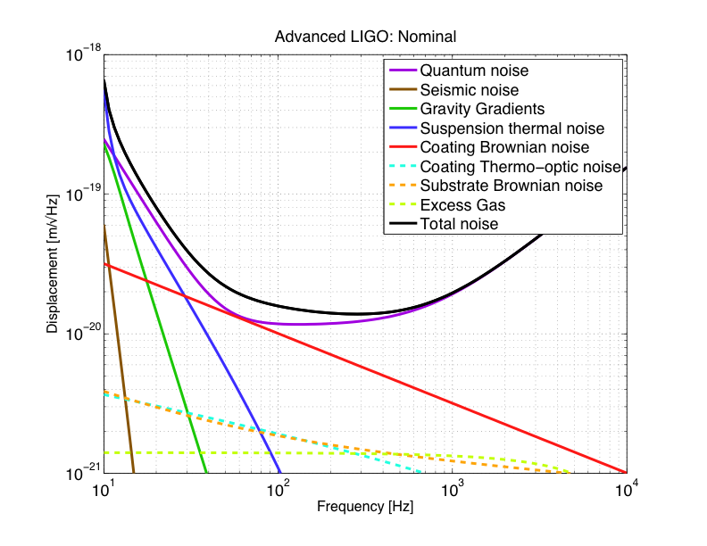
Advanced LIGO Sensitivity
Radiation pressure noise
Initial LIGO
Shot noise
Standard quantum limit

Slide 5
Sensitivity Sixth Science Run

Slide 6
Towards the
Quantum Ground State
Abbott et al.
New J. Phys. 11, 073032 (2009)

Slide 7
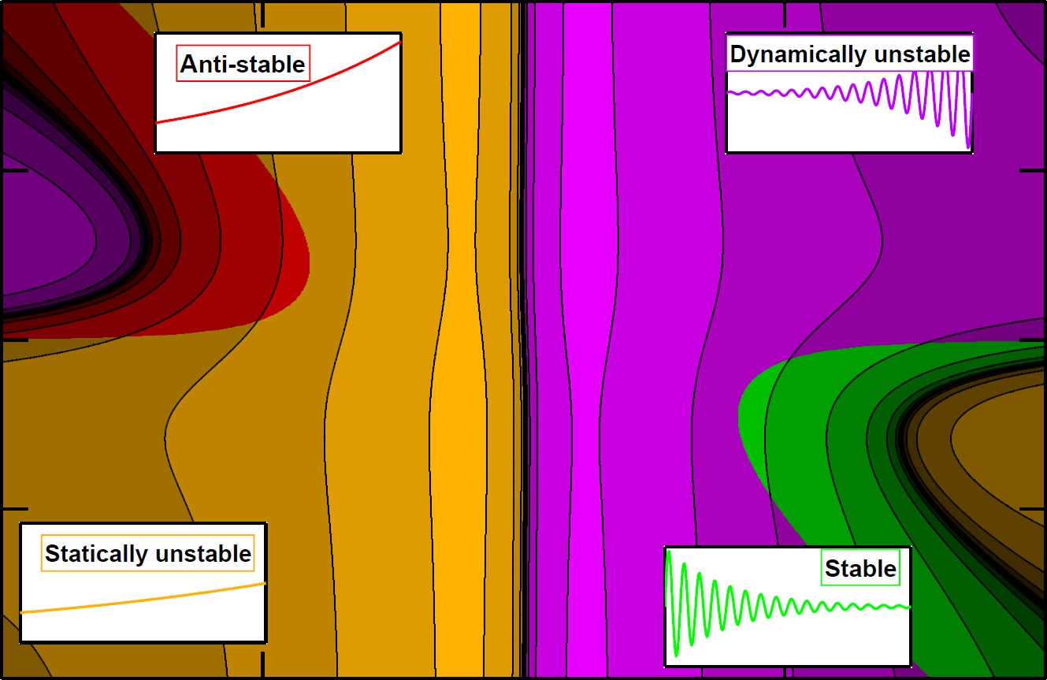
Optical Springs
2
1
subcarrier ~ 5% of carrier
Subcarrier detuning (HWHM)
0
–1
Corbitt et al.,
PRL 98, 150802 (2007)
– 2
– 5
–2.5
0
2.5
5
Carrier detuning (HWHM)

Slide 8
Squeezed Light
Normal light
Amplitude squeezing
Phase squeezing
│E │
ϕ

Slide 9
Key Insights
Shot noise in a Michelson interferometer is due to vacuum fluctuations entering the dark port.
Quantum noise also produces photon pressure noise.
Injecting a specially prepared light state with reduced phase noise (relative to vacuum) into the dark port will improve the shot noise sensitivity.
Similarly, injecting light with reduced amplitude noise will reduce the photon pressure noise.
Non-linear optical effects can be used to generate a squeezed “vacuum” state.

Slide 10
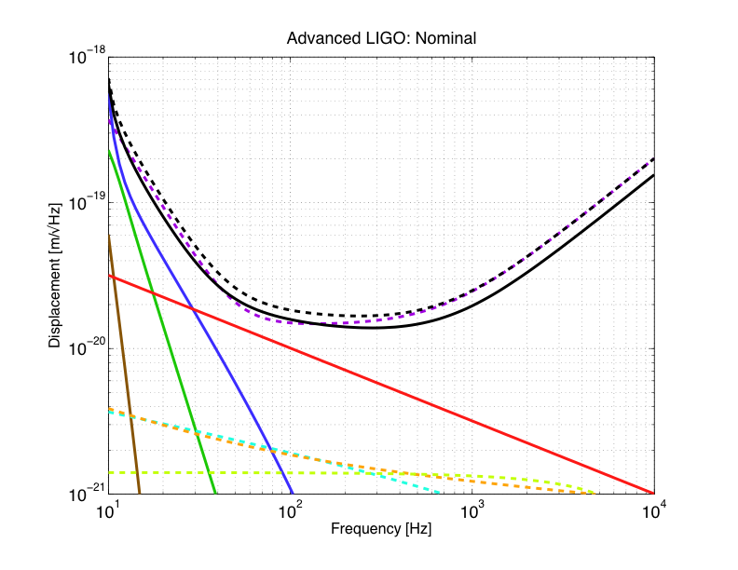
31 W + 6 dB of squeezing (10 dB of anti-squeezing, total losses ~20%)
31 W
125 W input power

Slide 11
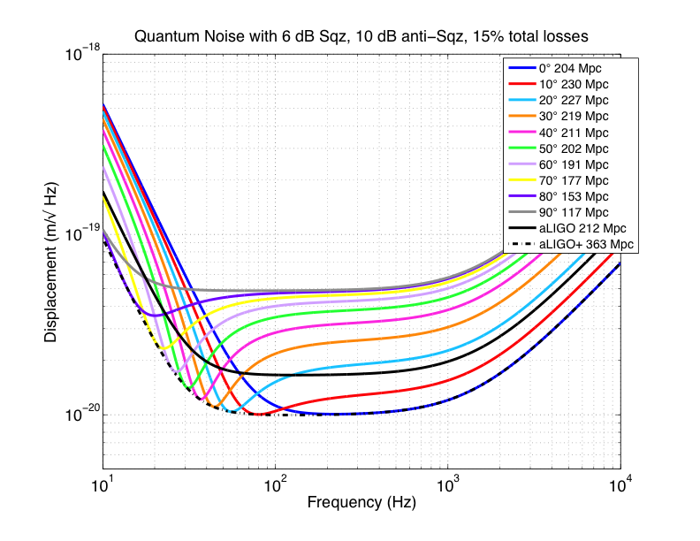

Slide 12
Experimental Confirmation at the GEO600 Detector
3.5 dB of squeezing
Abadie et al.
Nature Physics 7, 962 (2011)

Slide 13
In Fourier Space
Local oscillator
~
*
Noise ∝ E_{local} x e_{vac} + c.c.
Complex conjugate
Vacuum fluctuations
Frequency

Slide 14
Generating Squeezed “Vacuum”
Need an operation that applies
Optical parametric oscillator (OPO)
Non-linear crystal that is pumped at double the frequency and below threshold.
~
~
~
*
e_{vac} → e_{vac} + e^{2iφ} x e_{vac}
φ: squeezer angle
~
~
⇒
Noise ∝ |E_{local}| x |e_{vac}| x cos(Φ_{local} - φ) x cos(Φ_{vac} - φ)

Slide 15
Shot /Radiation Pressure Noise in the Quantum Picture
Phase fluctuations in the vacuum field entering the beamsplitter are responsible for the shot noise
Phase squeezing reduces shot noise
Amplitude fluctuations in the vacuum field entering the beamsplitter are responsible for radiation pressure noise
Amplitude squeezing reduced radiation pressure noise

Slide 16
The H1 Squeezer Experiment
Goals:
Demonstrate 3dB of squeezing at the initial LIGO sensitivity
Don’t degrade low frequency sensitivity
Risk mitigation for high power operations
Pathfinder for advanced LIGO squeezer
Potential show stoppers:
Back scattering
Stray light
Phase noise
Optical losses
Auxiliary servo noise
Alignment jitter
Stability

Slide 17
H1 Squeezer Experiment
ETM-Y
Interferometer Acronyms
PSL
- Pre-Stabilized Laser
- Vacuum System
IMC
- Input Mode Cleaner Cavity
PRM
- Power Recycling Mirror
Y
-Arm
BS
- Beam Splitter
(4km)
ITM
-
Arm Cavity Input Test Mass
ETM
-
Arm Cavity End Test Mass
ANU, AEI, MIT, LIGO collaboration
FI
- Faraday Isolator
OMC
- Output Mode Cleaner Cavity
PD
- Photodiode (Data Output)
ITM-Y
PRM
PSL
IMC
BS
ITM-X
ETM-X
PS
X-Arm (4km)
PLL1
FI
SHG
OPO
FI
Squeezed Light Source Acronyms
PS
MAIN
- Squeezing Main Laser
MAIN
AUX
- Squeezing
Auxiliary Laser
PLL
- Phase Lock Loop
PLL2
OMC
SHG
- Second Harmonic Generator
OPO
- Optical Parametric Oscillator
AUX
PS
- Phase Shifter
PD

Slide 18
H1 Squeezed
2 dB of squeezing
Preliminary
Best ever sensitivity!

Slide 19
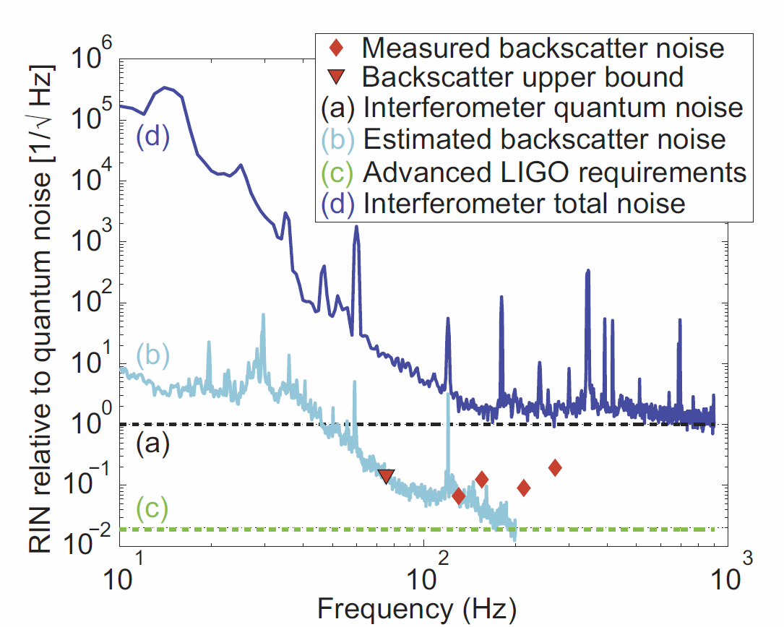
÷400
÷10

Slide 20
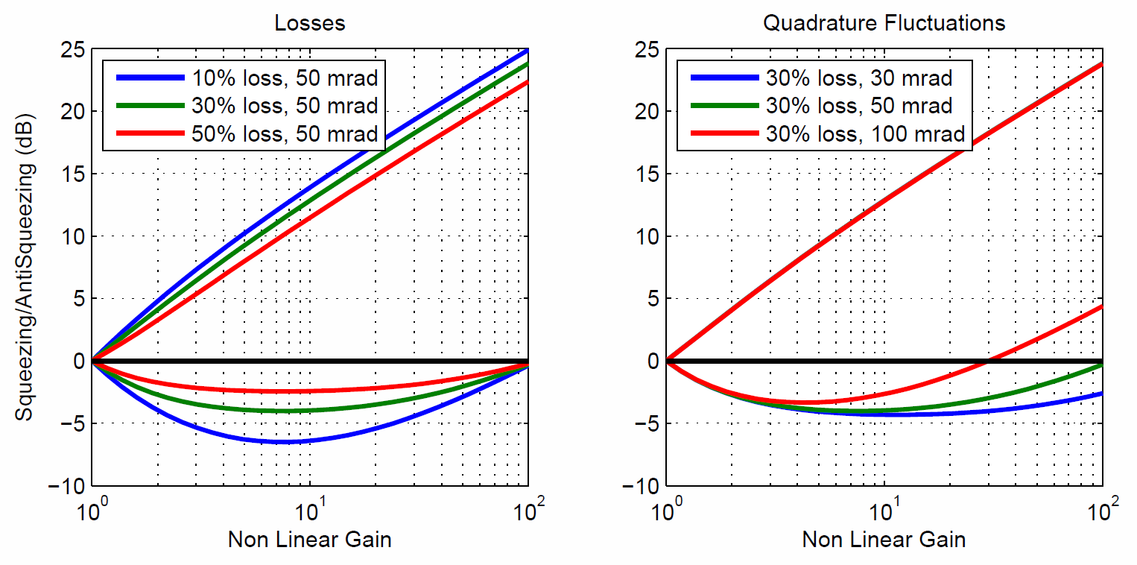
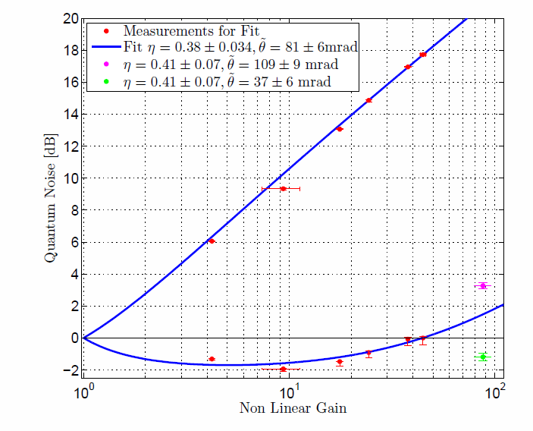

Slide 21
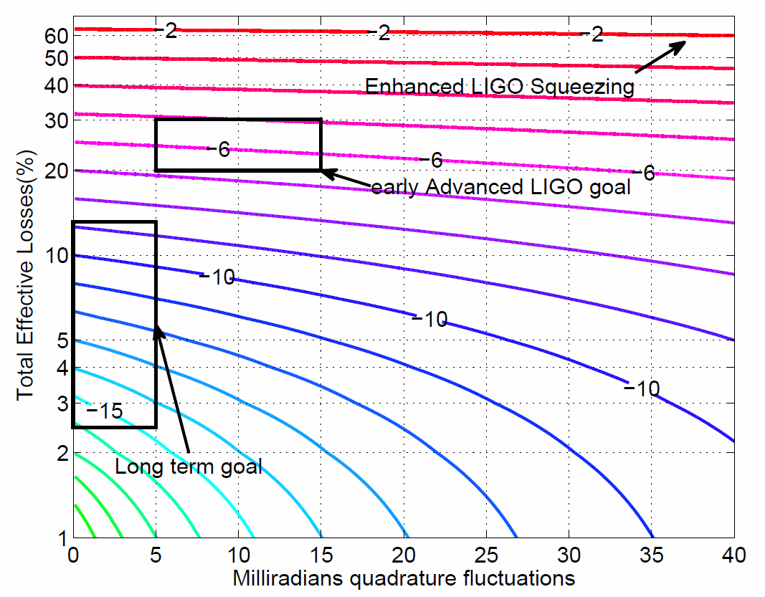

Slide 22
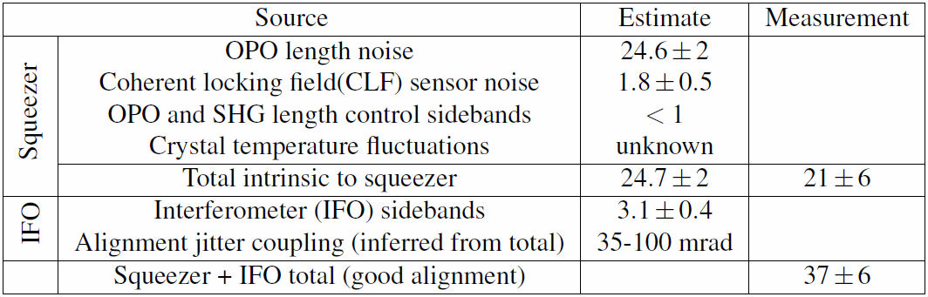
Optical Losses and Phase Noise
Measured mode mismatch squeezer/OMC | 25% | 5%
Measured scatter and absorption loss in OMC | 18% | 2%
Measured Faraday losses | 20% | 2%
Measured total optical losses | 56% | 2%

Slide 23
Summary and Outlook
Advanced LIGO squeezer needs in-vacuum OPO
  Planned R&D programs at ANU and MIT for VOPO
Need a low loss readout chain
GEO is developing an auto-alignment system
R&D program at MIT to work on filter cavities
Squeezed light sources will be the first upgrade to
advanced gravitational-wave interferometers

Slide 24
