Slide 1

Progress on Cryogenics for aLIGO upgrades
LIGO
Brett Shapiro
Stanford University

Slide 2
Summary
LIGO
Cryo test mass problem statement
LIGO III quad pendulum modeling – summer student work
  SUS conceptual design modeling
  Heat shield beam tube length
Stanford experiments
Future Work

Slide 3
Cyro Test Mass Problem Statement
* For LIGO III, reduce suspension and coating thermal noise by cooling the lower quad to 124 K (-149.15 C)
  Si test masses (blue team in T1200031)
  Get to 124 K in a timely manner
  Then maintain 124 K
Include a warm-up scheme (don’t forget!)
Do not increase the test mass lossiness
  Emissive coatings, heat links, thick sus fibers, etc
Do not compromise passive seismic isolation
  Cables, hoses, links, etc
The same seismic isolation platforms (ISIs, HEPIs)
  Limit the amount of extra weight on the ISI
  Leave the rest of the BSC warm

Slide 4
Possible LIGO III Cryogenic Upgrade
clamp
295 K
ISI stage 2
Vacuum flange
Flexible liquid nitrogen hose
(77 K = -196 C)
120 K
10 m
T1300556
≈ 3 W at 120 K
Heat shield
77 K
1560 nm laser rather than 1064 nm
See also G1200246-v1

Slide 5
Quad pendulum modeling
LIGO
LIGO III Conceptual Design
of blue team approach
in T1200031

Slide 6
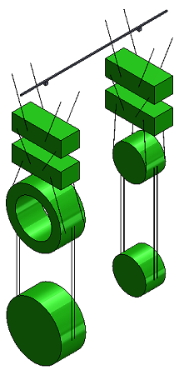
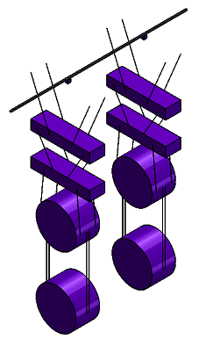
Possible LIGO III Mechanical Upgrades
Advanced LIGO quad pendulum
Preliminary LIGO III quad pendulum
Reaction
chain
Reaction
chain
Main
chain
Main
chain
2.14 m
1.626 m
10 kg
20 kg
? kg
? kg
20 kg
20 kg
40 kg
? kg
40 kg
143 kg
Fused silica, 295 K
Silicon, 120 K
G1300966

Slide 7
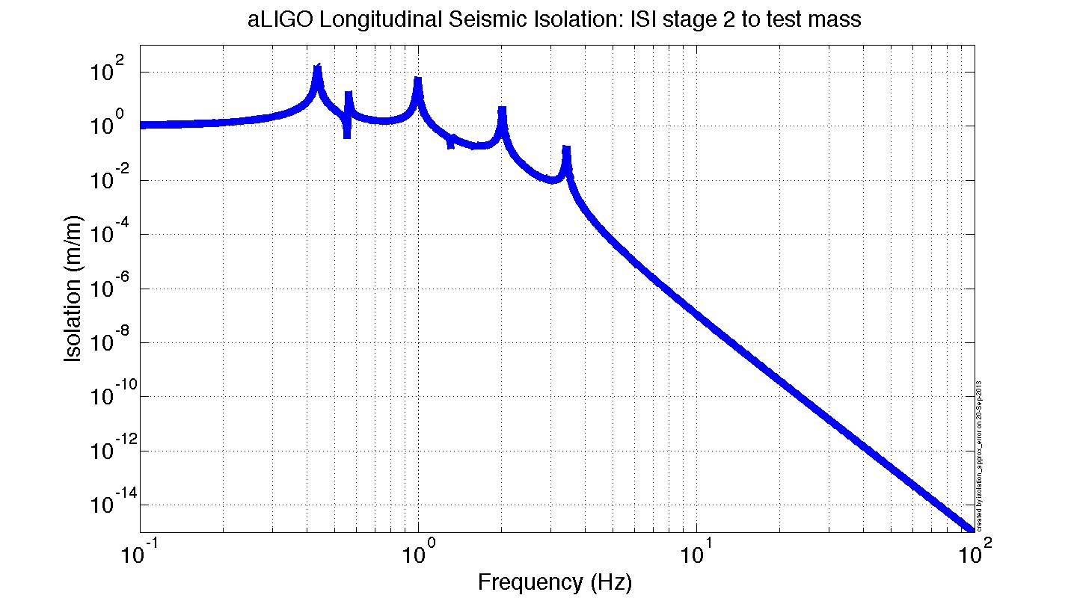
Optimizing the mass distribution
MATLAB model
m: mass of stage
L: wire length
k: vertical stiffness
x: longitudinal displacement
v: vertical displacement

Slide 8
Optimizing the mass distribution
MATLAB model
Meet or beat
aLIGO at 10 Hz
Fixed weight limit ≈ 270 kg
Target test mass m₄ ≈ 143 kg
Best m₁, m₂, m₃?
m: mass of stage
L: wire length
k: vertical stiffness
x: longitudinal displacement
v: vertical displacement

Slide 9
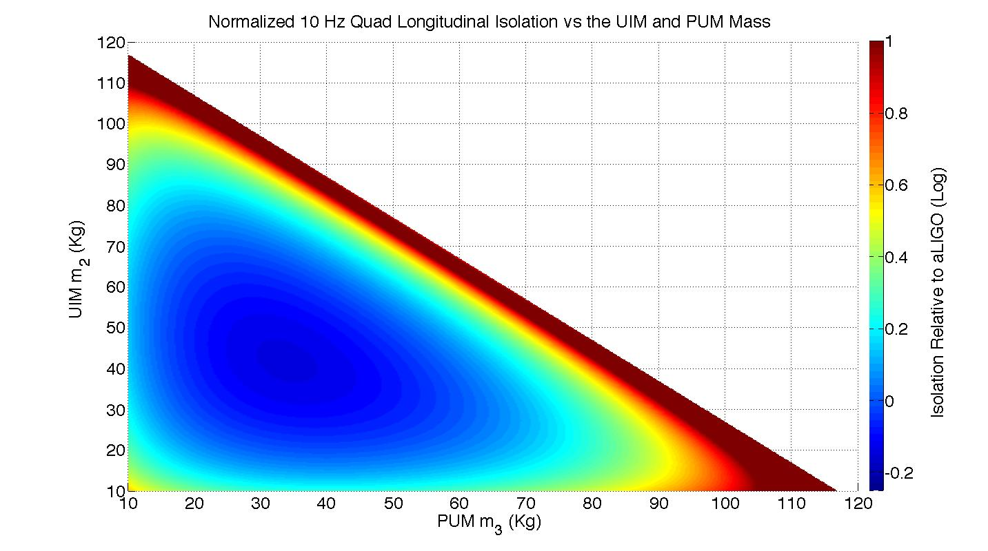
Model search for best mass values
Best values: m₃=33.68 kg, m₂=42.65 kg -> m₁ = 51.67 kg
For 143 kg test mass, 270 kg payload, and 0.535 m wire lengths
See T1300786

Slide 10
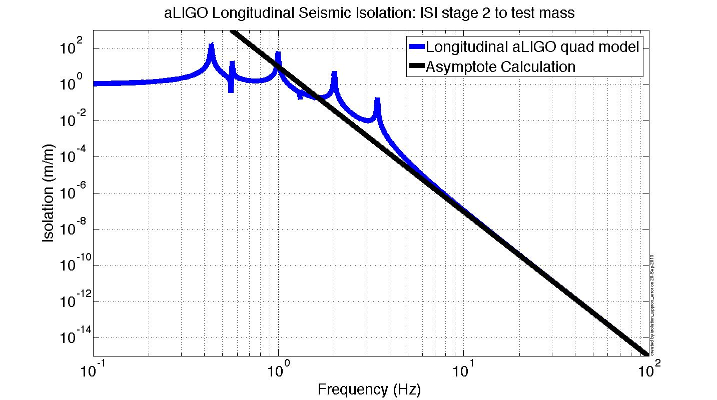
Longitudinal Isolation Asymptote
Asymptote:
See T1300786

Slide 11
Optimal Longitudinal Isolation
See T1300786
Unique optimal solution of isolation asymptote:
Given constrained test mass and payload:

Slide 12
Optimal Longitudinal Isolation
See T1300786
Unique optimal solution of isolation asymptote:
Given constrained test mass and payload:

Slide 13
Optimal Longitudinal Isolation
See T1300786
Unique optimal solution of isolation asymptote:
Given constrained test mass and payload:

Slide 14
Optimal Longitudinal Isolation
See T1300786
Unique optimal solution of isolation asymptote:
Given constrained test mass and payload:

Slide 15
Optimal Longitudinal Isolation
See T1300786
Unique optimal solution of isolation asymptote:
Given constrained test mass and payload:

Slide 16
Optimal Longitudinal Isolation
See T1300786
Unique optimal solution of isolation asymptote:
Iterate a few times to solve both simultaneously
Given constrained test mass and payload:

Slide 17
PUM and Test Mass Bounce Mode
…
m₃
L₄
m₄
See T1300786

Slide 18
PUM and Test Mass Bounce Mode
…
Vertical bounce frequency (Hz):
m₃
L₄
m₄
* U. Gysin, S. Rast, P. Ruff, E. Meyer, D. W. Lee, P. Vettiger, C. Gerber. “Temperature dependence of the force sensitivity of silicon cantilevers”,
2004, Physical Review B, Volume 69, Number 4, http://prb.aps.org/abstract/PRB/v69/i4/e045403
See T1300786

Slide 19
PUM and Test Mass Bounce Mode
…
Vertical bounce frequency (Hz):
m₃
L₄
For longitudinal optimal solution with m₃ = 33.74 kg, m₄ =143 kg
m₄
For aLIGO, f_{bounce} = 9.27 Hz
* U. Gysin, S. Rast, P. Ruff, E. Meyer, D. W. Lee, P. Vettiger, C. Gerber. “Temperature dependence of the force sensitivity of silicon cantilevers”,
2004, Physical Review B, Volume 69, Number 4, http://prb.aps.org/abstract/PRB/v69/i4/e045403
See T1300786

Slide 20
PUM and Test Mass Bounce Mode
…
Vertical bounce frequency (Hz):
m₃
L₄
For longitudinal optimal solution with m₃ = 33.74 kg, m₄ =143 kg
m₄
For aLIGO, f_{bounce} = 9.27 Hz
No solution that meets both aLIGO performance and our goals for payload and test mass weight.
* U. Gysin, S. Rast, P. Ruff, E. Meyer, D. W. Lee, P. Vettiger, C. Gerber. “Temperature dependence of the force sensitivity of silicon cantilevers”,
2004, Physical Review B, Volume 69, Number 4, http://prb.aps.org/abstract/PRB/v69/i4/e045403
See T1300786

Slide 21
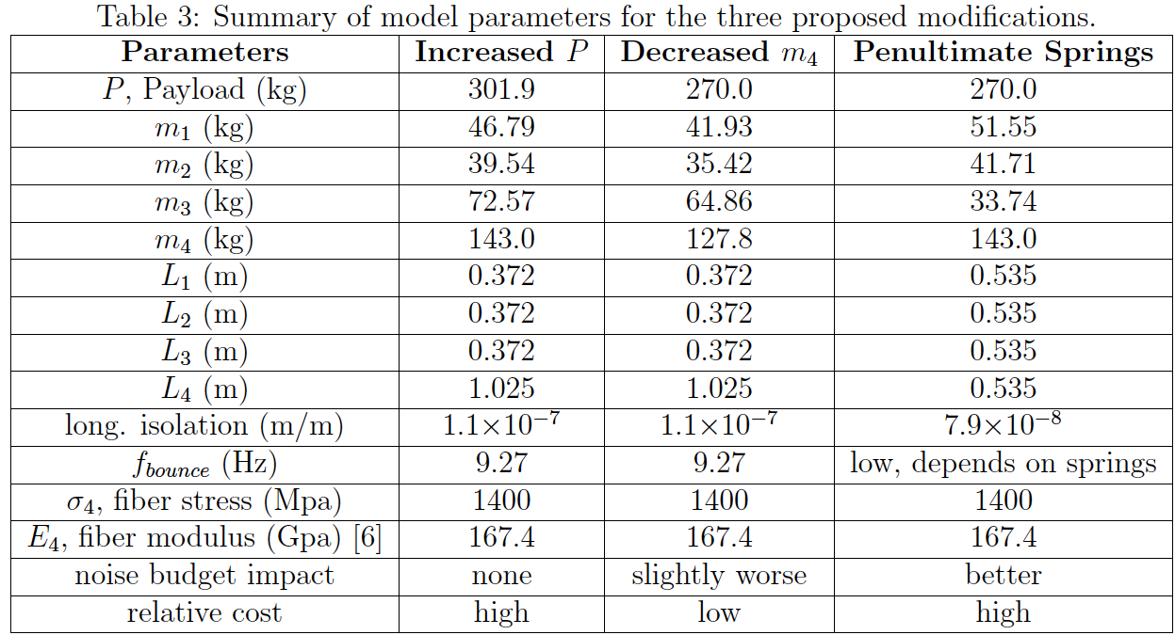
3 Quad Conceptual Designs
Higher payload
Lighter
Test mass
Ideal masses with PUM springs
T1300786

Slide 22
Quad pendulum modeling
LIGO
Heat shield beam tube length

Slide 23
Beam Tube Heat Shield Length
Test Mass
Heat Shield
T = 77 K
ε
Beam tube
Blackbody disc model
r_{j} = 0.28m
r_{i} = 0.6225m
T_{i} = 295 K
Ε = 0.1
T_{j} = 120 K
Ε = 1
L (m)
What is the optimal heat shield length in the beam tube?
See T1300556

Slide 24
Heat shield length in beam tube
Black body power from beam tube arriving at test mass
≈1/3 drop for every factor of 2 L
Test mass emissivity = 0.1
Beam tube shield length L (m)
See T1300556

Slide 25
Stanford Cryo Test Mass Experiments
LIGO

Slide 26
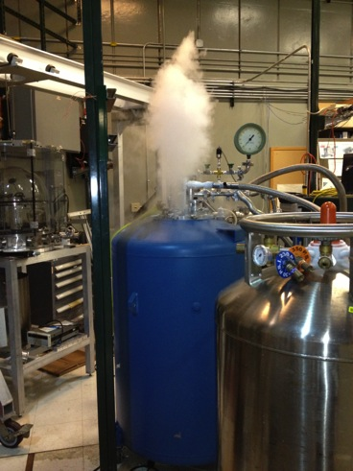

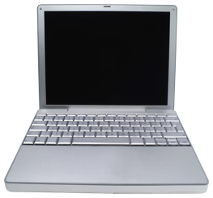
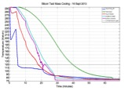
Goal of Stanford Cryo Experiments
Fastest method of cooling a LIGO III test mass to 124 K, -150 C
modify
extrapolate
understand
Stanford prototypes
Model
LIGO III design

Slide 27
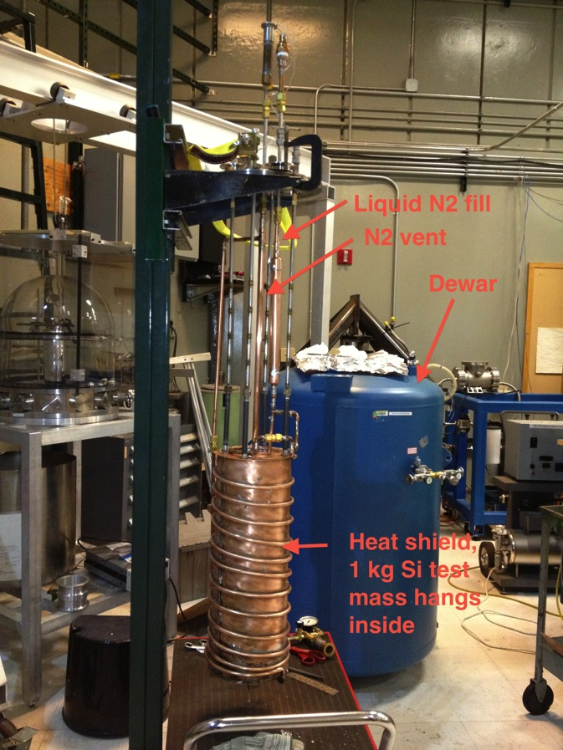
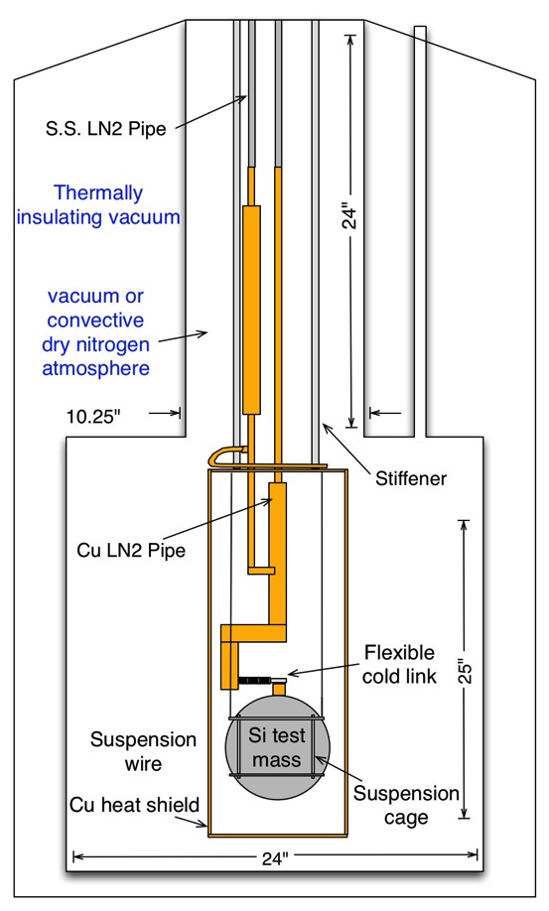
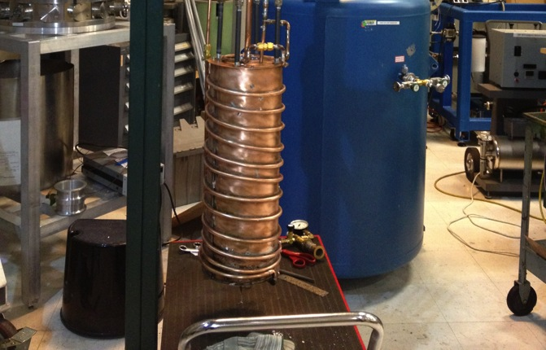
Experimental Setup
Test dewar
Heat shield

Slide 28
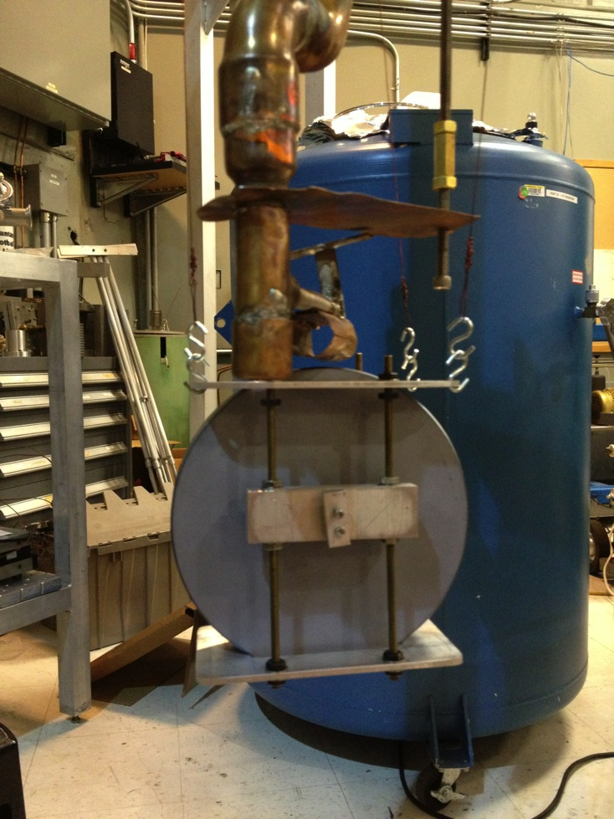
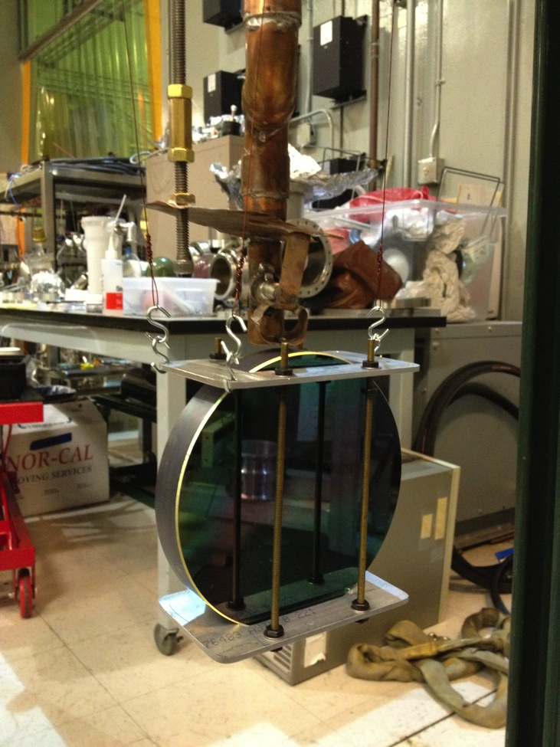
Test dewar
Nitrogen plumbing
Flexible cold link
1 kg Si test mass
Temperature sensor clamp

Slide 29
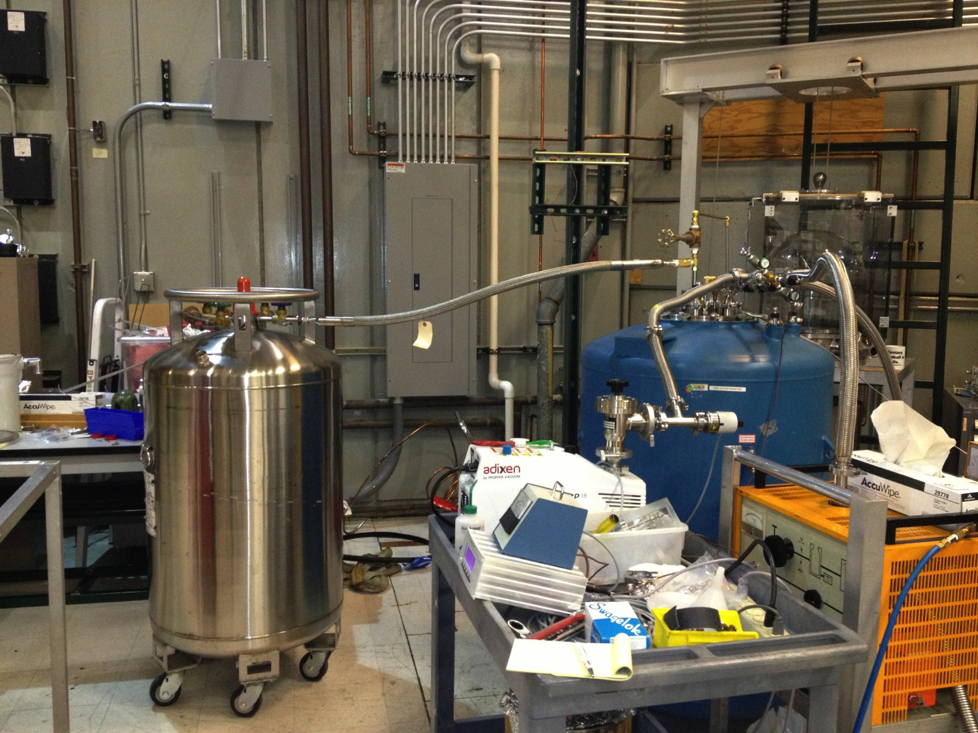
Test dewar
Liquid nitrogen dewar
Pumps

Slide 30
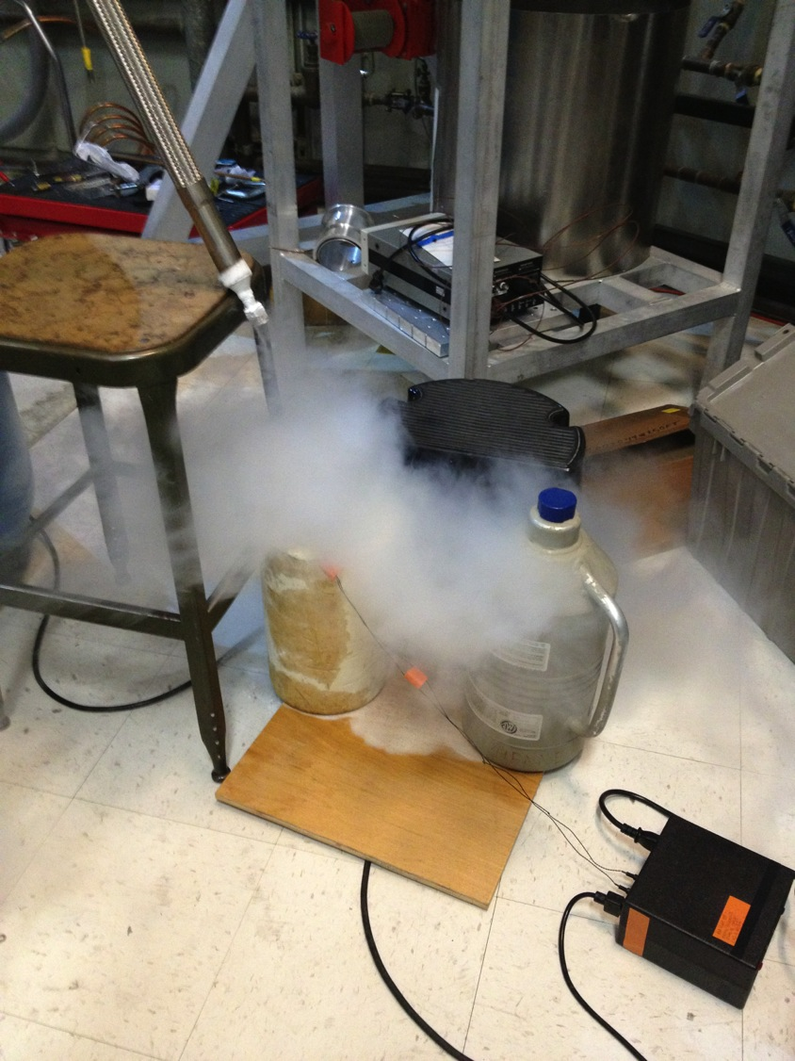
Nitrogen vent

Slide 31
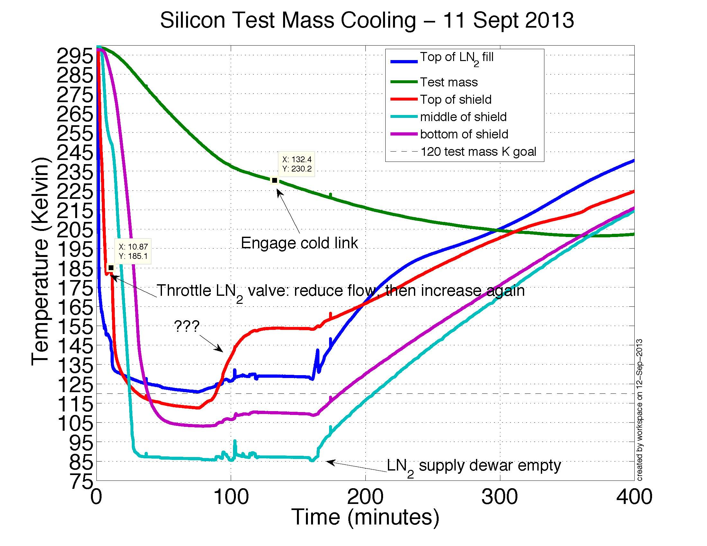

Slide 32
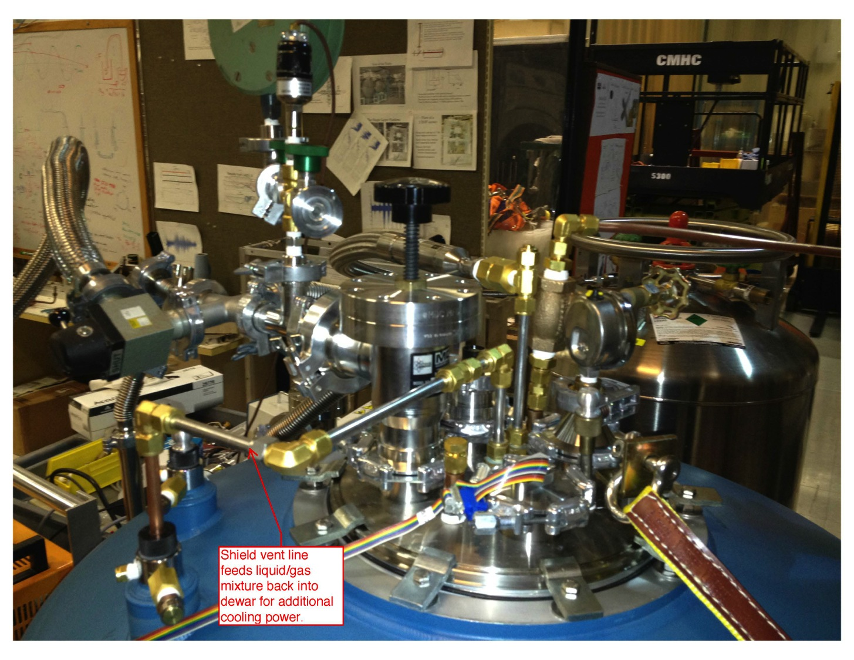

Slide 33
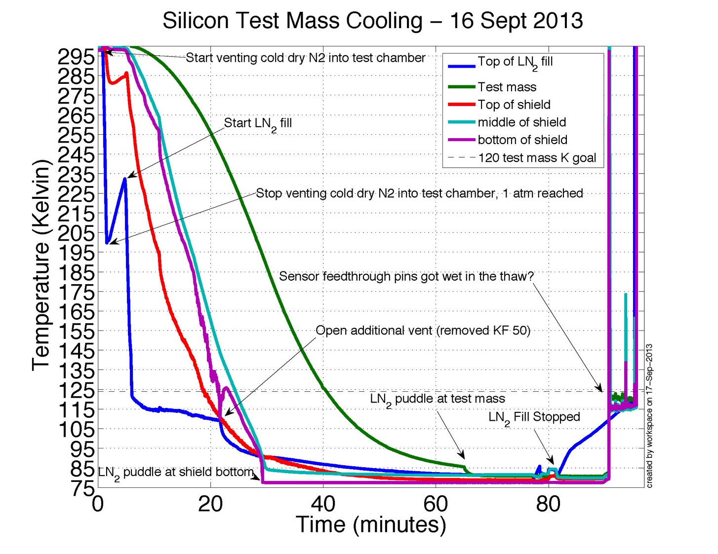

Slide 34
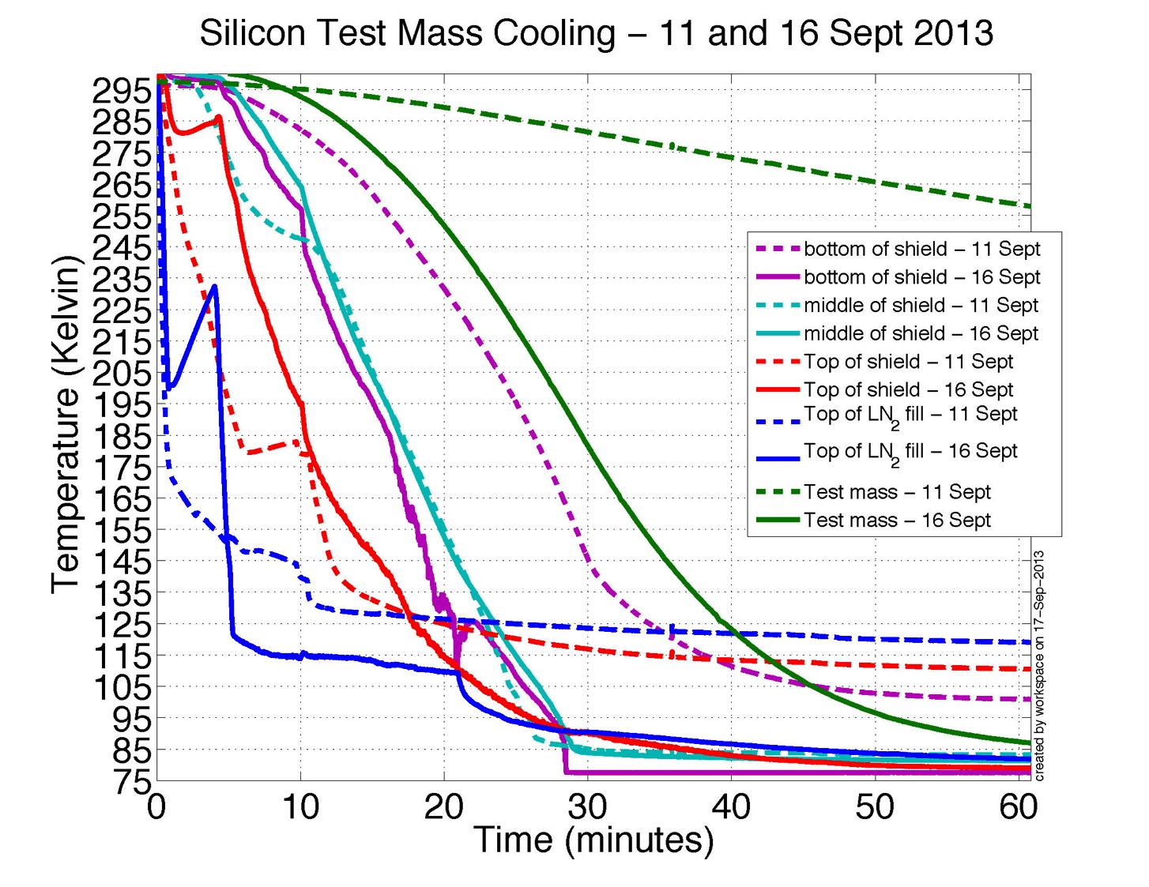
Much faster cool down

Slide 35
Future work
LIGO
More cooling experiments
  Iterate liquid nitrogen cooling design
  Apply emissive coatings
Modeling to understand cooling results
Modeling to extrapolate results to LIGO III
More complicated experiments
  Hang test mass on blade spring
  Move LN2 system onto vacuum seismic table with minimal seismic impact

Slide 36
Backups

Slide 37
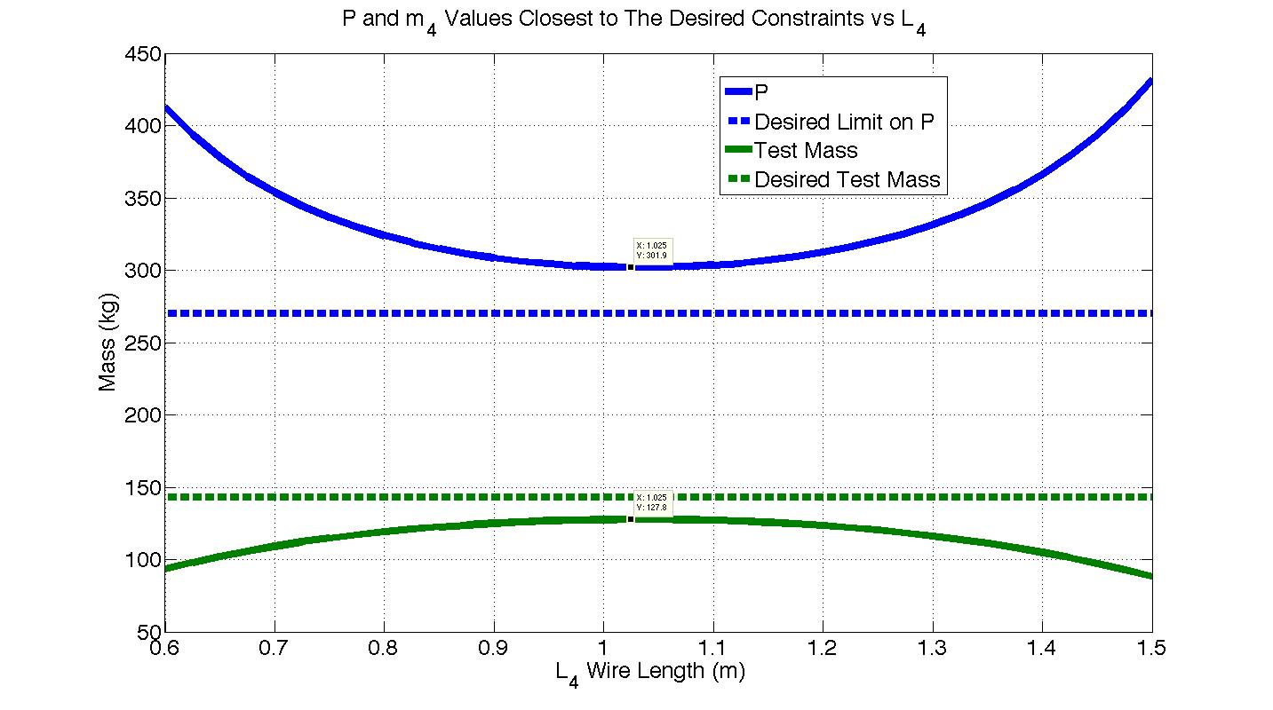
Optimal Fiber Length
Optimal length for fiber stress of 1.4 Gpa.

Slide 38
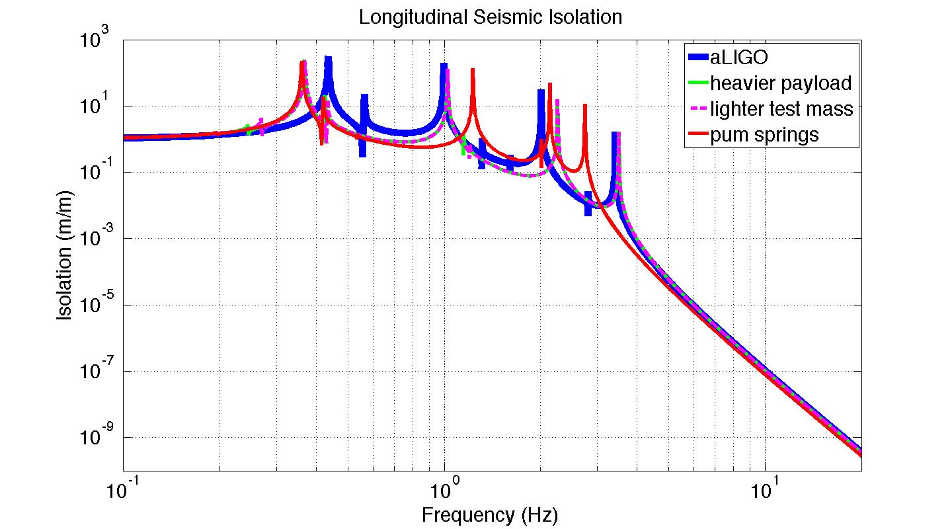
Comparing Quad Models

Slide 39
Longitudinal Stiffness
* Stiffness is the tension in the wire divided by the wire length

Slide 40
How to get a LN2 Hose to ST2
LN₂ hose
Stage 0
Actuators
Stage A
Stage 1
Sensors
Stage 2
Extra stage, A, in parallel with stage 1 carries hose. Stage A is actuated to follow stage 2 so the hose has does not short seismic isolation.

Slide 41
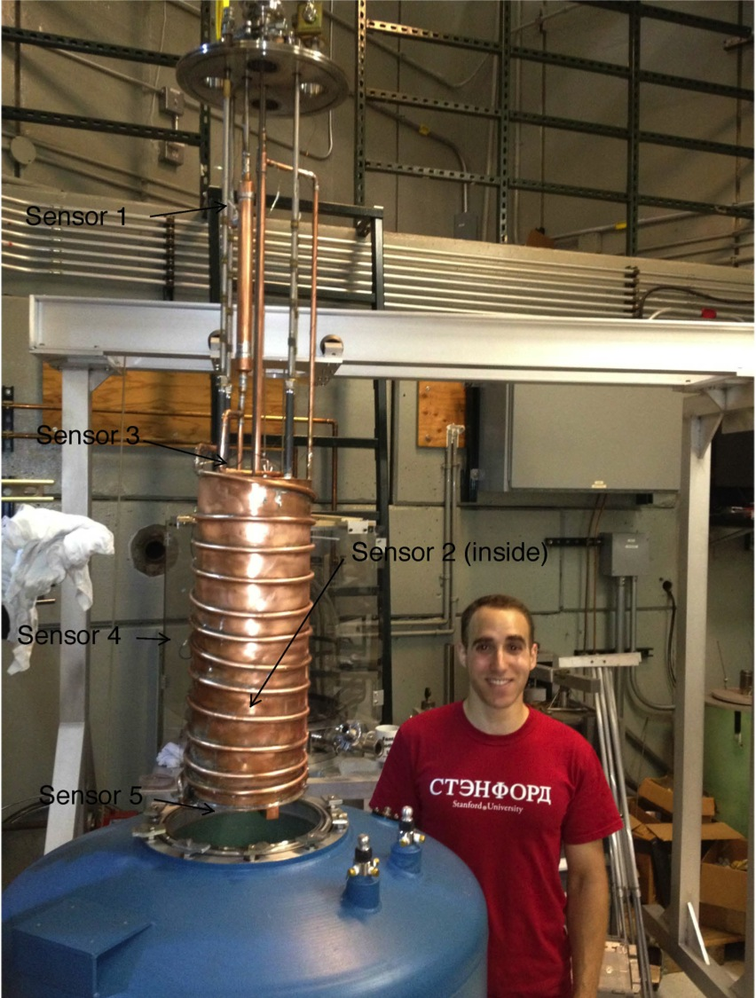

Slide 42
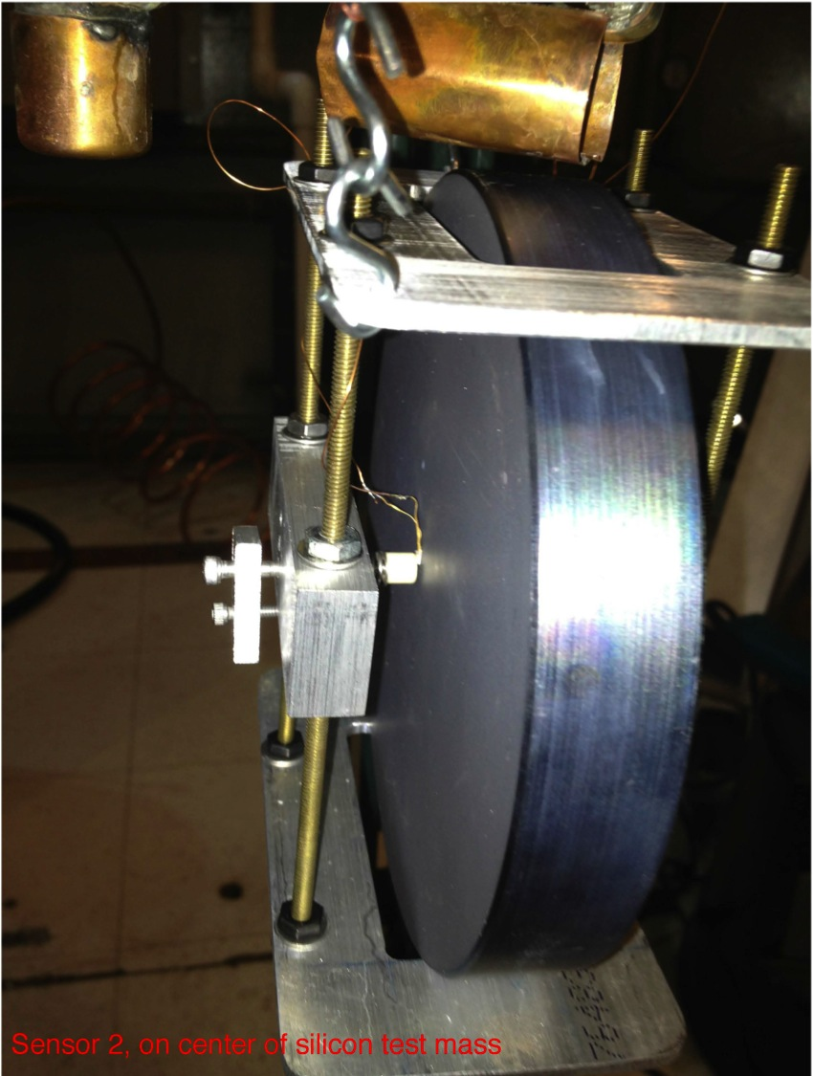

Slide 43
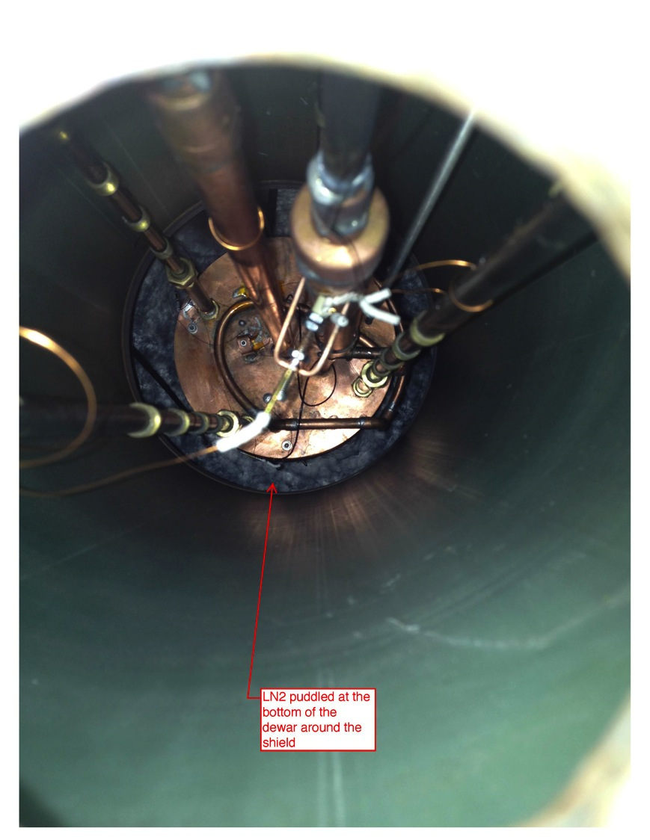
LN₂ Puddled around shield at bottom

Slide 44
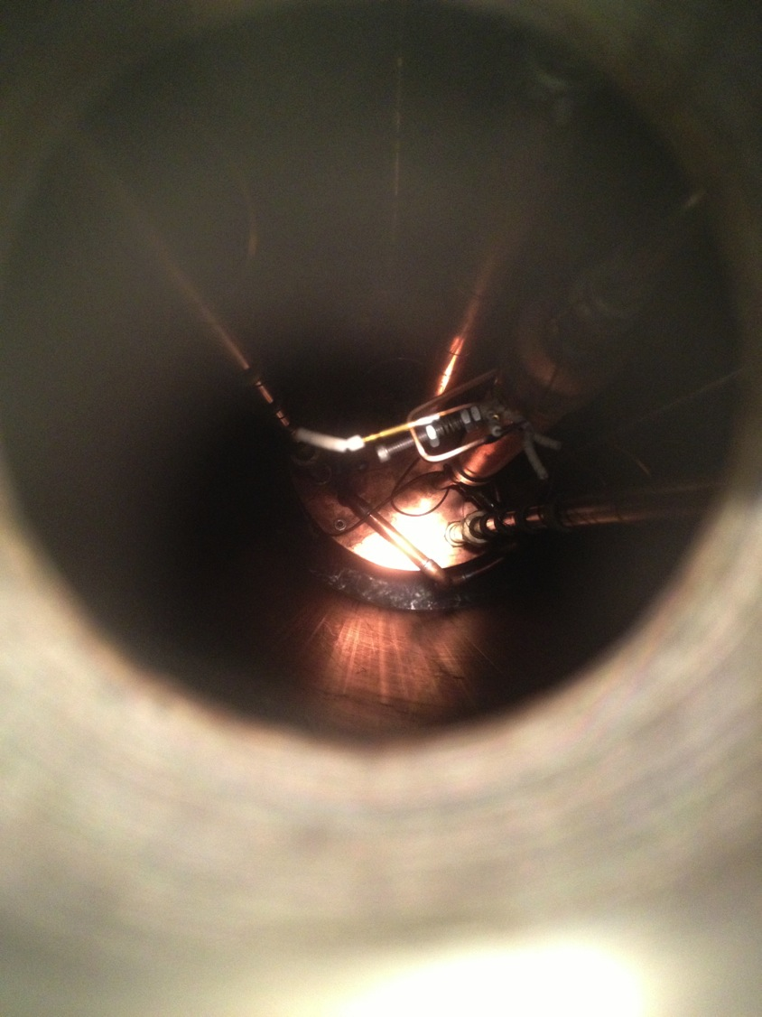
N₂ ice around shield at bottom. This happens when you try to remove the LN₂ by turning on the roughing pumps.

