Slide 1
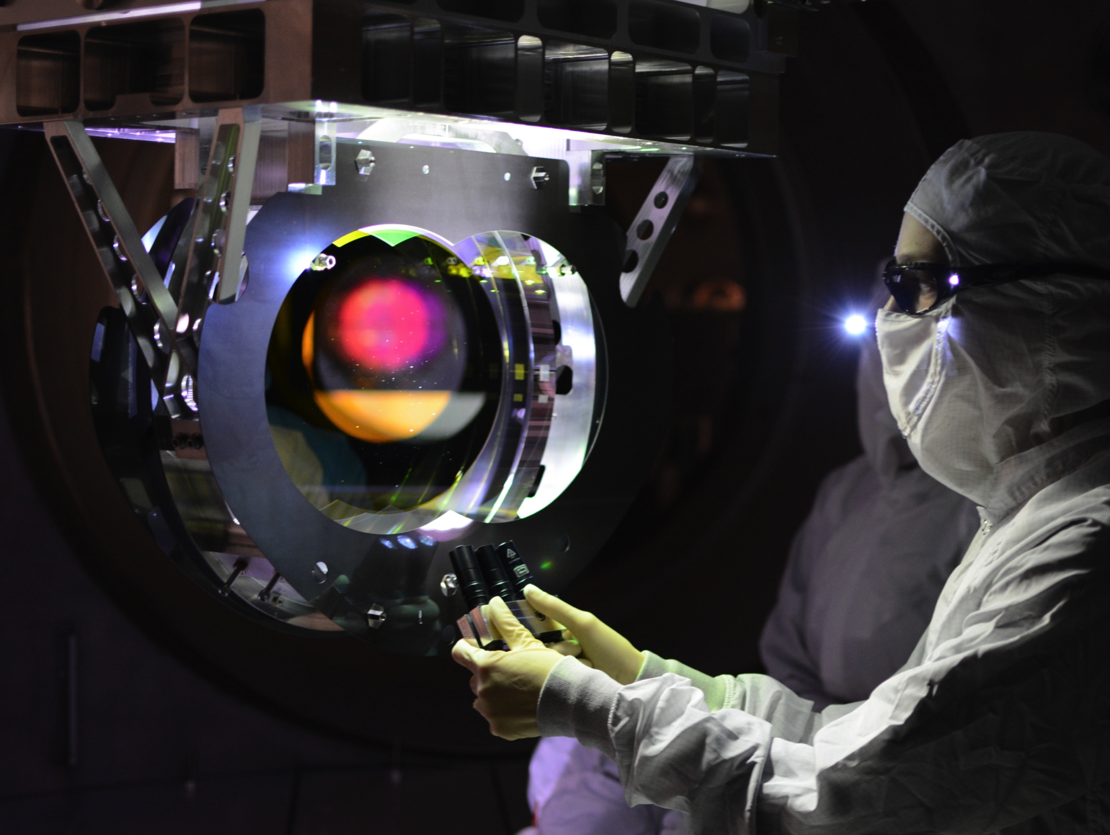
aLIGO Contamination Control & Analysis
Kate Gushwa
For the Contamination Control Working Group
LVC Meeting Hannover – September 24, 2013

Slide 2
Outline
Why do we care about contamination?
Diagnostic Tools
  How bad is it?
  Where is it coming from?
Mitigation & Protection

Slide 3
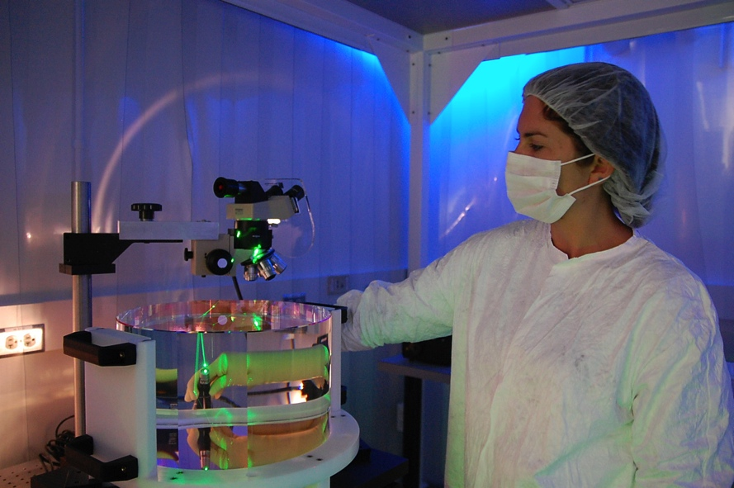
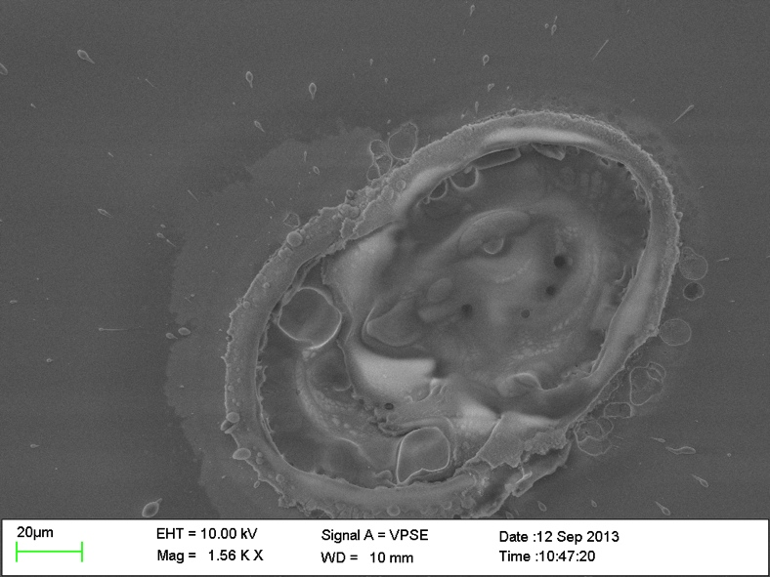
It’s All About Optics
Performance limited by core optics
Cavity loss budget: 70 ppm total
If optics are dirty…
Notes:
aLIGO optics are vulnerable to particulate contamination. Surface particles absorb and scatter power from the interferometer mode. Such losses limit recycling and signal cavity finesse, degrading shot-noise limited strain sensitivity.
Refer to Mike Zucker’s paper (see references)
Sensitivity: aLIGO is designed to be sensitive to 10⁻¹⁹ m changes in distance to detect GW.
Cavity Loss Budget: 70 ppm total for all sources between cavity mirrors.
Laser Intensity: Peak Laser Intensities of 200kW/cm²
Absorption, scatter, laser damage to optics and loss to overall sensitivity can/will result from contamination in the vacuum system.
5 ppm/optic Lambertian scatter
Allow ~2 ppm from dust over ~1 year service interval
For ε ~ 1: 0.1 ppm absorption is acquired in 6 minutes in a Class 100 cleanroom!
0.5 ppm/optic absorption
Allow 0.1 ppm from dust over ~1 year service interval
For ε ~ 1: 0.1 ppm corresponds to a single 30 µm particle in the beam area!

Slide 4
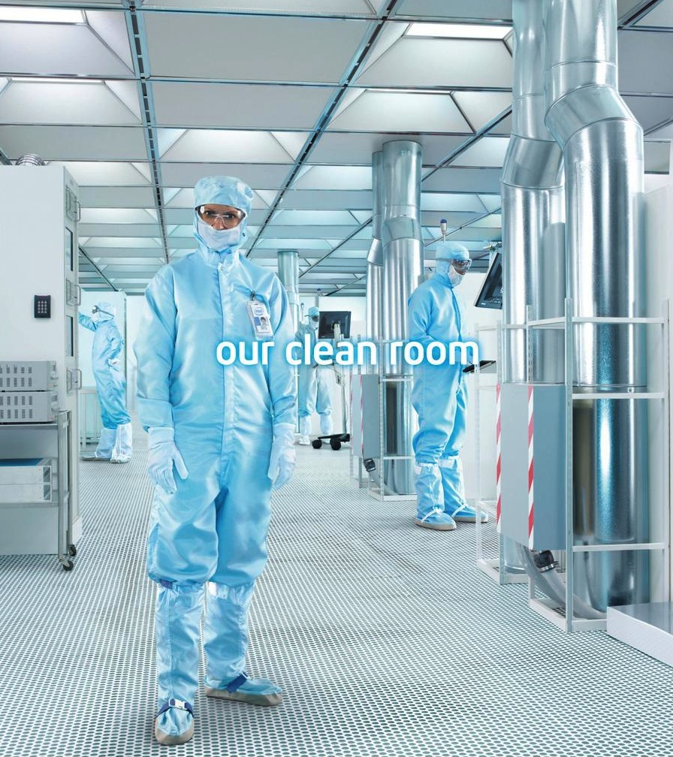
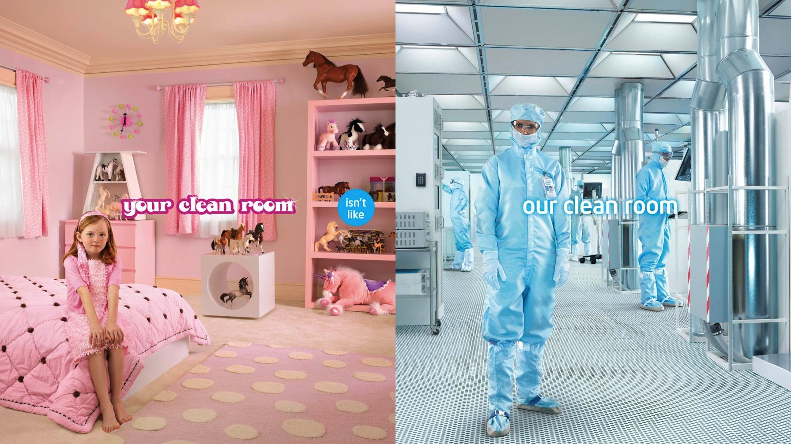
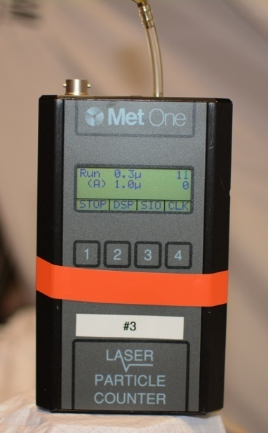
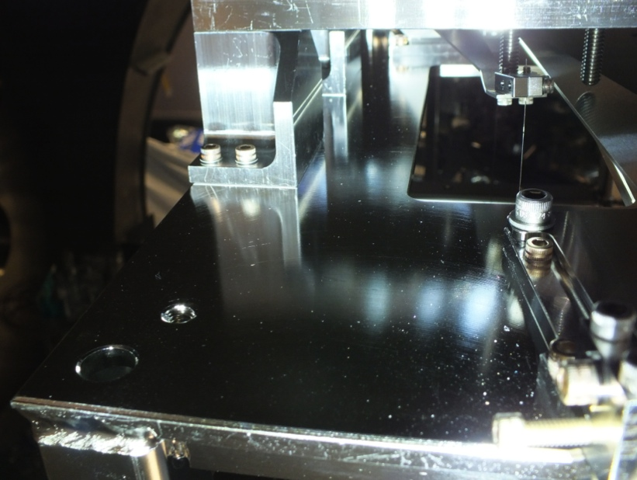
Defining Clean
Particles per:
Requirement:
Standard:
Tool:
Cleanroom Class
Volume of air
ISO 5 (Class 100)
ISO 14644-1
Particle counter
Particulate Cleanliness Level (PCL)
Area of surface
Level 65 (at full power)
IEST-STD-1246D
Not specified
Notes:
Cleanroom Class:
What we have been using all along to determine cleanliness.
Surface Cleanliness Level:
What we should have been looking at (in addition to Cleanroom Class).
ONE of the tools, but not the only one.

Slide 5
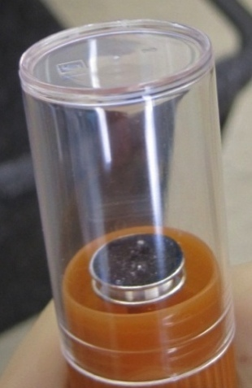
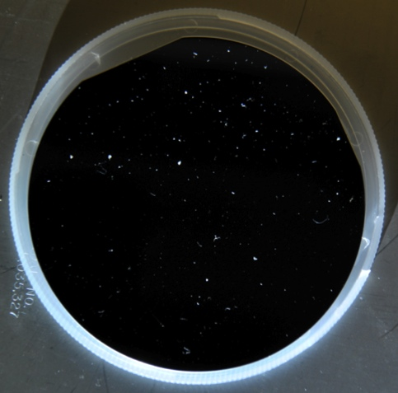
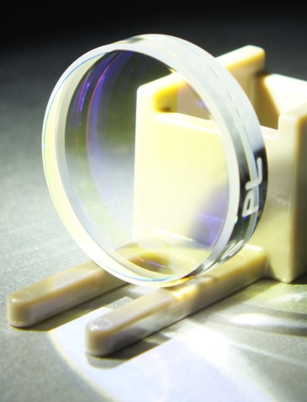
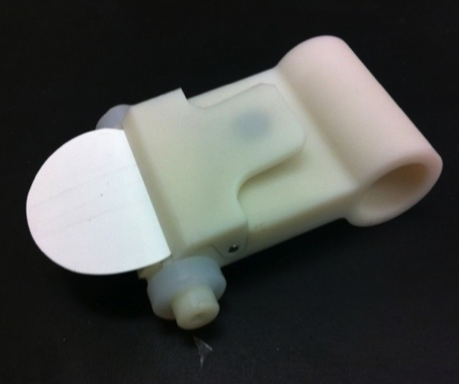
FBI Samples
4” Wafers
1” Optics
Swipe Tool
Nikon Counting Microscope
(Caltech)
PCL
Metrology Lab
(Caltech)
Absorption measurements
DIAGNOSTIC TOOLS
Scanning Electron Microscope
(Caltech)
Elemental analysis
High res images
AmScope Digital Microscope
(Caltech, observatories)
PCL
Jet Propulsion Laboratory
Automated microscope → PCL
Spectroscopy → Chemical function group

Slide 6
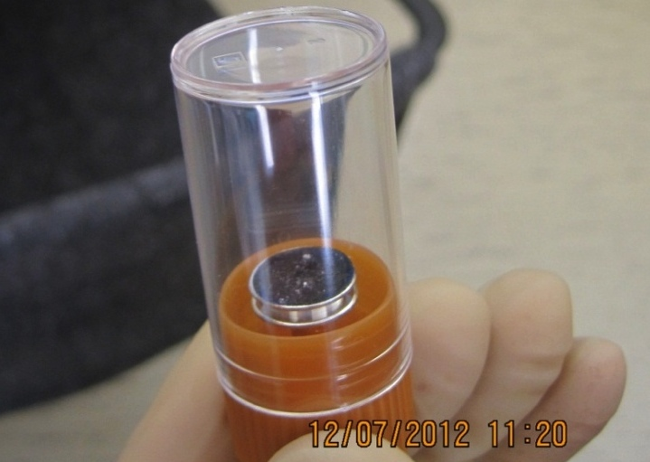
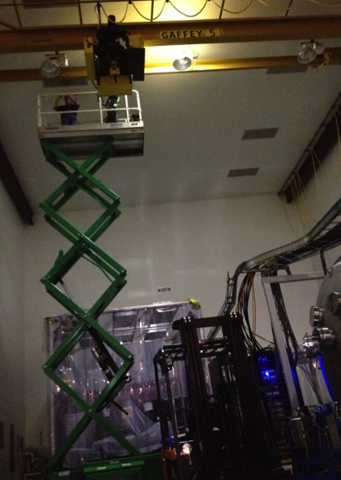
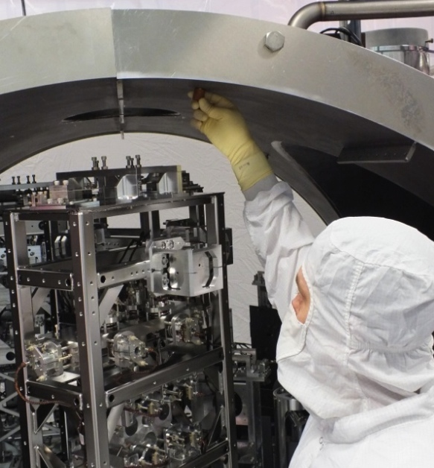
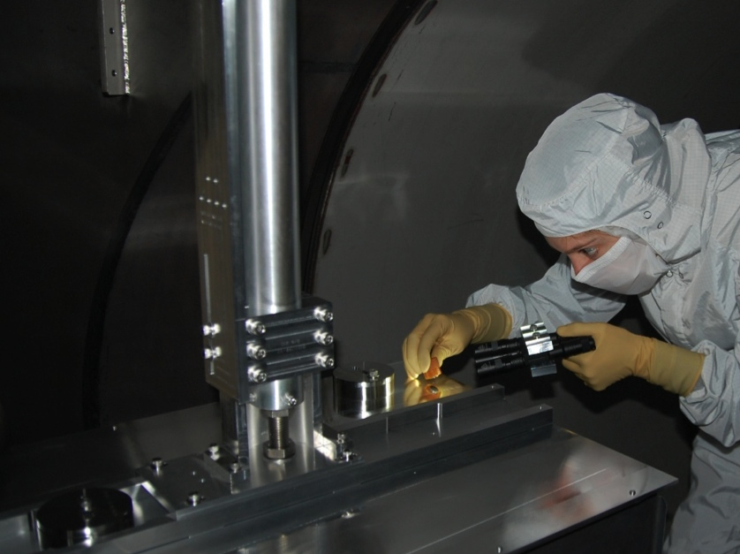
FBI Samples
Tube
Sample small area of interest
“Criminals”
“Known Suspects”
Carbon Adhesive Tab
Specimen Mount
Plug
Notes:
TO DO: FORMATTING, WORDING
DECIDE HOW TO SHORTEN SEVERAL SLIDES ON FBI SAMPLES FROM PARTICULATE TALK DOWN TO 1 SLIDE.
Collect samples at observatories of small areas and items of interest. Then sent to Caltech for analysis.
A database for all samples is in progress now.
Hunt for particulates on specimen using INCA software for EDS analysis at a selected point. INCA output:
image
peaks in spectrum
table of elements
Quorum meets to review SEM data. Factors considered:
element weight%
shape
location sampled
history
Identify by:
main element
reference, ex: SSTL
“known suspects”

Slide 8

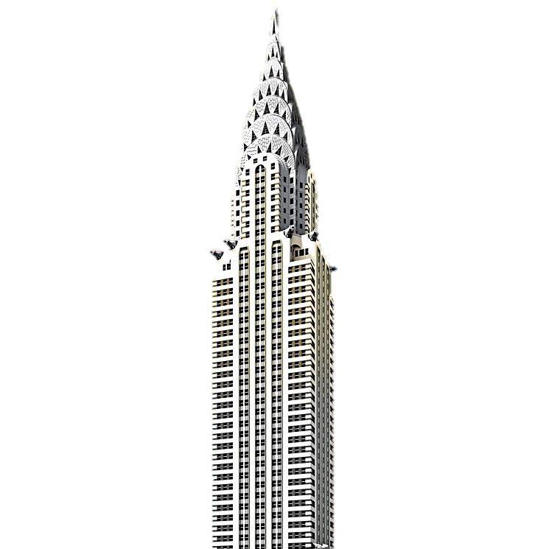
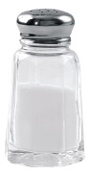


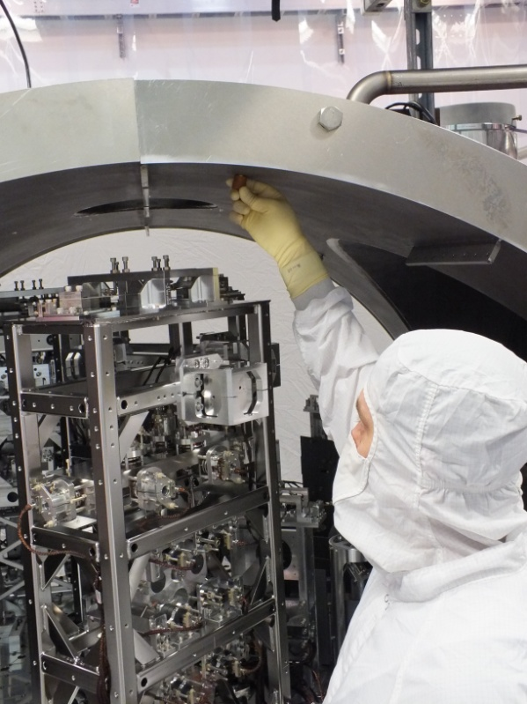
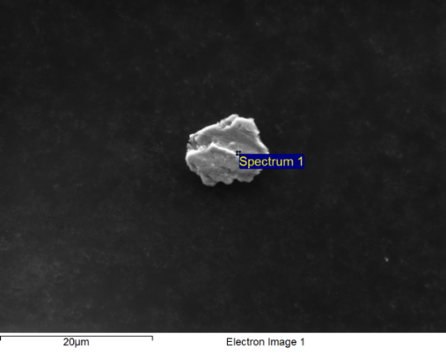
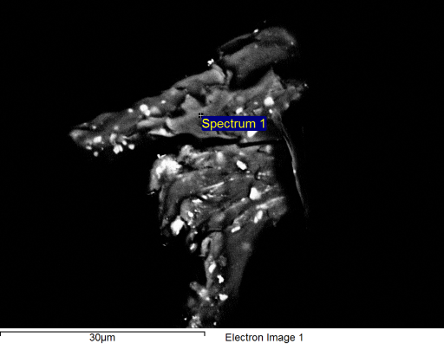
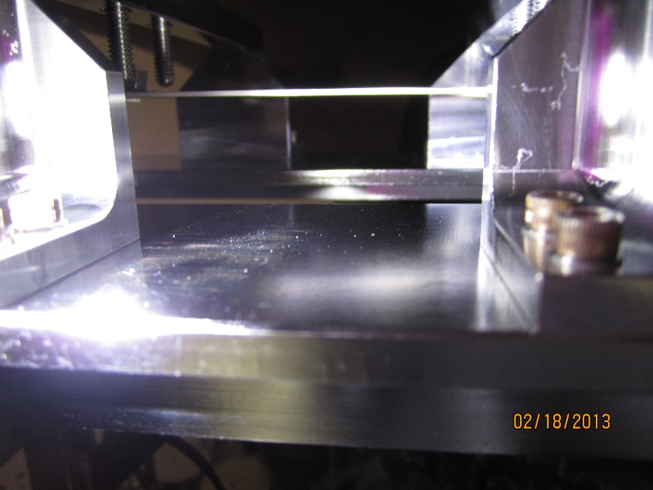
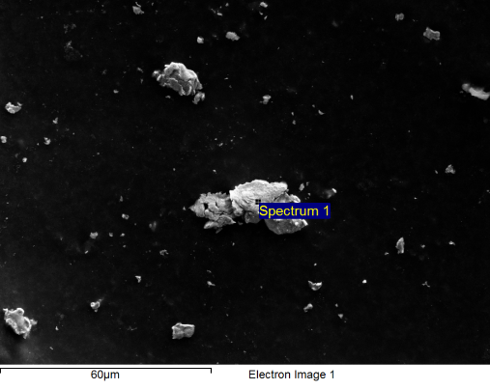
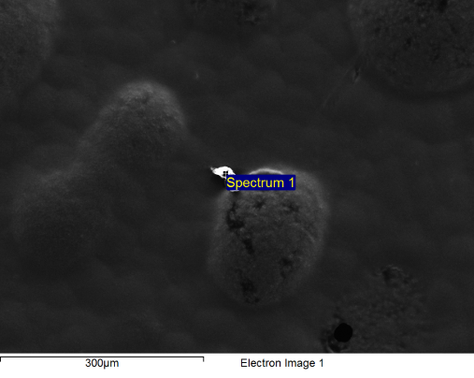
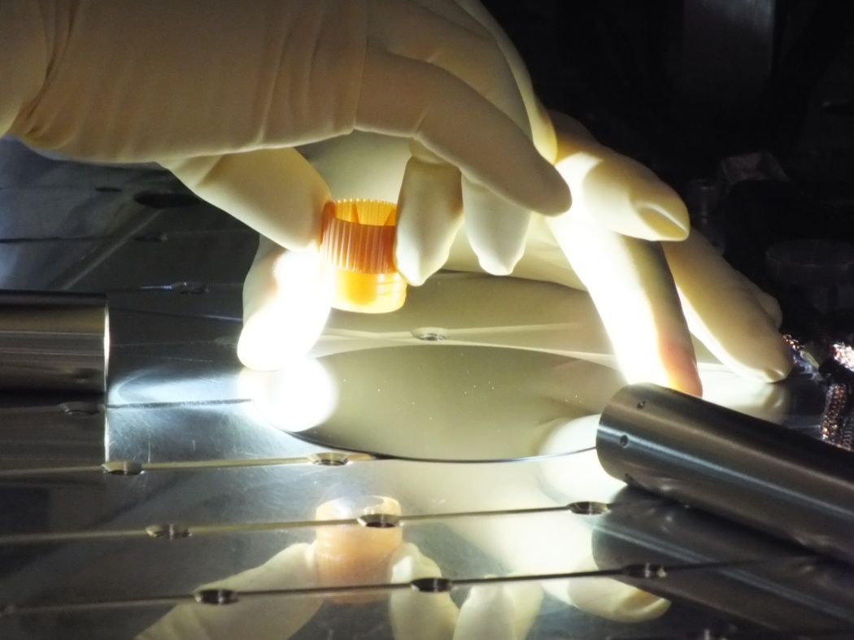
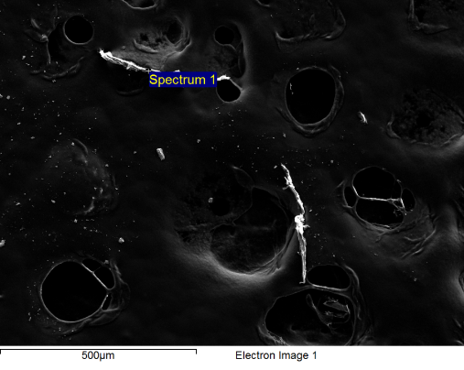
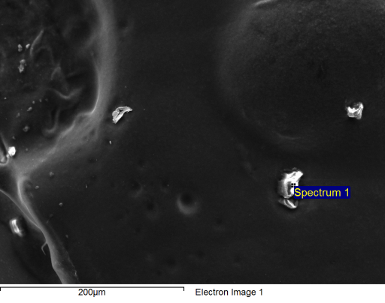
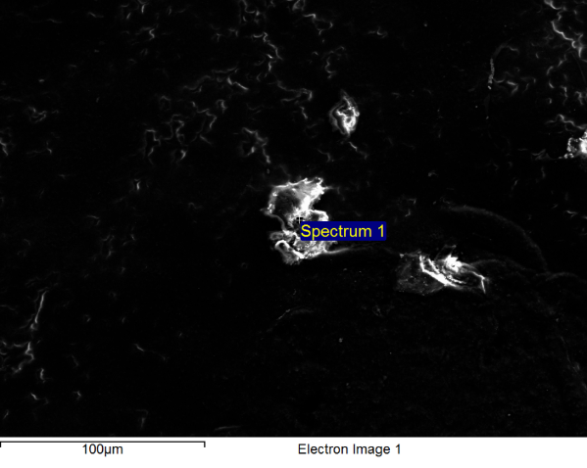
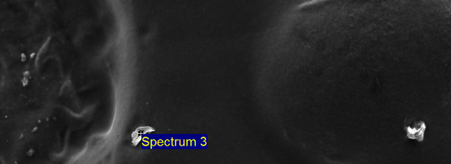
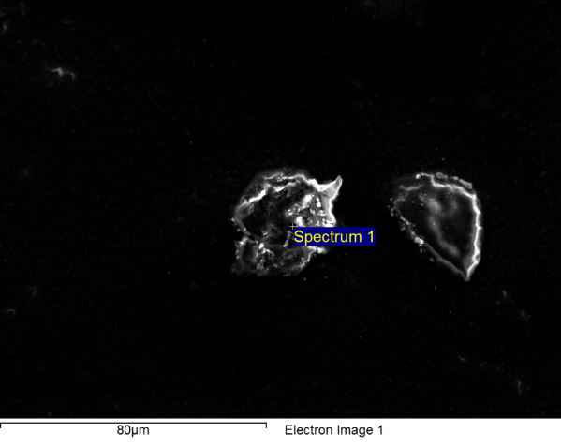
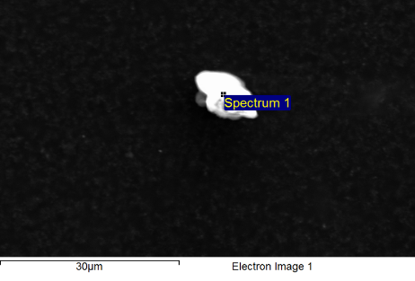
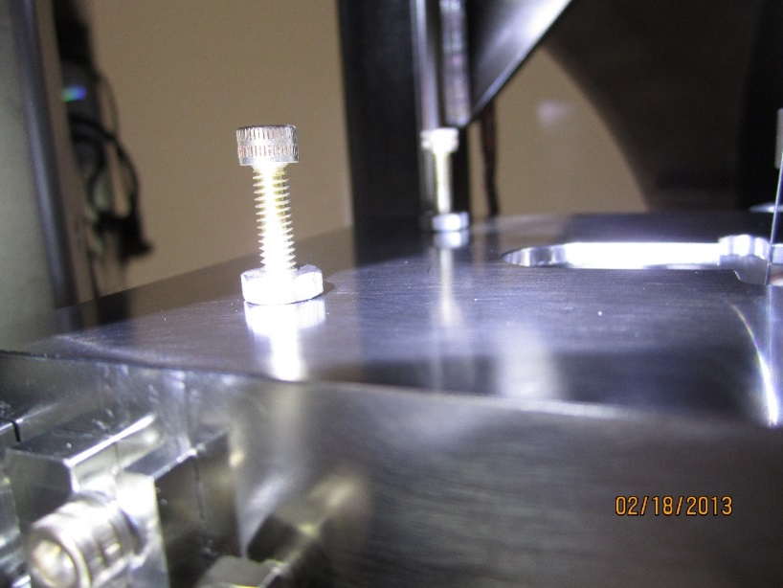
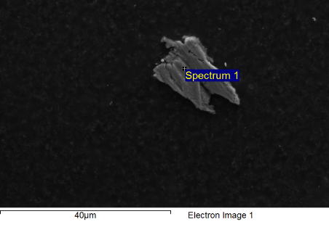
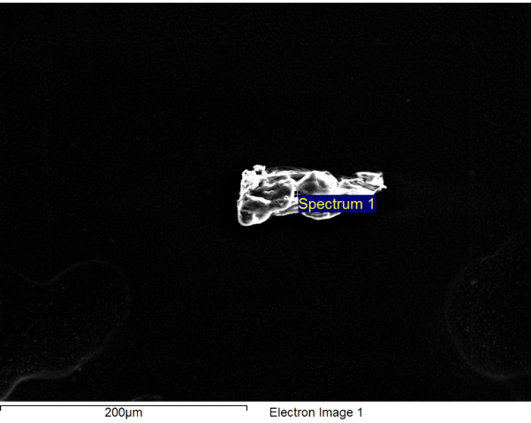
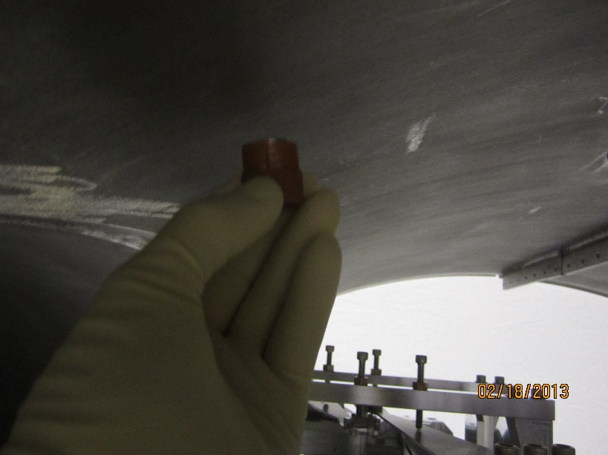
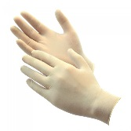
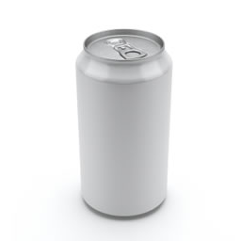
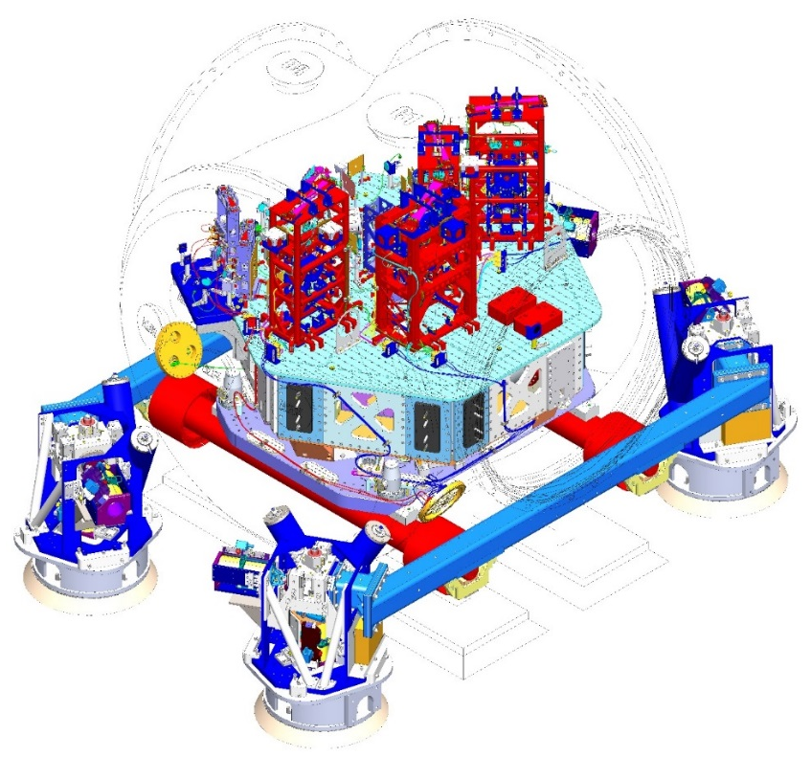
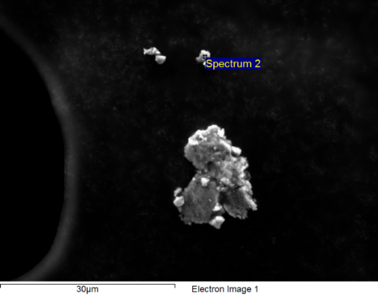
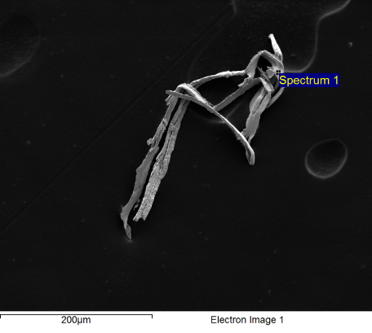
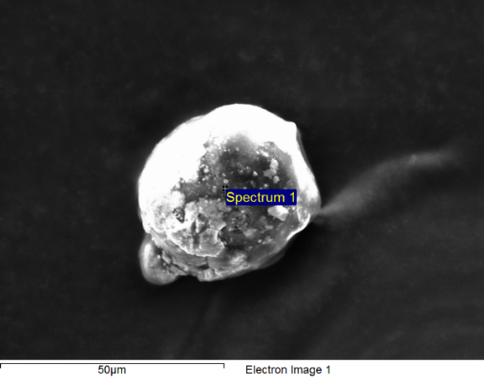
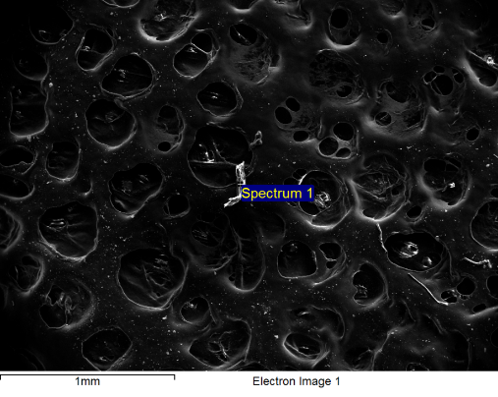
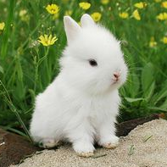

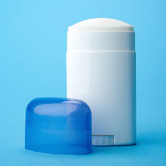
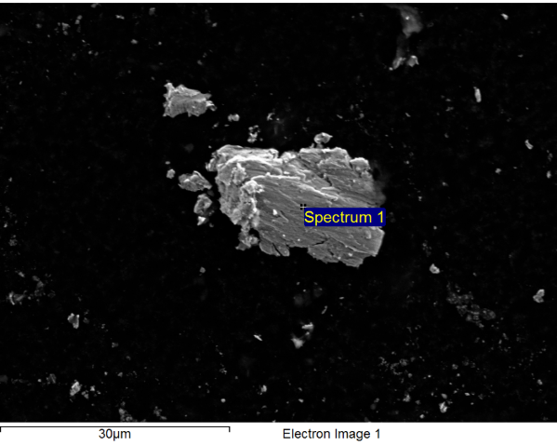
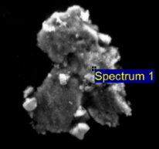
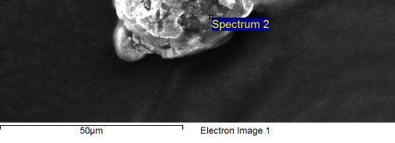
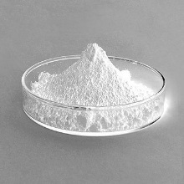
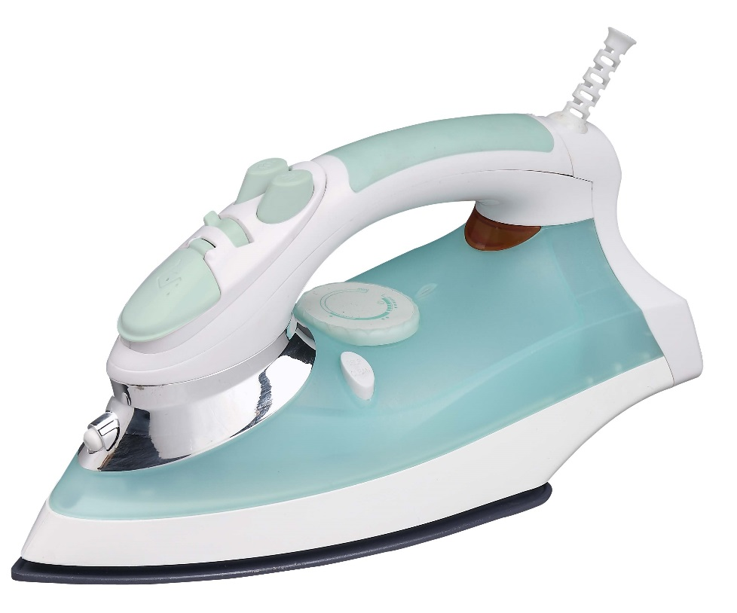
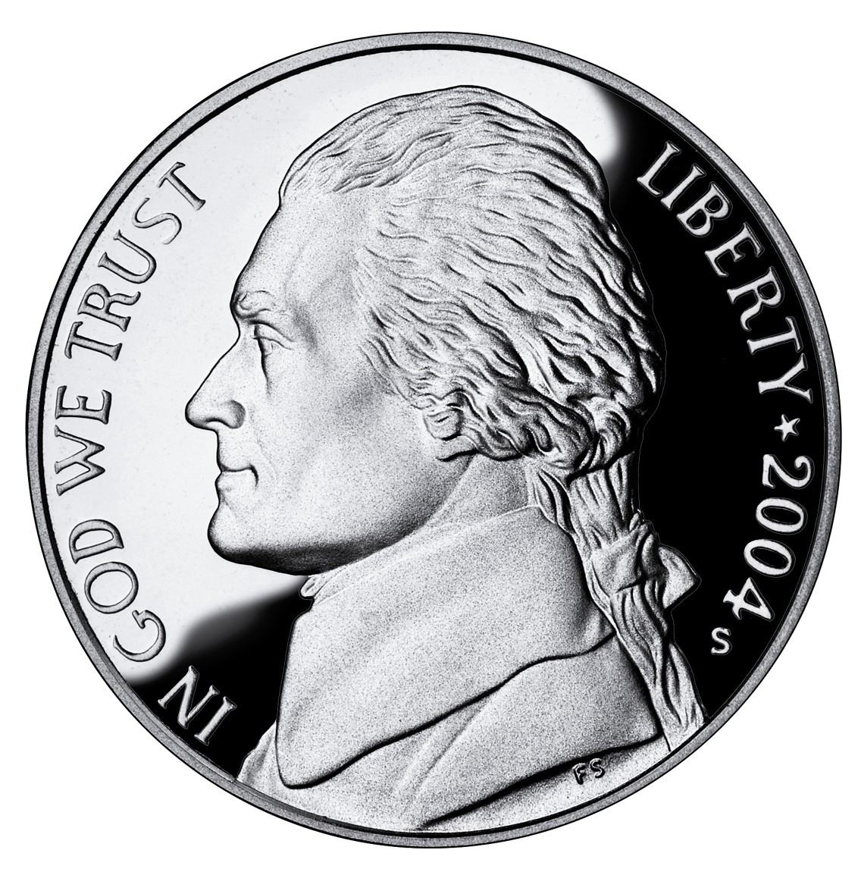
LHAM2 – SEM Analysis
Location: Ceiling above MC3
Date: Dec 2012
Guess: Metal
Location: MC3 tablecloth
Date: Dec 2012
Guess: Metal & C3
Location: Top of MC1
Date: Feb 2013
Guess: C3
Aluminum
Silver & Copper
Contaminated glove residue
Aluminum
SSTL
SSTL
Unknown salt
Gloves / Cable
C3
Unknown salt
Sweat
Zinc/ Nickel plating
Unknown
Location: MC1 tablecloth
Date: Feb 2013
Guess: C3
Unknown salt
Zinc oxide
Silver
C3 / Glove Liner
Iron oxide
Location: Ceiling
Date: Feb 2013
Guess: Metal
Location: Witness plate in front of MC1 & MC3
Date: Dec 2012
Guess: Metal & C3
?
SSTL

Slide 9
FBI Samples on Instrument Surfaces
Finding: no smoking gun
Group | Material | Specimen | Total
Metals | Any Metal | 63 | 63
Biological | Hair | 1 | 7
 | Skin, Sweat, Saliva | 6
Fibers | C3 | 9 | 28
 | Glove Liner | 2
 | Jeans | 1
 | Unknown Fiber | 4
 | Wipe | 12
Other | In-Vacuum Cable | 2 | 42
 | Carbon | 21
 | Fused Silica | 4
 | Glove | 15
Unknown | Unknown | 25 | 25
Notes:
*Define instruments
Important notes:
Tendency to collect particulates that are large, out of the ordinary, etc.
Tendency to analyze larger particles on SEM (miss a lot of the small stuff because hard to get a good reading)
Need to analyze more specimen to get a better percentage breakdown of materials.
A database is being created to store all the collected SEM data. Once operational, it will be much easier to compare samples and draw conclusions.
Summary:
Metal was most commonly found. This is not surprising given that most of our parts are metal.
Fairly high amount of carbon, whose source is unknown. Could be partially due to carbon tape on FBI samples.
After metal, we see a lot of C3, wipes, and gloves; suggesting we should re-evaluate our use of these materials.
15% unknowns. We still have a lot to learn.
Biological seems very low at 4% HOWEVER the biological materials tend to be very small (with the exception of hair) and are often overlooked. Have limited time per sample, and tend to focus on big stuff (especially in early SEM sessions). Plus small particles are hard to get a good reading on.

Slide 10
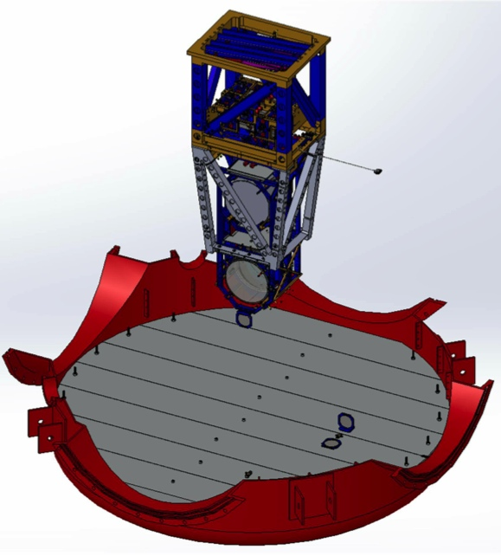






4” Wafers & 1” Optics
Notes:
TO DO: TWEAK LAYOUT, COLORS. GET IMAGES FROM EDDIE WITHOUT CIRCLES AND LINES ON THEM (like what is covered up by green here).
TRY TO FIND BETTER IN CHAMBER PICS.
W&O placed in chamber vertically and horizontally.
Allow us to collect data on contamination specific to chambers, certain activities (install work, pump down), over time.
Now putting wafers and optics in same locations, so no more apples to oranges comparisons.

Slide 11
Wafer PCLs – WHAM2 ISI Table
On the right track – Caltech and JPL PCLs matched.
Notes:
TO DO: TWEAK FORMATTING IF TIME (highlight particle size that defines PCL for each)
NOTES ARE DONE.
1 cycle, heavy work:
T1300171
Location: North end of stage 0 (mostly)
Witnessed ~6 weeks of install activities, pump down (Jan/Feb 2013), subsequent vent, first few weeks of install activities in Feb 2013.
Was moved when in the way of work, and accidentally touched and lifted with gloved hands.
Example of worse case scenario for chamber
Has same period of light work in common with both samples. Has pump down and vent in common with 448.
No pump down, light work:
T1300448
Location: SW side on stage 0 right hand side
In air ~8 weeks (Feb – April 2013) during MC and PR alignments.
Only difference between 448 and 447 is witnessing pump down.
1 cycle, light work:
T1300447
Location: NW side on stage 0 left hand side
Placed just prior to holiday pump down (Dec 18, 2012).
Witnessed pump down, subsequent vent, and ~8 weeks (Feb – April 2013) of light work during MC and PR alignments.
* How we know we’re doing it right– same results as JPL

Slide 12


Materials on Wafers and Optics
20 x Raman
Special cases – JPL organic material identification
Example: LLO HAM3
  Mixed silicates (soil)
  Complex mix of hydrocarbons
  Skin dander
  Polyester & cotton fibers
Notes:
TO DO: FORMATTING
IF TIME ALLOWS – ADD TOP HAM3 VIEW WITH ARROWS SHOWING WHERE THE WAFER AND OPTIC WERE PLACED
IF TIME ALLOWS – CAN ADD PSL WATER LINE SAMPLE (T1300461) TO SHOW FBI SAMPLE ANALYSIS BY CIT WAS CORRECT
JPL analysis only for special cases. Performed after counting at CIT.
Example:
Location:
T1300103 (wafer) – on +X of table
T1300109 (optic) – PEEK clamp in front of MC2
In chamber Dec 2012 – Feb 2013
Witnessed pump down and vent, but NO chamber work
BOTH:
Primary mixed silicates (quartz and mixed cation silicates). Common component of soil tracked into cleanrooms.
Molecular contamination absorbed on the particulate that is a complex mix of hydrocarbons
Skin dander
Wafer fibers:
123x13 microns = degraded polyester
568x72 microns = cotton

Slide 13


Particle Cleanliness Validation System (PCVS) aka Swipe Tool
Visited Nation Ignition Facility (NIF)
New swipe tool based on NIF design
Quick PCL calculation
To be implemented soon
Notes:
TO DO: FORMATTING, ADD BETTER TOOL PICTURE.
GET OFFICIAL NAME OF TOOL (and then change on ref slide).
National Ignition Facility (NIF) is a large laser-based inertial confinement fusion research project.
NIF & LIGO – different goals, but similar concerns. Even tiny amounts of contaminants can damage expensive optics and reduce the amount of laser light that reaches the target (which means less energy on the target, making ignition more difficult)
After being cleaned, NIF optics are always kept in a Class 100 environment or better.
https://dcc.ligo.org/LIGO-D1300697 (tool)
Developed new tool based on NIF design. Prototyped and tested at LLO.
First tools and Amscopes are already at the observatories.

Slide 14

MITIGATION & PROTECTION

Slide 15







The Human Factor
Body Box testing
  Finding: At least ½ class improvement with scrubs
Implemented:
  Scrubs
  Dedicated shoes
Future research:
  New garb options
Total Δ = 15,433 particles
Total Δ = 19,282 particles
Total Δ = 17,340 particles
Notes:
TO DO: FORMATTING, PICTURES
Body Box:
Performed series of exercises in an ISO Class 3 box, and particles were collected at knee and sub floor levels. This was done for older and newer garb, with street clothes and scrubs underneath.
Scrubs are ESD micro denier polyester.
Found that wearing scrubs, even with older garb, will significantly reduce contamination. For Kate & Margot, it made a difference in cleanroom class. For Calum, it made half a class difference.
Street clothes shed 15,400 – 19,300 more particles than scrubs during test.
In Japanese semiconductor industry, the cleanroom suits have 1 opening- a vent, which attaches to an active exhaust with a small HEPA unit. The HEPA unit is worn at the worker’s waist.

Slide 16





Facilities
Implemented:
  Optimized transition area
  Dycem flooring outside VEA
  Double buckets
  Nova Clean
Future (all portable):
  Dycem flooring in VEA
  Air showers
  Cross-flow system with ionization
  Particulate monitoring system
Notes:
TO DO: FIND BEFORE PHOTO OF TRANSITION AREA
FIX FORMATTING AND ANIMATIONS
Small changes make a big difference. See photo of optimized LLO transition area. Ex:
Define dirty and cleaner areas, so dirty shoes aren’t used in same area as clean booties.
Swap regular shoes for dedicated shoes, store in cubbies.
Visual reminder of proper method to gown and de-gown (Prudential posters).
Mirrors for self check.
Wipe down area with pre-saturated wipes to clean things like phones being taken into LVEA.

Slide 17






Mitigation Tools and Methods
Implemented:
  Cleaning on the go:
    Flashlight arrays
    UV-A blacklights
    Custom vacuum cleaners
    Wet wipes
  Glove wash with IPA
Currently testing gloves & wipes:
  Non-volatile residue
  Particles and fibers
  Particle removal efficiency
Notes:
TO DO:

Slide 18







Cleaning & Protecting Suspended Optics
No-contact cleaning approach aka cone of shame
  Protective device for spray application of First Contact
  Custom brushes
  Successful application to MC
Ionization gun aka Top Gun
  Efficient cleaning
  Rapid static discharge
Notes:
First Contact still the gold standard.
Impossible to keep optics clean through 3-5 months of open installation work.
Top Gun:
High-performance ionizing air gun used in both electronics manufacturing and cleanroom applications.
Features high blow-off force to provide efficient cleaning and rapid static charge decay.
A 0.2 micron filter at the exit of the gun ensures the air is clean. In our applications we used Nitrogend and currently restrict to pressure of 30 PSI.
Full details at https://dcc.ligo.org/LIGO-T1300687

Slide 19


Cleaning & Protecting Suspended Optics
Currently researching:
  Ionized air knife system
  Delivers 1 sec pulses up to 250 psi
Air knife
trolley assembly attached to Quad sleeve
Air knife with ionizing bar
Notes:
Air-Knife:
For in-situ cleaning of optics either just prior to pumpdown or after initial pump down (roughing) a team at CIT are developing an Ionized Air Knife System.
The system can deliver 1 second pulses up to a pressure of 250 psi through a 4 thou inch gap.
The system is being developed for air, but can also be used with Nitrogen. For cleanliness and to minimize contaminants being introduced the gas is filtered and all of the lines and connections are cleaned prior to use.
Similar device used by NIF shows we can remove surface debris between 30 micron and 100 micron with fairly high efficiency

Slide 20
Conclusions
Contamination is a problem without an quick, easy solution.
There are many sources and causes of contamination.
We should re-evaluate reasons for old practices and purchases.
A lot can be learned from industry.
We are taking steps in the right direction.

Slide 21
Contamination Control Working Group
Caltech – Calum Torrie, Margot Phelps, Kate Gushwa, and Jeff Lewis along with GariLynn Billingsley, Norna Robertson and Dennis Coyne
LHO – Betsy Weaver, Cheryl Vorvik, Jodi Fauver, Mike Landry, and John Worden
LLO – Bryan Smith, Danny Sellers, Gary Traylor, Matt Heintze, Brian O’Reilly, and Richard Oram

Slide 22
References
LIGO-T1300511-v1 Some thoughts regarding Particulate Contamination Requirements
LIGO-T080067-v1 Protecting Installed Optics from Particulates
Contamination Control wiki
LIGO-E0900047 aLIGO Contamination Control Plan
LIGO-T1300093-v7 Prudential Body Box Results
LIGO-G1300777-v2 Contamination Control Requirements – Gloves, Cleaning on the Go and The Plan (past, present, and future)
LIGO-G1300427-v3 Slides for Contamination Control
LIGO-T1300493-v1 “Known” Particulate Sample Poster
LIGO-E1201096-v4 Contamination Sample Handling – How to receive, use, send, buy and store samples.

Slide 23
The Human Factor (alternate)

