Slide 1
Advanced LIGO:
A second-generation gravitational-wave detector
The Violent Universe – Institute of Physics
31 October 2013
David Shoemaker
For the LIGO Scientific Collaboration

Slide 2
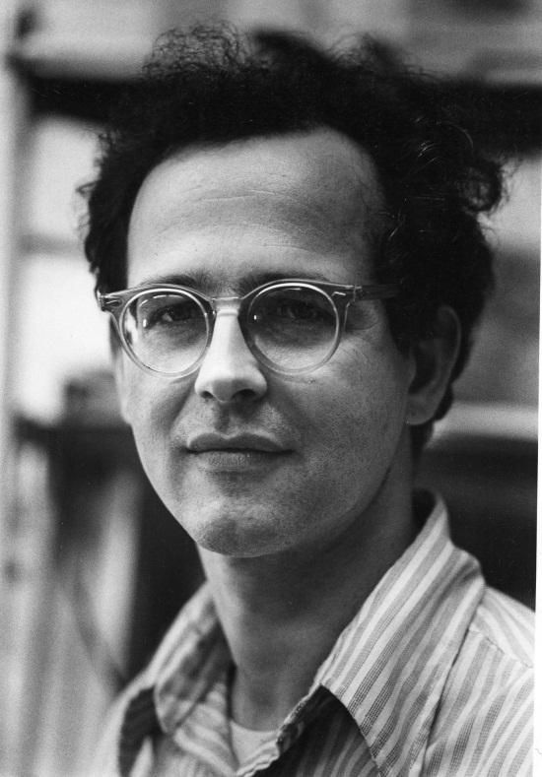
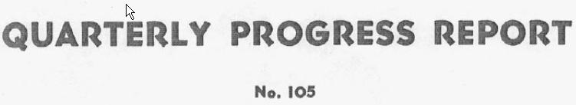
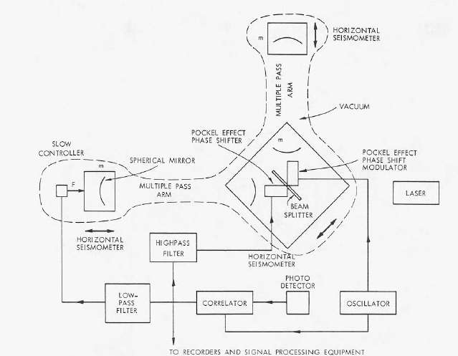

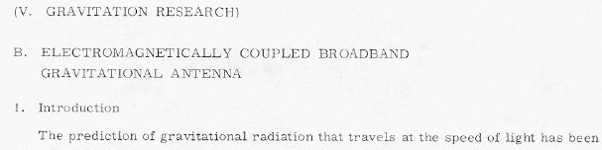
The starting point for GW detection via Interferometry
Rai Weiss of MIT was teaching a course on GR
in the late ‘60s
Wanted a good homework problem for the students
Why not ask them to work out how to use
laser interferometry to detect gravitational waves?
Weiss wrote the instruction book we have been following
ever since

Slide 3
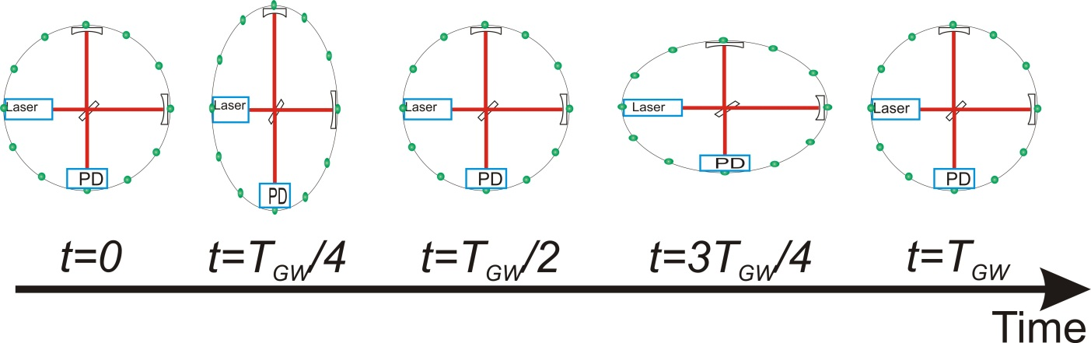
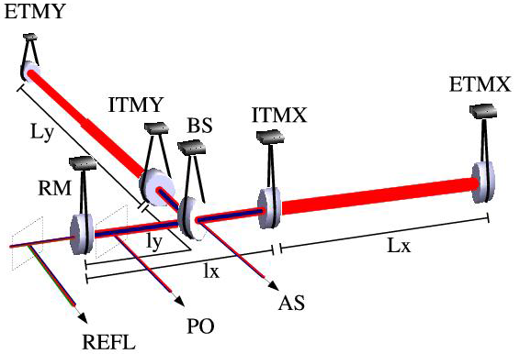
Interferometric Gravitational-wave Detectors
Enhanced Michelson interferometers
  LIGO, Virgo, and GEO600 use variations
Passing GWs modulate the distance between the end test mass and the beam splitter
The interferometer acts as a transducer, turning GWs into photocurrent proportional to the strain amplitude
Arms are short compared to GW wavelengths, so longer arms make bigger signals
→ multi-km installations
Arm length limited by
taxpayer noise….
←4km→
←4km→
Laser →
Photo
diode

Slide 4
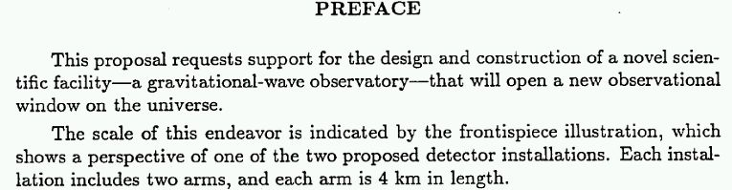
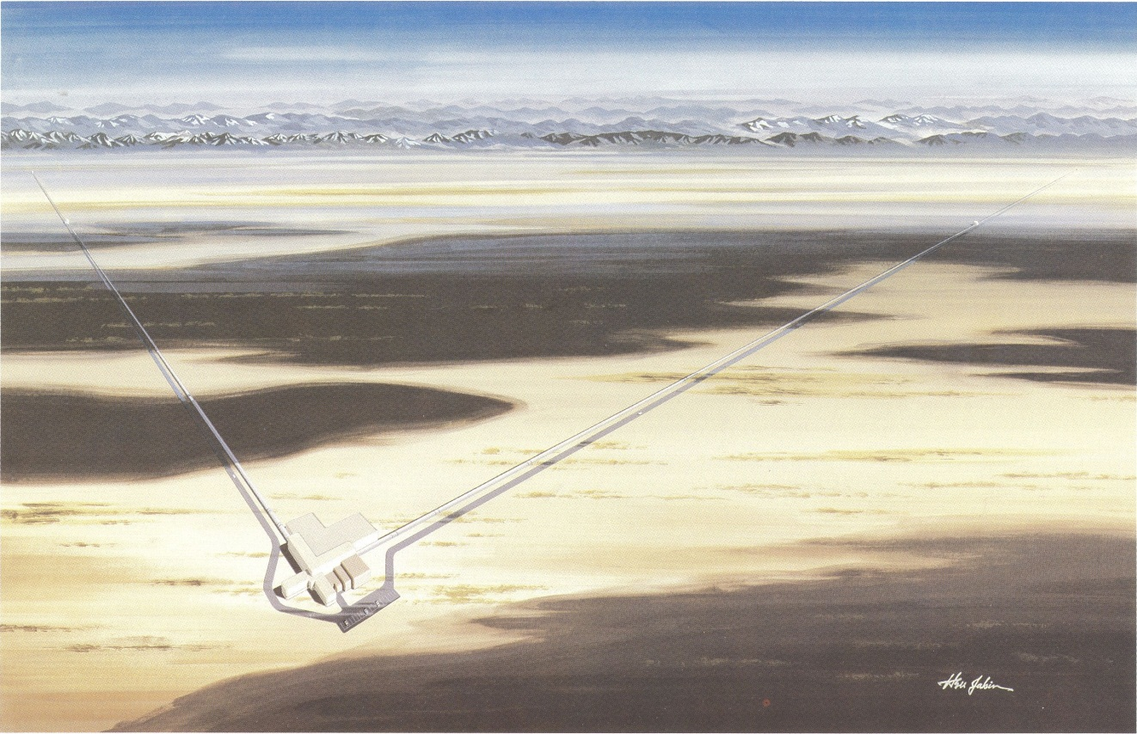
Weiss’ groundwork and a worldwide development effort led to a 1989 Proposal to the US NSF

Slide 5
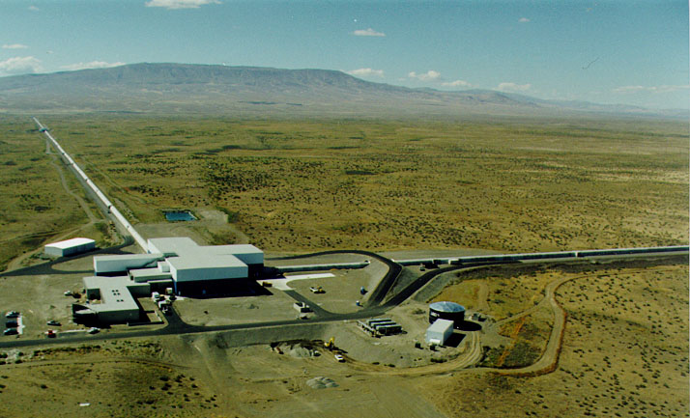
LIGO:
Today, Washington state…

Slide 6

…LIGO in Louisiana

Slide 7

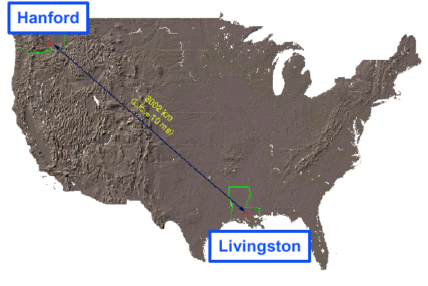
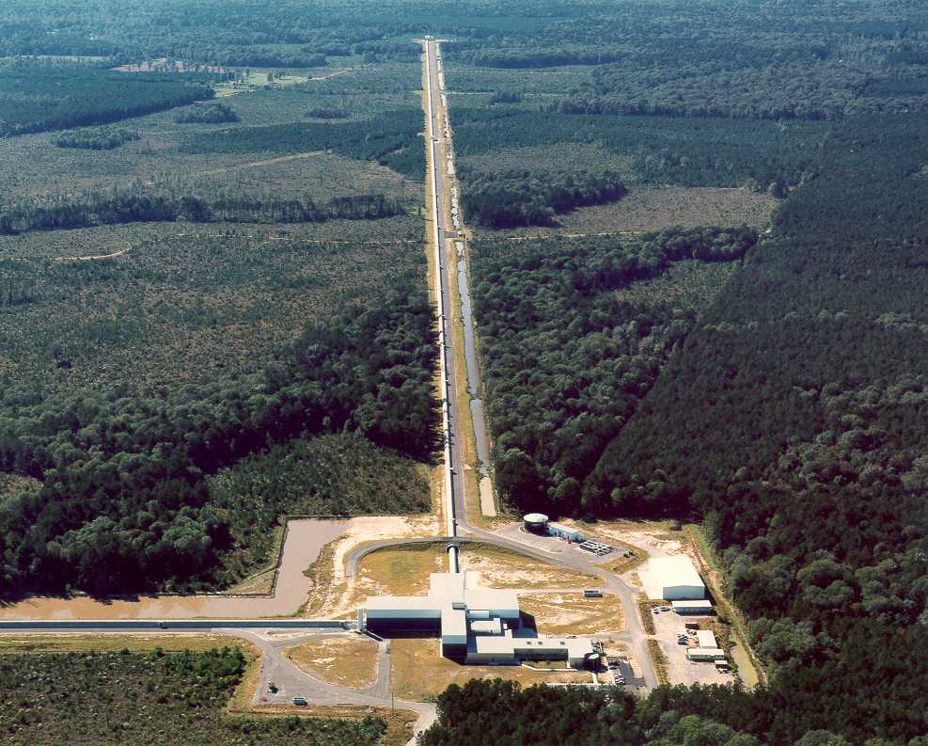
LIGO Laboratory: two Observatories and Caltech, MIT campuses
Mission: to develop gravitational-wave detectors, and to operate them as astrophysical observatories
Jointly managed by Caltech and MIT; responsible for operating LIGO Hanford
and Livingston Observatories
Requires instrument science at the frontiers of physics fundamental limits
MIT
Caltech
LIGO Livingston
Notes:
LIGO is actually two observatories.
Describe parameters
Emphasize that the arms are in ultra high vacuum. 8 km of steel 1.2 m dia beam tubes at each site
Separate observatories allow for coincidence detection – since the detectors see uncorrelated noise, only a true gravitational wave would appear on all the interferometers with the correct amplitude.
Emphasize that the LIGO Observatories were designed and are operated by Caltech and MIT

Slide 8
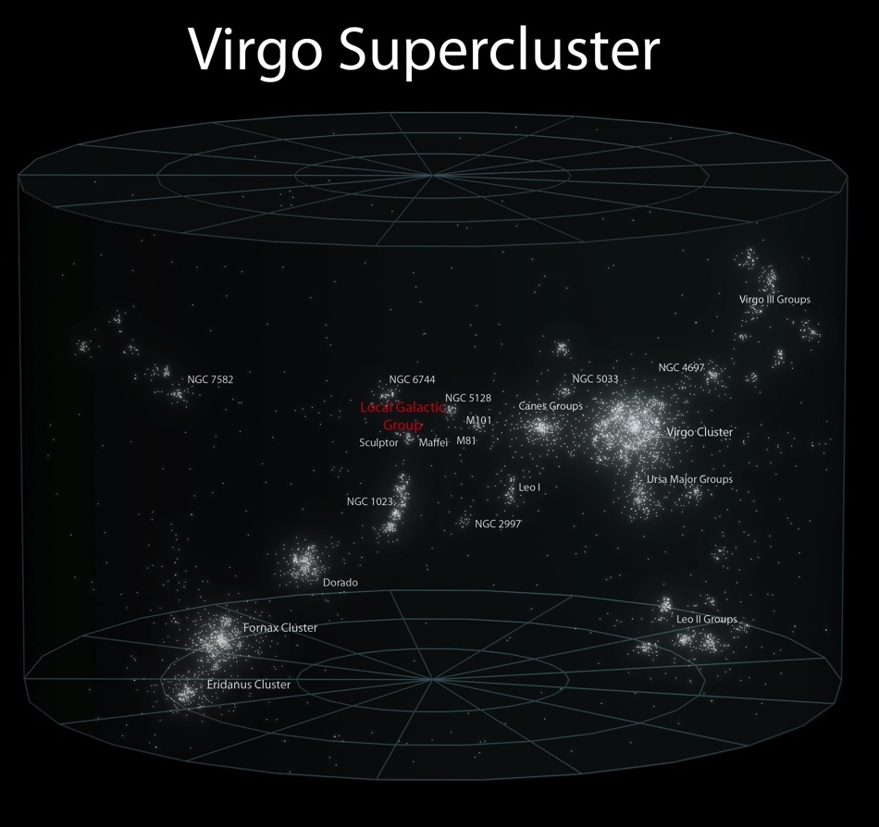
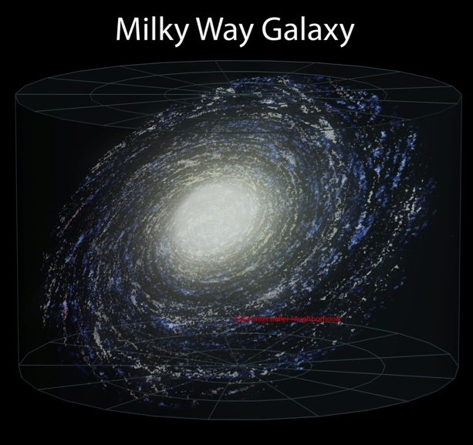

First generation detectors
First generation detectors and infrastructure built from mid-’90s to mid-2000; commissioned to design sensitivity; and observed for several years
Sensitivity sufficient to reach about 100 galaxies; however…
NS-NS coalescence events happen once every 10,000 years per galaxy…
Need to reach more galaxies
to see more than one signal per lifetime
Notes:
at 20 minutes here.

Slide 9
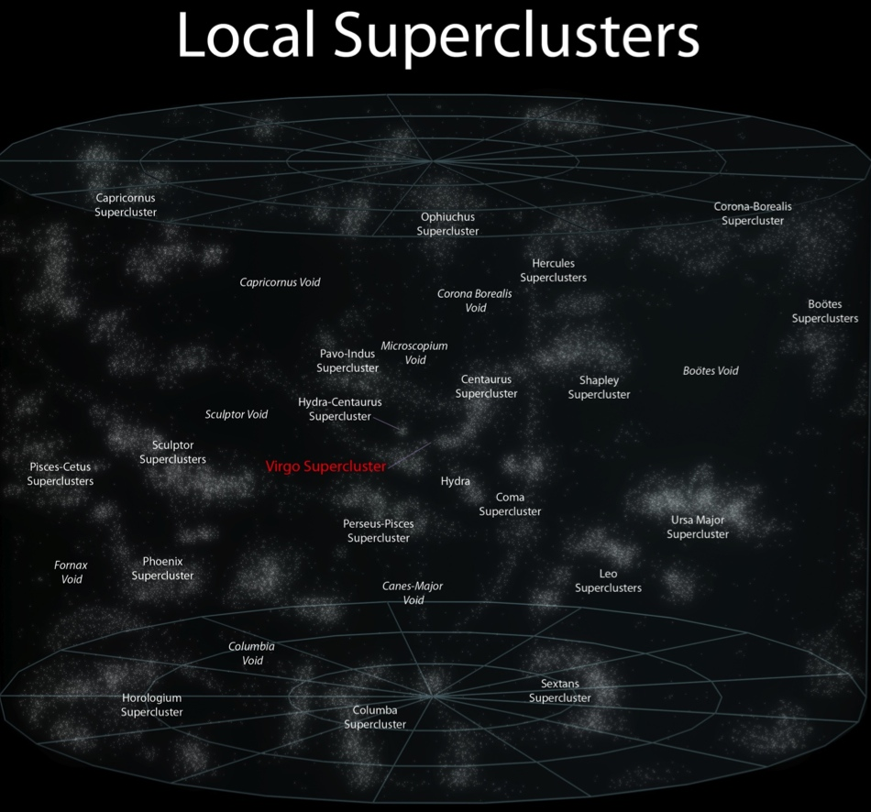
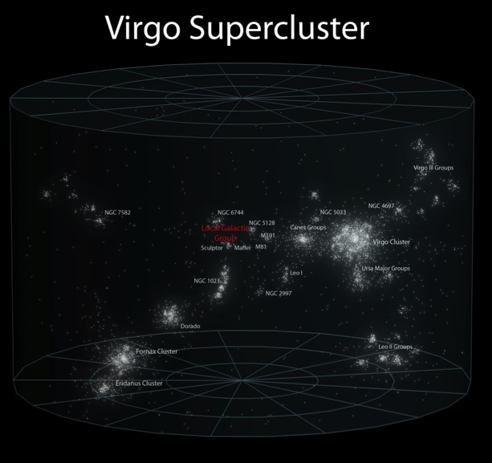
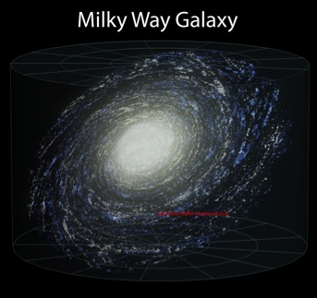
Advanced LIGO Sensitivity: a qualitative difference
While observing with initial detectors, parallel R&D led to better concepts
‘Advanced detectors’ are ~10x more sensitive, will reach about 100,000 galaxies
Events happen once every 10,000 years per galaxy…
NS-NS detection rate order of 1 per month...with
uncertainties
as noted
Advanced LIGO concept ~1999
Project start 2008, $205M NSF
Completion 2015, tuning follows
Initial Reach
Advanced Reach

Slide 10
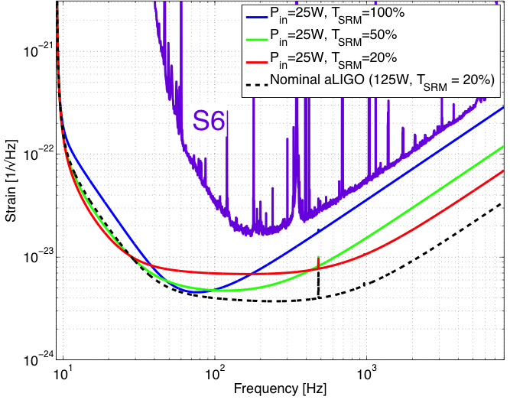
How to get there:
Addressing limits to performance
Shot noise – ability to resolve a fringe shift due to a GW (counting statistics)
Fringe Resolution at high frequencies improves as as
(laser power)^{1/2}
Point of diminishing returns when buffeting of test mass
by photons increases
low-frequency noise –
use heavy test masses!
‘Standard Quantum Limit’
Advanced LIGO reaches this limit with its 200W laser,
40 kg test masses
photodiode

Slide 11
Addressing limits to performance
Thermal noise – kT of energy
per mechanical mode
Wish to keep the motion of components due to thermal energy below the level which masks GW
Low mechanical loss materials gather this motion into a
narrow peak at resonant frequencies of system
Realized in aLIGO with an all fused-silica test mass
suspension – Q of order 10⁹
Test mass internal modes,
Mirror coatings engineered for
low mechanical loss

Slide 12
Addressing limits to performance
Seismic noise – must prevent masking of GWs, enable practical control systems
Motion from waves on coasts…and people moving around
GW band: 10 Hz and above – direct effect of masking
Control Band: below 10 Hz – forces needed to hold optics
on resonance and aligned
aLIGO uses active servo-controlled platforms, multiple pendulums
Ultimate limit on the ground: Newtownian background – wandering net gravity vector; a limit in the 10-20 Hz band

Slide 13
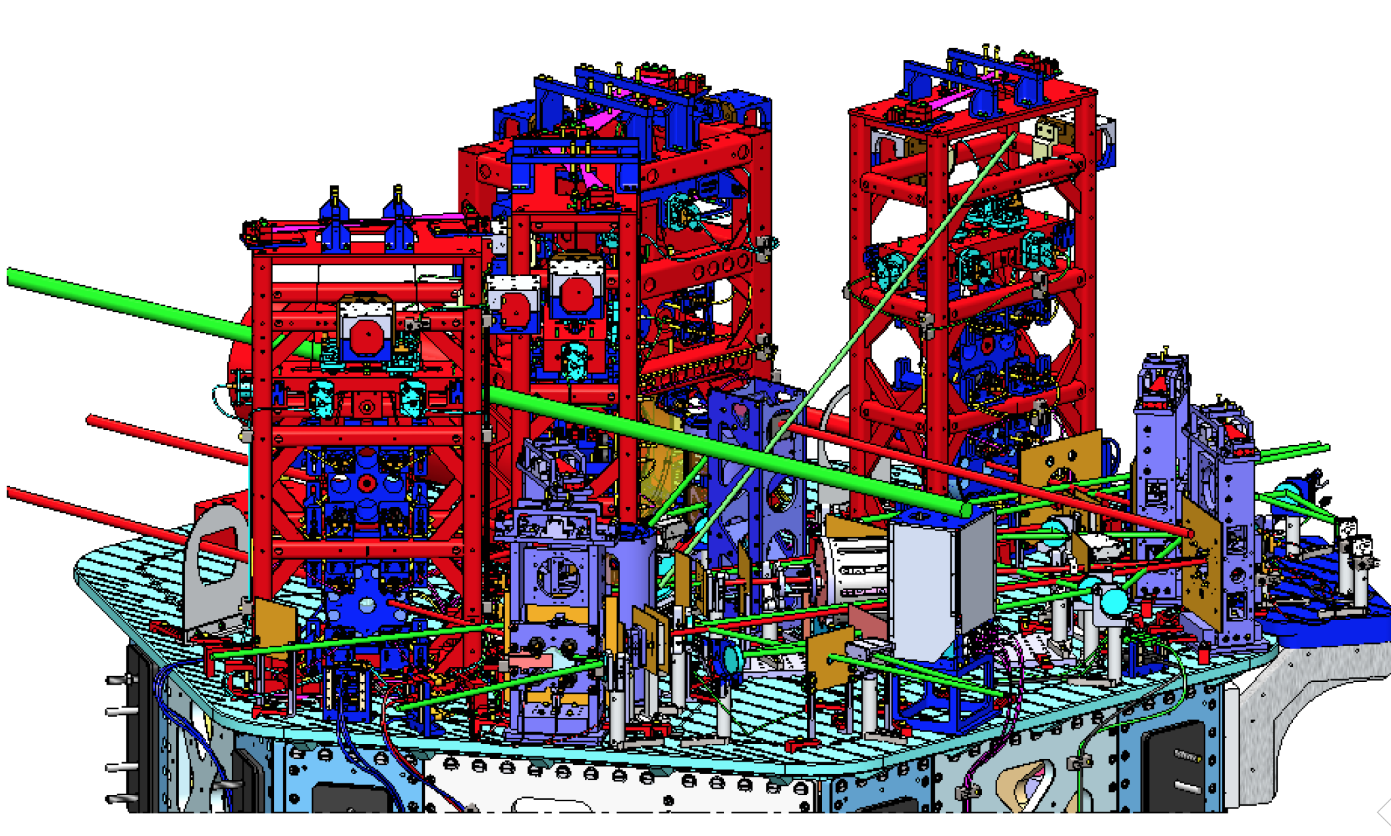

The real instrument is far more complex…
Reality axis
photodiode

Slide 14
The Design: Optical Configuration

Slide 15
Resulting flexibility in the instrument response
Initial LIGO curves for comparison

Slide 16

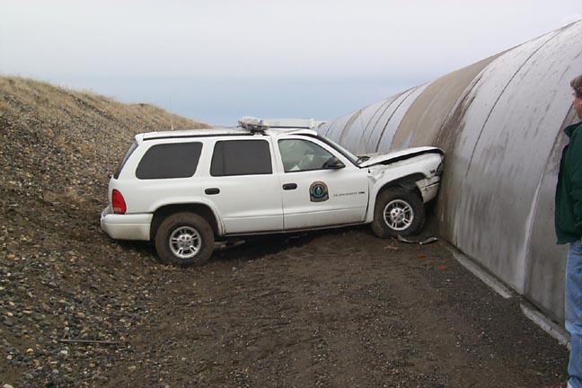
4km Beam Tubes
Light must travel in an excellent vacuum
  Just a few molecules traversing the optical path makes a detectable change in path length, masking GWs!
  1.2 m diameter – avoid scattering against walls
Cover over the tube – stops hunters’ bullets and the stray car
Tube is straight to a fraction of a cm…not like the earth’s curved surface
Notes:
Walk through slide

Slide 17
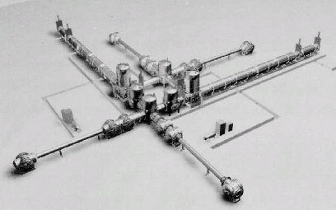
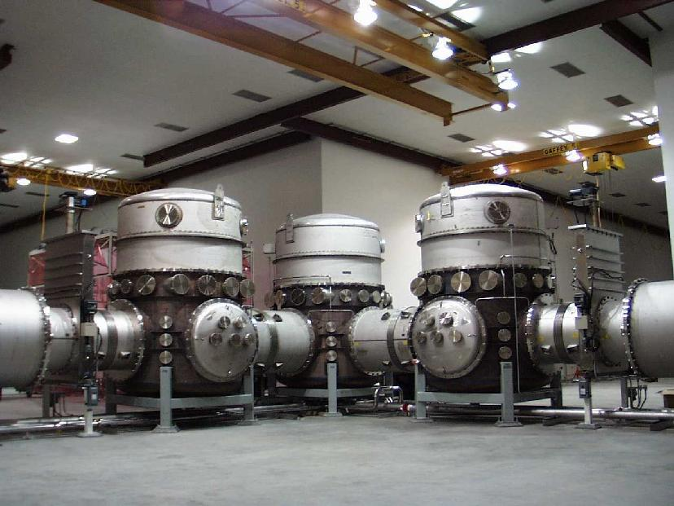
LIGO Vacuum Equipment – designed for several generations of instruments

Slide 18
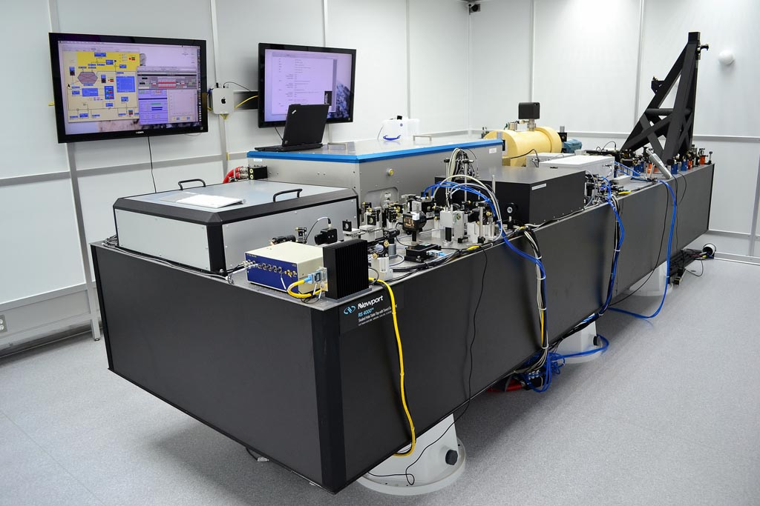
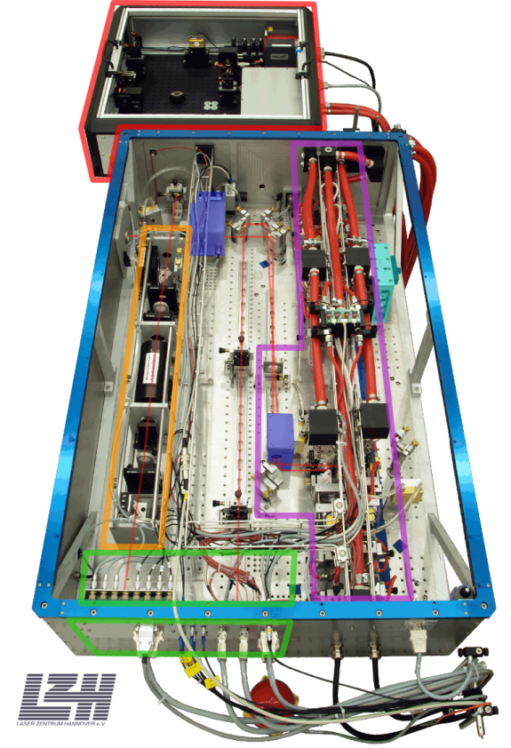
200W Nd:YAG laser
Designed and contributed by
Max Planck Albert Einstein Institute
Stabilized in power and frequency
Uses a monolithic master oscillator followed by injection-locked rod amplifier

Slide 19
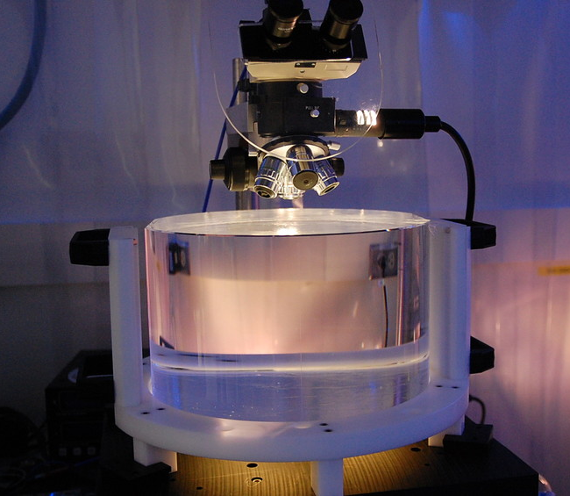
Test Masses
Requires the state of the art in substrates and polishing
Pushes the art for coating!
Sum-nm flatness over 300mm
Test Masses:
34cm φ x 20cm
40 kg
Round-trip optical loss: 75 ppm max
40 kg
Both the physical test mass – a free point in space-time – and a crucial optical element
Mechanical requirements: bulk and coating thermal noise, high resonant frequency
Optical requirements: figure, scatter, homogeneity, bulk and coating absorption
Compensation plates:
34cm φ x 10cm
BS:
37cm φ x 6cm
ITM
T = 1.4%

Slide 20
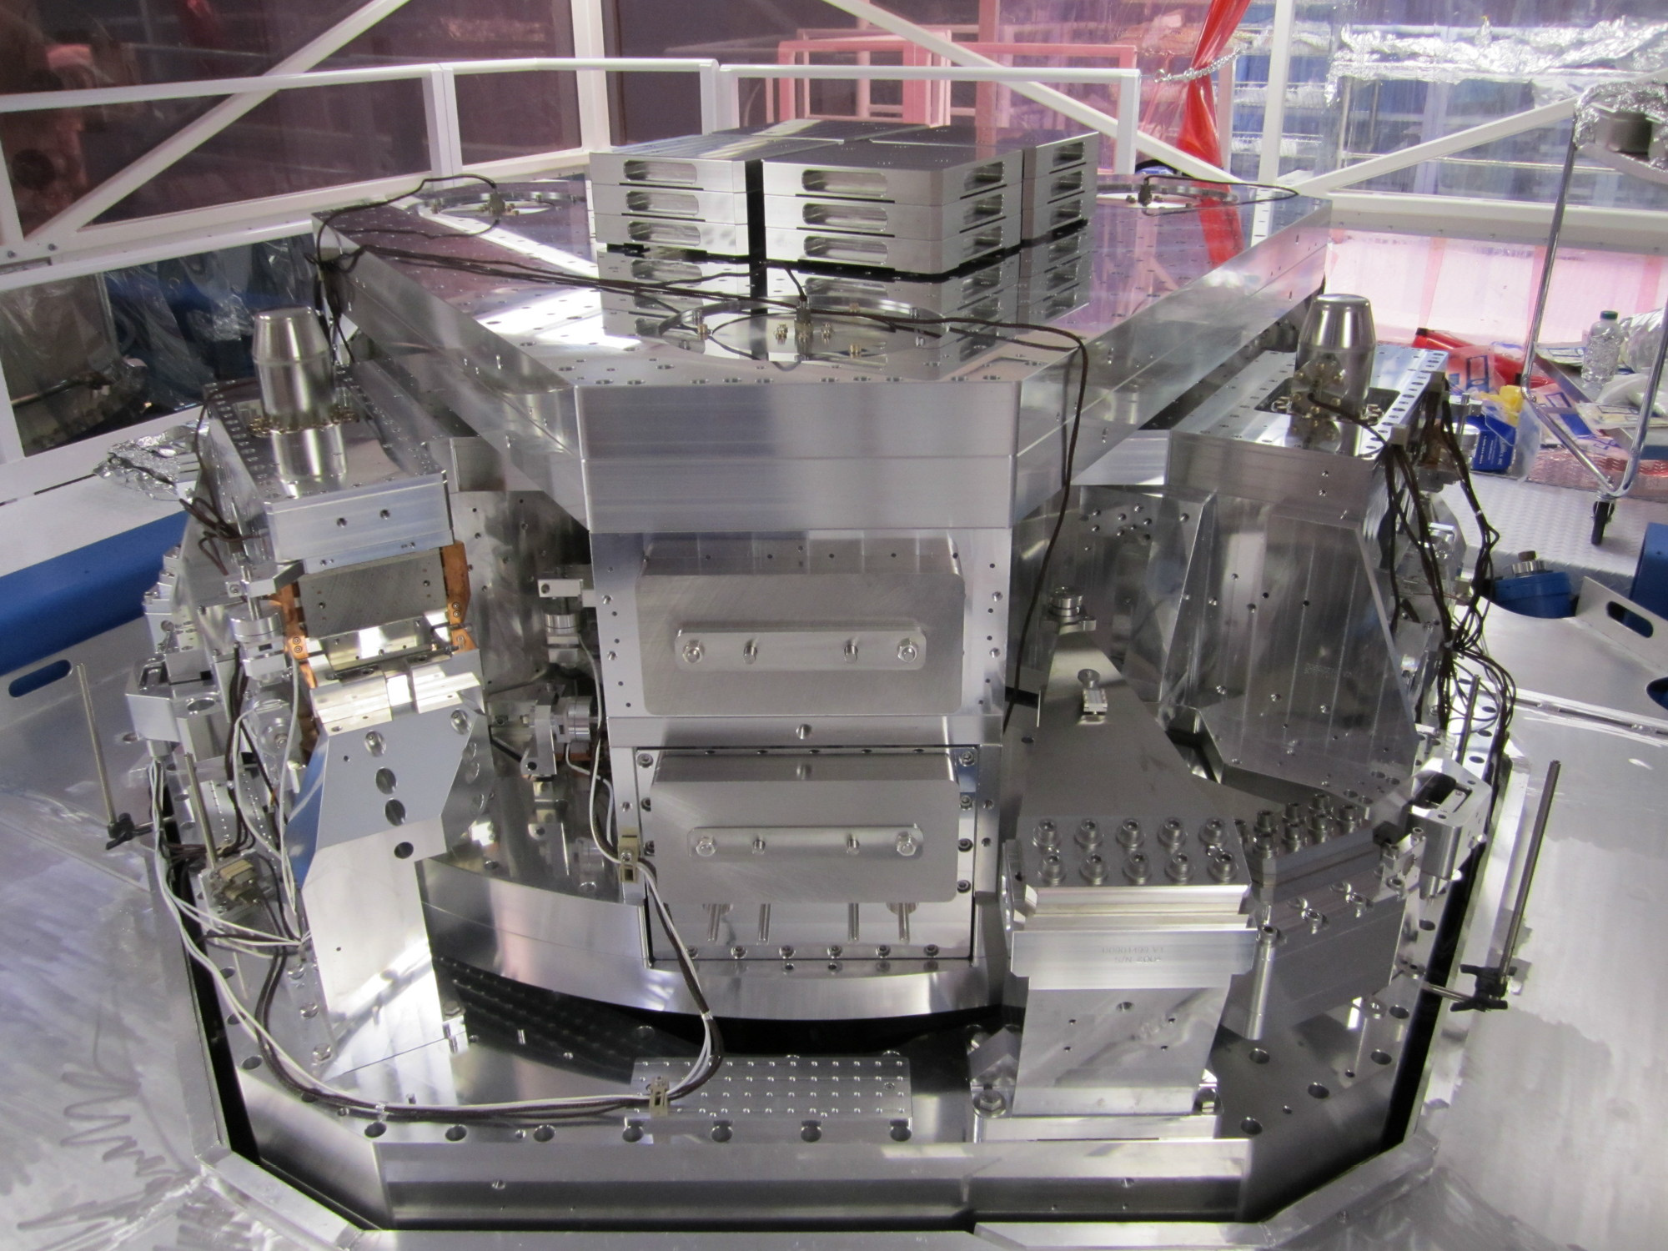
Seismic Isolation:
Multi-Stage Solution
Objectives:
  Render seismic noise a negligible limitation to GW searches
  Reduce actuation forces on test masses
Both suspension and seismic isolation systems contribute to attenuation
Choose an active isolation approach, 3 stages of 6 degrees-of-freedom :
  1) Hydraulic External Pre-Isolation
  2) Two Active Stages of Internal
  Seismic Isolation
Low noise sensors (position, velocity, acceleration) are combined, passed
through a servo amplifier, and delivered
to the optimal actuator as a function of
frequency to hold platform still in inertial
space

Slide 21
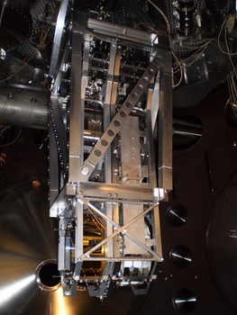
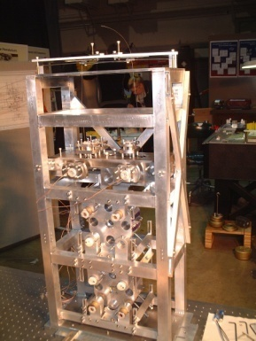
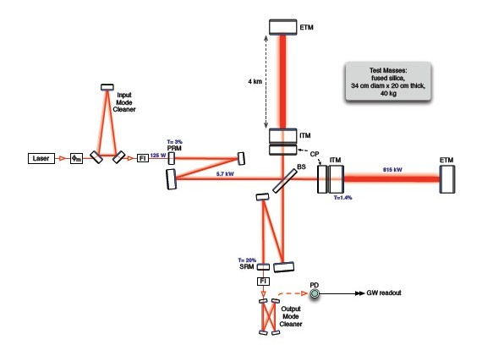
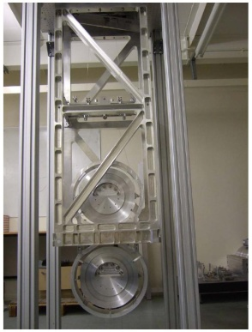
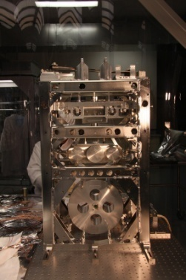
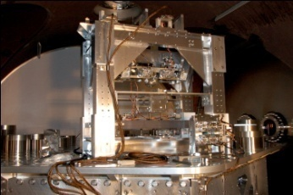
Optics suspensions: Pendulums

Slide 22
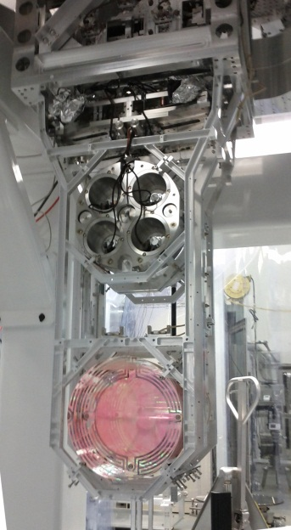

Test Mass Quadruple Pendulum suspension designed jointly by the UK (led by Glasgow) and LIGO lab, with capital contribution funded by PPARC/STFC
Quadruple pendulum suspensions for the main optics; second ‘reaction’ mass to give quiet point from which to push
Create quasi-monolithic pendulums using
fused silica fibers to suspend 40 kg test mass
  VERY Low thermal noise!
Another element in hierarchical control system
Optics Table Interface
(Seismic Isolation System)
Damping Controls
Hierarchical Global
Controls
Final elements
All Fused silica
Electrostatic
Actuation

Slide 23
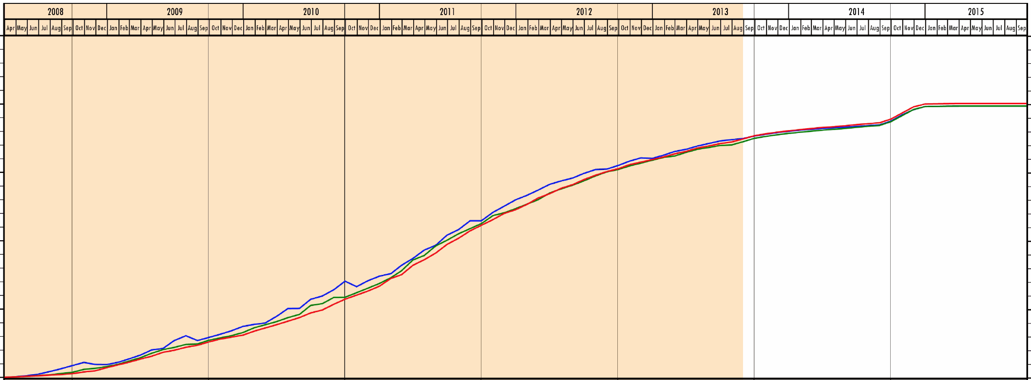
Where are we?
The detector subsystems are 99.1% complete: procurement, fabrication, cleaning, assembly, and stand-alone testing
Most of the hardware is now installed; almost every vacuum chamber has almost every component in it
At both observatories, installation is now
interleaved with integrated test –
multiple subsystems working together
Believe we can deliver instruments ready for
commissioning on time
  Have used several months of schedule
  over last 6 months due to installation
  hitches, surprises, etc; getting close to
  the end date…
  Have some cost contingency remaining
  to handle problems
  so far integrated test schedule matches
  planning, really good news
89%
Oct
‘13

Slide 24
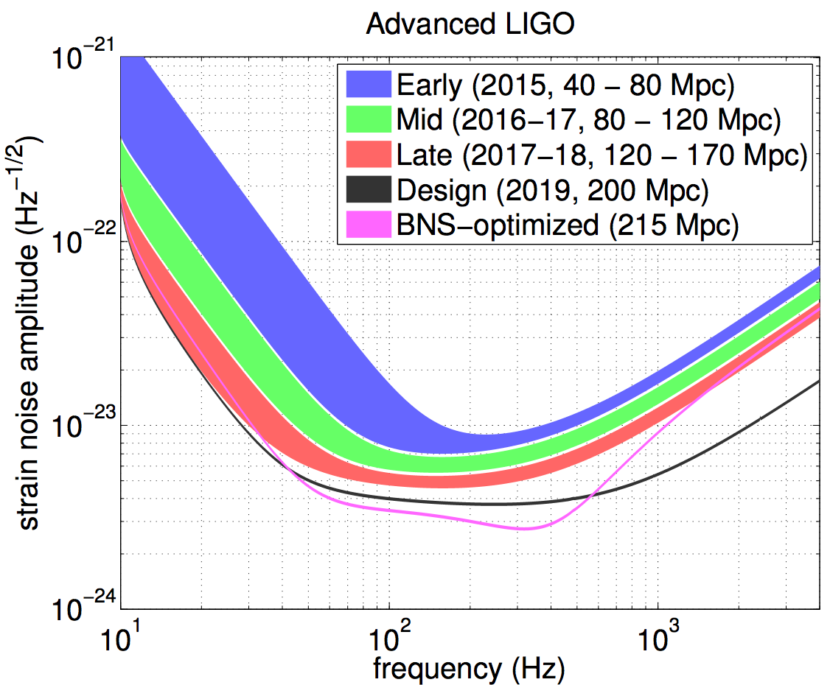
Post-Project commissioning
Taking instrument from 2-hour lock to astrophysically interesting sensitivity
TENTATIVE TIMELINE:
Complete integration by 2014
(interferometer “locked”)
“Early” Science Run in 2015
(~60 Mpc)
Within a factor of 2 of design sensitivity by 2016 (~100 Mpc)
http://arxiv.org/abs/1304.0670
Interesting to compare with Initial LIGO…

Slide 25
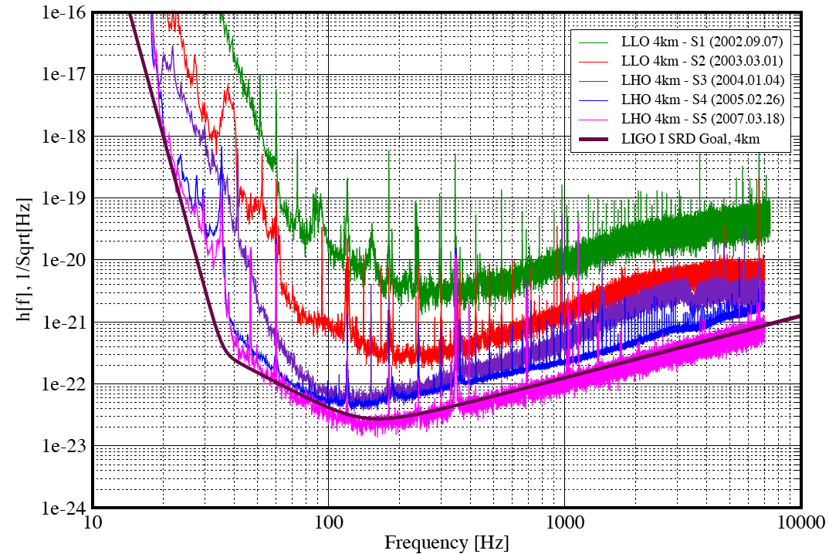
Initial LIGO: first lock in 2000 –
7 years to reach goal
2002
2003
2004
2005
2007
Design

Slide 26
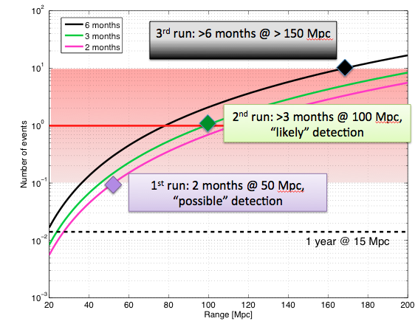
Detection Rate = (Sensitivity)³ × Time
Vertical scale is the number of binary inspirals detected
Rates based on population synthesis, realistic but uncertain
LIGO Scientific Collaboration (LSC) preparing for the data analysis challenge
Close collaboration with Virgo
Early detection
looks feasible
arXiv:1304.0670,
arXiv:1003.2480
Notes:
Lesson from iLIGO – short (months) runs interspersed with commissioning provides the best route to high sensitivity
Possible 1st run – 2 months at 50 Mpc
Possible 2nd run – >3 months at 100 Mpc
Possible ^{3rd} run – 2 months at 160 Mpc

Slide 27


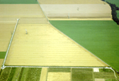

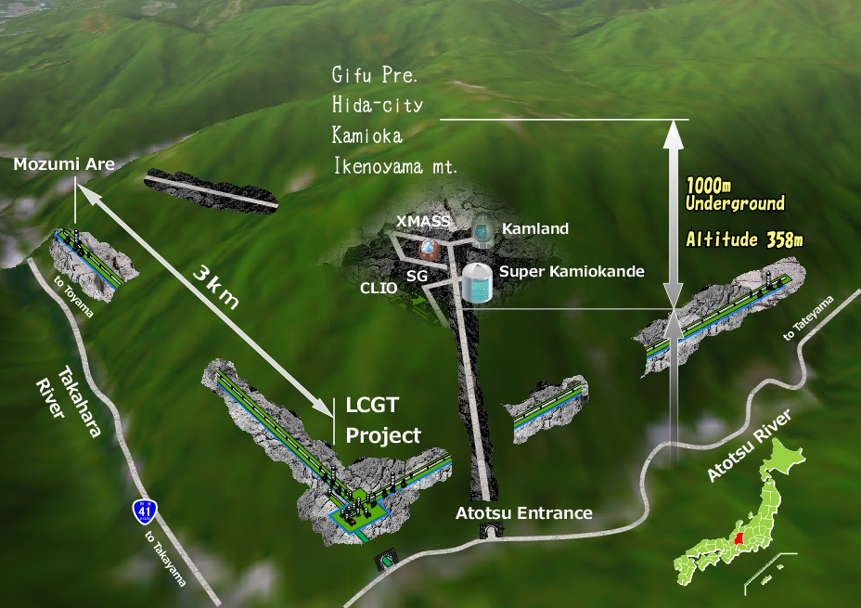



The advanced GW detector network
Advanced LIGO
Hanford
2015
GEO600 (HF)
2011
KAGRA
2018
Advanced LIGO
Livingston
2015
Advanced
Virgo
2015
LIGO-India
2020
27
27

Slide 28
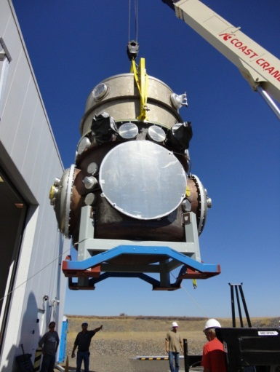

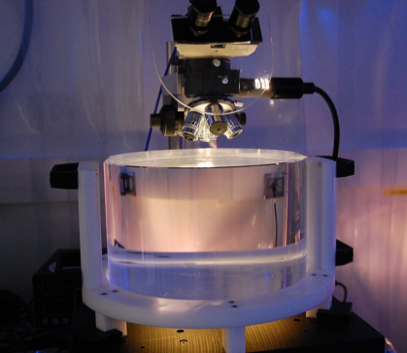
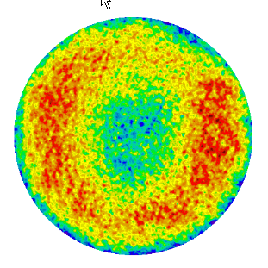
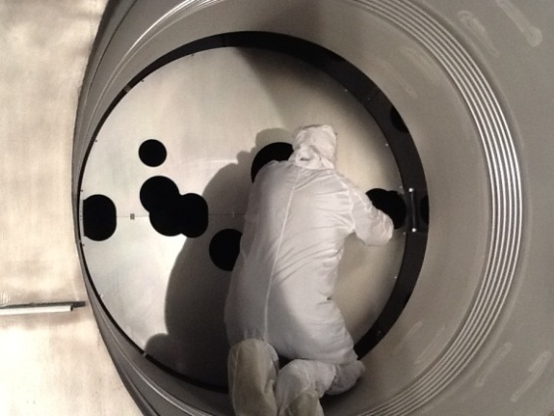
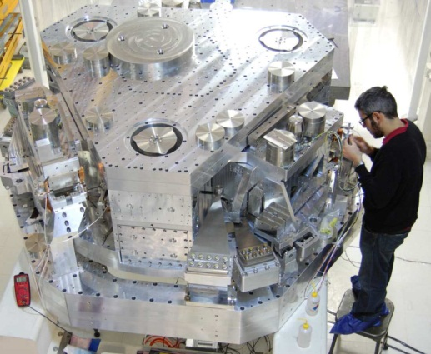
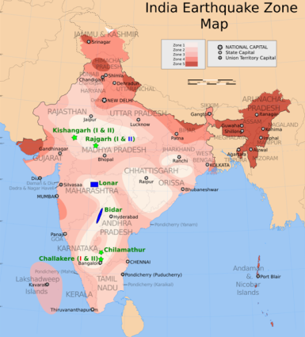
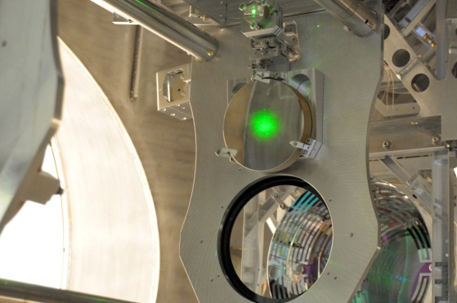
The Last Page
The next generation of gravitational-wave detectors will have the sensitivity to make frequent detections
The Advanced LIGO detectors are coming along well, planned to complete in 2015
The world-wide community is growing, and is working together toward the goal of gravitational-wave astronomy
Goal: Direct Detection 100 years after Einstein’s 1916 paper on GWs

