Slide 1
Adding ECD to Matlab/Mathematica SUS models
M. Barton
for SUS Testing Meeting 1/7/14,
revised 1/15/15

Slide 2
Damping for HAUX/HTTS
There is a suite of Matlab models for different suspension types, including a single pendulum with blades for HAUX/HTTS.
None of these have built-in eddy current damping – any damping has been added by wrapping a control system around the model in Simulink or the like.
HAUX and HTTS have built-in ECD and it is inconvenient not having this as part of the model.
Partial support was added a few months ago by hacking the state space A matrix. This was enough to support standard SUS testing by giving valid optic force/torque to optic displacement TFs.
Rana et al. have requested support for structure displacement to optic displacement TFs. This was trickier, and required adding a set of new structure-velocity inputs and hacking the B matrix.
The changes have been implemented but there is an outstanding bug.

Slide 3
Status Quo Ante
Each Mathematica model exports symbolic matrix elements in Matlab format, e.g., symbexport1bladesfull.m for single model with blades.
Damping had not been exported due to incompatible representations.
Mathematica uses frequency dependent complex matrixes acting on a state vector of (just) displacements.
Can easily represent arbitrary frequency dependence, including structural, thermoelastic and velocity damping terms.
Less convenient in time domain.
Matlab uses state-space formalism
Convenient for Matlab Simulink and linear analysis tools.
Can only represent velocity damping.
In principle, the velocity damping component of the total damping could be automatically exported from Mathematica, but historically hasn’t been.
=> Re-add from scratch.

Slide 4
Mathematica
Equation of motion (T020205):
All matrices complex and/or frequency-dependent.
Solved numerically for individual values of f.
ECD can be added as a spring with damping factor 0+2πif.
Curious sign of coupling matrix C_{XS(eff)} is artifact of definition as submatrix of master stiffness matrix – main entries are typically negative (see T020205).

Slide 5
Matlab (Old)
Usual Matlab model uses a state-space formulation:
State is optic displacements and velocities.
Inputs are structure displacements and direct forces/torques.
Outputs are pendulum displacements and (optionally) reaction force.
A/B equation becomes
C/D equation becomes
Velocity damping should go here in A matrix.
No input, so no place to put in B matrix.

Slide 6
Matlab (New – A&B stuff)
Velocity damping corner now filled out in A:
New input, corresponding new column in B
E matrix maps relative velocities to damping forces/torques.
O matrix maps velocities at structure origin to velocities near ECD.
is the "true length" from the suspension point down to the COM of the optic.
Bug described in –v1 of this presentation turned out to be a sign error in the LP term of O.

Slide 7
Matlab (New – C&D stuff)
New o (for OSEM/ECD position) output, corresponding rows in C and D:
New column in D for new input:
As before with A and B,
maps structure origin position or velocity to the position/velocity near the optic, and is the "true length" from the suspension point down to the COM of the optic.

Slide 8
Matlab (New – other stuff)
New fields in pend data structure in hauxopt_damp.m:
pend.B0xx = 0.5*pend.m0; pend.B0yy = 1.*pend.m0;
pend.B0zz = 1.*pend.m0; pend.B0yawyaw = 0.05*pend.I0z;
pend.B0pitchpitch = 2.*pend.I0y; pend.B0roll = 1.*pend.I0x;
New stuff in ssmake1MBf_damp.m:
E = diag([pend.B0xx,pend.B0yy,pend.B0zz,…
pend.B0yawyaw,pend.B0pitchpitch,pend.B0rollroll]);
O = [1 0 0 0 -pend.tl0 0; 0 1 0 0 0 pend.tl0; 0 0 1 0 0 0; …
0 0 0 1 0 0; 0 0 0 0 1 0; 0 0 0 0 0 1];
mbsingleA = [...
zeros(6) eye(6)
-km\(xm-cqxm'/qm*cqxm) -km\E
];
bm1 = -km\(cxsm-cqxm'/qm*cqsm);
bm2 = km\(E*O);
bm3 = km\eye(6);
mbsingleB = [...
zeros(6,18)
bm1 bm2 bm3
];
mbsingleC = [...
eye(6) zeros(6,6)
zeros(6,12)
];
mbsingleD = [...
zeros(6,18)
O zeros(6,12)
];

Slide 9
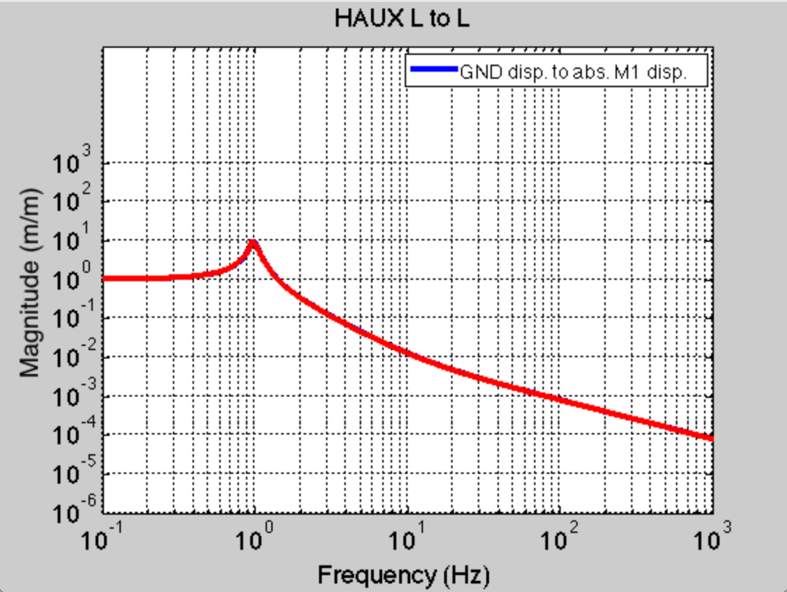
Results (L=x)
Perfect agreement between Mathematica and Matlab!
Note expected rolloff to 1/f at high frequency

Slide 10
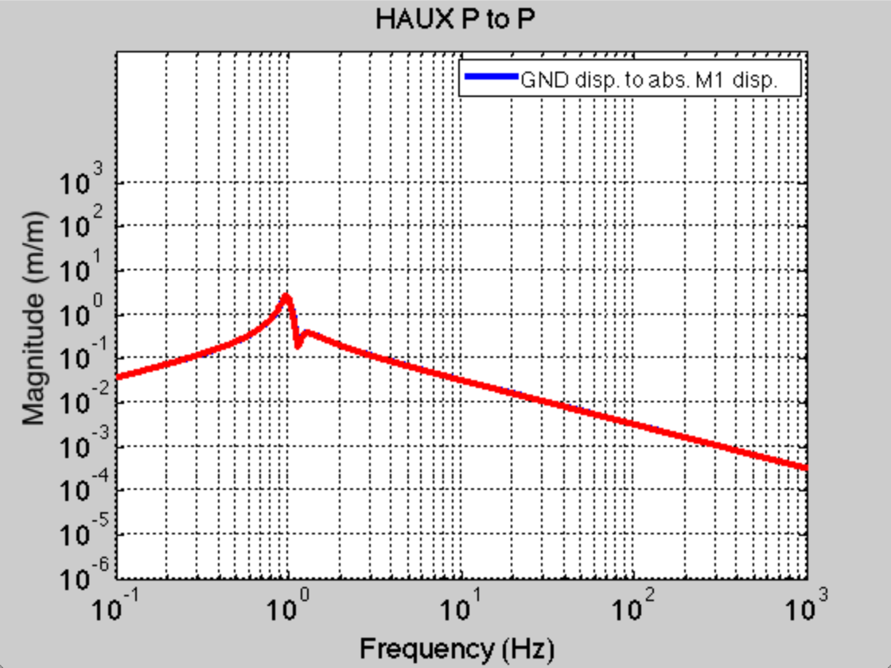
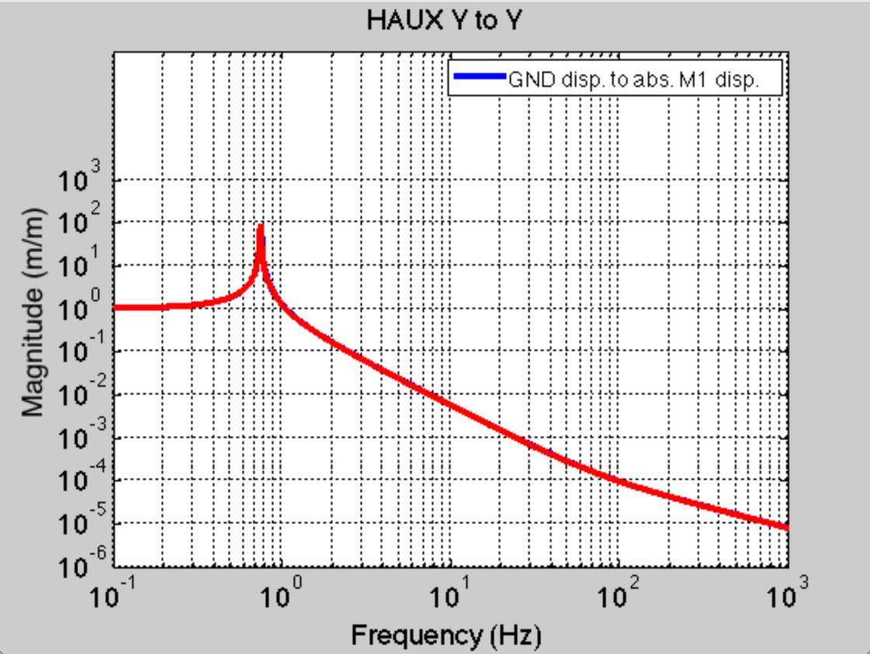
Results (P=pitch and Y=yaw )
Also good agreement!
Bug reported for P in –v1 turned out to be sign error in LP term of E_{B}

Slide 11
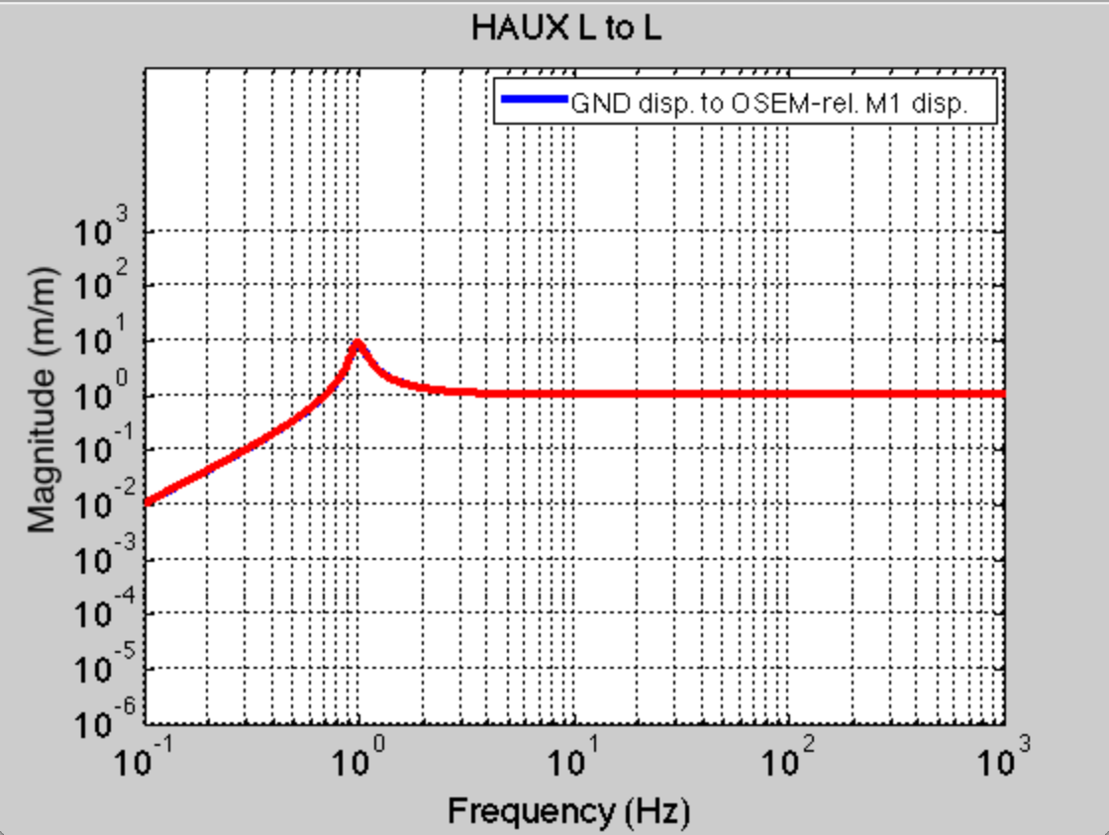
Results (L as measured at OSEM)
New outputs allow easy plotting of displacement as measured at OSEMs
Note however, the OSEM coordinate outputs track the s input and ignore - make sure they're consistent!

