Slide 1

Progress on Cryogenic Test Masses for aLIGO Upgrades
LIGO
Brett Shapiro
Stanford University
Notes:
Don’t hold onto the podium so much
Look around the audience more, don’t just stare at one person
Take a few more moments to explain plots. E.g. this is a plot of the temperature vs time …. The goal is for the test mass to reach the dotted line at 124 Kas fast as possible
Explain the steady state vs rapid cooling operation more clearly

Slide 2

Summary
Moving from Advanced LIGO to LIGO III
LIGO III cryogenic test mass suspensions
Stanford experiment
LIGO III simulation
Lessons learned / changes made
Future work

Slide 3

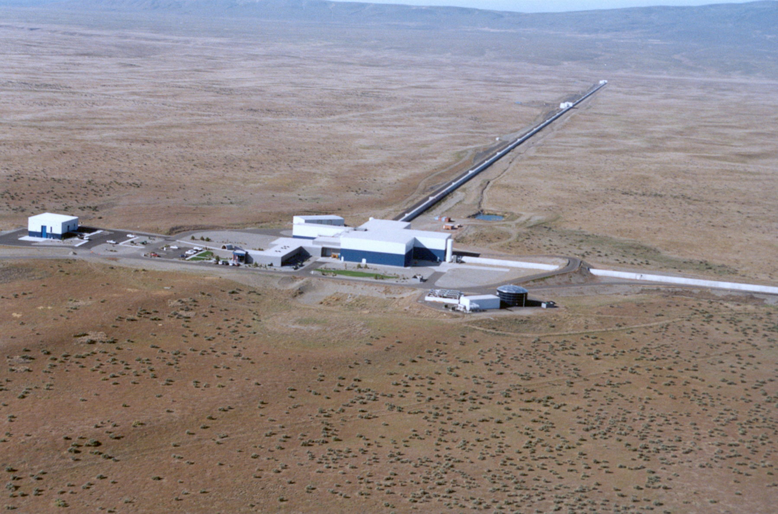
Advanced LIGO Timeline
Livingston, LA
Hanford, WA
Full lock testing
1st science run
GW
astronomy
Build LIGO III
Last core optics
March 2014
Aug-Sept 2014
Sept-Dec 2015
Soon after
Far after

Slide 4
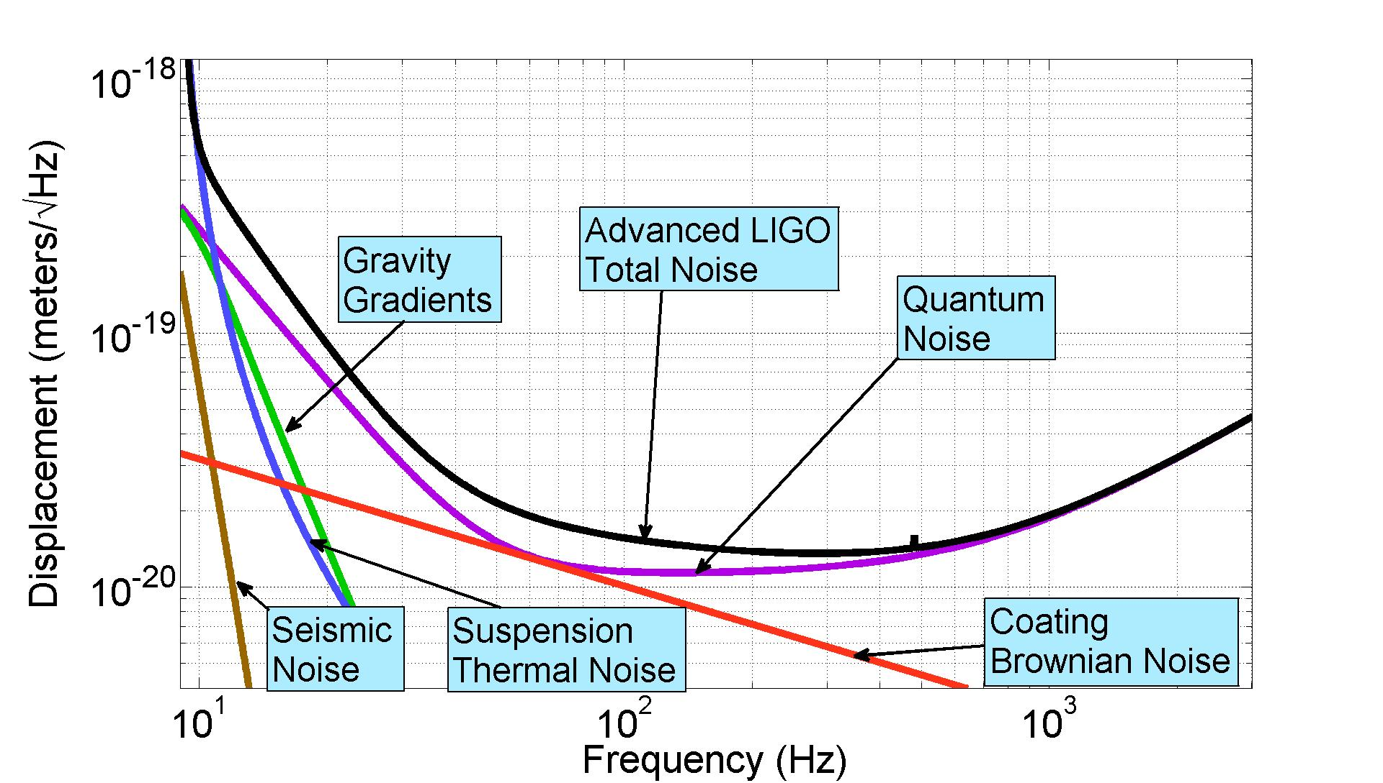
Predicted Advanced LIGO Sensitivity

Slide 5
Predicted Advanced LIGO Sensitivity
LIGO III aims to do better by a factor of 3

Slide 6
Predicted Advanced LIGO Sensitivity
Use cryogenics to push thermal noise down
LIGO III aims to do better by a factor of 3

Slide 7
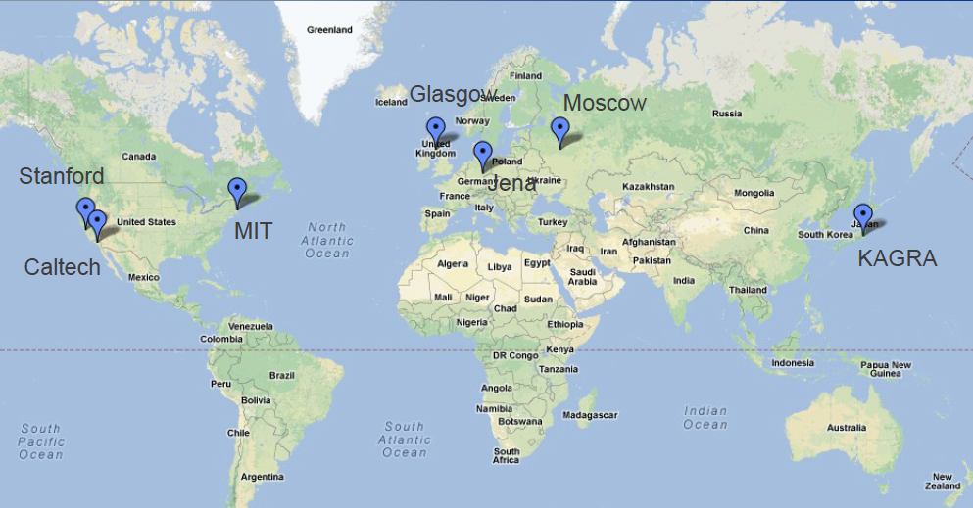
LIGO III cryo work distribution
Caltech - cryogenic reference cavities; direct thermal noise measurements
Jena/Glasgow/Moscow - mechanical loss
MIT – high emissivity coatings
KAGRA – 20 K sapphire suspensions
INPE Brazil – Cryogenic multi-nested pendulum
Stanford – optical coatings (Riccardo Bassiri’s talk); cryogenic technology
Courtesy of Nicolas Smith-Lefebvre

Slide 8
Cyro Test Mass Problem Statement
* For LIGO III, reduce suspension and coating thermal noise by cooling the lower quad to 124 K (-149.15 C)
  Si test masses (blue team in LIGO-T1200031)
  Get to 124 K in a timely manner <- Stanford experiment
  Then maintain 124 K
Include a warm-up scheme (don’t forget!)
Do not increase the test mass lossiness
  Emissive coatings, heat links, thick sus fibers, optical coatings, substrate, suspension fiber bonding, etc
Do not compromise passive seismic isolation
  Cables, hoses, links, etc
The same seismic isolation platforms (ISIs, HEPIs)
  Limit the amount of extra weight on these plaforms
  Leave the rest of the vacuum chamber warm

Slide 9
LIGO III Steady State Cooling
Active Seismic Isolation Table
…
…
clamp
295 K
ISI stage 2
Vacuum flange
Flexible liquid nitrogen hoses:
Supply and return
124 K
≤ 10 m
≈ 3 W absorption at 124 K
Heat shield at
80 K maintains 124 K through radiative coupling
1560 nm MW laser
143 kg Si test mass
See also G1200246-v1

Slide 10
Initial Cool Down Cold Link – 2 Designs
Conductive cooling, low pressure N₂ gas
Pros and Cons
liquid N₂ pipe flexures
Pros
Operates in partial vacuum.
Low heat transfer between cold and warm parts of vacuum system.
Fine temperature control – just back away when at desired temperature
Versatility, design permits both conductive and convective cooling.
Cons
Requires moving parts:
  flexible pipes
  actuators
Physically contacts barrel of test mass
return
supply
Test mass
thermally conductive plate with variable gap

Slide 11
Initial Cool Down Cold Link – 2 Designs
Pros and Cons
Convective cooling, up to 1 atm N₂ gas
Pros
No moving parts or actuators
No contact with test mass
Faster cooling than conduction
Cons
Convection between cold and warm parts of vacuum system
No fine temperature control – must return to vacuum to ‘turn off’ cold link.
Does not operate under vacuum
return
supply
liquid N₂
pipes
convective N2 gas
Test mass
thermally conductive plate with large fixed gap

Slide 12
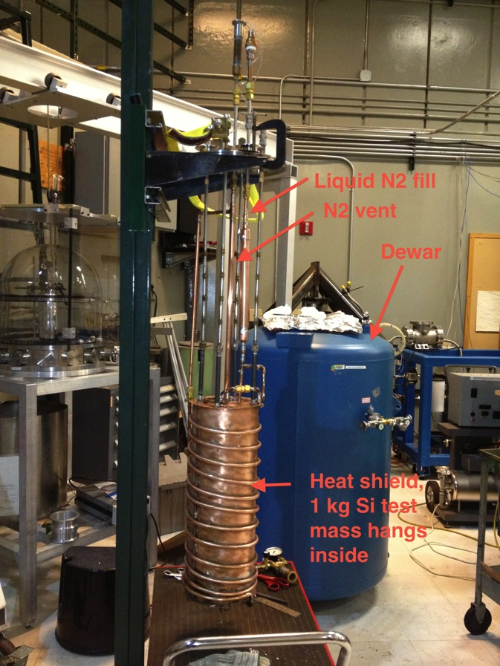
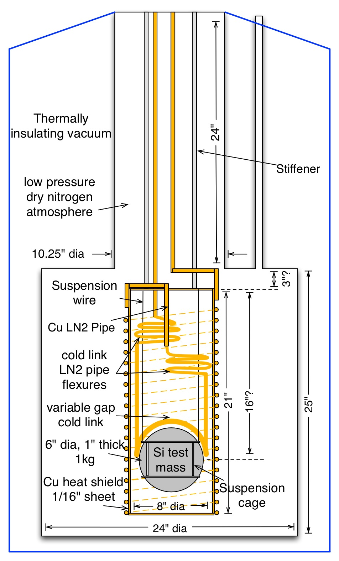
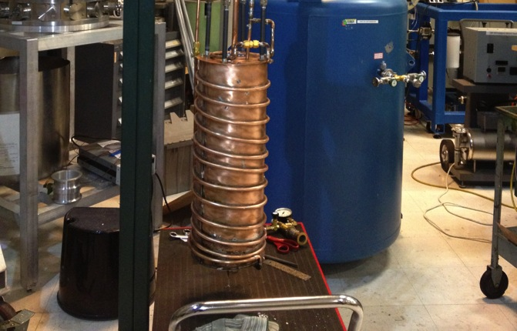
Experimental Setup
Test dewar
Heat shield

Slide 13
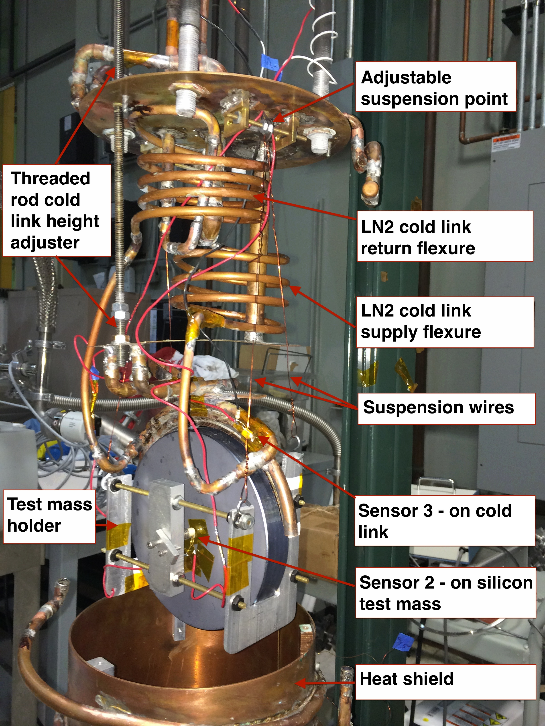

Slide 14
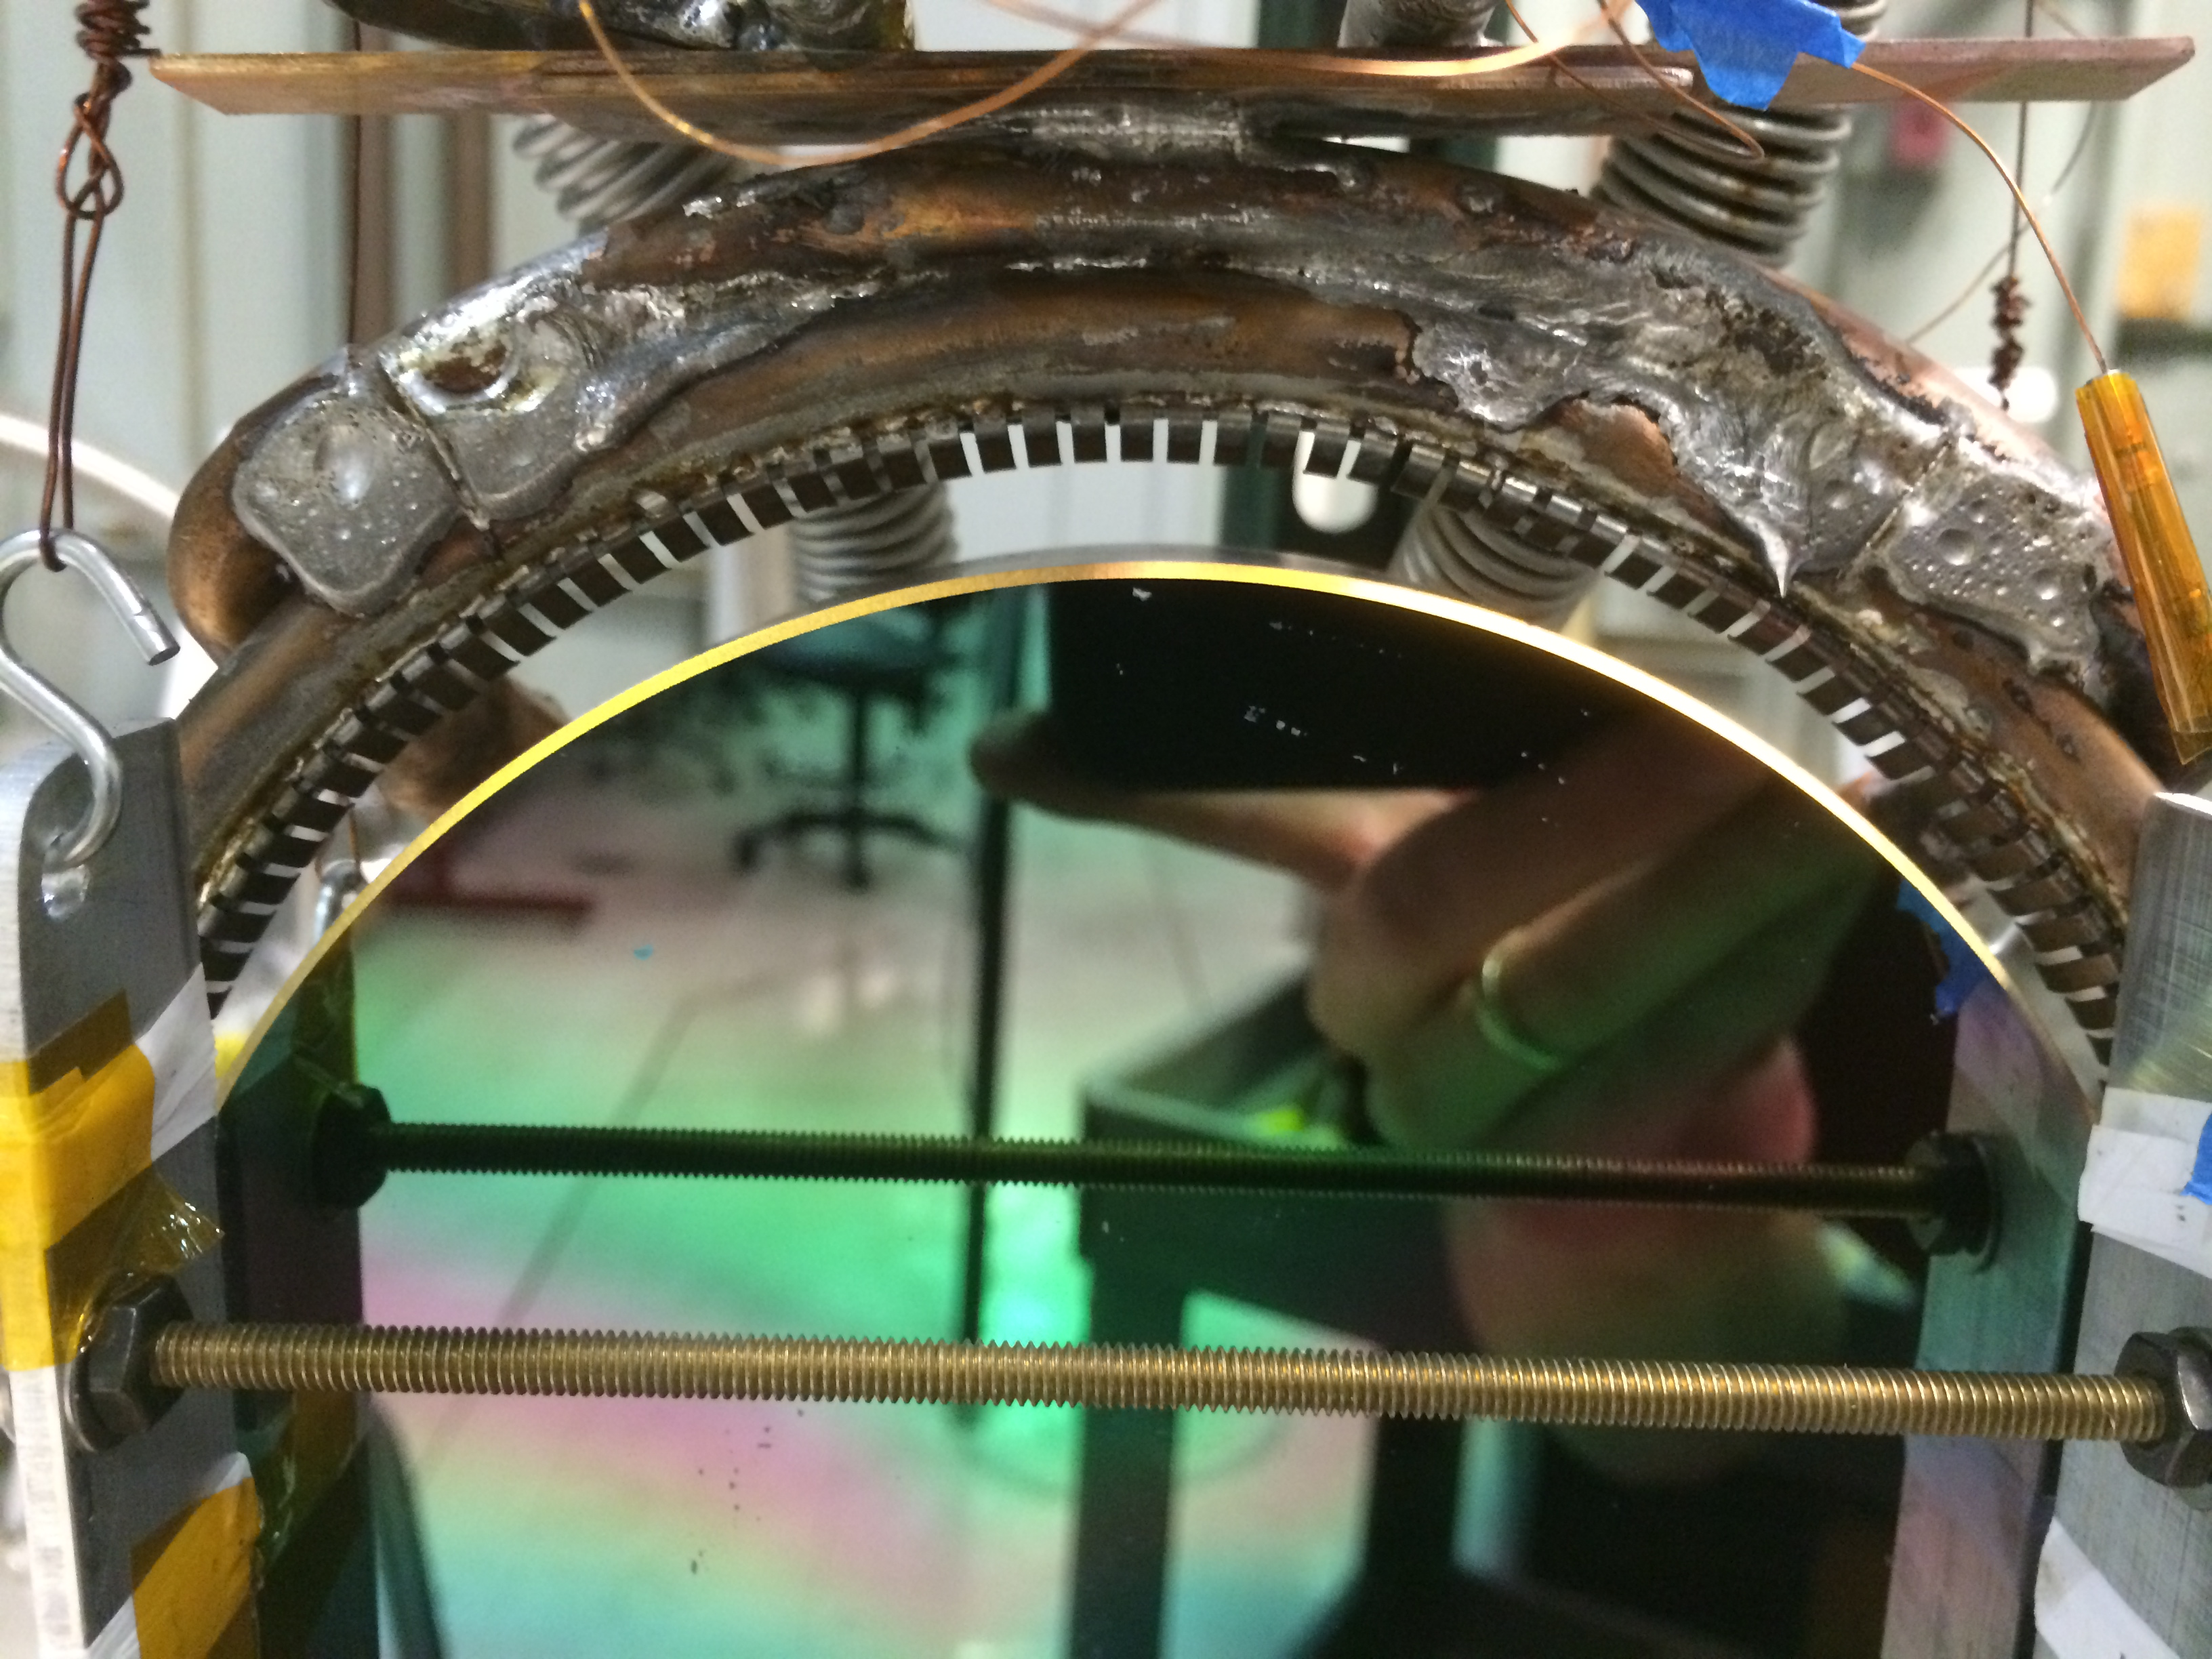
Close up of cold link
Cold link
Variable gap
Flexure ‘point’ contacts
Test
mass

Slide 15
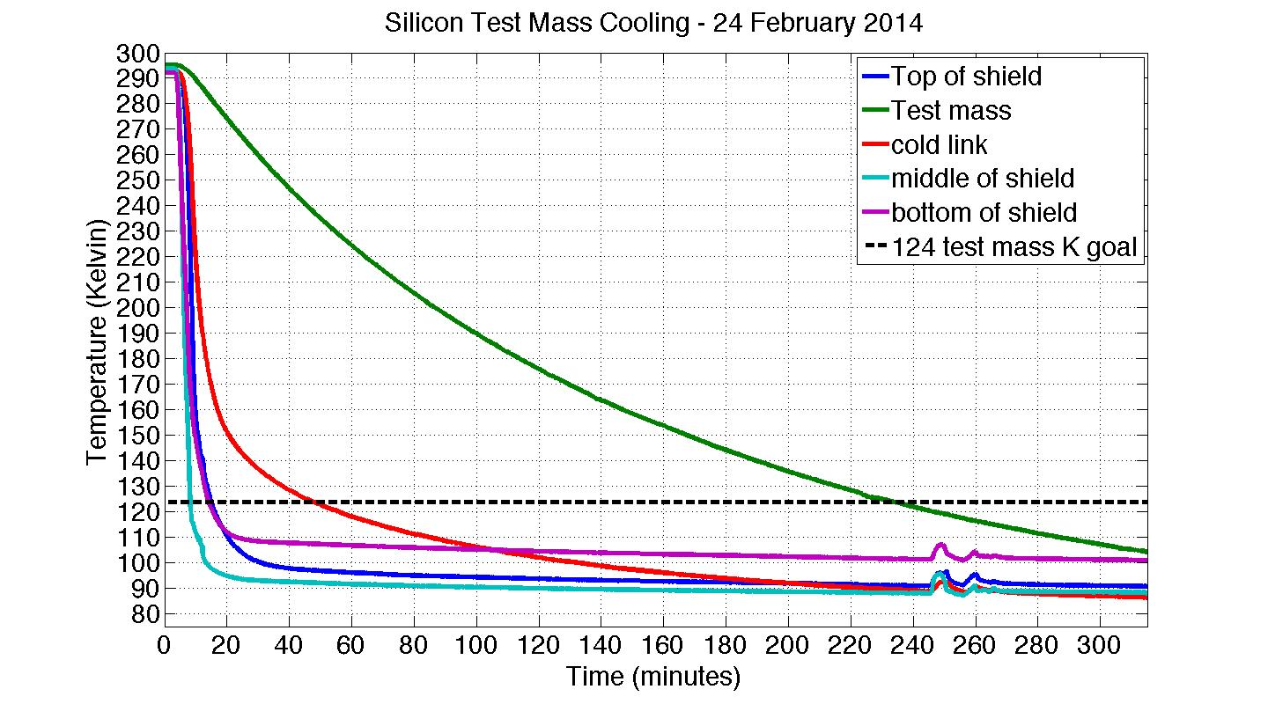
Measurement – cold link engaged
140 min time constant

Slide 16
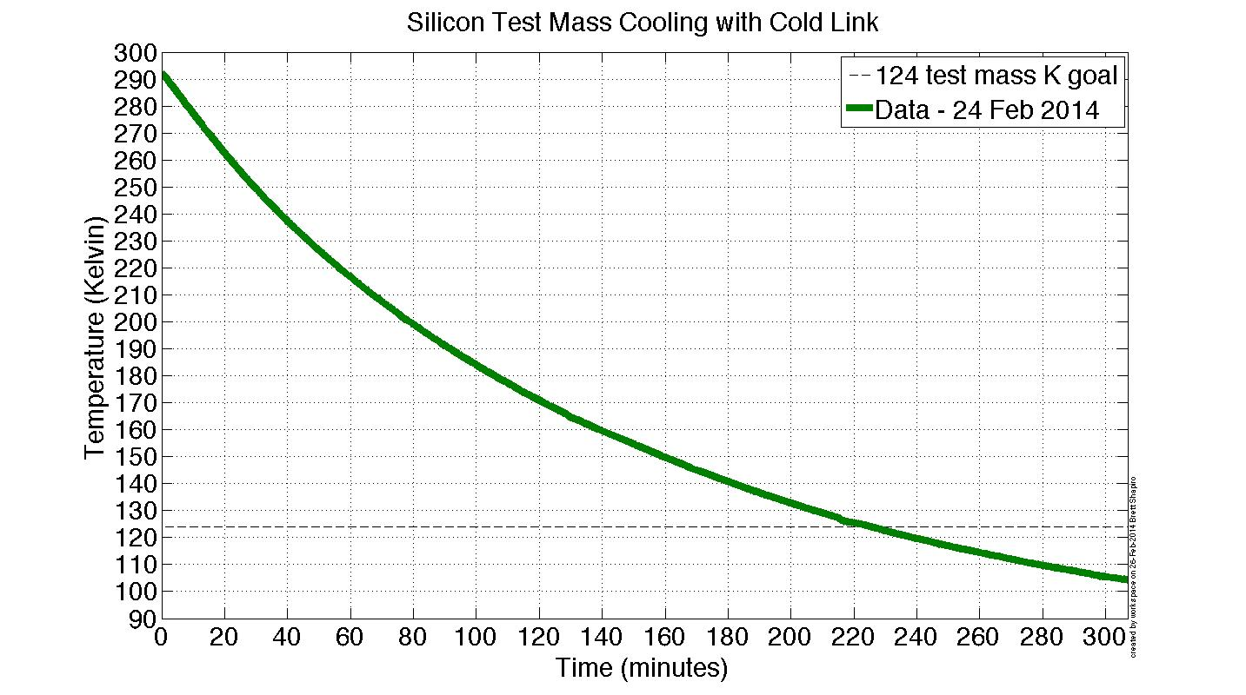
Test mass temperature modeling

Slide 17
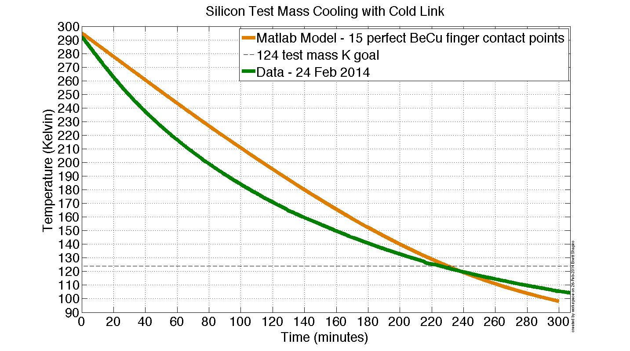
Test mass temperature modeling

Slide 18
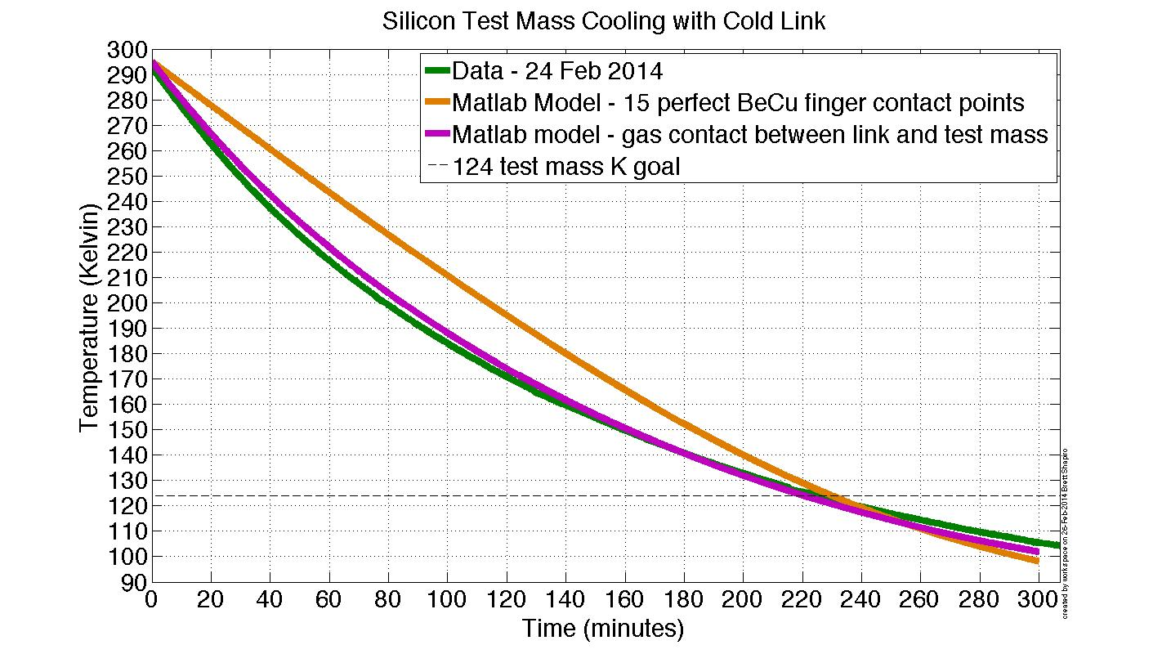
Test mass temperature modeling
Heat transfer goes through residual N₂ gas between test mass and cold link!

Slide 19
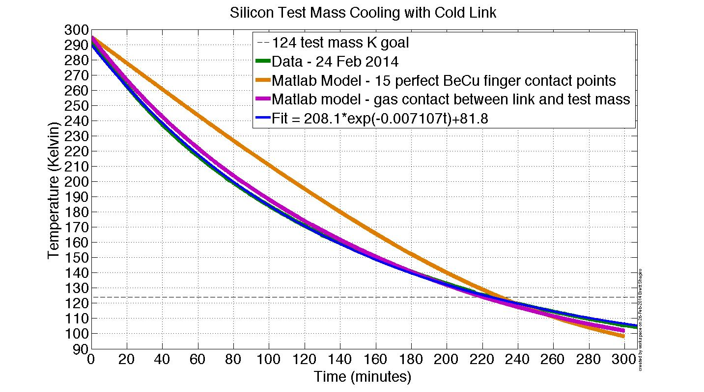
Test mass temperature modeling
This is a perfect exponential decay…
Heat transfer goes through residual N₂ gas between test mass and cold link!

Slide 20
Exponential Temperature Decay
These are both functions of temperature.
In general, the solution is not truly exponential since the time ‘constant’ changes.

Slide 21
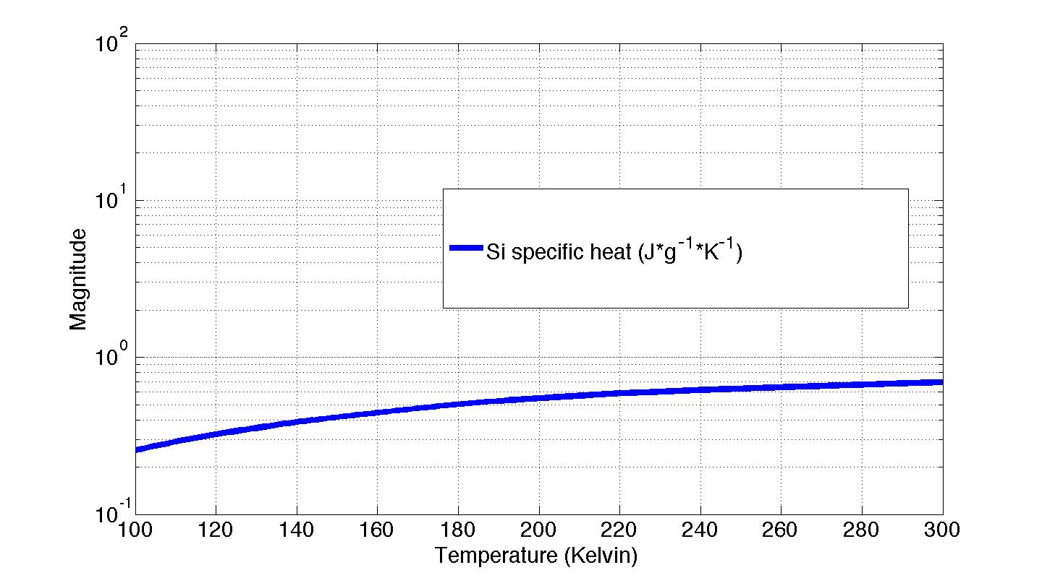
Exponential Temperature Decay

Slide 22
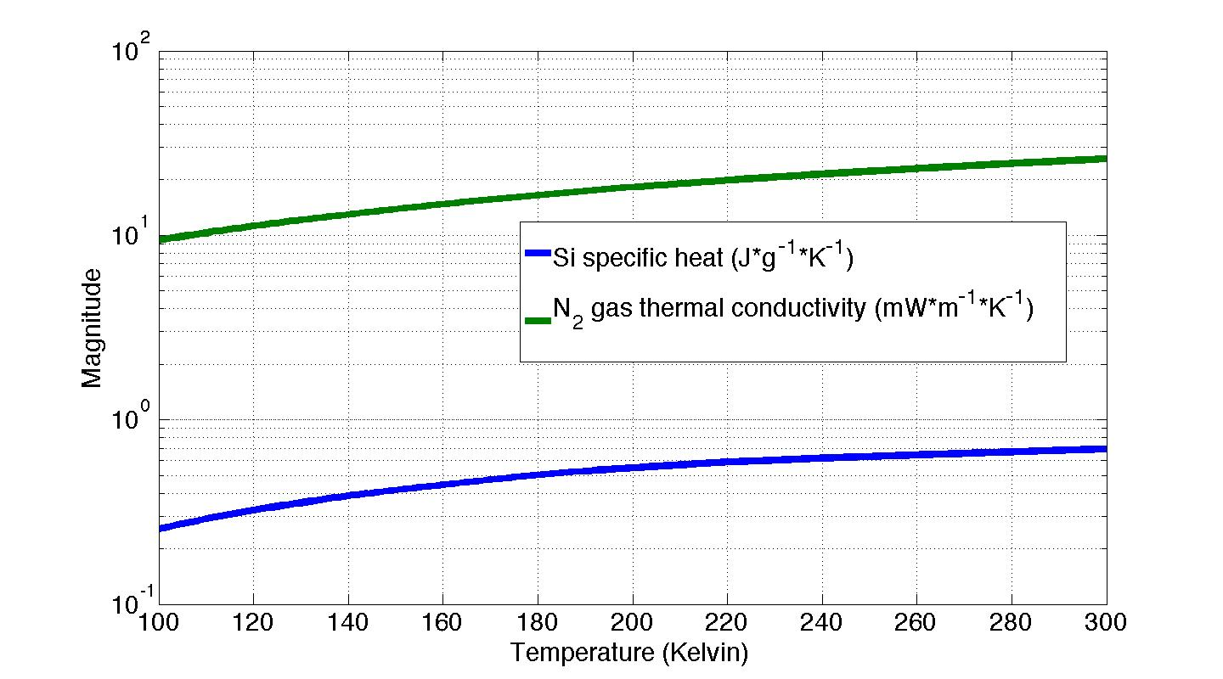
Exponential Temperature Decay

Slide 23
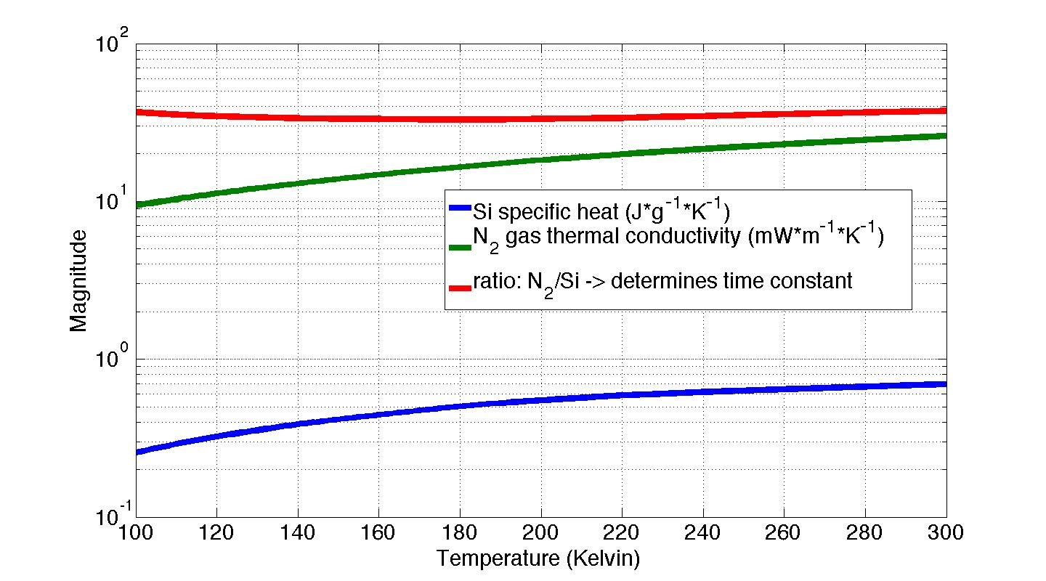
Exponential Temperature Decay

Slide 24
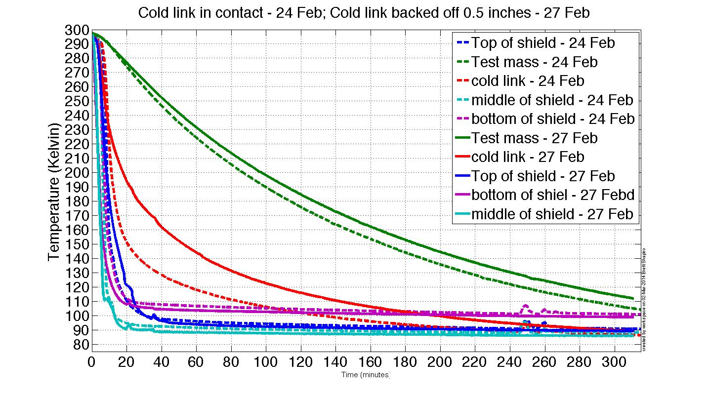
Measurement – cold link disengaged
160 min time constant

Slide 25
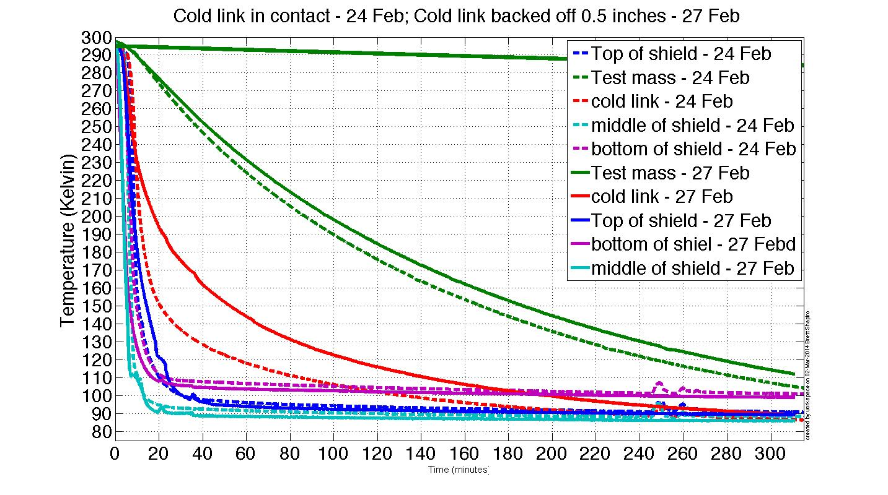
Measurement – cold link disengaged
Simulation assuming only N₂ gas conduction
160 min time constant

Slide 26
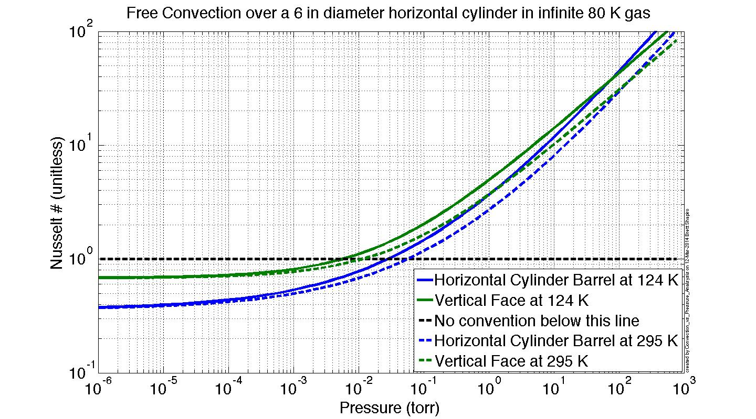
Conductive vs Convective Regimes

Slide 27
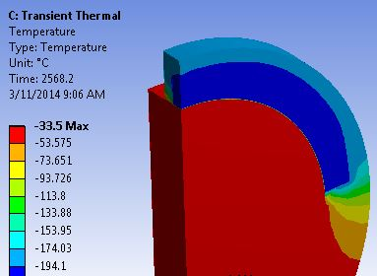
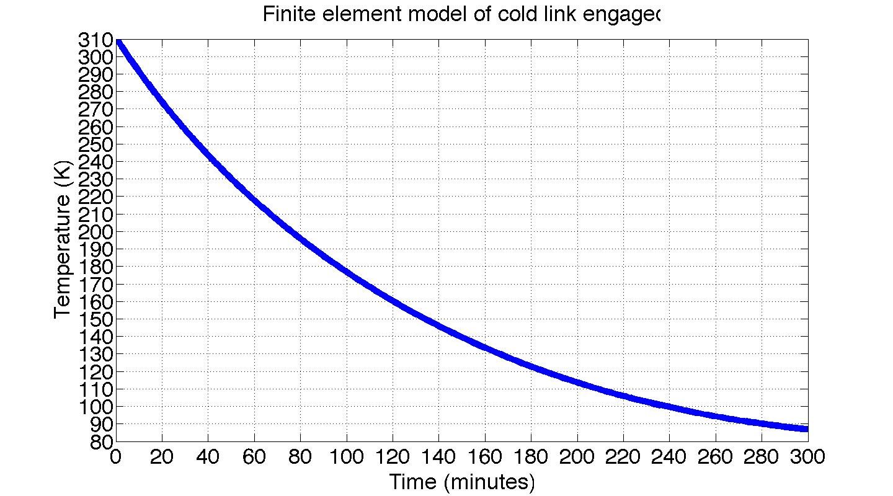
Finite Element Modeling
Due to complexity, LIGO III designs must be verified with FEM
Below: FEM of conduction through N₂ gas to cold link for Stanford experiment
N₂ gas
Cold link
Test mass
≈ 43 min into cool down
Convective FEM is proving to require large amounts of computing power
Images courtesy of Tim MacDonald

Slide 28
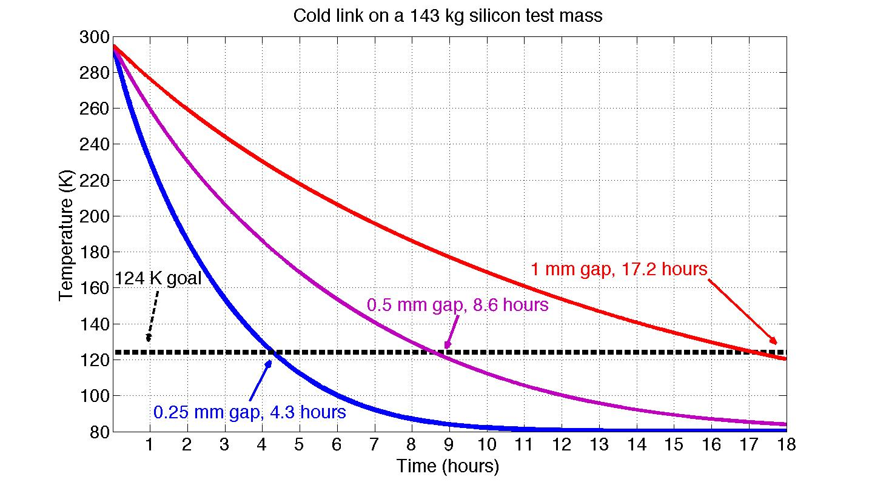
Cold link on a LIGO III test mass
Conduction limit, no convection
Test mass radius = 280 mm
Test mass thickness = 250 mm
Cold link covers 2/3 of top barrel

Slide 29
Experimentation lessons learned
Air dominates most heat flow across contacts
Cold links should have distributed contacts
Solder is not leak tight against high pressure cryogenic fluids – welding is probably best
Cryogenic fluid should have 1 flow path
Send fluid from bottom up
Use fatter pipes to minimize fluid pressure
Minimize the number of materials in the plumbing – joining and contraction issues
Leave room for differential contraction
Silicon diode temperature sensors are great

Slide 30
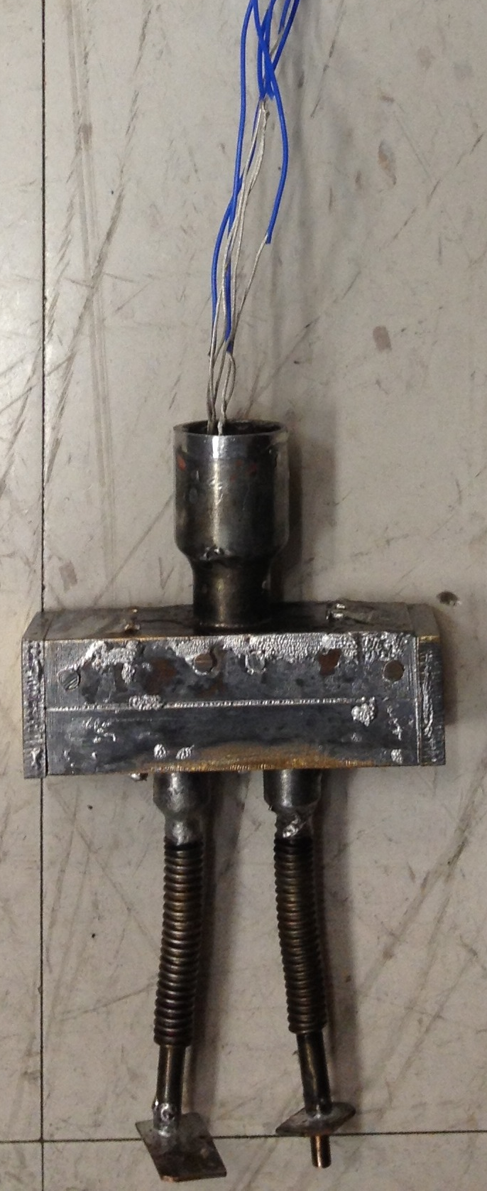
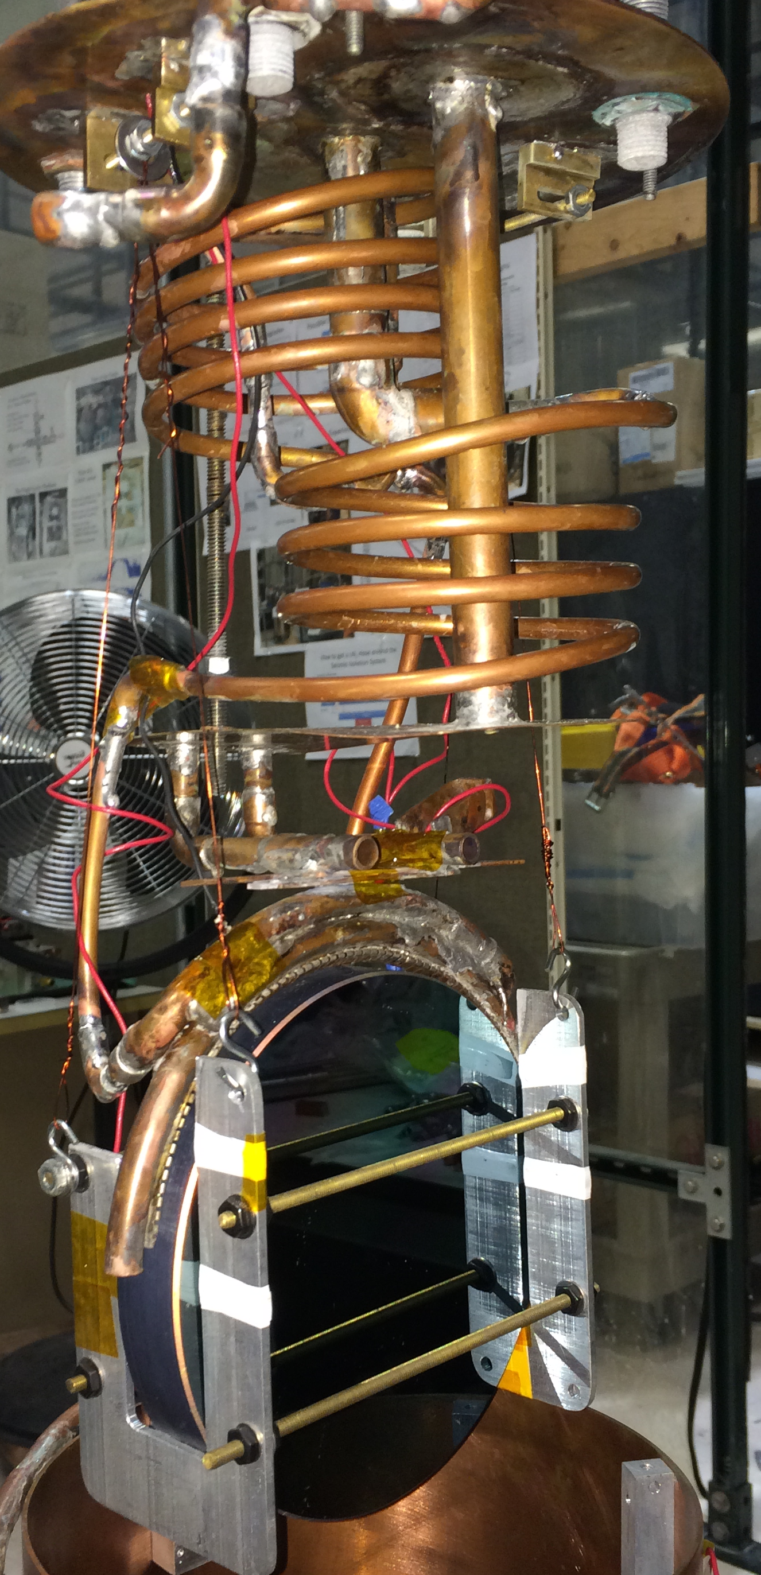
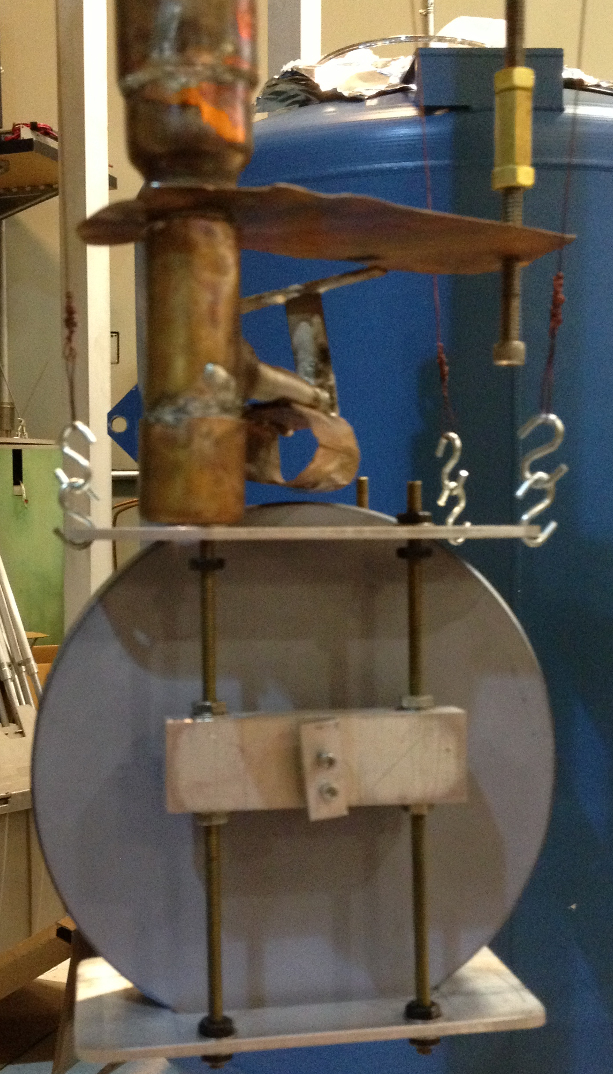
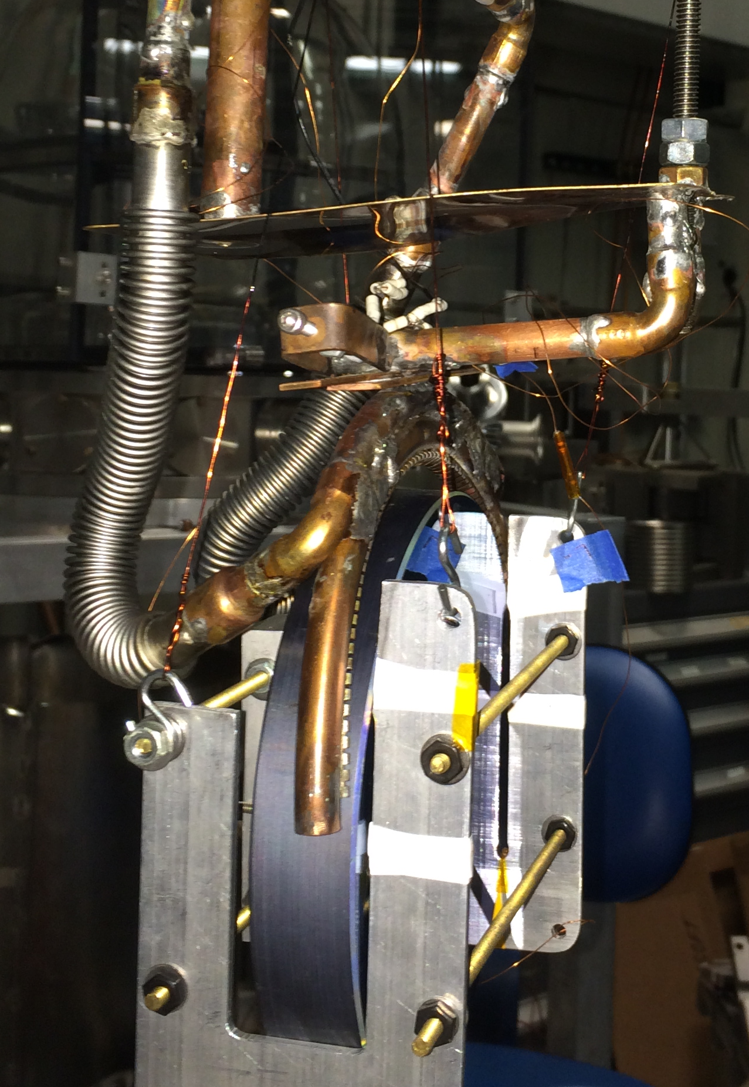
Flexible cold link evolution

Slide 31
Future work
LIGO
Get bigger pump to reduce pressure
Better computing for FEM of convection
Next generation experiment on the prototype aLIGO in-vacuum seismic isolation table.
  More realistic LIGO setup
  Measure temperature drifts on LIGO hardware
  Measure seismic noise of nitrogen delivery
  Use welded joints to prevent leaks.

Slide 32
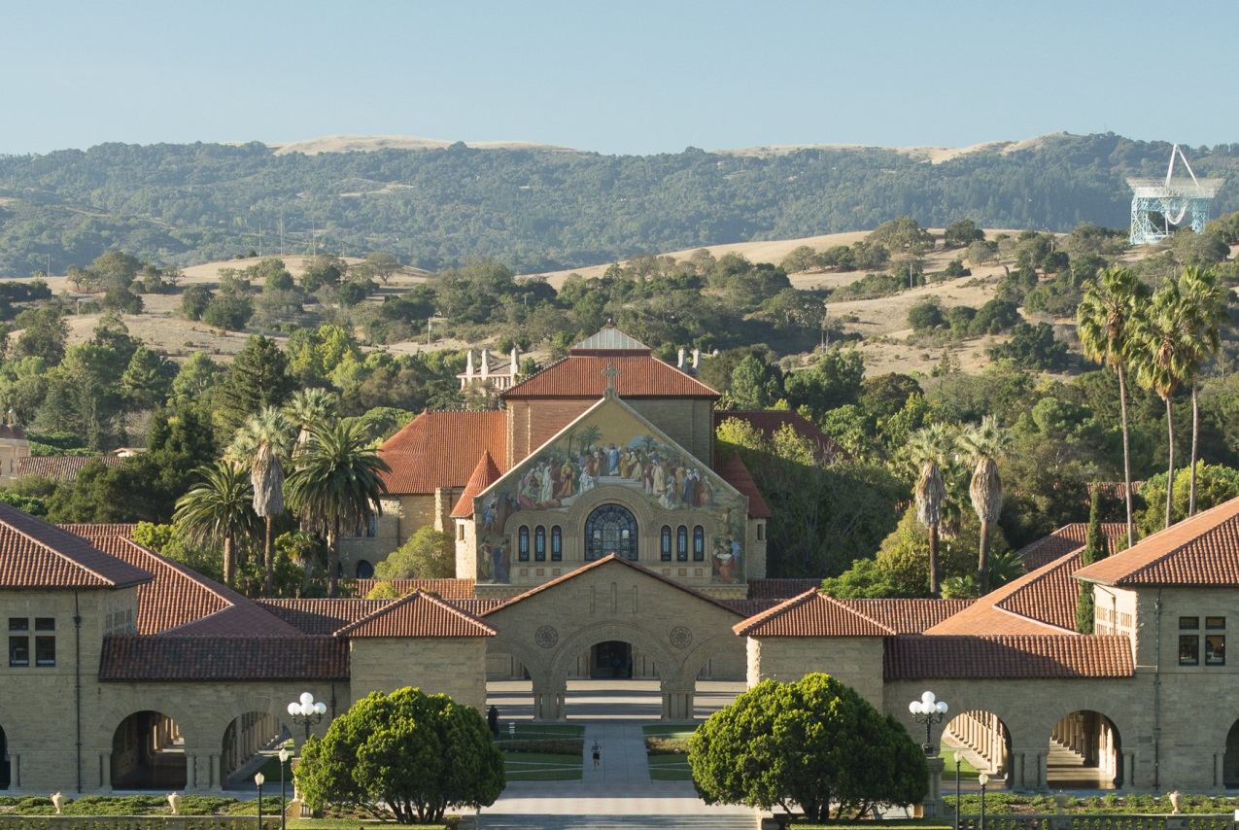
LVC STANFORD
August 25-29 2014

Slide 33
Backups
LIGO

Slide 34
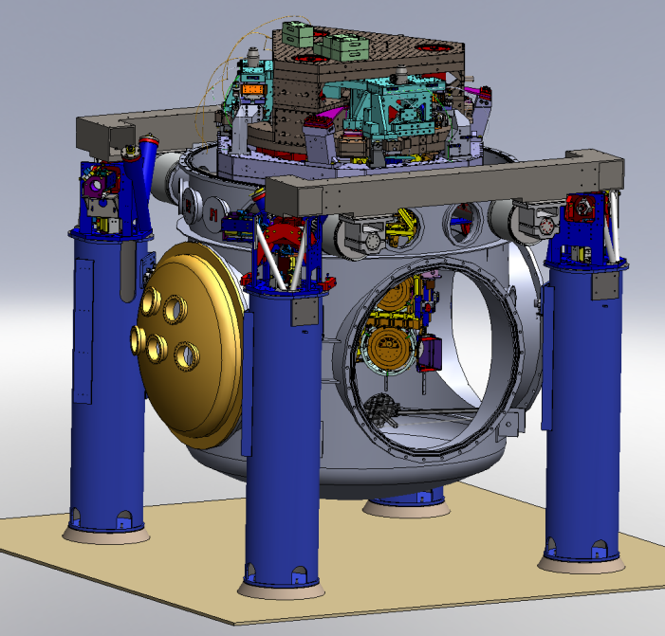
Advanced LIGO Layout
ETM
4 km
Input
Mode
Cleaner
Power Recycling
ITM
Φ
FI
CP
ITM
Laser
m
125 W
815 kW
ETM
5.7 kW
BS
Signal Recycling Cavity
FI
PD
Installation complete in 2014
Observing GWs in 2015
GW readout
Output
Mode
Cleaner

Slide 35
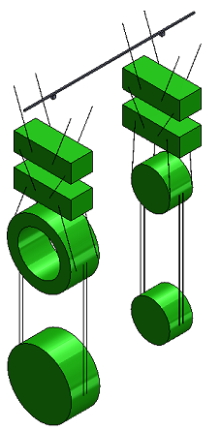
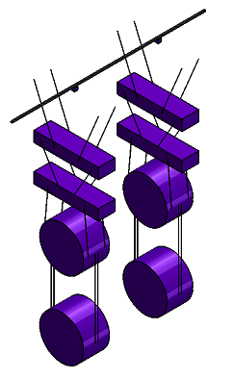
Possible LIGO III Mechanical Upgrades
Advanced LIGO quad pendulum
Preliminary LIGO III quad pendulum
Reaction
chain
Reaction
chain
Main
chain
Main
chain
2.14 m
1.626 m
10 kg
20 kg
? kg
? kg
20 kg
20 kg
40 kg
? kg
40 kg
143 kg
Fused silica, 295 K
Silicon, 120 K

Slide 36
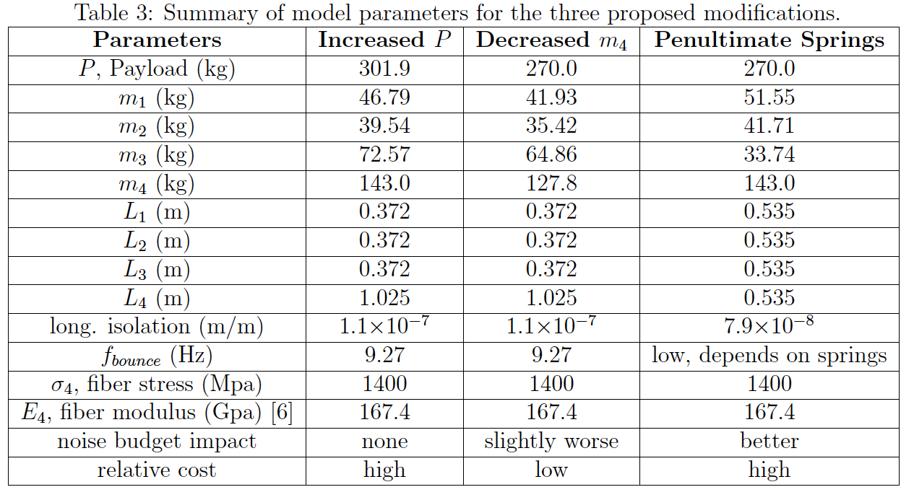
3 Quad Conceptual Designs
Higher payload
Lighter
Test mass
Ideal masses with PUM springs
T1300786

Slide 37
How to get a LN2 Hose to ST2
Vacuum flange
LN₂ hoses: Supply and return
Stage 0
Actuators
Stage A
Stage 1
Sensors
Stage 2
clamps
Extra stage, A, in parallel with stage 1 carries hose. Stage A is actuated to follow stage 2 so the hose has does not short seismic isolation. Stage A sensor noise is set by the stage 2 isolation requirement (so it follows stage 2 and not the sensor noise).

Slide 38
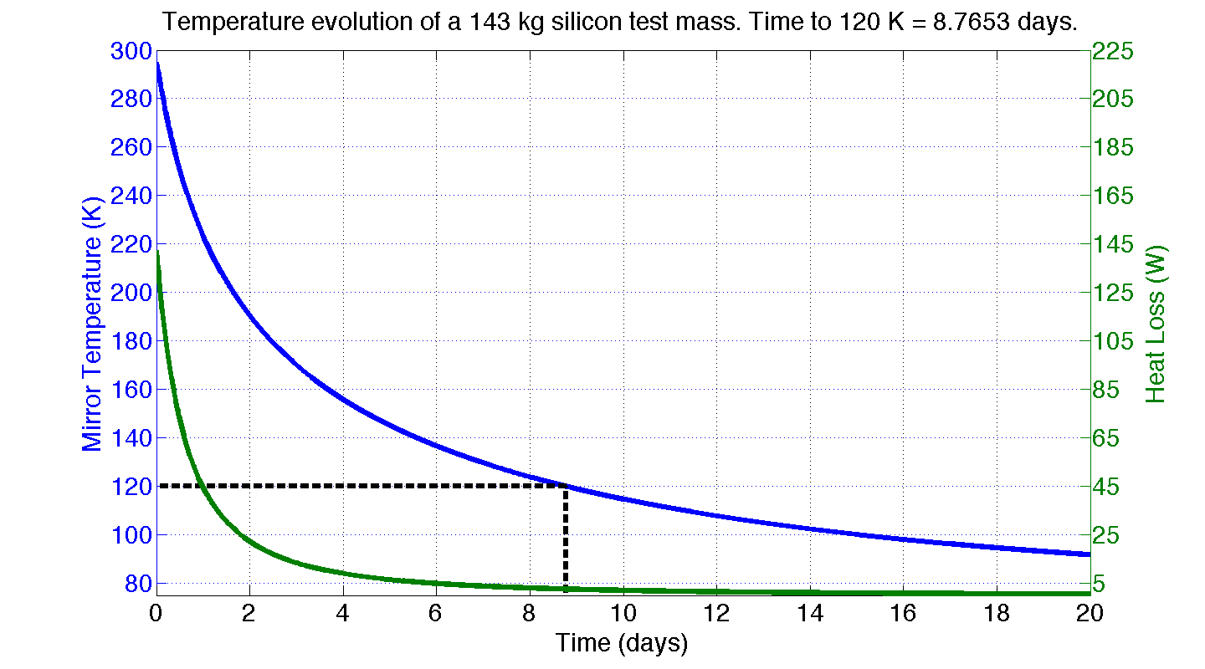
Test Mass Radiation Simulation
Ideal radiation shield:
Fully encloses test mass
77 K (liquid N₂)
Shield emissivity = 1
Test mass barrel emissivity = 0.5
Laser power = 0
Power α (Temperature)^4

Slide 39

A Lot of Heat to Remove
2.7 days to 120 K (295 K) at a constant 60 W
60 W
143 kg Test Mass:
14 MJ to get cold (warm)
Maybe there is another way to cool the test mass quickly

Slide 40
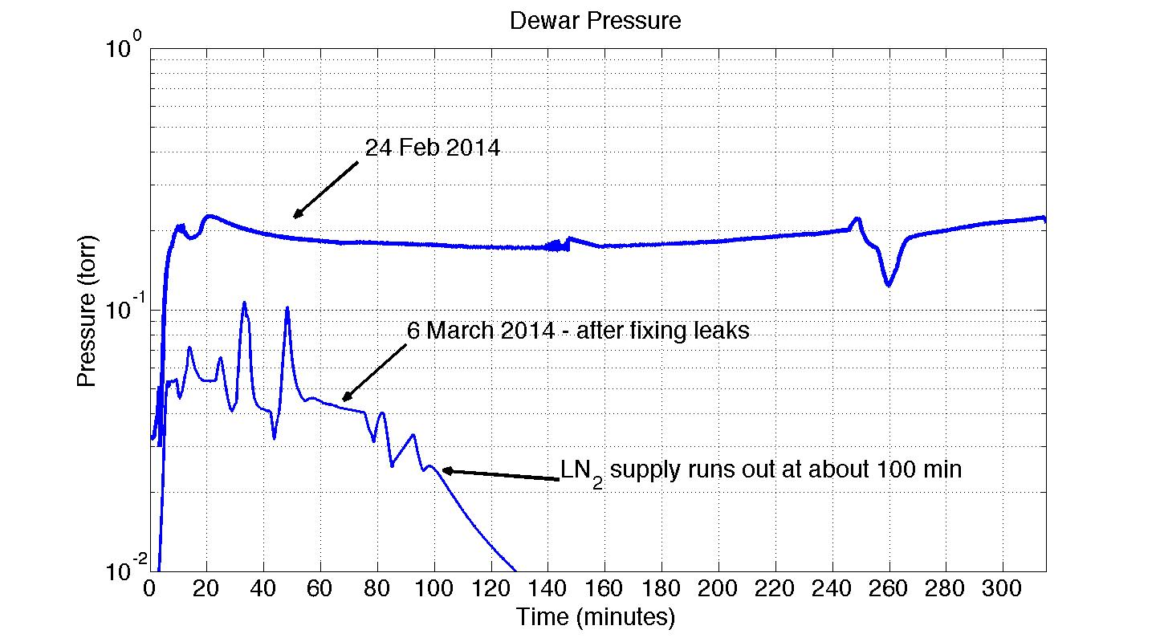
Dewar pressure during measurements

Slide 41
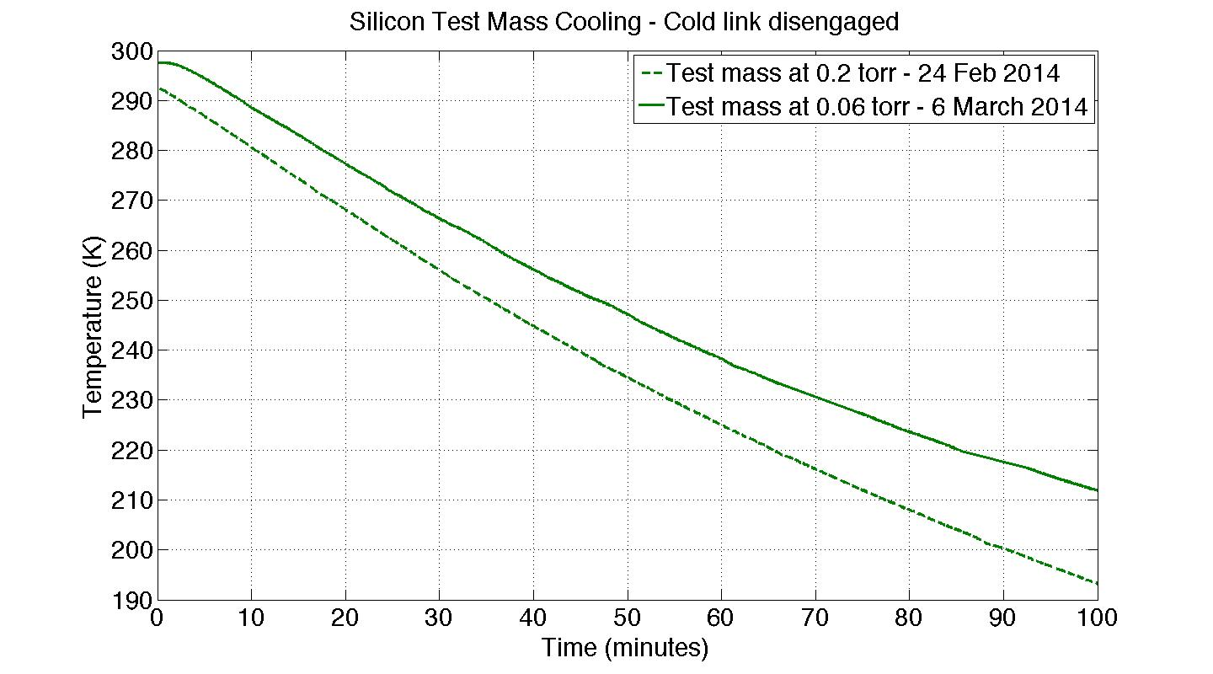
Effect of pressure on test mass temp

Slide 42
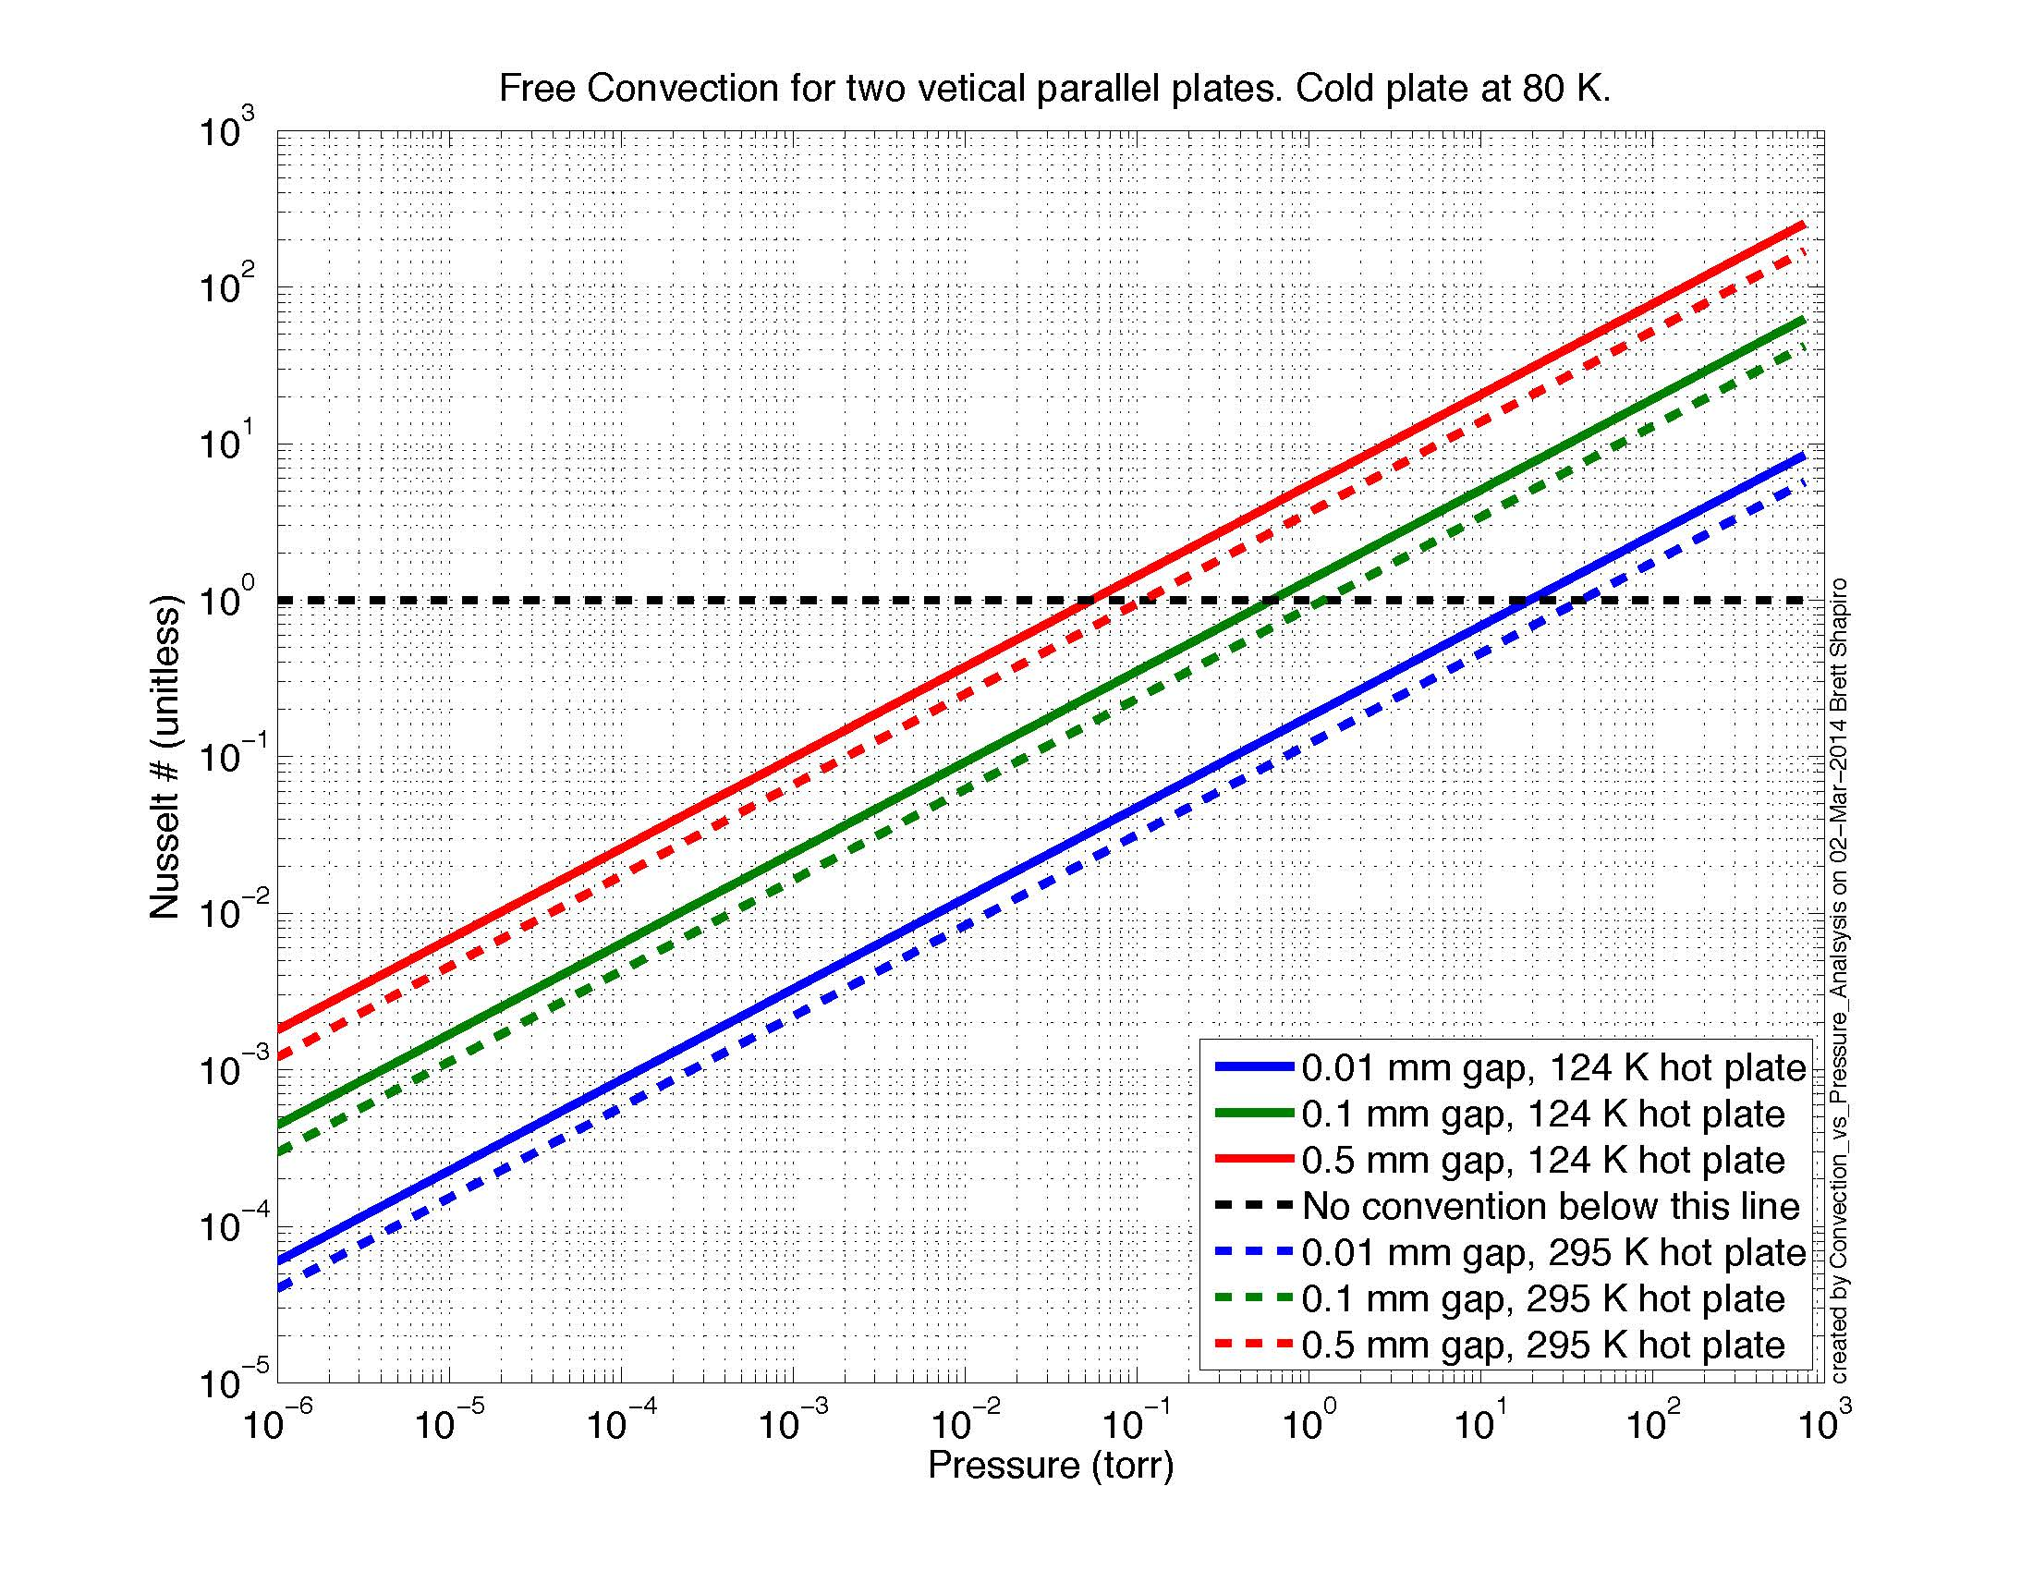

Slide 43
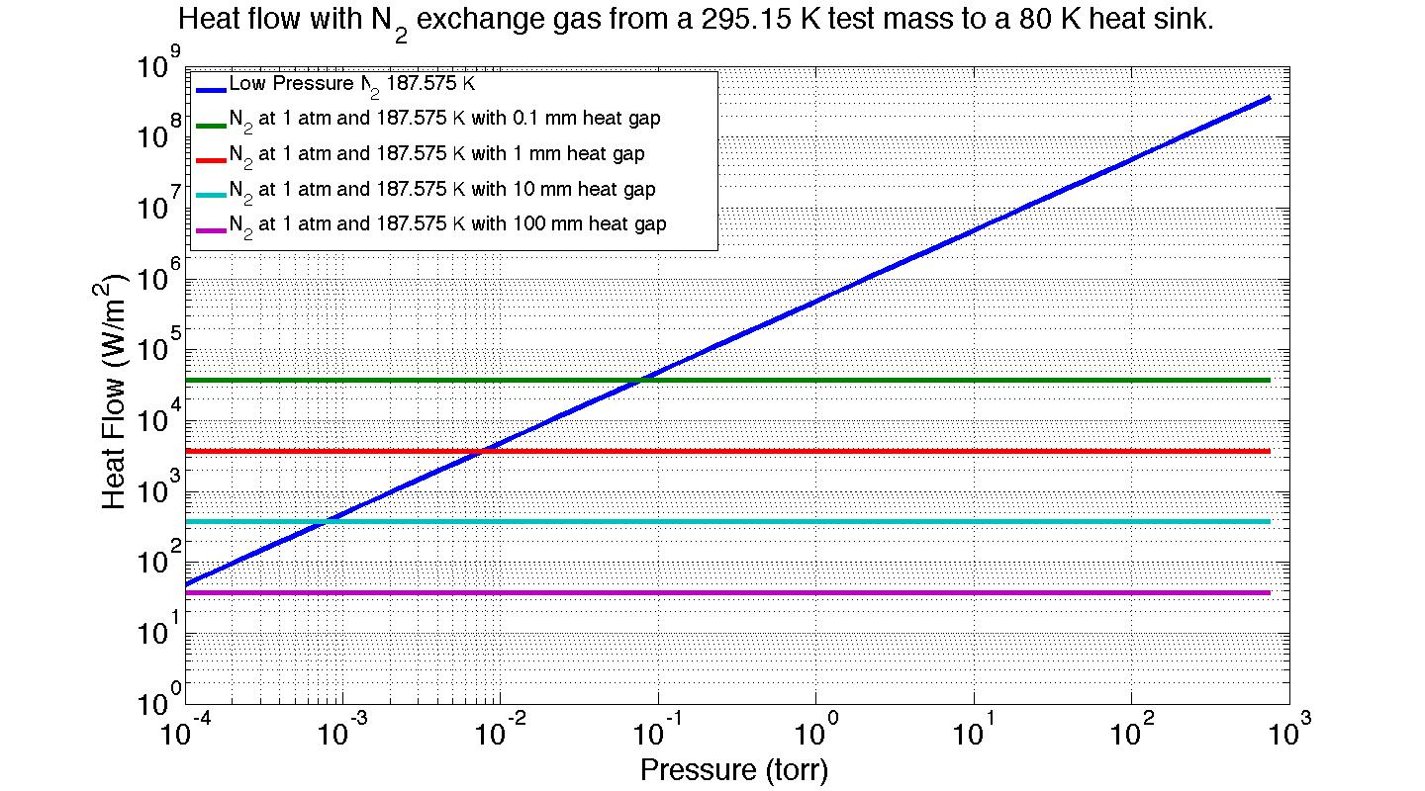
N₂ gas therm. cond. vs pressure

Slide 44
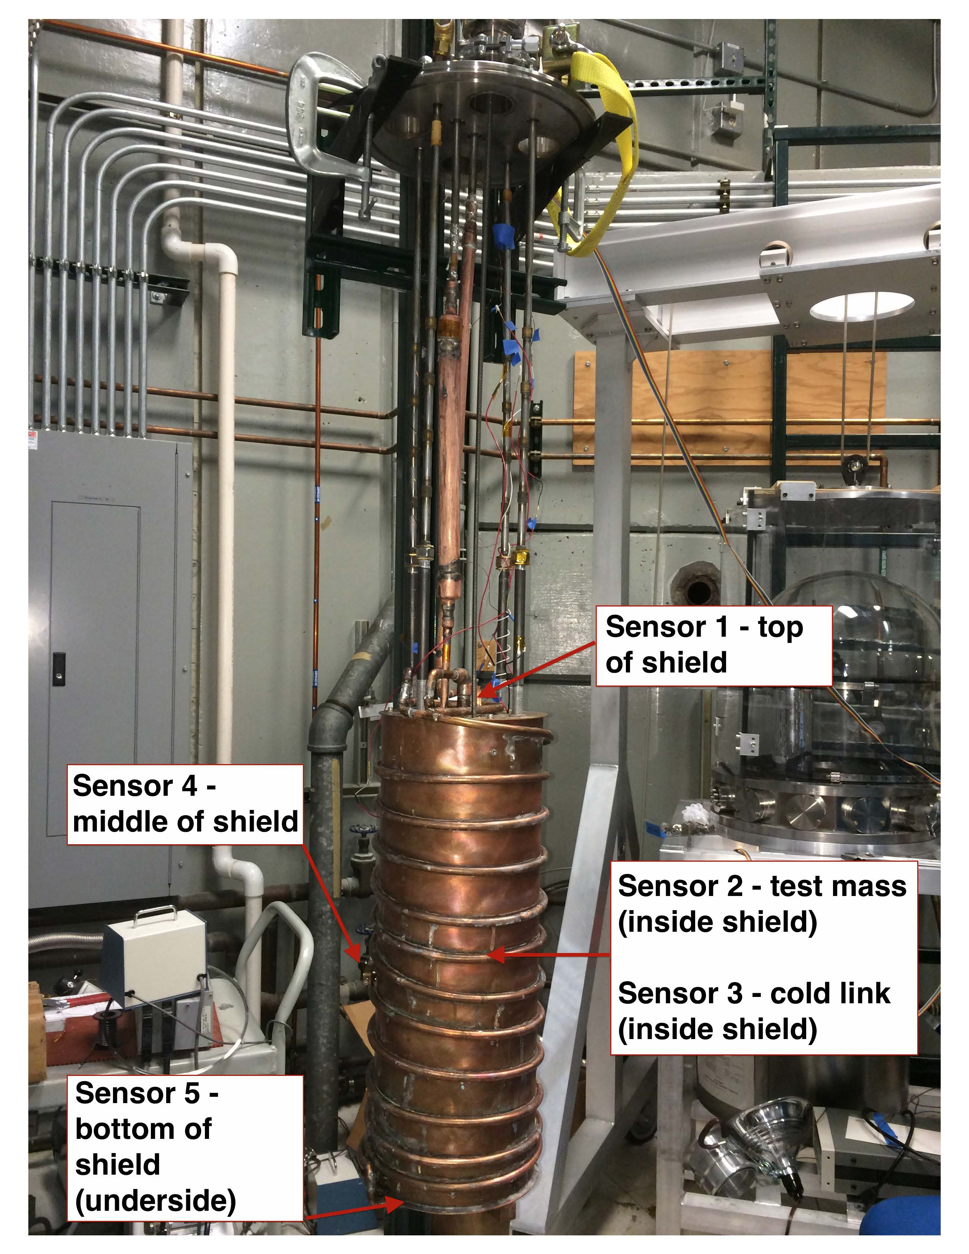
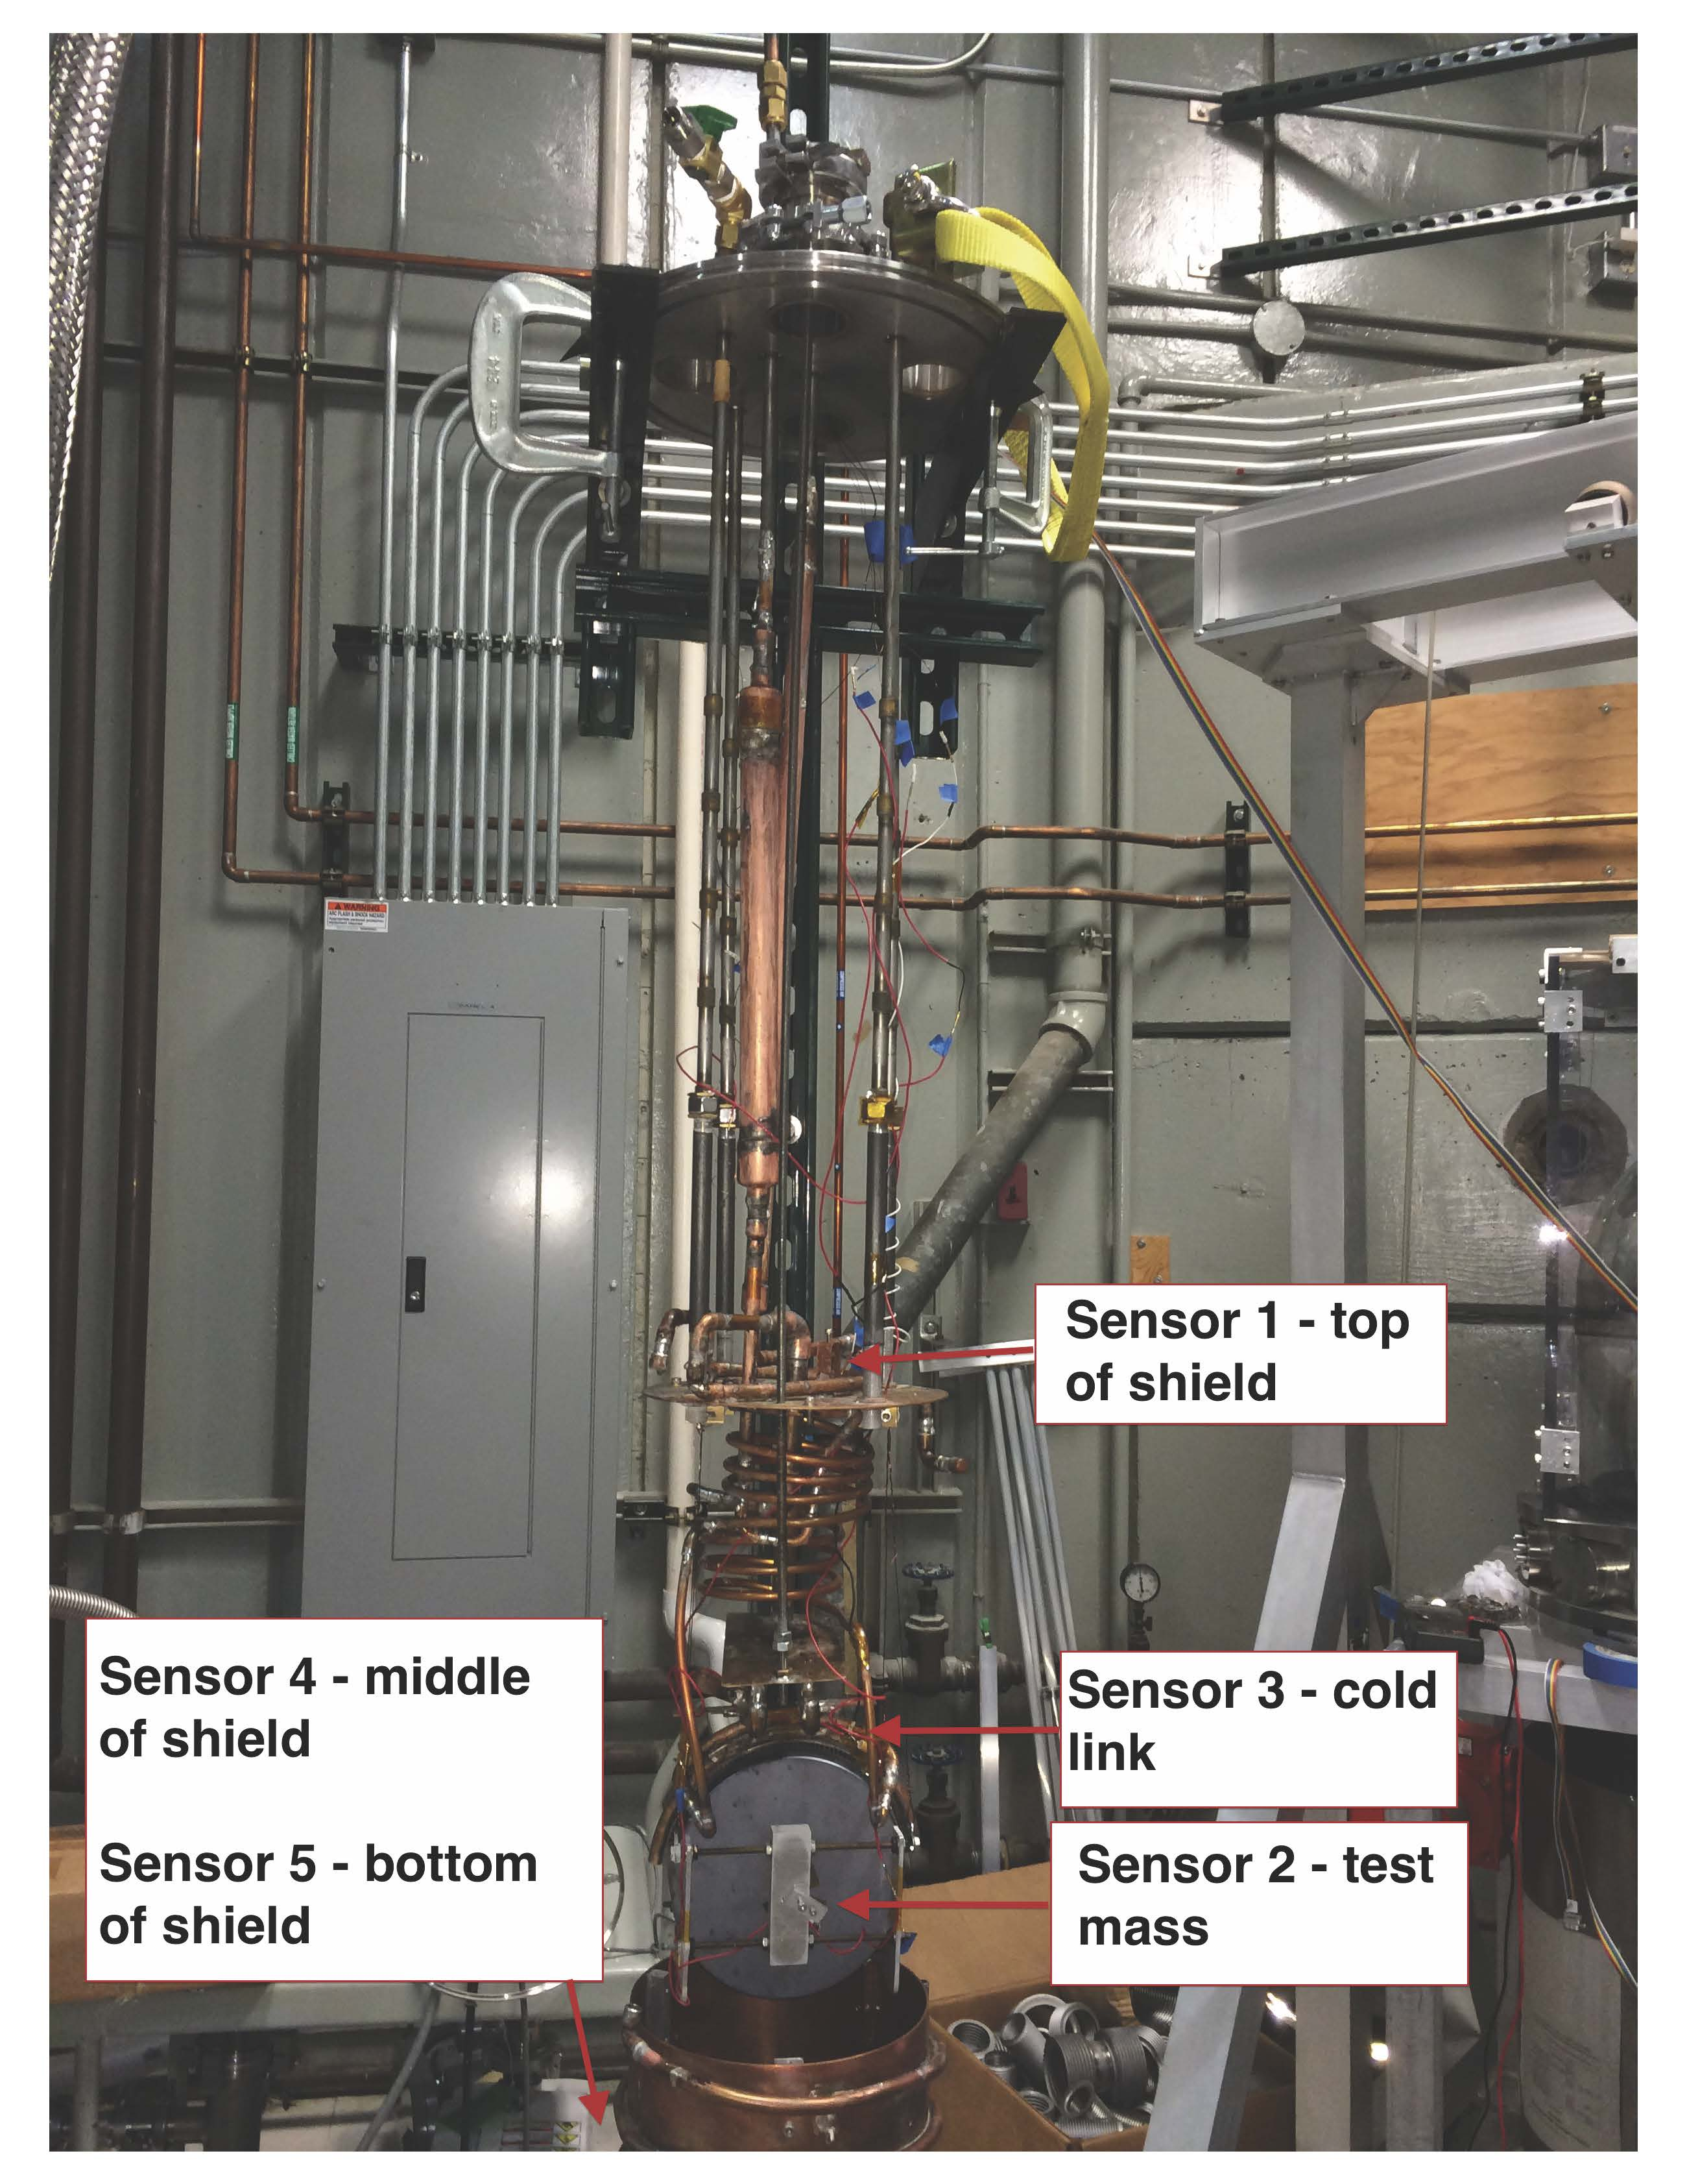
Temperature Sensor Locations

Slide 45
Test Mass Temperature Equations

Slide 46
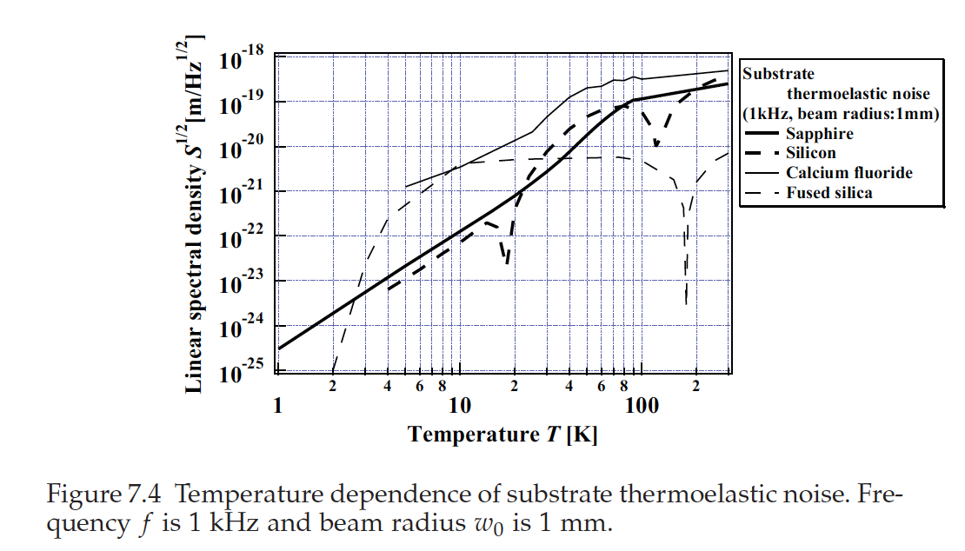
ref: Harry, Bodiya, Desalvo. Optical Coatings and Thermal Noise in Precision Measurement. 2012. pg 113.

Slide 47
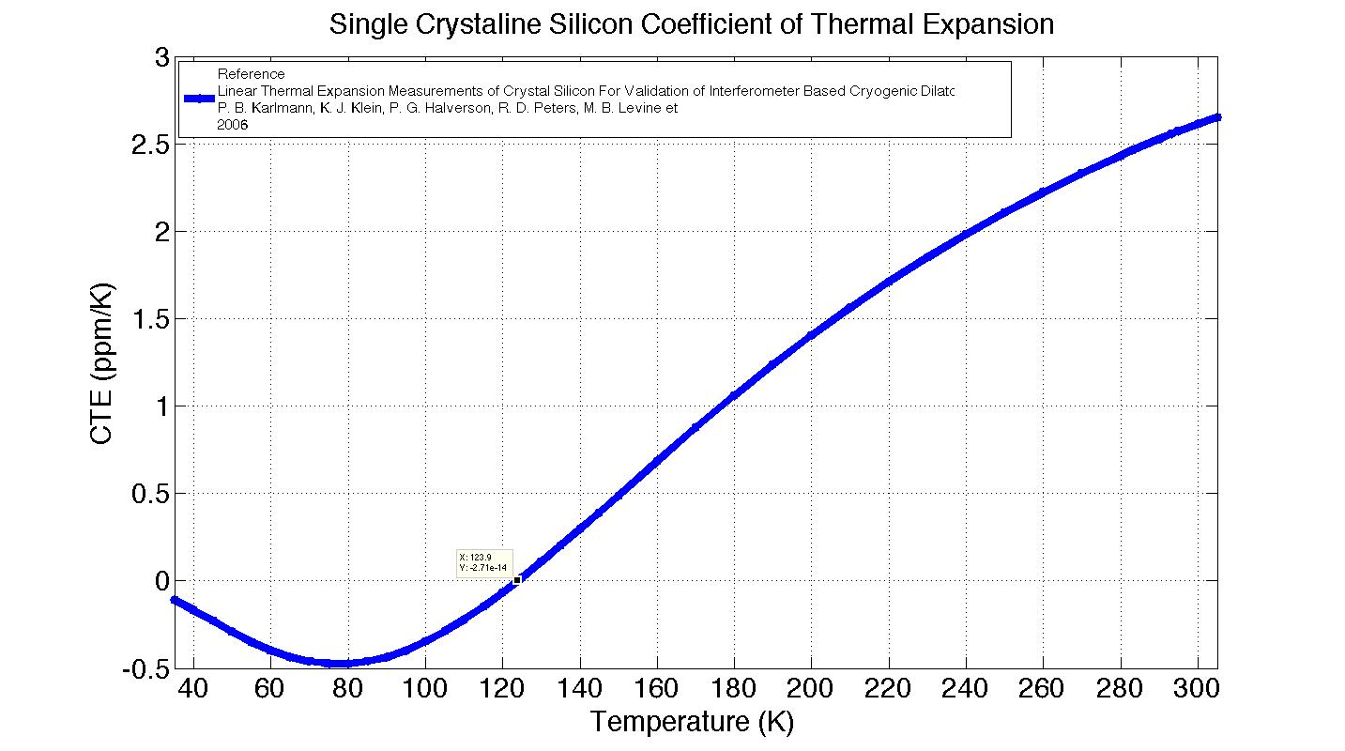
Si CTE vs Temperature
Thermoelastic component of thermal noise goes to zero with CTE.

Slide 48
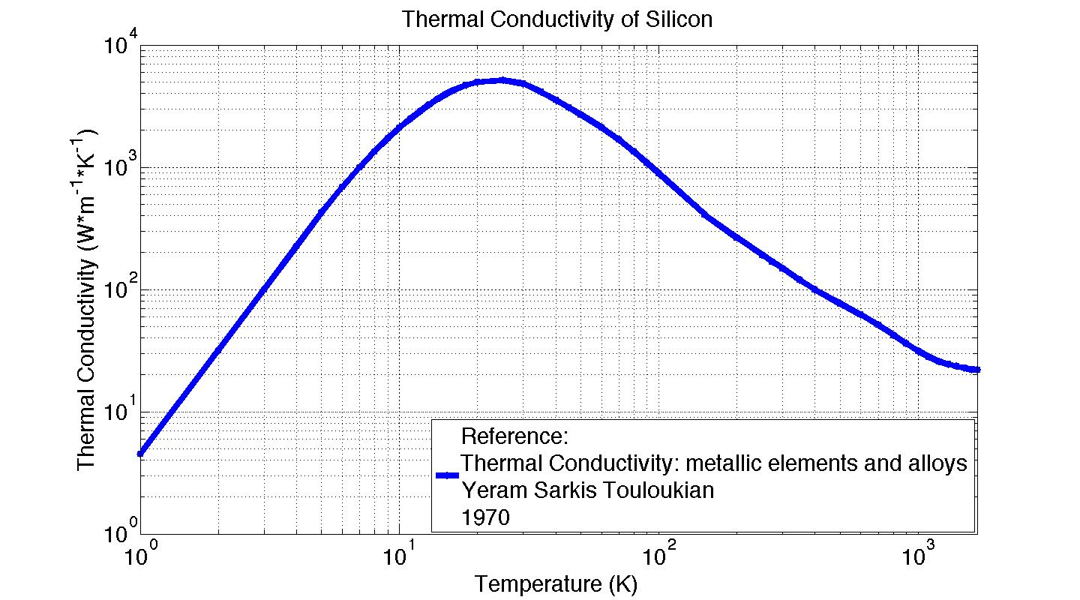
Si Thermal Conductivity vs Temp.

Slide 49
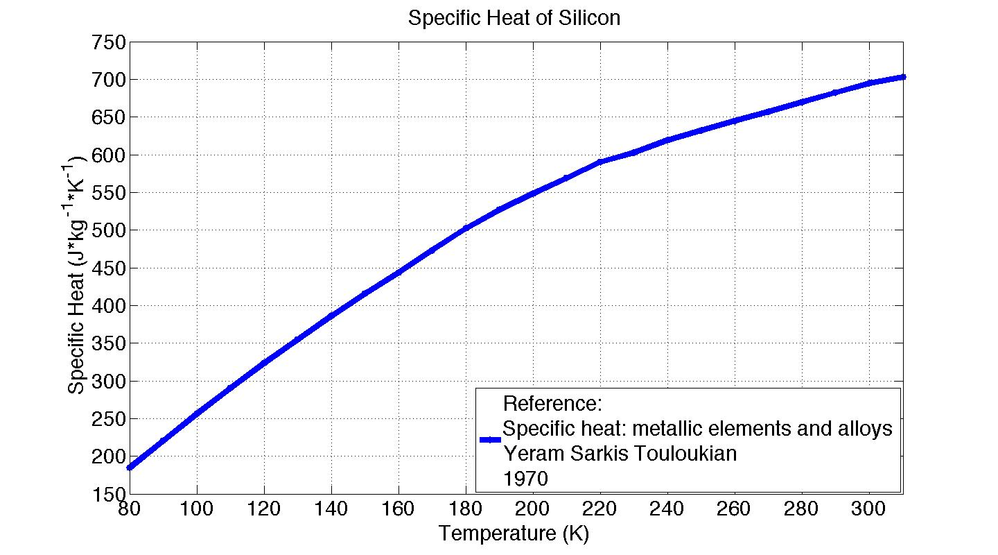
Si Specific Heat vs Temperature

Slide 50
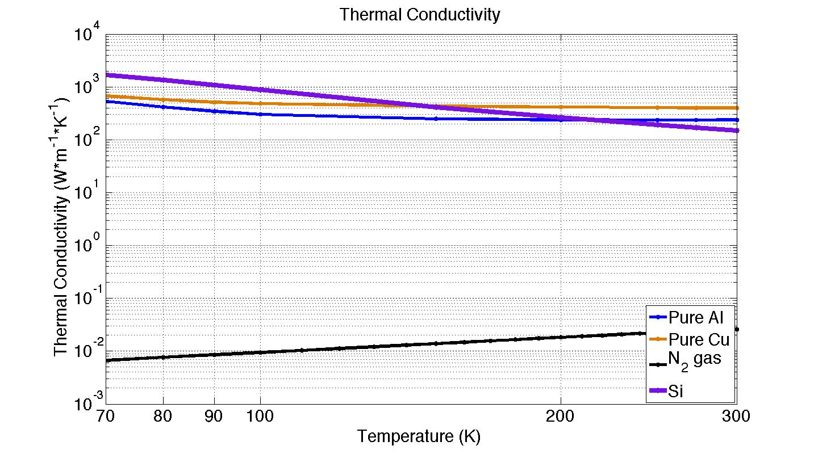
Thermal Conductivity of Materials

Slide 51
Beam Tube Heat Shield Length
Test Mass
Heat Shield
T = 77 K
ε
Beam tube
Blackbody disc model
r_{j} = 0.28m
r_{i} = 0.6225m
T_{i} = 295 K
Ε = 0.1
T_{j} = 120 K
Ε = 1
L (m)
What is the optimal heat shield length in the beam tube?
See T1300556

Slide 52
Heat shield length in beam tube
Black body power from beam tube arriving at test mass
≈1/3 drop for every factor of 2 L
Test mass emissivity = 0.1
Beam tube shield length L (m)
See T1300556

Slide 53
Other Problems To Solve
Liquid N₂ hoses flexible enough for ISI under vacuum
Temperature/height control of blade springs
Test mass temperature control
How to measure temperature?
  Measure acoustic modes – Young’s modulus is temp. dependent
  Infrared camera
Emissivity of optical coatings
Lossiness of emissive coatings
Good emissivity estimates/measurements of Si?
Power absorption in Si (ppm, W, etc)?
How noisy is bubbling nitrogen: seismic, Newtonian? Do boiling chips help?
Optical coating thermal noise at 120 K

