Slide 1
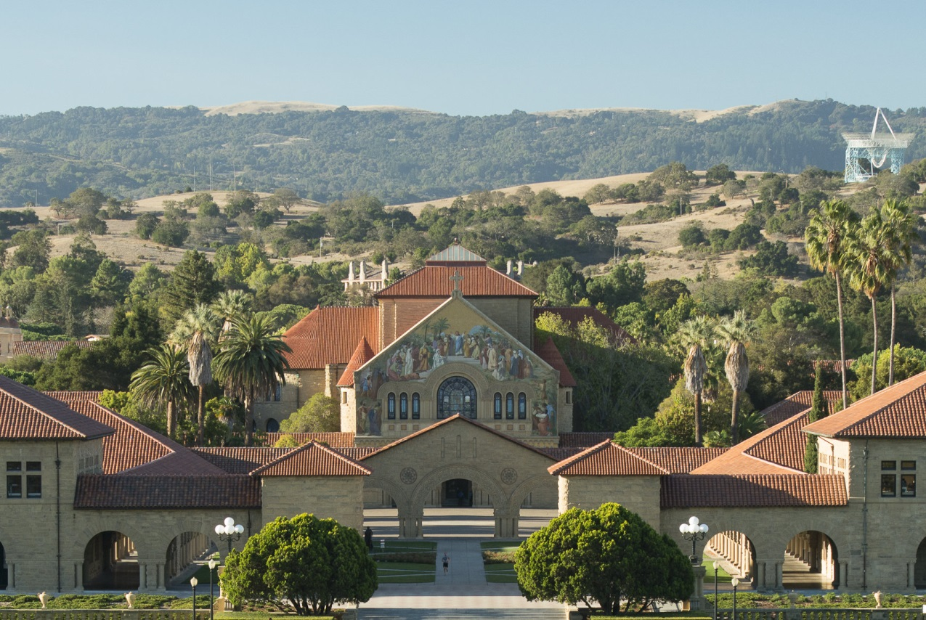
LVC STANFORD August 25-29 2014

Slide 2
LVC STANFORD August 25-29 2014
Accommodations
Registration – webpage available April 1
$250 Student rate
$500 Non-student rate
Includes:
Breakfast and lunch
Banquet dinner
Conference rooms
AV and AV Technicians
Poster session
Does not include:
Parking passes ($10/day)
Transportation to/from airport
Poster printing
Carothers Hall
(30) Single Rooms: $77.20 per person/night
(85) Double Rooms: $56.70 per person/night
Benefits:
5 minute walk to conference.
Outdoor facilities available:
Telephone in each
Comfortable and clean facility.
Onsite management.
Free laundry facilities.
Linens provided
Quiet areas including business center/lounge.
Crothers Hall is exclusive to LVC.
Free shuttle service to shopping/restaurants
Alternate accommodations (hotel)
$180-350/night
Contact
Vivian Drew
vdrew@stanford.edu
650-723-0227

