Slide 1
Impressions of CARM/ALS
J. Kissel, for the people way smarter than me.

Slide 2
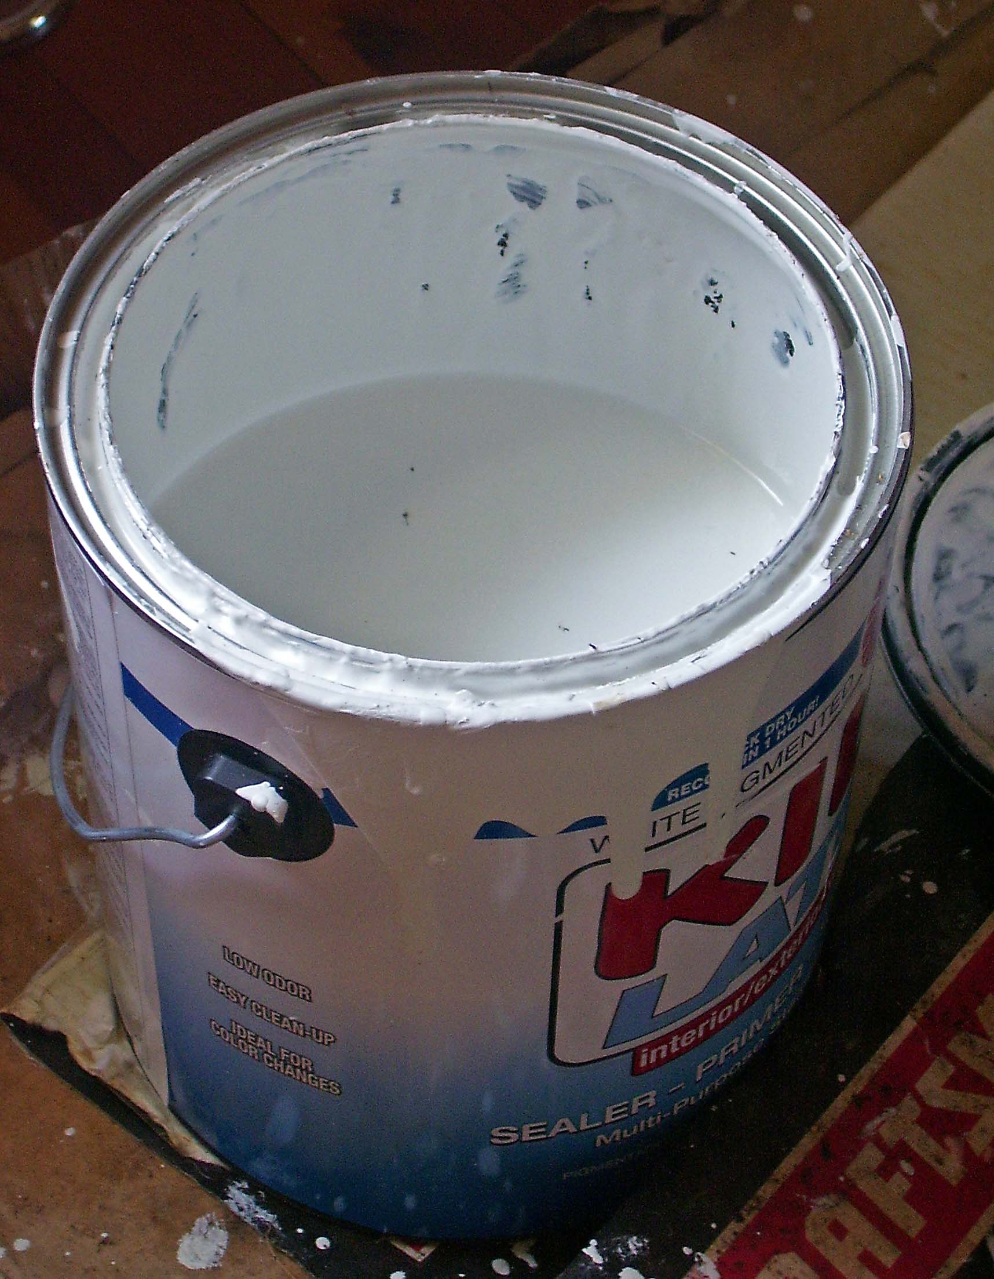
Primer
The development of CARM/ALS spans many decades, many people, and many subsystems, so documentation isn’t always consistent and it’s tough to find the big picture with everything included in one place. This is my attempt.
I’m still getting to know the subsystem
This presentation will not be perfect
Go to references (Related Documents on DCC file card) for guidance, they’ve done a better job.
This is now a “course” meant to be taught over a few days, so forgive its length
Thanks for your patience.

Slide 3
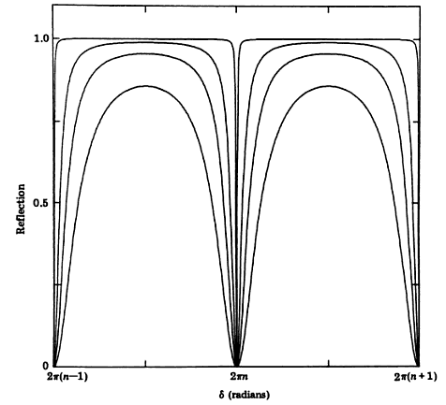
Intro to Cavity “Locking”
Optical
Isolator
Laser
High
Finesse
Resonant cavity resonates, when cavity length is an integer number of laser wavelengths
Low
Finesse
Reflected Power
More reflective mirrors
= Tighter resonance condition
Equivalent noise sources to this system:
cavity length changes or
laser frequency/wavelength changes
c L
___
ΔL = Δf
Free Spectral Range
λ
On Resonance

Slide 4
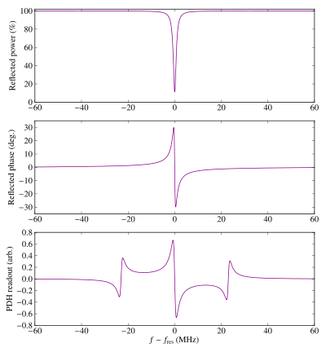
Intro to PDH
Robert V. Pound
Ron W P Drever
John L Hall
Locks laser frequency to resonant cavity, following the length of the cavity as it changes
Phase /
Frequency
Modulator
Faraday
Isolator
Optical
Isolator
Laser
Local
Oscillator
(LO)
Control
Filter
“Servo”
Reflected Field Power
Phase
Delay
Reflected Field Phase
Low-Pass
Filter
Mixer/
“Demodulator”
“Lock acquisition” or “catch (and hold) lock”
= Length changes slower than the control bandwidth
Control servo holds the laser frequency within linear operating regime
PDH Error Signal
Non-linear in regions outside cavity linewidth

Slide 5
Intro to PDH
Phase /
Frequency
Modulator
Faraday
Isolator
Optical
Isolator
Laser
Local
Oscillator
(LO)
PDH locking the Laser to
Cavity reduces frequency noise
Cavity treated as
“frequency reference”
Control
Filter
“Servo”
Phase
Delay
Low-Pass
Filter
Mixer
λ
The LONGER the cavity, and/or
the SMALLER the length changes,
the better the frequency reference,
the lower the frequency noise
___
Δf = ΔL
c L
See Appendix A for more Essential Cavity Eqs.

Slide 6
The LIGO Arm Cavity Problem
Laser frequency = 3 [THz] = 3e14 [Hz]
Standard Nd:YAG laser frequency noise at ~10-100 Hz = 1e4 [Hz/rtHz]
Highly reflective mirrors
Long light storage time
High finesse
Great for gravitational wave detection
Highly reflective mirrors
Very small / tight cavity line width:
FWHM ≈ 100 [Hz] ≈ 1 [nm]
Difficult to catch a resonance condition
aLIGO Needs frequency stabilization at ~10-100 Hz = 1e-6 [Hz/rtHz] level!
(in loop)
Needs 10 orders of magnitude of frequency noise suppression!
In order to merge corner station with arms during lock acquisition, while building up frequency stability, we need *LOTS* of loops.
Notes:
Approximately equals “≈“ mac keystroke is simultaneous “option/alt”+”x”

Slide 7
LIGO = PDH to the MAX
SIX nested / interconnected PDH loops to control the laser frequency:
FSS
IMC PDH
Fiber PLL
ALS PDH
ALS COMM
CARM

Slide 8

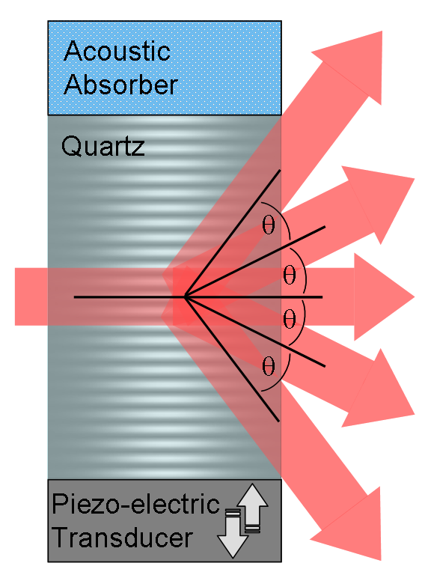
Frequency Actuators on Light
AOMs vs. EOMs
Acousto-Optic Modulator
Bragg Crystal acoustically excited by PZT
Diffraction light frequency is Doppler shifted to
  f -> f + m F
  where m is the diffraction order and F is excitation frequency
Electro-Optic Modulator
Creates sidebands via phase modulation via Pockels effect
  Refractive index is a function of the electric field
  Output phase proportional to how much time in crystal
  Change electric field, change refractive index, change the phase of light.
m=+2
m=+1
m=0
A e^{iwt} -> A e^{iwt+i Γ sin(Wt)}
~A e^{iwt} (1 + i Γ sin(Wt) + …) (for small Γ)
sin(x) = (1/2i) e^{+ix} –e^{-ix}
= A e^{iwt} (1 + Γ/2 e^{+iWt} - Γ/2 e^{-iWt} + …)
= A (e^{iwt} + Γ/2 e^{+i(w+W)t} - Γ/2 e^{+i(w-W)t} + …)
m=-1
m=-2

Slide 9
Frequency Stabilization Servo
FSS
IMC PDH
Fiber PLL
ALS PDH
ALS COMM
ALS DIFF
Just a fancy PDH loop!
Light sent into Reference Cavity serving as an external frequency reference
L ≈ 0.5 [m]
In a vacuum can on the PSL
EOM adds 21.5 MHz sidebands for PDH locking the laser to the reference cavity
AOM shifts the picked-off laser frequency up by +80 upon first pass and then another +80 upon second
Voltage-Controlled Oscillator (VCO) provides adjustable local oscillator (LO) frequency at 80 +/- 1 [MHz], so we can adjust the main PSL carrier frequency.
Photo-diode demodulated at 21.5 [MHz], low passed, and control filtered, and sent to laser
Low Frequency = “Slow” = laser temperature
High Frequency = “Fast” = Laser cavity length

Slide 10
Input Mode Cleaner PDH
FSS
IMC PDH
Fiber PLL
ALS PDH
ALS COMM
ALS DIFF
Just a fancy PDH loop!
(but now nested with FSS)
Now 16 [m], suspended input mode cleaner cavity serves as frequency reference
EOM for IMC oscillator is set at 24 [MHz]
Fast control sent as control input PSL VCO (remember the +/- 1 [MHz]?), adjusting the carrier frequency to follow the IMC’s stable reference
Slow control sent to IMC cavity length (because VCO doesn’t have the low-frequency range for HAM2-HAM3 differential motion)

Slide 11
PSL / End-Station
Laser Phase-Locking Loop
FSS
IMC PDH
Fiber PLL
ALS PDH
ALS COMM
ALS DIFF
MEANWHILE!!! Begin to prep the arms for merging with the red…
Take the *transmitted* light from Reference Cavity,
feed it into a optical fiber (on the PSL),
down-shift back to 0 [MHz] with fiber AOM (in the PSL racks)
Ship to end stations (via optical fiber),
Phase lock the carrier of an independent, RED / GREEN auxiliary laser to PSL fiber transmission
  Catch PSL / Aux RED beat note on PD, a send to a phase-frequency detector as the mixer, demodulate at ~40 [Hz] with VCO
  Laser / PLL forces aux laser to have a RED, 1064nm carrier +/-40 [MHz], therefore GREEN, 532nm carrier +/- 80 [MHz] in GREEN
  - for X arm, + for Y arm
Phase-Locking Loop = PLL

Slide 12
Arm Length Stabilization PDH
IMC PDH
Fiber PLL
ALS PDH
ALS COMM
ALS DIFF
FIND IR
Just a fancy PDH loop!
(Now nested with Fiber PLL)
Now back to standard PDH locking of arm with green
Send fast feed back to end-VCO
Send slow feed back to arm cavity length
… just like IMC
… just like IMC

Slide 13
PSL / Common Arm Stabilization
Fiber PLL
ALS PDH
ALS COMM
ALS DIFF
FIND IR
IR FOUND
Now we nest the green and red frequency, starting to sync the PSL to the arms.
Transmitted green from X arm is steered to combine with a pick-off of the PSL, frequency-doubled (turning RED to GREEN) via second harmonic generator (SHG).
That beat note (-80 [MHz]), is fed into another PLL / VCO combination
The control signal is fed into a summing node, which cascades down to the IMC, then to the PSL (or IMC)
This is sometimes called an “additive offset” because you’re adding the ARM offset to the laser frequency to the IMC control, which is already offsetting the carrier

Slide 14
Differential Arm Length Stabilization
ALS PDH
ALS COMM
ALS DIFF
FIND IR
IR FOUND
ARMS OFF REZ
Now compare the X arm transmitted green light against the Y arm, using the beat note (160 [MHz]) as the first sensitive measure of DARM
Unlike COMM, DIFF is digitized and send to ETMs for control
We usually control DIFF by just pushing on one arm

Slide 15
The Rest of the Lock Acquisition Sequence
ALS PDH
ALS COMM
ALS DIFF
FIND IR
IR FOUND
ARMS OFF REZ
From here, we have the arms controlled, but at this point the frequency control is no where near good enough, and we don’t have DRMI locked.
The next MANY steps are all in place such that we can lock DRMI independently, then slowly bring the arms into resonance with DRMI.
It’s a convoluted process that involves slowly/carefully switching between equivalent sensors and actuators, but going from high noise / high range to low noise / low range.
Let’s go!

Slide 16
FIND IR
ALS COMM
ALS DIFF
FIND IR
IR FOUND
ARMS OFF REZ
DRMI
Steer around COMM then DIFF frequency control (via slow digital control of COMM then DIFF VCO frequencies, which in turn pushes around the PSL frequency), to find what frequency resonates in the arms
Whether arms are resonant or not is measured by the RED transmitted power on the transmon platform

Slide 17
IR FOUND
ALS DIFF
FIND IR
IR FOUND
ARMS OFF REZ
DRMI
CARM ON TR
Congrats!
Now we know at what carrier frequency we should operate the PSL such that IR will resonate in the arms.

Slide 18
ARMS OFF RESONANCE
FIND IR
IR FOUND
ARMS OFF REZ
DRMI
CARM ON TR
DARM TO RF
Here, we then intentionally add an OFFSET to the ALS DIFF and COMM loops to push the arms off resonance, so we can lock DRMI without the interference of the arms

Slide 19
DRMI (1F, 3F)
IR FOUND
ARMS OFF REZ
DRMI
CARM ON TR
DARM TO RF
CARM TO REFL
In this step, we use the temporary sensors, REFL AIR (shown) and AS AIR (not shown) to lock PRCL, MICH, and SCRL (a.k.a DRMI) on first on “1f” (9 and 45 MHz), then temporarily switch to an harmonic of the modulation frequency (“3f”) that won’t be confused when the arms come back into resonance

Slide 20
An aside: Why 1f vs 3f DRMI?
IR FOUND
ARMS OFF REZ
DRMI
CARM ON TR
DARM TO RF
CARM TO REFL
I lied to you a bit on slide 8 when I said
A e^{iwt} -> A e^{iwt+i Γ sin(Wt)}
~A e^{iwt} (1 + i Γ sin(Wt) + …) (for small Γ)
sin(x) = (1/2i) e^{+ix} –e^{-ix}
= A e^{iwt} (1 + Γ/2 e^{+iWt} - Γ/2 e^{-iWt})
= A (e^{iwt} + Γ/2 e^{+i(w+W)t} - Γ/2 e^{+i(w-W)t})
To be more complete…
And that’s the electric field.
Photodetectors measure power (=|field|²), so there will be cross-terms as well…
9, (2*9)=18, (2*9-45) = 27, (9-45)=36, 45, etc.
A e^{iwt} -> A e^{iwt+i Γ sin(Wt)}
= A e^{iwt} Σ_{k} [ J_{k}(Γ) e^{ikWt} ]
J_{k}(Γ) ~ 1/k! (Γ/2)^{k} (for small Γ)
J_{-k}(Γ) = - J_{k}(Γ)
= A e^{iwt} (… - Γ/6 e^{-i3Wt} - Γ/4 e^{-i2Wt} - Γ/2 e^{-iWt}
+ 1
+ Γ/2 e^{+iWt} + Γ/4 e^{-i2Wt} + Γ/6 e^{-i3Wt} + … )
… one modulation frequency yields lots of harmonics:
The RF response of our LSC photodetectors

Slide 21
An aside: Why 1f vs 3f DRMI?
IR FOUND
ARMS OFF REZ
DRMI
CARM ON TR
DARM TO RF
CARM TO REFL
Arai, Koji, et al. Phys. Lett A 273.1-2 (2000): 15-24.
3f signals are inherently better than 1f signals at distinguishing δL₊ (CARM) from δl₊ (PRCL)
aLIGO Schnupp Asymmetry
As we reduce the CARM offset (bring the arms into resonance), 3f signals are much less effected, and don’t flip sign, unlike 1f signals!

Slide 22
DRMI (1F, 3F)
IR FOUND
ARMS OFF REZ
DRMI
CARM ON TR
DARM TO RF
CARM TO REFL
Back to the acquisition sequence…
We leave this slide with DRMI on 3f, and CARM held off resonance with ALS COMM

Slide 23
CARM ON TRANSMISSION
ARMS OFF REZ
DRMI
CARM ON TR
DARM TO RF
CARM TO REFL
RESONANCE
OK, so we’ve got DRMI on 3f so it’s ”insensitive” to CARM, so let’s reduce the offset (and improve the sensor as we go) …
First, bring the arms in a bit, and use the transmitted light from the arms as our first better sensor
CARM_150_PICOMETERS…

Slide 24
DARM to RF
DRMI
CARM ON TR
DARM TO RF
CARM TO REFL
RESONANCE
DRMI ON POP
OK, this talk admittedly ignores the anti-symmetric port (DARM, MICH, and SRCL) but there’s an in-air RFPD there (AS AIR) that can be used to measure DARM with IR, digitized PDH scheme that’s more sensitive, so we switch from DIFF to RF DARM here.
CARM_5_PICOMETERS…

Slide 25
CARM to REFL
CARM ON TR
DARM TO RF
CARM TO REFL
RESONANCE
DRMI ON POP
PARK ALS VCO
While we continue to reduce the CARM offset, we switch CARM control from the combo of arm transmissions to a digitized RF PDH scheme with an in-air RFPD at the REFL port
still not good enough frequency noise, though…

Slide 26
RESONANCE
DARM TO RF
CARM TO REFL
RESONANCE
DRMI ON POP
PARK ALS VCO
SHUTTER ALS
Huzzah! The CARM DOF is now completely resonant, no longer detuned by our intentional offset!
We also switch to our control of CARM to completely analog, such that we can increase the bandwidth of our loop to ~20 kHz

Slide 27
DRMI ON POP
DARM TO RF
CARM TO REFL
RESONANCE
DRMI ON POP
PARK ALS VCO
SHUTTER ALS
Lastly, but not leastly, we switch control of DRMI to the in-vac RFPD called POP (Pick-Off port of the Power recycling cavity) for further improved DRMI noise
(and we’re also beginning to shut off the ALS system)

Slide 28
PARK ALS VCO
DARM TO RF
CARM TO REFL
RESONANCE
DRMI ON POP
PARK ALS VCO
SHUTTER ALS
Now, since we’re no longer using them, we drive a hard offset into the ALS VCOs to “park” them at a frequency so they don’t wander around and interfere with the IMC’s IR VCO (>> CARM >> DARM)
Whistle glitches anyone?
No thank you!

Slide 29
SHUTTER ALS
DARM TO RF
CARM TO REFL
RESONANCE
DRMI ON POP
PARK ALS VCO
SHUTTER ALS
And here, at the final stages of the CARM portion of the lock acquisition sequence, we use remote mirror / dump flippers to completely block green light from entering into the arms.
Goodnight moo… *AHEM* green

Slide 30
Now You Understand this Diagram
Congratulations!

Slide 31
The Nested Loop Topology for Frequency Stabilization
From Evan Hall’s Thesis P1600295
A(f) = The IMC PDH control filter and requested voltage control to the AOM frequency before the reference cavity
F(f) = The “Fast” CARM path to PDH control a.k.a. “Additive offset” path
G(f) = Reference cavity control over PSL frequency, a.k.a the FSS
K(f) = The IMC (and MC REFL PD) Response to Frequency/Length
changes
M(f) = The “Slow” CARM path to Control IMC Length and the corresponding frequency change
T(f) = Very slow Tidal control
fed directly to the ETMs ***
P(f) = The interferometer’s CARM degree of freedom (and the REFL PD that measures it) Response to Frequency/ Length changes
*** We didn’t talk about this. See T1400733.

Slide 32

The Nested Loop Open Loop Gain TFs
From Evan Hall’s Thesis P1600295
CARM OLG TF
IMC OLG TF
FSS OLG TF
15,000 Hz UGF
30,000 Hz UGF
300,000 Hz UGF
x1e3 at 100 Hz
x1e4 at 100 Hz
x1e3 at 100 Hz
= 10 orders of magnitude 100 Hz

Slide 33
Appendix to PDH
(Essential Cavity Equations)
Cavity Resonance Condition
Integer Number of Wavelengths fit inside length of the cavity
Phase <-> Length <-> Frequency
Free Spectral Range
**
Cavity Linewidth = Full-width Half Maximum = 2* Cavity Pole
** Check out P010013 for why this is an approximation
Mirror reflectivities go up, cavity Finesse goes up, Linewidth gets smaller

