Slide 1
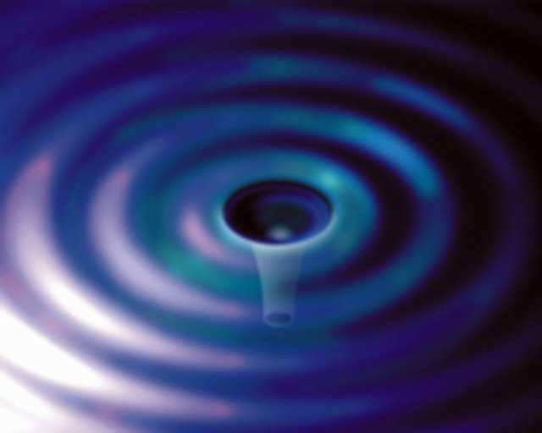
Mechanical Loss of Epoxies
Gregory Harry
Department of Physics, American University
May 20, 2014
G1400597

Slide 2

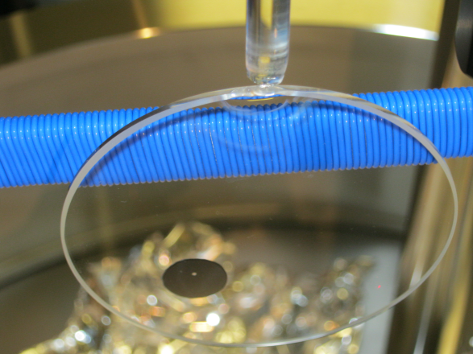
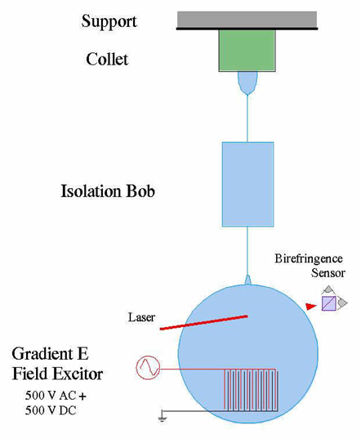
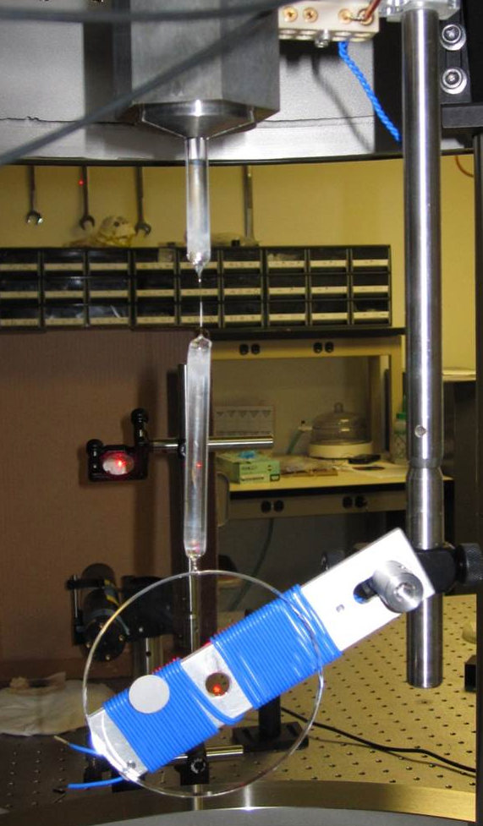
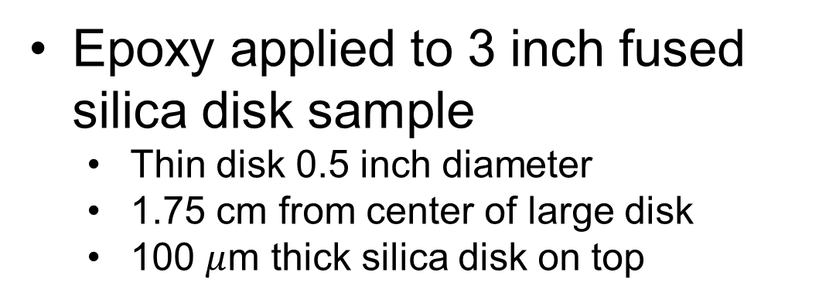
Q Measuring Technique
Epoxy applied to 3 inch fused silica disk sample
  Thin disk 0.5 inch diameter
  1.75 cm from center of large disk
  100 $μ$m thick silica disk on top
Welded to silica fiber/bob isolation
Suspended in vacuum
Excite normal modes using comb capacitor
Modes at 2.7 – 10 kHz
  Some high frequency pure shear modes

Slide 3
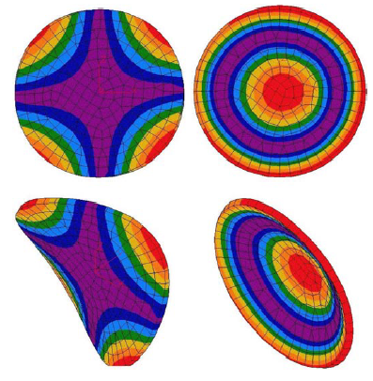
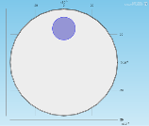
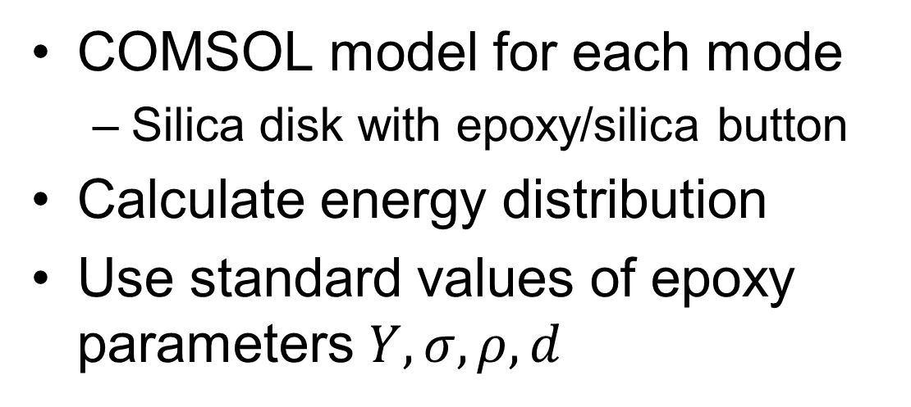
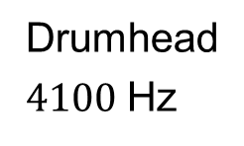
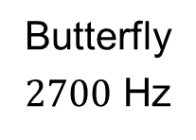
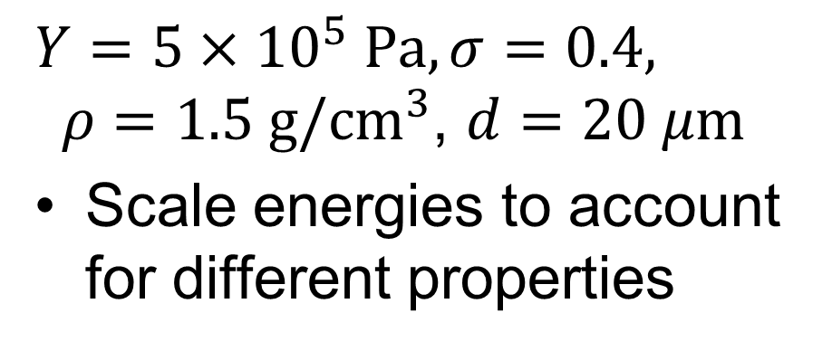
Finite Element Modeling
Butterfly
$2700$ Hz
Drumhead
$4100$Hz
COMSOL model for each mode
  Silica disk with epoxy/silica button
Calculate energy distribution
Use standard values of epoxy parameters $Y,σ,ρ,d$
$Y=5×10^{5} \text{Pa}, σ=0.4, ρ=1.5 \text{g}/{\text{c}\text{m}}^{3}$, $d=20 μm$
Scale energies to account for different properties

Slide 4
Epoxies of Interest
Hysol Tra-Duct 2902: Conducting, LHV* approve
EMI Optocast 3553LV: aLIGO OMC, LHV approve
Masterbond EP30: aLIGO replacement for VacSeal, TM standoffs, LASTI AMD tests, E1000386
Epotek 353ND: T. Bodiya suggestion, not LHV
Hysol EA9313: LISA Optical Bench use, not LHV
EP1730-1: aLIGO connectors, LHV approve
Cyanoacrylate: Superglue
* LHV –LIGO High Vacuum E960050

Slide 5
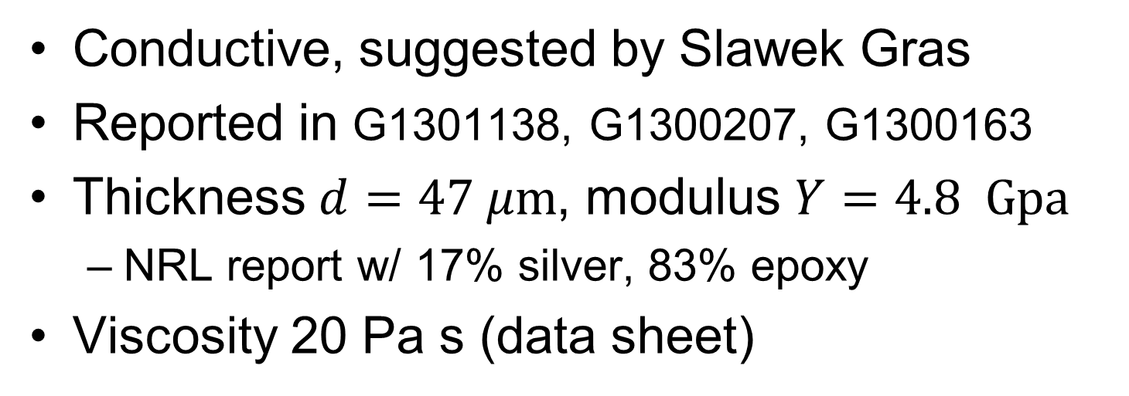
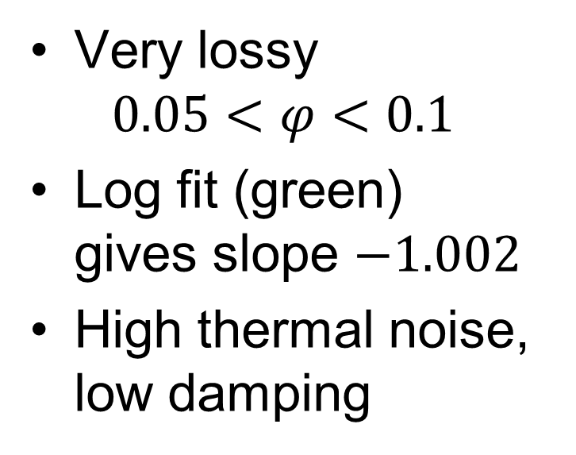
Hysol Tra-Duct 2902
Conductive, suggested by Slawek Gras
Reported in G1301138, G1300207, G1300163
Thickness $d=47 μ\text{m}$, modulus $Y=4.8 Gpa$
  NRL report w/ 17% silver, 83% epoxy
Viscosity 20 Pa s (data sheet)
Very lossy
$$0.05<φ<0.1$$
Log fit (green) gives slope $−1.002$
High thermal noise, low damping

Slide 6
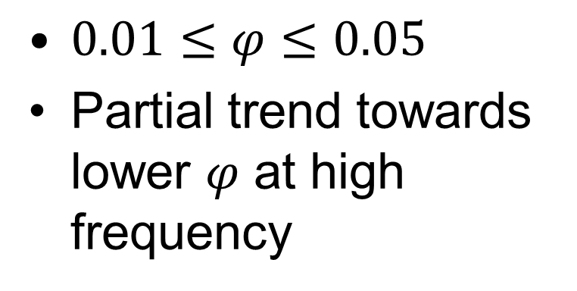
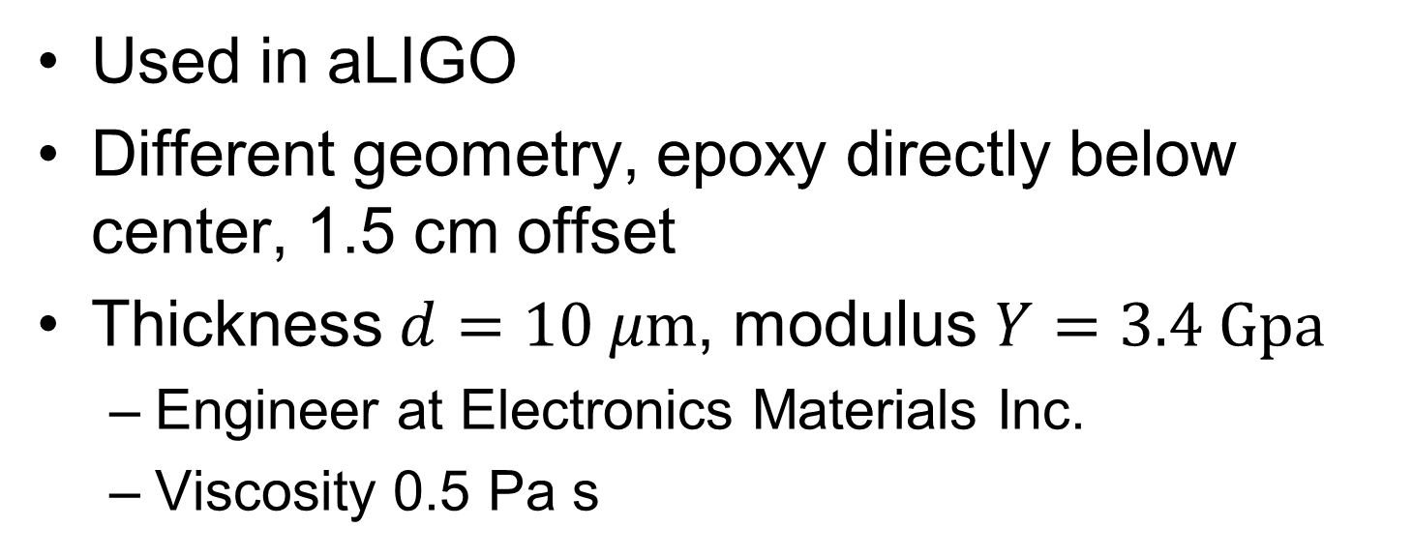
EMI Optocast 3553LV
Used in aLIGO
Different geometry, epoxy directly below center, 1.5 cm offset
Thickness $d=10 μ\text{m}$, modulus $Y=3.4 Gpa$
  Engineer at Electronics Materials Inc.
  Viscosity 0.5 Pa s
$0.01≤φ≤0.05$
Partial trend towards lower $φ$ at high frequency

Slide 7
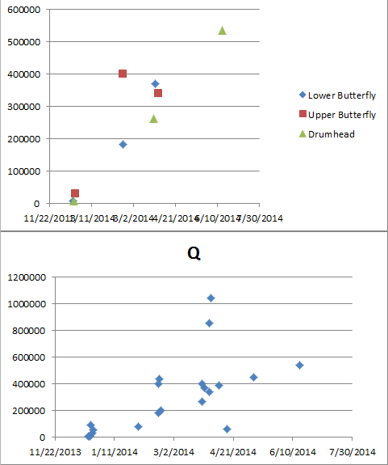
Optocast Curing
Optocast was cured with heat rather than UV
  Unclear what exactly EMI suggests
Used PID controlled oven at 90º C for 2 hours
Q data suggests curing may not have completed before hanging in vacuum

Slide 8
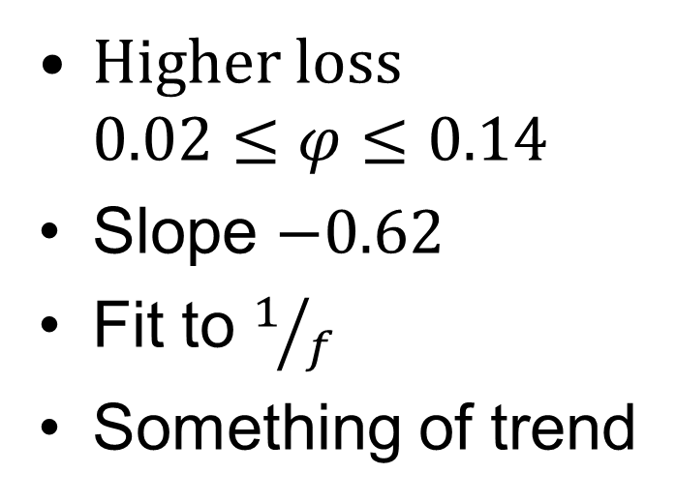
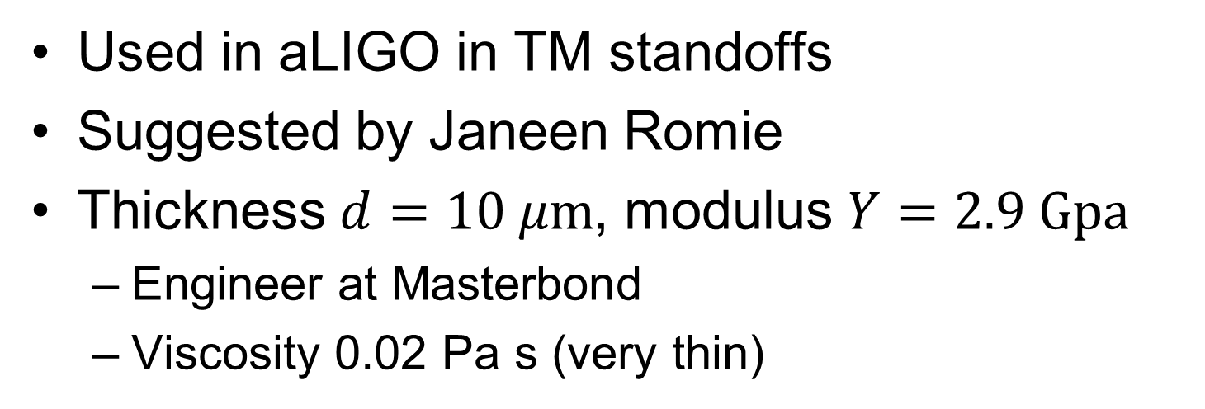
Masterbond EP30
Used in aLIGO in TM standoffs
Suggested by Janeen Romie
Thickness $d=10 μ\text{m}$, modulus $Y=2.9 Gpa$
  Engineer at Masterbond
  Viscosity 0.02 Pa s (very thin)
Higher loss $0.02≤φ≤0.14$
Slope $−0.62$
Fit to $1/f$
Something of trend

Slide 9
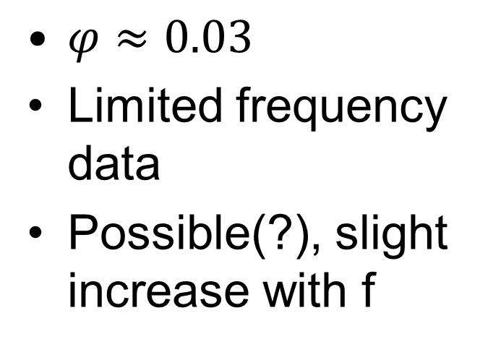
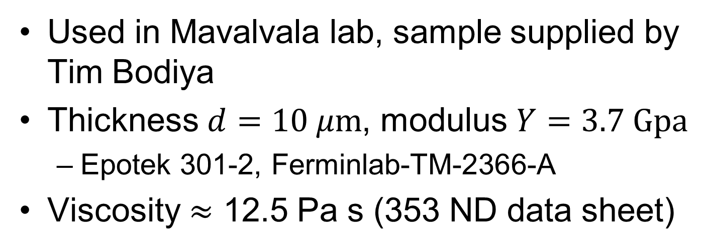
Epotek 353ND
Used in Mavalvala lab, sample supplied by Tim Bodiya
Thickness $d=10 μ\text{m}$, modulus $Y=3.7 Gpa$
  Epotek 301-2, Ferminlab-TM-2366-A
Viscosity $≈$ 12.5 Pa s (353 ND data sheet)
$φ≈0.03$
Limited frequency data
Possible(?), slight increase with f

Slide 10
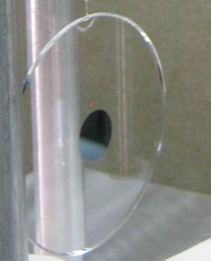
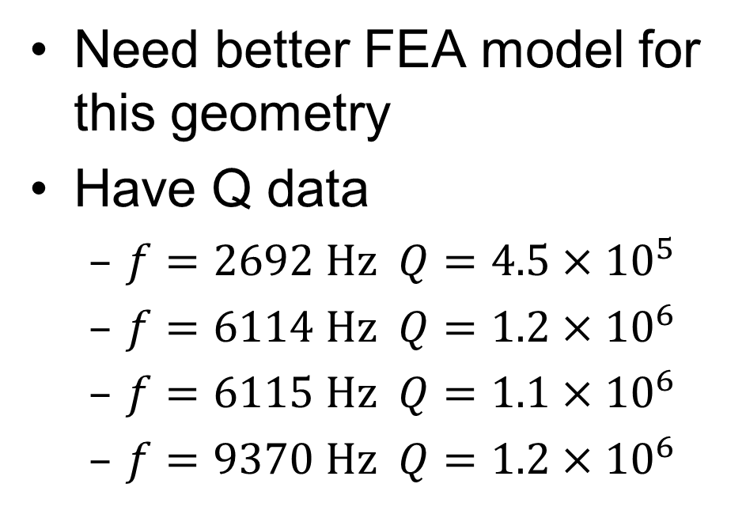
Hysol EA 9313
Epoxy applied at center of sample
  Not ideal, poor energy coupling to modes
Viscosity 1.2 Pa s
Need better FEA model for this geometry
Have Q data
  $f=2692 \text{Hz} Q=4.5×10^{5}$
  $f=6114 \text{Hz} Q=1.2×10^{6}$
  $f=6115 \text{Hz} Q=1.1×10^{6}$
  $f=9370 \text{Hz} Q=1.2×10^{6}$

Slide 11
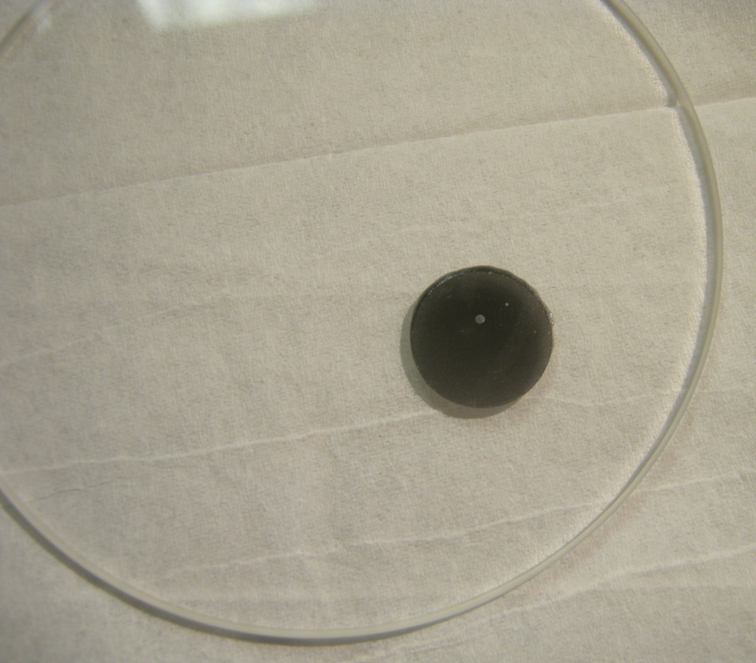
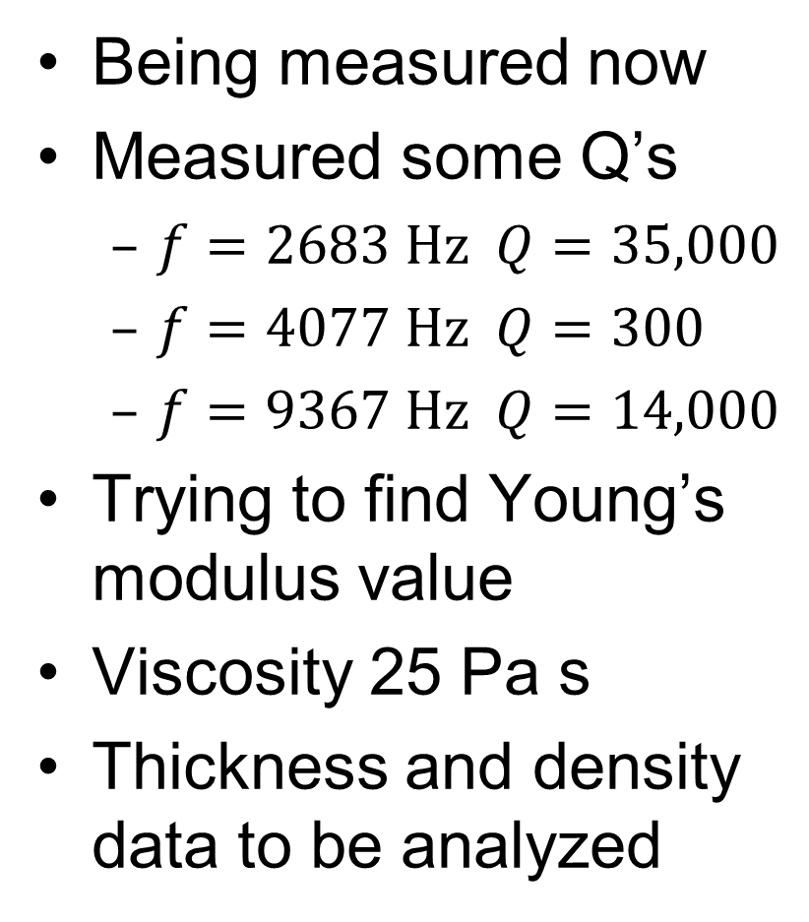
EP 1730
Being measured now
Measured some Q’s
  $f=2683 \text{Hz} Q=35,000$
  $f=4077 \text{Hz} Q=300$
  $f=9367 \text{Hz} Q=14,000$
Trying to find Young’s modulus value
Viscosity 25 Pa s
Thickness and density data to be analyzed

Slide 12
Combined Data
Green – Tra-Duct 2902 Red – Epotek 353ND
Blue – Optocast 3553LV Cyan – EP 30

Slide 13
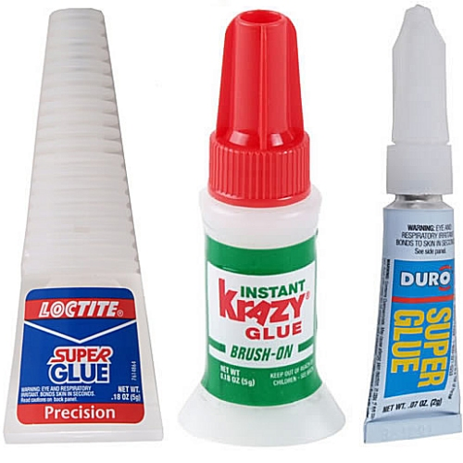
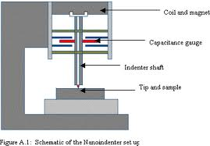
Other Issues and Future Plans
Did measure cyanoacrylate (super glue)
  Found that super glue does not stick to glass
  Very lossy, probably rubbing
Viscosity important for thickness
Glass transition temperature TRA-DUCT 52º C, EPO-TEK 353ND 90º C
Remeasure key mode Q’s
Finish EA 9313 and EP 1730
Divide energy into bulk and shear
Measure Young’s modulus
  M. Abernathy at Caltech/M. Zanolin at ERAU
Calculate thicknesses from epoxy volume

Slide 14
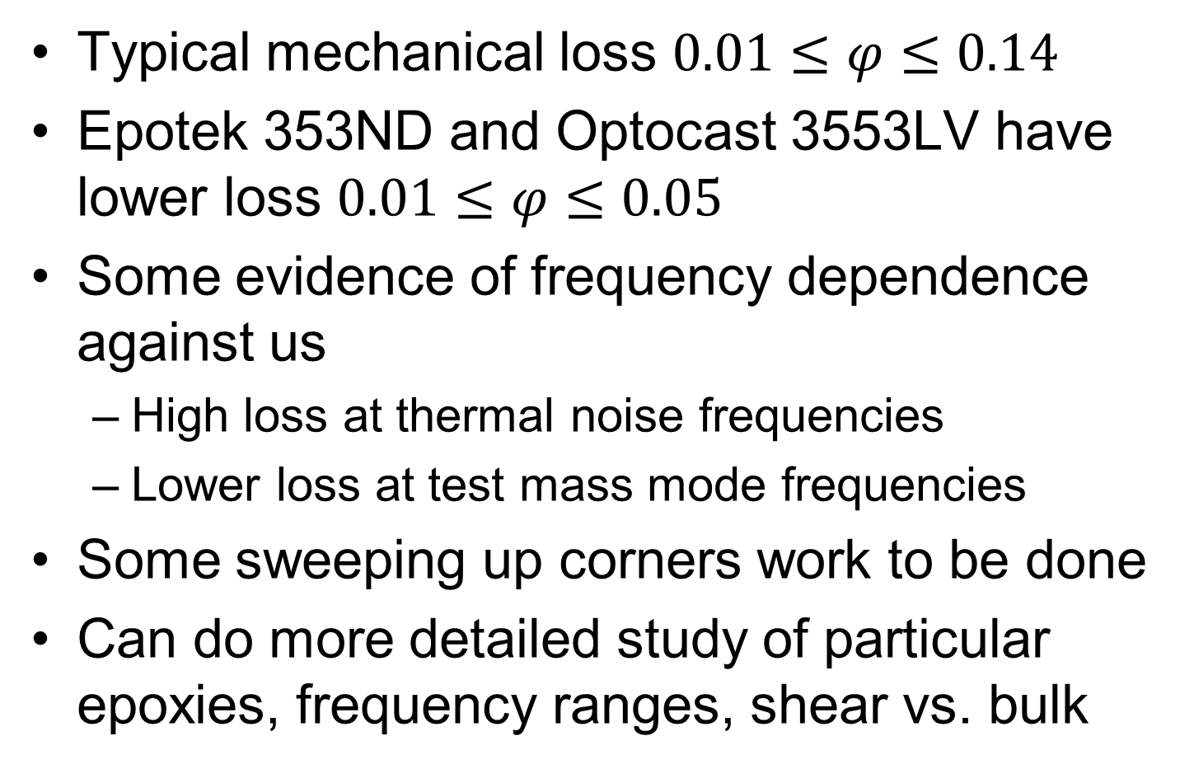
Conclusions
Typical mechanical loss $0.01≤φ≤0.14$
Epotek 353ND and Optocast 3553LV have lower loss $0.01≤φ≤0.05$
Some evidence of frequency dependence against us
  High loss at thermal noise frequencies
  Lower loss at test mass mode frequencies
Some sweeping up corners work to be done
Can do more detailed study of particular epoxies, frequency ranges, shear vs. bulk

