Slide 1
Some notes on the Electro-Static Drives
July 1, 2014

Slide 2
LLO ESD actuation calibration, log 13298
Used ALS DIFF, at 42 Hz, bias at -400 V
ETMX: 1.85e-13 / f² m/count
ETMY: 1.73e-13 / f² m/count
Using F = 2*alpha*V_{bias}*V_{sig} = x*M*(2pi f)²:
alpha = 1.2e-10 N/V²
Linearizer increases effective bias to -560 V, reducing inferred alpha to 0.9e-10 N/V²
Expected alpha = 4e-10 N/V²
131,000ct -> 400V
3e-3 V/ct

Slide 3
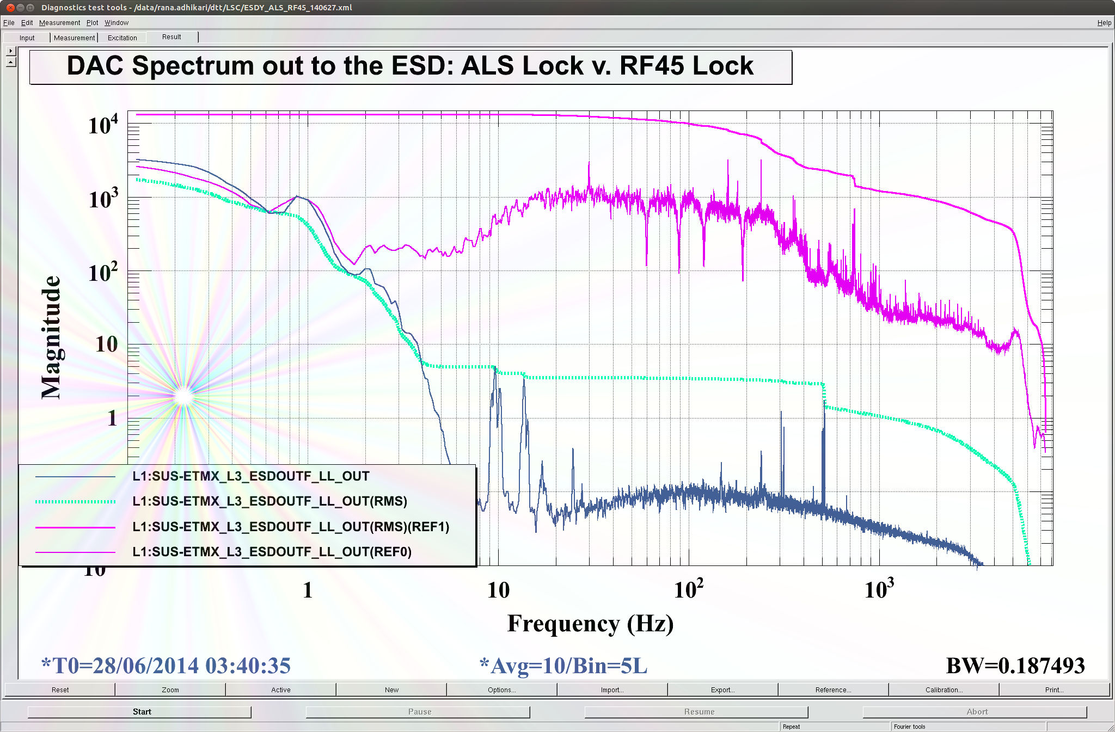
DAC noise
DAC output noise is 150 nV/rHz, higher than ESD input noise of 25 nV/rHz: need some sort of filter between DAC and ESD
Can we filter out more below 1 Hz?
Need full range in this band for locking

Slide 4
ESD noise monitors
Each channel: straight 1/40 monitor, then differential output
1 uV/rtHz noise divided to 25 nV/rHz (each leg)
ADC input noise is 4 uV/rtHz
Need a pre-amp with a gain of a few hundred, AC-coupling at a few Hz (this is essentially what the SUS noise monitor circuit does, D070480)

