Slide 1
Investigating the Possibility of Dynamical Tuning of a Signal Recycling Cavity
Chasya Eli Church
Mentor: Kiwamu Izumi

Slide 2
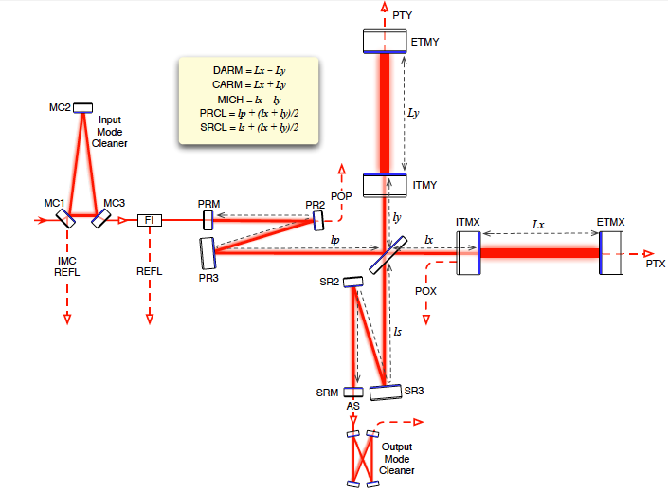
The Project:
Dynamical tuning is a method of tuning the signal recycling cavity of a laser interferometer.
It involves moving the signal recycling mirror back and forth a microscopic amount in order to track chirp signals from binary star coalescence.

Slide 3
Project Background:
My project deals mostly with the Signal Recycling Cavity (SRC).
Signal recycling allows us to tune the observational bandwidth by introducing an extra mirror at the output side of the interferometer
The sidebands are extracted (not reflected back) when the cavity is resonant
One drawback of adding the SRC: it adds another degree of freedom to be controlled and sensed (length sensing and control system

Slide 4
Signal Tuning – What Is It?
Tuning is in the Signal Recycling Cavity to detect meaningful signals
We need SRC tuning to amplify the specific gravitational wave signal we’re searching for
Dynamical tuning is a particular method of detecting chirp signals (increases or decreases in the measured frequency)
This type of tuning involves tracking the instantaneous frequency through tuning the SRC detector so that the signal is properly amplified

Slide 5
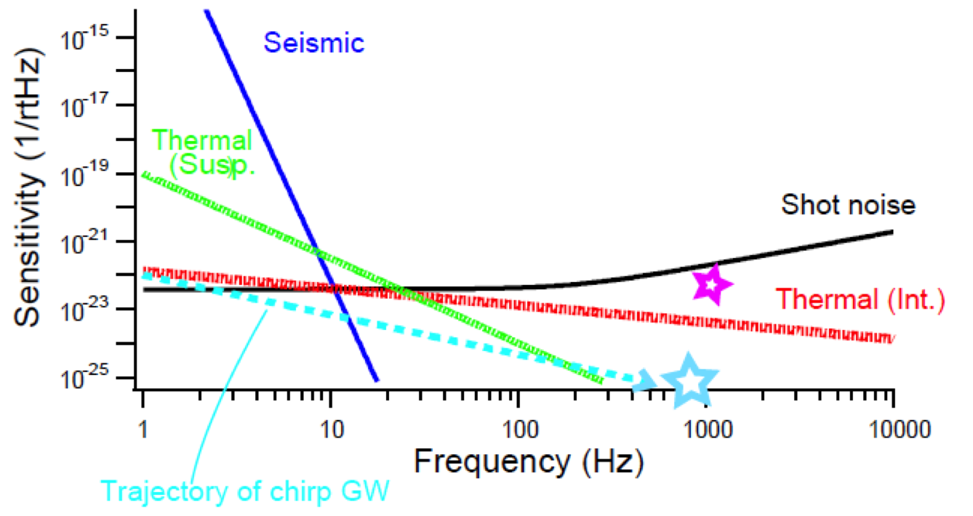
Why Implement Dynamical Tuning?
An orbiting binary star system, coalescing star system, and one that is transforming into a black hole post-coalescence all have different frequencies in their gravitational wave signatures.

Slide 6
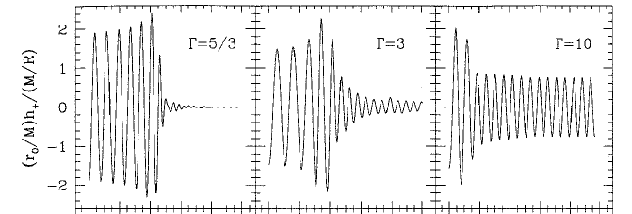
Why Implement Dynamical Tuning?
Binary star and black hole coalescence have three phases:
In-spiral
Merger
Ring down
The gravitational waves change depending on what phase the star or black hole is in.

Slide 7
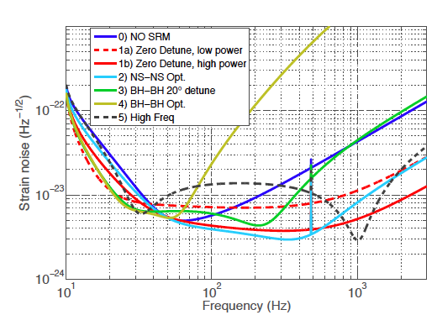
Why Implement Dynamical Tuning?
Current detection is not tuned at all, but sensitive to broadband signals up to ~400Hz. This is called wide-band detection.
This is good for sensing a wide frequency range but sensitivity is lacking.
The other non-tuning option is narrow band detection but this has the opposite problem: although it is much more sensitive, its range is very limited.
With dynamical tuning, we can track the chirp signal's trajectory.

Slide 8
Project Goals:
Examine and model the feasibility of using dynamical tuning to tune the observational bandwidth of the signal recycling cavity in a laser interferometer detecting gravitational waves.
Investigate the possibility of dynamical tuning of the Signal Recycling Cavity under more realistic conditions once the ideal situation is modeled.
Determine what real-world changes would need to be made and whether or not any of these factors make this endeavor impossible.

Slide 9
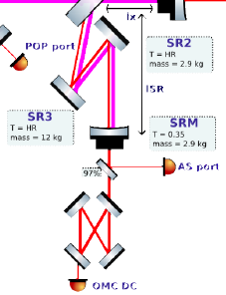
Project Basics
This investigation was done in a purely theoretical way; the situations and outcomes were modeled using a MATLAB-based program called Optickle to model the interferometer and the characteristics of the signals.
These models were used because it is much easier to make a computer model than to change the interferometer for the experiment.
Note the SRC’s intricate optical system at left; it’s easier to change the Optickle system than the optical system!

Slide 10
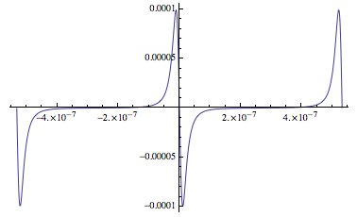
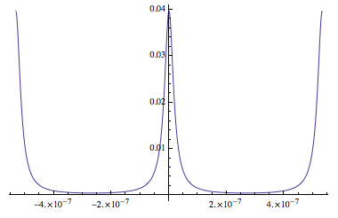
Investigation I: Ideal Situation with 45MHz AS and 90MHz REFL Signals
Our AS signal needs to have a large linear range – this means a range with no curves or bumps that the SR mirror can move within
The situation I modeled first involved carrier light with 45MHz sidebands
These sidebands interact to create a 90MHz beat note pattern
Watts
Watts
Displacement (nm)
Displacement (nm)

Slide 11
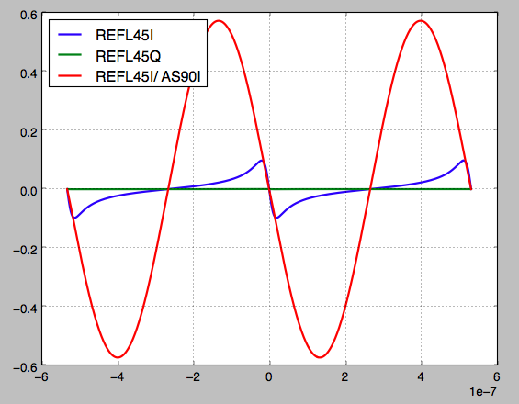
Investigation I
The original linear range of the 45MHz signal was not ideal, so we normalized the 45MHz signal by the 90MHz signal to investigate if this would increase the linear range.
(It did!)
Watts
Displacement (nm)

Slide 12
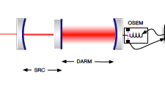
Investigation II: DARM Offset Effects
The DARM offset is a degree of freedom that is used by the interferometer’s length sensing and control system in order to keep it optically resonant and sensitive to gravitational waves. It results in carrier light at the output port.
This offset had to be implemented in Optickle and its effects on the signal investigated, as it could potentially have unintended affects on the 45MHz and 90MHz signals.

Slide 13
Investigation II
Through trial and error, a 10 pM DARM offset was chosen (anything smaller increases noise in the signals)
This DARM offset did NOT adversely affect the linear range or the signals we were investigating.

Slide 14
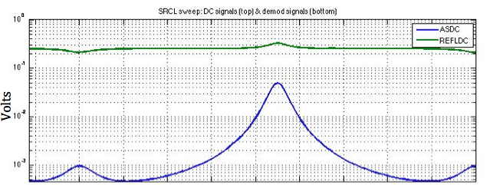
Investigation II
Attenuation of the AS port had to be adjusted in order to avoid over-saturating the port.
Displacement (nm)
The attenuation was adjusted until the photo detector read 50mV for the carrier signal.
Displacement (nm)

Slide 15
Investigation III: 36MHz and 54MHz REFL signals
Advanced LIGO Length Sensing and Control Final Design, suggests the possibility of using reflected 36MHz or 54MHz signals in place of the current 45MHz reflected signal.
We sought to find out if these were better suited to our work.

Slide 16
Investigation III
Neither the reflected 36MHz signal nor the 54MHz signal have a large enough linear range to make them attractive candidates for use in RSE.
The demodulated 45MHz signal has a much larger linear range and is appropriate for our applications.
Watts

Slide 17
Investigation IV: Noise to Simulate a Real-World Signal
Signals in a real laser interferometer will encounter some level of random noise.
In order to account for this, random noise was added to the Optickle plots and its affects on the signals were studied.
Watts

Slide 18
Investigation IV
The random noise encountered by our modeled signal does change the sinusoidal nature of the reflected 45MHz signal. (Note that the valley to the right of the zero marker is less deep than the one to the left.)
Watts

Slide 19
Final Notes
I still need to check the 36MHz and 54MHz REFL signals against the documentation in Advanced LIGO Length Sensing and Control Final Design to ensure that they are correct.
I additionally need to check the math on these same signals to verify for sure that they aren’t useful for detuning.
There is a possibility that another signal could be used for detuning during the period where the 45MHz signal is unusable.

Slide 20
Conclusion
The 90MHz REFL signal resulting from the 45MHz sideband interference is a good candidate for improving the linear range of the 45MHz AS signal.
The DARM offset does not appear to adversely effect the linear range of these signals.
Noise does appear to be a small concern, however, the noise that deforms the signals is outside of the linear range, so it likely will not have a significant effect on our ability to use the 45MHz signal.
It appears to be possible to implement dynamical tuning for a laser interferometer under these parameters.

Slide 21
Acknowledgements
I’d like to thank:
The entire LIGO program and the CalTech SURF program for allowing me to conduct these experiments over the summer and for giving me the chance to broaden my knowledge
My mentor, Kiwamu Izumi for teaching me so much this summer and helping me conduct a productive experiment
Thank you!

