Slide 1
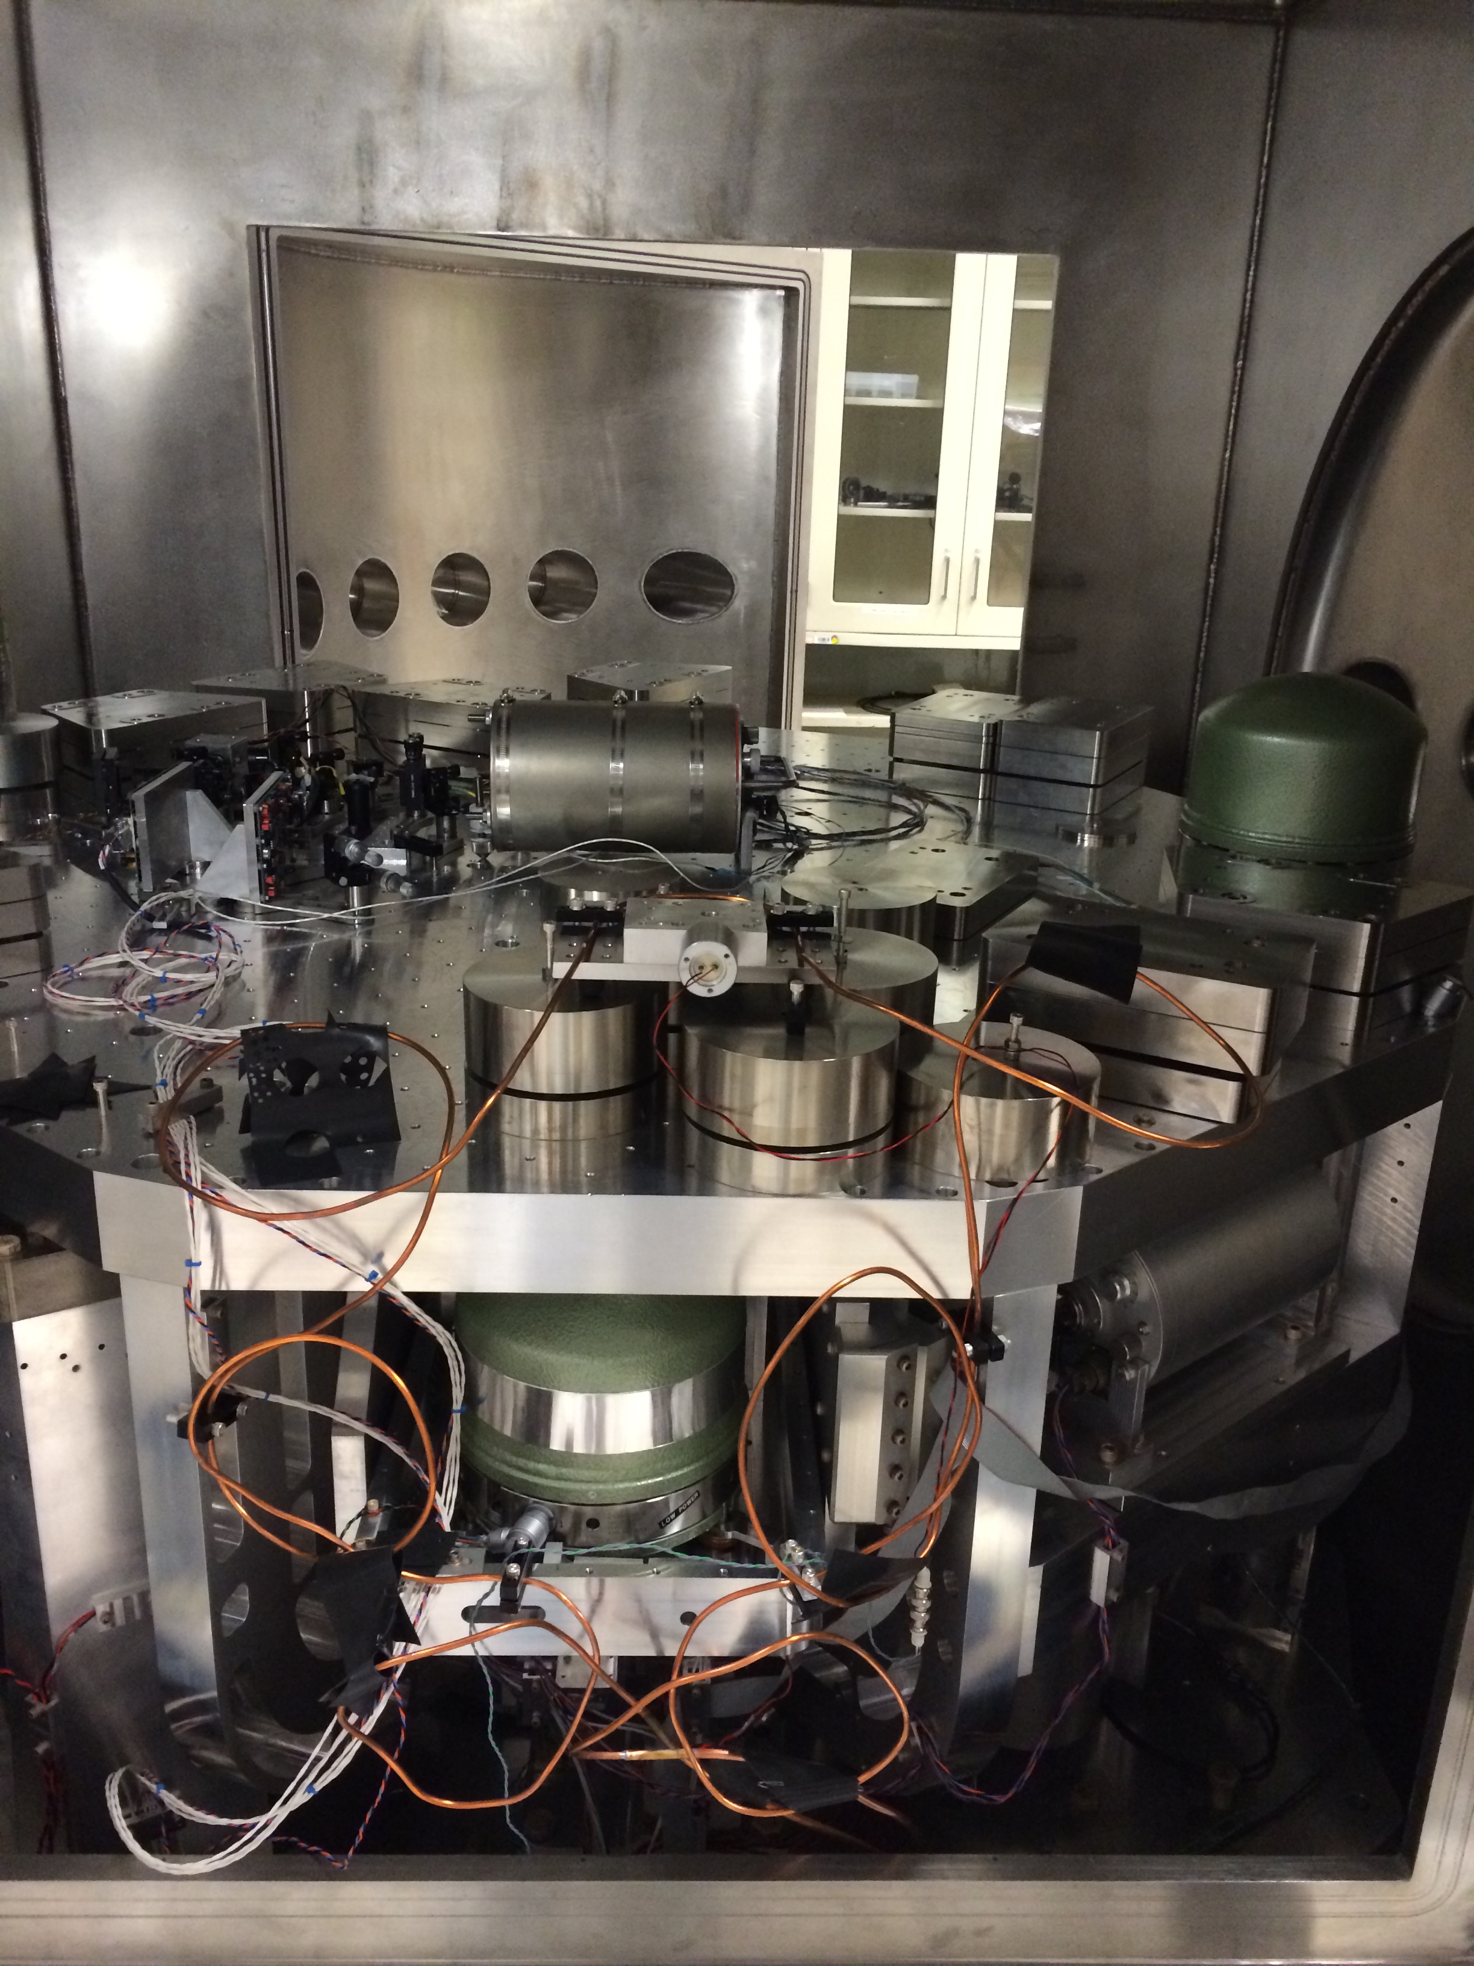
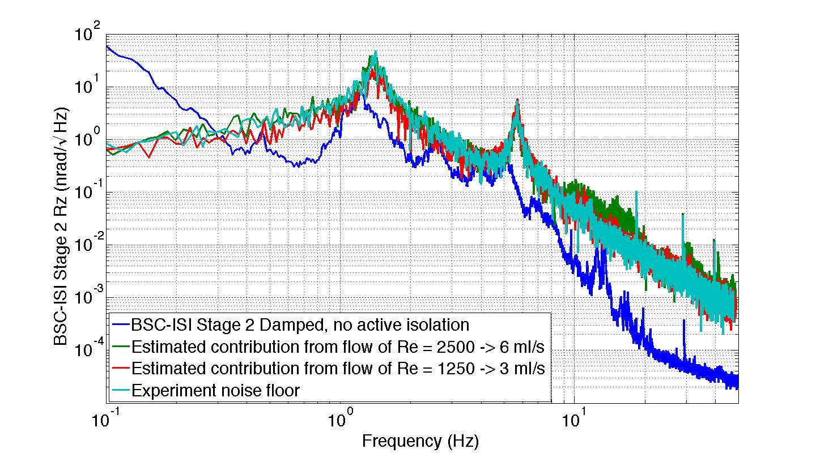
Cryogenic Systems for Future LIGO Detectors - G1400940
Brett Shapiro, Brian Lantz, Tim MacDonald, Dakota Madden-Fong
LIGO III Cryogenic System
This poster explores the details of a cryogenic system for the ITM and ETM suspensions in 3rd generation LIGO observatories. Cold silicon test masses improve thermal noise and thermal lensing issues. The poster follows the Blue Team description in the Instrument Science White Paper T1200199.
The figure on the left illustrates an overview of what such a system may look like for one of the test mass suspensions. The figure on the right is a planned test at the Stanford facility integrating as many of these components as possible.
Integrated System Test Beginning at Stanford
chiller
Active Seismic Isolation Table
The goal of this test is to show we can build a low vibration cryogenic environment.
Maraging steel
blade spring
Vacuum wall
…
ISI stage 2
Cold link
Cold link
motor
…
clamp
295 K
Heat shield
T1400553
GN₂ feedthrough
Not shown:
A movable cold link achieves the initial test mass cool down in ≈ 1 day.
LN₂ pipe around shield
1 kg silicon
test mass
Vacuum flange
Flexible LN₂ tubing
or Cu cables
LN₂ return
Silicon fibers
≈ 124 K
Stainless steel legs
LN₂ supply
≤ 10 m
≈ 3 W absorption at 124 K
LN₂ feedthrough
ISI Stage 2
1560 nm MW laser
Heat shield at
80 K maintains 124 K through radiative coupling
ISI Stage 1
≈140 kg Si test mass
chiller
Quadruple Suspension Redesign
Cooling with Cu cables or Liquid Nitrogen (LN₂) Pipes?
The figures below show a recent measurement of the magnitude of vibration induced by flowing fluids. The experiment uses water for its ease of use and similarity to LN₂ in terms of density and viscosity. So far the measured vibration is low enough it is difficult to distinguish from noise. More work is required.
Advanced LIGO
LIGO III
 | Heat Transfer | Added weight | Seismic shorting | System Complexity | Vacuum leaks
Cu cables
LN₂ pipes
Reaction Chain
Main Chain
Reaction Chain
Main Chain
?
22 kg
52 kg
Good
Fair
Risky
Show stopper
10 kg
LN₂ has more cooling power, and can be pumped where needed, but it is unknown how much noise its flow will generate. The LN₂ is pre-cooled so it does not boil.
1.6 m
42 kg
2.1 m
40 kg
silica
34kg
silicon
ETM ITM
53 kg 60 kg
Vibration test plate on viton balls
26 kg 20 kg
20 kg
HS1 Geophone
143 kg
silicon
One of 3 conceptual designs for a LIGO III quad suspension discussed in T1300786. The test mass is silicon rather than fused silica, with an increase in weight. Silicon is useful at cryogenic temperatures for its low loss and high thermal conductivity. The remaining stages are optimized in terms of mass and wire length. This particular design assumes the test mass hangs from silicon springs at the penultimate mass. However, T1300786 also considers designs without these springs, at the expense of some increase in noise.
Stage 2
Cu Water pipes with Viton damping
Stage 1
The measured vibration for reasonable flow rates is difficult to distinguish from the experiment noise floor. This noise floor, projected onto BSC-ISI stage 2 Rz motion (the ‘quietest’ ISI DOF), is more than the seismic noise.

