Slide 1
LSC Political Outreach
Gregg Harry, Reiter Boldt
American University
EPO Workshop
August 2014
G1400962

Slide 2
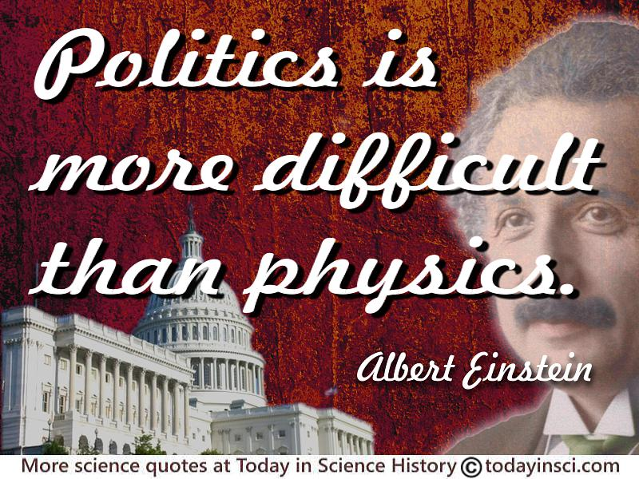
Political Outreach
What does political outreach mean?
From the 2014 EPO Whitepaper
“Political outreach” refers to educational and outreach initiatives aimed at informing the political class and the segment of the citizenry which is active in politics, and from which the national leadership is largely drawn. Political outreach is diﬀerent than lobbying; the former is done for sake of informing
while the latter aims at requesting support or assistance.
Our goal: Help prepare LVC members to inform and educate the “political class”, including politicians, political staffers, journalists, and citizens

Slide 3
First Idea: Success Stories
Collect “Broader Impact” successes
Students using “LIGO Skills” in industry
Vendors using technology developed for LIGO
Outreach that inspired students to study science
Publicize these stories
Continually updated webpage
E. Gustafson maintains one now
Occasional features in LIGO Magazine
Paper brochure to hand out
Give ideas to LSC PIs

Slide 4
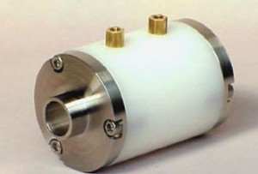
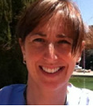
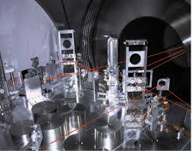
Progress on Brochure
Gathered some stories
E. Gustafson collecting examples
Data analysis software in cell phone
aLIGO optics hardware patents
Need more, especially human interest
Some good career stories at industry panel and recent LIGO magazine
More synergy with magazine possible
Introductory paragraphs on LIGO science and technology
Sent to list
Need feedback

Slide 5
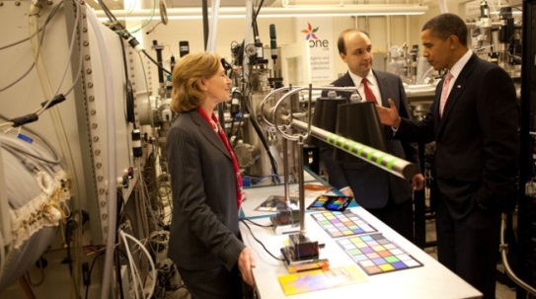
Second Idea: Congressional Outreach
Professional organizations sponsor congressional visits for scientists
Publicize these in LSC
AU can act as local host for DC visits
Congressional Visit Day, April 13-14, 2015
Help LSC labs to invite politicians /staff to visit labs in their districts
Developing “how-to” template on this
Test run at AU? No DC Rep/Senator
PhD Scientists Congressional Fellowships
Publicize with LSC grad students/postdocs (LAAC)

Slide 6
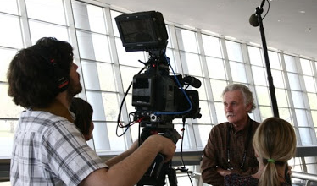
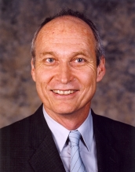
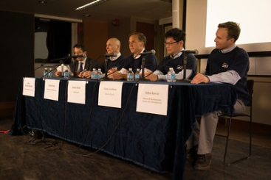
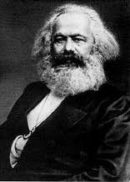
Third Idea: Media Campaign
Writing “how-to” manual on media interviews and relations
Get (more) LSC members interviewed for big science stories
Did okay with BICEP2, how?
Work with university media offices on “Broader Impact” stories
Science and/or general media
Highlight particular people/projects?
Prepare for detection
Should we have a strategy in place?
“Revolution comes fast” - Marx/Turner

Slide 7
Further Plans
How do non-US LSC groups fit in
Got some feedback from non-US LVC members, need more
Get a European/Australian/Indian other collaborator to help with this?
More discussions with professionals about non-lobbying outreach
More input from NSF officers
More detailed discussions with media offices including AU, Caltech, and MIT

