Slide 1
BSC HEPI Motion
Tim MacDonald
9/26/14
Notes:
Check Hugos log entry

Slide 2
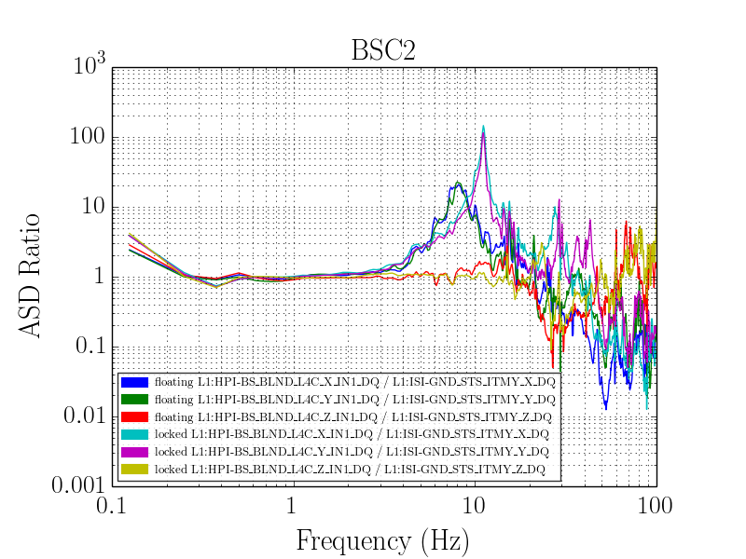
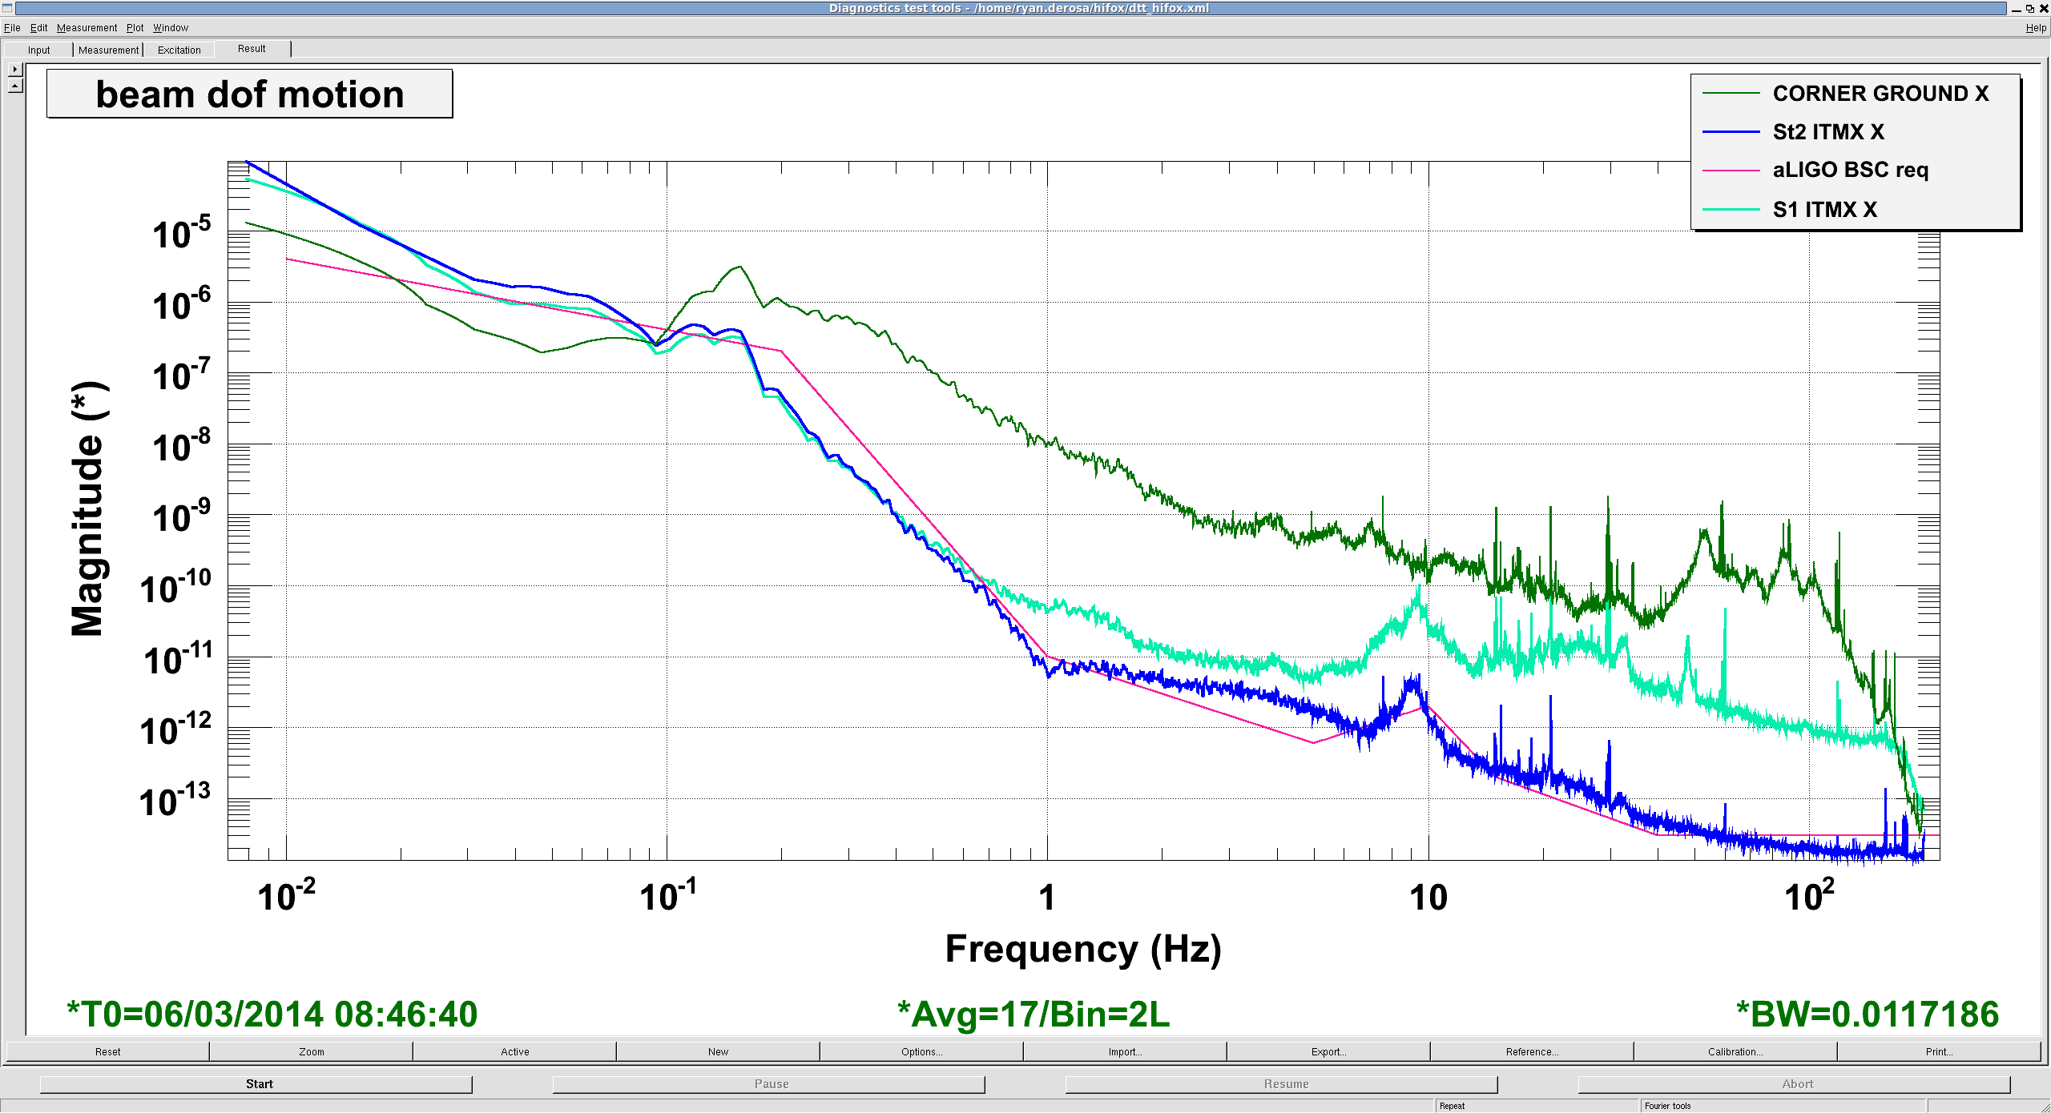
The Issue
Ground Motion
First Isolation Stage
Optics Suspension
Acceptance Requirements
Notes:
Get better plots from laura

Slide 3
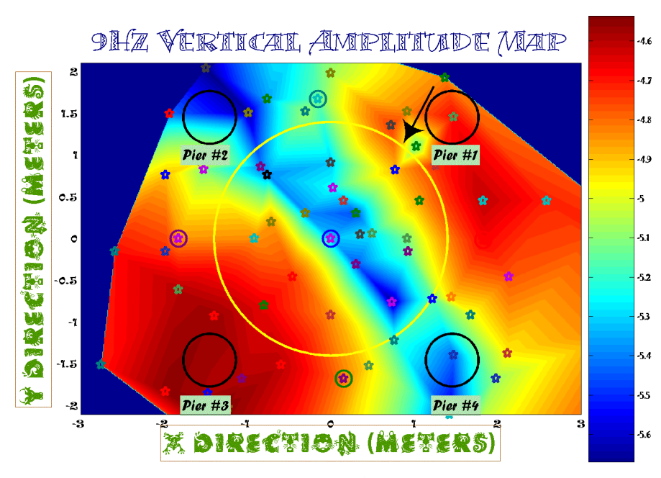
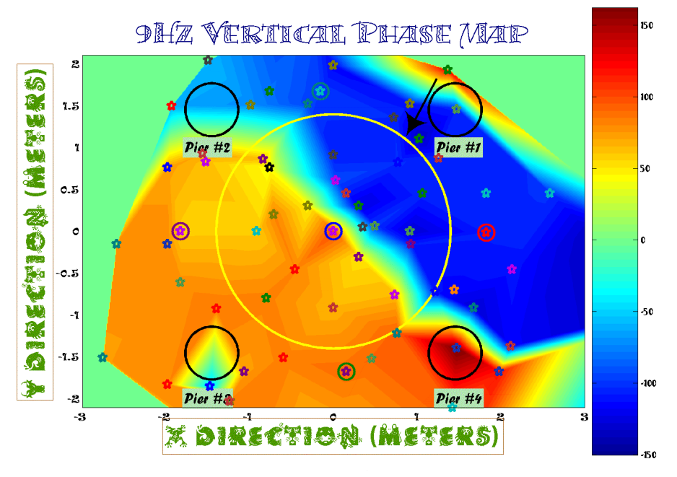
LASTI Result (2005)
LASTI measurements suggested floor motion was coupled with pier motion
Notes:
Check if amplitude is calibrated (nope)
See if amplitude is close to LHO measurements

Slide 4
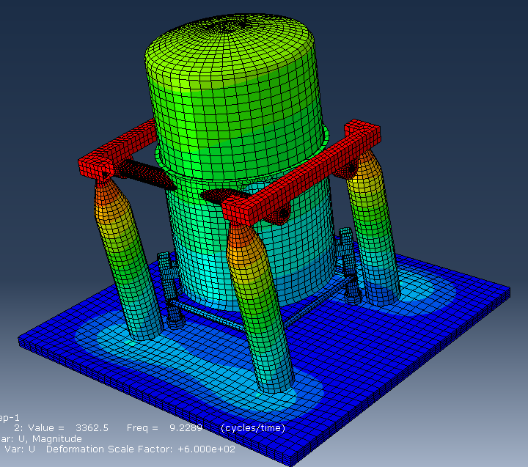
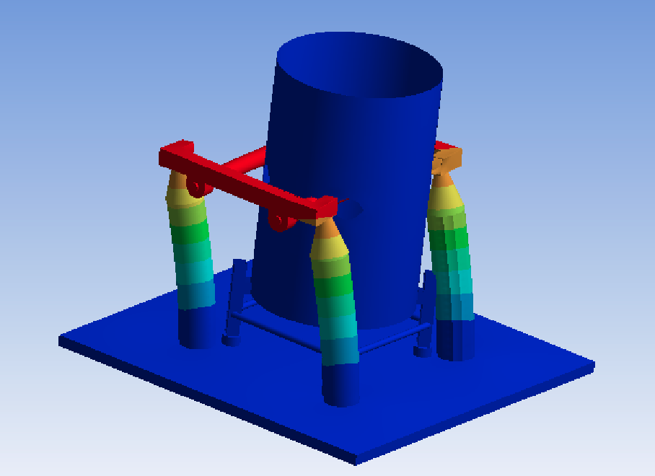
Modeling Efforts
Christophe at the University of Brussels (Abaqus)
Stanford (ANSYS)

Slide 5
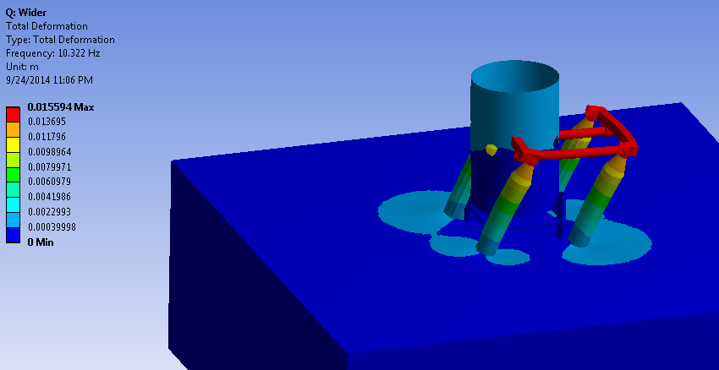
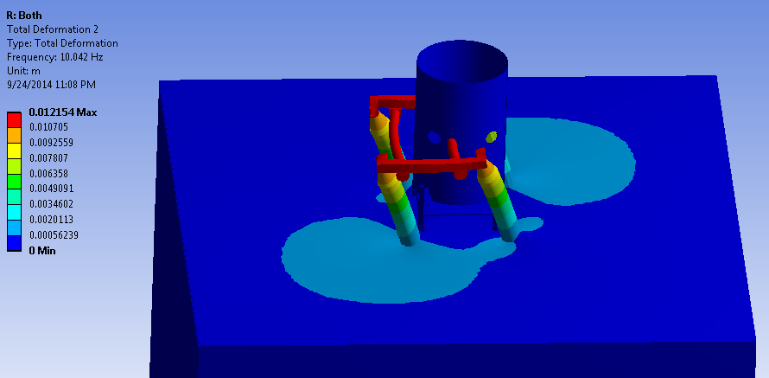
Modeling Results
Models do not clearly agree with measurements or between models
Variation of boundary conditions led to different results
Unclear which BCs to use

Slide 6
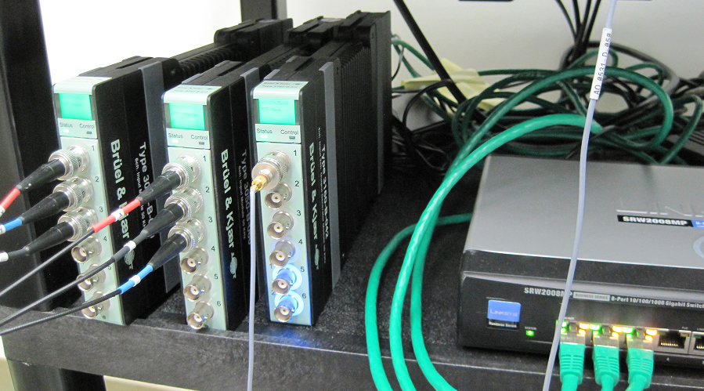
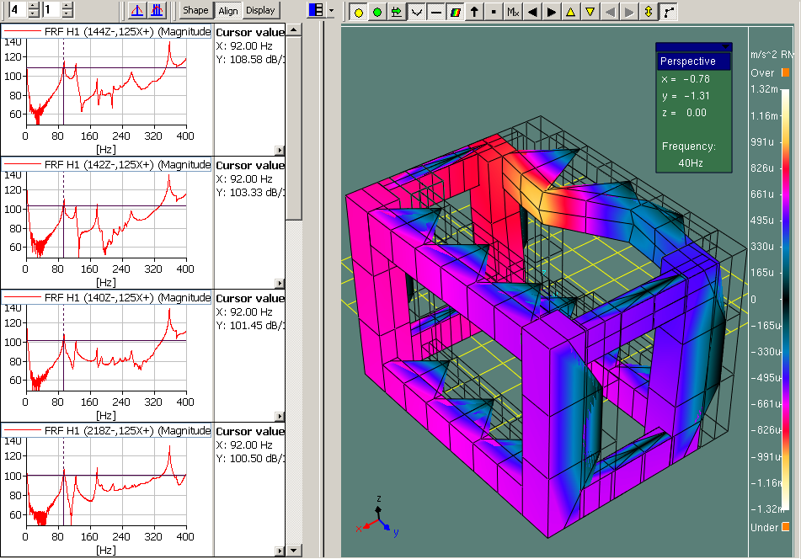
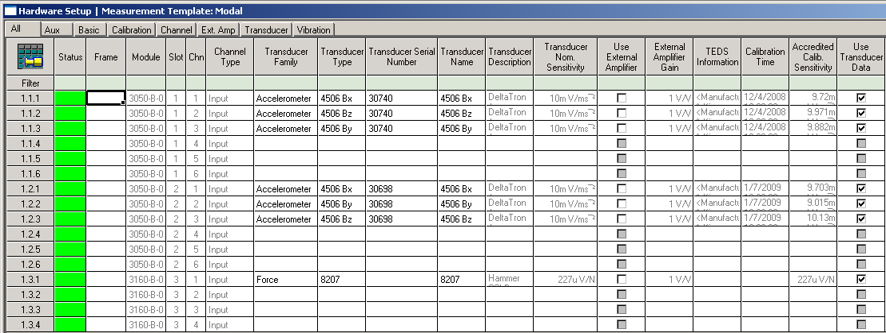
Real Information Needed
Want specific mode shapes to determine how the floor and the rest of the structure is moving
B&K system can be used for this function
Notes:
Talk about reciprocity

Slide 7
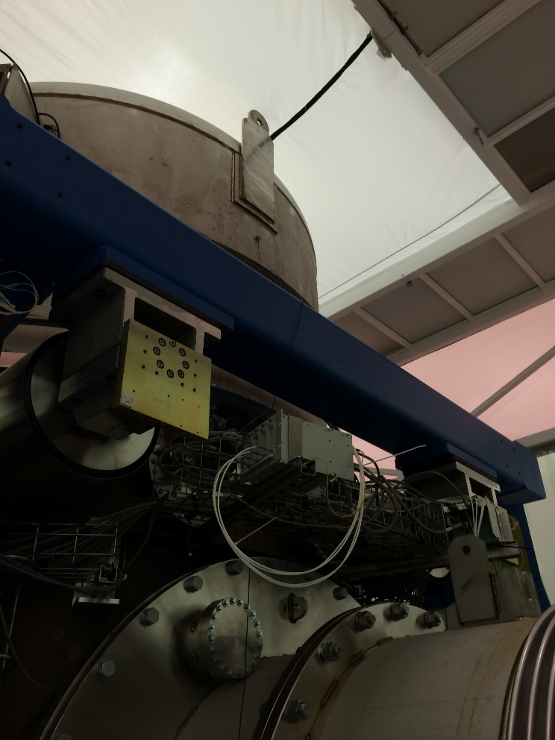
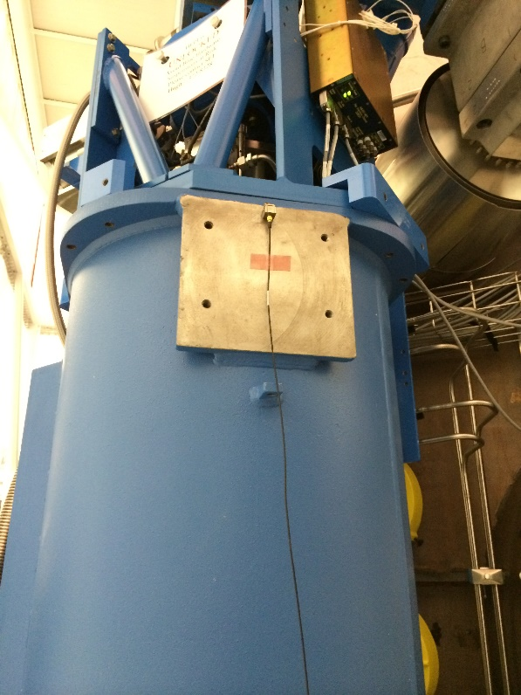
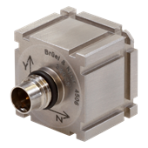
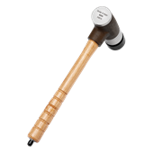
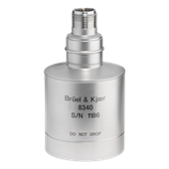
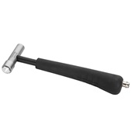
B&K Setup at LHO
Three 4506 accelerometers
One 8340 accelerometers (the big one)
8208 Impact hammer (3 lb)
8206 Impact hammer
4506
4506
4506
8340

Slide 8
Initial Measurements
Hammer hits on the floor and pier
Nothing seen near 8 Hz
Low coherence on 4506s
Moved 8340 to pier, still nothing

Slide 9
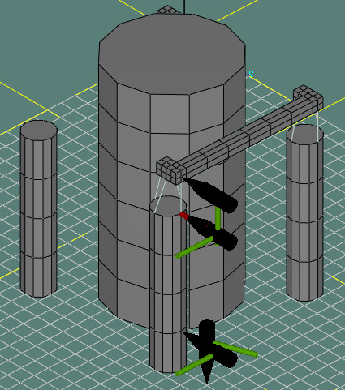
Initial Measurements
Check L4C data and location
L4C location in foot had not been hit
Tried an impact on the crossbeam
LHO Y
LHO X
8340 Location

Slide 10
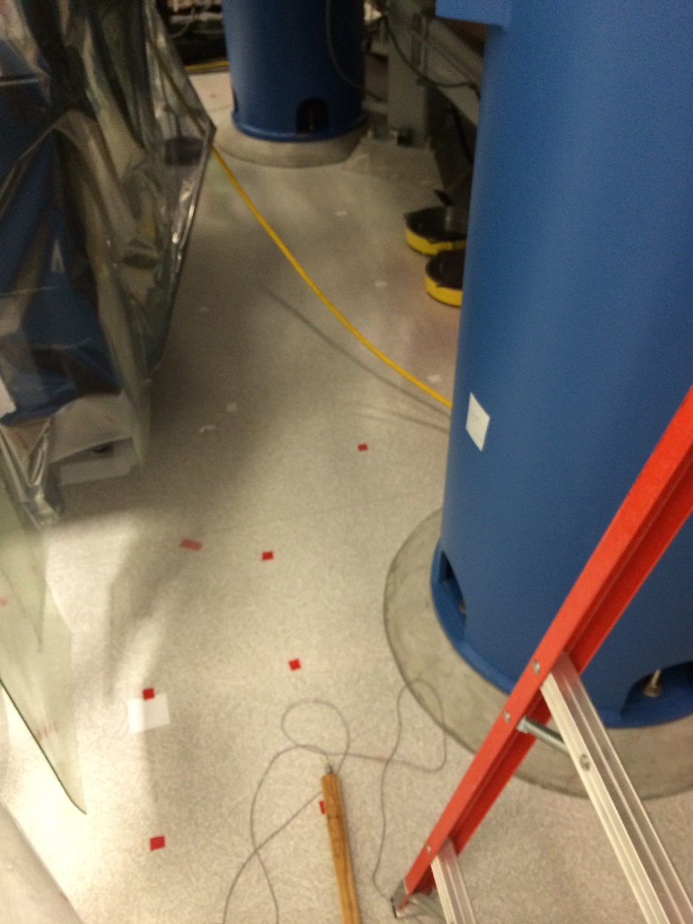
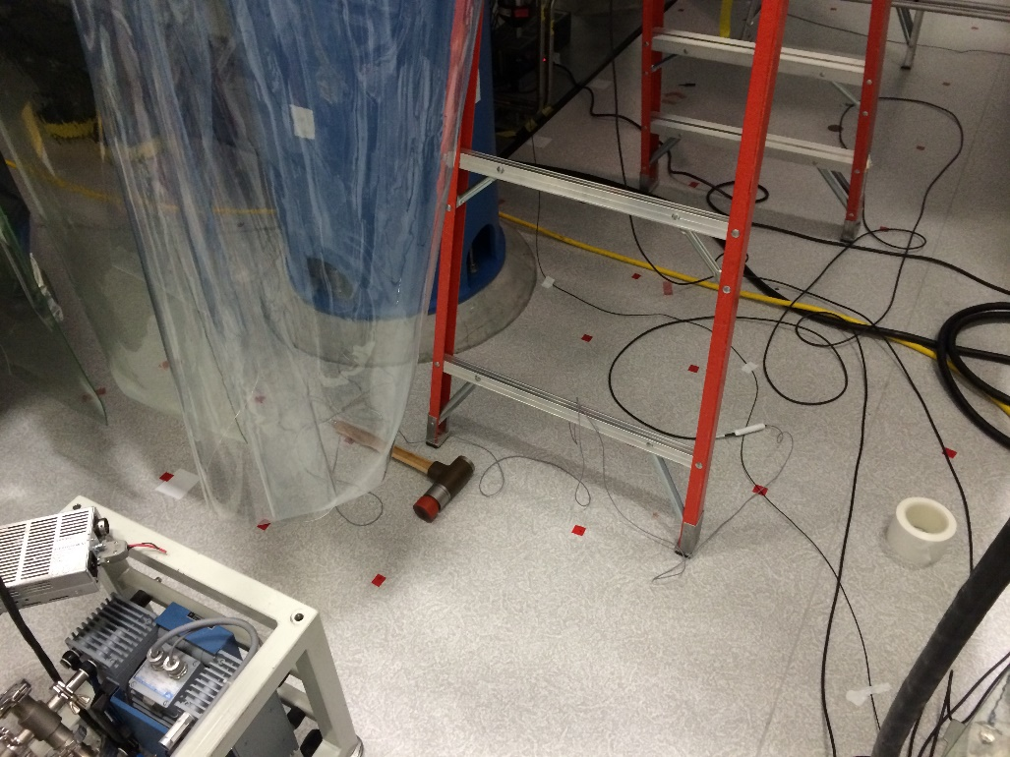
Full Floor System Measurement
Created hit pattern up and around BSC
Included the crossbeam

Slide 11
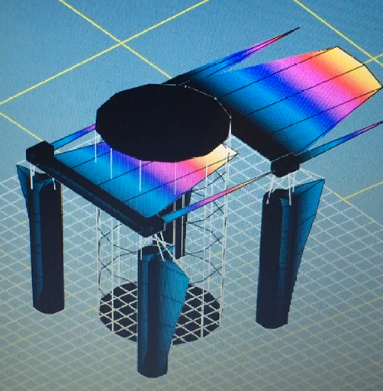
Full System Results
Motion in crossbeam roughly 2-3x pier motion
Almost no motion visible in the floor
Crossbeam does not appear to bend
Lack of impact at these points creates illusion of bending. Motion only appears at impact points.
Notes:
Check amplitude of floor motion

Slide 12
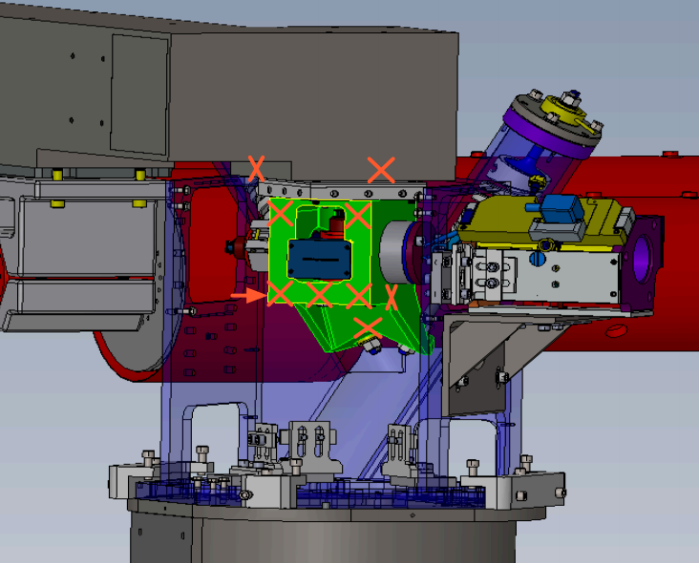
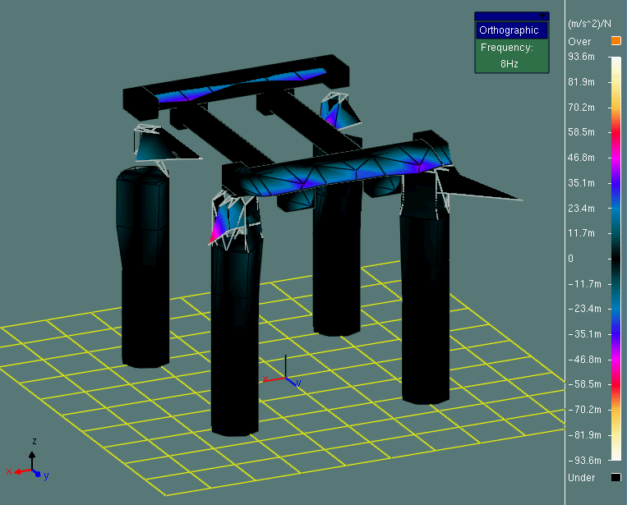
Measurements including HEPI
New sequence including the HEPI actuator system
Large motion seen with the foot, about twice the crossbeam
Odd in that it only appears at the low point of the foot
Notes:
Talk about why the difference matters

Slide 13
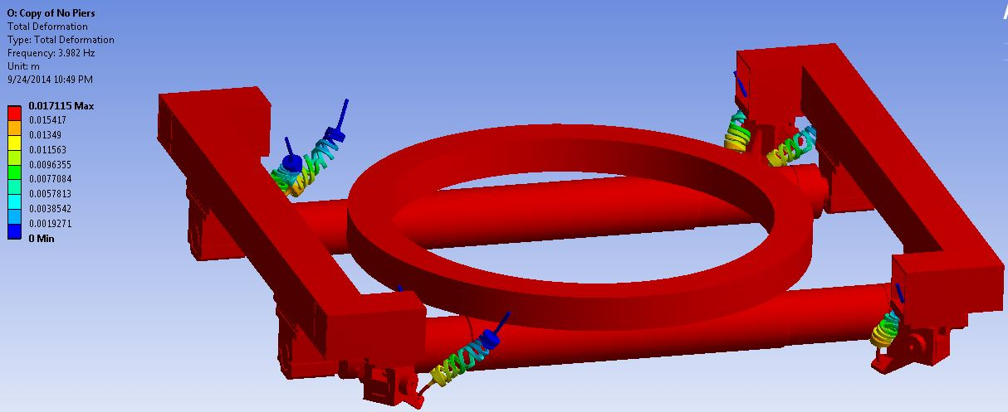
New Modeling at Stanford
Now that we believe the HEPI system is the source of the issue, see if we can properly model it
Initial modeling did not include the pier or actuators
Odd motion not visible, frequency of 4 Hz

Slide 14
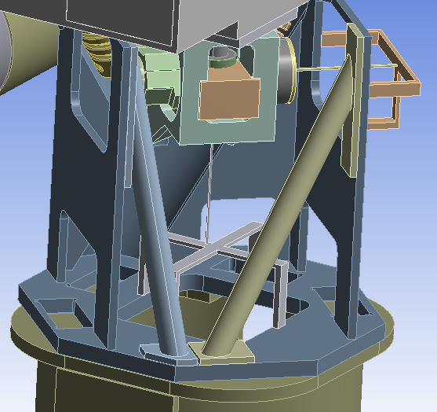
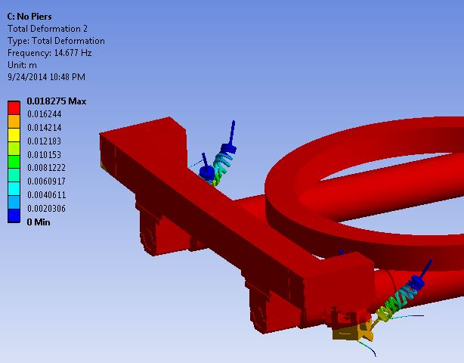
Actuator Addition
Added actuators based on Brian’s old model at 8 Hz
Frequency more reasonable, still nothing on the foot motion
Desired K | 1.6e7 N/m
E | 1.88e11 Pa
Length | 0.25 m
Radius | 0.0026 m
New Freq | 14.68 Hz
See https://alog.ligo-la.caltech.edu/SEI/index.php?callRep=543
Notes:
Point to log entry

Slide 15
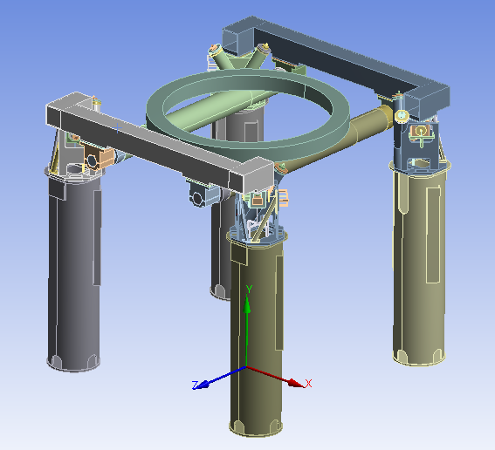
Piers and Full Model Setup
Added piers, attached end of actuators to pier with stiff structures
Fixed supports at floor
Component | Mass | Material
Piers | 750 kg each | Steel
HEPI Housing | 160 each | Steel
HEPI Foot | 20 kg each | Steel
Crossbeam | 480 kg each | Steel
Support Tube Attach | 140 kg each | Steel
Support Tubes | 460 kg each | Steel
Stage 0 | 700 kg | Aluminum
Total Mass w/o Piers/Housing | 3220 kg | -
Total Mass | 7060 kg | -

Slide 16
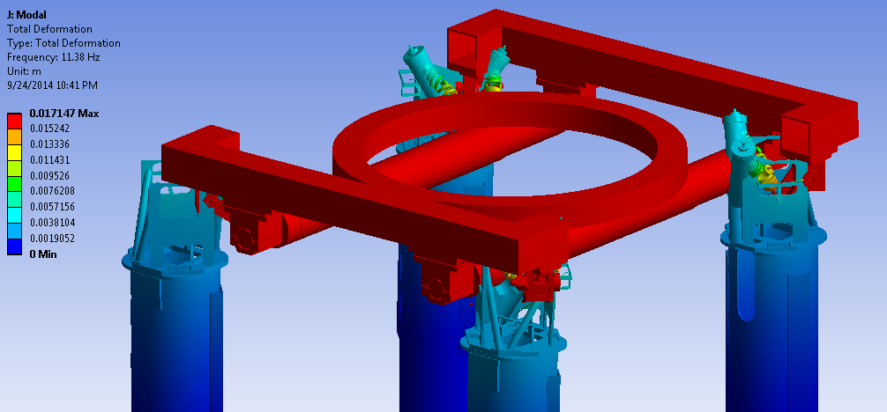
Full Model Results
Beam tube direction mode at 11.4 Hz

Slide 17
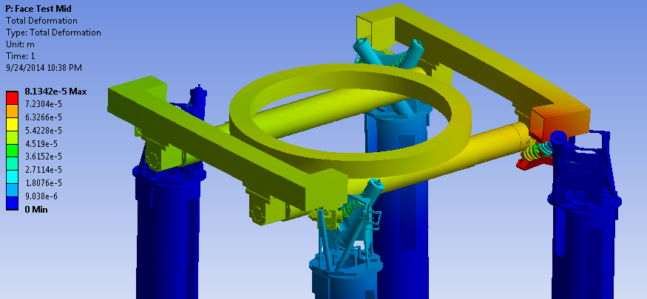
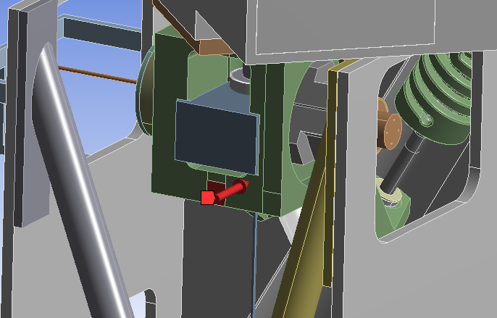
Other Attempts
Static structural testing at crossbeam and foot
Response spectra at crossbeam and foot
No new insight

Slide 18
Stiffness Data from Measurements
$$\frac{1}{2π}\sqrt{\frac{1e7 N/m}{3220 kg}}=8.9 Hz$$
Coherence above 0.9
Notes:
Get stiffness at accel location for both 8340 locations

Slide 19
Proposed Solutions
Add another actuator
Likely not possible due to space and construction issues
See if the mode can be controlled with existing actuators
Replace/modify the crossbeam
Add vibration absorbers to crossbeam
Stiffen the piers
Reaction mass actuator
Notes:
Adding HEPI actuator
-impractical because we don’t have more and there’s no space
Modifying crossbeam useful if foot moving more or allows control
Stiffening the piers useful if it allows control with existing actuators, could move some frequencies apart

Slide 20
Next Steps
Get foot measurement resolved
Will determine usefulness of crossbeam modification
Paper study of controller for 8 Hz mode
Can it be controlled with existing system?
Create models of passive and active damping systems
Determine feasibility
Create model with additional actuator
Probably not practical
Create model with stiffer piers
Could make HEPI control simpler
$$\frac{1}{2π}\sqrt{\frac{1e7 N/m}{3220 kg}}=8.9 Hz$$
$$\frac{1}{2π}\sqrt{\frac{4e7 N/m}{3220 kg}}=17.7 Hz$$
Notes:
Remember to ask fabrice to do this

Slide 21
Extra Slides

Slide 22
/SeismicSVN/seismic/HEPI/Stanford/Transfer/2014_09_25_H1_ETMY_HEPI_Controller/

Slide 23
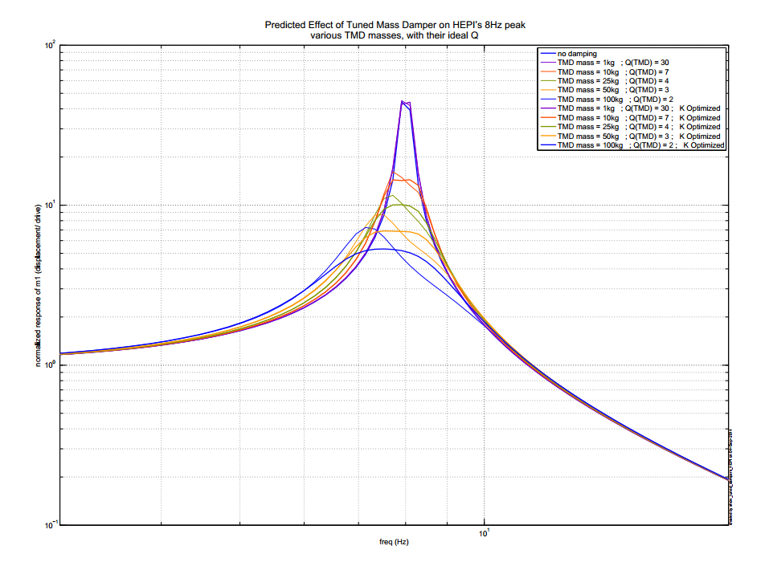
SeiSVN/seismic/Common/Documents/2014_09_04_HEPI_TMDs/

Slide 24
