Slide 1
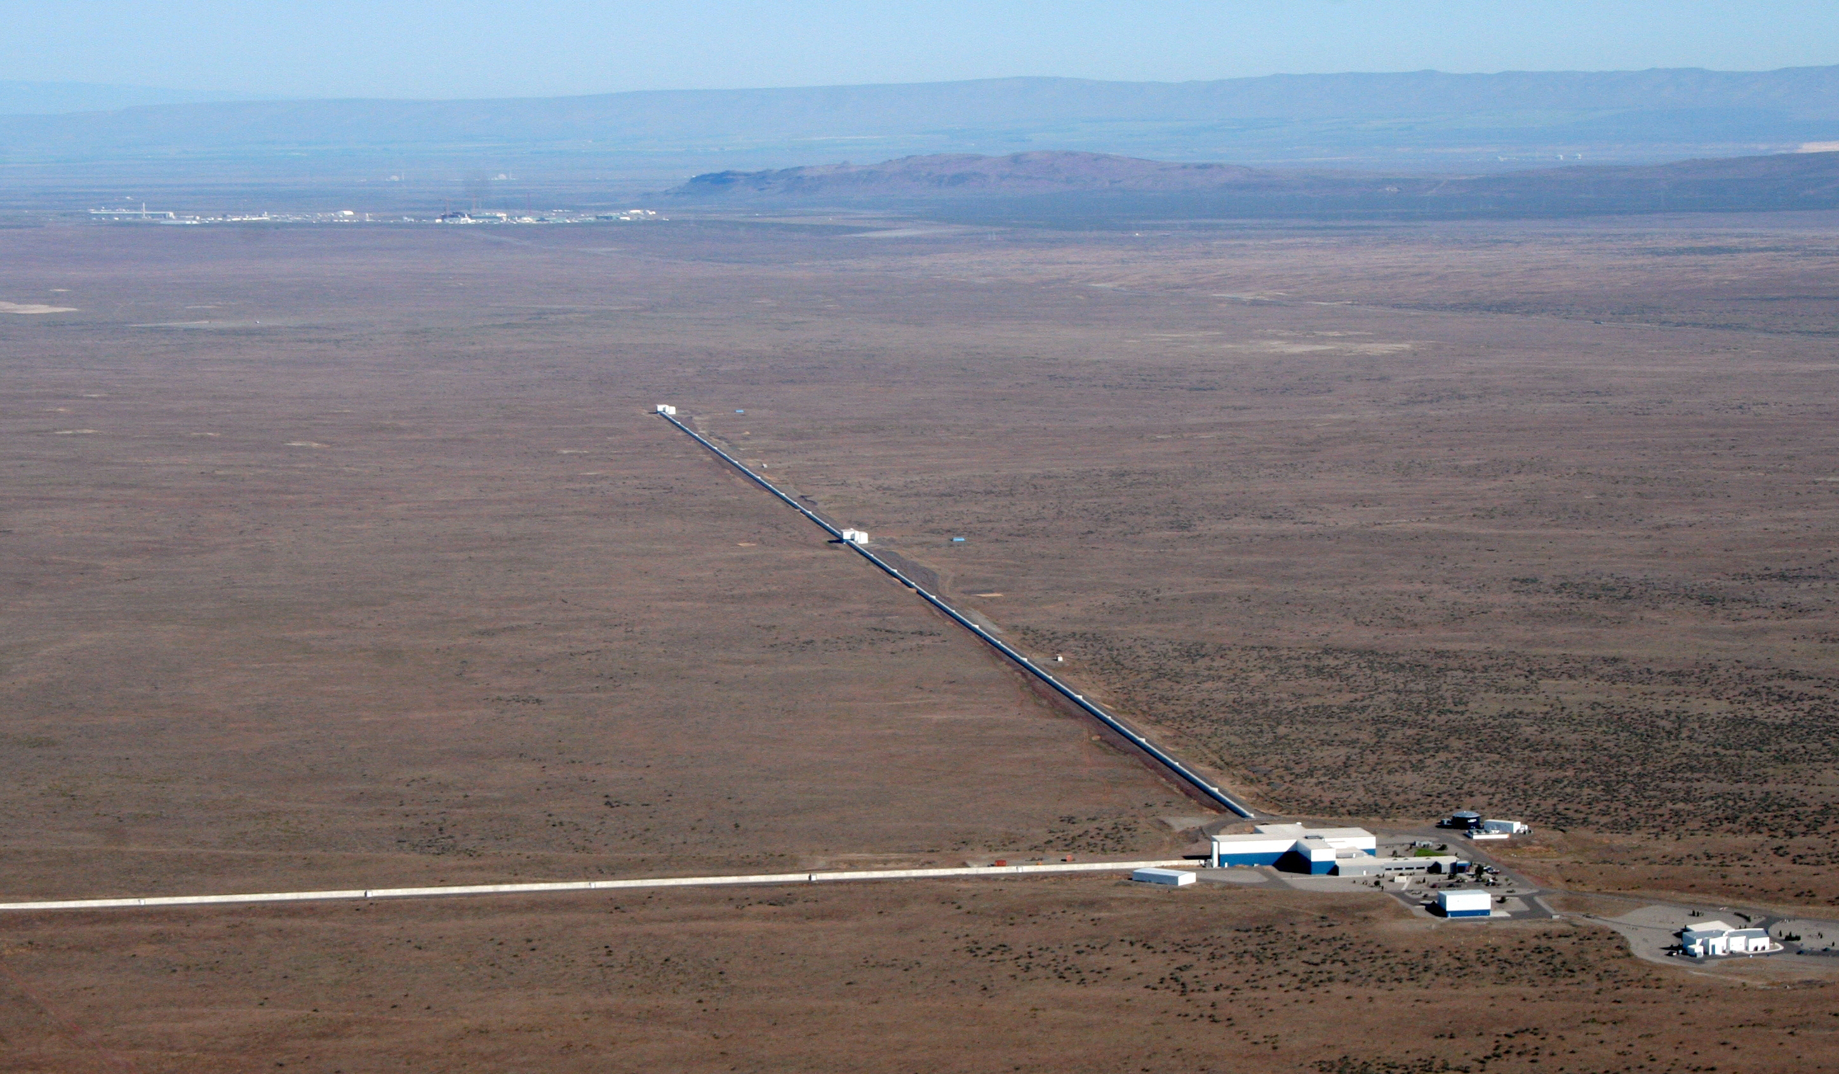
Interferometry and Optics in Advanced LIGO
David Shoemaker
For the LIGO Scientific Collaboration
ASPE Boston 2014-11-13

Slide 2

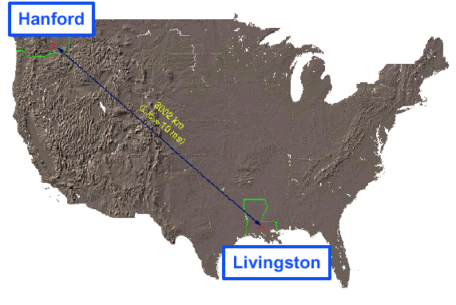
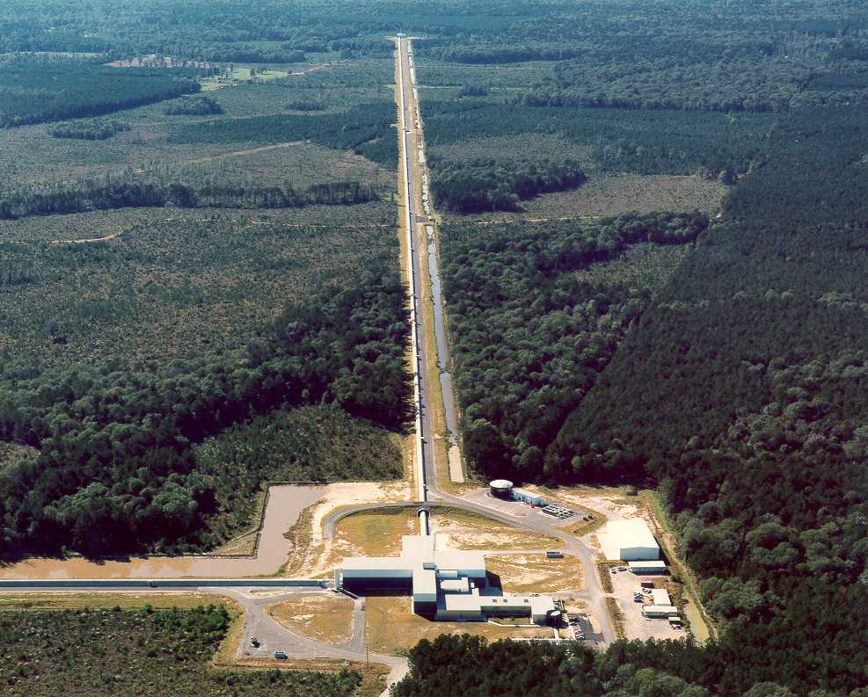
LIGO Laboratory: two Observatories and Caltech, MIT campuses
Mission: Develop gravitational-wave detectors; Operate them as astrophysical observatories
Jointly managed by Caltech and MIT
Requires instrument science at the frontiers of physics fundamental limits
This talk covers 10⁻²¹ of a very neat story!
MIT
Caltech
LIGO Livingston
Notes:
LIGO is actually two observatories.
Describe parameters
Emphasize that the arms are in ultra high vacuum. 8 km of steel 1.2 m dia beam tubes at each site
Separate observatories allow for coincidence detection – since the detectors see uncorrelated noise, only a true gravitational wave would appear on all the interferometers with the correct amplitude.
Emphasize that the LIGO Observatories were designed and are operated by Caltech and MIT

Slide 3
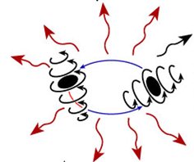
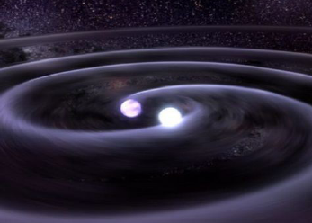
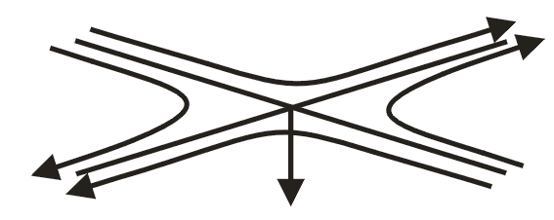
Gravitational waves
Gravitational waves are propagating dynamic fluctuations in the curvature of space-time (‘ripples’ in space-time)
Emissions from rapidly accelerating non-spherical mass distributions
  Practically, need massive objects moving at speeds
  approaching the speed of light
  According to GR, GWs propagate at the speed of light
  Quadrupolar radiation; two polarizations: h₊ and h_{x}
  Physically, GWs are strains
  GWs carry direct information about the dynamics of matter
  Space is stiff… h is 10⁻²¹ for a ~monthly signal rate
Credit: T. Strohmayer and D. Berry

Slide 4
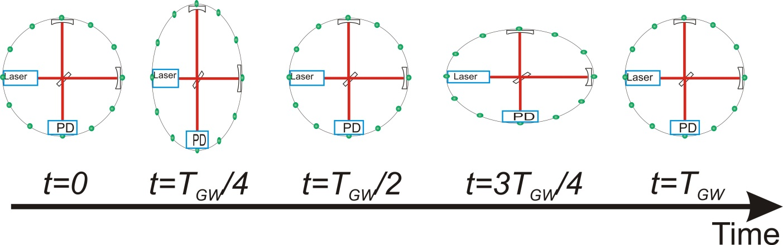
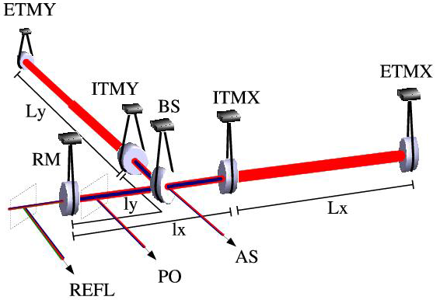
Interferometric Gravitational-wave Detectors
Enhanced Michelson interferometers
Passing GWs modulate the distance between the end test mass and the beam splitter
The interferometer acts as a transducer, turning GWs into photocurrent proportional to the strain amplitude
Arms are short compared to GW wavelengths, so longer arms make bigger signals
→ multi-km installations
Arm length limited by
taxpayer noise….
←4km→
←4km→
Laser →
Photo
diode

Slide 5
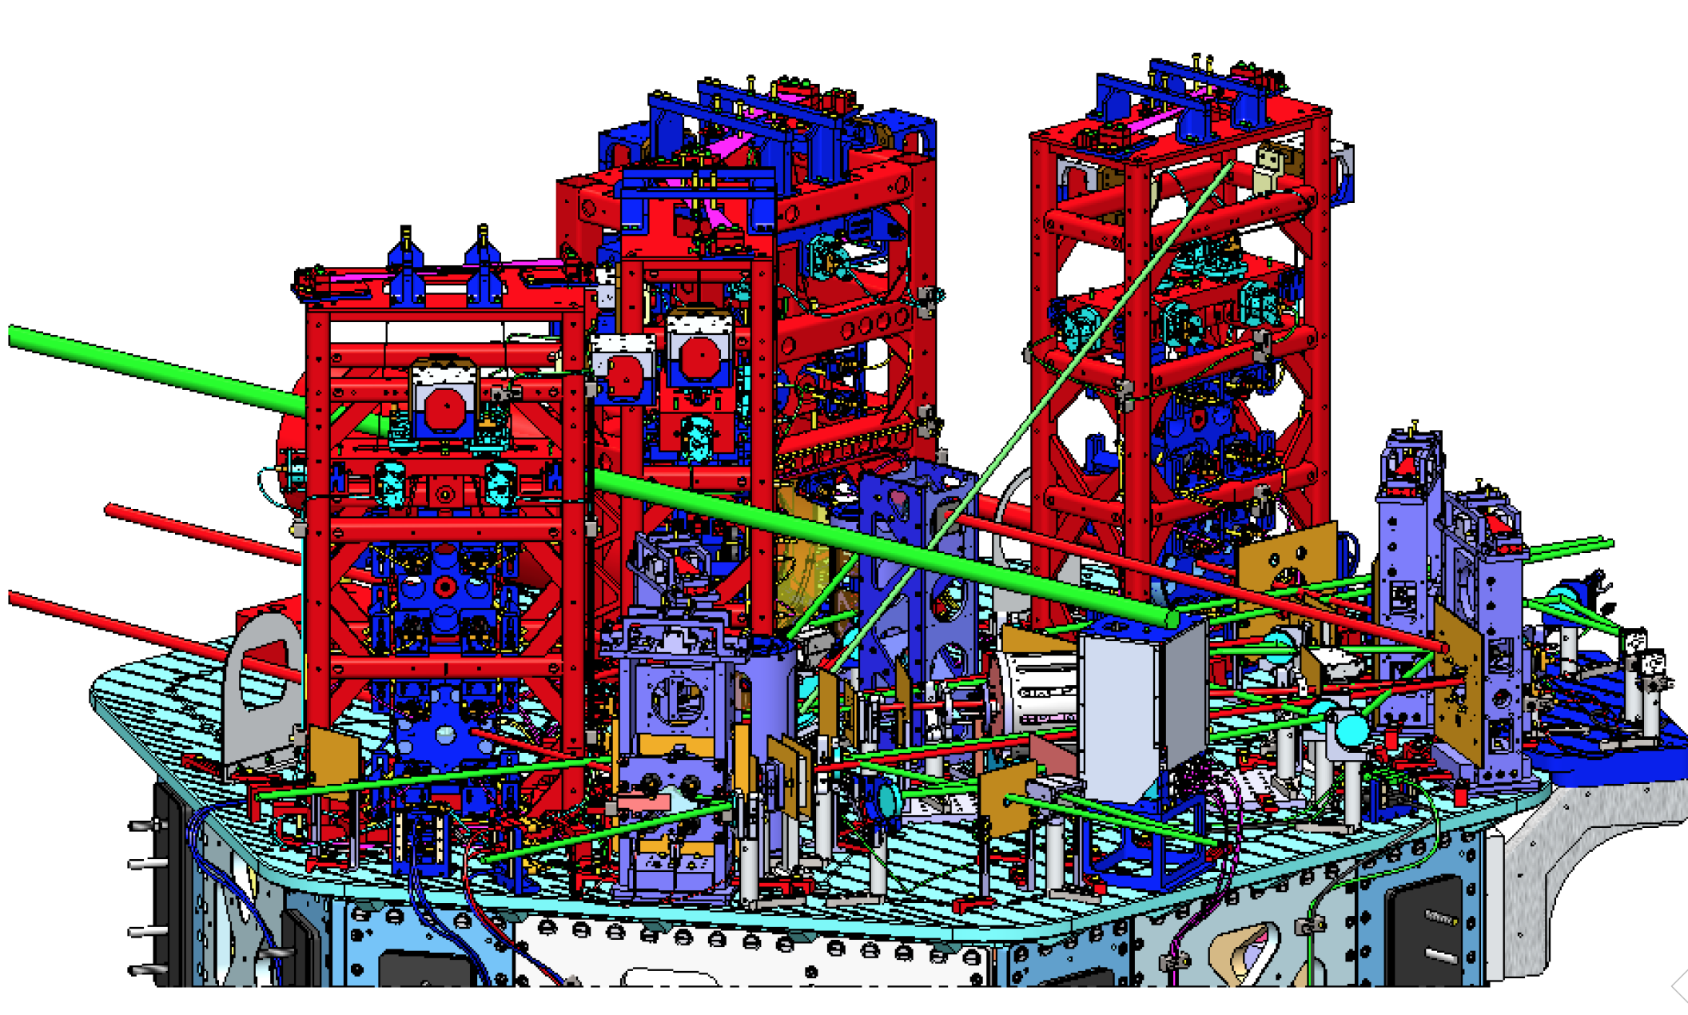

The real instrument is far more complex…
Reality axis

Slide 6

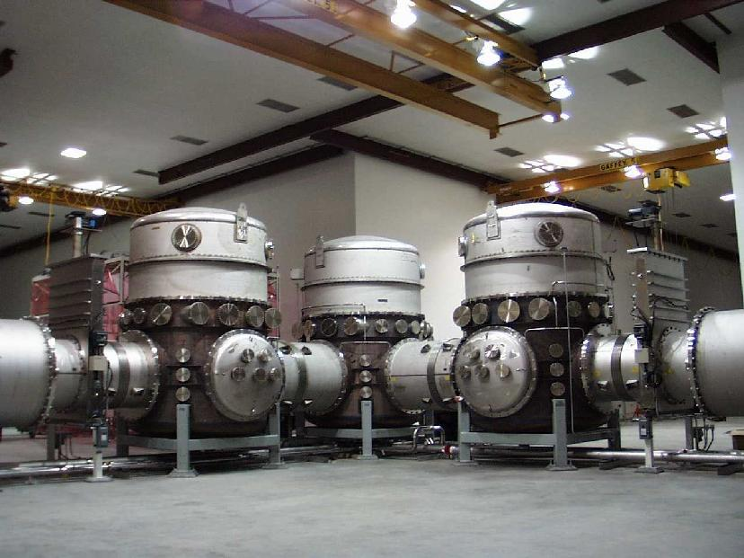
Design drivers
Long arms and extreme interferometry lead to many design impacts
World’s biggest UHV vacuum system, straighter than earth’s curvature
Optics size – 1064 nm over 4km means beam spots of ~12 cm, 34cm optics
Readout requirements of one part in 10¹⁰ of a fringe requires 200W CW Nd:YAG lasers, stabilized in frequency, intensity, and pointing; boosted to ~1 MW with optical resonant cavities
Pointing and control requirements – hold 4km cavities on resonance to 10⁻¹⁵ m;
point optics with microradian RMS motion; 5 coupled cavities, 21 coupled DOF
Suppress seismic and anthropogenic noise input; another 18×5 + 12×5 MIMO DOF

Slide 7
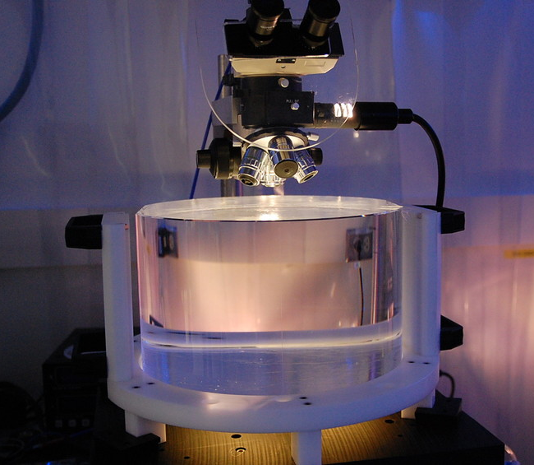
Test Masses
Requires the state of the art in substrates, polishing, coating
Both the physical test mass –
a free point in space-time – and a crucial optical element
Test Masses:
34cm φ x 20cm
40 kg
Round-trip optical loss: 75 ppm max
40 kg
Half-nm flatness over 300mm diameter
0.2 ppm absorption at 1064nm
Coating specs for 1064 and 532 nm
Mechanical requirements: bulk and coating thermal noise, high resonant frequency
Compensation plates:
34cm φ x 10cm
BS:
37cm φ x 6cm
ITM
T = 1.4%

Slide 8
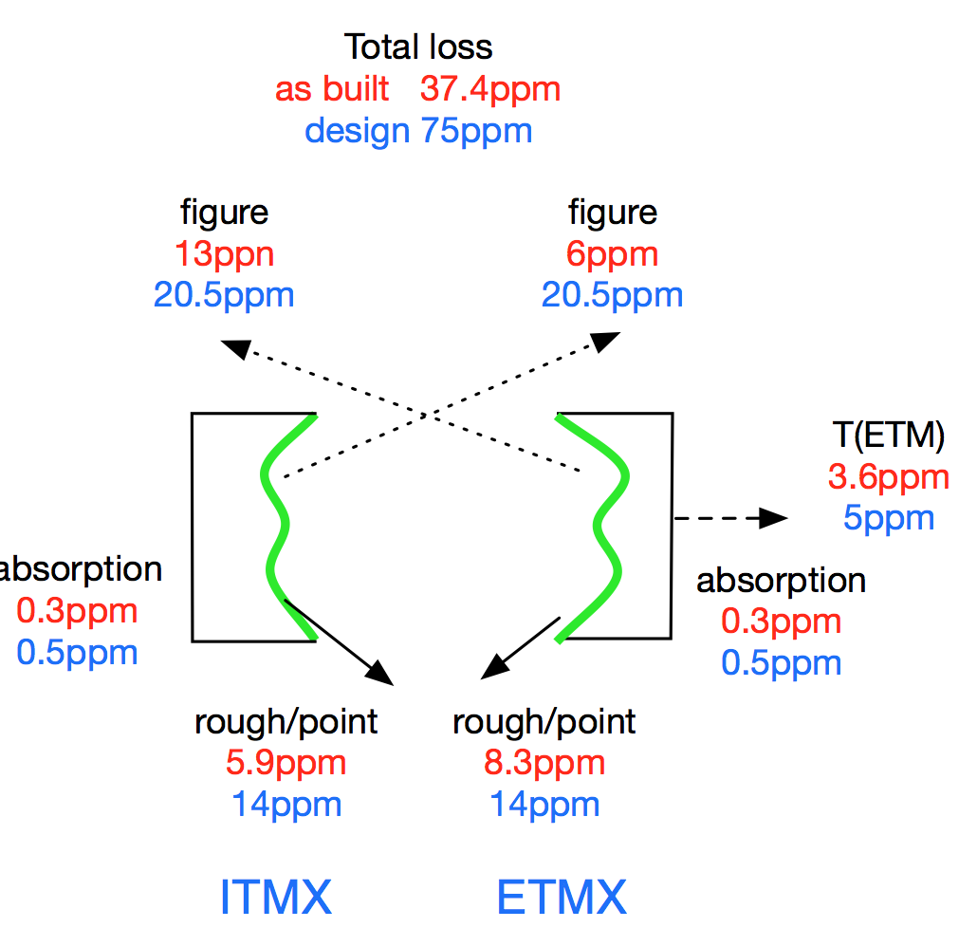
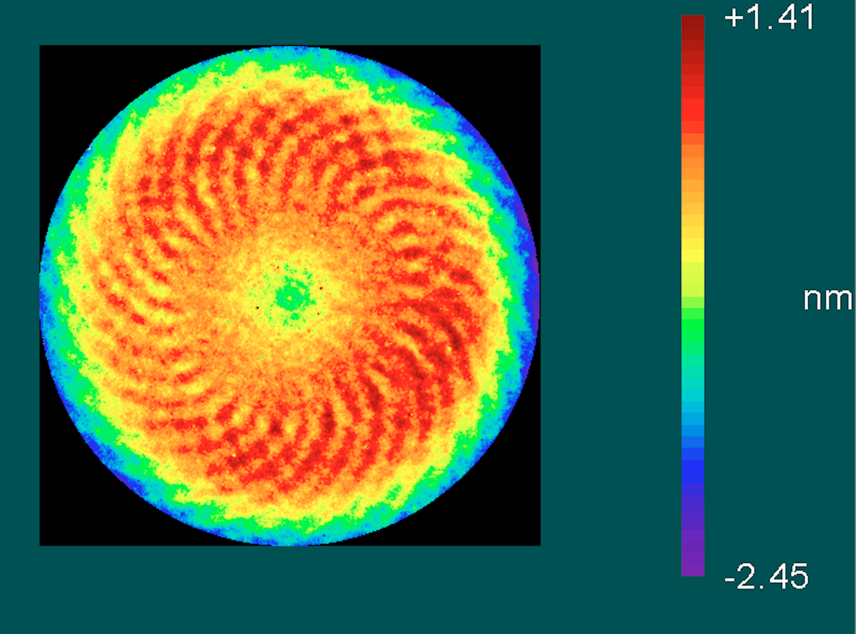
Test mass Optics figure
In-house metrology on 300 mm diameter shows 0.66 nm RMS
  Note spiral from planetary system; about 0.2 nm pk-pk
In-situ measurements of as-built 4km cavity show results are better than requirements!

Slide 9
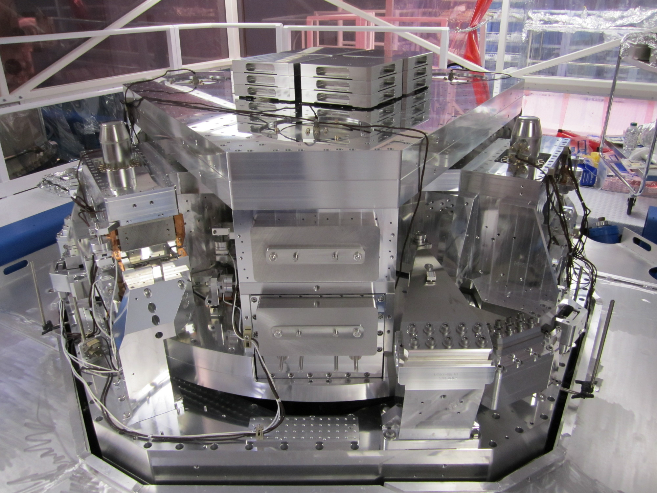
Seismic Isolation:
Multi-Stage Solution
(talk by Matichard)
Objectives:
  Render seismic noise a negligible limitation to GW searches
  Reduce actuation forces on test masses
Both suspension and seismic isolation systems contribute to attenuation
Choose an active isolation approach, 3 stages of 6 degrees-of-freedom :
  1) Hydraulic External Pre-Isolation
  2) Two Active Stages of Internal
  Seismic Isolation
Low noise sensors (position, velocity, acceleration) are combined, passed
through a servo amplifier, and delivered
to the optimal actuator as a function of
frequency to hold platform and 1-ton payload
still in inertial space
At 10Hz: 10⁻¹² m/rHz and -80 dB transmissibility
~2m

Slide 10
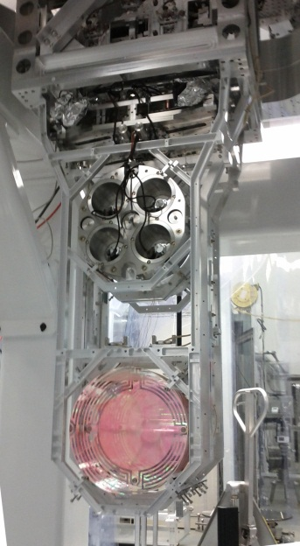

Test Mass Quadruple
Pendulum suspension
Quadruple pendulum suspensions for the test masses; second ‘reaction’ mass to give quiet point from which to push
Create quasi-monolithic pendulums using
fused silica fibers to suspend 40 kg test mass
  VERY Low thermal noise! Q = 10⁹
Another element in hierarchical control system
Optics Table Interface
(Seismic Isolation System)
Damping Controls
Hierarchical Global
Controls
Final elements
All Fused silica
Electrostatic
Actuation

Slide 11
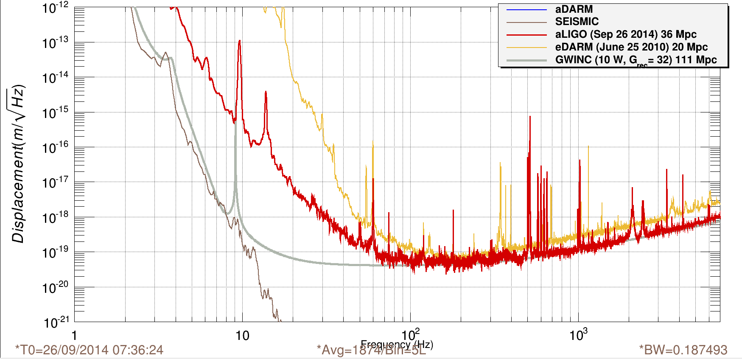
Advanced LIGO commissioning just starting – already more sensitive than any previous detector
Sufficient in principle to detect the GW signal from a binary star system 120,000,000 light years distant
Frequency (Hz)
Accomplished in 4 months what it took
~ 4 years to do in Initial LIGO

Slide 12
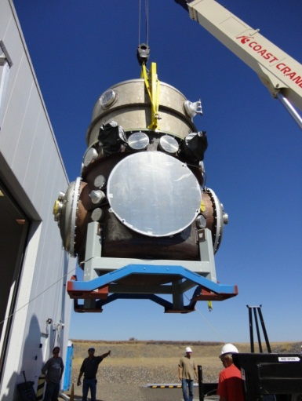
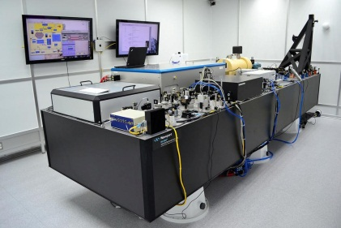
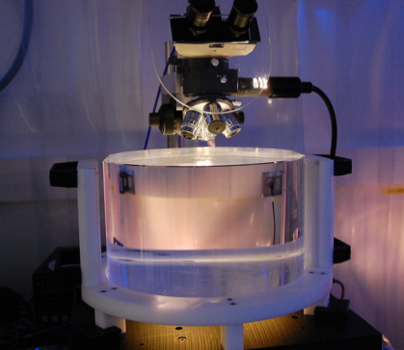
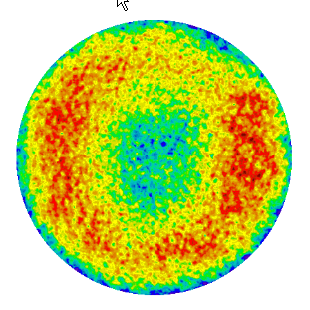
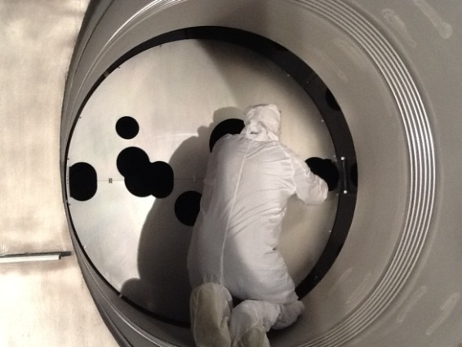
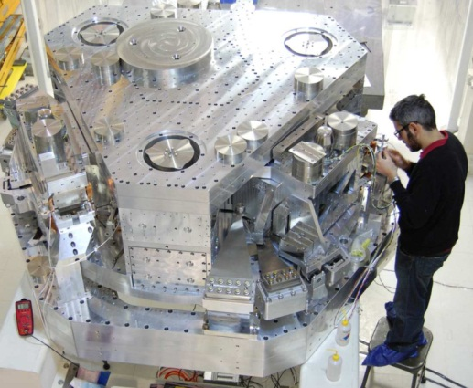
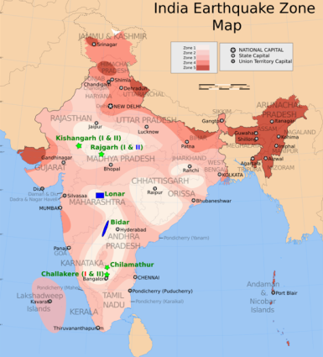
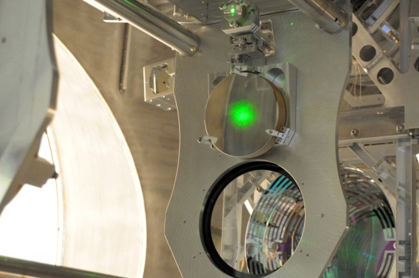
The Last Page
The next generation of gravitational-wave detectors will have the sensitivity to make frequent detections
The Advanced LIGO detectors are coming along well, planned to observe in 2015
The world-wide community is growing, and is working together toward the goal of gravitational-wave astronomy
www.advancedligo.mit.edu
Goal: Direct Detection 100 years after Einstein’s 1916 paper on GR

