Slide 1
History and status of LIGO
Laser Interferometer
Gravitational Wave Observatory
Hiroaki Yamamoto Caltech/LIGO
Introduction
  Newton’s gravity to Einstein’s general relativity
Gravitational Wave
  Source and signal
Detection of the Gravitational Wave Signal
Second generation detectors
Plan toward the first detection of GW
Many items in the presentations are from
“Listening to the Universe through Einstein’s Waves” by S. Whitcomb LIGO-G0900456
“Projected Integrated Testing & Operations Commissioning” by P. Fritschel LIGO-G1400628
“ET-aLIGO and beyond” by David Shoemaker LIGO-G14001331

Slide 2
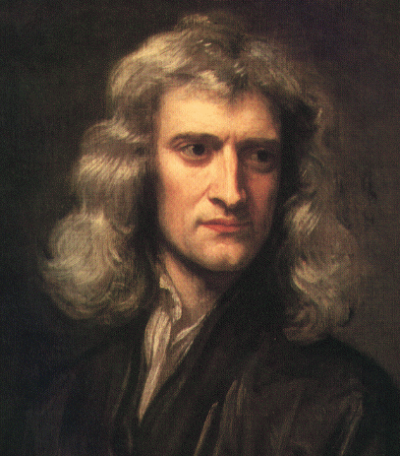

Newton’s Theory of Gravity
(1686)
Equal and opposite forces between pairs of bodies

Slide 3
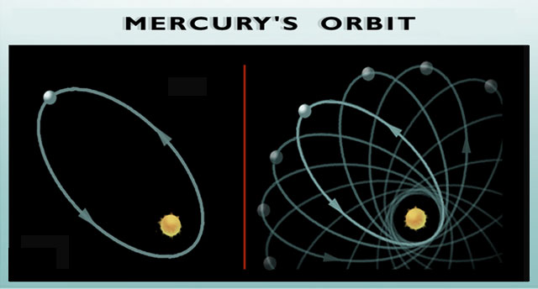
Newton’s Theory of Gravity to
Einstein’s General Theory of Relativity
Newton’s Theory of Gravity was very successful
However, One Unexplained Fact
and Two Mysteries
Astronomers observed
perihelion of Mercury advances by 43”/century compared to Newton’s theory
What causes the mysterious force in Newton’s theory ?
How can a body know the instantaneous positions of all the other bodies in the Universe?

Slide 4
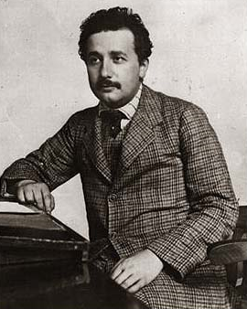
General Relativity
A Radical Idea
Overthrew the 19th-century concepts of absolute space and time
Spacetime = 3 spatial dimensions + time
Perception of space and time is relative
AIP Emilio Segrè Visual Archives
Notes:
http://fisica.fc.ul.pt/einstein.gif

Slide 5
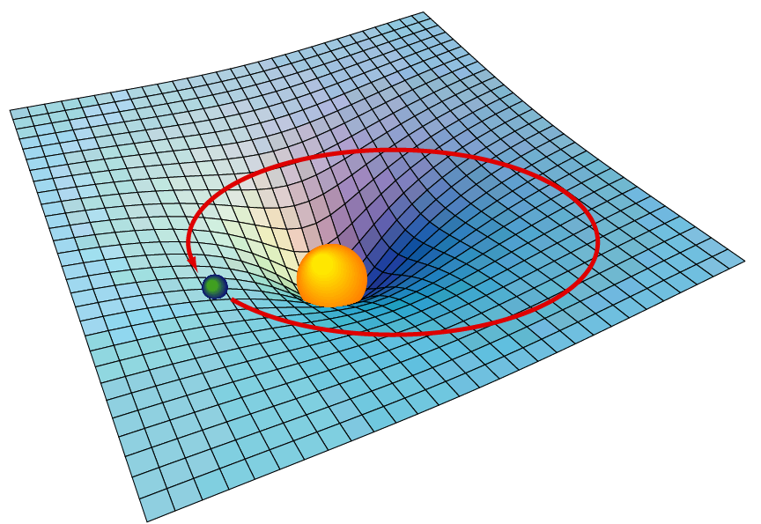
General Relativity
A Radical Idea
Gravity is not a force, but a property of space & time
Concentrations of mass or energy distort (warp) spacetime
Objects follow
shortest path
through this
warped spacetime
Explained the
precession of
Mercury
A
B
Notes:
http://fisica.fc.ul.pt/einstein.gif

Slide 6
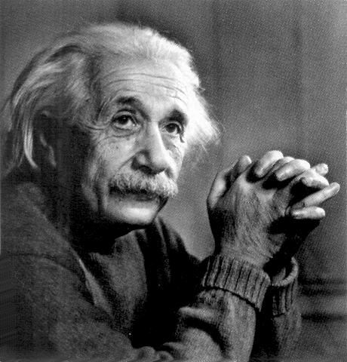
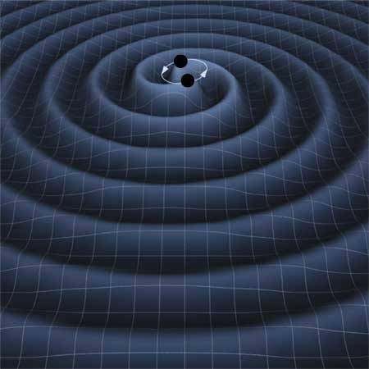
A New Prediction:
Gravitational Waves
Photograph by Yousuf Karsh of Ottawa, courtesy AIP Emilio Segre Visual Archives
Ripples in spacetime
moving at the
speed of light

Slide 7
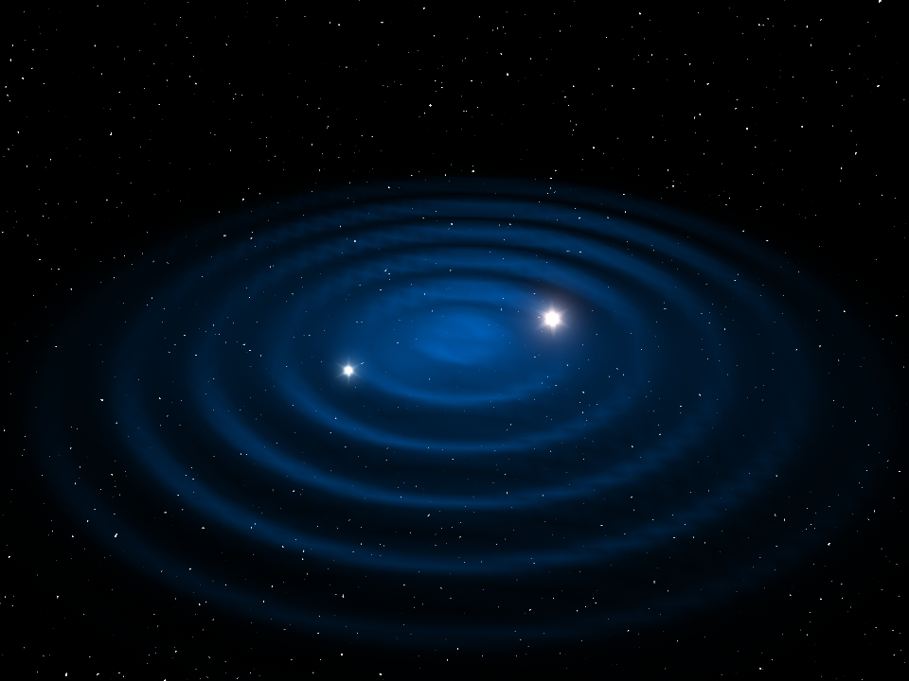
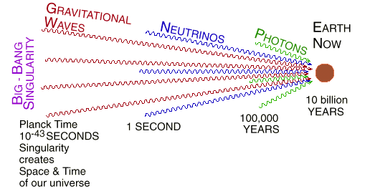

Source of Gravitational Waves
Any massive objects can radiate GWs
  Black Halls, Neutron Stars, Pulsars, Supernova, Big Bang, etc
Using GW signals, we can investigate sources
Least unambiguous detectable GW source : coalescence of neutron binary stars
Cosmic
microwave background

Slide 8
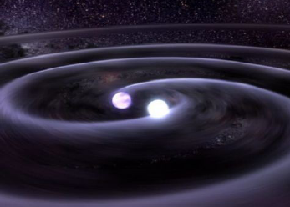
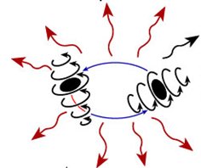
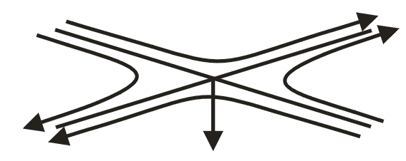
Propagation of Gravitational waves

Slide 9
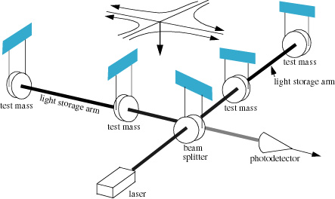
Direct Detection of
Gravitational Waves
L₁
E₁
E₂
L₂
E₁- E₂∝ L₁-L₂
h~10⁻²³
L₁-L₂~10⁻¹⁹m

Slide 10
How Small is 10⁻¹⁹ Meter?
One meter
Human hair ~ 100 microns
Wavelength of light ~ 1 micron
Atomic diameter 10⁻¹⁰ m
Nuclear diameter 10⁻¹⁵ m
GW detector 10⁻¹⁹ m

Slide 11
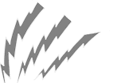


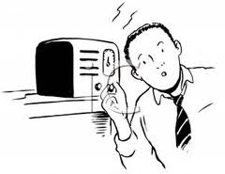
GW detector sensitivity
or Listening to the GW songs
First generation detector
Too noisy and hard to hear
Second generation detector
Low noise and enjoy music

Slide 12
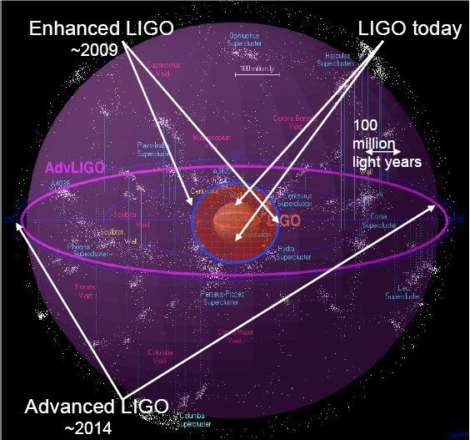
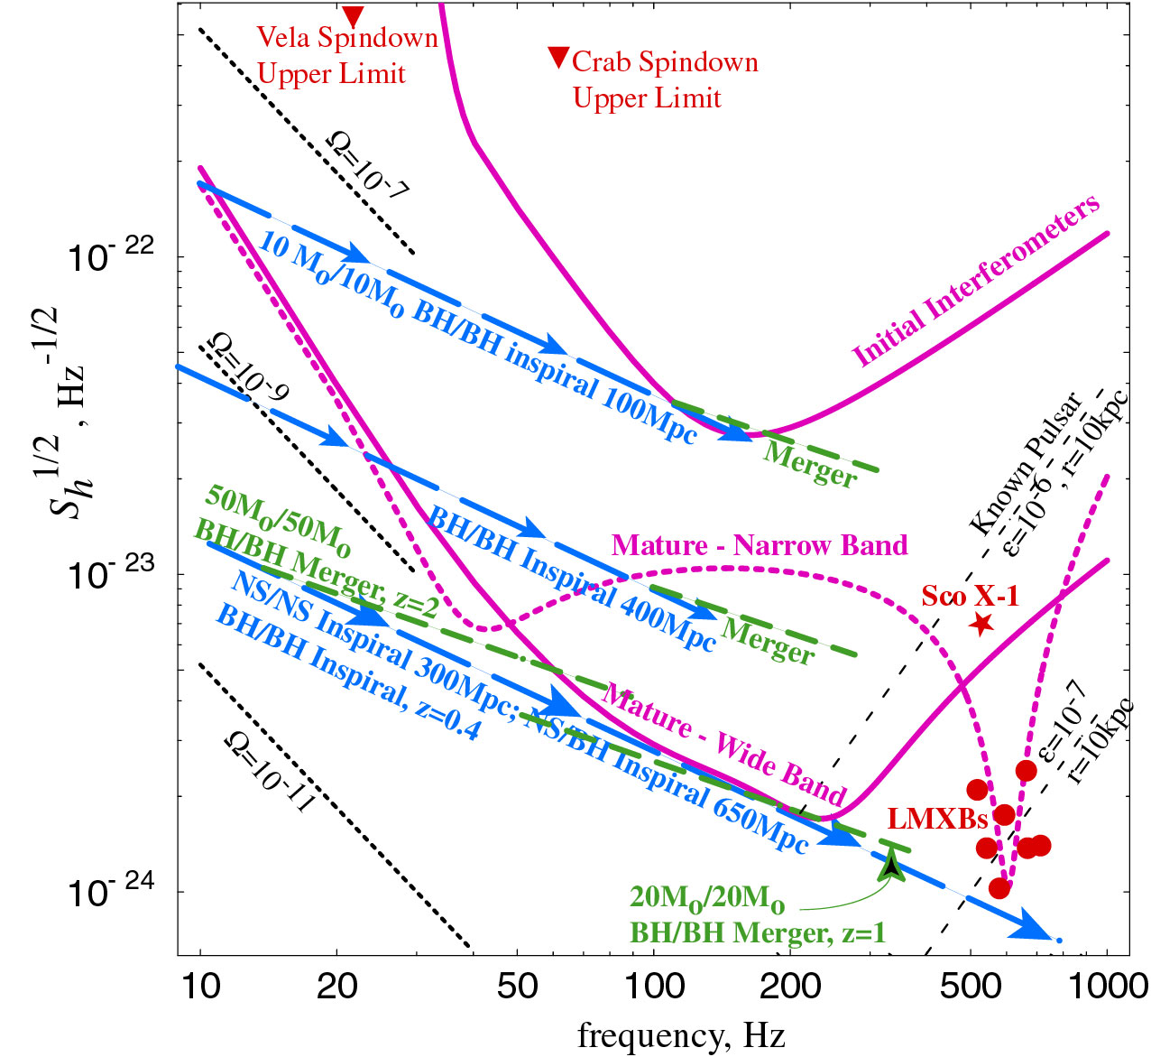
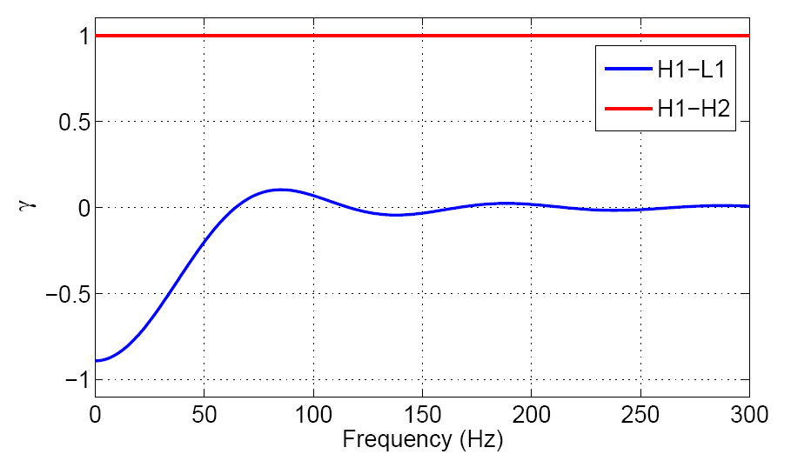
Initial LIGO
Advanced LIGO Scope
and Deliverables
Factor 10 better amplitude sensitivity
  (Reach)³ = rate
Factor 4 lower frequency bound
Tunable for various sources
NS Binaries: for three interferometers,
  Initial LIGO: ~20 Mpc
  Adv LIGO: ~300 Mpc, expect
  one event/week or so
BH Binaries:
  Initial LIGO: 10 M_{o}, 100 Mpc
  Adv LIGO : 50 M_{o}, z=2
Stochastic background:
  Initial LIGO: Ω~3e-6
  Adv LIGO ~3e-9
Image courtesy of Beverly Berger
Cluster map by Richard Powell
12

Slide 13
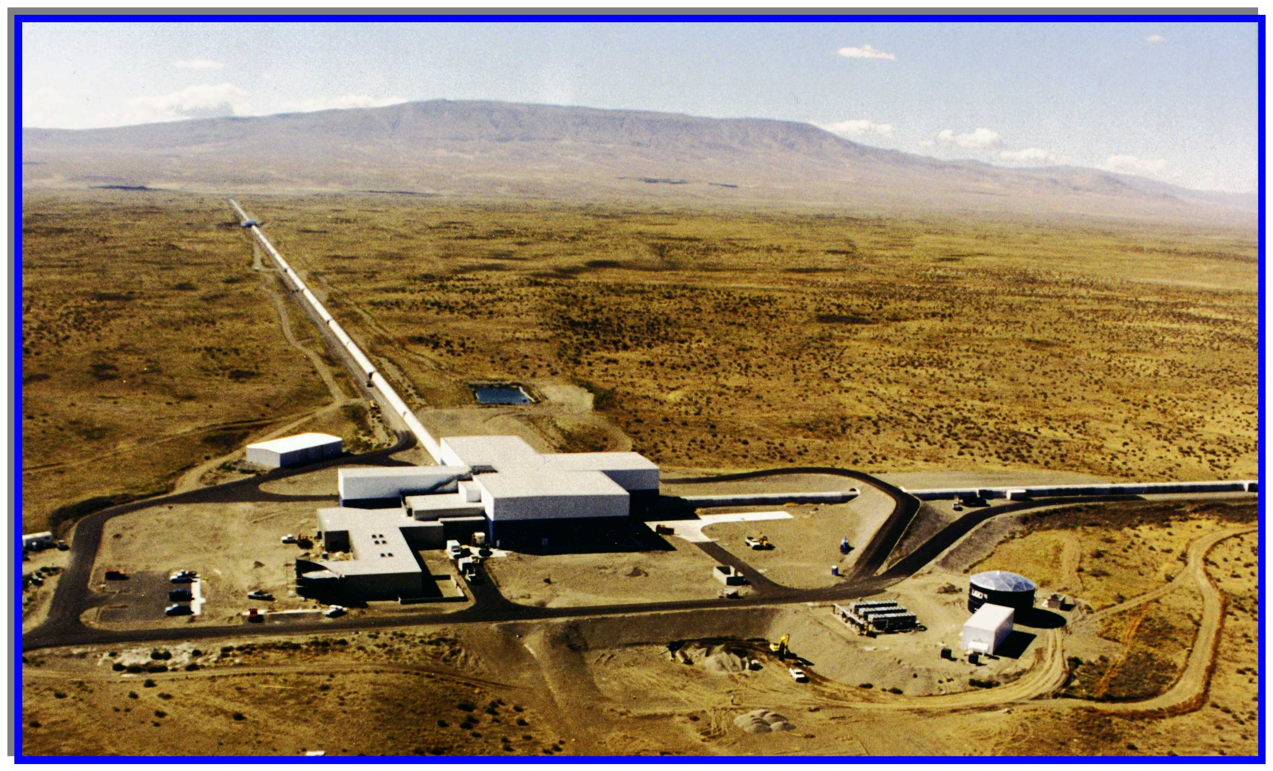
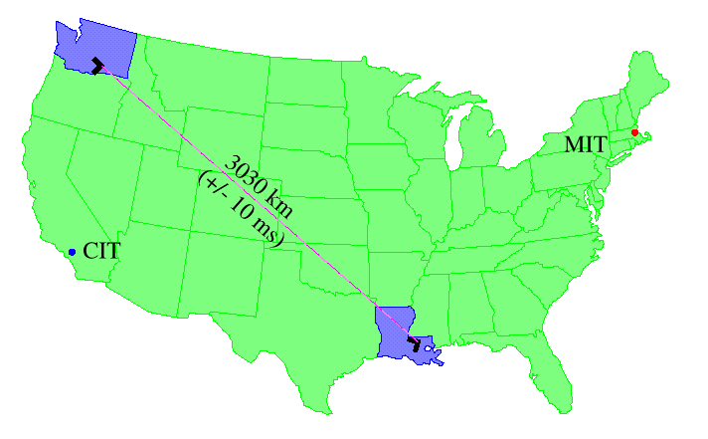
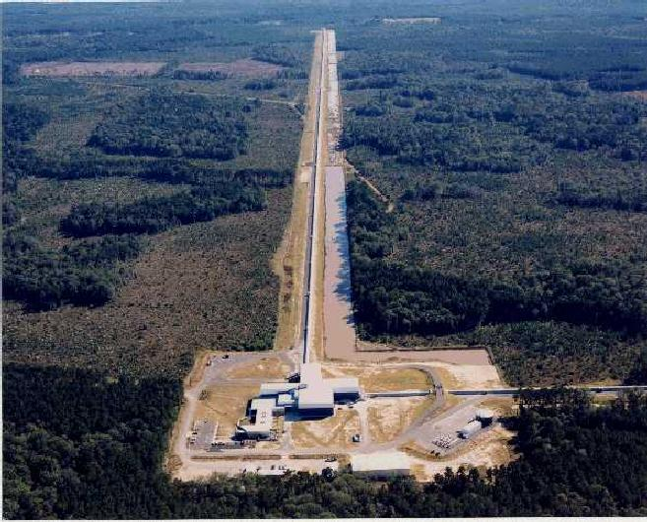
LIGO sites
Hanford
Observatory
(H2K and H4K)
4 km
+ 2 km
Hanford, WA (LHO)
located on DOE reservation
treeless, semi-arid high desert
25 km from Richland, WA
Two IFOs: H2K and H4K -> 4k LHO + 4k India
Livingston, LA (LLO)
located in forested, rural area
commercial logging, wet climate
50km from Baton Rouge, LA
One 4K IFO
Livingston
Observatory
(L4K)
4 km

Slide 14
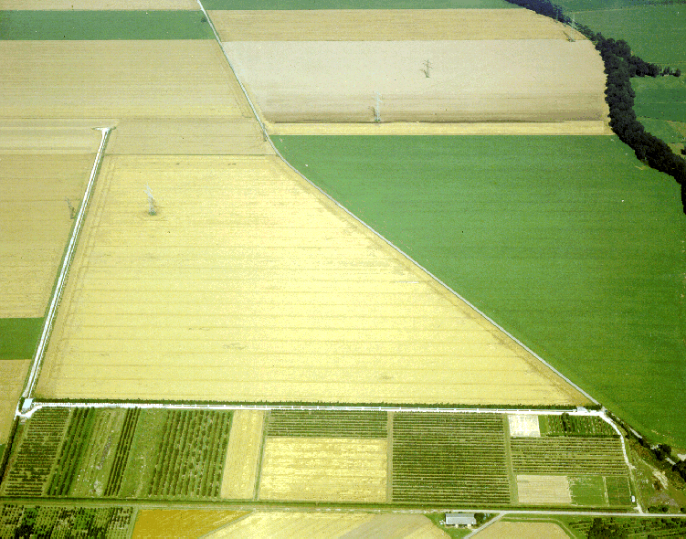
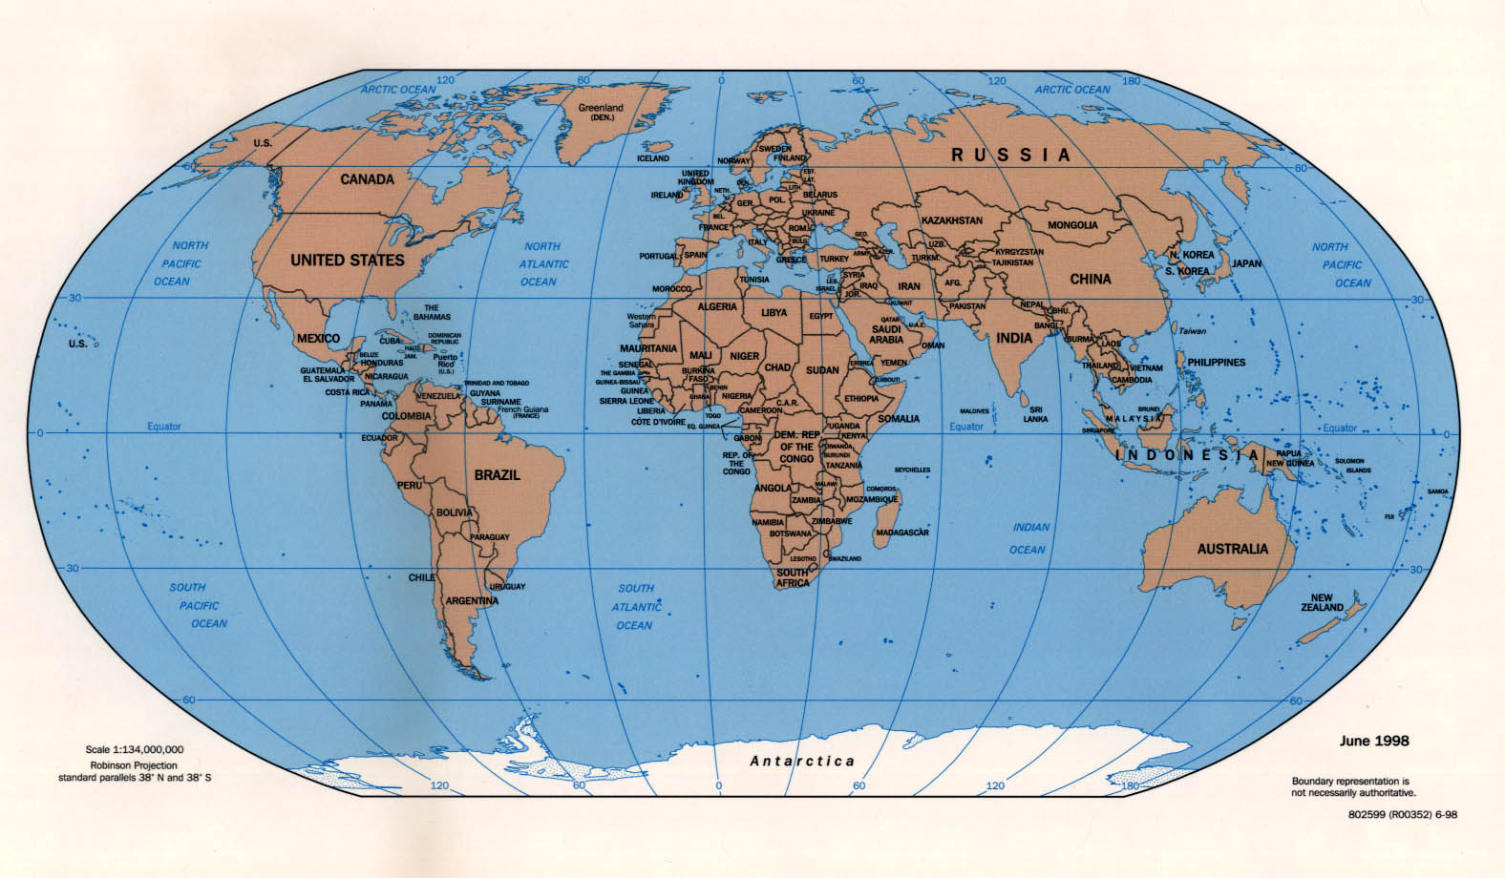
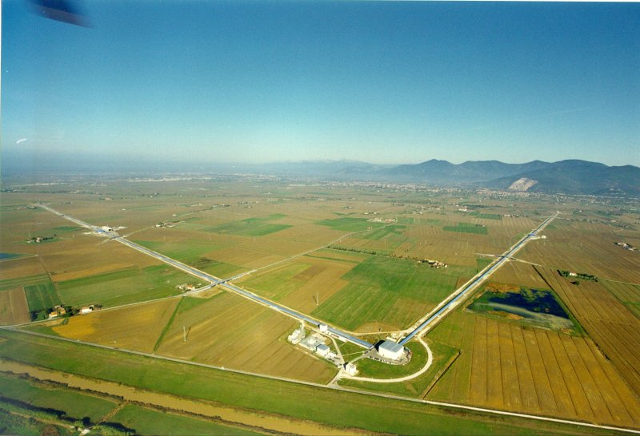
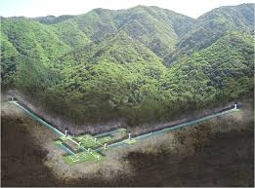
International network
LIGO
GEO
detection confidence
locate the sources
verify light speed propagation
decompose the polarization of gravitational waves
Open up a new field of astrophysics!
Virgo
KAGRA
LIGO
LIGO-India

Slide 15

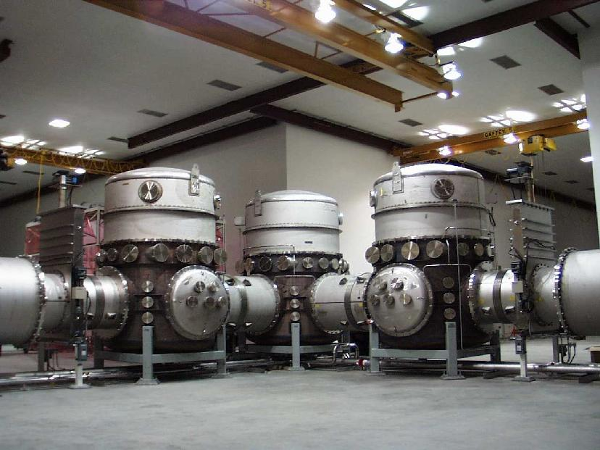
LIGO Large vacuum enclosures
All optical components must be in high vacuum, so mirrors are not “knocked around” by gas pressure
Beam light path must be high vacuum, to minimize “phase noise”

Slide 16
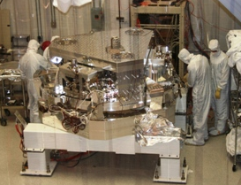
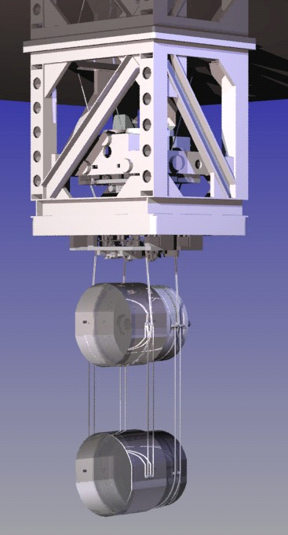
Design Overview
Signal- and Power-recycled Fabry-Perot interferometer
180 W 1064 nm laser
thermal compensation of
optics with CO₂ laser and
Ring-Heater
Arm-Length Stabilization to
aid locking
← 4km →
Active Seismic Isolation
← 4km →
Higher-mass, lower-loss, larger test mass optics
Mode-stable
Recycling Cavities
Quad
Fused-silica
suspension

Slide 17
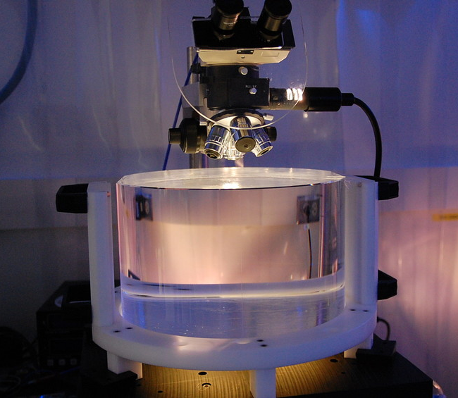
aLIGO Test Masses
Requires the state of the art in substrates, polishing, coating
Both the physical test mass –
a free point in space-time – and a crucial optical element
40 kg
Test Masses:
34cm ∅ x 20cm
Round-trip optical loss: 75 ppm max
Half-nm flatness over 300mm diameter
0.2 ppm absorption at 1064nm
Coating specs for 1064 and 532 nm
Mechanical requirements: bulk and coating thermal noise, high resonant frequency
40 kg
Compensation plates:
34cm ∅x 10cm
BS:
37cm ∅ x 6cm
ITM
T = 1.4%

Slide 18
Historical perspective:
Initial LIGO commissioning
1999
2000
2001
2002
2003
2004
2005
2006
2007
3
4
1
2
3
4
1
2
3
4
1
2
3
4
1
2
3
4
1
2
3
4
1
2
3
4
1
2
3
4
1
2
3
Inauguration
First Lock
Full Lock all IFO
Design sensitivity
4 km strain noise
10⁻¹⁷
10⁻¹⁹
10⁻²¹
10⁻²²
2.5x10⁻²³
10⁻¹⁸
10⁻²⁰
at 150 Hz [Hz^{-1/2}]
Engineering
E2
E3
E5
E7
E8
E9
E10
E11
Runs
Science
S1
S2
S3
S4
S5
First Science Data
Overall, 4-5 years from locking to design sensitivity

Slide 19
Project Integrated Testing Plan
Integrated testing phases interleaved with installation
Complementary division between LHO and LLO
  Designed to address biggest areas of risk as soon as possible
  H1 focused on long arm cavities; L1 worked outward from the vertex
July 2012
Oct 2012
Jan 2013
Apr 2013
July2013
Oct 2013
Jan 2014
Apr 2014
July2014
One Arm Test 1st arm cavity Green only
Input Mode Cleaner
HIFO-XY
Both arms + corner
No AS port
H1
HIFO-Y Y-arm + corner
Green + PSL IR
Build & test from the arms backward
L1
Input Mode Cleaner with high power test
Dual recycled Michelson
Full Interferometer
I
II
III
Build & test from the laser outward

Slide 21
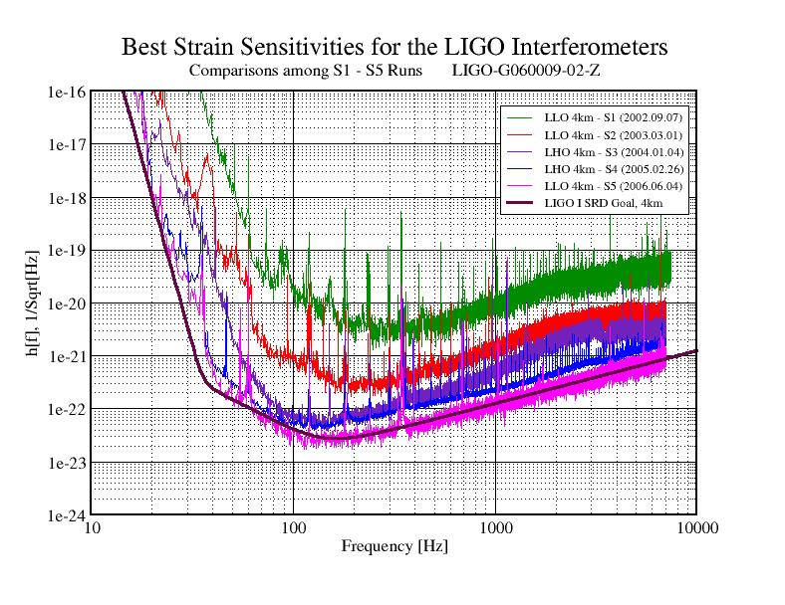
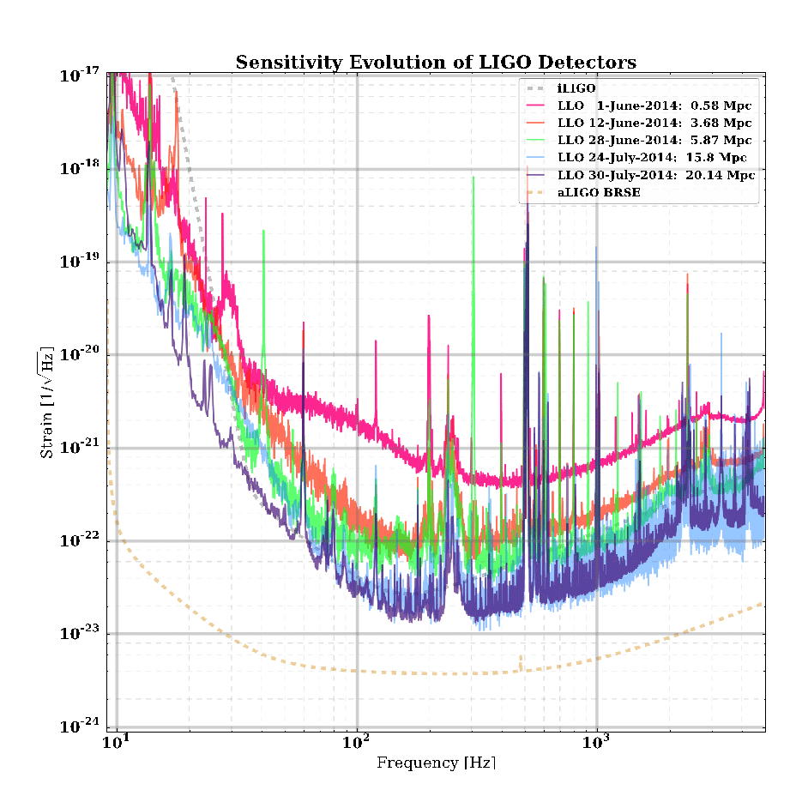
Improving sensitivities

Slide 22
LLO Project scope finished
The full interferometer lock was achieved on May 26, 2014
L1 formally met the aLIGO goal of a 2h stable lock
The IFO has been locked for as long as 7.5h
Initial alignment and the lock acquisition are mostly automated
Currently recovering from some in-vacuum work
(Need to complete System Acceptance/documentation)

Slide 23
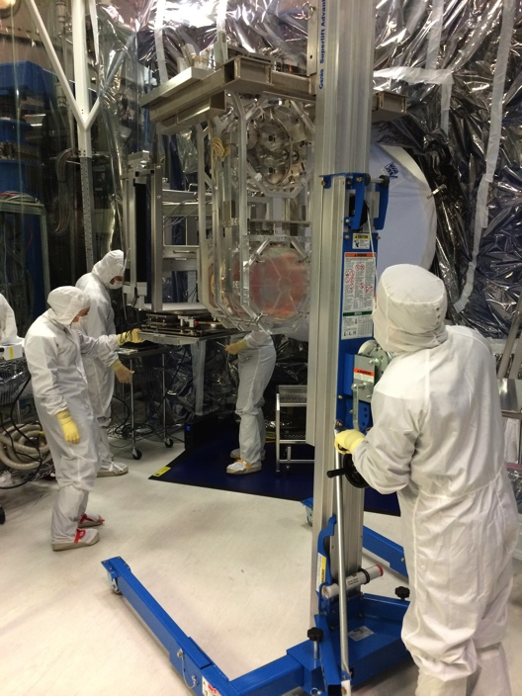
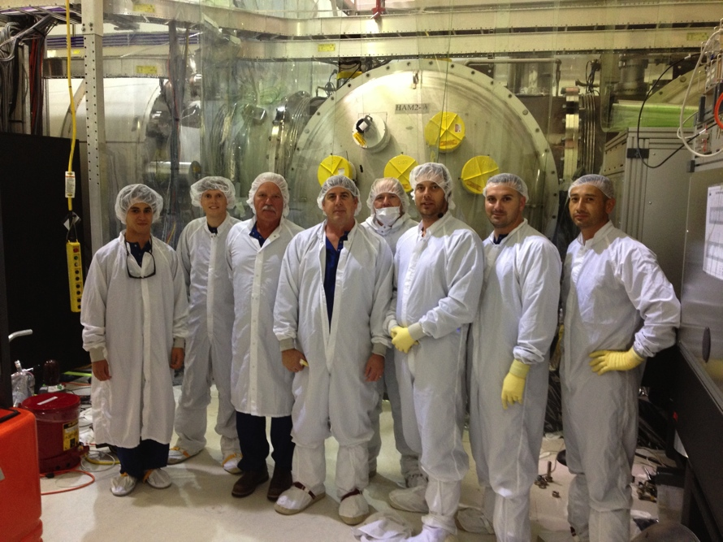
LHO installation complete
Now under vacuum at all stations. Dual-recycled Michelson test underway; arms lockable with green Arm Length Stabilization, working toward full lock
Accomplished with huge help from LLO, CIT and MIT
Next: installation acceptance, and get to two-hour-lock milestone
Also, responsibility for 3rd ifo (India) is at Hanford – non-trivial task.

Slide 24
Targeting the first observations
ER6 slated for start December 8th, 2014
  L1 expected to be locked for multiple-hour intervals, although not at peak sensitivity; H1 not locking yet
  Significant discussion in Joint Run Planning Committee on ER6 readiness (throughout the LSC), start date, calibration/freeze/run durations, and impact on commissioning
O1 observation run slated for as early as mid-July 2015; an evolving discussion as commissioning progress is understood
Important point: we want Both LIGO instruments working at comparable sensitivity for the first observing run
  Catch-up needed at LHO – integrated testing starting ~6 months later than LLO, and e.g., operator/detector support training just getting going; lessons learned will help, but only so much
  Still ‘all hands on deck’ from LLO, MIT, CIT and of course LHO to reach that goal, but with competing needs to complete aLIGO hardware and documentation, work on BeamTube leak repair

Slide 25
Advanced LIGO: anticipated science runs
3rd: 2017-2018
Full sensitivity (200 Mpc): end-2018
2nd run: 6 months @80-120 Mpc likely detection
2016-2017
1st run: 3 months @40-80 Mpc possible detection
2015

