Slide 1
Sapphire Fused Silica and EP30-2
Removing prisms from ITM09
G. Billingsley
C. Torrie
N. Robertson
11-5-14
LIGO-T1400711-v1

Slide 2
Chemical removal
Prisms on ITM09 were soaked in methylene chloride.
An early attempt at spreading the prisms during soaking did result in a slight bond lift for one prism, but also in the breakage of the Test Mass. See T1400562
Additionally the remaining prism was soaked for two months without change.

Slide 3
View from below, soak and spread

Slide 4
Slight lift visible on second prism edge after spreading/breaking

Slide 5
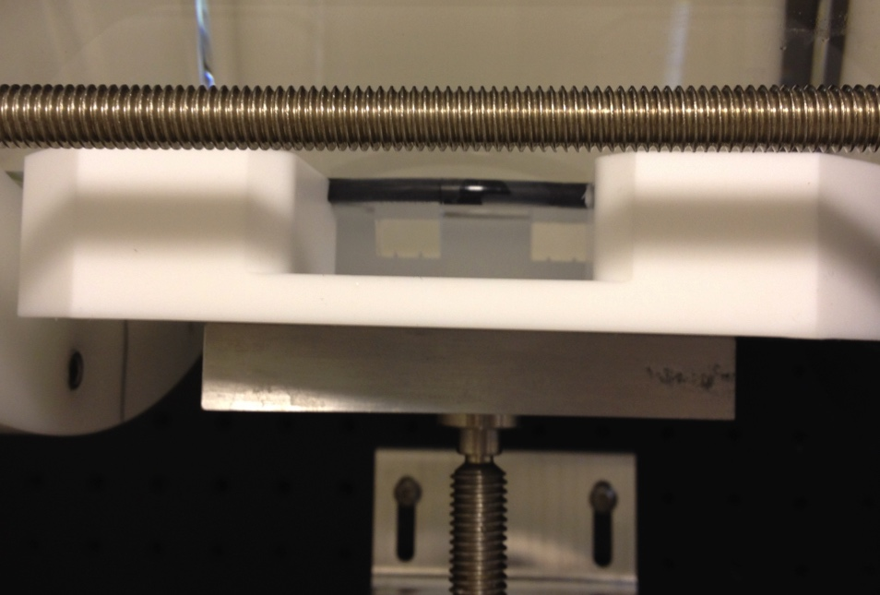
Soak both sides at once

Slide 6
Heat removal – Test Plate
5 sapphire prisms were glued to an AR coated fused silica test plate.
Bonds were 7-12 days old, made according to LIGO-T1300322-v6 with no spacers
34 C° cure occurred well after ~44 hours of room temperature cure.
450 gram weight was used, suspended at the end of a 6” Crescent wrench. Presence of weight is necessary for de-bonding.
FLIR was positioned 13” from plate – detection point was aimed at prism apex – front/center.
Heating rate is highly dependent on insulation

Slide 7
First prism removed with heat gun Not easy to control

Slide 8
Test Plate Four prisms removed with heat tape

Slide 9
Test plate Thermal Profile
Group order:
Highest Temp: T2-plate at prism base
FLIR-on prism apex
Lowest Temp: T1-clamped on prism flat with wrench
3 – change every 3 min
4a – “High – prism remained
”
Temperature C°
4b-more insulation
controller – “High”
2C/min goal
5- goal is < 2C/min per Heraeus annealing guidelines
Time in minutes
Notes:
Final temperature at High is dependent on insulation
No de-bond without weight

Slide 10
Insulation configuration used in Test plate prism 2, 3 and 4a removal
T2
T1

Slide 11
Final Insulation configuration Used in Test Plate prism 4b and 5 removal

Slide 12
Test Plate After 5 Prism removal Polariscope shows no stress near prism footprint
1 – Heat Gun
2 – 3 cycles per ½ tic
3 – 3 minutes per tic
4 a – Set to High at outset glue did not release
4b – same as 4a but added kevlar insulation
5 – try 2C/min ramp
1
4
3
2
5

Slide 13
Test Plate After most glue removal
1 – Heat Gun
2 – 3 cycles per ½ tic
3 – 3 minutes per tic
4 a – Set to High at outset
4b – same/kevlar insulation
5 – try 2C/min ramp
1
3
4
2
5

Slide 14
Test plate Glue removal
Most Glue remained on the silica plate
The plate was soaked in methylene chloride, however the glue could not be rubbed off with a cotton q-tip.
Eventually, a razor blade was used after soak.
A faint discoloration of the AR coating on the silica plate can still be seen in the prism footprint.
The microscope slide used to proof the glue was soaked in Methylene chloride, exposed for several days – that glue would still not scrub off with a q-tip.

Slide 15
ITM09 Prism removal Polariscope image of all prisms viewed through both flats, showing no measurable stress

Slide 16
Same view after prism removal

Slide 17
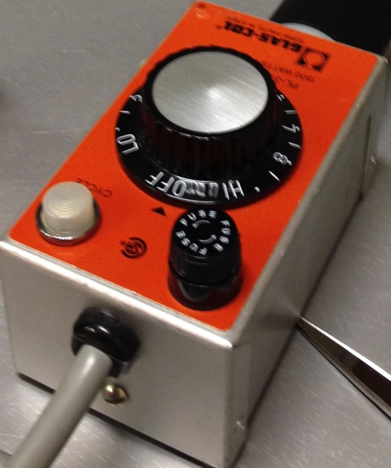
Higher Temperature and more force to de-bond prisms from ITM09
A ramp rate of < 2 C°/minute was used per Heraeus annealing instructions
* measured at the prism base as shown in this photograph
* Accomplished by increasing the controller by ~1/4 every 3 minutes
The ITM09 prisms released at:
~ 240 C° - measured with a type k thermocouple attached as shown
1.6 kg suspended at the end of a 6’ wrench as seen in the test plate photos
Compare to 150 C°- 190 C° and 450 g for the test plate.
Great care was taken to ensure the weighted wrench did not impact the Test Mass

Slide 18
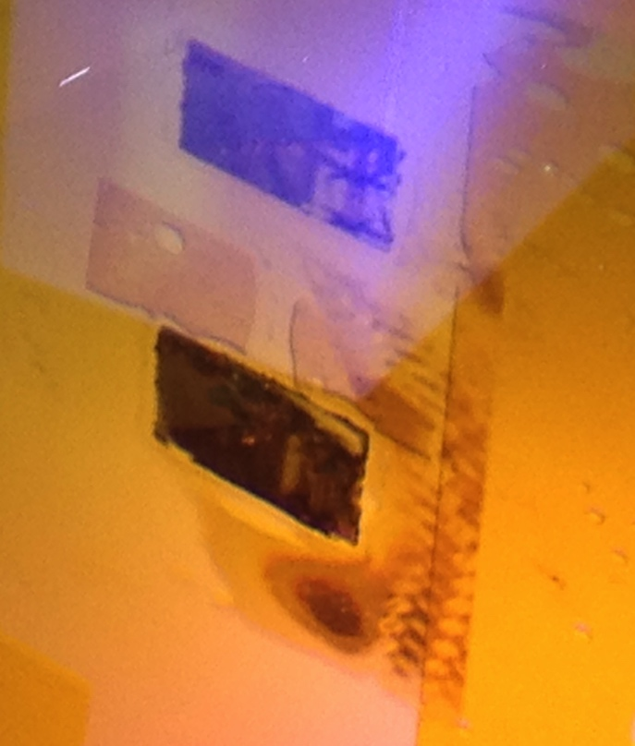
Test Mass required additional insulation to reach de-bonding temperatures Kevlar burnt and left a residue
The kevlar insulation burnt, leaving a residue. This residue was removed, along with the EP30 by scraping with a razor blade after soaking in Methelyne Chloride.
* Kapton tape was quite resistant to high temperatures It was used successfully to protect the ear-bond zone: beginning at 16mm below center.
* A layer of microscope slides and foil between the heater tape and the first kevlar insulation kept the insulation from burning on subsequent prisms

Slide 19
Test Mass Glue removal
Glue remained on the Test Mass
The ITM was soaked in methylene chloride, however the glue would not be rubbed off with a cotton q-tip.
Eventually, a razor blade was used.
Great care was taken to avoid the silicate bond area.
A faint discoloration can be seen on the Left side prism footprint – this measures ~ 10 nm in phase height on the flat figure measurement shown on page 22 .

Slide 20
Entire Left Flat with previous scratch, and missing clamshell

Slide 21
Left Ear Bond Zone λ/31

Slide 22
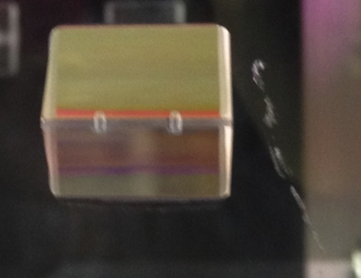
Left flat, former prism position
The scratch was present upon return of ITM09 from LMA as shown in the photo.
The prism outline has a phase height of ~10 nm

Slide 23
Entire Right Flat

Slide 24
Right Ear Bond Zone λ/26

Slide 25
Right Flat, Former Prism Position reflection noise from the chip on the opposite side is seen at left.

Slide 26
Homogeneity through the glass flats Just for grins…. Do we see stress at the optical surfaces?

Slide 27
Summary
Heat was the best method for removing the sapphire prisms bonded with EP30-2 epoxy.
There appears to be no residual stress in either the clamshell or the former prism positions.
The silicate bonding zones remain within flatness specification.
There appears to be no damage due to use of the razor blade for glue removal.

